Slide 1
Picture Reflections
Equality – Valued, regardless of age

Slide 2
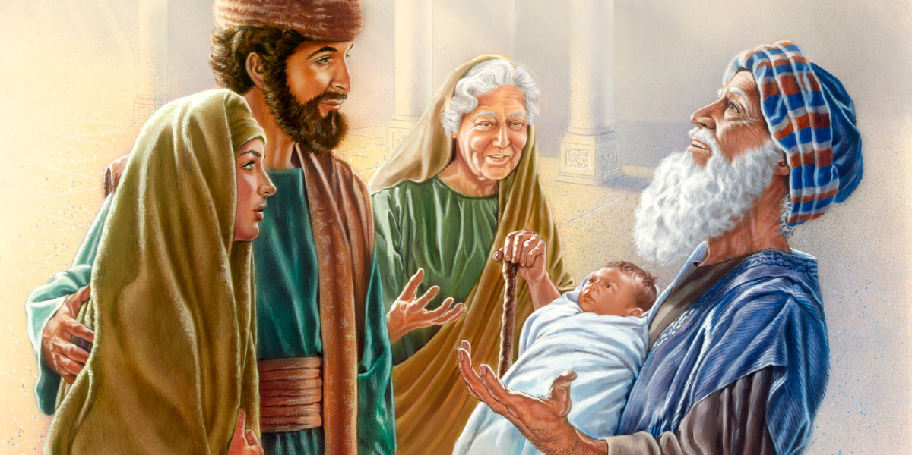

Slide 3

What do you see in the picture?
Can you make a prediction about what we are going to talk about today?
What questions do you have about this picture?
Come up with three questions.

Slide 4

Challenge question
What’s Christmas about for Christians?
Traditionally at Christmas we hear about Mary and Joseph, wise men and shepherds but we rarely hear about two old people Anna and Simeon who play an important part in the very early days of Jesus’ life on earth.
Who are the older people in your life that you lookup to and respect?
What things have you learnt from them?
What have they added to your life?
Read Anna and Simeon’s story. What can you find out about them?
What clues are there that God treated them with respect and equality?

Slide 5
The time came for Mary and Joseph to do what the law of Moses taught about being made pure. They took Jesus to Jerusalem to present him to the Lord. It is written in the law of the Lord: “Give every firstborn male to the Lord.” Mary and Joseph also went to offer a sacrifice, as the law of the Lord says: “You must sacrifice two doves or two young pigeons.”
A man named Simeon lived in Jerusalem. He was a good man and very religious. He was waiting for the time when God would help Israel. The Holy Spirit was in him. The Holy Spirit told Simeon that he would not die before he saw the Christ promised by the Lord. The Spirit led Simeon to the Temple. Mary and Joseph brought the baby Jesus to the Temple to do what the law said they must do. Then Simeon took the baby in his arms and thanked God:
“Now, Lord, you can let me, your servant,
die in peace as you said.
I have seen your Salvation with my own eyes.
You prepared him before all people.
He is a light for the non-Jewish people to see.
He will bring honour to your people, the Israelites.”
Jesus’ father and mother were amazed at what Simeon had said about him. Then Simeon blessed them and said to Mary, “Many in Israel will fall and many will rise because of this child. He will be a sign from God that many people will not accept. The things they think in secret will be made known. And the things that will happen will make your heart sad, too.”
Anna, a prophetess, was there at the Temple. She was from the family of Phanuel in the tribe of Asher. Anna was very old. She had once been married for seven years. Then her husband died and she lived alone. She was now 84 years old. Anna never left the Temple. She worshiped God by going without food and praying day and night. She was standing there at that time, thanking God. She talked about Jesus to all who were waiting for God to free Jerusalem.

Slide 6
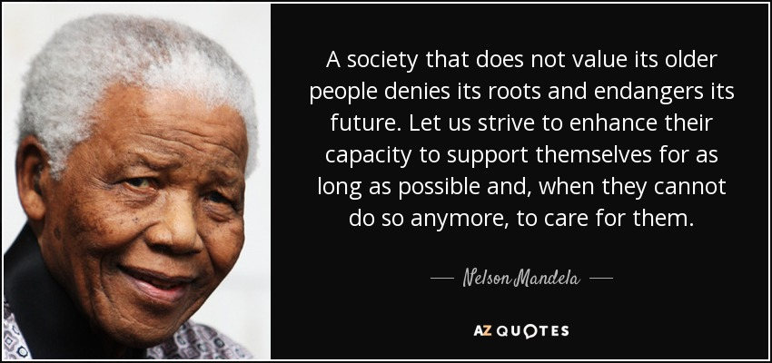
Reflection Time
How do you feel about this story?
What words or phrases stand out for you?
What questions do you have?
What do you think about Nelson Mandela’s quote?
Do you think that old people are treated with enough respect and equality in every part of our society?
What can we learn from Anna and Simeon about the importance of older people?

Slide 7
Reflection Time
Take time to think about your answers to the previous questions and then feedback your thoughts.

Slide 8
If you would like to, join in with this Prayer or sit and think quietly about all we have Talked about today
Help us to remember that one of the most precious gifts we have is the care and wisdom of the elderly. They are the keepers of our traditions and memories. It is a special gift to have the opportunity to spend time with our elders and learn from them. Help us to always treat them with equality and respect as we listen and learn from them.

Slide 9

think…
What advice have you received from an older member of your family?
Did you follow that advice? Why or Why not?
If you haven’t received ask an older member of your family for some.
What do you think the older members of our communities can teach you? What do you think you can teach them?
How would you like to be treated when you are older?

