Slide 1
Picture Reflections
Equality – A young woman’s story

Slide 2
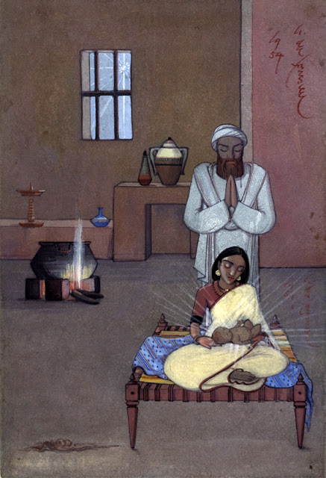

Slide 3

What do you see in the picture?
What questions do you have about this picture?
Come up with three questions.
Can you make a prediction about what we are going to talk about today?
Angelo da Fonseca (Indian, 1902-1967), Nativity, 1954.

Slide 4

Challenge question
What’s Christmas about for Christians?
If you answered, “Jesus,” then you can get a pat on the back.
For Christians Christmas is definitely about the baby in the manger. But it’s also about some other people whose part in the first Christmas should not be ignored.
One of these is Mary.
Do you think we all have a job to do in this world?
What do you think your job is?
Do you think it is an important job?
How do you think you would feel if you had a visit from an angel who told you that God had a very special job for you?
Read Mary’s story. According to the Bible what job was she given?

Slide 5

God sent the angel Gabriel to a virgin who lived in Nazareth, a town in Galilee. She was engaged to marry a man named Joseph from the family of David. Her name was Mary. The angel came to her and said, “Greetings! The Lord has blessed you and is with you.”
But Mary was very confused by what the angel said. Mary wondered, “What does this mean?”
The angel said to her, “Don’t be afraid, Mary, because God is pleased with you. Listen! You will become pregnant. You will give birth to a son, and you will name him Jesus. He will be great, and people will call him the Son of the Most High. The Lord God will give him the throne of King David, his ancestor. He will rule over the people of Jacob forever. His kingdom will never end.”
Mary said to the angel, “How will this happen? I am not yet married!”
The angel said to Mary, “The Holy Spirit will come upon you, and the power of the Most High will cover you. The baby will be holy. He will be called the Son of God. Now listen! Elizabeth, your relative, is very old. But she is also pregnant with a son. Everyone thought she could not have a baby, but she has been pregnant for six months. God can do everything!”
Mary said, “I am the servant of the Lord. Let this happen to me as you say!” Then the angel went away.

Slide 6

Reflection Time
How do you feel about this story?
What words or phrases stand out for you?
What questions do you have?
Many of us long to know that we are loved and that we are seen as equal to others. We do not want to be treated unfairly just simply because of who we are – we want to be respected regardless of our age, background or gender. Mary as a young woman would not have been treated by many at the time as equal to a man. Christians believe that the Christmas story shows that God did not have those same views. God did not judge Mary because she was a woman or because she was young but only saw the faith that she had. In giving her such a responsible job, God showed that he sees all people as equal and so should we.

Slide 7
Reflection Time
Take time to think about your answers to the previous questions and then feedback your thoughts.

Slide 8
If you would like to, join in with this Prayer or sit and think quietly about all we have Talked about today
As we celebrate and give thanks for the achievements of women, we remember the women who have played a part in our lives.
Those who have nurtured us, taught us, inspired us and loved us.
Forgive us when we have not treated them with equality, dignity, and respect.
We acknowledge the challenges that people, both men and women, still face all around the world we pray that all people may know equality of healthcare, of education, of wealth, and of prospects. We pray that all people may know themselves to be respected, safe, included, and empowered.

Slide 9

think…
Have you learnt about any other women who ‘broke the mould’ and achieved what some thought they could not do? Do you have a woman who you look up to? Why do you look up to her?
Maybe you could research some of these women:
https://www.ducksters.com/biography/women_leaders/marie_curie.php
https://www.ducksters.com/biography/women_leaders/rosa_parks.php
Dr. Hawa Abdi https://www.youtube.com/watch?v=l0WENROEFA8&t=14s

