Slide 1
Picture Reflections
Equality – A young child who did the right thing

Slide 2
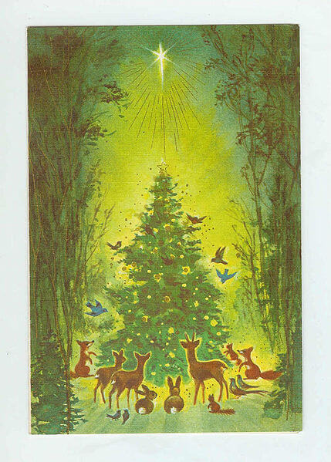

Slide 3

What do you see in the picture?
What questions do you have about this picture?
Come up with three questions.
Can you make a prediction about what we are going to talk about today?

Slide 4

Challenge question
According to the Bible, after Jesus was born, he was wrapped in strips of cloth and placed in a manger. A manger is a feeding trough from which donkeys, horses, and other animals eat. One reason Christians believe Jesus was put into the manger is that it is a symbol of Jesus’ humble birth. Christians believe that it points to an amazing truth: that on his first night on this earth, the Son of God, slept in a trough where the animals fed. What a picture of God’s desire to show that he has no favourites. God does not judge a person by wealth or status, He does not have favourites but treats all people equally. This is why Jesus was born on earth in the poorest of situations, giving up all the glory and beauty of heaven.
Do you think it is important to treat all people as equals and with dignity and respect?
Why or why not?
What do you think Christians can learn from the Christmas account about treating people equally?
Do you believe that God has favourites? Does your belief make a difference to how you treat others?
As you think about these things – read the following traditional story…

Slide 5

Two little children were sitting by the fire one cold winter's night. All at once they heard a timid knock at the door, and one ran to open it. There, outside in the cold and the darkness, stood a child with no shoes upon his feet and dressed in thin, ragged garments. He was shivering with cold, and he asked to come in and warm himself.
"Yes, come," cried both the children; "you can sit at the fire with us. Come in!"
They drew the little stranger to their warm seat and shared their food with him, and gave him their bed, while they slept on the hard floor. In the night they were woken up by sounds of sweet music and, looking out, they saw a band of angels in shining garments approaching the house. They were playing on golden harps, and the air was full of melody.
Suddenly the Stranger Child stood beside them; no longer cold and ragged, but dressed in silvery light.
His soft voice said: "I was cold and you took Me in. I was hungry, and you fed Me. I was tired, and you gave Me your bed. I am the Christ Child, wandering through the world to bring peace and happiness to all good children. As you have showed me love and treated me with respect and kindness, so may this tree every year give rich fruit to you."
As he said this, he broke a branch from the fir tree that grew near the door, and He planted it in the ground and disappeared. But the branch grew into a great tree, and every year it bore wonderful golden fruit for the kind children.

Slide 6
Reflection Time
How do you feel about this story?
What words or phrases stand out for you?
What questions do you have?
Although this story is not a true one, it does contain an important teaching from the Bible:
I was cold and you took Me in. I was hungry, and you fed Me. I was tired, and you gave Me your bed.
This teaches us that it does not matter the background of a person, whether they are rich or poor, whether they are the same as us in any way or not – we need to treat all people equally and when they are in need of help we must help them. The Bible teaches us that treating all people equally, without prejudice and appreciating their worth as created by God is what it means to be human.
This Christmas time how can we give help to those in need whilst showing love and respect to all?

Slide 7
Reflection Time
As you take sometime thinking about these questions. Think about the people who you know who are sad and lonely. What can you do to help them? A smile or a kind word may be all they need…

Slide 8



Slide 9
If you would like to, join in with this Prayer or sit and think quietly about all we have Talked about today
Open our eyes to anyone within our school or community who are sad or lonely at this holiday time. We ask for love and encouragement as we offer friendship and care to them. Help us to understand the need of others in such a way that we would no longer ignore them. Raise us up to step outside of our own traditions and show love to all people.

Slide 10

think…
Have you learnt about anyone or organisation that help those in need?
Do you know of any stories from your own faith or family background that teaches us how we should treat others?
What one thing have you learnt over this last term that has challenged you to behave differently towards others?

