Slide 1
Picture Reflections
Equality – a Time To care for all

Slide 2
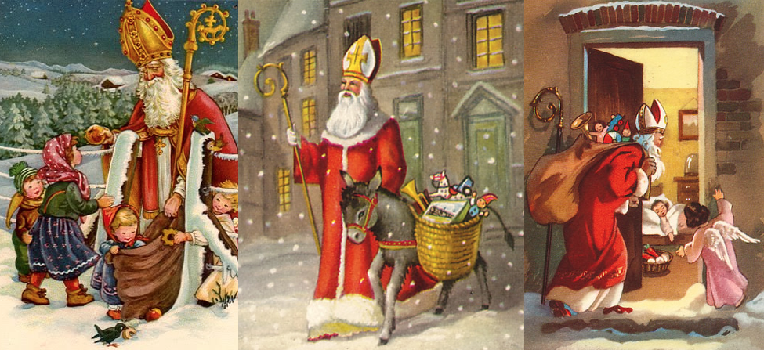

Slide 3

What do you see in the picture?
Can you make a prediction about what we are going to talk about today?
What questions do you have about this picture?
Come up with three questions.

Slide 4

Challenge question
So Christmas is just around the corner. For many people the holiday can bring many mixed feelings. It has be said that modern day Christmas encourages greed and overspending and has no other real purpose.
However, there is also a very positive side to the Christmas season! For Christians, it is one of the most important festivals of the year, marking the birth of Jesus and a time to share God’s love for all people.
Christmas is also a time for many - regardless of their religious faith - to celebrate friendship, generosity, joy and kindness; to spend time with our loved ones; and to do nice things for others.
It is a time to show others how important they are.
Do you think it is important to have special times in the year when we show people how special they are to us?
Or is this something we should do any way all year round?

Slide 5
Santa Claus has become an important part of Christmas for many people and although he has nothing to do with the biblical story of Christmas there is something that we can learn from the true story of Santa Claus
The true story of Santa Claus begins with Nicholas, who was born during the third century in the village of Patara in Asia Minor. At the time the area was Greek and is now on the southern coast of Turkey. His wealthy parents, who raised him to be a Christian, died in an epidemic while Nicholas was still young. Obeying Jesus’ words to “sell what you own and give the money to the poor,” Nicholas used his whole inheritance to help the needy, the sick, and the suffering. He dedicated his life to serving God and was made Bishop of Myra while still a young man. Bishop Nicholas became known throughout the land for his generosity to those in need, his love for children, and his concern for sailors and ships.
Nicholas believed that everyone was equal in God’s eyes and so should be treated with love and respect. One of the most famous stories about Nicholas involves a poor man and his three daughters.
In those days a young woman’s father had to offer prospective husbands something of value before they would marry. This poor man could not afford this for his daughters and so they had no other option but to become slaves. Mysteriously, on three different occasions, a bag of gold appeared in their home meaning that all three daughters could marry. The bags of gold were gifts from Nicholas. And so Nicholas began to be seen as a gift-giver. Due to this and other amazing gifts of love Nicholas became known as saint Nicholas or Saint Claus.

Slide 6

Reflection Time
How do you feel about this story?
What words or phrases stand out for you?
What questions do you have?
Nicholas believed that everyone was equal in God’s eyes – how did this impact how he lived and his actions?
If we believed that everyone was equal – how would we treat others?
Just as Saint Nicholas gave those gifts of gold to the three sisters -
what gift could we give to the world this Christmas that would help to address the problem of inequality that we see all around us?

Slide 7

Reflection Time
As you think about your answers to the previous questions also think about what one gift would you give to the World.

Slide 8
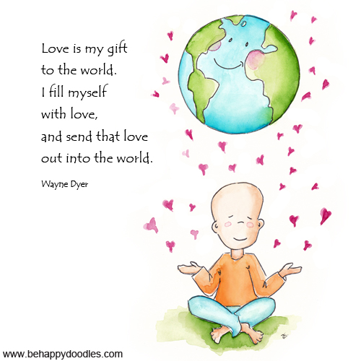


Slide 9
If you would like to, join in with this Prayer or sit and think quietly about all we have Talked about today
We pray for all those in our world suffering from racism, sexism and religious discrimination.
For the individuals who are silenced for expressing their beliefs.
Please help them to have the strength to cope with life and all its challenges.
Help them to forgive those who persecute them or who fail to treat them with equality.
Forgive us, Lord, if we ever fail to treat others with respect.
Guide lawmakers and those at the head of government make decisions that grant all individuals equal status under the law.
Amen.

Slide 10

think…
Do you know of anyone or any organisation who has challenged inequality in our world today?
What actions have they taken? Have they worked?
What inequalities do you see in the world?
What are the barriers to true equality in our world?
How would you tackle the issue of inequality?

