Slide 1


COLLECTIVE Worship and Reflections
Self Control

Slide 2

Church of England Colours for Worship

Slide 3
Church of England
Collective worship
ABSTRACT
This resource supports delivery of collective worship through the theme of Fruit of the Spirit.
It provides opportunities to look at some of life’s big issues in a prayerful and reflective manner.
Collective worship in a classroom has a different feel from worship in the hall. The more intimate nature of the worship can make everyone feel more readily included.

Slide 4
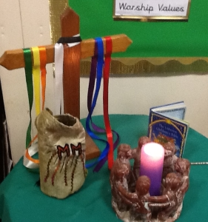
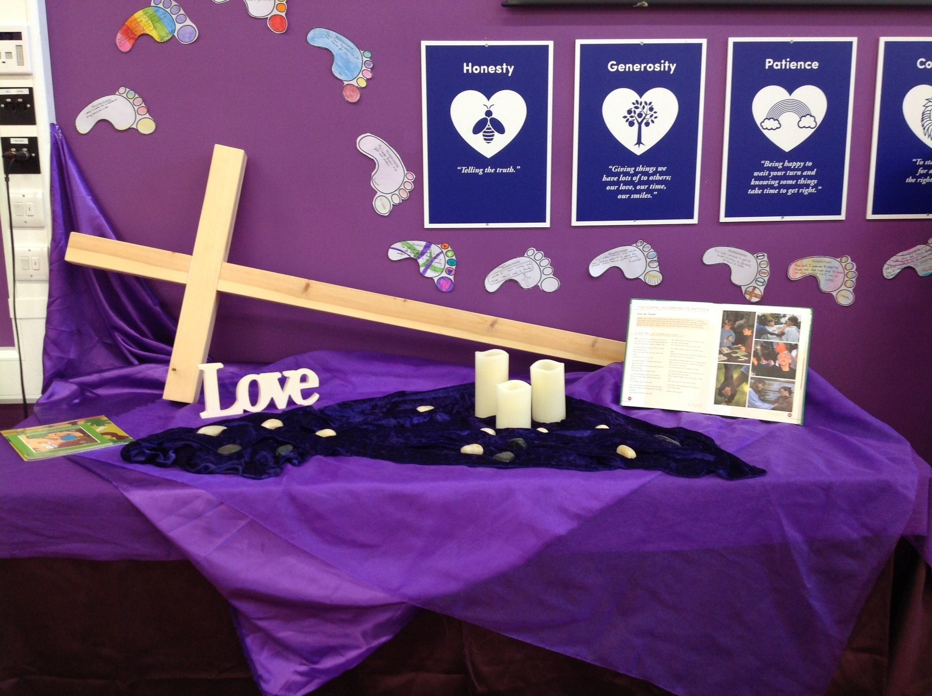
COLLECTIVE Worship
Introduction for Teachers
Ideas for the Worship Table
Special covering – possibly using liturgical colours
Candle or candles
Cross
Prayer box
Pebbles (prayer)
Flowers

Slide 5

Collective Worship
Possible music
Light of the World
https://www.youtube.com/watch?v=-MmRGSEG2LM
10,000 Reasons
https://www.youtube.com/watch?v=DXDGE_lRI0E
Blessed be the Name of the Lord
https://www.youtube.com/watch?v=PnWKehsOXu8
Hosanna in the Highest
https://www.youtube.com/watch?v=p8xHr8krAII

Slide 6

Gathering these can be used at the beginning of each session
Once everyone is set up ready for worship you may want to start by lighting a candle, followed by one of these:
Leader: Peace be with you.
Pupils: And also with you.
Leader: Welcome everyone
Pupils: It is good to be here together
Play a ‘Welcome’ song as children settle.
We meet in the name of God:
  God the Father,
  God the Son,
  God the Spirit:
  God is one.
Sign: ‘Welcome everybody here’ in BSL

Slide 7
Gathering these can be used at the beginning of each session
Christ the light of the world is here
God help us to speak positive words
To share peace with everyone
To remember that you are with us
Let us celebrate what God has made
Let’s remember to show God’s love,
and to show a bit of heaven to everyone we meet.

Slide 8

Sending these can be used at the End of each session
You may want to end your time together with one of these short prayers or blessings:
As we end this time
May we live with your love
Build on your truth
Share your forgiveness
Rest in your peace
For the whole of the day. AMEN
Thank you for this day,
For fun, friendship and learning.
We give thanks for this time
As we share peace with each other. AMEN
Help us as we as we move on
To carry hope in us for the day
Turning our thoughts towards others,
Our hearts towards love,
And our hands towards serving those in need. AMEN

Slide 9
Sending these can be used at the End of each session
The Lord bless us and watch over us, he is kind and helps us to show peace. Amen
Let’s remember today to show peace and love
To forgive when others upset us
To remember that we are all equal to God
To think about what we say before we say it
To thank God for a new day
Thank you God for all your good gifts
Christ our Lord,
Just as kings bowed down and offered you gifts,
May we know your strength and peace
And see all the free gifts you have given to us
and the blessing of the Father, Son and Holy Spirit,
be with you all, evermore
Amen

Slide 10
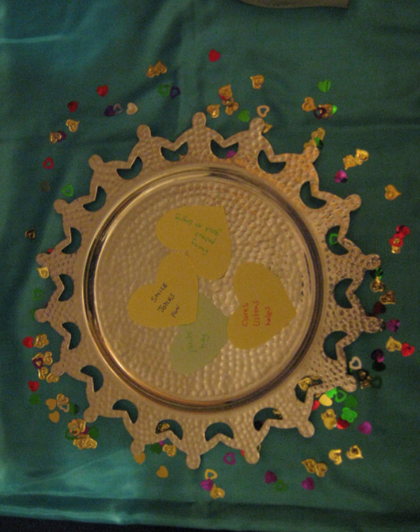
Fruit of the spirit
SELF Control
WISDOM

Slide 11
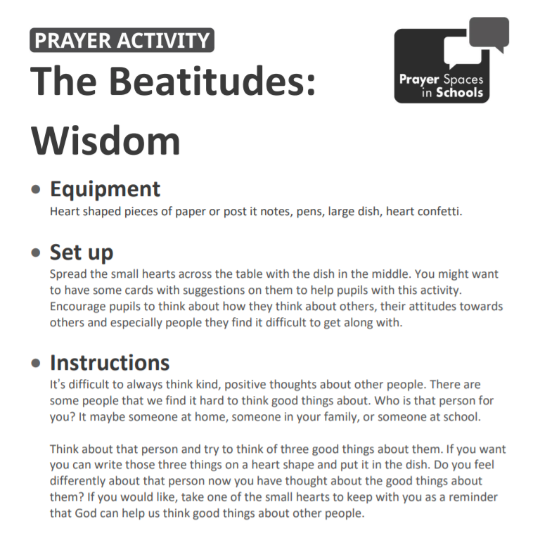
Classroom Reflection Space
SELF Control
Wisdom

Slide 12

Monday

Slide 13
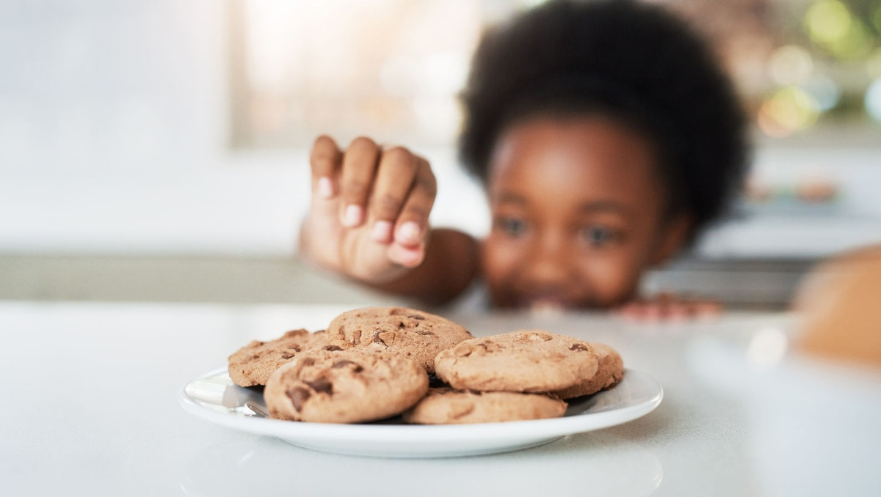


Slide 14

What do you see in the picture?
Can you make a prediction about what we are going to talk about today?
What questions do these pictures make you ask?
Think of two or three questions.

Slide 15

Responding: Bible Passage
We can link self-control with not giving in to temptation.
This week we are thinking about self-control…
What do you think it means to have self-control?

Slide 16
Bible passage: Jesus is tempted in the desert
Mark 4:1-11
(alternatively watch: https://www.youtube.com/watch?v=mc-x4qKY6Wc)
The Temptation of Jesus
4 Then the Spirit led Jesus into the desert to be tempted by the devil. ² Jesus ate nothing for 40 days and nights. After this, he was very hungry. ³ The devil came to Jesus to tempt him. The devil said, “If you are the Son of God, tell these rocks to become bread.”
⁴ Jesus answered, “It is written in the Scriptures, ‘A person does not live only by eating bread. But a person lives by everything the Lord says.’”^{[a]}
⁵ Then the devil led Jesus to the holy city of Jerusalem. He put Jesus on a very high place of the Temple. ⁶ The devil said, “If you are the Son of God, jump off. It is written in the Scriptures,
‘He has put his angels in charge of you.
They will catch you with their hands.
And you will not hit your foot on a rock.’” Psalm 91:11-12

Slide 17
Bible passage: Jesus is tempted in the desert
Mark 4:1-11
(alternatively watch: https://www.youtube.com/watch?v=mc-x4qKY6Wc)
⁷ Jesus answered him, “It also says in the Scriptures, ‘Do not test the Lord your God.’”^{[b]}
⁸ Then the devil led Jesus to the top of a very high mountain. He showed Jesus all the kingdoms of the world and all the great things that are in those kingdoms. ⁹ The devil said, “If you will bow down and worship me, I will give you all these things.”
¹⁰ Jesus said to the devil, “Go away from me, Satan! It is written in the Scriptures, ‘You must worship the Lord your God. Serve only him!’”^{[c]}
¹¹ So the devil left Jesus. And then some angels came to Jesus and helped him.

Slide 18
Responding
Have you ever felt tempted to do something?
How can we avoid giving in to temptation?
Did you give in to temptation or stay strong?
Notes:
Allow children time to think about this.

Slide 19
Responding
https://www.youtube.com/watch?v=jjMfRyO0DcQ
Have you ever read Chocolate Cake by Michael Rosen?
Talk to a friend about how much self control you think you would have, especially when faced with chocolate cake or a marshmallow!
https://www.youtube.com/watch?v=QX_oy9614HQ You could watch the Marshmallow Test…or even have a go at it!
Notes:
Allow children time to think about this.

Slide 20
Prayer
Encourage the pupils to respond with their own prayers in the prayer space or use the prayer below:
Dear God
Thank you for the story of Jesus being tempted in the desert.
Thank you for what it teaches us about self control.
Please help us as we try to follow his example, and avoid temptation.
Amen

Slide 21

Tuesday

Slide 22
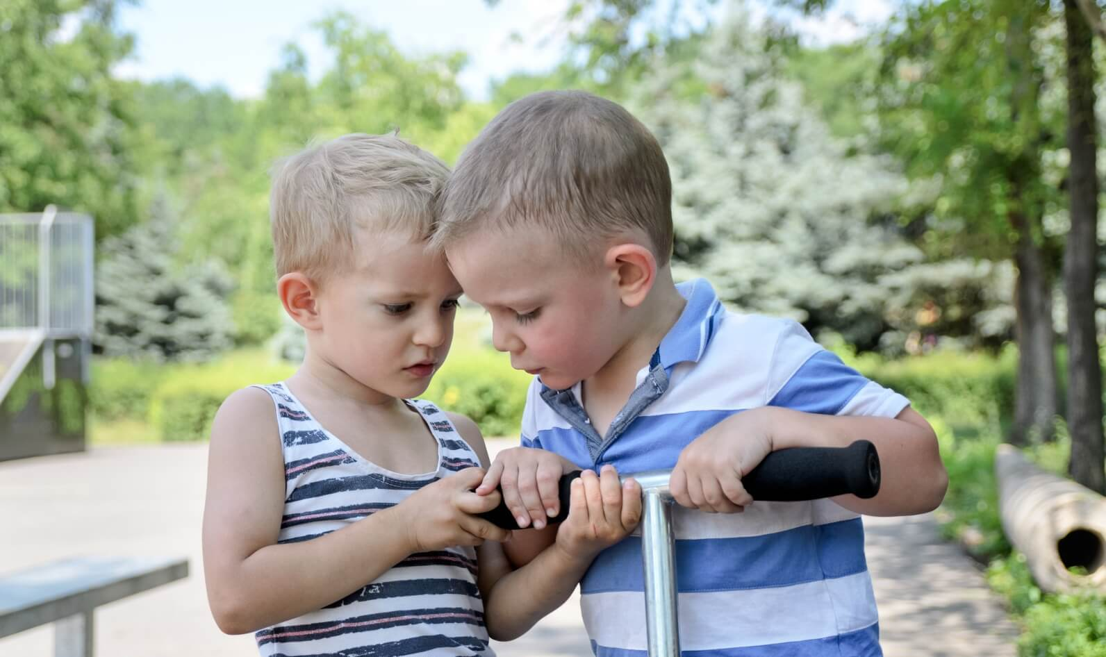

Slide 23
What do you see in the picture?
Can you make a prediction about what we are going to talk about this week?
What questions do these pictures make you ask?
Think of two or three questions.

Slide 24

Self-Control
RESPOND
What might happen next?
What advice would you give to the boys in the picture?
Notes:
Proverbs is a book in the Bible that is full of wisdom.

Slide 25
RESPOND: Bible verses
Can you think of a time when you wanted to get angry and had to control your words?
It makes a lot of sense
to be a person of few words
and to stay calm.
Even fools seem smart
when they are quiet.
Proverbs 17:27-28
Controlling your temper
is better than being a hero
who captures a city.
Proverbs 16:32
Do you think it’s always wise to stay calm and quiet?
Why?
Notes:
Proverbs is a book in the Bible that is full of wisdom. It was written by King Solomon, who was the son of King David. The wisdom in Proverbs is seen as applicable to Christians today and full of common sense guidance.

Slide 26
Discuss these scenarios with a talking partner… share your responses with your class
Someone says that your favourite football team are rubbish…what do you say?
Your friend asks what you think of their new shoes. You don’t really like them…what do you say?
Gina kicks the desk when her friend won’t share something with her.
Is she showing self control?
During lesson time you want to get up to talk to a friend.
What should you do?
You feel frustrated when you don’t understand your homework.
What should you do?
Can you come up with your own proverb about self control?

Slide 27
Prayer
Encourage the pupils to respond with their own prayers first, using the class prayer space/area or with the prayer below:
Dear God, when I am having trouble controlling my tongue, and I say unkind things without thinking, please help me to think before I speak.
If I am upset and getting close to losing self-control, please remind me to ask for your help to talk about problems rather than acting out towards others. Amen.

Slide 28

Wednesday

Slide 29
Prompted to action - challenge
Remember our theme this week…
Self Control
and our Bible passages…
Jesus is Tempted in the Desert
Proverbs 16 & 17

Slide 30
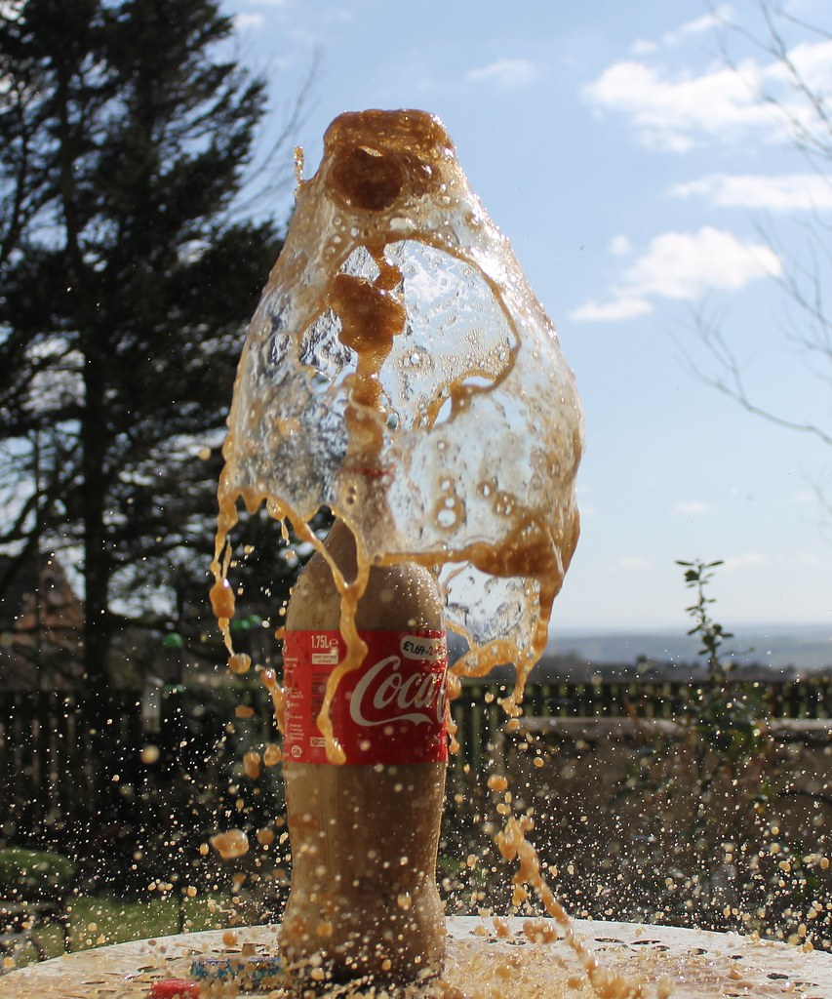
Prompted to action – challenge ideas
This analogy is best demonstrated outside or in a space that can be easily cleaned!
Shake the bottle of pop up a lot. As the bottle is shaken, remember that life has its shake-ups, too. Life’s shake-ups are times when we feel a lot of pressure. For example, perhaps teasing from a sibling shakes you up; maybe it is feeling as though you’re not getting your fair share or being treated unjustly.
Next, take the top off the bottle of pop and fizz from the pop will fly everywhere.
When we lack self-control, we are just like the bottle of pop. Just as the pop flying everywhere makes a mess, we make messes when we lack self-control.

Slide 31
Prompted to action – challenge ideas
^{Galatians 5:13-15}
¹³ My brothers, God called you to be free. But do not use your freedom as an excuse to do the things that please your sinful self. Serve each other with love. ¹⁴ The whole law is made complete in this one command: “Love your neighbour as you love yourself.”^{[a]} ¹⁵ If you go on hurting each other and tearing each other apart, be careful! You will completely destroy each other.

Slide 32
Responding
What kind of messes do we get ourselves into?
How can we avoid causing mess and hurt?
Is it a mess when we hurt someone’s feelings?
Notes:
Allow children time to think about this.

Slide 33
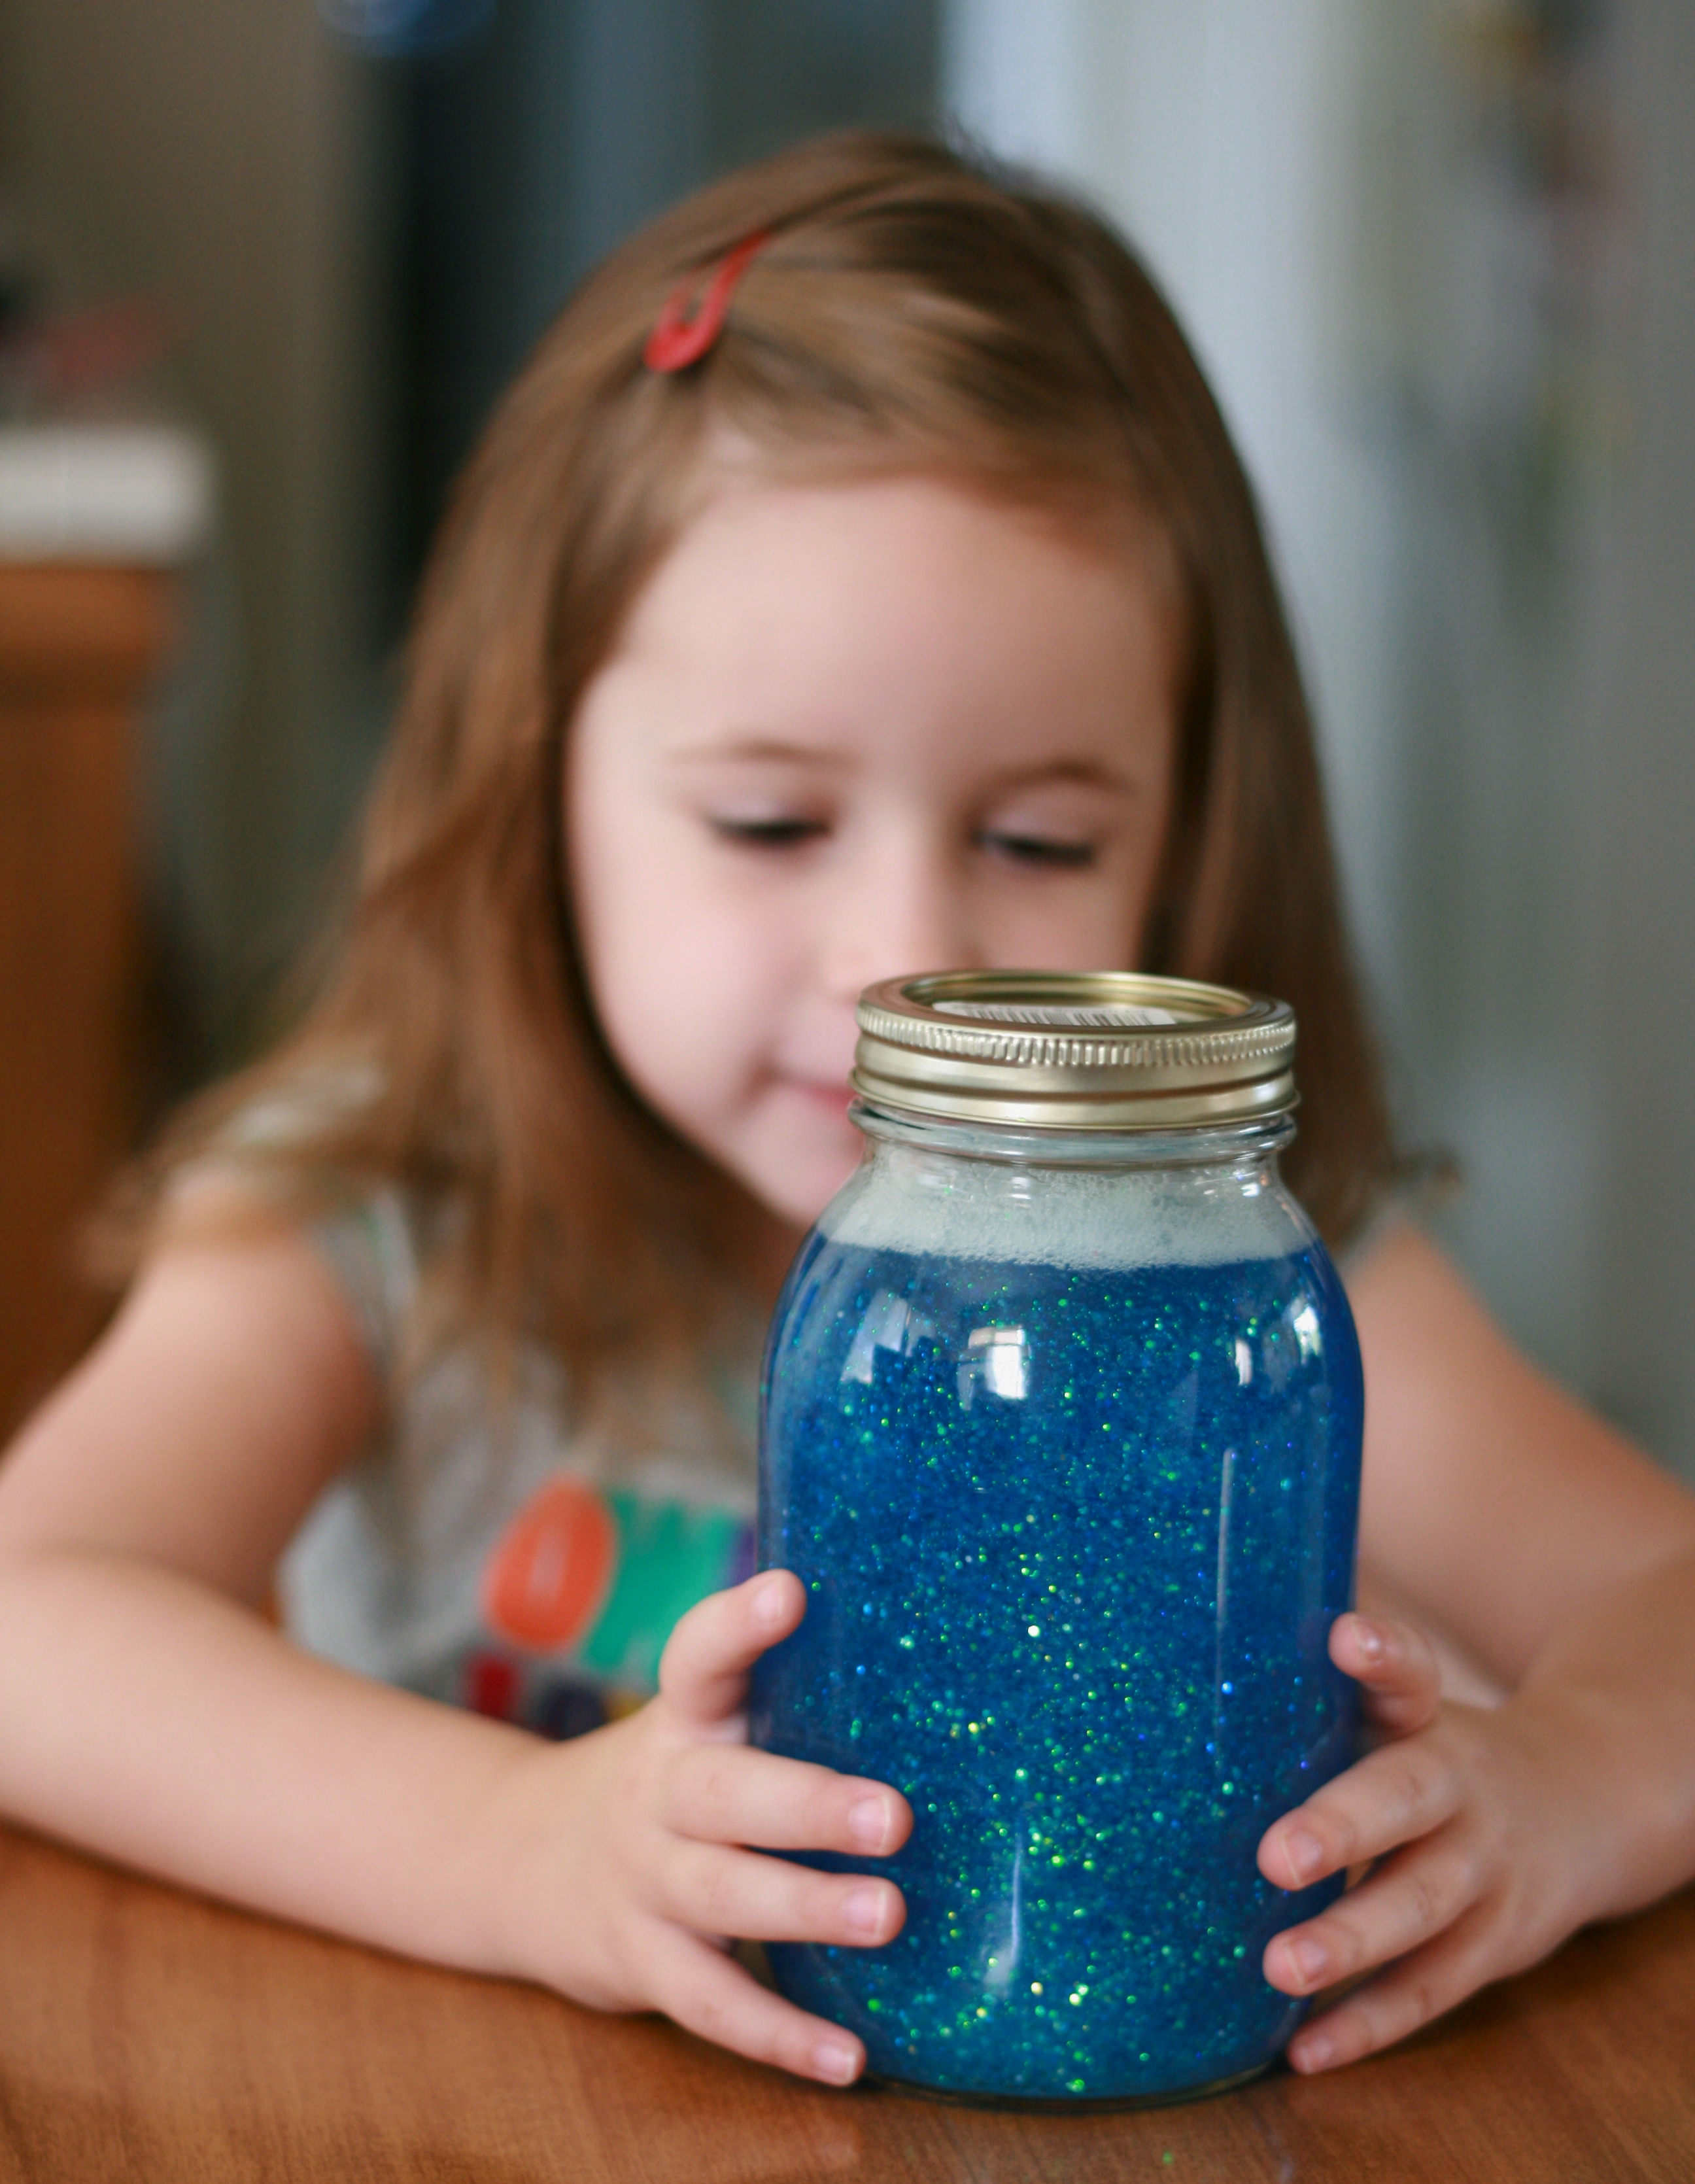
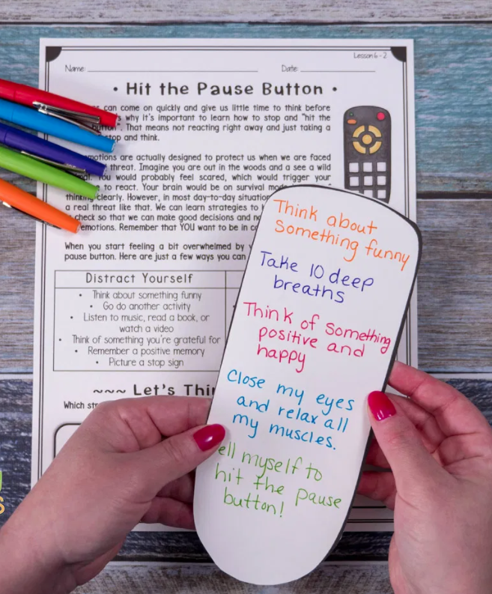
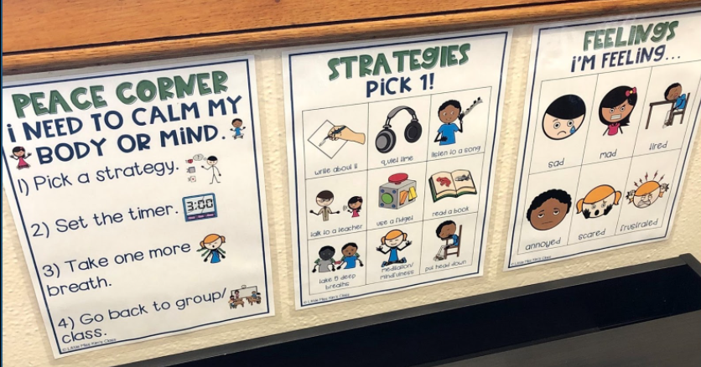
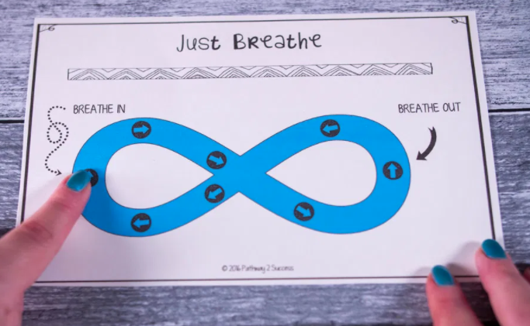
Prompted to action – challenge ideas
Can you create a space where people can take a ‘time out’ or find some wisdom to help them to show self-control and avoid temptation?

Slide 34
Prayer
Encourage the pupils to respond with their own prayers in the class prayer space/area. You could use the school’s prayer or the Lord’s Prayer:
Our Father, in heaven,
Holy is your name.
Your Kingdom come,
Your will be done on earth, as it is in heaven.
Give us this day our daily bread,
And forgive us our sins,
As we forgive those who sin against us,
And lead us not into temptation,
But deliver us from evil.
Amen.

Slide 35

Thursday

Slide 36
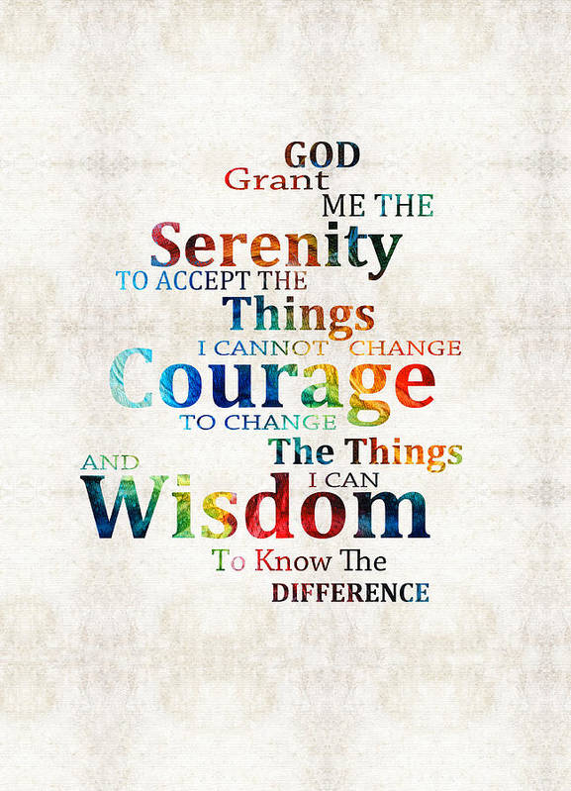
Use the Meditation resource alongside the Spiritual Encounters – bible-based meditation teacher’s pack: http://www.ldbe.co.uk/about/guidance- resources/worship-and-meditation/

Slide 37

Friday

Slide 38
Take this time to celebrate what has happened during the week – you may want to give out awards. If possible, join the bubbles using Zoom or Teams so that the whole school can come together in a time of celebration.
Remember that this should also be a time of worship and celebration so begin with a gathering, include a prayer, a blessing, and a song of celebration.

