Slide 1


COLLECTIVE Worship and Reflections
Goodness

Slide 2

Church of England Colours for Worship

Slide 3
Church of England
Collective worship
ABSTRACT
This resource supports delivery of collective worship through the theme of Fruit of the Spirit.
It provides opportunities to look at some of life’s big issues in a prayerful and reflective manner.
Collective worship in a classroom has a different feel from worship in the hall. The more intimate nature of the worship can make everyone feel more readily included.

Slide 4
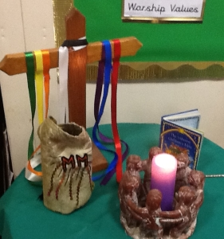
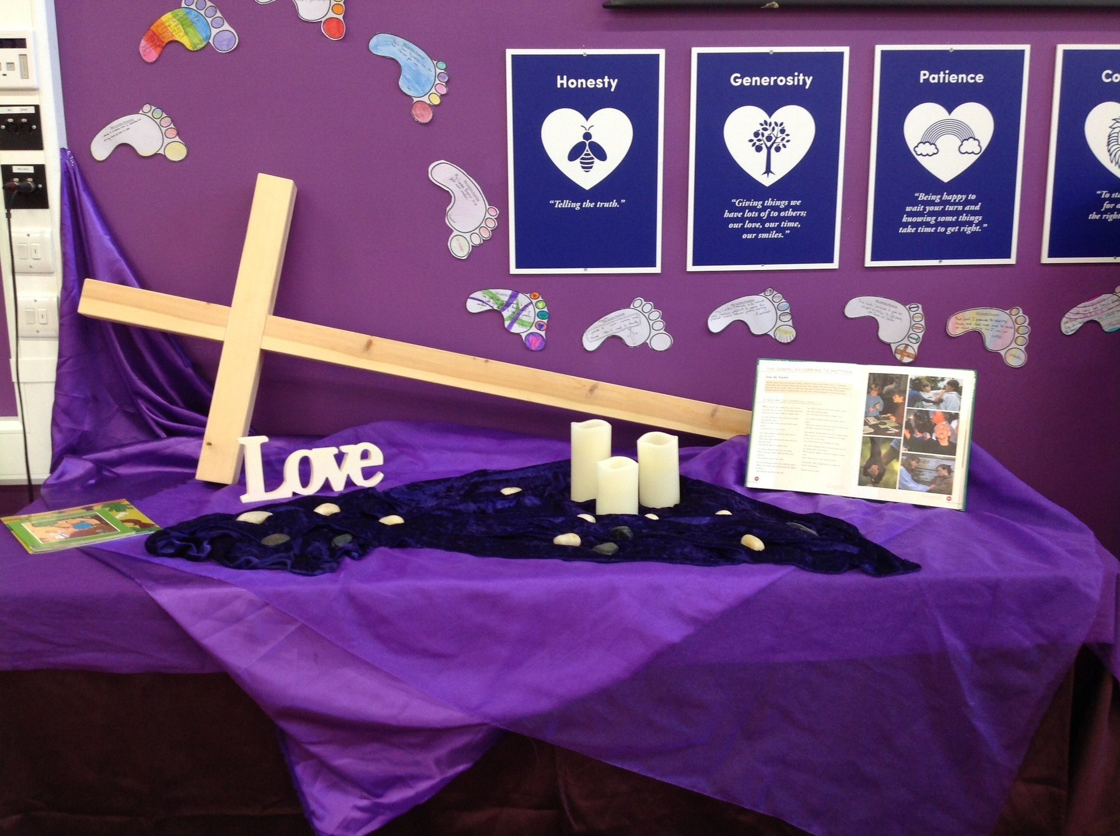
COLLECTIVE Worship
Introduction for Teachers
Ideas for the Worship Table
Special covering – possibly using liturgical colours
Candle or candles
Cross
Prayer box
Pebbles (prayer)
Flowers

Slide 5

Collective Worship
Possible music
Good Good Father
https://www.youtube.com/watch?v=gFayN_nkzaU
My Lighthouse
https://www.youtube.com/watch?v=JeJvKkBV6rY
Be Praised
https://www.youtube.com/watch?v=WT3UviMrudA

Slide 6

Gathering these can be used at the beginning of each session
Once everyone is set up ready for worship you may want to start by lighting a candle, followed by one of these:
Leader: Peace be with you.
Pupils: And also with you.
Leader: Welcome everyone
Pupils: It is good to be here together
Play a ‘Welcome’ song as children settle.
We meet in the name of God:
  God the Father,
  God the Son,
  God the Spirit:
  God is one.
Sign: ‘Welcome everybody here’ in BSL

Slide 7
Gathering these can be used at the beginning of each session
Christ the light of the world is here
God help us to speak positive words
To share peace with everyone
To remember that you are with us
Let us celebrate what God has made
Let’s remember to show God’s love,
and to show a bit of heaven to everyone we meet.

Slide 8

Sending these can be used at the End of each session
You may want to end your time together with one of these short prayers or blessings:
As we end this time
May we live with your love
Build on your truth
Share your forgiveness
Rest in your peace
For the whole of the day. AMEN
Thank you for this day,
For fun, friendship and learning.
We give thanks for this time
As we share peace with each other. AMEN
Help us as we as we move on
To carry hope in us for the day
Turning our thoughts towards others,
Our hearts towards love,
And our hands towards serving those in need. AMEN

Slide 9
Sending these can be used at the End of each session
The Lord bless us and watch over us, he is kind and helps us to show peace. Amen
Let’s remember today to show peace and love
To forgive when others upset us
To remember that we are all equal to God
To think about what we say before we say it
To thank God for a new day
Thank you God for all your good gifts
Christ our Lord,
Just as kings bowed down and offered you gifts,
May we know your strength and peace
And see all the free gifts you have given to us
and the blessing of the Father, Son and Holy Spirit,
be with you all, evermore
Amen

Slide 10
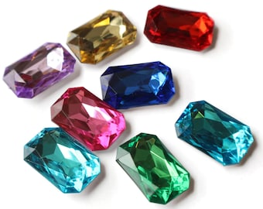
Fruit of the spirit
Goodness

Slide 11
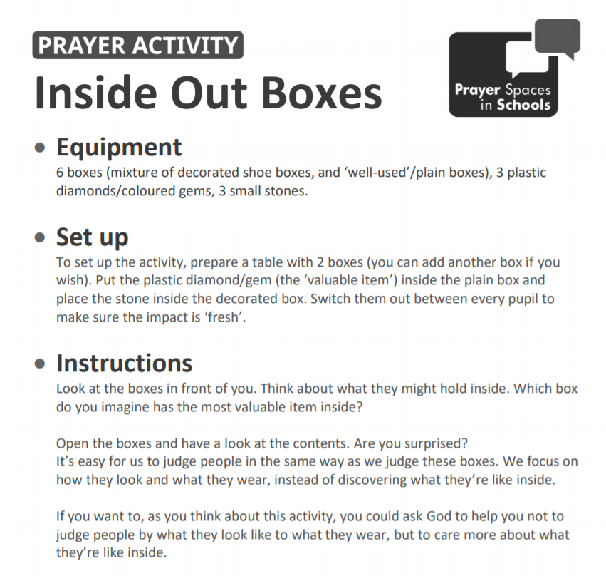
Classroom Reflection Space
Goodness

Slide 12

Monday

Slide 13



Slide 14
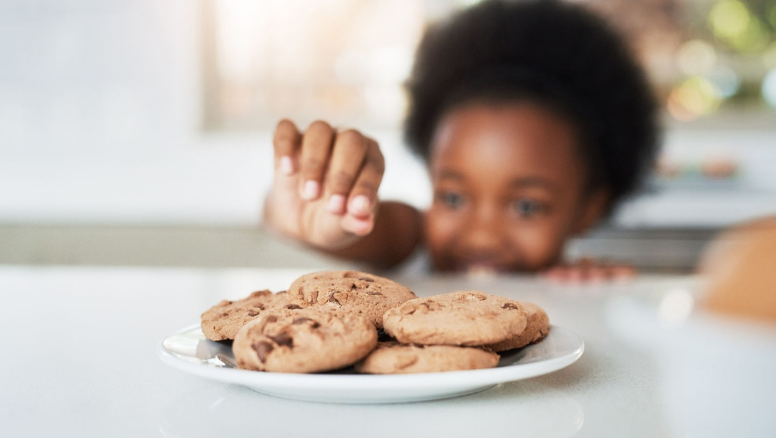

What do you see in the picture?
Can you make a prediction about what we are going to talk about today?
What questions do these pictures make you ask?
Think of two or three questions.

Slide 15

Responding:
Can we see God’s goodness in action even when times are hard?
This week we are thinking about goodness…
Where can we see signs of God’s goodness in the world?
What does the word goodness make you think of?
Christians believe that God is good, all of the time.

Slide 16
Bible Verses: God’s Goodness
Psalms
Thank the Lord because he is good.
His love continues forever.
Psalm 107:1
How great is your goodness!
You have stored it up for those who fear you.
You do good things for those who trust you.
You do this for all to see.
Psalm 31:19
David (remember him from the story with Goliath?) wrote lots of Psalms (songs) about God’s goodness…
Here is something I am still sure of.
I will see the Lord’s goodness
while I’m still alive.
Psalm 27:13
…even when he was going through difficult times.
He often sang about the beauty of creation and the good things that God has given.
Notes:
The Psalms were mostly written by David, who was an accomplished musician. They’re songs of praise, thanks and sometimes lament and desperation.

Slide 17
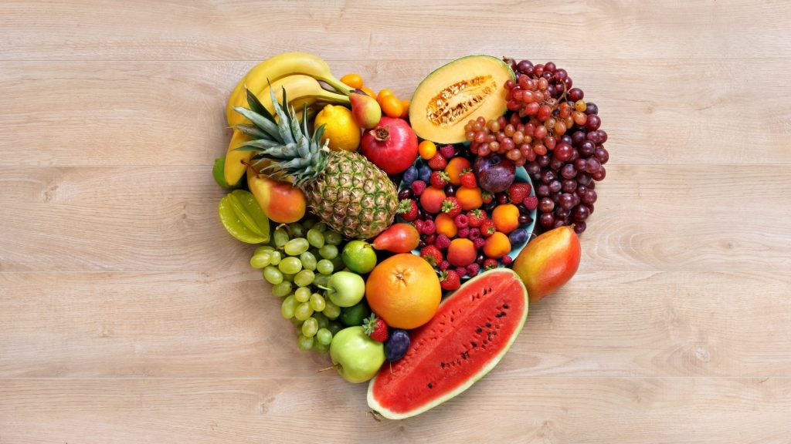
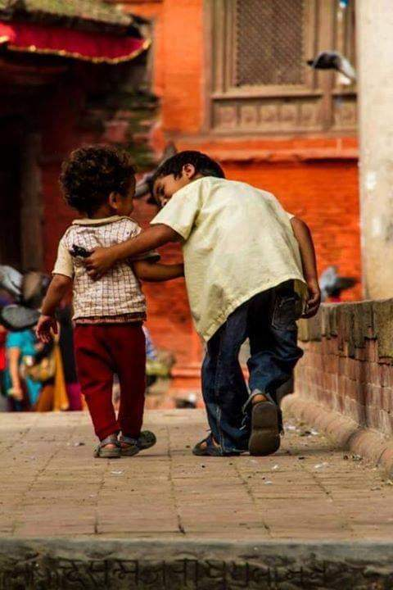
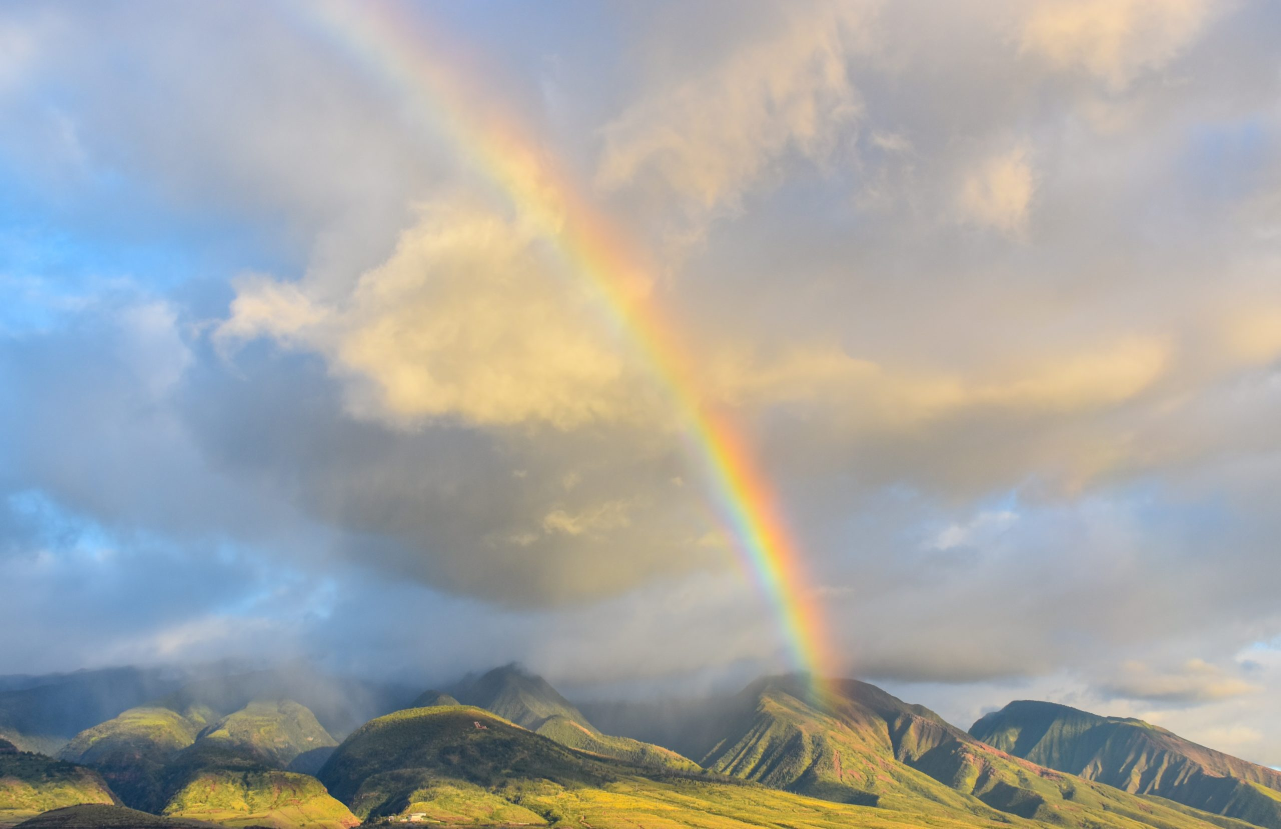
Responding
Where will you find it?
How can this help us when we’re having a tough day?
Can you look for signs of God’s goodness?
This song by the Christian band Rend Collective talks about counting our blessings and recognising God’s goodness.
https://www.youtube.com/watch?v=7X9d4ubvWH4
Notes:
Allow children time to think about this.

Slide 18
Prayer
Encourage the pupils to respond with their own prayers in the prayer space or use the prayer below:
Dear God,
Thank you that you are a good Father and that your goodness can be seen in the beauty of creation and in the gifts that you have given.
Amen

Slide 19
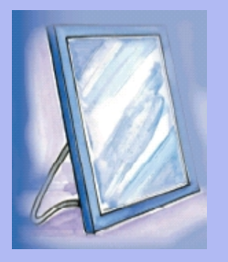
Tuesday

Slide 20
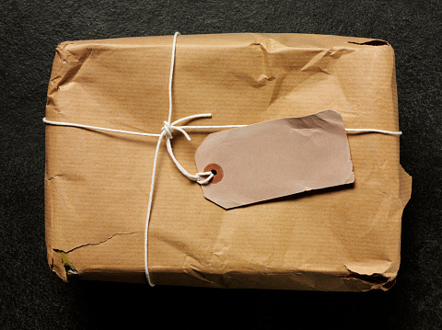

Slide 21
What do you see in the picture?
Can you make a prediction about what we are going to talk about this week?
What questions do these pictures make you ask?
Think of two or three questions.

Slide 22
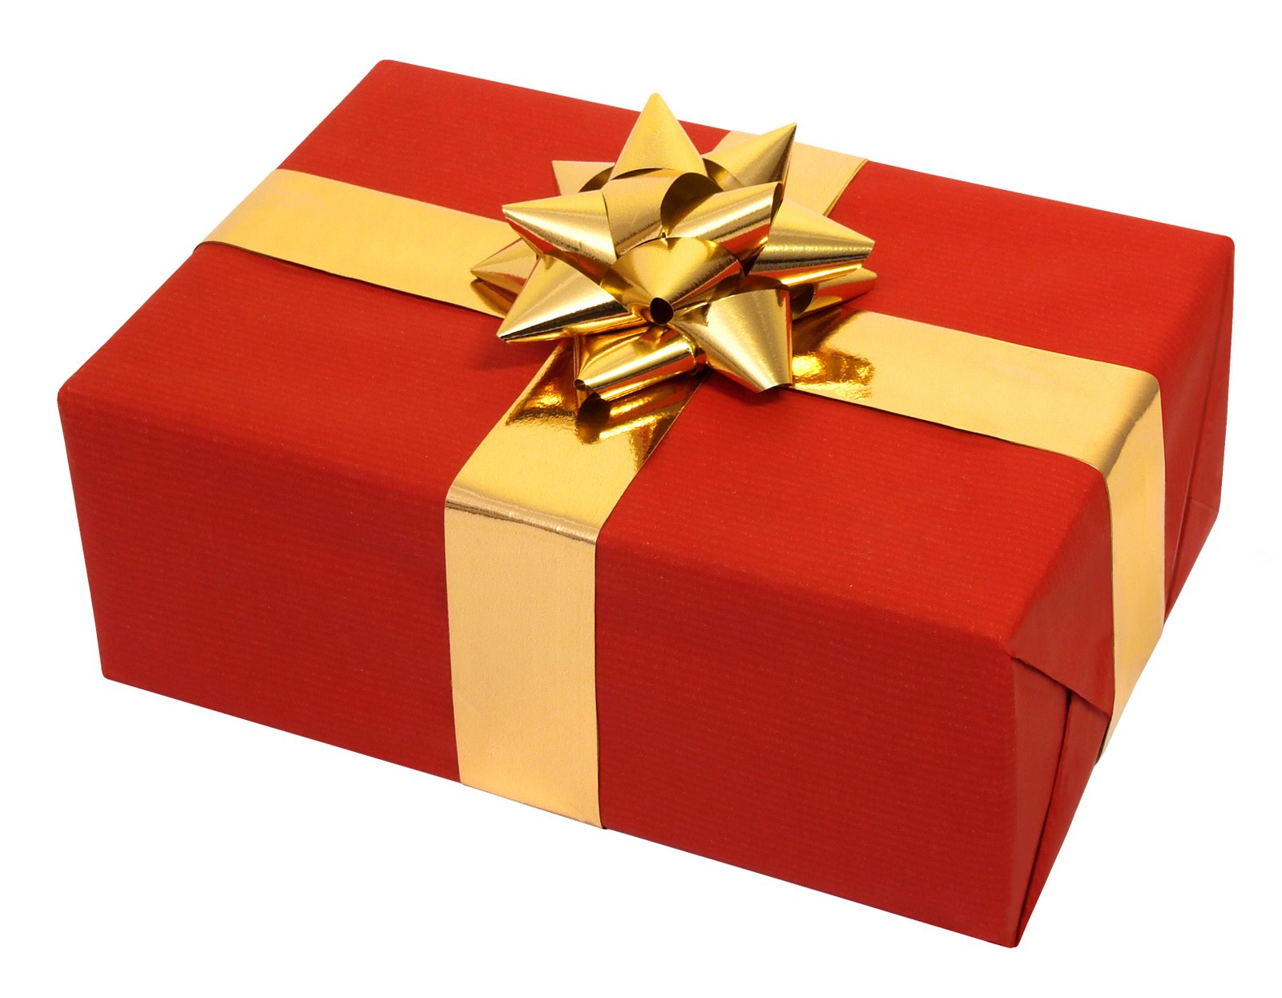

GOODNESS
RESPOND
Be honest…which parcel would you prefer to receive? Why?
Notes:
You could do this as a practical activity by having two parcels wrapped up like the pictures above. The tatty parcel could contain something of significant value and the beautifully wrapped parcel could have very disappointing contents.

Slide 23
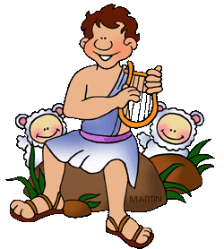
RESPOND: Bible
Remember David?
Well, long before he fought Goliath, he spent most of his time with a flock of sheep!
He certainly wasn’t what you’d call ‘potential King material’!

Slide 24
RESPOND: Bible story
1 Samuel 16:1-13
16 ¹ One day God said, “Samuel, I’ve rejected Saul, and I refuse to let him be king any longer. Stop feeling sad about him. Put some olive oil^{[a]} in a small container^{[b]} and go visit a man named Jesse, who lives in Bethlehem. I’ve chosen one of his sons to be my king.”
² Samuel answered, “If I do that, Saul will find out and have me killed.”
“Take a calf with you,” the Lord replied. “Tell everyone that you’ve come to offer it as a sacrifice to me, ³ then invite Jesse to the sacrifice.^{[c]} When I show you which one of his sons I have chosen, pour the olive oil on his head.”
⁴ Samuel did what the Lord told him and went to Bethlehem. The town leaders went to meet him, but they were terribly afraid and asked, “Is this a friendly visit?”
⁵ “Yes, it is!” Samuel answered. “I’ve come to offer a sacrifice to the Lord. Get yourselves ready^{[d]} to take part in the sacrifice and come with me.” Samuel also invited Jesse and his sons to come to the sacrifice, and he got them ready to take part.
Notes:
Samuel was God’s prophet and was given the task of anointing the new king. The king that had

Slide 25
RESPOND: Bible story
1 Samuel 16:1-13
⁶ When Jesse and his sons arrived, Samuel noticed Jesse’s oldest son, Eliab. “He has to be the one the Lord has chosen,” Samuel said to himself.
⁷ But the Lord told him, “Samuel, don’t think Eliab is the one just because he’s tall and handsome. He isn’t the one I’ve chosen. People judge others by what they look like, but I judge people by what is in their hearts.”
⁸ Jesse told his son Abinadab to go over to Samuel, but Samuel said, “No, the Lord hasn’t chosen him.”
⁹ Next, Jesse sent his son Shammah to him, and Samuel said, “The Lord hasn’t chosen him either.”

Slide 26
RESPOND: Bible story
1 Samuel 16:1-13
¹⁰ Jesse had all seven of his sons go over to Samuel. Finally, Samuel said, “Jesse, the Lord hasn’t chosen any of these young men. ¹¹ Do you have any more sons?”
“Yes,” Jesse answered. “My youngest son David is out taking care of the sheep.”
“Send for him!” Samuel said. “We won’t start the ceremony until he gets here.”
¹² Jesse sent for David. He was a healthy, good-looking boy with a sparkle in his eyes. As soon as David came, the Lord told Samuel, “He’s the one! Get up and pour the olive oil on his head.”^{[e]}
¹³ Samuel poured the oil on David’s head while his brothers watched. At that moment, the Spirit of the Lord took control of David and stayed with him from then on.

Slide 27

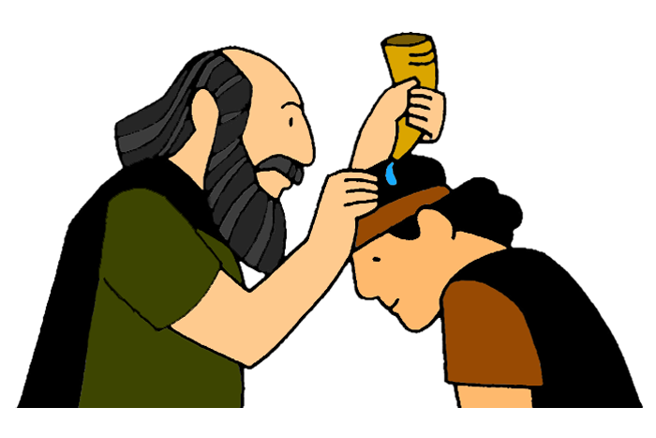
DON’T JUDGE A BOOK BY ITS COVER!
Have you heard this saying before?
Can you think of examples of where people have been judged by what they look like on the outside, rather than the goodness inside?
How does it link to David’s story?
Christians believe that God looks at what is in a person’s heart and not what they look like on the outside. Goodness comes from within!

Slide 28
Prayer
Encourage the pupils to respond with their own prayers first, using the class prayer space/area or with the prayer below:
Dear God,
Help us to never judge other people by their appearance. Thank you that you look at what is within our hearts…help us to do the same.
Amen

Slide 29

Wednesday

Slide 30
Prompted to action - challenge
Remember our theme this week…
Goodness
and our Bible passages…
1 Samuel 16
Psalms 31:19, 27:13, 107:1

Slide 31
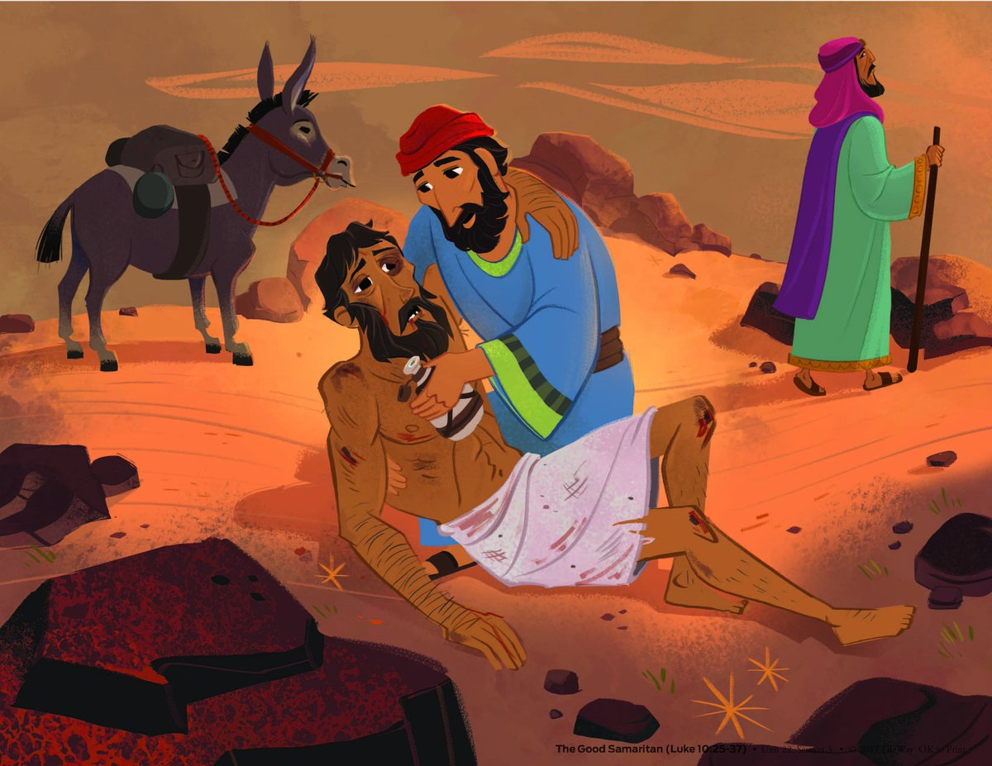
Prompted to action - challenge
Jesus told a story about what being full of goodness looks like in practice.
I’m sure you know the story well! Can you guess?

Slide 32
Prompted to action – challenge
The Parable of the Good Samaritan - Luke 10:25-37
The Good Samaritan
²⁵ Then a teacher of the law stood up. He was trying to test Jesus. He said, “Teacher, what must I do to get life forever?”
²⁶ Jesus said to him, “What is written in the law? What do you read there?”
²⁷ The man answered, “Love the Lord your God. Love him with all your heart, all your soul, all your strength, and all your mind.”^{[a]} Also, “You must love your neighbour as you love yourself.”^{[b]}
²⁸ Jesus said to him, “Your answer is right. Do this and you will have life forever.”

Slide 33
Prompted to action – challenge
The Parable of the Good Samaritan - Luke 10:25-37
²⁹ But the man wanted to show that the way he was living was right. So he said to Jesus, “And who is my neighbour?”
³⁰ To answer this question, Jesus said, “A man was going down the road from Jerusalem to Jericho. Some robbers attacked him. They tore off his clothes and beat him. Then they left him lying there, almost dead. ³¹ It happened that a Jewish priest was going down that road. When the priest saw the man, he walked by on the other side of the road. ³² Next, a Levite^{[c]} came there. He went over and looked at the man. Then he walked by on the other side of the road. ³³ Then a Samaritan^{[d]} traveling down the road came to where the hurt man was lying. He saw the man and felt very sorry for him. ³⁴ The Samaritan went to him and poured olive oil and wine^{[e]} on his wounds and bandaged them. He put the hurt man on his own donkey and took him to an inn. At the inn, the Samaritan took care of him.

Slide 34
Prompted to action – challenge
The Parable of the Good Samaritan - Luke 10:25-37
³⁵ The next day, the Samaritan brought out two silver coins^{[f]} and gave them to the innkeeper. The Samaritan said, ‘Take care of this man. If you spend more money on him, I will pay it back to you when I come again.’”
³⁶ Then Jesus said, “Which one of these three men do you think was a neighbour to the man who was attacked by the robbers?”
³⁷ The teacher of the law answered, “The one who helped him.”
Jesus said to him, “Then go and do the same thing he did!”

Slide 35
Responding
…would the man have expected the Samaritan to help him when he first saw him?
The Samaritan people were the enemy of the Jewish people at the time that Jesus told this story…
Notes:
Allow children time to think about this.

Slide 36
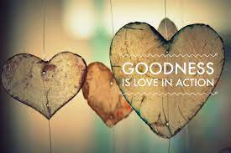
Prompted to action – challenge ideas
Then go and do the same thing he did!
At the end of the story, Jesus says…
How do you show goodness as a school?
What other things could you do to show goodness and ‘love in action’ to your ‘neighbours’?
How could you encourage the school community to join in?

Slide 37
Prayer
Encourage the pupils to respond with their own prayers in the class prayer space/area. You could use the school’s prayer or the Lord’s Prayer:
Our Father, in heaven,
Holy is your name.
Your Kingdom come,
Your will be done on earth, as it is in heaven.
Give us this day our daily bread,
And forgive us our sins,
As we forgive those who sin against us,
And lead us not into temptation,
But deliver us from evil.
Amen.

Slide 38

Thursday

Slide 39


Use the Meditation resource alongside the Spiritual Encounters – bible-based meditation teacher’s pack: http://www.ldbe.co.uk/about/guidance- resources/worship-and-meditation/

Slide 40

Friday

Slide 41
Take this time to celebrate what has happened during the week – you may want to give out awards. If possible, join the bubbles using Zoom or Teams so that the whole school can come together in a time of celebration.
Remember that this should also be a time of worship and celebration so begin with a gathering, include a prayer, a blessing, and a song of celebration.

