Slide 1
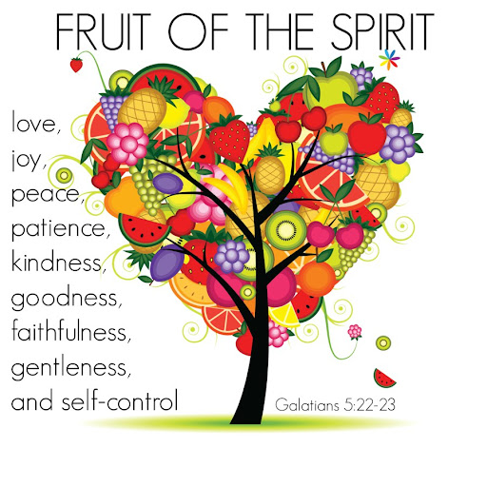

COLLECTIVE Worship and Reflections
Goodness

Slide 2

Church of England Colours for Worship

Slide 3
Church of England
Collective worship
ABSTRACT
This resource supports delivery of collective worship through the theme of Fruit of the Spirit.
It provides opportunities to look at some of life’s big issues in a prayerful and reflective manner.
Collective worship in a classroom has a different feel from worship in the hall. The more intimate nature of the worship can make everyone feel more readily included.

Slide 4
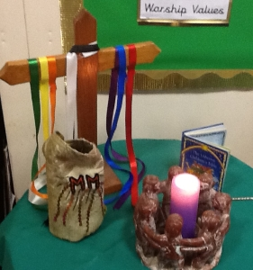
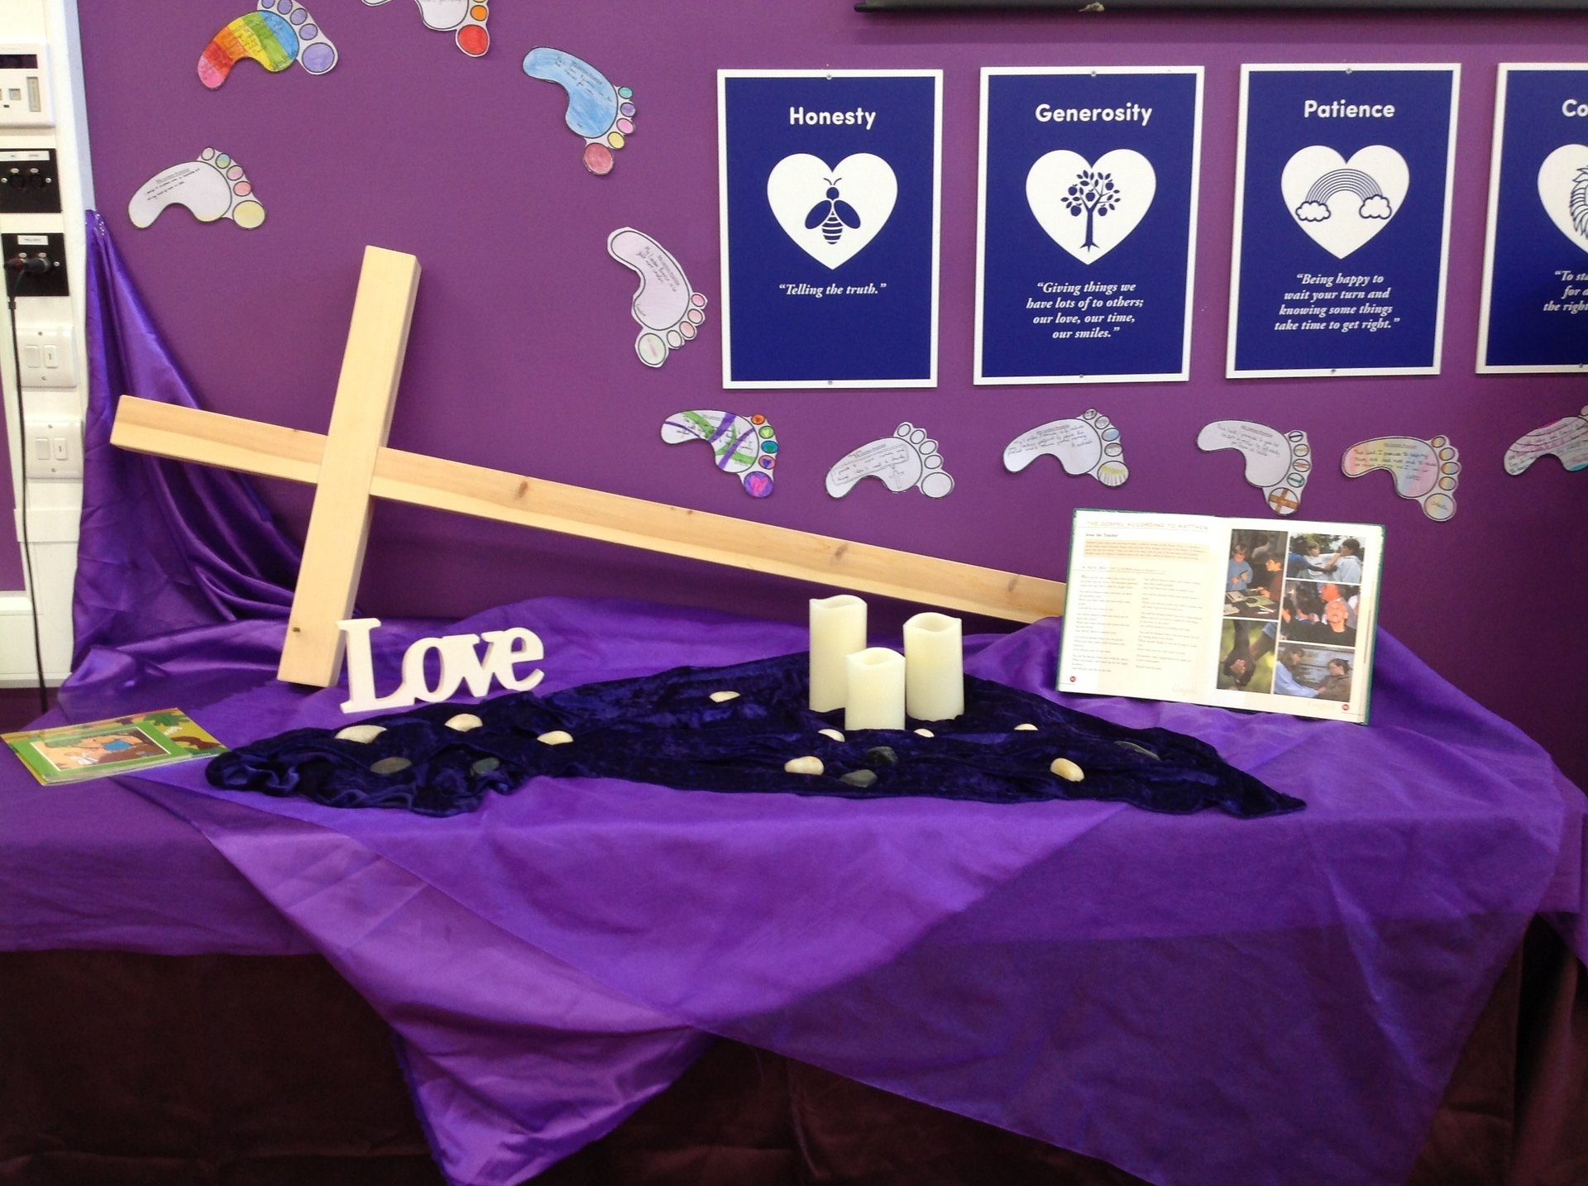
COLLECTIVE Worship
Introduction for Teachers
Ideas for the Worship Table
Special covering – possibly using liturgical colours
Candle or candles
Cross
Prayer box
Pebbles (prayer)
Flowers

Slide 5

Collective Worship
Possible music
The Blessing (Kids)
https://www.youtube.com/watch?v=uiWZXLsdE9w
Rend Co. Kids - Feels Good
https://www.youtube.com/watch?v=LJxVHzARMmE&list=PLGXQK3aC61FSm_22oqfft0m2Oje499lC4&index=1
I the Lord of Sea and Sky
https://www.youtube.com/watch?v=4t6mz8yoocY

Slide 6

Gathering these can be used at the beginning of each session
Once everyone is set up ready for worship you may want to start by lighting a candle, followed by one of these:
Leader: Peace be with you.
Pupils: And also with you.
Leader: Welcome everyone
Pupils: It is good to be here together
Play a ‘Welcome’ song as children settle.
We meet in the name of God:
  God the Father,
  God the Son,
  God the Spirit:
  God is one.
Sign: ‘Welcome everybody here’ in BSL

Slide 7
Gathering these can be used at the beginning of each session
Christ the light of the world is here
God help us to speak positive words
To share peace with everyone
To remember that you are with us
Let us celebrate what God has made
Let’s remember to show God’s love,
and to show a bit of heaven to everyone we meet.

Slide 8

Sending these can be used at the End of each session
You may want to end your time together with one of these short prayers or blessings:
As we end this time
May we live with your love
Build on your truth
Share your forgiveness
Rest in your peace
For the whole of the day. AMEN
Thank you for this day,
For fun, friendship and learning.
We give thanks for this time
As we share peace with each other. AMEN
Help us as we as we move on
To carry hope in us for the day
Turning our thoughts towards others,
Our hearts towards love,
And our hands towards serving those in need. AMEN

Slide 9
Sending these can be used at the End of each session
The Lord bless us and watch over us, he is kind and helps us to show peace. Amen
Let’s remember today to show peace and love
To forgive when others upset us
To remember that we are all equal to God
To think about what we say before we say it
To thank God for a new day
Thank you God for all your good gifts
Christ our Lord,
Just as kings bowed down and offered you gifts,
May we know your strength and peace
And see all the free gifts you have given to us
and the blessing of the Father, Son and Holy Spirit,
be with you all, evermore
Amen

Slide 10
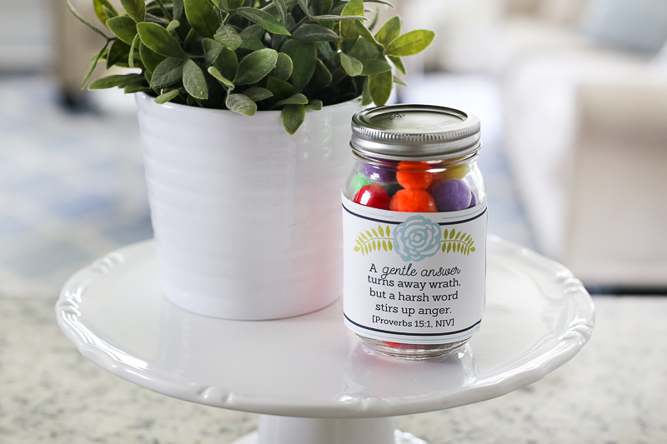
Fruit of the spirit
GENTLENESS

Slide 11
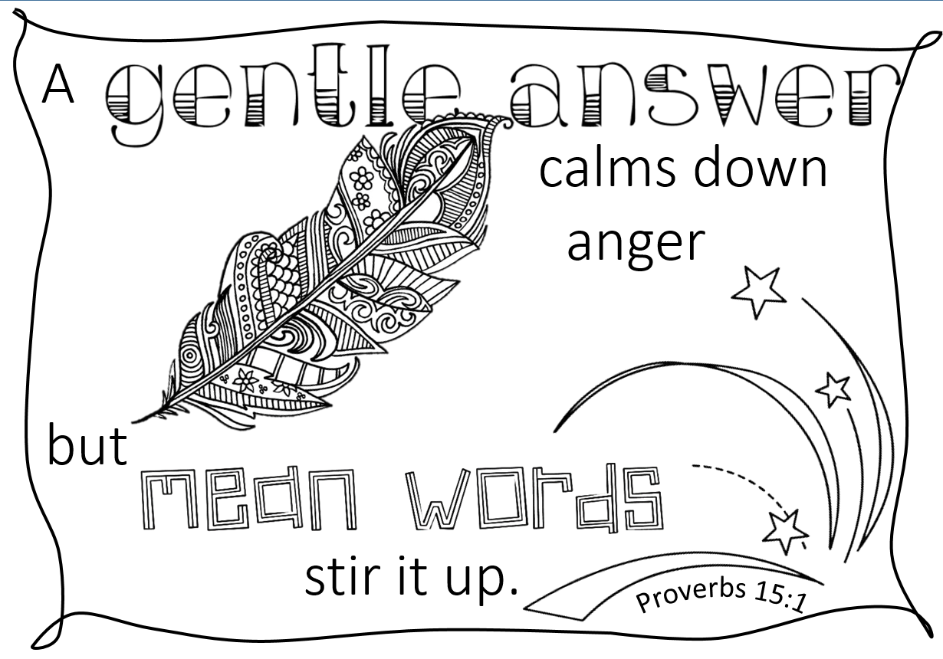
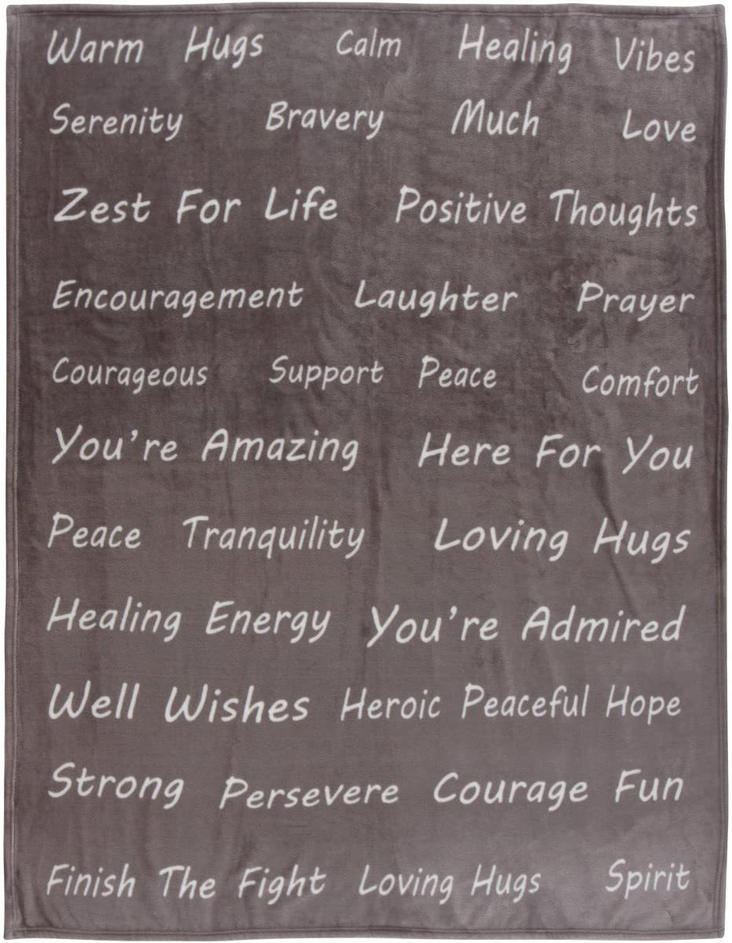
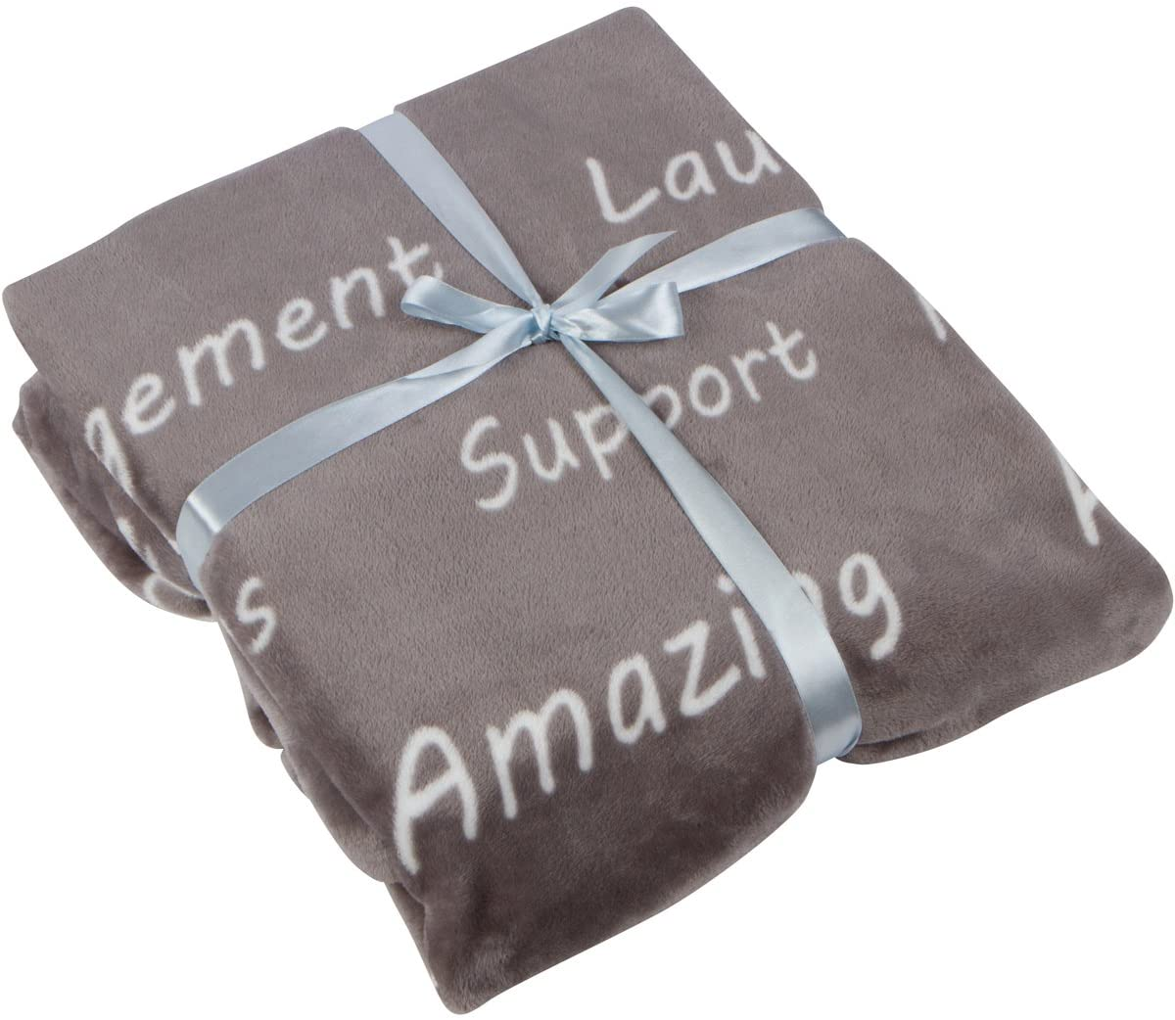
Classroom Reflection Space
GENTLENESS
Create a gentle words jar for your reflection area, adding pompoms for every gentle word spoken.
You could also add a gentleness blanket – a piece of soft fabric for gentle words to be written on or pinned to.

Slide 12

Monday

Slide 13
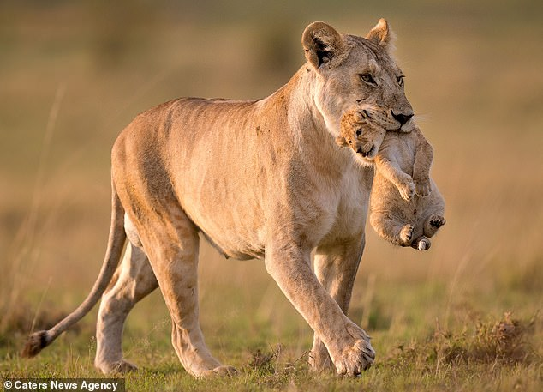


Slide 14

What do you see in the picture?
Can you make a prediction about what we are going to talk about today?
What questions do these pictures make you ask?
Think of two or three questions.

Slide 15

Responding
This week we are thinking about gentleness…
https://www.youtube.com/watch?v=88CoZKwCzmU
Was the lioness being gentle with her cub? Watch the video to find out…

Slide 16
Responding
It’s about how you choose to use your strength!
Gentleness is about putting others first.
Gentleness is power under control!
You can be gentle but still be really strong!
Think about how you might hold a pet or a baby.

Slide 17
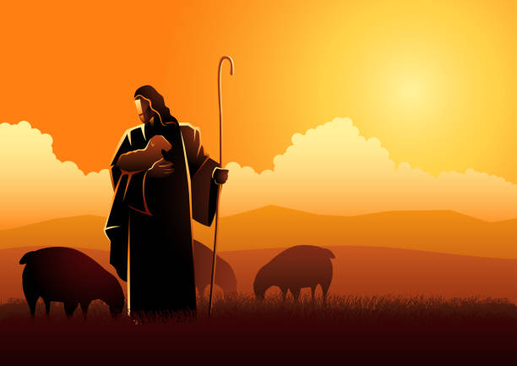
Bible Verse
Isaiah 40:11
This verse from Isaiah describes God’s gentleness. He is described as being like a shepherd who gently cares for his sheep.
The Lord takes care of his people like a shepherd.
He gathers the people like lambs in his arms.
He carries them close to him.
He gently leads the mothers of the lambs.
Just like the little lion cub, the sheep will wander into trouble from time to time. The shepherd, like the lioness, is there to gently help them.

Slide 18
Responding
Can you think of any jobs that require gentleness?
Have you ever had to take control of your strength to do something with gentleness?
Share your ideas!
Notes:
Allow children time to think about this.

Slide 19
Prayer
Encourage the pupils to respond with their own prayers in the prayer space or use the prayer below:
Dear God
Help us to choose to be gentle with each other, to control our strength and use gentle hands and gentle words.
Amen

Slide 20

Tuesday

Slide 21


Slide 22
What do you see in the picture?
Can you make a prediction about what we are going to talk about this week?
What questions do these pictures make you ask?
Think of two or three questions.

Slide 23

RESPOND: Bible verses
Have you ever used unkind words and seen a situation get worse?
Can you think of a time when someone spoke to you gently, even if it was to tell you to change your behaviour?
A gentle answer will calm a person’s anger.
But an unkind answer will cause more anger.
Proverbs 15:1
Can you think of a time when someone spoke to you harshly or unkindly?
How did you feel and how did you respond each time?

Slide 24
Prayer
Encourage the pupils to respond with their own prayers first, using the class prayer space/area or with the prayer below:
Dear God,
Help us to remember the wisdom in Proverbs and to think before we speak. Help us to choose to use gentle words to calm situations down rather than angry words which might make things worse.
Amen

Slide 25

Wednesday

Slide 26
Prompted to action - challenge
Remember our theme this week…
Gentleness
and our Bible passages…
Isaiah 40:11
Proverbs 15:1

Slide 27
Prompted to action – challenge ideas
A gentle answer will calm a person’s anger.
But an unkind answer will cause more anger.
Proverbs 15:1
Think about the impact of the Proverb on your class and school.
How much better would it be if everyone used gentle words?

Slide 28
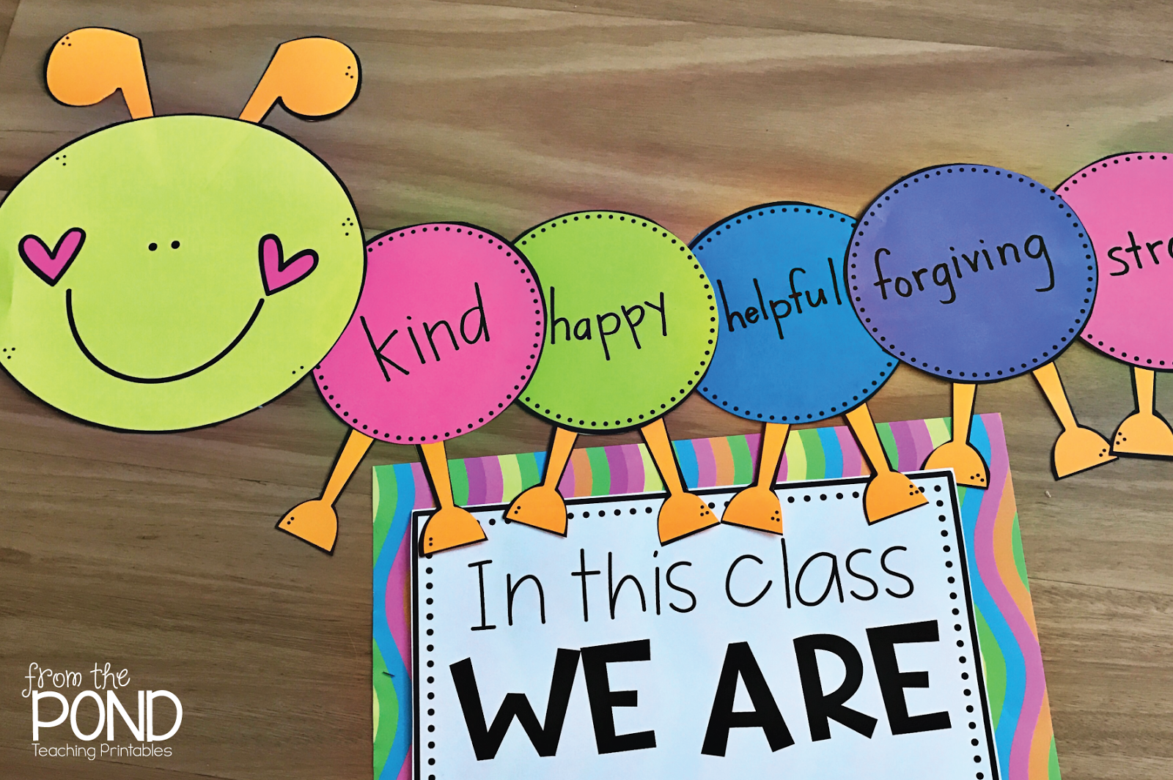
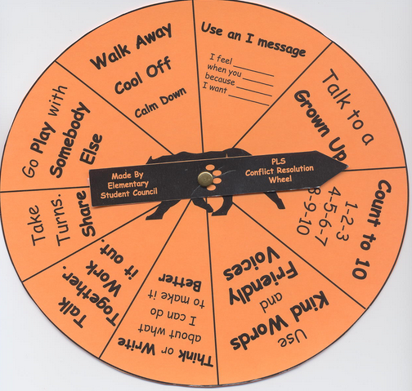
Prompted to action – challenge ideas
Can you think of some practical ideas to help everyone in your class to use
^{gentle words?}
Could you discuss some helpful alternative words/phrases that would help to keep a gentle atmosphere in your classroom?
You could put your suggestions on display as a reminder to everyone…

Slide 29
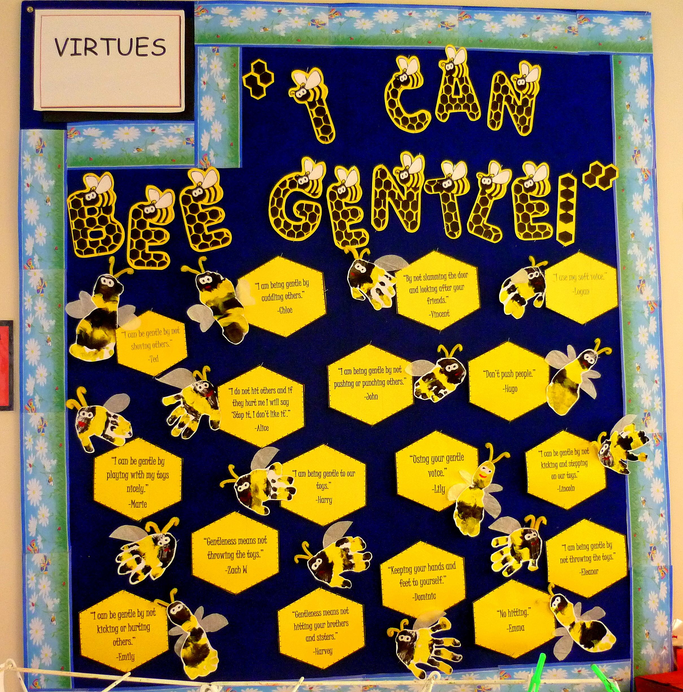

Responding

Slide 30
Prayer
Encourage the pupils to respond with their own prayers in the class prayer space/area. You could use the school’s prayer or the Lord’s Prayer:
Our Father, in heaven,
Holy is your name.
Your Kingdom come,
Your will be done on earth, as it is in heaven.
Give us this day our daily bread,
And forgive us our sins,
As we forgive those who sin against us,
And lead us not into temptation,
But deliver us from evil.
Amen.

Slide 31

Thursday

Slide 32
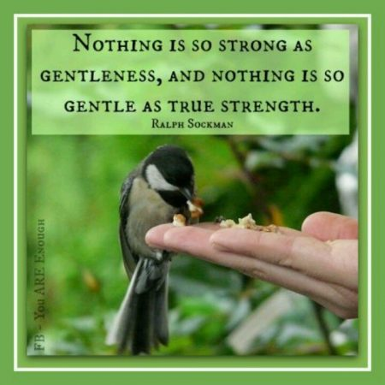
Use the Meditation resource alongside the Spiritual Encounters – bible-based meditation teacher’s pack: http://www.ldbe.co.uk/about/guidance- resources/worship-and-meditation/

Slide 33

Friday

Slide 34
Take this time to celebrate what has happened during the week – you may want to give out awards. If possible, join the bubbles using Zoom or Teams so that the whole school can come together in a time of celebration.
Remember that this should also be a time of worship and celebration so begin with a gathering, include a prayer, a blessing, and a song of celebration.

