Slide 1
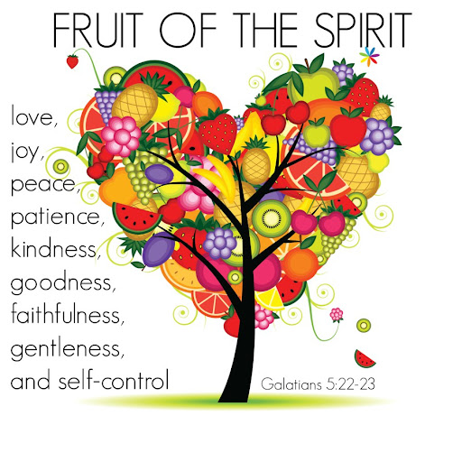

COLLECTIVE Worship and Reflections
Faithfulness

Slide 2

Church of England Colours for Worship

Slide 3
Church of England
Collective worship
ABSTRACT
This resource supports delivery of collective worship through the theme of Fruit of the Spirit.
It provides opportunities to look at some of life’s big issues in a prayerful and reflective manner.
Collective worship in a classroom has a different feel from worship in the hall. The more intimate nature of the worship can make everyone feel more readily included.

Slide 4
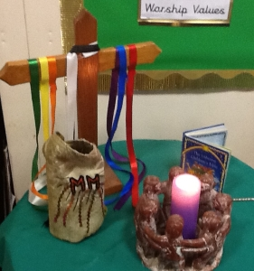
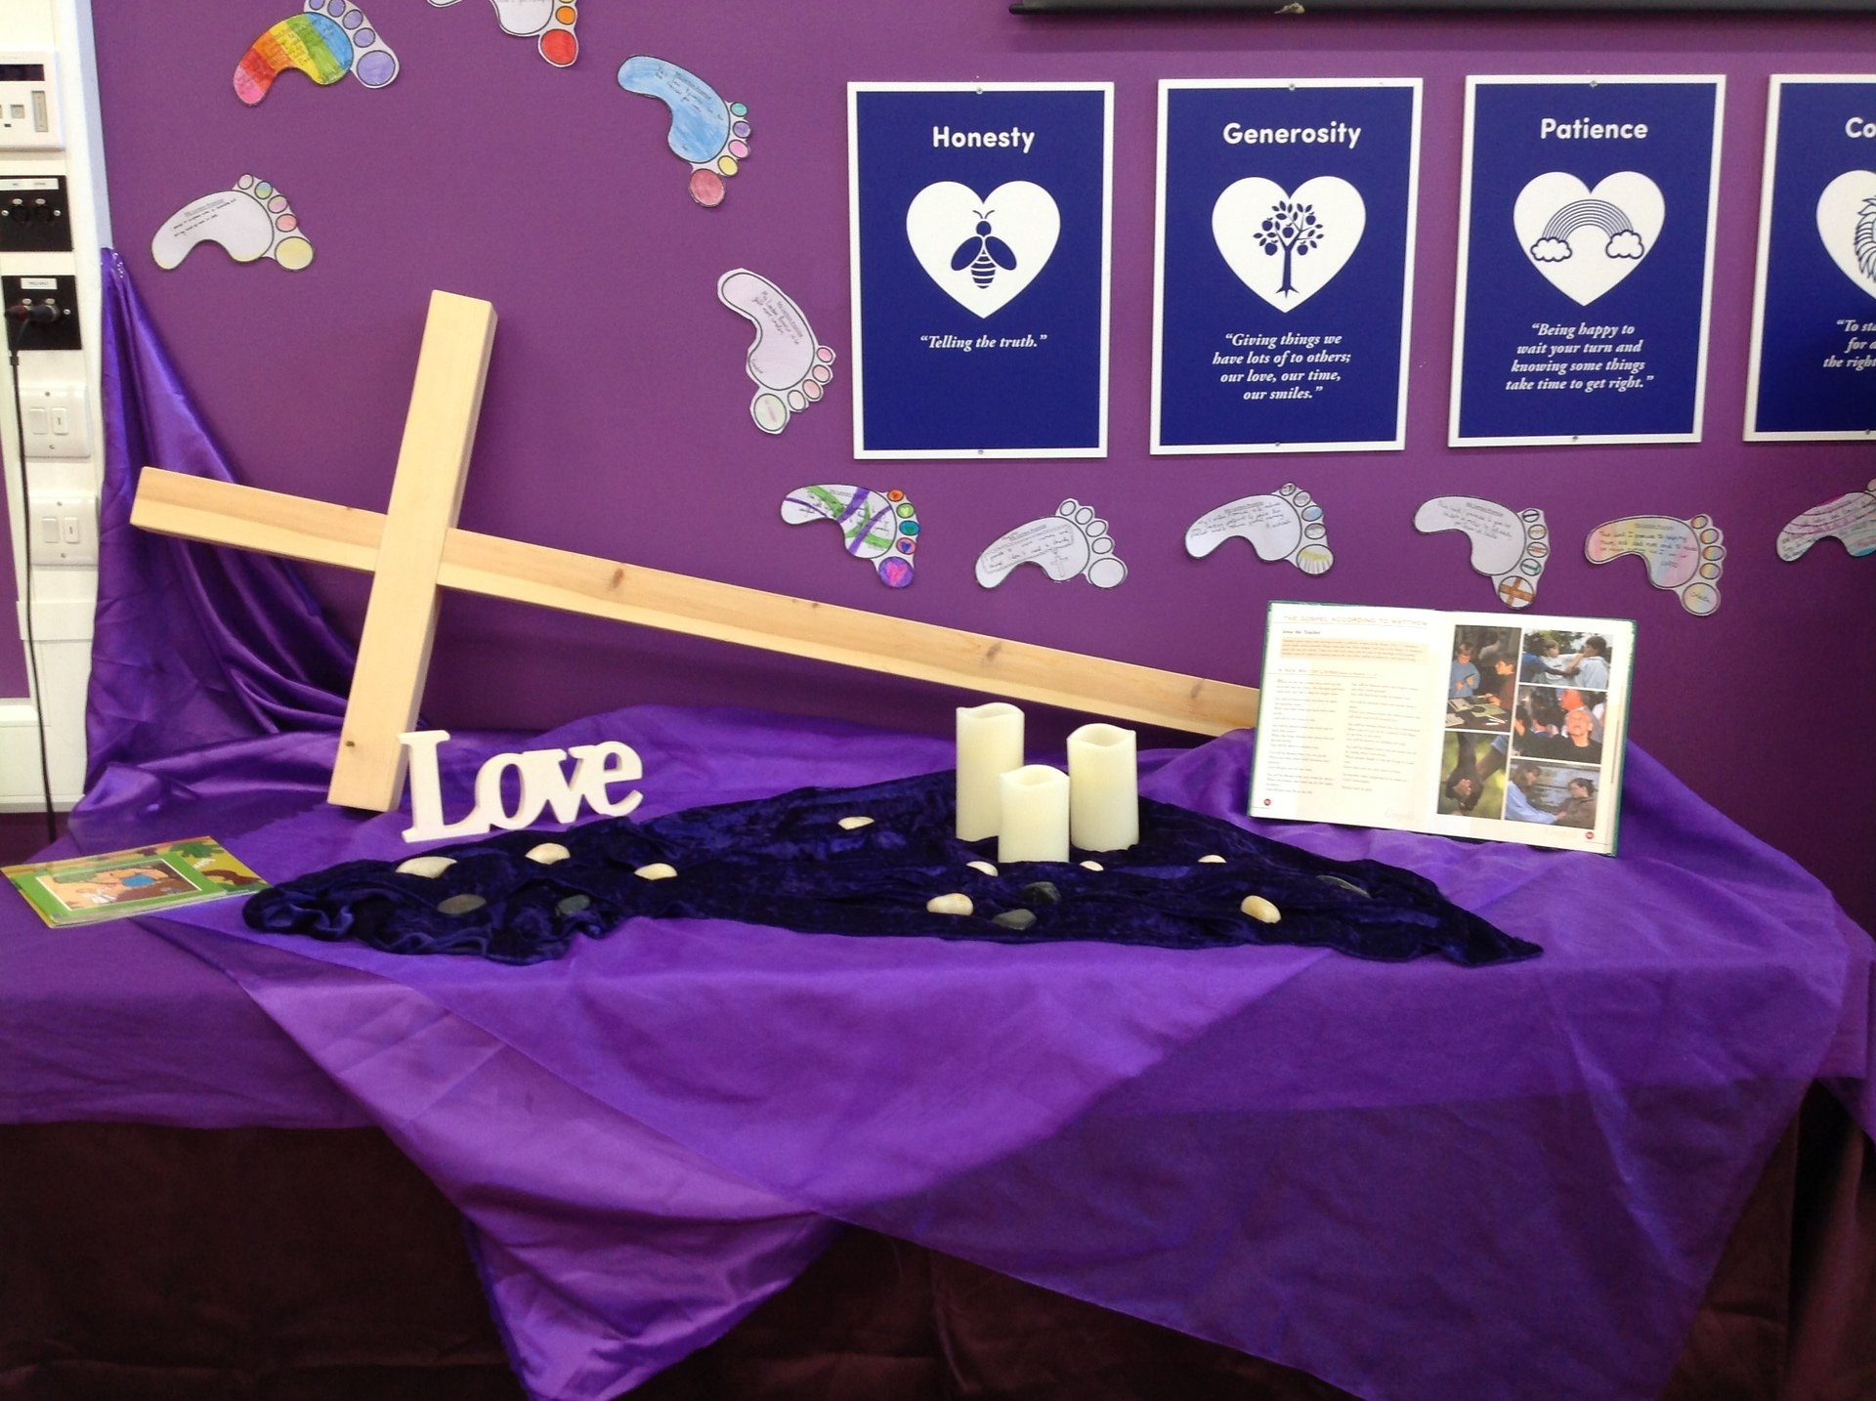
COLLECTIVE Worship
Introduction for Teachers
Ideas for the Worship Table
Special covering – possibly using liturgical colours
Candle or candles
Cross
Prayer box
Pebbles (prayer)
Flowers

Slide 5

Collective Worship
Possible music
My Lighthouse
https://www.youtube.com/watch?v=reAlJKv7ptU
City on a Hill
https://youtu.be/lTEadEftdnM
All Through History
https://www.youtube.com/watch?v=hQS2HHayr38

Slide 6

Gathering these can be used at the beginning of each session
Once everyone is set up ready for worship you may want to start by lighting a candle, followed by one of these:
Leader: Peace be with you.
Pupils: And also with you.
Leader: Welcome everyone
Pupils: It is good to be here together
Play a ‘Welcome’ song as children settle.
We meet in the name of God:
  God the Father,
  God the Son,
  God the Spirit:
  God is one.
Sign: ‘Welcome everybody here’ in BSL

Slide 7
Gathering these can be used at the beginning of each session
Christ the light of the world is here
God help us to speak positive words
To share peace with everyone
To remember that you are with us
Let us celebrate what God has made
Let’s remember to show God’s love,
and to show a bit of heaven to everyone we meet.

Slide 8

Sending these can be used at the End of each session
You may want to end your time together with one of these short prayers or blessings:
As we end this time
May we live with your love
Build on your truth
Share your forgiveness
Rest in your peace
For the whole of the day. AMEN
Thank you for this day,
For fun, friendship and learning.
We give thanks for this time
As we share peace with each other. AMEN
Help us as we as we move on
To carry hope in us for the day
Turning our thoughts towards others,
Our hearts towards love,
And our hands towards serving those in need. AMEN

Slide 9
Sending these can be used at the End of each session
The Lord bless us and watch over us, he is kind and helps us to show peace. Amen
Let’s remember today to show peace and love
To forgive when others upset us
To remember that we are all equal to God
To think about what we say before we say it
To thank God for a new day
Thank you God for all your good gifts
Christ our Lord,
Just as kings bowed down and offered you gifts,
May we know your strength and peace
And see all the free gifts you have given to us
and the blessing of the Father, Son and Holy Spirit,
be with you all, evermore
Amen

Slide 10
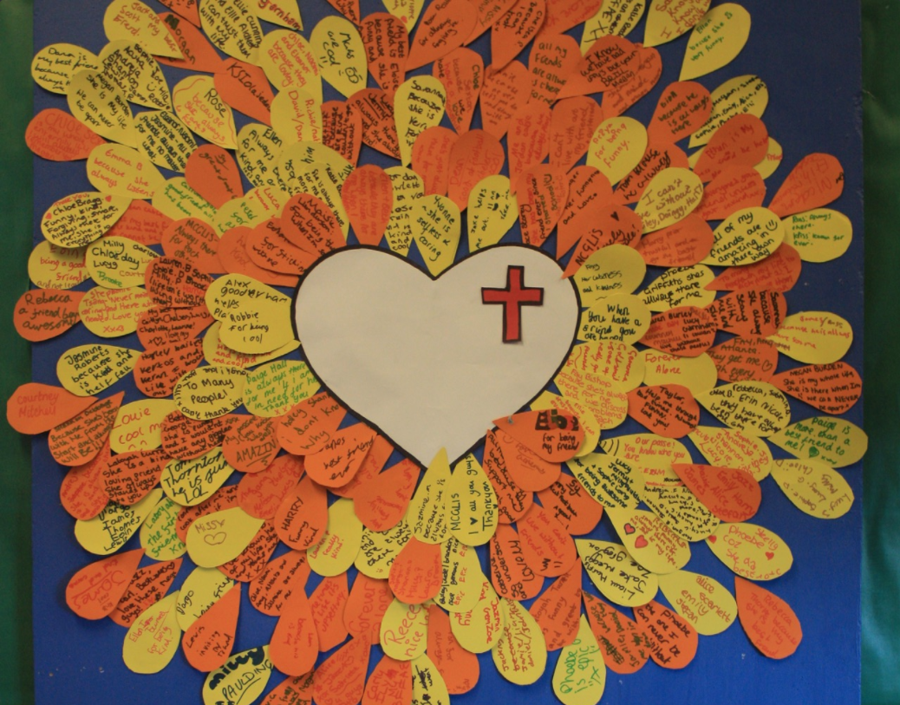
Fruit of the spirit
FAITHFULNESS

Slide 11
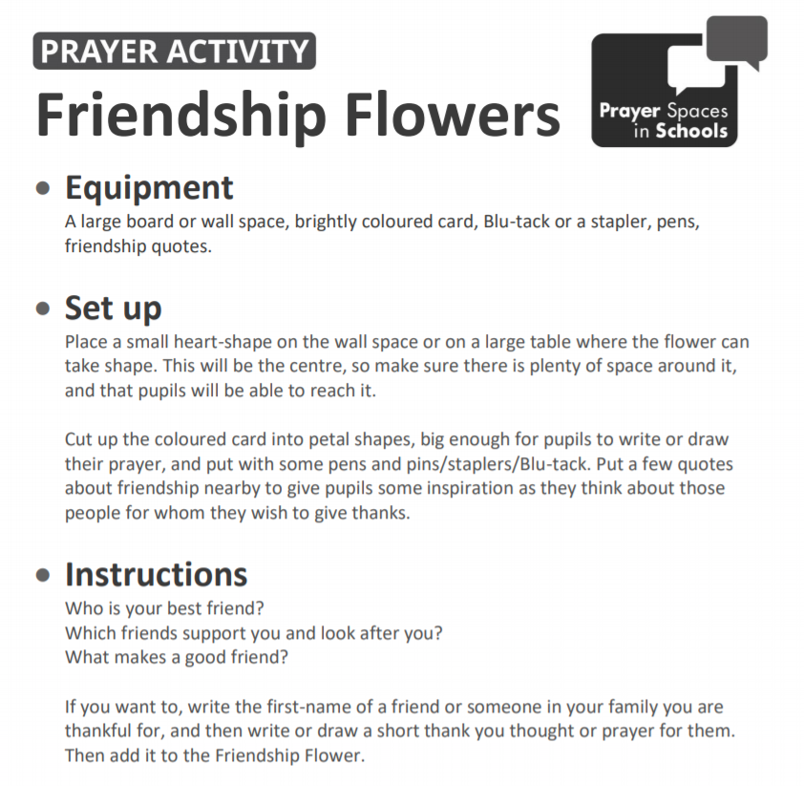
Classroom Reflection Space
FAITHFULNESS

Slide 12

Monday

Slide 13
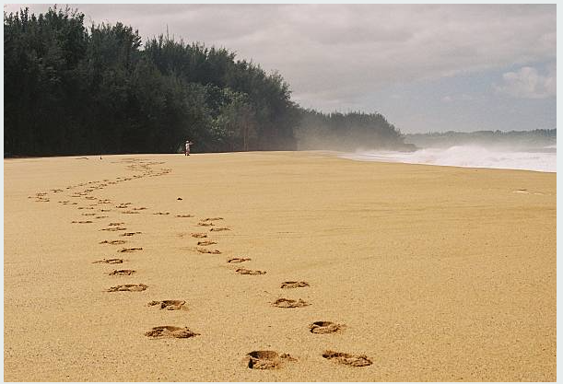


Slide 14

What do you see in the picture?
Can you make a prediction about what we are going to talk about today?
What questions do these pictures make you ask?
Think of two or three questions.

Slide 15

Responding:
What does faithfulness make you think of?
This week we are thinking about faithfulness…
Faithfulness is linked to trust, loyalty and being constant.

Slide 16
Bible passage:
Mark 4:1-11
The Lord will keep you safe.
He will spread his wings
over you
and keep you secure.
His faithfulness is like
a shield or a city wall.
Psalm 91:4
The Lord is my shepherd.
I have everything I need.
He gives me rest in green pastures.
He leads me to calm water.
He gives me new strength.
For the good of his name,
he leads me on paths that are right.
Even if I walk
through a very dark valley,
I will not be afraid
because you are with me.
Your rod and your shepherd’s staff comfort me.
Psalm 23:1-4
Notes:
David talked about God’s faithfulness in the psalms. He described God as protecting and walking alongside us.

Slide 17
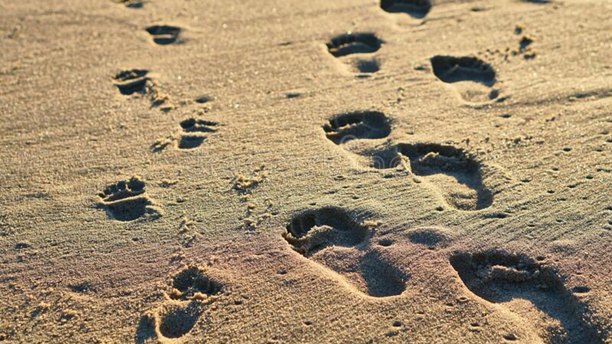
Footprints in the sand by Mary Stevenson (1936)
One night I dreamed I was walking along the beach with the Lord. Many scenes from my life flashed across the sky.
In each scene I noticed footprints in the sand. Sometimes there were two sets of footprints, other times there was one only.
This bothered me because I noticed that during the low periods of my life, when I was suffering from anguish, sorrow or defeat, I could see only one set of footprints, so I said to the Lord,
“You promised me Lord,
that if I followed you, you would walk with me always. But I have noticed that during the most trying periods of my life there has only been one set of footprints in the sand. Why, when I needed you most, have you not been there for me?”
The Lord replied, “The years when you have seen only one set of footprints, my child, is when I carried you.”

Slide 18
Responding
How does the Footprints poem show God’s faithfulness?
Who walks beside you in your life?
How does it feel to think that someone is walking beside us each day?
Notes:
Allow children time to think about this.

Slide 19
Prayer
Encourage the pupils to respond with their own prayers in the prayer space or use the prayer below:
Dear God
Thank you that you walk beside us in the good times and the hard times. Thank you for your faithfulness.
Amen

Slide 20

Tuesday

Slide 21
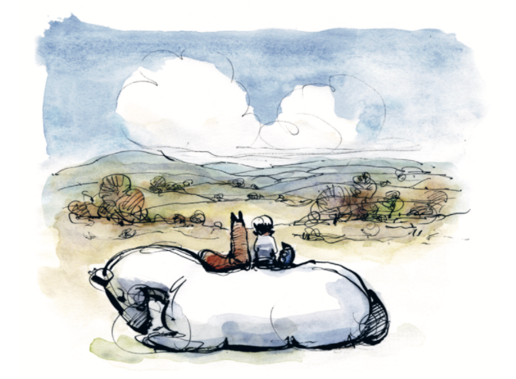

Slide 22
What do you see in the picture?
Can you make a prediction about what we are going to talk about this week?
What questions do these pictures make you ask?
Think of two or three questions.

Slide 23

RESPOND: Bible story
1 Samuel 17:55-58
David Becomes One of Saul’s Officers
⁵⁵ After King Saul had watched David go out to fight Goliath, Saul turned to the commander of his army and said, “Abner, who is that young man?”
“Your Majesty,” Abner answered, “I swear by your life that I don’t know.”
⁵⁶ “Then find out!” Saul told him.
⁵⁷ When David came back from fighting Goliath, he was still carrying Goliath’s head.
Abner took David to Saul, ⁵⁸ and Saul asked, “Who are you?”
“I am David the son of Jesse, a loyal Israelite from Bethlehem.”
Notes:
David has defeated Goliath and has been noticed by King Saul (who David is ultimately set to replace as King).

Slide 24
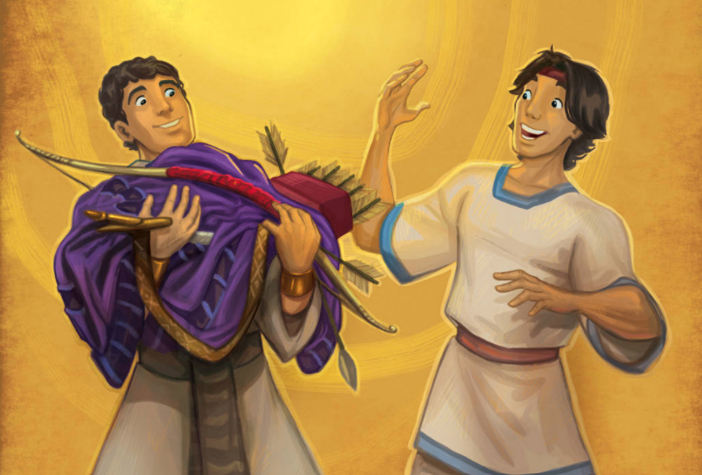
RESPOND: Bible story
1 Samuel 18:1-5
David and Saul finished talking, and soon David and Jonathan^{[a]} became best friends. Jonathan thought as much of David as he did of himself. ² From that time on, Saul kept David in his service and would not let David go back to his own family.
³ Jonathan liked David so much that they promised to always be loyal friends. ⁴ Jonathan took off the robe that he was wearing and gave it to David. He also gave him his military clothes,^{[b]} his sword, his bow and arrows, and his belt.
⁵ David was a success in everything that Saul sent him to do, and Saul made him a high officer in his army. That pleased everyone, including Saul’s other officers.
Notes:
David and Saul’s son Jonathan strike up a friendship which eventually sees Jonathan act to protect David from his father.

Slide 25
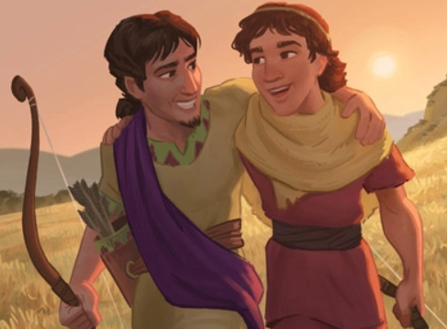
RESPOND: Bible story
1 Samuel 20:9-13
⁹ “Don’t worry,” Jonathan said. “If I find out that my father wants to kill you, I’ll certainly let you know.”
¹⁰ “How will you do that?” David asked.
¹¹ “Let’s go out to this field, and I’ll tell you,” Jonathan answered.
When they got there, ¹² Jonathan said:
I swear by the Lord God of Israel, that two days from now I’ll know what my father is planning. Of course I’ll let you know if he’s friendly toward you. ¹³ But if he wants to harm you, I promise to tell you and help you escape. And I ask the Lord to punish me severely if I don’t keep my promise.
Notes:
David and Saul’s son Jonathan strike up a friendship which eventually sees Jonathan act to protect David from his father.

Slide 26
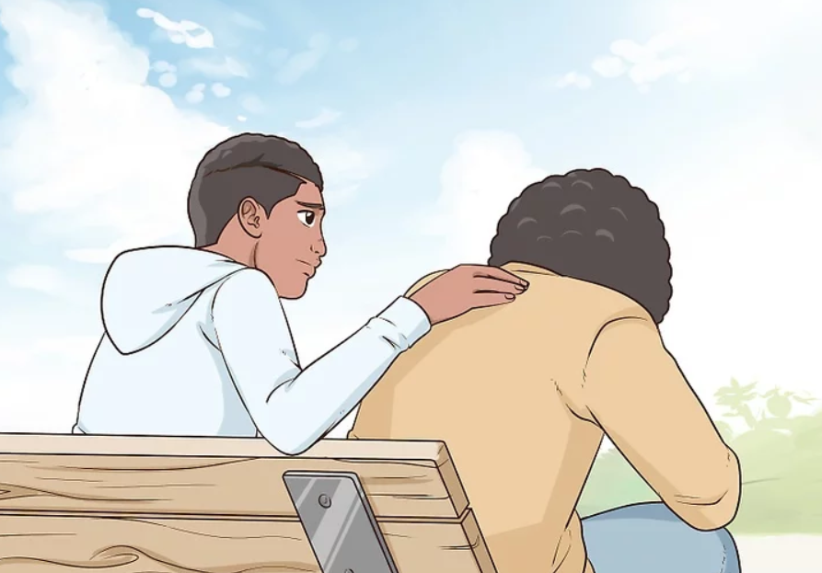
Being a faithful friend is very important. It means that you are there for each other, even in tough times…
How has someone been a faithful friend to you?
How have you been a faithful friend?
Share your ideas on what makes a faithful friend with your class.

Slide 27

You may want to share ‘The Boy, the Mole, the Fox and the Horse’ by Charlie Mackesy for some brilliant examples of faithful friendship.

Slide 28
Prayer
Encourage the pupils to respond with their own prayers first, using the class prayer space/area or with the prayer below:
Dear God,
Thank you for my friends and for the way that they care for me. Help me to be a faithful friend.
Amen.

Slide 29

Wednesday

Slide 30
Prompted to action - challenge
Remember our theme this week…
Faithfulness
and our Bible passages…
David and Jonathan (1 Samuel)
Psalm 91 and 23

Slide 31
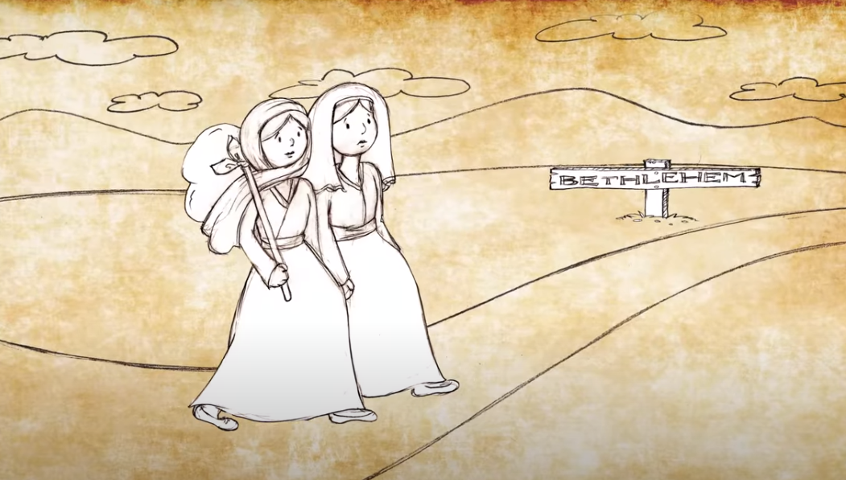
RESPOND: Bible story
Ruth 1
The story of Ruth and Naomi from the Old Testament is all about the loyalty and faithfulness of friends.
https://www.youtube.com/watch?v=gR2sZRAVcwc

Slide 32
Responding
How could you encourage faithful friendship in your school?
What practical things could you do to help build strong and faithful friendships?
How can you make sure that everyone has a friend in your school?
Notes:
Allow children time to think about this.

Slide 33
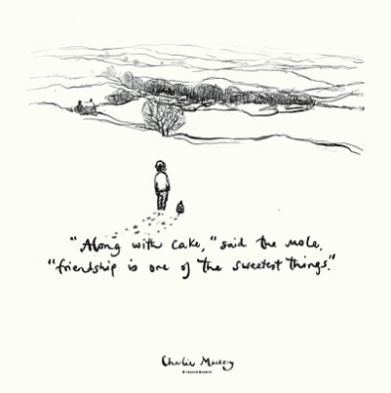
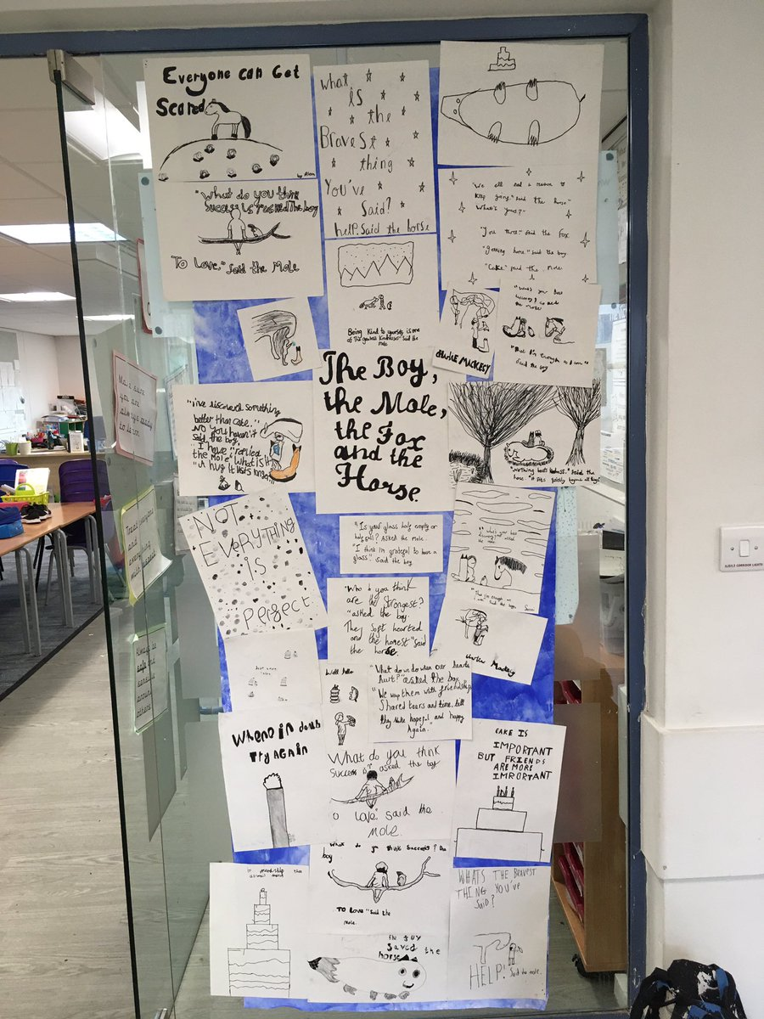
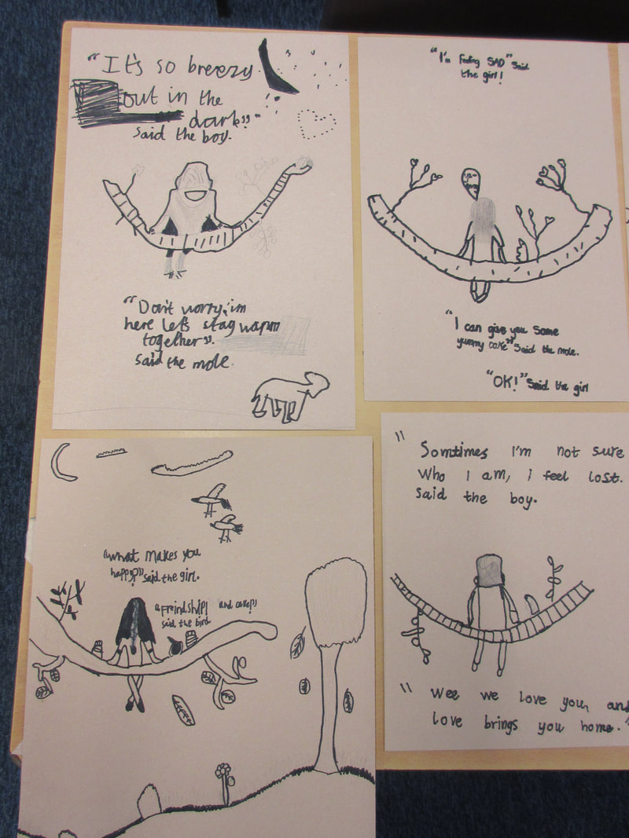
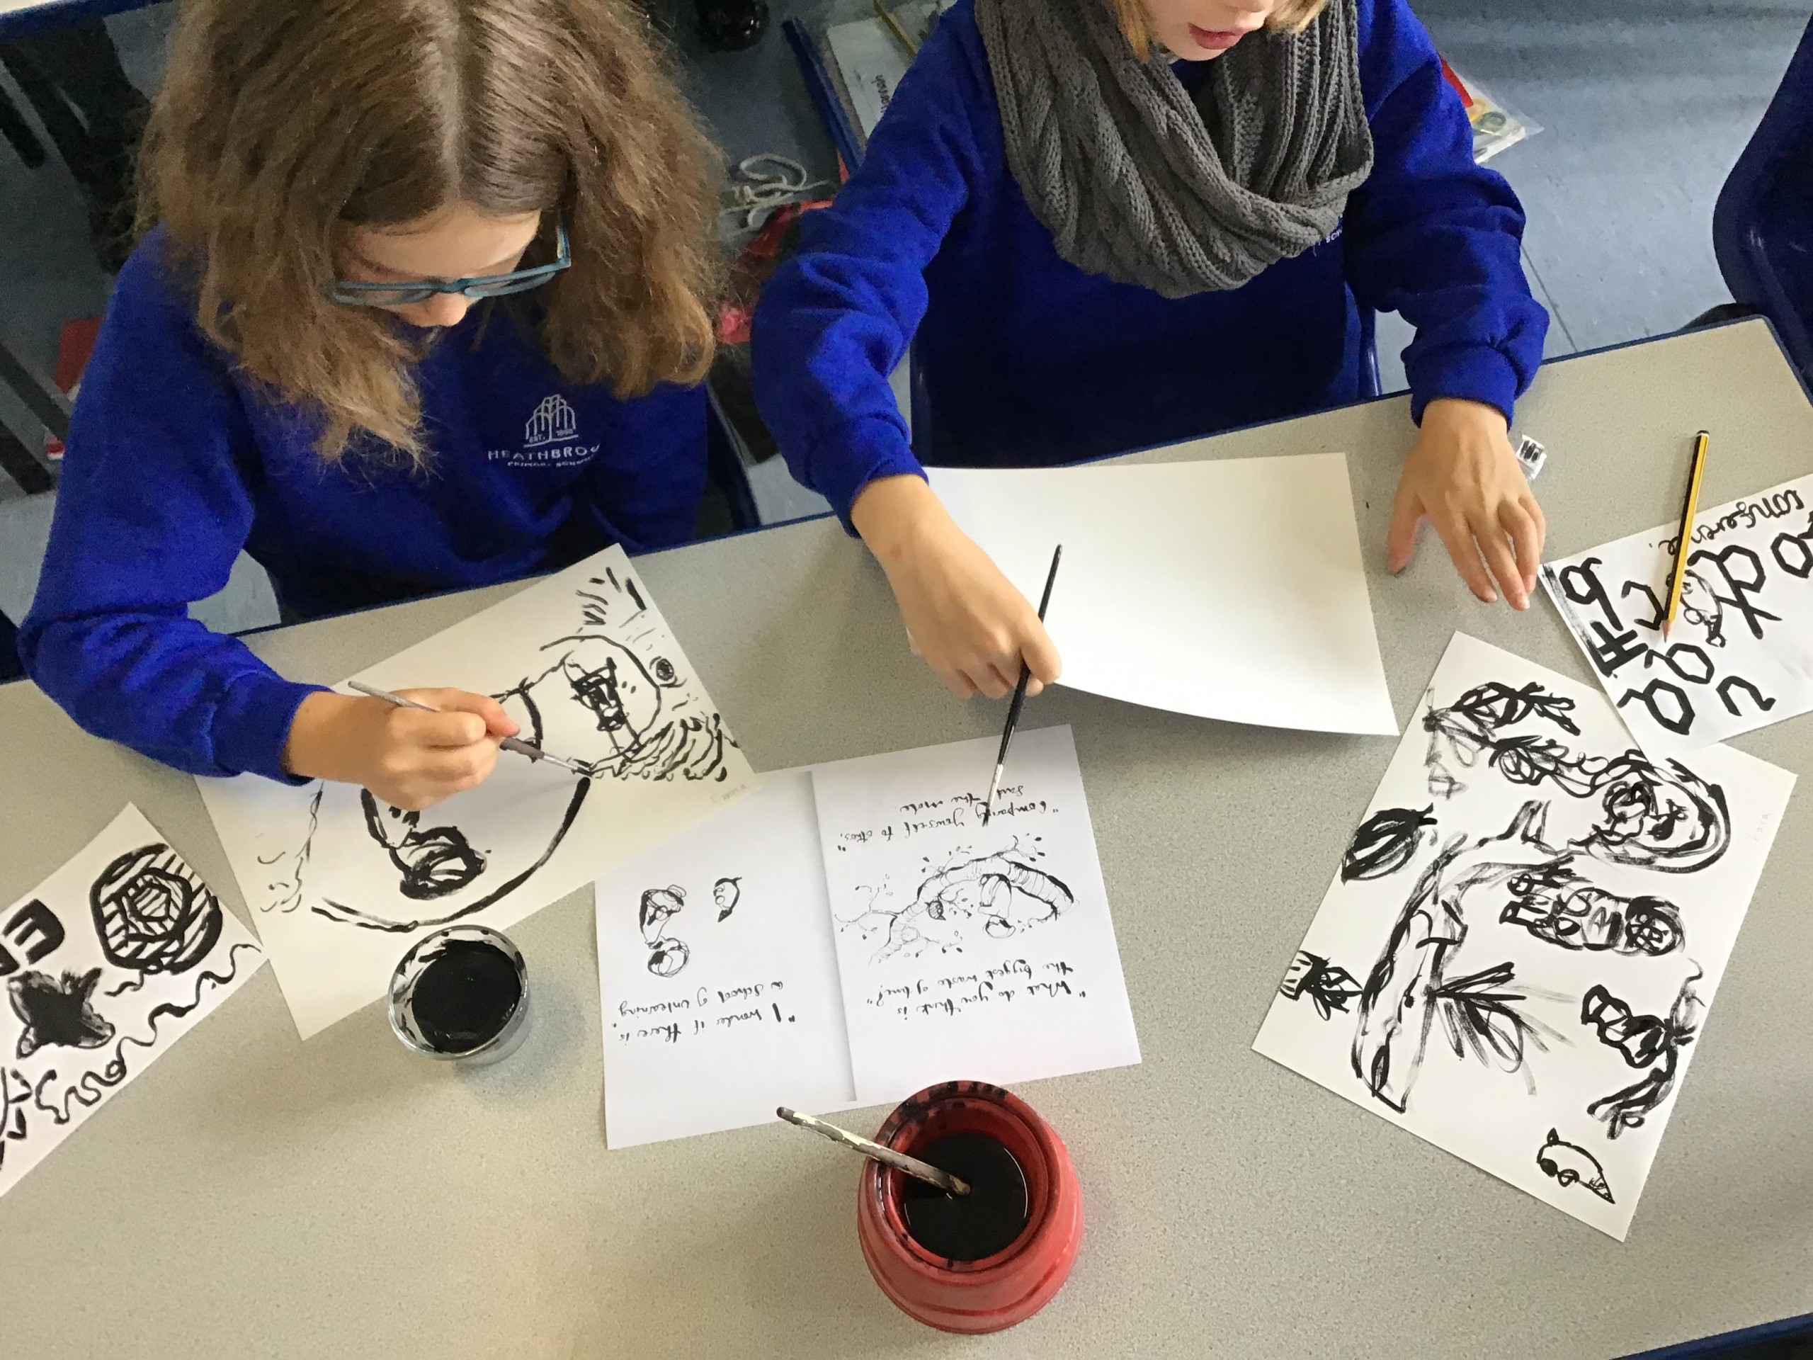
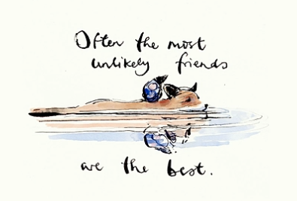
Prompted to action – challenge ideas
Could you take inspiration from Charlie Mackesy’s illustrations and use them as the starting point for encouraging faithful friendships in your school?

Slide 34
Prayer
Encourage the pupils to respond with their own prayers in the class prayer space/area. You could use the school’s prayer or the Lord’s Prayer:
Our Father, in heaven,
Holy is your name.
Your Kingdom come,
Your will be done on earth, as it is in heaven.
Give us this day our daily bread,
And forgive us our sins,
As we forgive those who sin against us,
And lead us not into temptation,
But deliver us from evil.
Amen.

Slide 35

Thursday

Slide 36
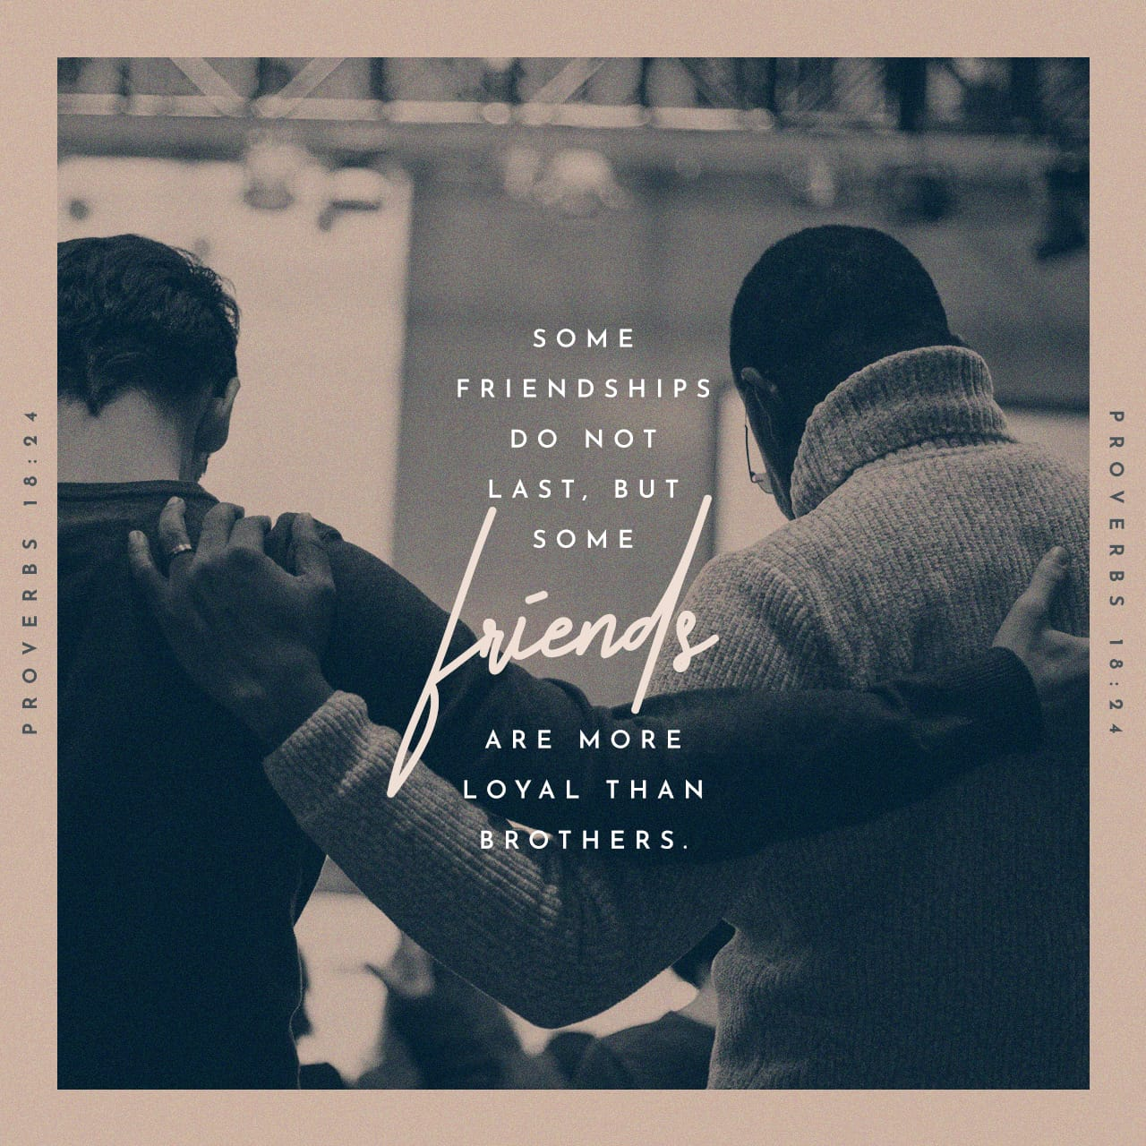
Use the Meditation resource alongside the Spiritual Encounters – bible-based meditation teacher’s pack: http://www.ldbe.co.uk/about/guidance- resources/worship-and-meditation/

Slide 37

Friday

Slide 38
Take this time to celebrate what has happened during the week – you may want to give out awards. If possible, join the bubbles using Zoom or Teams so that the whole school can come together in a time of celebration.
Remember that this should also be a time of worship and celebration so begin with a gathering, include a prayer, a blessing, and a song of celebration.

