Slide 1
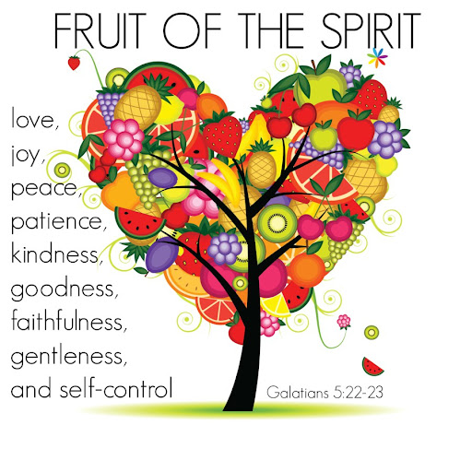

COLLECTIVE Worship and Reflections
PEACE

Slide 2

Church of England Colours for Worship

Slide 3
Church of England
Collective worship
ABSTRACT
This resource supports delivery of collective worship through the theme of Fruit of the Spirit.
It provides opportunities to look at some of life’s big issues in a prayerful and reflective manner.
Collective worship in a classroom has a different feel from worship in the hall. The more intimate nature of the worship can make everyone feel more readily included.

Slide 4
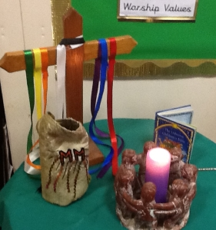
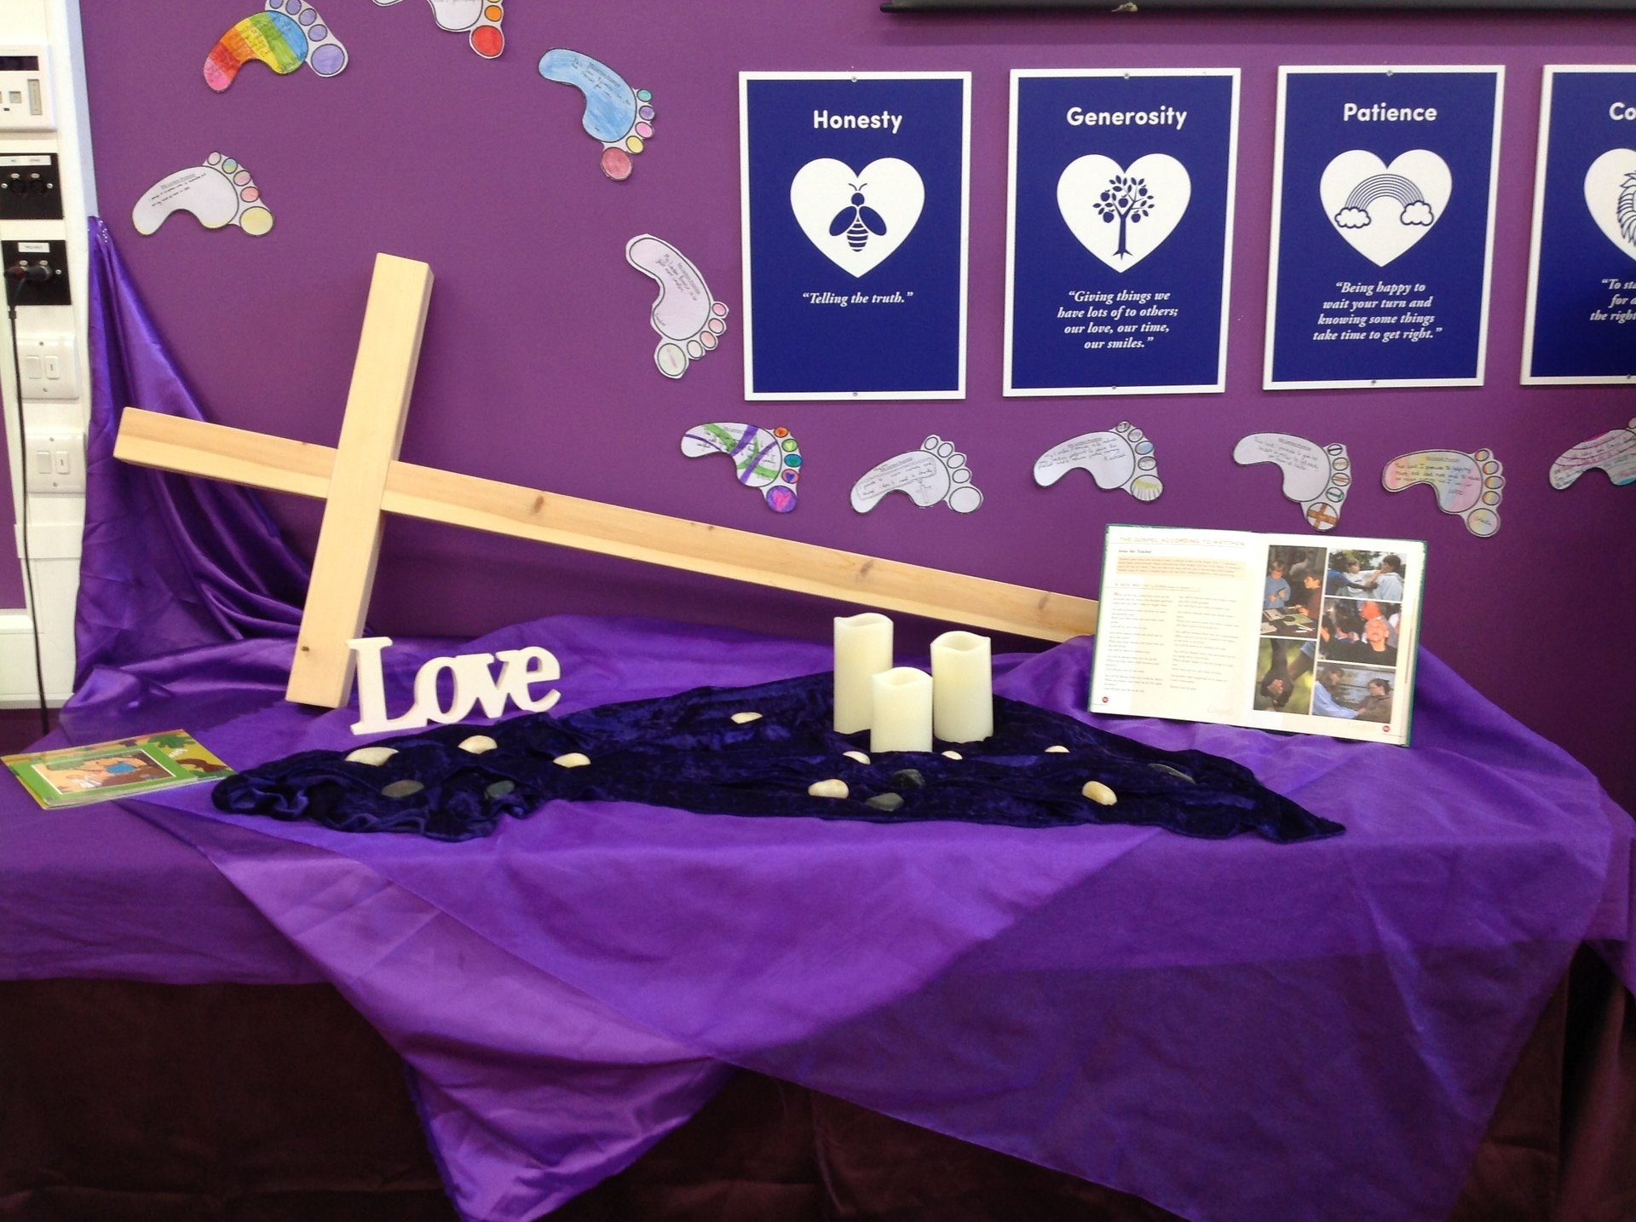
COLLECTIVE Worship
Introduction for Teachers
Ideas for the Worship Table
Special covering – possibly using liturgical colours
Candle or candles
Cross
Prayer box
Pebbles (prayer)
Flowers

Slide 5

Collective Worship
Possible music
Peace
https://www.youtube.com/watch?v=uW6xcmqfiY4
Peace Be Still
https://www.youtube.com/watch?v=lsIpGiz3SfQ
Make me a Channel of Your Peace
https://www.youtube.com/watch?v=ihhvm6eLWZI
Peace Like a River
https://www.youtube.com/watch?v=d6085sLXCMs
You are my Peace
https://www.youtube.com/watch?v=Dg56EmUG6nc
Peace in the Valley
https://www.youtube.com/watch?v=ai69MeKWurI
Notes:
Music suggestions are both secular and Christian worship. These could be used as a listening focus around the theme or as a part of sung worship.
What does this song say about…..
How does it make you feel?

Slide 6
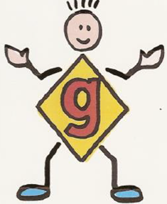
Gathering these can be used at the beginning of each session
Once everyone is set up ready for worship you may want to start by lighting a candle, followed by one of these:
Leader: Peace be with you.
Pupils: And also with you.
Leader: Welcome everyone
Pupils: It is good to be here together
Play a ‘Welcome’ song as children settle.
We meet in the name of God:
  God the Father,
  God the Son,
  God the Spirit:
  God is one.
Sign: ‘Welcome everybody here’ in BSL

Slide 7
Gathering these can be used at the beginning of each session
Christ the light of the world is here
God help us to speak positive words
To share peace with everyone
To remember that you are with us
Let us celebrate what God has made
Let’s remember to show God’s love,
and to show a bit of heaven to everyone we meet.

Slide 8

Sending these can be used at the End of each session
You may want to end your time together with one of these short prayers or blessings:
As we end this time
May we live with your love
Build on your truth
Share your forgiveness
Rest in your peace
For the whole of the day. AMEN
Thank you for this day,
For fun, friendship and learning.
We give thanks for this time
As we share peace with each other. AMEN
Help us as we as we move on
To carry hope in us for the day
Turning our thoughts towards others,
Our hearts towards love,
And our hands towards serving those in need. AMEN

Slide 9
Sending these can be used at the End of each session
The Lord bless us and watch over us, he is kind and helps us to show peace. Amen
Let’s remember today to show peace and love
To forgive when others upset us
To remember that we are all equal to God
To think about what we say before we say it
To thank God for a new day
Thank you God for all your good gifts
Christ our Lord,
Just as kings bowed down and offered you gifts,
May we know your strength and peace
And see all the free gifts you have given to us
and the blessing of the Father, Son and Holy Spirit,
be with you all, evermore
Amen

Slide 10
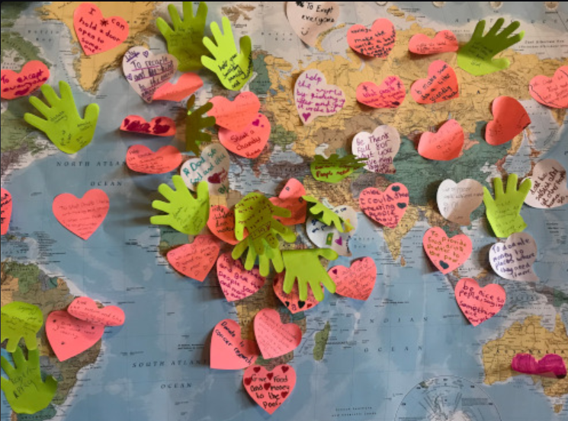
Fruit of the spirit peace

Slide 11
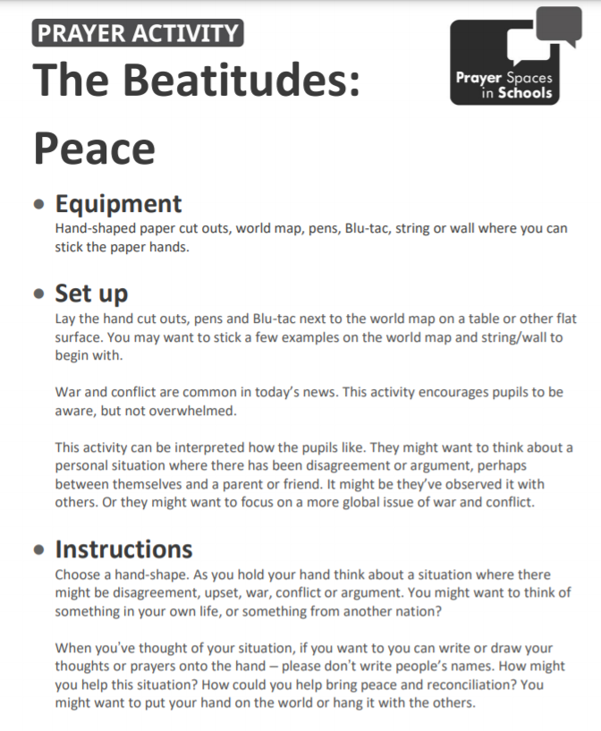
Classroom Reflection Space
peaCE

Slide 12

Monday

Slide 13
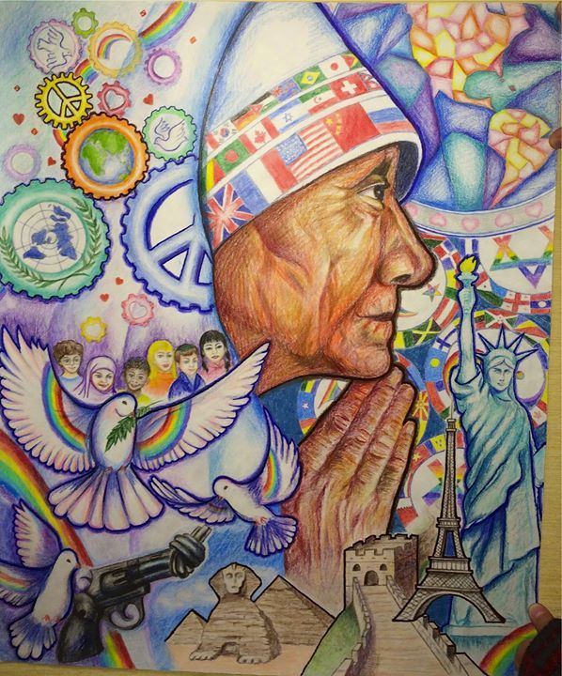


Slide 14

What do you see in the picture?
Can you make a prediction about what we are going to talk about this week?
What questions do these pictures make you ask?
Think of two or three questions.

Slide 15

RESPOND: Bible passage
Those who work to bring peace are happy. God will call them his children.
Matthew 5:9
What does PEACE mean to you? What do you think of?
Notes:
In this passage, Jesus teaches his followers to do as he did – to bring peace wherever they could, changing situations of conflict, being a calming influence….. one Bible translation calls it being a ‘peacemaker’.

Slide 16

Which line stands out to you?
I wonder if you are facing any situations which need a little peace ?
I wonder how you might be a peacemaker?

Slide 17

Prayer
Encourage the pupils to respond with their own prayers first, using the class prayer space/area or with the prayer below:
Dear God,
We thank you for giving us your peace.
Help us to spread peace at home and at school
by loving and caring for one another.
Help us to spread peace by listening to one another,
even when we don’t agree.
Help us to spread peace by sharing our time
with those who are lonely and who need a friend.
Let us pray every day for peace
for our families, for our friends
and for ourselves.
Amen

Slide 18
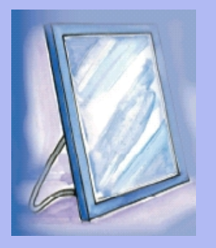
Tuesday

Slide 19
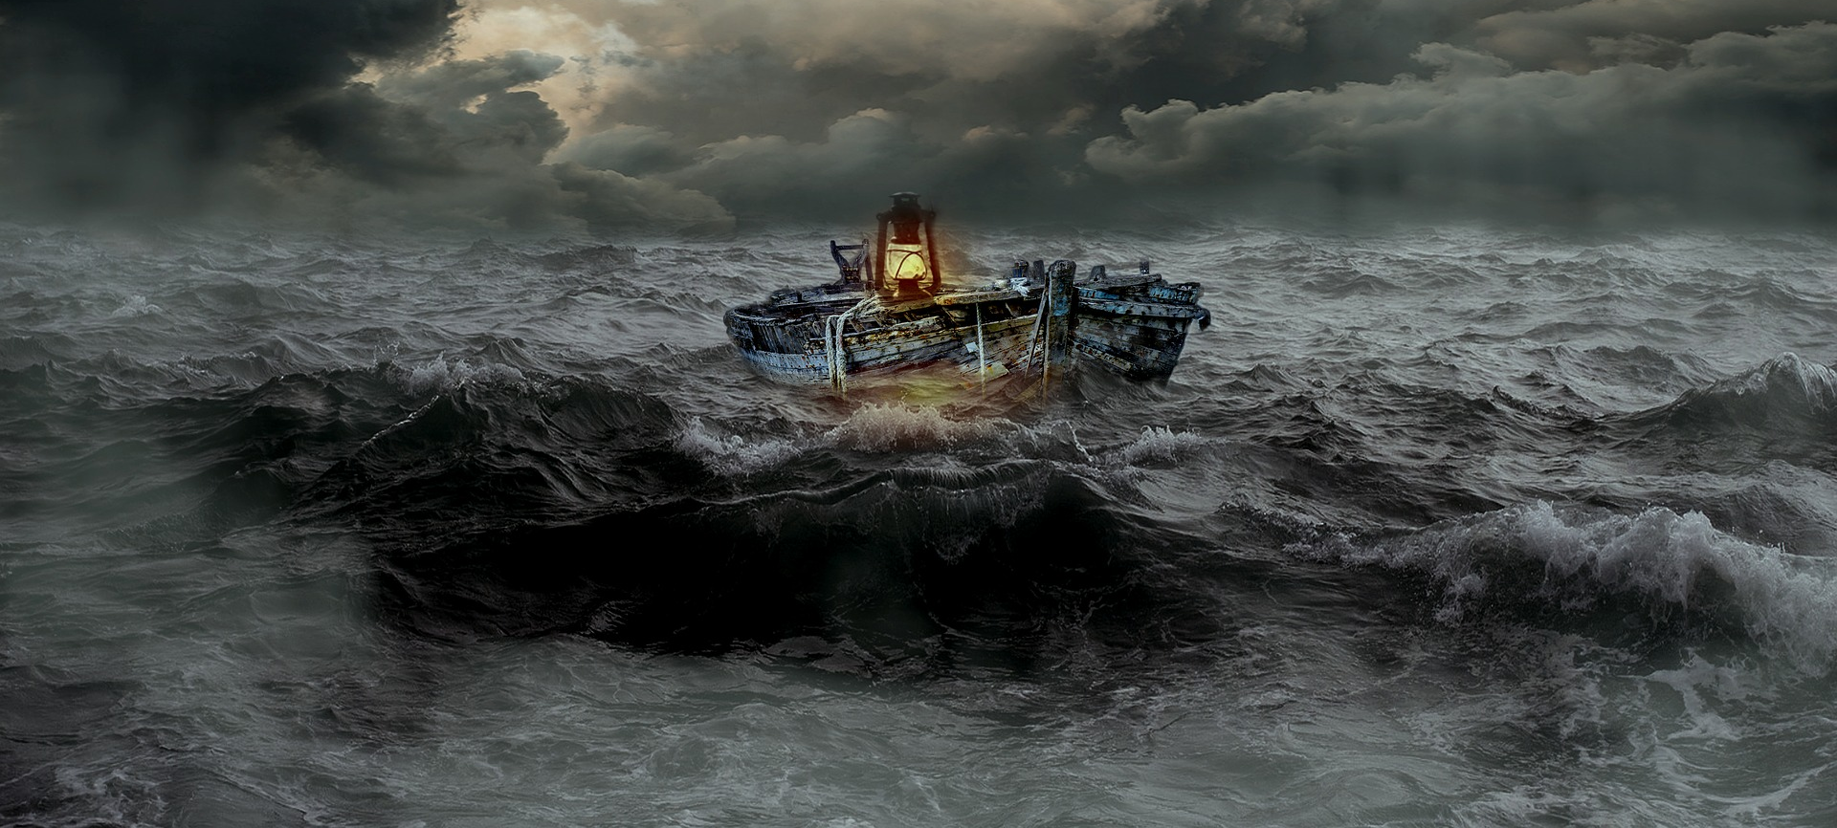

Slide 20
What do you see in the picture?
Can you make a prediction about what we are going to talk about today?
What questions do these pictures make you ask?
Think of two or three questions.

Slide 21
Responding
I wonder what questions you asked?
Notes:
Allow children time to think about this.

Slide 22
Bible passage: Jesus calms the storm
Watch: https://www.youtube.com/watch?v=uYLHqdSO9OY or Read the following action story
^{Calming the storm}
The actions for the story may need a quick rehearsal, just so that you can establish signals for stopping! The rain and storm are the actions that will need the most careful explanation, because you want the knee-patting to be very quiet to start with, but a full-on storm for the climax of the story, so make sure you establish this with children before you start. It’s only a precaution, as the pace of the story should keep them too busy to worry about getting too excited, and in any case, it’s supposed to sound like a storm!
^{Word Action}
‘Jesus’ touch palms one at a time with opposite middle finger, left palm first (this is the BSL sign for ‘Jesus’)
^{‘night’ lay head on hands}
‘friends’ wave and say ‘Hello!’
^{‘boat’ say ‘Aye aye Cap’n!’}
^{‘sleep’ snore gently}
‘waves’ make sea motion with hands – this can be varied as the sea gets rougher!
‘rain’ pat hands on knees, again getting louder as the storm progresses
‘wind blew’ make a wind sound with mouth
‘terrified’ put hands over face as if in terror
‘storm’ do rain and wind together, loudly
Notes:
This story is about a storm, a not-very-peaceful experience! As the story is told, there are certain words you’ll hear that mean you need to do or say something rehearse the actions if you need to.

Slide 23
Bible passage: Jesus calms the storm
Watch: https://www.youtube.com/watch?v=uYLHqdSO9OY or Read the following action story
Jesus [touch palms one at a time with opposite middle finger, left palm first] had been busy all day, teaching the crowds of people about God and his kingdom. It was nearly night [lay head on hands] so Jesus [touch palms one at a time with opposite middle finger, left palm first] said to his friends [wave and say ‘Hello!’] ‘Let us go in this boat [say ‘Aye aye Cap’n!’] over to the other side of the lake. And so Jesus [touch palms one at a time with opposite middle finger, left palm first]...and his friends [wave and say ‘Hello!’] got into the boat [say ‘Aye aye Cap’n!’] and they began to row [pretend to use oars]. There were many other boats [say ‘Aye aye Cap’n!’ several times!] on the lake with them as night [lay head on hands] fell.
As the boat [say ‘Aye aye Cap’n!’] rocked gently on the lake, Jesus [touch palms one at a time with opposite middle finger, left palm first] went to sleep [snore gently] in the back of the boat [say ‘Aye aye Cap’n!’], lying down on some cushions.
Then, as the night [lay head on hands] got darker, it began to rain [pat hands on knees] and the wind blew [make a wind sound with mouth] and the waves [make sea motion with hands] got a little bit wavier [make sea motion with hands more wavy!], the boat [say ‘Aye aye Cap’n!’] began to go UP [raise hands up] and DOWN [make hands go down like a roller coaster].

Slide 24
Bible passage: Jesus calms the storm
Watch: https://www.youtube.com/watch?v=uYLHqdSO9OY or Read the following action story
And as the wind blew even harder [make a louder wind sound with mouth], the rain [pat hands on knees] got heavier [pat knees more loudly]…..and the waves [make sea motion with hands] got VERY wavy [make sea motion with hands even more wavy!]….. and the little boat [say ‘Aye aye Cap’n!’] began to go UP [raise hands up] and DOWN [make hands go down like a roller coaster] ……..and UP [raise hands up] and DOWN [make hands go down like a roller coaster] …….and UP [raise hands up] and DOWN [make hands go down like a roller coaster].
The waves [make sea motion with hands] got so rough that the little boat [say ‘Aye aye Cap’n!’] was almost swamped by the sea and the friends [wave and say ‘Hello!’] of Jesus [touch palms one at a time with opposite middle finger, left palm first] were terrified [put hands over face as if in terror] because of the storm [do rain and wind together]. But Jesus [touch palms one at a time with opposite middle finger, left palm first] was still asleep [snore gently].
The terrified [put hands over face as if in terror] friends [wave and say ‘Hello!’] woke Jesus [touch palms one at a time with opposite middle finger, left palm first] and said to him ‘Teacher, don’t you care if we drown?! Can’t you hear the storm?’ [do rain and wind together, loudly, for as long as you dare! – then shout in a loud voice over the storm]

Slide 25
Bible passage: Jesus calms the storm
Watch: https://www.youtube.com/watch?v=uYLHqdSO9OY or Read the following action story
‘BE QUIET!!!! BE STILL!!!!’ [signal for children to stop] Jesus [touch palms one at a time with opposite middle finger, left palm first] said, and it was…..still…..and quiet. [leave a pause]
‘Why were you terrified?’ [put hands over face as if in terror] Jesus [touch palms one at a time with opposite middle finger, left palm first] said to them ‘Where is your faith?’
But the friends [wave and say ‘Hello!’] were now terrified [put hands over face as if in terror] in a different way and asked each other ‘Who can this man be? Even the wind [make a wind sound with mouth] and the waves [make sea motion with hands] obey him! We thought only God [point upwards] could do that!’

Slide 26
Responding
I wonder how this story made you feel?
I wonder what this story might mean for you today or in the next week?
I wonder what this story tells us about peace?
Notes:
Allow children time to think about this.

Slide 27
Prayer
Encourage the pupils to respond with their own prayers in the prayer space or use the prayer below:
Dear God
Thank you for the story of Jesus calming the storm.
Thank you for what it teaches us about Jesus being present through good times and through bad.
Please help us as we try to follow his example, and be peacemakers in our troubled world.
Amen

Slide 28

Wednesday

Slide 29

Prompted to action - challenge
Remind children of the theme for the week and of the Bible story
Peace

Slide 30
Prompted to action – challenge ideas
Think of one thing you could do to be a peacemaker?
How would this make your class/home/community a better place to be?

Slide 31





Prompted to action – challenge ideas
Create your own PEACE symbol. Use it as a reminder to be a peacemaker

Slide 32
Prayer
Encourage the pupils to respond with their own prayers in the class prayer space/area. You could use the school’s prayer or the Lord’s Prayer:
Our Father, in heaven,
Holy is your name.
Your Kingdom come,
Your will be done on earth, as it is in heaven.
Give us this day our daily bread,
And forgive us our sins,
As we forgive those who sin against us,
And lead us not into temptation,
But deliver us from evil.
Amen.

Slide 33

Thursday

Slide 34
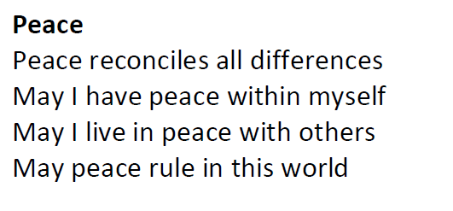
Use the Meditation resource alongside the Spiritual Encounters – bible-based meditation teacher’s pack: http://www.ldbe.co.uk/about/guidance- resources/worship-and-meditation/

Slide 35

Friday

Slide 36
Take this time to celebrate what has happened during the week – you may want to give out awards. If possible, join the bubbles using Zoom or Teams so that the whole school can come together in a time of celebration.
Remember that this should also be a time of worship and celebration so begin with a gathering, include a prayer, a blessing, and a song of celebration.

