Slide 1


COLLECTIVE Worship and Reflections
PATIENCE

Slide 2

Church of England Colours for Worship

Slide 3
Church of England
Collective worship
ABSTRACT
This resource supports delivery of collective worship through the theme of Fruit of the Spirit.
It provides opportunities to look at some of life’s big issues in a prayerful and reflective manner.
Collective worship in a classroom has a different feel from worship in the hall. The more intimate nature of the worship can make everyone feel more readily included.

Slide 4
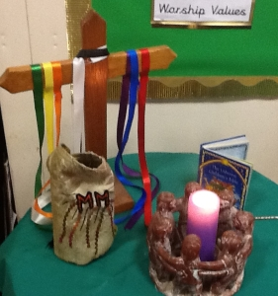
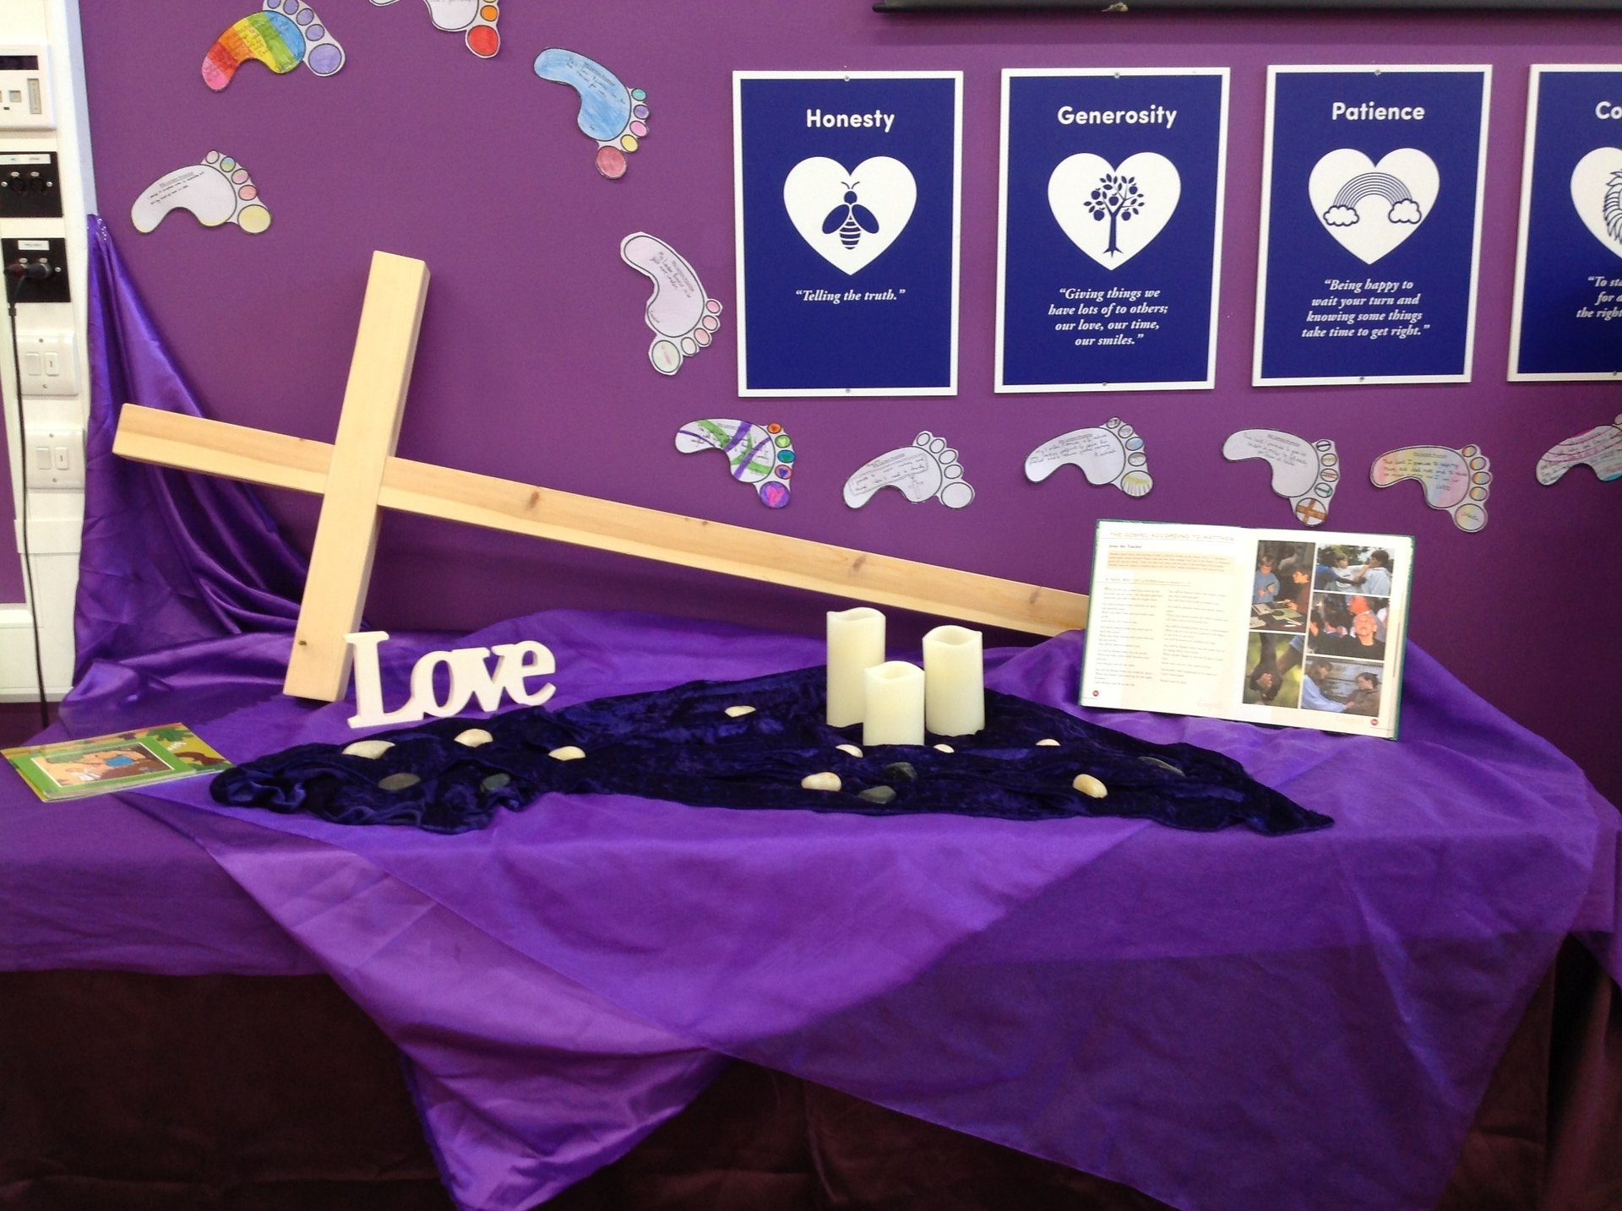
COLLECTIVE Worship
Introduction for Teachers
Ideas for the Worship Table
Special covering – possibly using liturgical colours
Candle or candles
Cross
Prayer box
Pebbles (prayer)
Flowers

Slide 5

Collective Worship
Possible music
While I Wait (Lincoln Brewster)
https://www.youtube.com/watch?v=uvSD57FJKLc
Those Who Wait
https://www.youtube.com/watch?v=Cun9t5Z_zHU
Wait on You
https://www.youtube.com/watch?v=sAHnUUGMIcs
Patience (Chris Cornell)
https://www.youtube.com/watch?v=myZ32Pf-5PE
Patience (Take That)
https://www.youtube.com/watch?v=273eSvOwpKk
Notes:
Music suggestions are both secular and Christian worship. These could be used as a listening focus around the theme or as a part of sung worship.
What does this song say about…..
How does it make you feel?

Slide 6

Gathering these can be used at the beginning of each session
Once everyone is set up ready for worship you may want to start by lighting a candle, followed by one of these:
Leader: Peace be with you.
Pupils: And also with you.
Leader: Welcome everyone
Pupils: It is good to be here together
Play a ‘Welcome’ song as children settle.
We meet in the name of God:
  God the Father,
  God the Son,
  God the Spirit:
  God is one.
Sign: ‘Welcome everybody here’ in BSL

Slide 7
Gathering these can be used at the beginning of each session
Christ the light of the world is here
God help us to speak positive words
To share peace with everyone
To remember that you are with us
Let us celebrate what God has made
Let’s remember to show God’s love,
and to show a bit of heaven to everyone we meet.

Slide 8

Sending these can be used at the End of each session
You may want to end your time together with one of these short prayers or blessings:
As we end this time
May we live with your love
Build on your truth
Share your forgiveness
Rest in your peace
For the whole of the day. AMEN
Thank you for this day,
For fun, friendship and learning.
We give thanks for this time
As we share peace with each other. AMEN
Help us as we as we move on
To carry hope in us for the day
Turning our thoughts towards others,
Our hearts towards love,
And our hands towards serving those in need. AMEN

Slide 9
Sending these can be used at the End of each session
The Lord bless us and watch over us, he is kind and helps us to show peace. Amen
Let’s remember today to show peace and love
To forgive when others upset us
To remember that we are all equal to God
To think about what we say before we say it
To thank God for a new day
Thank you God for all your good gifts
Christ our Lord,
Just as kings bowed down and offered you gifts,
May we know your strength and peace
And see all the free gifts you have given to us
and the blessing of the Father, Son and Holy Spirit,
be with you all, evermore
Amen

Slide 10
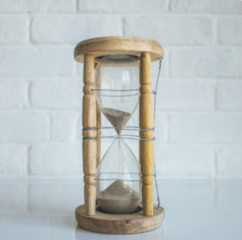
Fruit of the spirit
PATIENCE

Slide 11

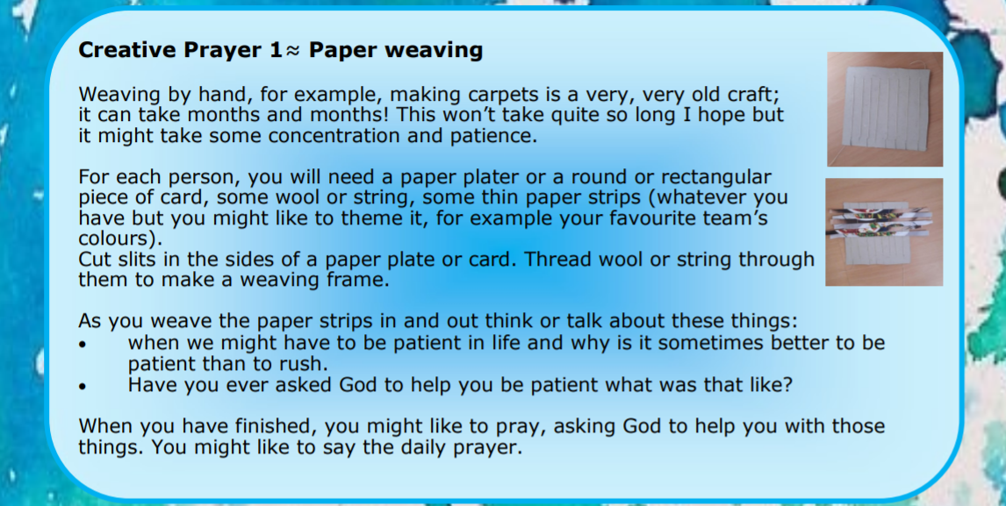
Classroom Reflection Space
PATIENCE

Slide 12

Monday

Slide 13
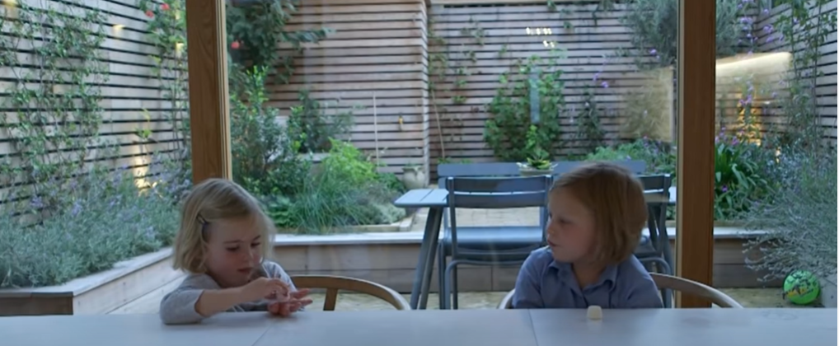


Slide 14

What do you see in the picture?
Can you make a prediction about what we are going to talk about this week?
What questions do these pictures make you ask?
Think of two or three questions.

Slide 15
What would you have done??
Can you remember a time when you had to be patient?
Watch film clip from 0:33 seconds
Notes:
The clip illustrates patience- waiting for future rewards.
Explore some of the children’s responses about times when they were patient.

Slide 16

Reflection questions
Can you remember a time when you had to be patient?
I wonder how easy you found it to be patient?
How do you feel about being patient?

Slide 17
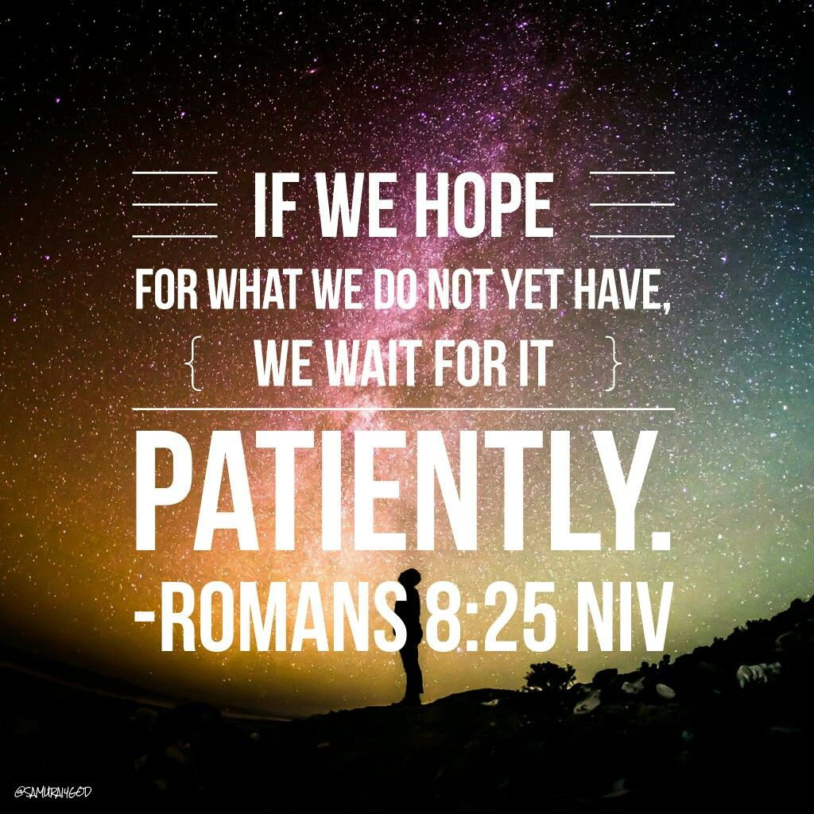
Patience in the bible

Slide 18

Prayer
Encourage the pupils to respond with their own prayers first, using the class prayer space/area or with the prayer below:
Dear God,
I have been finding it hard to wait for ________.
Please help me to be more patient. Amen.

Slide 19

Tuesday

Slide 20
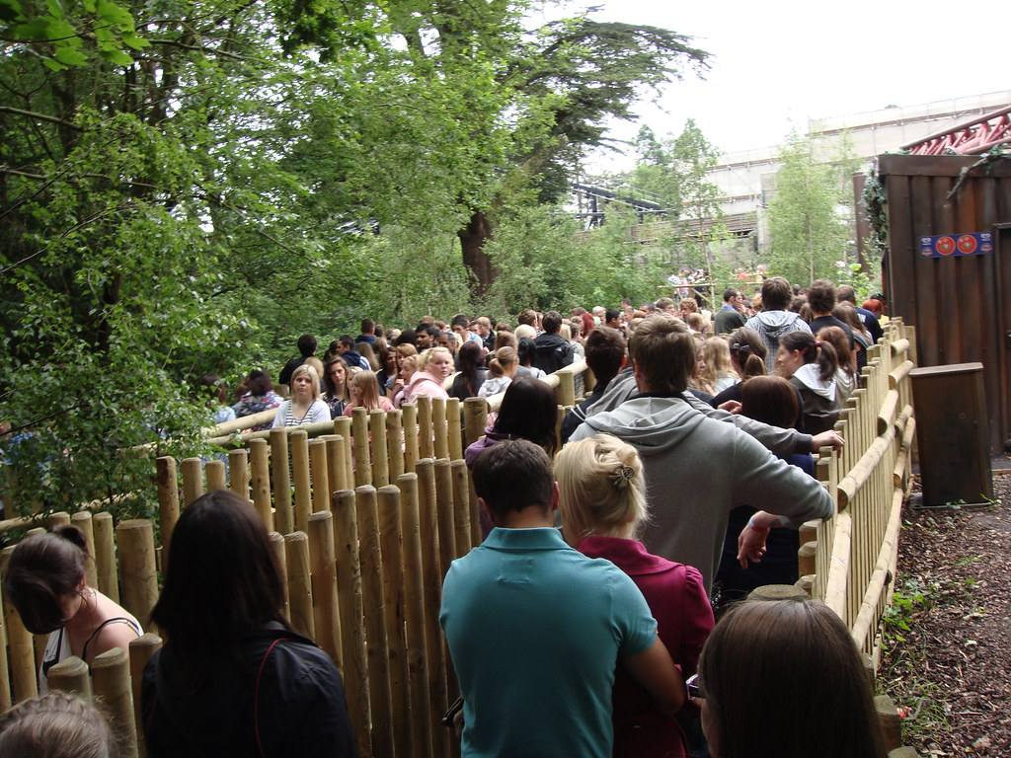

Slide 21
What do you see in the picture?
Can you make a prediction about what we are going to talk about today?
What questions do these pictures make you ask?
Think of two or three questions.

Slide 22
Responding
I wonder what questions you asked?
I wonder what this picture says about patience?
Notes:
Allow children time to think about this.

Slide 23
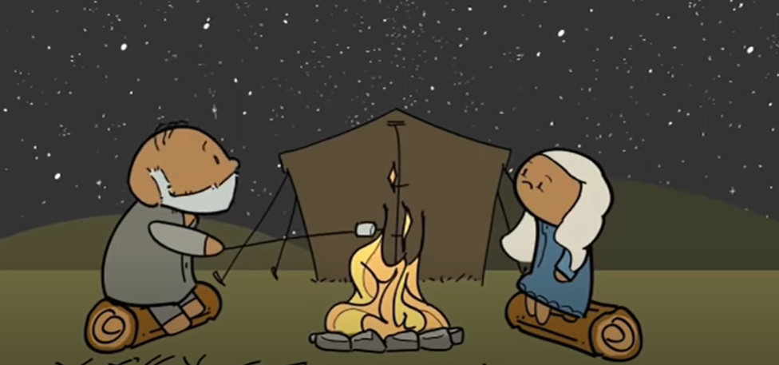
Bible Story: abraham and sarah
Watch: https://www.youtube.com/watch?v=NdqrwGJYePQ this is a long story but can be Read in genesis 12
Click on the picture for the film link.
Notes:
Click on the picture for the film link. How difficult was it for Abraham and Sarah to be patient?

Slide 24
Responding
I wonder how hard it was for Abraham and Sarah to be patient?
I wonder what this story might mean for you today or in the next week?
Notes:
Allow children time to think about this.

Slide 25
Prayer
Encourage the pupils to respond with their own prayers in the prayer space or use the prayer below:
Dear God,
Thank you that you love each of us and are
always patient with us.
It can be hard to wait especially in difficult times.
Please give me the strength to be patient in
everything that comes my way.
Amen

Slide 26

Wednesday

Slide 27

Prompted to action - challenge
Remind children of the theme for the week and of the Bible story
Patience

Slide 28
Prompted to action – practice patience
Think of one thing you could do to practice patience?
How might it help you be more patient?
How might it be better for your family/community?

Slide 29
Prompted to action – practice patience
Write a letter to your future self. Set a time to open it and wait patiently to open it.
Play the card game ‘Patience’
Draw a picture. Create a jigsaw by cutting it into pieces.
Do a jigsaw.
Go a day without using any technology
Play a board game
Do some colouring in.

Slide 30
Prayer
Encourage the pupils to respond with their own prayers in the class prayer space/area. You could use the school’s prayer or the Lord’s Prayer:
Our Father, in heaven,
Holy is your name.
Your Kingdom come,
Your will be done on earth, as it is in heaven.
Give us this day our daily bread,
And forgive us our sins,
As we forgive those who sin against us,
And lead us not into temptation,
But deliver us from evil.
Amen.

Slide 31

Thursday

Slide 32
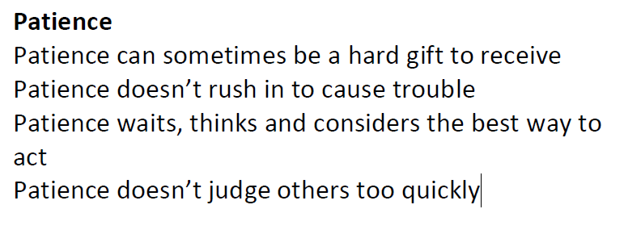
Use the Meditation resource alongside the Spiritual Encounters – bible-based meditation teacher’s pack: http://www.ldbe.co.uk/about/guidance- resources/worship-and-meditation/

Slide 33

Friday

Slide 34
Take this time to celebrate what has happened during the week – you may want to give out awards. If possible, join the bubbles using Zoom or Teams so that the whole school can come together in a time of celebration.
Remember that this should also be a time of worship and celebration so begin with a gathering, include a prayer, a blessing, and a song of celebration.

