Slide 1


COLLECTIVE Worship and Reflections
LOVE

Slide 2

Church of England Colours for Worship

Slide 3
Church of England
Collective worship
ABSTRACT
This resource supports delivery of collective worship through the theme of Fruit of the Spirit.
It provides opportunities to look at some of life’s big issues in a prayerful and reflective manner.
Collective worship in a classroom has a different feel from worship in the hall. The more intimate nature of the worship can make everyone feel more readily included.

Slide 4
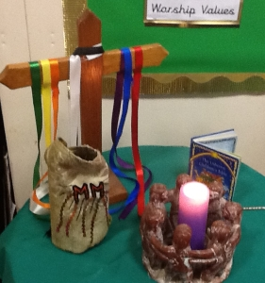
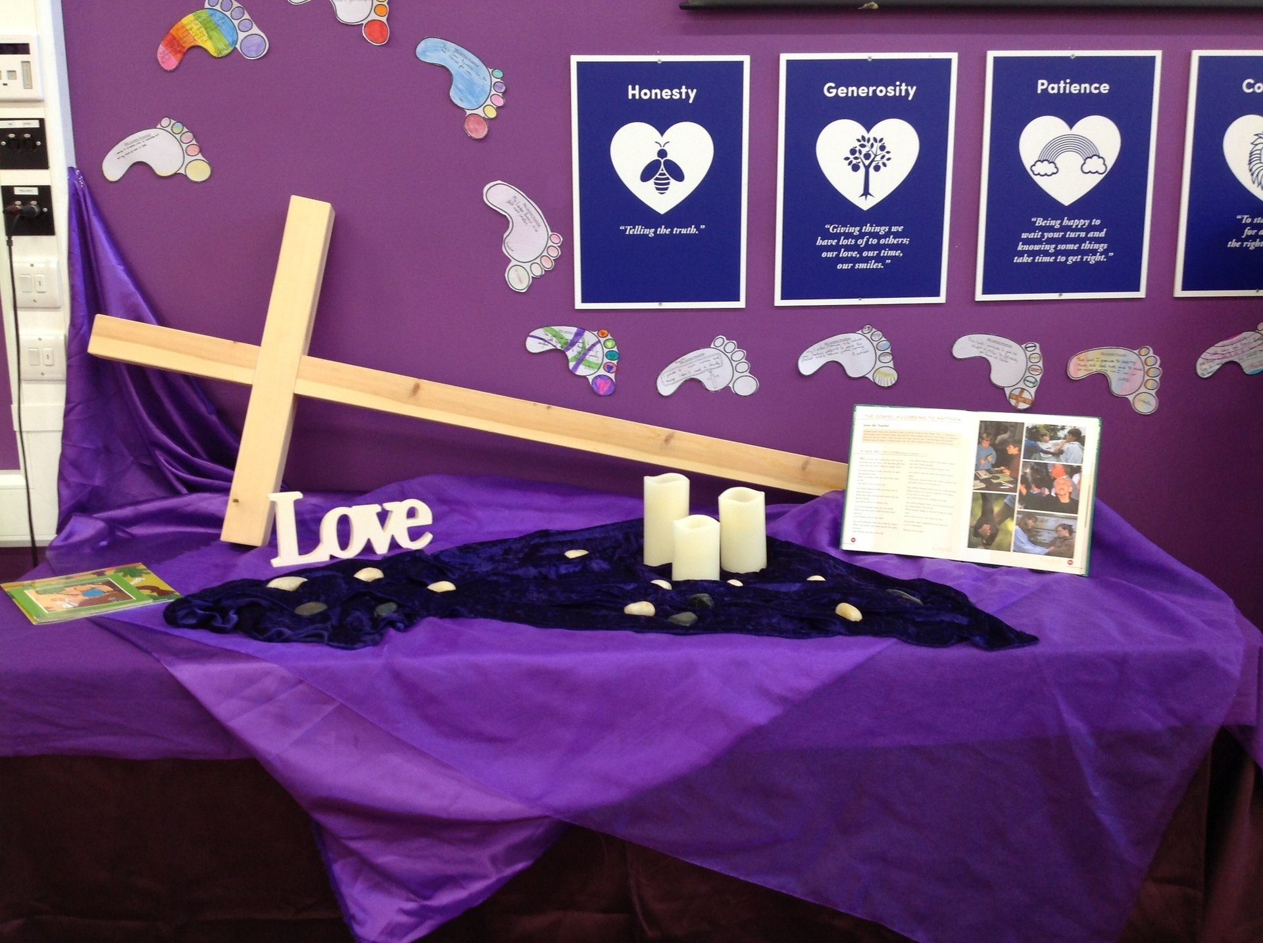
COLLECTIVE Worship
Introduction for Teachers
Ideas for the Worship Table
Special covering – possibly using liturgical colours
Candle or candles
Cross
Prayer box
Pebbles (prayer)
Flowers

Slide 5

Collective Worship
Possible music
Your Love
https://img2.cdn.schooljotter2.com/media/45/13824045.mp4
Reckless Love
https://www.youtube.com/watch?v=Sc6SSHuZvQE
Love God, Love People
https://www.youtube.com/watch?v=t-29WLQ3trA
Love Divine, All Love Excelling
https://www.youtube.com/watch?v=sw5ZCZeS32M
Love Song Medley
https://www.youtube.com/watch?v=8iIEvQNRs_M
One Love (Bob Marley)
https://www.youtube.com/watch?v=vdB-8eLEW8g
One (U2)
https://www.youtube.com/watch?v=ftjEcrrf7r0
Notes:
Music suggestions are both secular and Christian worship. These could be used as a listening focus around the theme or as a part of sung worship.
What does this song say about…..
How does it make you feel?

Slide 6

Gathering these can be used at the beginning of each session
Once everyone is set up ready for worship you may want to start by lighting a candle, followed by one of these:
Leader: Peace be with you.
Pupils: And also with you.
Leader: Welcome everyone
Pupils: It is good to be here together
Play a ‘Welcome’ song as children settle.
We meet in the name of God:
  God the Father,
  God the Son,
  God the Spirit:
  God is one.
Sign: ‘Welcome everybody here’ in BSL

Slide 7
Gathering these can be used at the beginning of each session
Christ the light of the world is here
God help us to speak positive words
To share peace with everyone
To remember that you are with us
Let us celebrate what God has made
Let’s remember to show God’s love,
and to show a bit of heaven to everyone we meet.

Slide 8

Sending these can be used at the End of each session
You may want to end your time together with one of these short prayers or blessings:
As we end this time
May we live with your love
Build on your truth
Share your forgiveness
Rest in your peace
For the whole of the day. AMEN
Thank you for this day,
For fun, friendship and learning.
We give thanks for this time
As we share peace with each other. AMEN
Help us as we as we move on
To carry hope in us for the day
Turning our thoughts towards others,
Our hearts towards love,
And our hands towards serving those in need. AMEN

Slide 9
Sending these can be used at the End of each session
The Lord bless us and watch over us, he is kind and helps us to show peace. Amen
Let’s remember today to show peace and love
To forgive when others upset us
To remember that we are all equal to God
To think about what we say before we say it
To thank God for a new day
Thank you God for all your good gifts
Christ our Lord,
Just as kings bowed down and offered you gifts,
May we know your strength and peace
And see all the free gifts you have given to us
and the blessing of the Father, Son and Holy Spirit,
be with you all, evermore
Amen

Slide 10
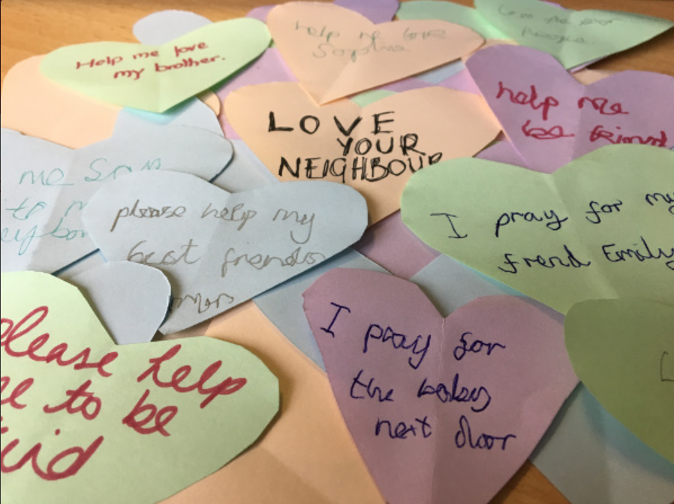
Fruit of the spirit love

Slide 11
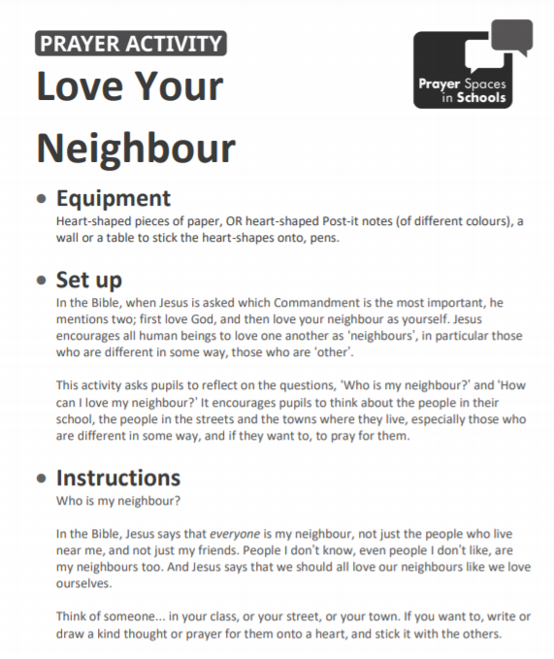
Classroom Reflection Space
LOVE Your neighbour

Slide 12

Monday

Slide 13
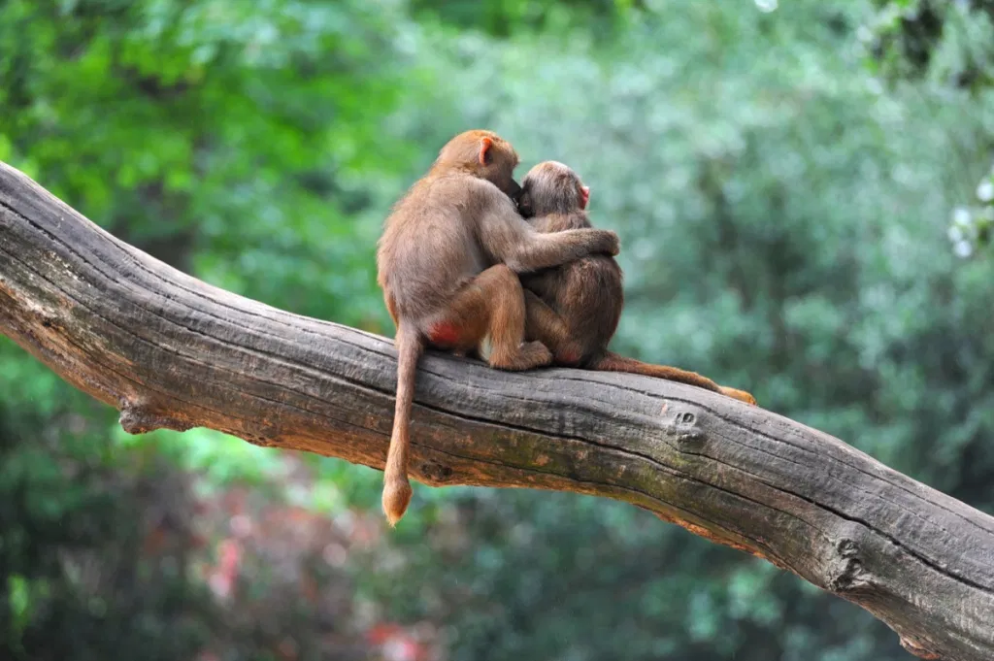


Slide 14

What do you see in the picture?
Can you make a prediction about what we are going to talk about this week?
What questions do these pictures make you ask?
Think of two or three questions.

Slide 15
ENGAGE:
How would you finish off this sentence?
Love is …..
Notes:
There are lots of different types of love, I wonder if you can think of any? There is the love between brothers and sisters and other family members, love between friends, romantic love, love you have for your favourite food or the love you feel for your pets.

Slide 16

The Bible tells us what love is and what it isn’t.
I wonder which description of love you think matters most?
Which line stands out to you?
I wonder if you noticed that love is described as an action.

Slide 17

Reflection questions
I wonder how you know someone loves you?
Love is an action.
Do you agree?

Slide 18

Prayer
Encourage the pupils to respond with their own prayers first, using the class prayer space/area or with the prayer below:
Dear God,
Sorry for the times when I haven’t loved people through my thoughts or actions.
Thank you for all those that love me and for all those I love.
Help me and my community to share love with each other through actions.
Please help me to love people in practical ways, especially those who are harder to love.
Amen

Slide 19

Tuesday

Slide 20
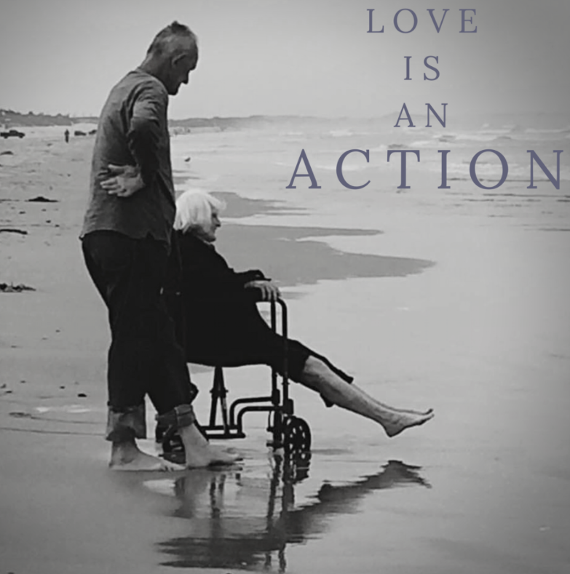

Slide 21
What do you see in the picture?
Can you make a prediction about what we are going to talk about today?
What questions do these pictures make you ask?
Think of two or three questions.
Notes:
Story taken from a wedding florist’s website:
It was a misty morning in September. I live in a sleepy little beach town and I walk this beach most days. I have seen several weddings and proposals on this section of beach. But that day in September, I witnessed true love. I watched him wrestle the wheel chair from the trunk of his very dated vehicle. He then proceeded to open the passenger door and assist her into her chariot. She was smiling at him as he rolled up her pant legs, and then rolled up his own. He then started the arduous task of pushing that wheeled chair through the soft sand toward the water. He was unsteady, but he kept going until they reach the edge of the surf. She waited with anticipation for the next wave to reach her. When the cold water rushed over her feet, she let out a squeal of delight, like a child who had just jumped into the cold water. She pulled her feet up and laughed. They only stayed 5 minutes and then they headed back to the car. But I will never forget the love in action that I witnessed that morning.

Slide 22
Responding
I wonder what questions you asked?
I wonder what this picture says about love?
Notes:
Allow children time to think about this.

Slide 23
Bible passage: Jesus heals a paralysed man
Watch: https://www.youtube.com/watch?v=dlBOmQ1PaMY or Read
¹⁷ One day Jesus was teaching the people. The Pharisees and teachers of the law were there, too. They had come from every town in Galilee and from Judea and Jerusalem. The Lord was giving Jesus the power to heal people. ¹⁸ There was a man who was paralyzed. Some men were carrying him on a mat. They tried to bring him in and put him down before Jesus. ¹⁹ But because there were so many people there, they could not find a way to Jesus. So the men went up on the roof and made a hole in the ceiling. They lowered the mat so that the paralyzed man was lying right before Jesus. ²⁰ Jesus saw that these men believed. So he said to the sick man, “Friend, your sins are forgiven.”
²¹ The Jewish teachers of the law and the Pharisees thought to themselves, “Who is this man? He is saying things that are against God! Only God can forgive sins.”
²² But Jesus knew what they were thinking. He said, “Why do you have thoughts like that in your hearts? ²³ Which is easier: to tell this paralysed man, ‘Your sins are forgiven,’ or to tell him, ‘Stand up and walk’? ²⁴ But I will prove to you that the Son of Man has authority on earth to forgive sins.” So Jesus said to the paralysed man, “I tell you, stand up! Take your mat and go home.”
Notes:
Can you spot ‘ love in action’ in our Bible story today?

Slide 24
Responding
I wonder how this story shows love?
I wonder what this story might mean for you today or in the next week?
Notes:
Allow children time to think about this.

Slide 25
Prayer
Encourage the pupils to respond with their own prayers in the prayer space or use the prayer below:
Dear God, we thank for Jesus, the gift that demonstrated your love for us.
Help us to share and show this love with others, even when it is difficult.
Help us to love those who are difficult to love.
Guide us to people who need to know your love.
Amen

Slide 26

Wednesday

Slide 27

Prompted to action - challenge
Remind children of the theme for the week and of the Bible story
Love

Slide 28
Prompted to action – challenge ideas
Give everyone a heart shape/heart post it.
Write or draw to complete the sentence on their heart.
I want to love others by…….

Slide 29
Prompted to action – challenge ideas
Think of one thing you could do to put love in action?
How would this make your class/home/community a better place to be?

Slide 30
Prayer
Encourage the pupils to respond with their own prayers in the class prayer space/area. You could use the school’s prayer or the Lord’s Prayer:
Our Father, in heaven,
Holy is your name.
Your Kingdom come,
Your will be done on earth, as it is in heaven.
Give us this day our daily bread,
And forgive us our sins,
As we forgive those who sin against us,
And lead us not into temptation,
But deliver us from evil.
Amen.

Slide 31

Thursday

Slide 32
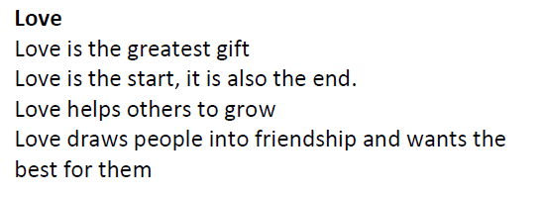
Use the Meditation resource alongside the Spiritual Encounters – bible-based meditation teacher’s pack: http://www.ldbe.co.uk/about/guidance- resources/worship-and-meditation/

Slide 33

Friday

Slide 34
Take this time to celebrate what has happened during the week – you may want to give out awards. If possible, join the bubbles using Zoom or Teams so that the whole school can come together in a time of celebration.
Remember that this should also be a time of worship and celebration so begin with a gathering, include a prayer, a blessing, and a song of celebration.

