Slide 1


COLLECTIVE Worship and Reflections
JOY

Slide 2

Church of England Colours for Worship

Slide 3
Church of England
Collective worship
ABSTRACT
This resource supports delivery of collective worship through the theme of Fruit of the Spirit.
It provides opportunities to look at some of life’s big issues in a prayerful and reflective manner.
Collective worship in a classroom has a different feel from worship in the hall. The more intimate nature of the worship can make everyone feel more readily included.

Slide 4
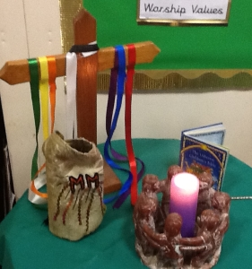
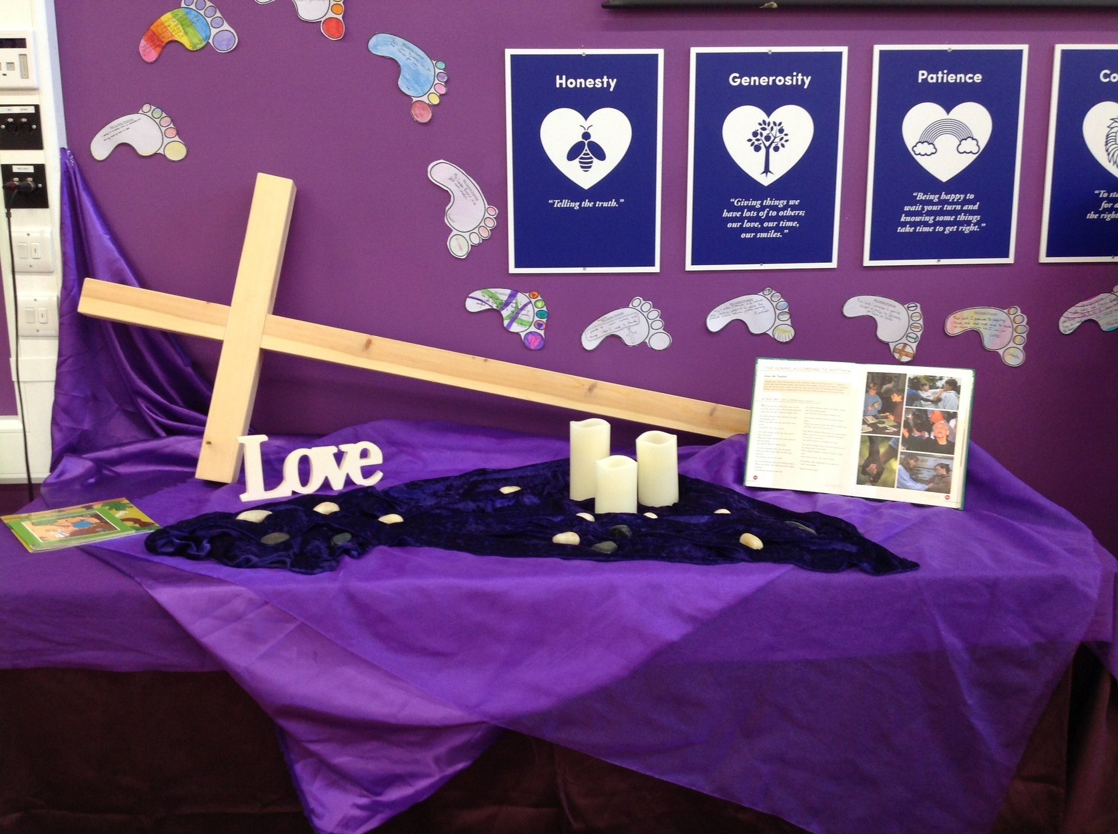
COLLECTIVE Worship
Introduction for Teachers
Ideas for the Worship Table
Special covering – possibly using liturgical colours
Candle or candles
Cross
Prayer box
Pebbles (prayer)
Flowers

Slide 5

Collective Worship
Possible music
Joy (Rend Collective)
https://www.youtube.com/watch?v=VDiETOLBvxA
Joy (Planetshakers)
https://www.youtube.com/watch?v=MoyHjjHTO14
The Joy of the Lord (Rend Collective)
https://www.youtube.com/watch?v=x3gLeCiMJqI
I’ve got that joy, joy, joy down in my heart
https://www.youtube.com/watch?v=imK7pAMf61E
Notes:
Music suggestions are both secular and Christian worship. These could be used as a listening focus around the theme or as a part of sung worship.
What does this song say about…..
How does it make you feel?

Slide 6

Gathering these can be used at the beginning of each session
Once everyone is set up ready for worship you may want to start by lighting a candle, followed by one of these:
Leader: Peace be with you.
Pupils: And also with you.
Leader: Welcome everyone
Pupils: It is good to be here together
Play a ‘Welcome’ song as children settle.
We meet in the name of God:
  God the Father,
  God the Son,
  God the Spirit:
  God is one.
Sign: ‘Welcome everybody here’ in BSL

Slide 7
Gathering these can be used at the beginning of each session
Christ the light of the world is here
God help us to speak positive words
To share peace with everyone
To remember that you are with us
Let us celebrate what God has made
Let’s remember to show God’s love,
and to show a bit of heaven to everyone we meet.

Slide 8

Sending these can be used at the End of each session
You may want to end your time together with one of these short prayers or blessings:
As we end this time
May we live with your love
Build on your truth
Share your forgiveness
Rest in your peace
For the whole of the day. AMEN
Thank you for this day,
For fun, friendship and learning.
We give thanks for this time
As we share peace with each other. AMEN
Help us as we as we move on
To carry hope in us for the day
Turning our thoughts towards others,
Our hearts towards love,
And our hands towards serving those in need. AMEN

Slide 9
Sending these can be used at the End of each session
The Lord bless us and watch over us, he is kind and helps us to show peace. Amen
Let’s remember today to show peace and love
To forgive when others upset us
To remember that we are all equal to God
To think about what we say before we say it
To thank God for a new day
Thank you God for all your good gifts
Christ our Lord,
Just as kings bowed down and offered you gifts,
May we know your strength and peace
And see all the free gifts you have given to us
and the blessing of the Father, Son and Holy Spirit,
be with you all, evermore
Amen

Slide 10
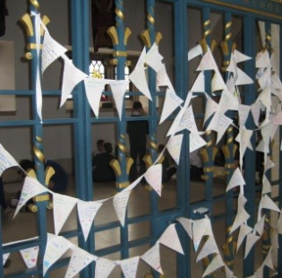
Fruit of the spirit
JOY

Slide 11
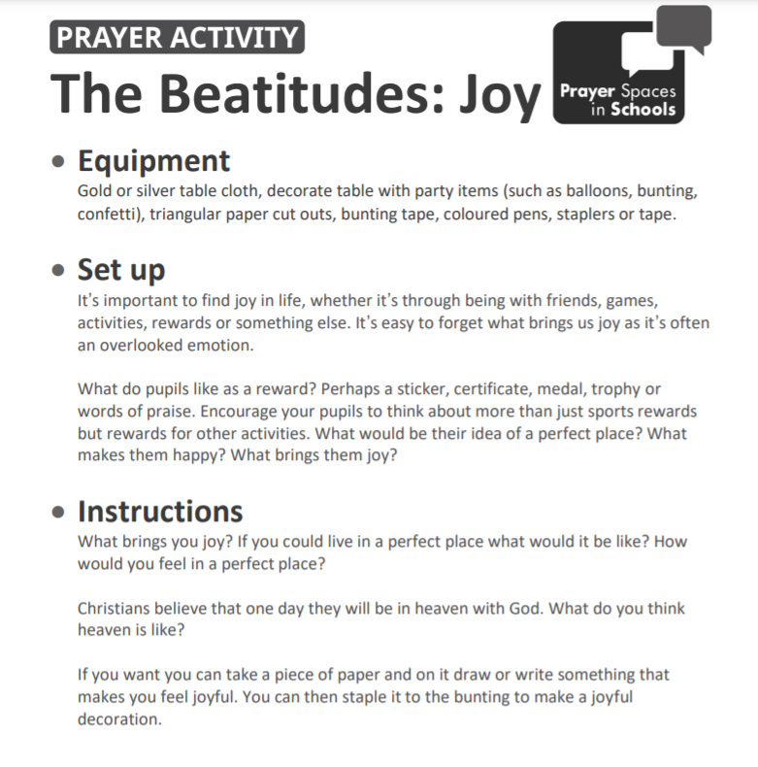
Classroom Reflection Space
Joy

Slide 12

Monday

Slide 13



Slide 14

What do you see in the picture?
Can you make a prediction about what we are going to talk about this week?
What questions do these pictures make you ask?
Think of two or three questions.
Notes:
This week’s theme is Joy.

Slide 15
What does it mean to be joyful?
How is this different to happiness?

Slide 16
ENGAGE:
How would you finish off this poem?
Joy is a gift.
Joy is a choice.
Joy is a happy, healthy heart.
Joy is sharing a smile.
Joy is blowing bubbles.
Joy is…
Joy is…

Slide 17
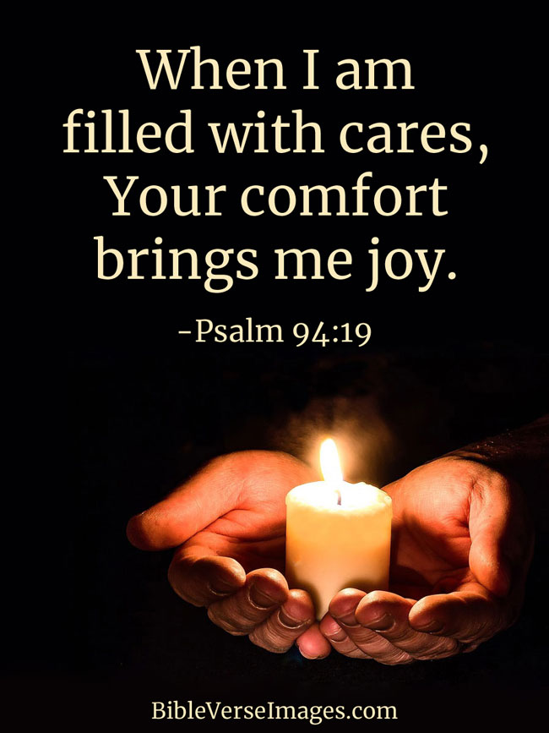
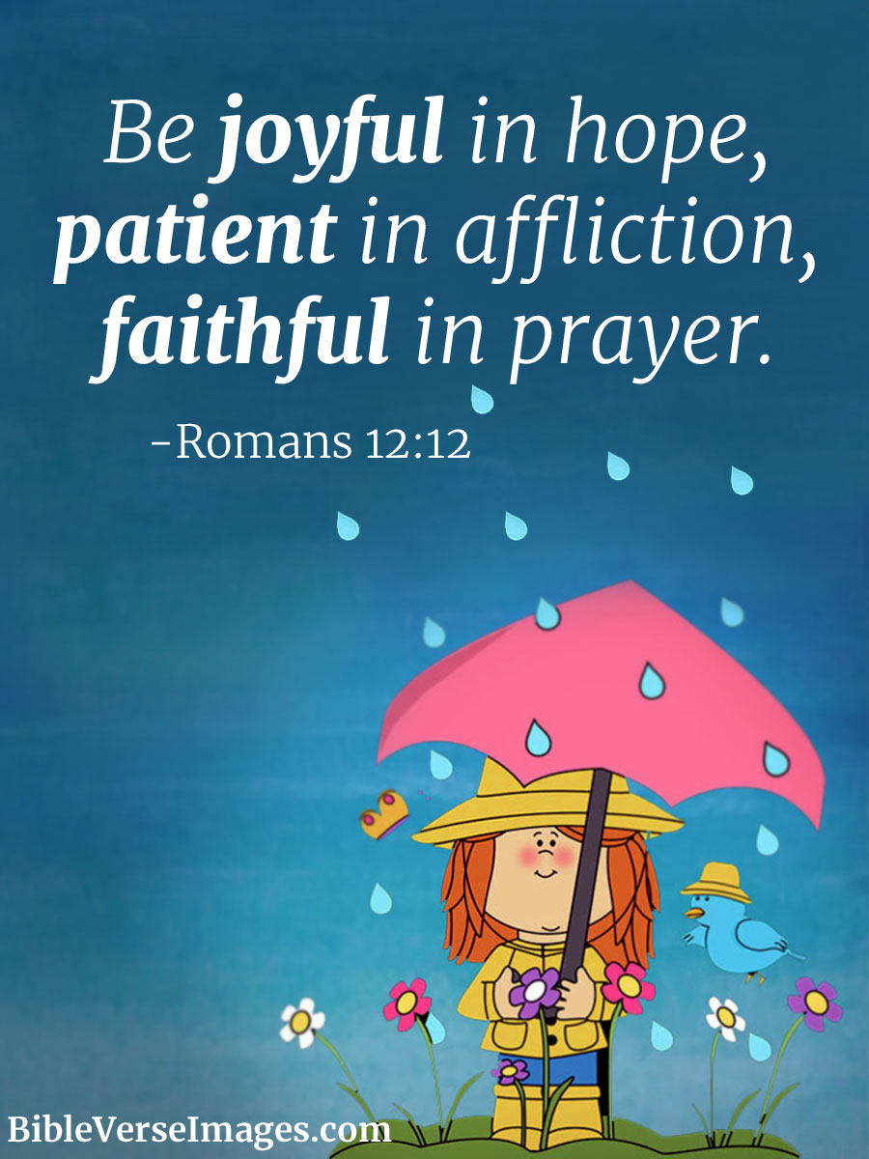

Christians believe joy is a gift from God. It involves looking beyond the ‘ows’ in life and finding the strength and comfort that comes from God, choosing to be positive and becoming a source of joy to others.

Slide 18

Reflection questions
I wonder how you can be joyful?
As go through today, think about the things which bring you joy?

Slide 19

Prayer
Encourage the pupils to respond with their own prayers first, using the class prayer space/area or with the prayer below:
Dear God,
Thank you for eyes to see and ears to hear.
Thank you for so many beautiful things around us.
which bring us joy and fill us with excitement.
Amen

Slide 20

Tuesday

Slide 21
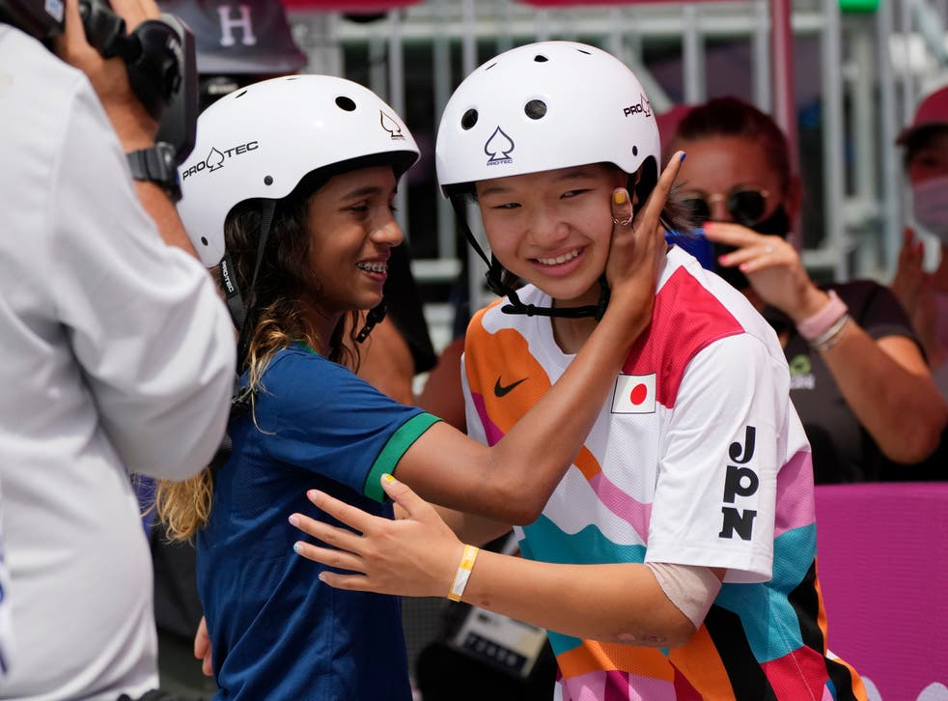

Slide 22
What do you see in the picture?
Can you make a prediction about what we are going to talk about today?
What questions do these pictures make you ask?
Think of two or three questions.

Slide 23
Responding
I wonder what questions you asked?
I wonder what this picture says about joy?
Notes:
Allow children time to think about this. The picture shows the skateboarding Olympic gold and silver medal winner. Could there still be joy if they hadn’t won medals?

Slide 24
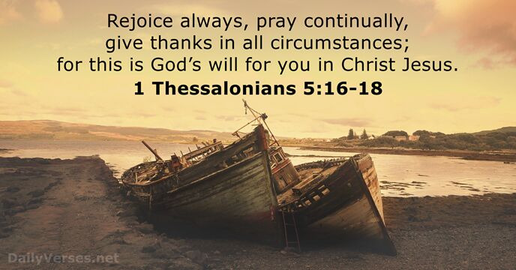
Bible passage: 1 Thessalonians 5: 16-18
Notes:
What joy might the athletes who didn’t win medals find?
Joy is about choosing to look beyond the sadness and be positive, finding the good things.

Slide 25
Responding
I wonder if this quote might be helpful for those who didn’t win?
I wonder what this quote might mean for you today or in the next week? What could you give thanks for
Notes:
Allow children time to think about this.

Slide 26

Prayer
What brings you joy?
Reflect on those things that bring you joy, even when you might feel sad.
You may wish to pray a prayer of thanks for these things.

Slide 27

Wednesday

Slide 28

Prompted to action - challenge
Remind children of the theme for the week

Slide 29
Prompted to action – challenge ideas
Create something which will bring joy to someone this week.

Slide 30
Prompted to action – challenge ideas
I will help wash the car.
Make some special tokens to give to your family and help bring joy to your house.
I will keep my room tidy all week.
How could you share some joy?
I will feed the cat.

Slide 31
Prayer
Encourage the pupils to respond with their own prayers in the class prayer space/area. You could use the school’s prayer or the Lord’s Prayer:
Our Father, in heaven,
Holy is your name.
Your Kingdom come,
Your will be done on earth, as it is in heaven.
Give us this day our daily bread,
And forgive us our sins,
As we forgive those who sin against us,
And lead us not into temptation,
But deliver us from evil.
Amen.

Slide 32

Thursday

Slide 33
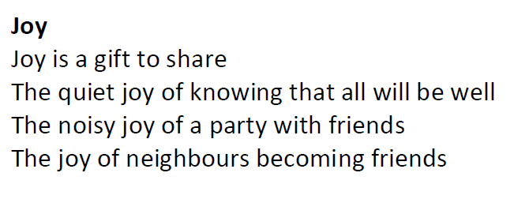
Use the Meditation resource alongside the Spiritual Encounters – bible-based meditation teacher’s pack: http://www.ldbe.co.uk/about/guidance- resources/worship-and-meditation/

Slide 34

Friday

Slide 35
Take this time to celebrate what has happened during the week – you may want to give out awards. If possible, join the bubbles using Zoom or Teams so that the whole school can come together in a time of celebration.
Remember that this should also be a time of worship and celebration so begin with a gathering, include a prayer, a blessing, and a song of celebration.

