Slide 1
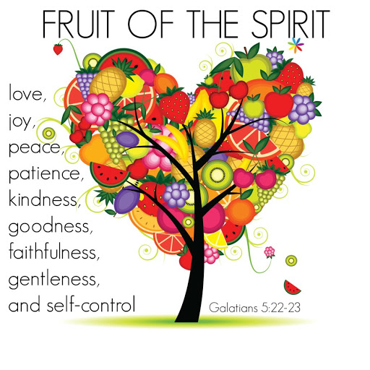

Class Worship and Reflections
Fruit of the Spirit
Kindness

Slide 2

Church of England Colours for Worship

Slide 3
Church of England
Collective worship
ABSTRACT
Collective worship in a classroom has a different feel from worship in the hall. The more intimate nature of the worship can make everyone feel more readily included.
It is also the perfect setting to look at some of life’s big issues in a prayerful and reflective manner.
This resource supports small group worship through the theme of Parables

Slide 4
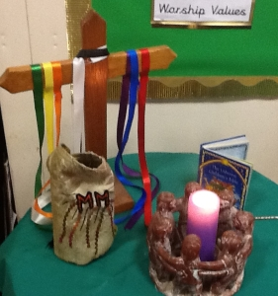
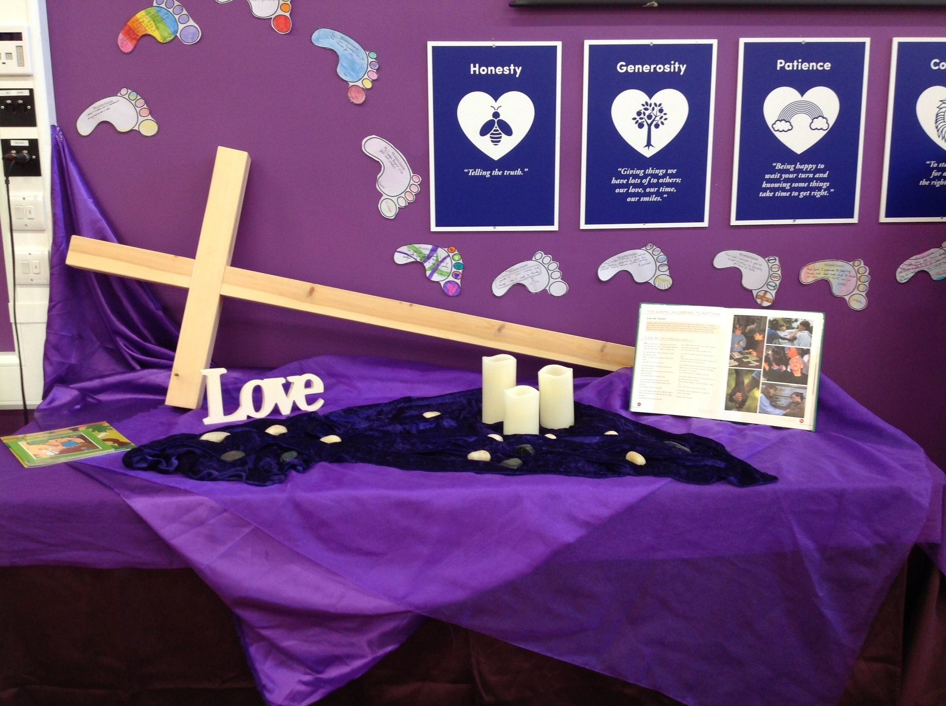
Classroom Worship
Introduction for Teachers
Ideas for the Worship Table
Special covering – possibly using liturgical colours
Candle or candles
Cross
Prayer box
Pebbles (prayer)
Flowers

Slide 5

Classroom Worship
Possible music
Fruit of the Spirit: https://www.youtube.com/watch?v=xWoWDdeD-ns
Fruit of the Spirit: https://www.youtube.com/watch?v=pB2WmMcBNks
Holy Spirit Song: https://www.youtube.com/watch?v=VDhWLf6MC0c

Slide 6

Gathering these can be used at the beginning of each session
Once everyone is set up ready for worship you may want to start by lighting a candle, followed by one of these:
Leader: Peace be with you.
Pupils: And also with you.
Leader: Welcome everyone
Pupils: It is good to be here together
Play a ‘Welcome’ song as children settle.
We meet in the name of God:
  God the Father,
  God the Son,
  God the Spirit:
  God is one.
Sign: ‘Welcome everybody here’ in BSL

Slide 7
Gathering these can be used at the beginning of each session
Christ the light of the world is here
God help us to speak positive words
To share peace with everyone
To remember that you are with us
Let us celebrate what God has made
Let’s remember to show God’s love,
and to show a bit of heaven to everyone we meet.

Slide 8

Sending these can be used at the End of each session
You may want to end your time together with one of these short prayers or blessings:
As we end this time
May we live with your love
Build on your truth
Share your forgiveness
Rest in your peace
For the whole of the day. AMEN
Thank you for this day,
For fun, friendship and learning.
We give thanks for this time
As we share peace with each other. AMEN
Help us as we as we move on
To carry hope in us for the day
Turning our thoughts towards others,
Our hearts towards love,
And our hands towards serving those in need. AMEN

Slide 9
Sending these can be used at the End of each session
The Lord bless us and watch over us, he is kind and helps us to show peace. Amen
Let’s remember today to show peace and love
To forgive when others upset us
To remember that we are all equal to God
To think about what we say before we say it
To thank God for a new day
Thank you God for all your good gifts
Christ our Lord,
Just as kings bowed down and offered you gifts,
May we know your strength and peace
And see all the free gifts you have given to us
and the blessing of the Father, Son and Holy Spirit,
be with you all, evermore
Amen

Slide 10
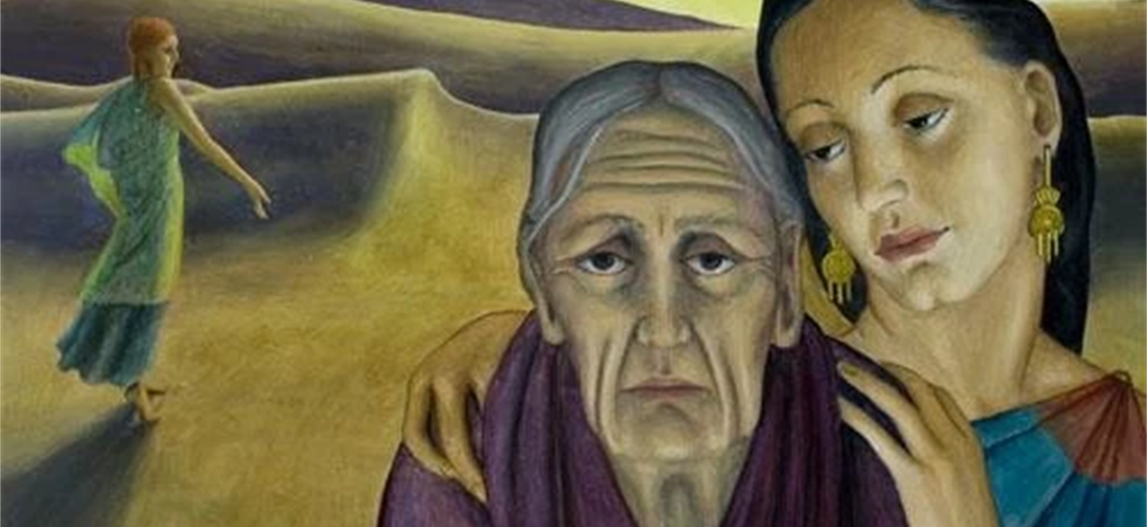
Fruit of the Spirit
Kindness

Slide 11
Classroom Worship
Reflection Space https://prayerspacesinschools.com/resources/people-tree/
At the heart of any relationship, no matter how brief, there should be kindness. Within the worship this week we will be reflecting on a friendship between two ladies – one old and one young but both widows. At the hear of their friendship was a deep love and amazing kindness.
This reflection space encourages the pupils to think about how they can show that same kindness to those people they encounter on life’s journey.
We meet lots of people. Some people we grow to know really well, like our parents, family and friends. Others we meet for a brief moment, at a bus stop or in a shop, or even in the street. This activity encourages pupils to spend time thinking about a couple of people that they know. Maybe someone that they know who needs help, or someone that they find it hard to get on with, or maybe someone that they want to say thank you for?
The pupils are invited to draw a picture of each person and write a prayer on the back, and then add it onto a big ‘people tree’.

Slide 12
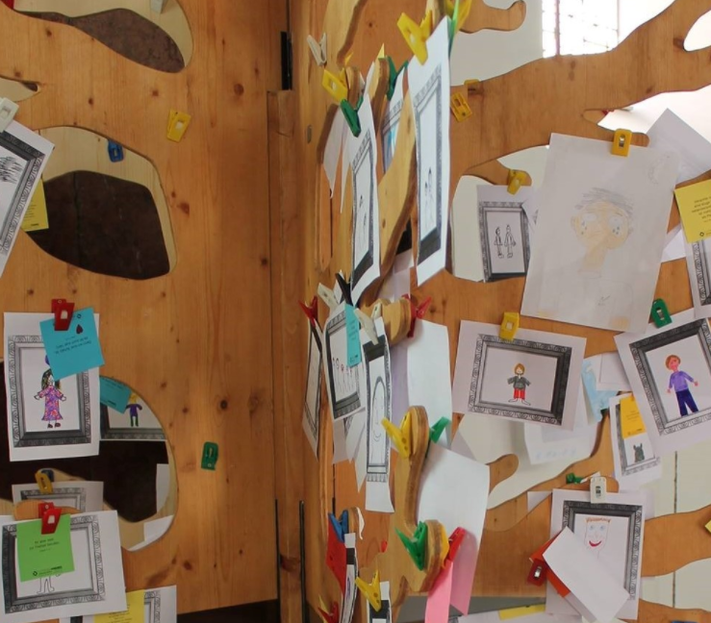
Classroom Worship
Reflection Space
Kindness Tree

Slide 13
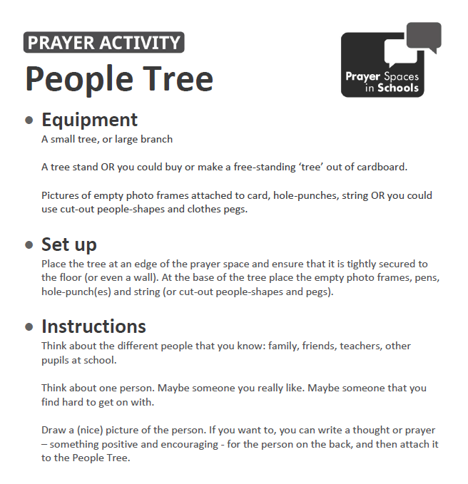
Classroom Worship
Reflection Space

Slide 14

Monday

Slide 16

What do you see in the picture?
What questions does this picture make you ask?
Think of two or three questions.
Can you make a prediction about what we are going to talk about today?

Slide 17

Bible passage: Naomi and Ruth
In a place called Moab there lived a nice family. Elimelech, his wife Naomi and their two sons moved there because there was more food there than where they used to live. After a while Elimelech died but Naomi wasn't alone she still had two sons.
Her sons got married but after about ten years they died too. At least Naomi still had her sons wives to keep her company, their names were Orpah and Ruth.
Naomi called her sons wives and told them, "I am going to go back to where I used to live and I would like you also to go back to your family where you used to live. May God show you kindness as you have showed me." All the women cried and hugged each other because they were such good friends.
Orpah didn't want to leave Naomi but Naomi told her not to worry, she would be fine. So Orpah left to go back to her family. But no matter what Naomi said to Ruth, Ruth would not leave. "Don't ask me to leave. Where you go I will go, and where you stay I will stay. Your friends will be my friends and your God will be my God."

Slide 18
Bible passage: Naomi and Ruth
So Ruth and Naomi returned to Bethlehem together. It was a good thing Ruth went with Naomi because Bethlehem was very far away and Naomi couldn't have travelled all that way by herself. Notice that Ruth never complains but is a good friend to Naomi. She wasn't expecting anything in return, she just wanted to help.
When they got there Ruth decided that she should do some kind of work. It was harvest time, so she worked in the fields following behind the harvesters and picked up any barley that they had dropped.
The owner of the field came by to greet the harvesters and noticed Ruth in the field. He asked one of the harvesters who she was. "She came back from Moab with Naomi, that's all I know." Lucky for Ruth the owner of the field was Boaz, he was a kind man who believed in God. He had also been related to Elimelech (Naomi's husband that died).

Slide 19
Bible passage: Naomi and Ruth
Boaz went to go talk to Ruth, he said to her, "Don't go work in any other field but stay here with the other servant girls. I will make sure you are safe and whenever you are thirsty go and get a drink from the water jars." When Ruth heard this she bowed down to Boaz and asked, "Why are you being so nice to me, I'm not even from here."
Boaz replied, "I know what you've done for Naomi, you left your family and moved to a place you've never been. May the Lord reward you for your kindness."
Ruth thanked Boaz and continued with her work in the hot sun. Boaz even ordered his workers to drop extra barley so Ruth could have more for herself.
Ruth took all the barley home and shared what she had with Naomi. And eventually Ruth married Boaz and everyone was very happy!

Slide 20

Naomi and Ruth – reflection questions
Was the decision that Ruth made an easy on – why or why not?
Ruth was amazingly kind to Naomi – she did not have to stay.
Why is kindness so important in the world today?
How different would it have been if Ruth had left Naomi?
Has anyone ever been a ‘Ruth’ to you and shown you real kindness at a tough time?
What did that mean to you at the time?

Slide 21
If you would like to, join in with this Prayer Time or sit and think quietly about all we have Talked about today
Encourage any pupils who would like to respond with their own prayers to do so, or share together with the prayer below:
We thank you for our friends and for the happy times we share with them. Help us to be a good friend to them. Teach us how to be kind to everyone and to share our time with those who need us. Help us to recognise loneliness in others and for us to show kindness towards them.
Amen.

Slide 22
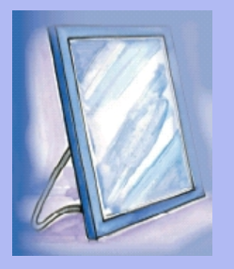
Tuesday

Slide 23
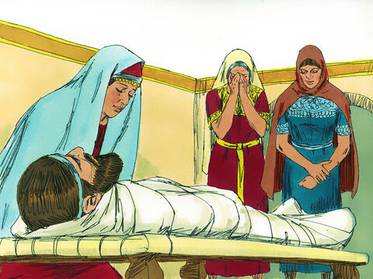
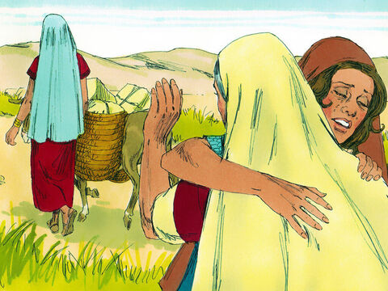
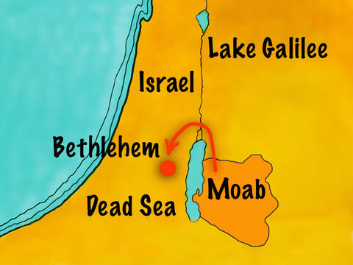
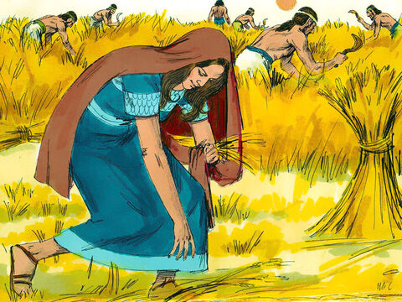
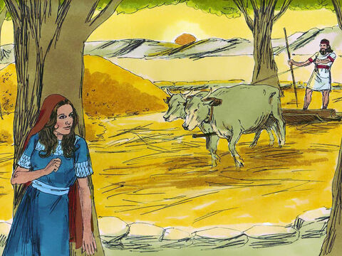
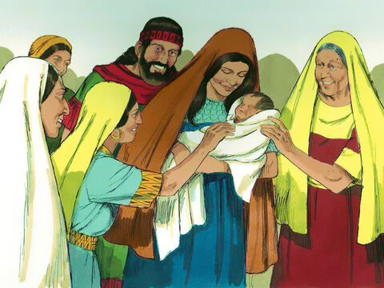

Bible passage: Ruth and Naomi
Using the images below recap the story of Ruth and Naomi

Slide 24
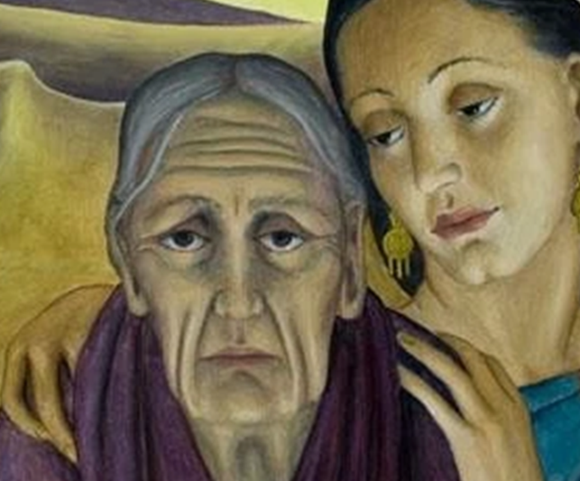
Responding
I am feeling…
Can you imagine and describe how Naomi and Ruth are feeling at this point in their lives?
Notes:
Allow children time to think about this.

Slide 25

Responding
Have you ever felt like this?
What or who helped you at this time?
Do you know anyone who is feeling this now? What could you do to help them?

Slide 26
If you would like to, join in with this Prayer Time or sit and think quietly about all we have Talked about today
Encourage the pupils to respond with their own prayers in the prayer space or use the prayer below:
The light of God surrounds me,
the love of God enfolds me,
the power of God protects me,
the presence of God watches over me,
wherever I am, God is,
and where God is, I am cared for.
Amen

Slide 27

Wednesday

Slide 28


Prompted to action - challenge
Can you remember our value theme for worship this week?

Slide 29


Prompted to action – challenge ideas
Kindness
At the toughest time of her life Naomi needed someone to be kind to her; Ruth and Orpah showed her that kindest. Naomi blessed both of her daughter in laws with these words, ‘May God show you kindness as you have showed me.’ Ruth then made the choice to show even deeper kindness by giving up her home and staying to look after her mother in law.
Look at the tile to the left… Do you agree with the statement? Is being kind the best thing you can be? What does being kind look like practically?

Slide 30

Prompted to action – challenge ideas
Kindness

Slide 31
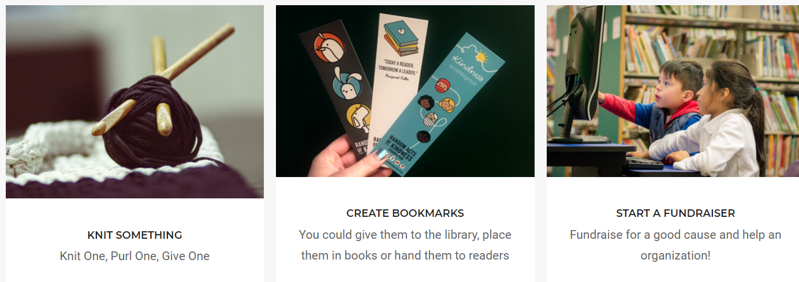

Prompted to action –
Take the Kindness challenge
https://www.randomactsofkindness.org/kindness-ideas
Have a search on this website to see some simple acts of kindness that you could do in your school. Have a vote and choose one to do as a class. At the end of the project come together as a school to share what you have done and the impact that you have had through your kindest.

Slide 32

Prompted to action – Download posters for your classroom: https://www.randomactsofkindness.org/printables

Slide 33
If you would like to, join in with this Prayer Time or sit and think quietly about all we have Talked about today
Encourage the pupils to respond with their own prayers in the class prayer space/area. You could use the school’s prayer or the Lord’s Prayer:
Our Father, in heaven,
Holy is your name.
Your Kingdom come,
Your will be done on earth, as it is in heaven.
Give us this day our daily bread,
And forgive us our sins,
As we forgive those who sin against us,
And lead us not into temptation,
But deliver us from evil.
Amen.

Slide 34

Thursday

Slide 35
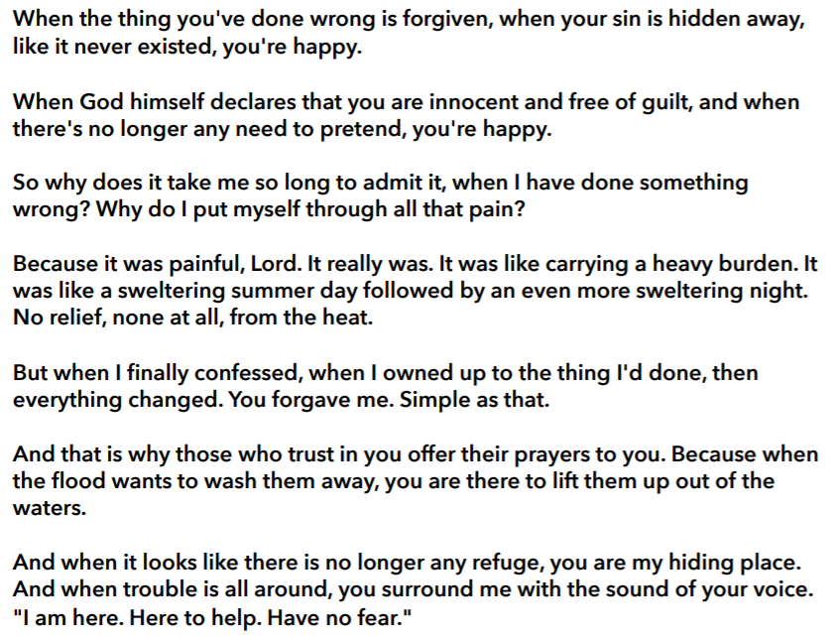
Use the Meditation resource alongside the Spiritual Encounters – bible-based meditation teacher’s pack: http://www.ldbe.co.uk/about/guidance- resources/worship-and-meditation/
This creative paraphrase of Psalm 32 by Bob Hartmann could work well as a meditation on forgiveness.

Slide 36

Friday

Slide 37
Take this time to celebrate what has happened during the week – you may want to give out awards. If possible, join the bubbles using Zoom or Teams so that the whole school can come together in a time of celebration.
Remember that this should also be a time of worship and celebration so begin with a gathering, include a prayer, a blessing, and a song of celebration.

