Slide 1

Monday

Slide 2

Welcome
Welcome Words
We have gathered here together to worship God, the Father, Son and Holy Spirit,
And to learn how Jesus brought calm in the middle of a storm.
Today we are thinking about the value peace.

Slide 3
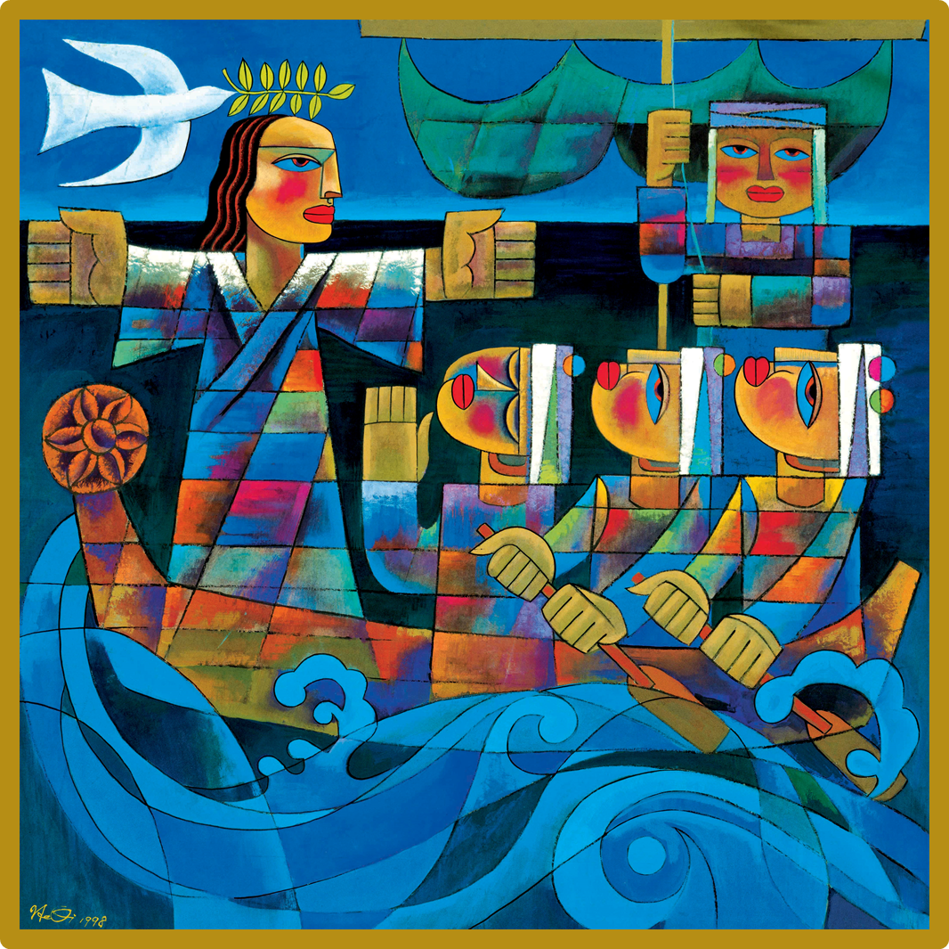


Slide 4


What do you see in the picture?
Look at the waves. What do you think the weather and sea conditions were like that day?
Can you suggest some adjectives to describe this picture?
Who is in the boat?
Which figure is Jesus?
How do you know?
Why are all the seated figures turned toward Jesus?
What do you think Jesus is saying?
Why do you think the artist He Qi has included a dove carrying an olive branch in its beak?

Slide 5
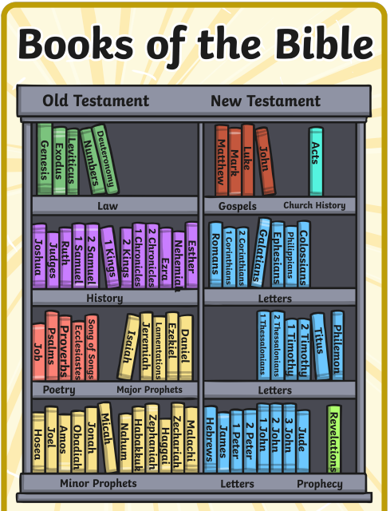
Todays story about one of the Miracles of Jesus and is from one of the Gospels.
Mark 4.35-41
Notes:
Perhaps ask children to put this part of the bible in context. What do they know about the Old Testament? Explain that the bible actually describes it as a big fish.

Slide 6
Let’s see what happens in this story
https://www.youtube.com/watch?v=ZzPwRXytr7U

Slide 7

Responding
Looking at the painting again.
What do you think the artist He Qi wants us to know about Jesus?

Slide 9
Responding
Jesus is sometimes known as “The Prince of Peace” His disciples shouted out to him when they were scared. Christians believe that Jesus wants them to know that when they face tough and challenging times they too can ask him for help.
Who do you ask for help?

Slide 10
Prayer
A Haiku Prayer
Jesus, calm the storm.
When I’m worried and afraid,
Bring your peace and love.
Amen

Slide 11

Tuesday

Slide 12
Let’s think again about the picture we saw yesterday. Particularly think about the last question.
Who is in the boat?
Which figure is Jesus?
How do you know?
Why are all the seated figures turned toward Jesus?
What do you think Jesus is saying?
Why do you think the artist He Qi has included a dove carrying an olive branch in its beak?

Slide 13

Reflection Challenge
Yesterday’s story gave a message that Jesus will help in challenging times. The picture and story remind Christians that Jesus is “ The Prince of Peace.
What do you think about these ideas? Do you feel school, home or the world are places of peace for everyone?

Slide 14
Reflection challenge
How can you work to make school, home and the world more peaceful?
Write your ideas down.
You may each like to write your ideas on a dove outline and create a tree of peace for your reflection area.

Slide 15

Wednesday

Slide 16
Welcome
Welcome Words
We have gathered here together to worship God, the Father, Son and Holy Spirit,
And to learn how Jesus brought calm in the middle of a storm.
Today we are thinking about the value peace.

Slide 17
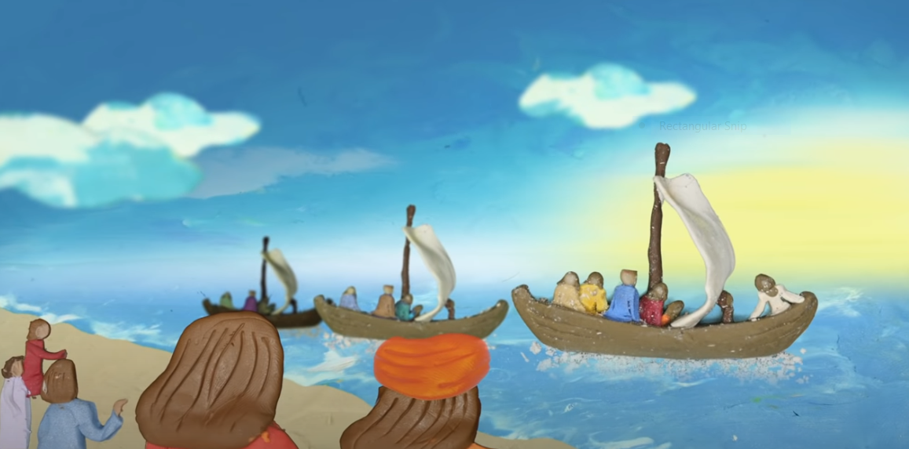
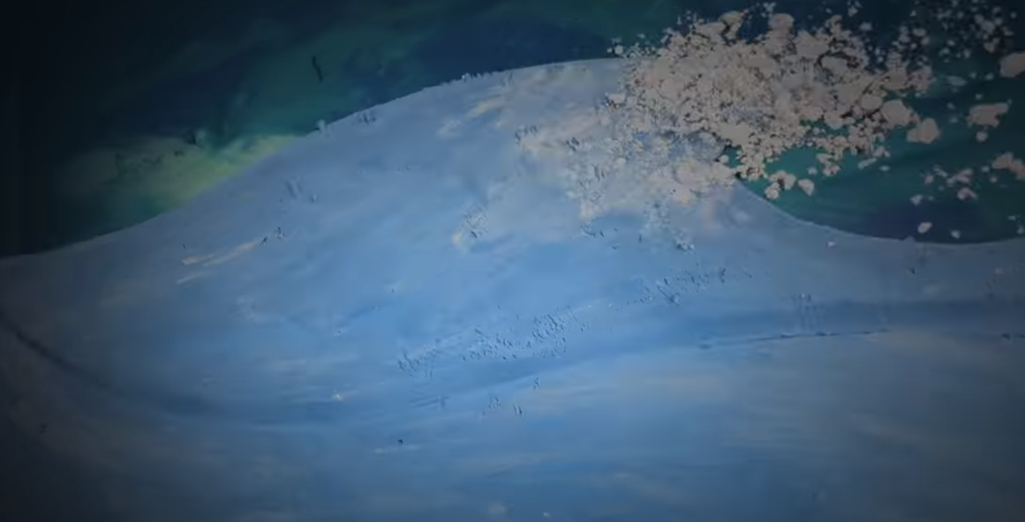
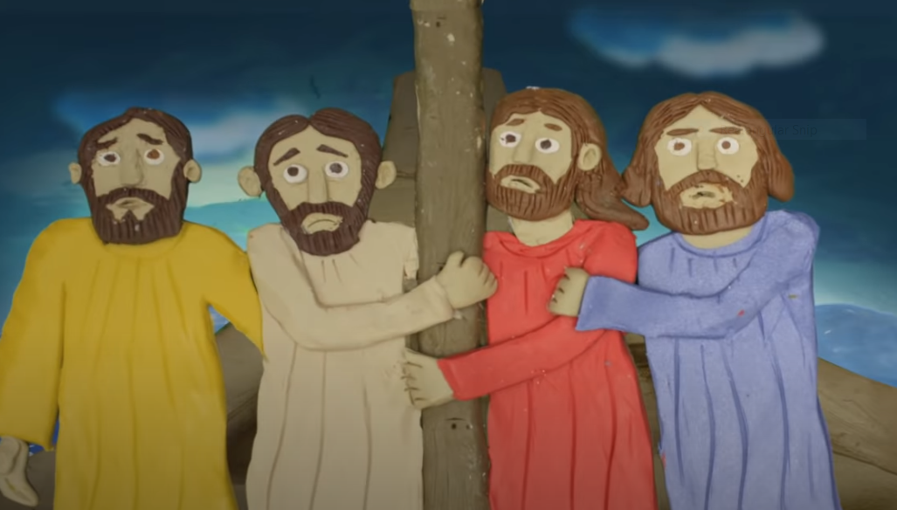
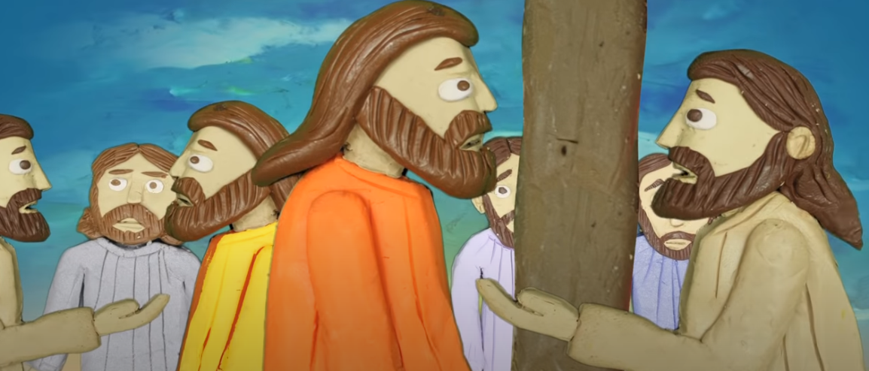
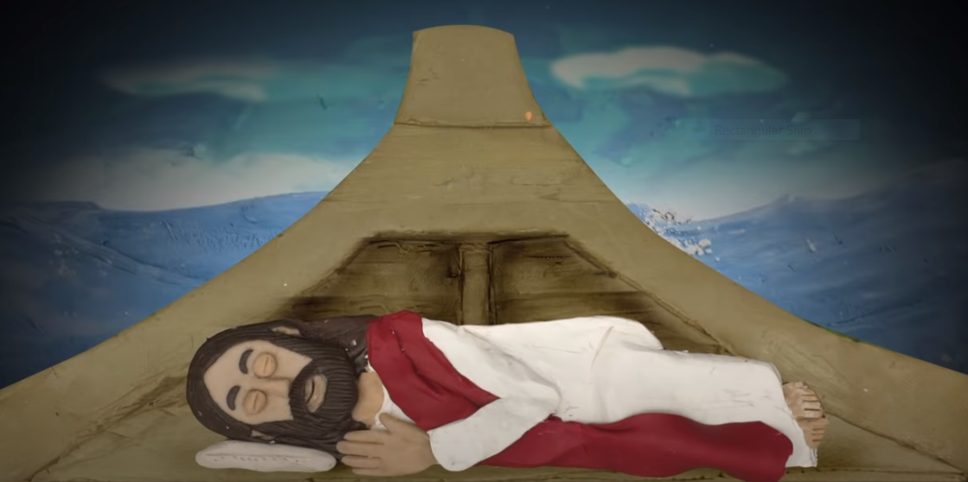
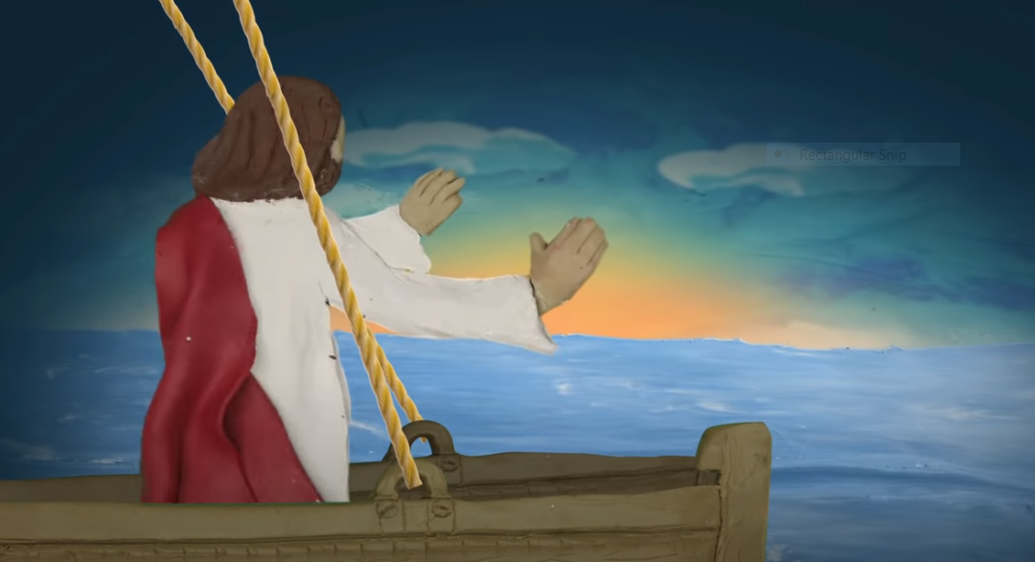
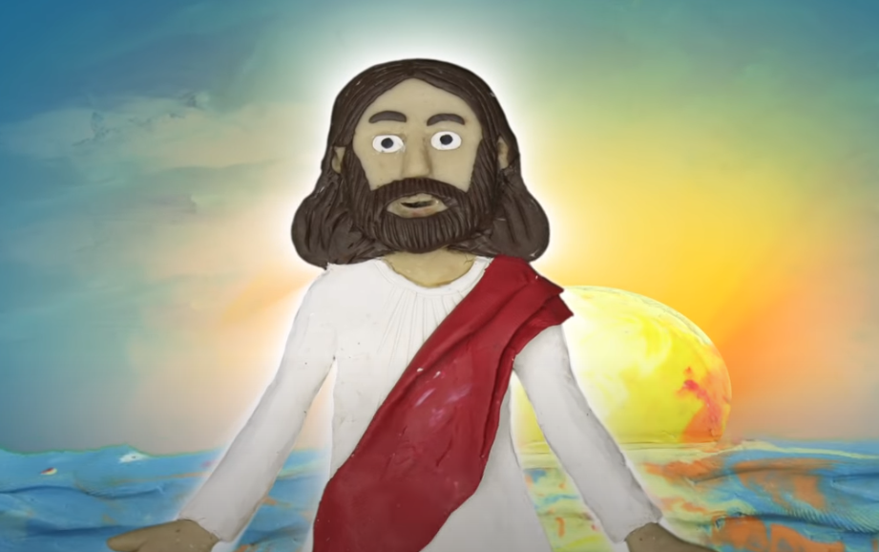
Can you remember the Bible story we heard on Monday?

Slide 18
The disciples thought Jesus did not care about them. What did he do and say?
Calmed the waves and wind
Left them to drown because they had no faith

Slide 19
Jesus calmed the storm but his words after show he felt that the disciples fears in his presence showed they still did not really believe who he was.
Do you agree?

Slide 20
Over time, as the disciples saw Jesus perform many miracles some of them began to believe he was God’s son but their doubts stayed with them. This is very true for most people of faith- sometimes their faith and belief is strong- sometimes they struggle to believe and trust.
Challenging times often challenge our faith.

Slide 21
Time for Action
Even without faith it can be hard to believe that we can make a difference in the world. Jesus was a courageous man who showed through his life the importance of small actions as well as big in making change.
Find out what small things you can do that might help make the world a more peaceful place.
Think about:
What peace means to you?

Slide 22
Prayer
God of love,
We pray for peace in our world, and an end to war.
Instead of hatred, let there be love.
Shelter your children and protect us.
Guide us and keep us from harm,
so we can build a world of love and live our lives in peace.
Amen.

Slide 23

Thursday

Slide 24
Prayer of St Francis
Lord, make me instruments of your peace.
Where there is hatred, let me sow love; where there is hurt, forgiveness; where there is doubt, faith; where there is despair, hope; where there is darkness, light; where there is sadness, joy.
O god help me to think of others before myself; grant that we may not so much seek to be consoled as to console, to be understood as to understand; to be loved as to love.
For it is in giving that we receive, it is in forgiving that we are forgiven and it is in dying that we are born to eternal life
Use the Meditation resource alongside the Spiritual Encounters – bible-based meditation teacher’s pack:
https://www.youtube.com/watch?v=ihhvm6eLWZI

Slide 25

Friday- celebration worship

