Slide 1

Monday

Slide 2

Welcome/Gathering
Welcome everyone
It is good to be here together

Slide 3
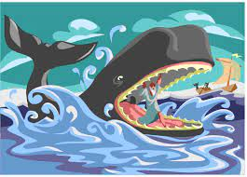


Slide 4

What do you see in the picture?
Can you make a prediction about what we are going to talk about today?
What questions do you have about this picture?
Come up with three questions.

Slide 5
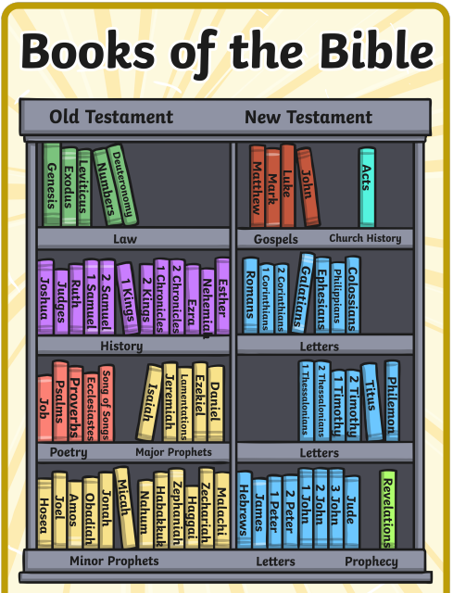
Let’s ‘dive in’ to the bible.
Jonah 1-4
Notes:
Perhaps ask children to put this part of the bible in context. What do they know about the Old Testament? Explain that the bible actually describes it as a big fish.

Slide 6
Let’s see what happens in this story
https://www.bbc.co.uk/programmes/articles/3N40HrCvgDcFwXDJPhtm2M0/saying-sorry-jonah-and-the-whale

Slide 7

Responding
Why did Jonah run away?
What could he have done?

Slide 8
Responding
Jonah found it hard to say sorry. He didn't want to make the journey because he didn’t believe that the people of Nineveh deserved God’s forgiveness.
Why is saying sorry so hard?

Slide 9
Prayer
Dear God,
We sometimes find it hard to admit we have done something wrong and to say sorry
Help us to say sorry at the right time
Forgive us for those times when we don’t accept our part in something or don’t say sorry
Amen.

Slide 10

Tuesday- class worship

Slide 11

Reflection Challenge
Why is it hard to admit when you have done something wrong? Share your ideas.

Slide 12
What words or phrases might you use when you are apologising. Write these down.

Slide 13

Wednesday

Slide 14
Welcome/Gathering
Welcome everyone
It is good to be here together

Slide 15
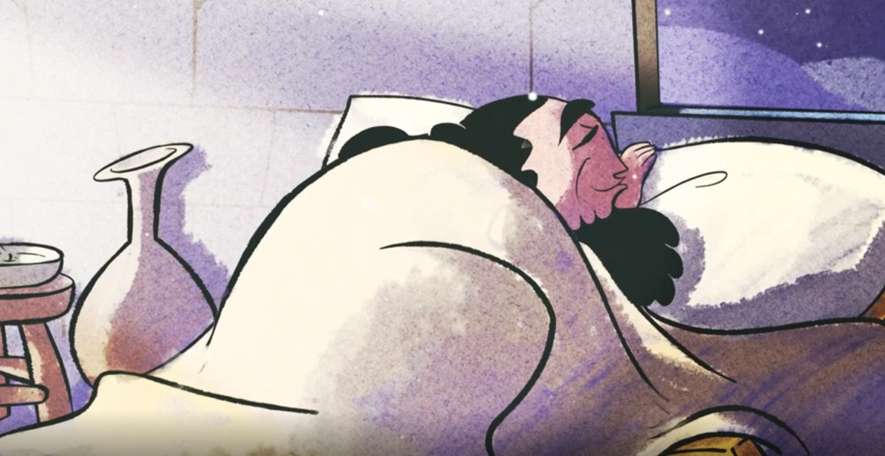
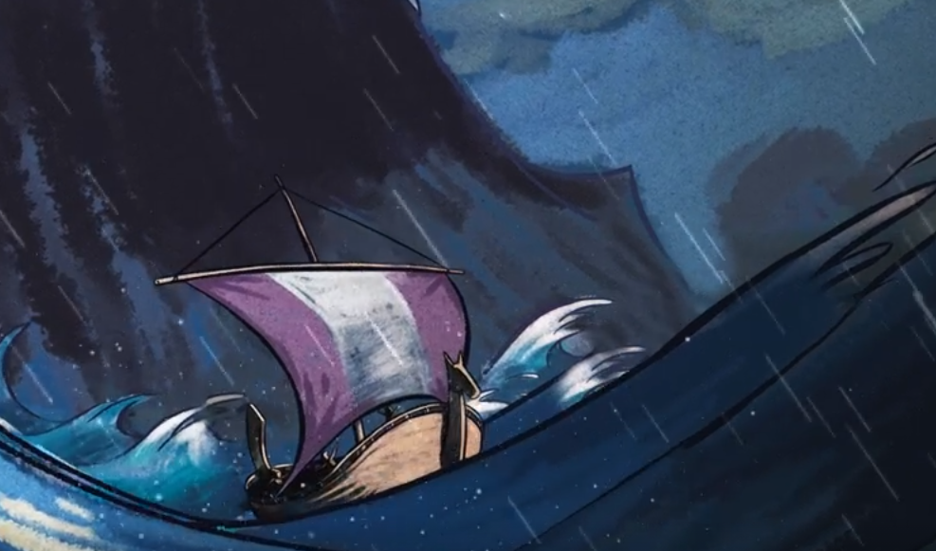
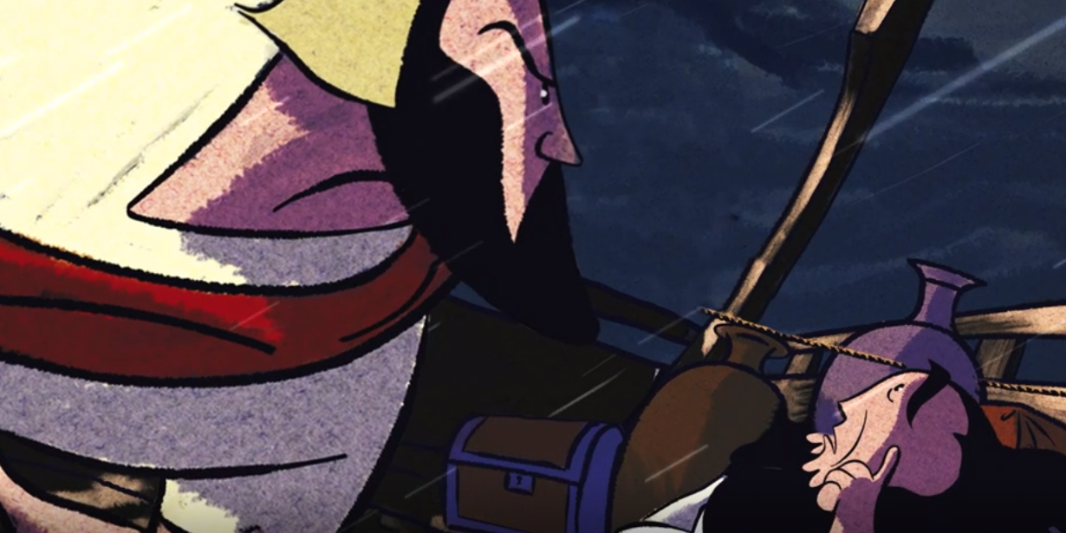
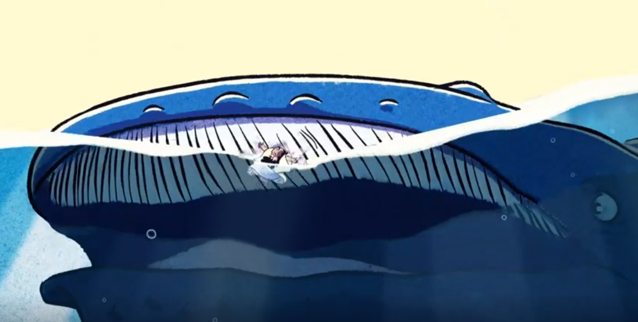
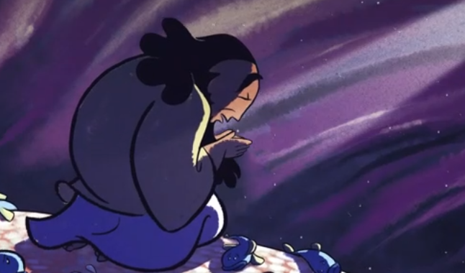
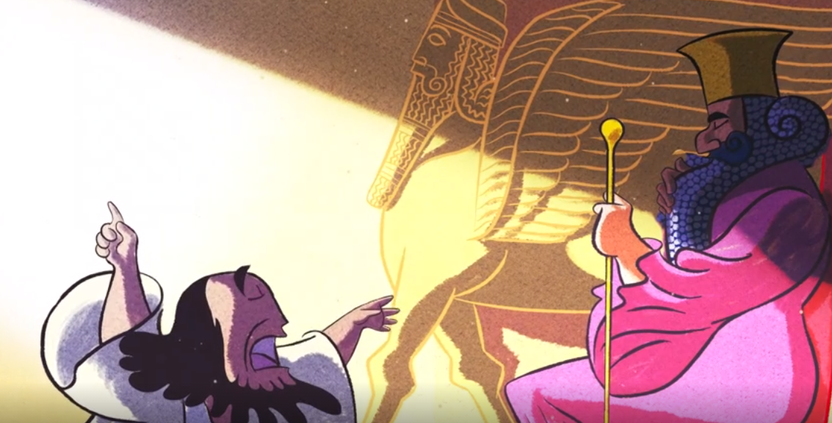
Can you remember the bible story we heard on Monday?

Slide 16
When Jonah said sorry, what did god do?
Send a whale to eat him
Send a whale to save him

Slide 17
God gave Jonah a chance to do the right thing

Slide 18
When given God’s warning, the people of Nineveh changed their ways. They demonstrated that they were sorry and God forgave them.

Slide 19
What is forgiveness?

Slide 20
Prayer
Dear Lord,
God forgave the people of Nineveh because they realised they had done wrong and showed they were sorry by changing their ways
It is hard to say sorry so we ask for your help to forgive others when we have been wronged
Forgive us for holding a grudge
Amen.

Slide 21
Thursday

Slide 22
Welcome/Gathering
Welcome everyone
It is good to be here together

Slide 23
It takes a strong person to say sorry, and an even stronger person to forgive.
Do you think this is true? Why?

Slide 24
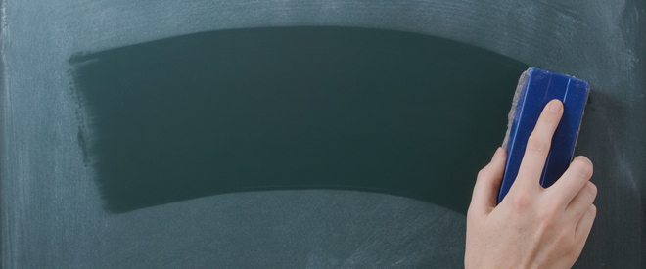
What is happening here and what does it have to do with forgiveness?

Slide 25
Why do we refer to forgiveness as wiping the slate clean?

Slide 26

Can you think of other examples of forgiveness in the bible?
The forgiveness symbol might help you think of one.
Notes:
Discuss forgiveness in the context of Jesus’ crucifixion, the

Slide 27
Forgiveness is…
Forgetting the hurts
Offering a new beginning
Restoring a friendship
Given and received
Identifying responsibility
Valuing the truth
Ending the argument
Not holding a grudge
Encouraging honesty
Saying sorry
Starting again

Slide 28
Forgiveness is…
Which of these do you find most challenging. Could you write a pledge, choosing some of the tasks on the list to work hard at?
Forgetting the hurts
Offering a new beginning
Restoring a friendship
Given and received
Identifying responsibility
Valuing the truth
Ending the argument
Not holding a grudge
Encouraging honesty
Saying sorry
Starting again

Slide 29
Prayer
Here is part of a prayer. Can you complete it to make it personal to you following today’s worship?
Dear Lord
Thank you that you offer forgiveness to all, through Jesus.
Sorry for the times when I have found it hard to ……..
Please help me to …………
Amen

Slide 30
Friday- celebration worship

Slide 31
Taking it further
What does the passage below tell you about Jonah?
In Jonah 4:1-4 it explains that
Jonah had been forgiven and given a second chance in life but is furious that God would forgive the Ninevites and turn away from punishing them.

