Slide 1

Class Worship and Reflections
Parable of the
Sower
Mark 4 1-20

Slide 2

Church of England Colours for Worship

Slide 3
Church of England
COLLective worship
ABSTRACT
Collective worship in a classroom has a different feel from worship in the hall. The more intimate nature of the worship can make everyone feel more readily included.
It is also the perfect setting to look at some of life’s big issues in a prayerful and reflective manner.
This resource supports small group worship through the theme of Parables

Slide 4
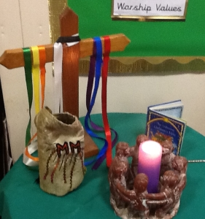
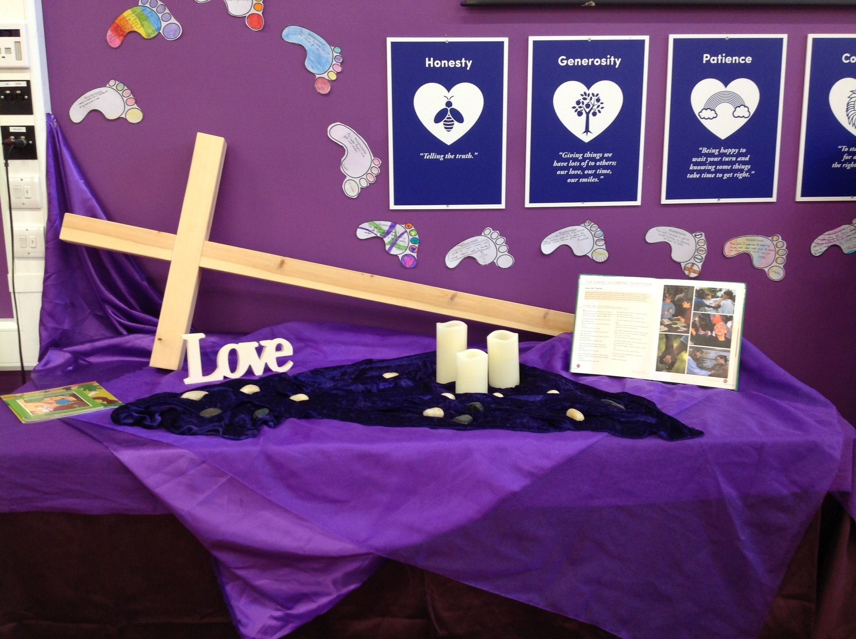
Classroom Worship
Introduction for Teachers
Ideas for the Worship Table
Special covering – possibly using liturgical colours
Candle or candles
Cross
Prayer box
Pebbles (prayer)
Flowers

Slide 5

Classroom Worship
Possible music
Go tell everyone
https://vimeo.com/280567738
Build up
https://www.youtube.com/watch?v=b2NV6K89DBk
My Lighthouse
https://www.youtube.com/watch?v=JeJvKkBV6rY
Tell the world
https://www.youtube.com/watch?v=Es4-7S1hsps

Slide 6

Gathering these can be used at the beginning of each session
Once everyone is set up ready for worship you may want to start by lighting a candle, followed by one of these:
Leader: Peace be with you.
Pupils: And also with you.
Leader: Welcome everyone
Pupils: It is good to be here together
Play a ‘Welcome’ song as children settle.
We meet in the name of God:
  God the Father,
  God the Son,
  God the Spirit:
  God is one.
Sign: ‘Welcome everybody here’ in BSL

Slide 7
Gathering these can be used at the beginning of each session
Christ the light of the world is here
God help us to speak positive words
To share peace with everyone
To remember that you are with us
Let us celebrate what God has made
Let’s remember to show God’s love,
and to show a bit of heaven to everyone we meet.

Slide 8

Sending these can be used at the End of each session
You may want to end your time together with one of these short prayers or blessings:
As we end this time
May we live with your love
Build on your truth
Share your forgiveness
Rest in your peace
For the whole of the day. AMEN
Thank you for this day,
For fun, friendship and learning.
We give thanks for this time
As we share peace with each other. AMEN
Help us as we as we move on
To carry hope in us for the day
Turning our thoughts towards others,
Our hearts towards love,
And our hands towards serving those in need. AMEN

Slide 9
Sending these can be used at the End of each session
The Lord bless us and watch over us, he is kind and helps us to show peace. Amen
Let’s remember today to show peace and love
To forgive when others upset us
To remember that we are all equal to God
To think about what we say before we say it
To thank God for a new day
Thank you God for all your good gifts
Christ our Lord,
Just as kings bowed down and offered you gifts,
May we know your strength and peace
And see all the free gifts you have given to us
and the blessing of the Father, Son and Holy Spirit,
be with you all, evermore
Amen

Slide 10

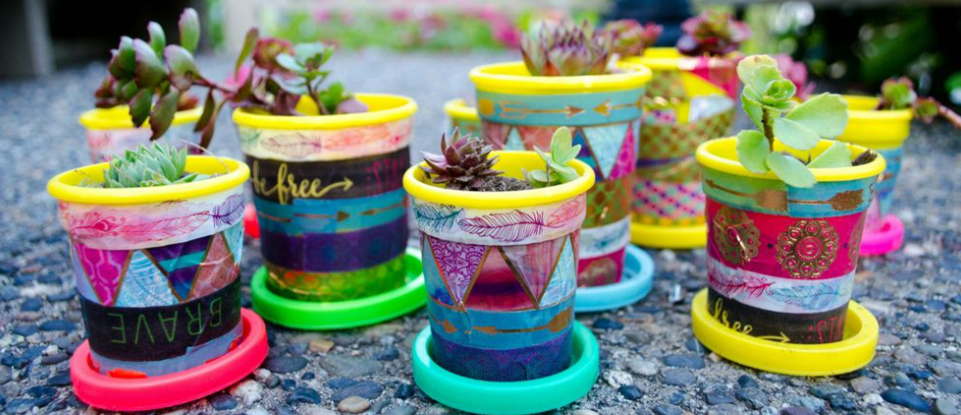
Classroom Worship
Reflection Space
Is there anything you want to thank God for?
Plant a seed in a pot. How might you decorate it to show a value that you want to live out in your own life?
As you help the seed to grow, can you spend time reflecting on how you have lived out your chosen value.
Is there anything you want ask God to help you with?
This week’s parable challenges us to think about how we listen and respond to the messages we hear in our collective worships.
Love
Patience
Kindness
Self-control

Slide 11
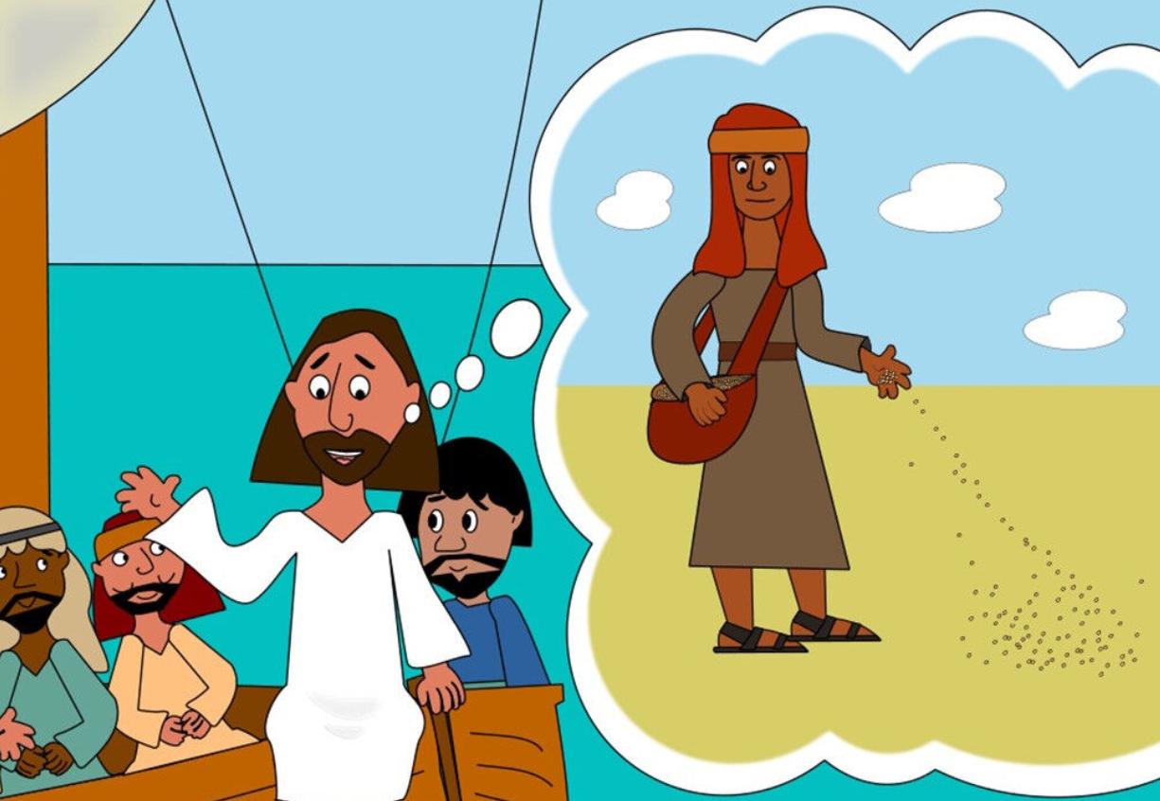
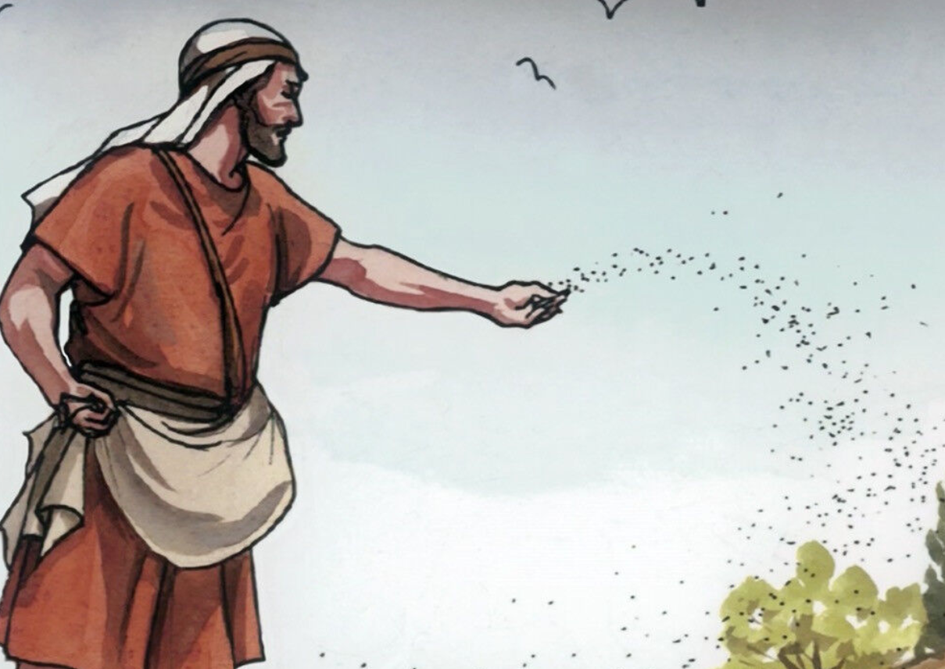
The parable of The Sower

Slide 12

Monday

Slide 13
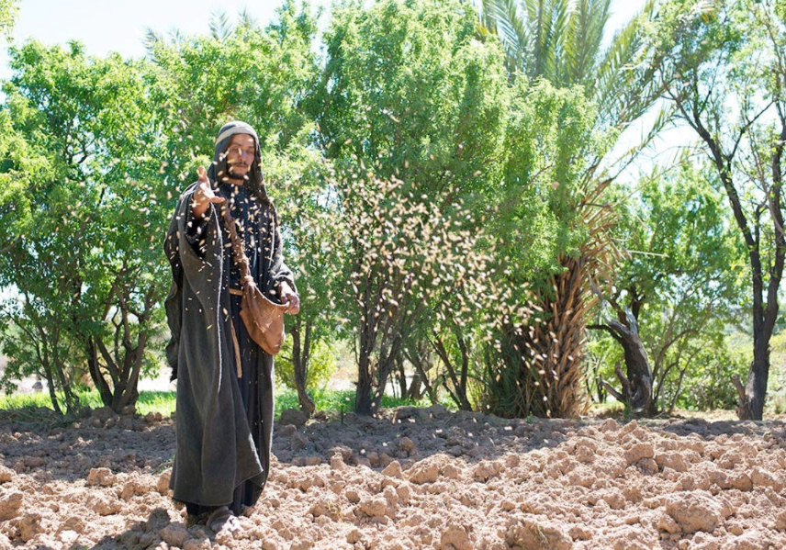


Slide 14

What do you see in the picture?
Can you make a prediction about what we are going to talk about today?
What questions do these pictures make you ask?
Think of two or three questions.

Slide 15

Bible passage: The parable of the Sower
Read or Watch Parable of the Sower (max7.org)
The parable of the sower
4 Another time Jesus began teaching by the lake, and a large crowd gathered around him. He got into a boat so that he could sit and teach from the lake. All the people stayed on the shore near the water. ² Jesus used stories to teach them many things. One of his lessons included this story:
³ “Listen! A farmer went out to sow seed. ⁴ While he was scattering the seed, some of it fell by the road. The birds came and ate all that seed. ⁵ Other seed fell on rocky ground, where there was not enough dirt. It grew quickly there because the soil was not deep. ⁶ But then the sun rose and the plants were burned. They died because they did not have deep roots. ⁷ Some other seed fell among thorny weeds. The weeds grew and stopped the good plants from growing. So they did not make grain. ⁸ But some of the seed fell on good ground. There it began to grow, and it made grain. Some plants made 30 times more grain, some 60 times more, and some 100 times more.”
⁹ Then Jesus said, “You people who hear me, listen!”
Mark 4 15:1-9

Slide 16

Reflection questions
I wonder what Jesus was trying to teach in this parable?
What did Jesus mean when he said, “You people who hear me, listen?”

Slide 17
Reflection questions
I wonder why Jesus told this story…
Have a think about what He was trying to say.

Slide 18
Prayer
Encourage the pupils to respond with their own prayers first, using the class prayer space/area or with the prayer below:
Dear God,
Thank you for stories.
A story can be like a seed,
it can grow in our minds,
helping us to think and feel differently.
Let your good story -
of people living for each other,
sharing with each other,
caring for each other -
let this good story grow and grow in me.
Amen.

Slide 19
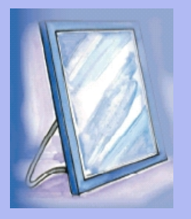
Tuesday

Slide 20
Bible passage: The parable of the Sower – Making sense the parable Today.
Read or Watch Parable of the Sower (max7.org)
The parable of the sower
4 Another time Jesus began teaching by the lake, and a large crowd gathered around him. He got into a boat so that he could sit and teach from the lake. All the people stayed on the shore near the water. ² Jesus used stories to teach them many things. One of his lessons included this story:
³ “Listen! A farmer went out to sow seed. ⁴ While he was scattering the seed, some of it fell by the road. The birds came and ate all that seed. ⁵ Other seed fell on rocky ground, where there was not enough dirt. It grew quickly there because the soil was not deep. ⁶ But then the sun rose and the plants were burned. They died because they did not have deep roots. ⁷ Some other seed fell among thorny weeds. The weeds grew and stopped the good plants from growing. So they did not make grain. ⁸ But some of the seed fell on good ground. There it began to grow, and it made grain. Some plants made 30 times more grain, some 60 times more, and some 100 times more.”
⁹ Then Jesus said, “You people who hear me, listen!”
Mark 4 15:1-9

Slide 21
Responding
PAIRED TALK:
Why do you think Jesus told this story?

Slide 22
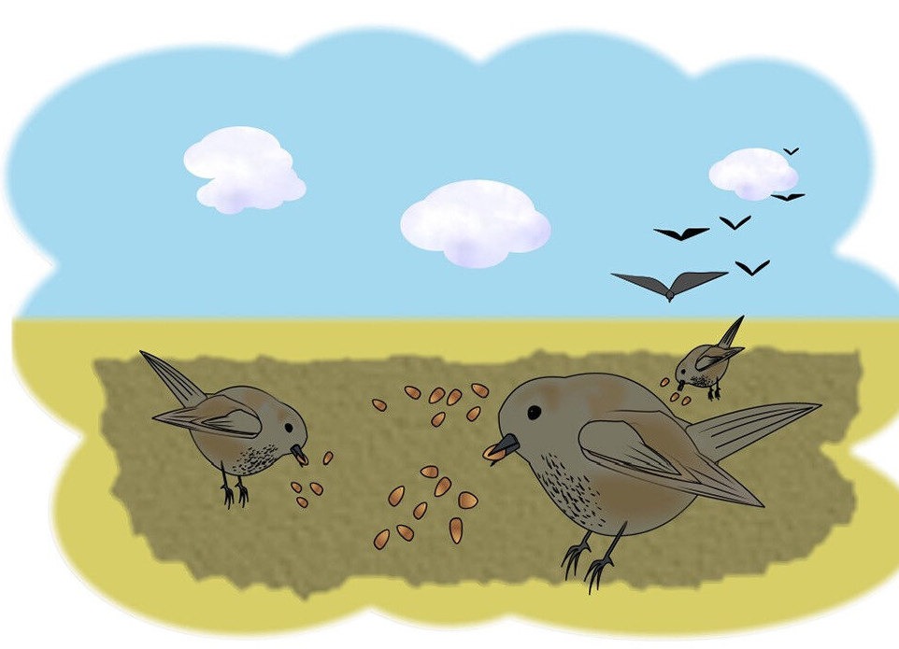
What sort of listener am I?
The seeds in this parable are used by Jesus to show how some people respond to the word of God.
Are there times when you might hear a message but respond like this?
Think about what happened at this time.
This week’s parable was used by Jesus, to help Christians think about how they respond God’s messages. You may find it helpful to think about what sort of listener you are, and how you respond to messages around you.

Slide 23
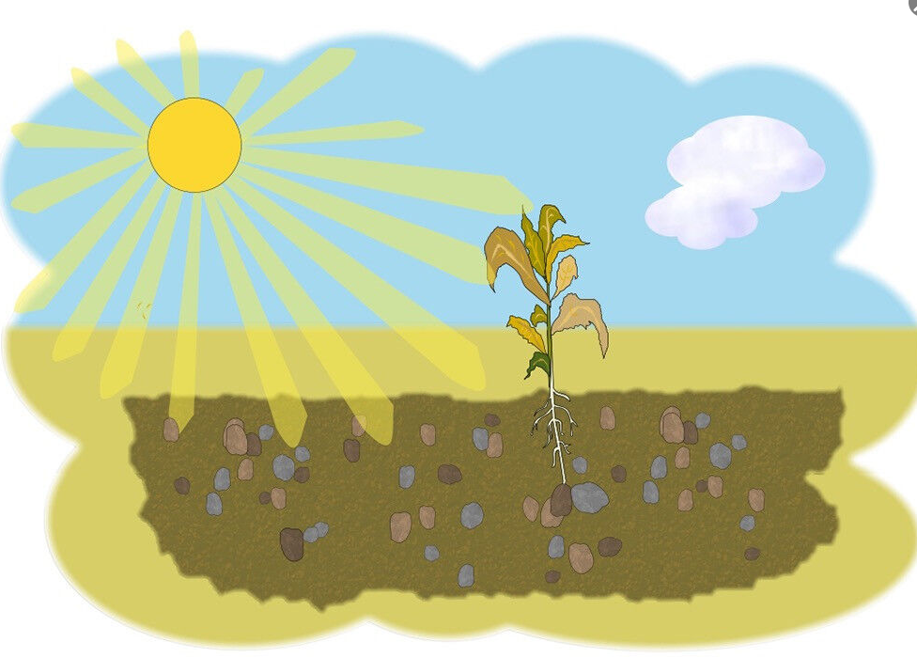
What sort of listener am I?
The seeds in this parable are used by Jesus to show how some people respond to the word of God.
Are there times when you might hear a message but respond like this?
Think about what happened at this time.
This week’s parable was used by Jesus, to help Christians think about how they respond God’s messages. You may find it helpful to think about what sort of listener you are, and how you respond to messages around you.

Slide 24
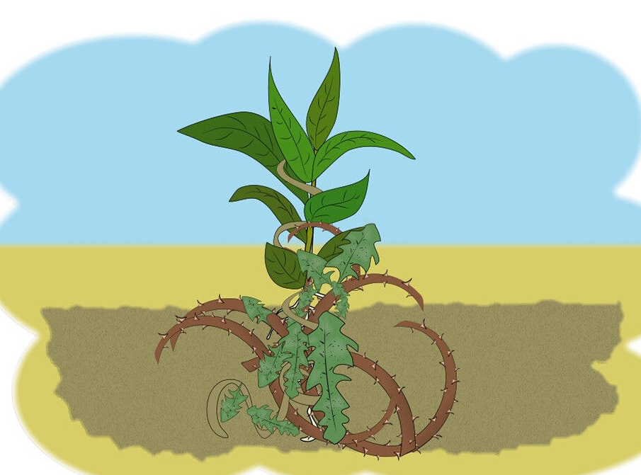
What sort of listener am I?
The seeds in this parable are used by Jesus to show how some people respond to the word of God.
Are there times when you might hear a message but respond like this?
Think about what happened at this time.
This week’s parable was used by Jesus, to help Christians think about how they respond God’s messages. You may find it helpful to think about what sort of listener you are, and how you respond to messages around you.

Slide 25
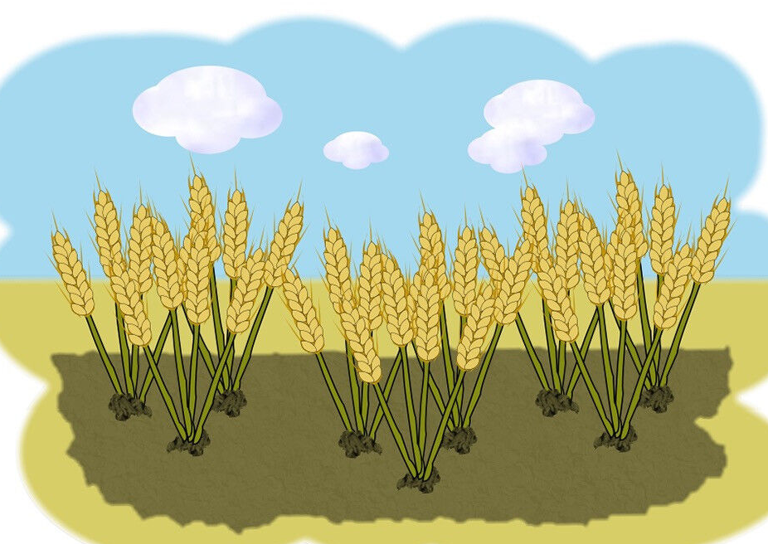
What sort of listener am I?
The seeds in this parable are used by Jesus to show how some people respond to the word of God.
Are there times when you might hear a message but respond like this?
Think about what happened at this time.
This week’s parable was used by Jesus, to help Christians think about how they respond God’s messages. You may find it helpful to think about what sort of listener you are, and how you respond to messages around you.

Slide 26

Can you think of any other things which Jesus said help you lead a good life?

Slide 27
Prayer
Encourage the pupils to respond with their own prayers in the prayer space or use the prayer below:
Dear God,
Thank you for stories.
A story can be like a seed,
it can grow in our minds,
helping us to think and feel differently.
Let your good story -
of people living for each other,
sharing with each other,
caring for each other -
let this good story grow and grow in me.
Amen.

Slide 28

Wednesday

Slide 29
Prompted to action - challenge
Remind children of the theme for the week and of the Bible story
The Parable of the sower.
In this parable Jesus challenges people not just to hear God’s word, but to listen and to act.

Slide 30
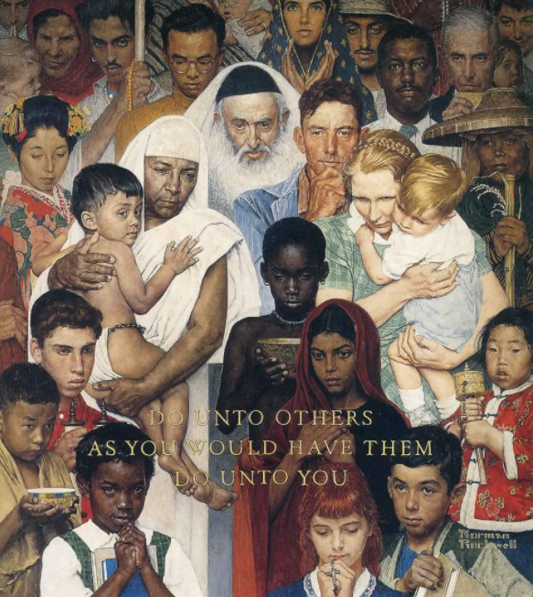
Prompted to action – challenge ideas
Matthew 7:12
¹² “Do for others what you would want them to do for you. This is the meaning of the Law of Moses and the teaching of the prophets.
Notes:
The very name may also be a way of connecting with what this story is saying because 'all sorts' were now coming to Jesus, and a number of people didn't like it.

Slide 31
Prompted to action – challenge ideas
Can you think carefully about a time when you have done something that you would not like done to you?
How did the positive thoughts and feelings get smothered in weeds?
What might you do differently next time?

Slide 32
Prompted to action – challenge ideas
Watch the short hopeworks video – Balloon Girl
Is there something that you can do to help someone in need?
How might you hear and listen to the messages from the Bible, or positive role models in your life?

Slide 33

Prompted to action – challenge ideas
Is there something that you can do to help someone in need?
Write the responses from the pupils on a red balloon before inflating and adding to the reflection area.

Slide 34
Prayer
Encourage the pupils to respond with their own prayers in the class prayer space/area. You could use the school’s prayer or the Lord’s Prayer:
Our Father, in heaven,
Holy is your name.
Your Kingdom come,
Your will be done on earth, as it is in heaven.
Give us this day our daily bread,
And forgive us our sins,
As we forgive those who sin against us,
And lead us not into temptation,
But deliver us from evil.
Amen.

Slide 35

Thursday

Slide 36
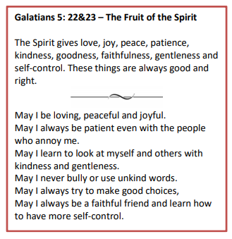
Use the Meditation resource alongside the Spiritual Encounters – bible-based meditation teacher’s pack:

Slide 37

Friday

Slide 38

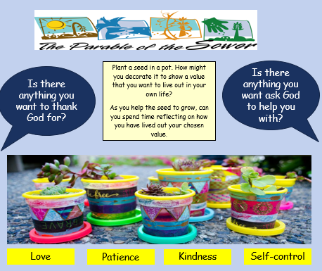
Take this time to celebrate what has happened during the week – you may want to give out awards (The red balloon award). If possible, join the bubbles using Zoom or Teams so that the whole school can come together in a time of celebration.
Remember that this should also be a time of worship and celebration so begin with a gathering, include a prayer, a blessing, and a song of celebration.
Love
Patience
Kindness

Slide 39
Classroom Worship
Reflection Space
Is there anything you want to thank God for?
Plant a seed in a pot. How might you decorate it to show a value that you want to live out in your own life?
As you help the seed to grow, can you spend time reflecting on how you have lived out your chosen value.
Is there anything you want ask God to help you with?
This week’s parable challenges us to think about how we listen and respond to the messages we hear in our collective worships.
Love
Patience
Kindness
Self-control

