Slide 1

Class Worship and Reflections
Parable of the Lost Son

Slide 2

Church of England Colours for Worship

Slide 3
Church of England
COLLective worship
ABSTRACT
Collective worship in a classroom has a different feel from worship in the hall. The more intimate nature of the worship can make everyone feel more readily included.
It is also the perfect setting to look at some of life’s big issues in a prayerful and reflective manner.
This resource supports small group worship through the theme of Parables

Slide 4
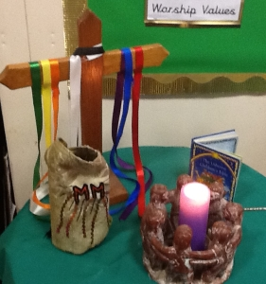
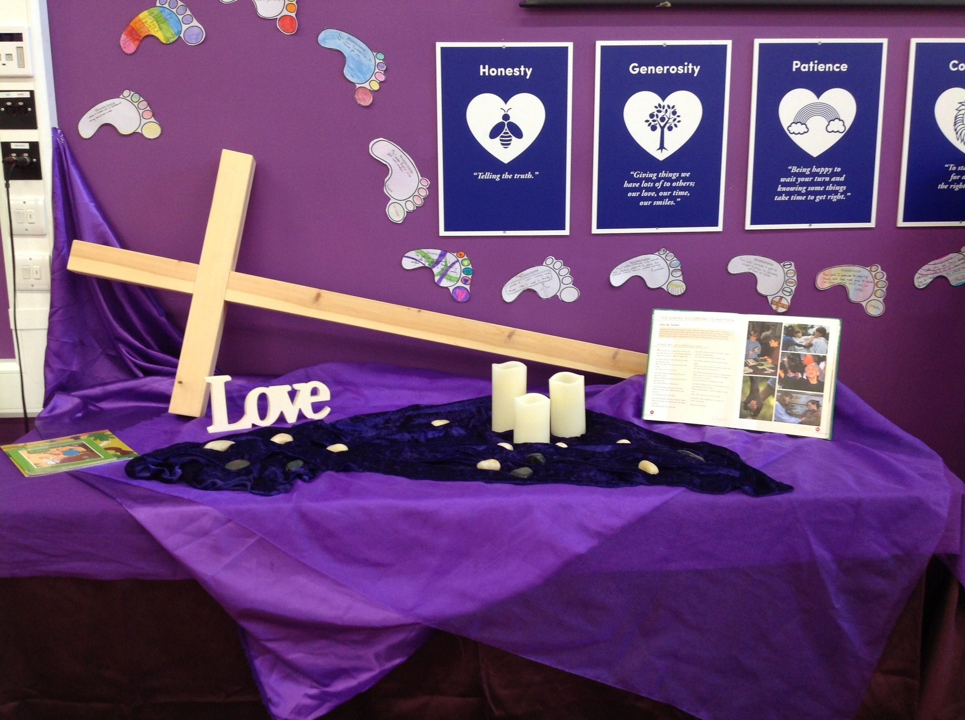
Classroom Worship
Introduction for Teachers
Ideas for the Worship Table
Special covering – possibly using liturgical colours
Candle or candles
Cross
Prayer box
Pebbles (prayer)
Flowers

Slide 5

Classroom Worship
Possible music
Good Good Father
https://www.youtube.com/watch?v=gFayN_nkzaU
My Lighthouse
https://www.youtube.com/watch?v=JeJvKkBV6rY
Be Praised
https://www.youtube.com/watch?v=WT3UviMrudA

Slide 6

Gathering these can be used at the beginning of each session
Once everyone is set up ready for worship you may want to start by lighting a candle, followed by one of these:
Leader: Peace be with you.
Pupils: And also with you.
Leader: Welcome everyone
Pupils: It is good to be here together
Play a ‘Welcome’ song as children settle.
We meet in the name of God:
  God the Father,
  God the Son,
  God the Spirit:
  God is one.
Sign: ‘Welcome everybody here’ in BSL

Slide 7
Gathering these can be used at the beginning of each session
Christ the light of the world is here
God help us to speak positive words
To share peace with everyone
To remember that you are with us
Let us celebrate what God has made
Let’s remember to show God’s love,
and to show a bit of heaven to everyone we meet.

Slide 8

Sending these can be used at the End of each session
You may want to end your time together with one of these short prayers or blessings:
As we end this time
May we live with your love
Build on your truth
Share your forgiveness
Rest in your peace
For the whole of the day. AMEN
Thank you for this day,
For fun, friendship and learning.
We give thanks for this time
As we share peace with each other. AMEN
Help us as we as we move on
To carry hope in us for the day
Turning our thoughts towards others,
Our hearts towards love,
And our hands towards serving those in need. AMEN

Slide 9
Sending these can be used at the End of each session
The Lord bless us and watch over us, he is kind and helps us to show peace. Amen
Let’s remember today to show peace and love
To forgive when others upset us
To remember that we are all equal to God
To think about what we say before we say it
To thank God for a new day
Thank you God for all your good gifts
Christ our Lord,
Just as kings bowed down and offered you gifts,
May we know your strength and peace
And see all the free gifts you have given to us
and the blessing of the Father, Son and Holy Spirit,
be with you all, evermore
Amen

Slide 10
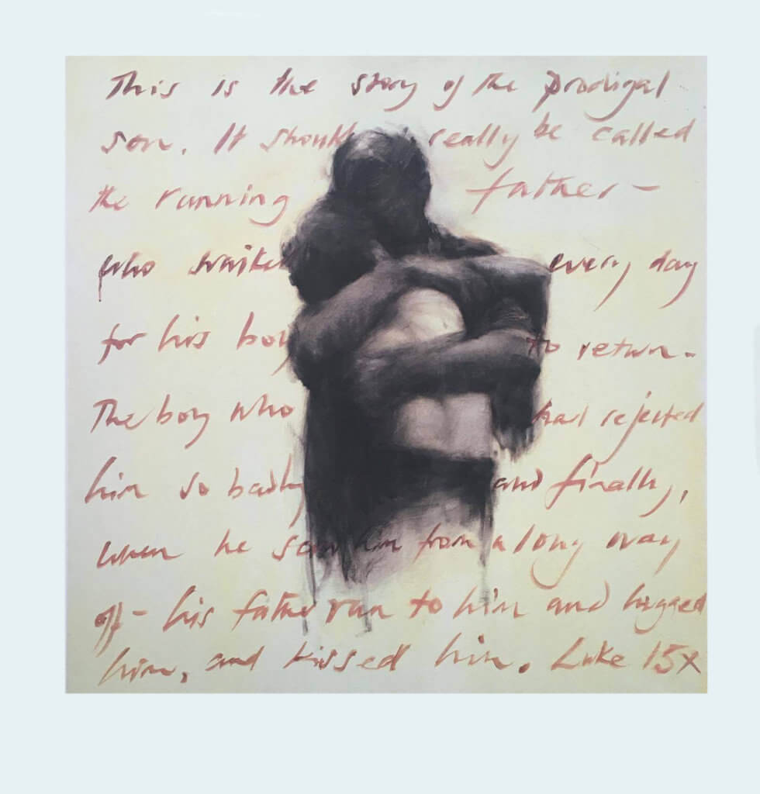
The parable of the LOST son

Slide 11
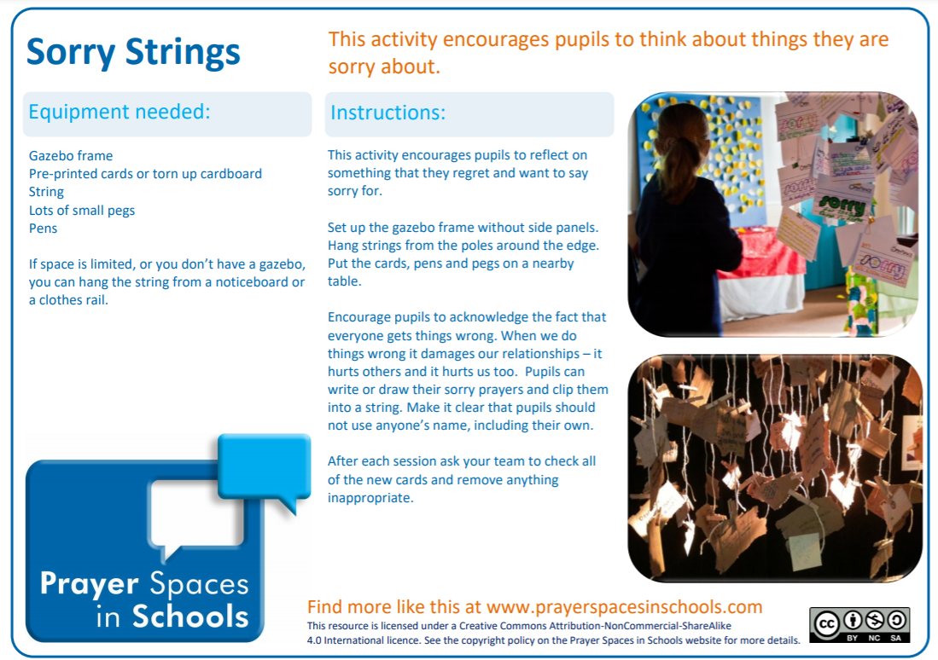
Classroom Worship
Reflection Space

Slide 12
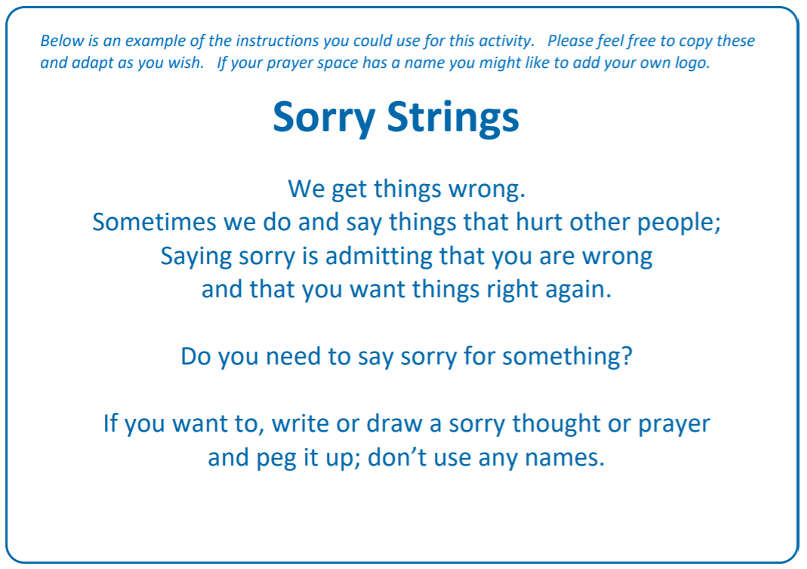
Classroom Worship
Reflection Space

Slide 13
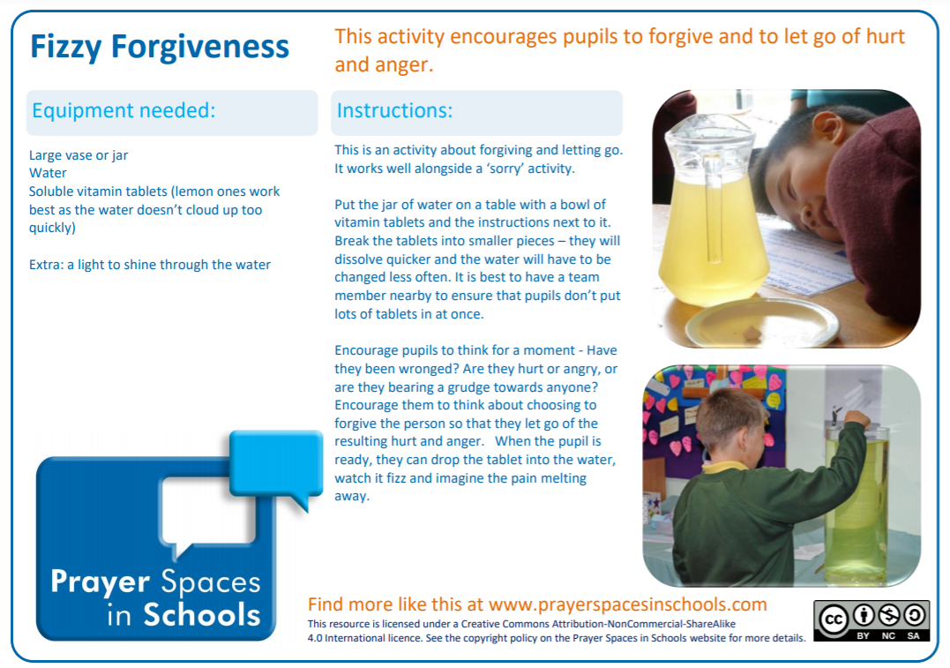
Classroom Worship
Reflection Space

Slide 14
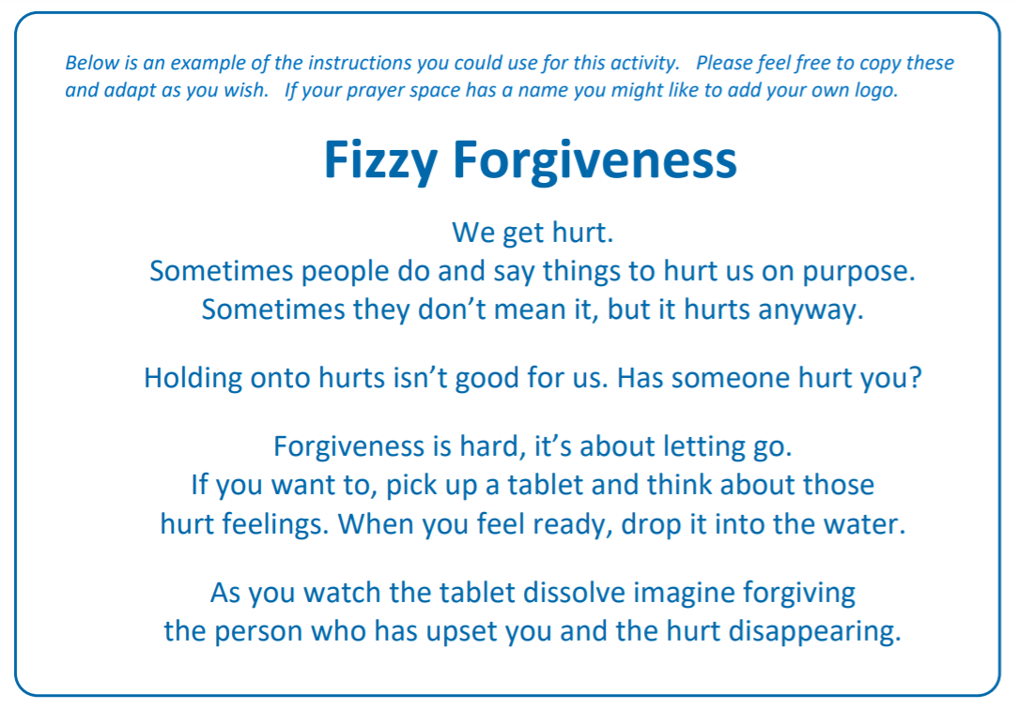
Classroom Worship
Reflection Space

Slide 15

Monday

Slide 16
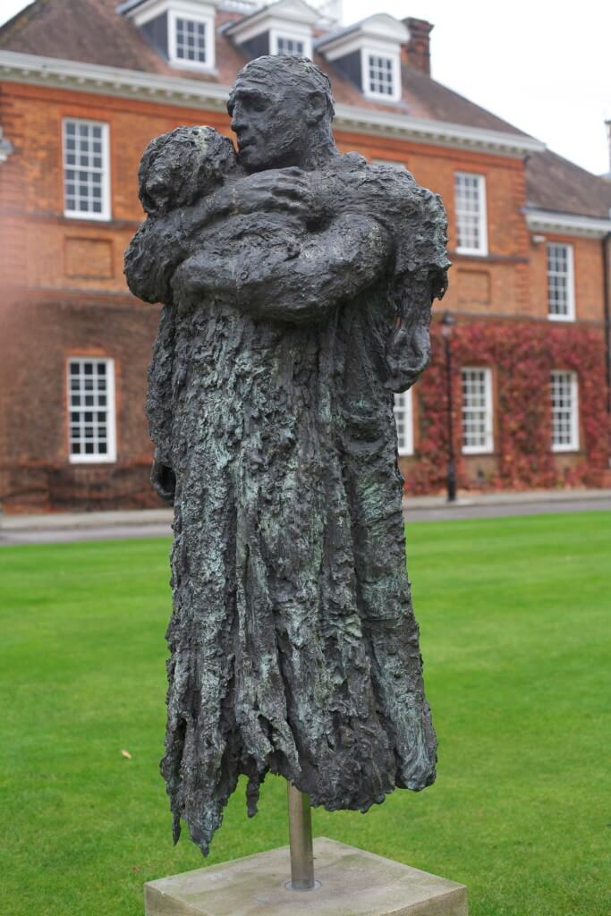


Slide 17

What do you see in the picture?
Can you make a prediction about what we are going to talk about today?
What questions does this picture make you ask?
Think of two or three questions.

Slide 18

Bible passage: The parable of the Lost son
Read or Watch https://www.youtube.com/watch?v=zNuBLJ1Aw0o
Luke 15:11-32 Two Sons
¹¹ Jesus also told them another story:
Once a man had two sons. ¹² The younger son said to his father, “Give me my share of the property.” So the father divided his property between his two sons.
¹³ Not long after that, the younger son packed up everything he owned and left for a foreign country, where he wasted all his money in wild living. ¹⁴ He had spent everything, when a bad famine spread through that whole land. Soon he had nothing to eat.
¹⁵ He went to work for a man in that country, and the man sent him out to take care of his pigs.^{[a]} ¹⁶ He would have been glad to eat what the pigs were eating,^{[b]} but no one gave him a thing.
¹⁷ Finally, he came to his senses and said, “My father’s workers have plenty to eat, and here I am, starving to death! ¹⁸ I will go to my father and say to him, ‘Father, I have sinned against God in heaven and against you. ¹⁹ I am no longer good enough to be called your son. Treat me like one of your workers.’”
²⁰ The younger son got up and started back to his father. But when he was still a long way off, his father saw him and felt sorry for him. He ran to his son and hugged and kissed him.
²¹ The son said, “Father, I have sinned against God in heaven and against you. I am no longer good enough to be called your son.”

Slide 19
Bible passage: The parable of the Lost son
²² But his father said to the servants, “Hurry and bring the best clothes and put them on him. Give him a ring for his finger and sandals^{[c]} for his feet. ²³ Get the best calf and prepare it, so we can eat and celebrate. ²⁴ This son of mine was dead, but has now come back to life. He was lost and has now been found.” And they began to celebrate.
²⁵ The older son had been out in the field. But when he came near the house, he heard the music and dancing. ²⁶ So he called one of the servants over and asked, “What’s going on here?”
²⁷ The servant answered, “Your brother has come home safe and sound, and your father ordered us to kill the best calf.” ²⁸ The older brother got so angry that he would not even go into the house.
His father came out and begged him to go in. ²⁹ But he said to his father, “For years I have worked for you like a slave and have always obeyed you. But you have never even given me a little goat, so that I could give a dinner for my friends. ³⁰ This other son of yours wasted your money. And now that he has come home, you ordered the best calf to be killed for a feast.”
³¹ His father replied, “My son, you are always with me, and everything I have is yours. ³² But we should be glad and celebrate! Your brother was dead, but he is now alive. He was lost and has now been found.”

Slide 20


Reflection questions
Money?
Forgiveness?
Is this story about…
Family?
Jealousy?
Greed?
Something else?
Notes:
Take ideas and responses from the children initially, giving them time to reflect on the meaning of the story. Jesus said: Sometimes people lose their way and do wrong things, but God never stops loving them. Through the parable Jesus wanted to show that God is a loving father who waits for the return of his children who wander far from him and that even when they are underserving, he forgives them.

Slide 21
Reflection questions
How do you think the father felt when his son left home?
How did he feel when his son came home?
How is the father in
the story like God?

Slide 22
Prayer
Encourage the pupils to respond with their own prayers first, using the class prayer space/area or with the prayer below:
Thank you God for loving each and every one of us.
Thank you that you are always willing to forgive us.
Help us to remember that you are like the father in the story,
ready to welcome us with open arms.
Amen

Slide 23

Tuesday

Slide 24
Notes:
How does she feel? How do you know? What might have happened?

Slide 25
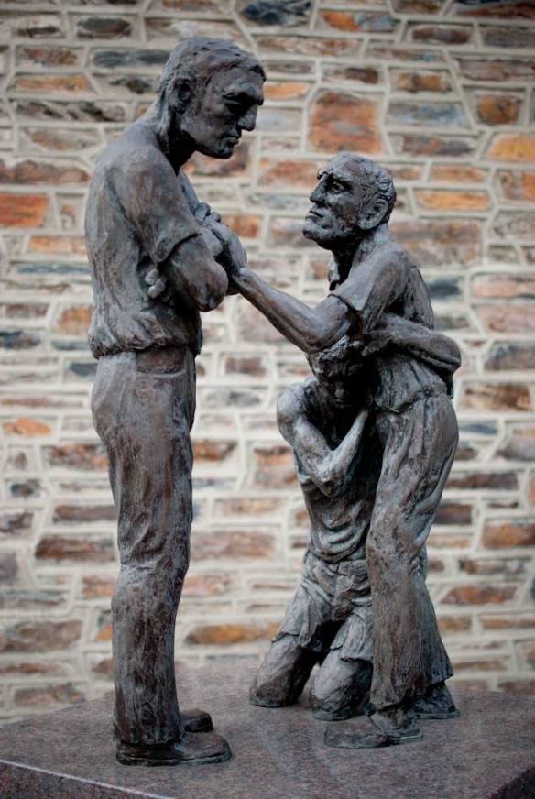
What do you see in the picture?
Can you make a prediction about what we are going to talk about today?
What questions does this picture make you ask?
Think of two or three questions.

Slide 26
Bible passage: The parable of the LOST son
Recap the end of the story: Luke 15 25-32
²⁵ The older son had been out in the field. But when he came near the house, he heard the music and dancing. ²⁶ So he called one of the servants over and asked, “What’s going on here?”
²⁷ The servant answered, “Your brother has come home safe and sound, and your father ordered us to kill the best calf.” ²⁸ The older brother got so angry that he would not even go into the house.
His father came out and begged him to go in. ²⁹ But he said to his father, “For years I have worked for you like a slave and have always obeyed you. But you have never even given me a little goat, so that I could give a dinner for my friends. ³⁰ This other son of yours wasted your money. And now that he has come home, you ordered the best calf to be killed for a feast.”
³¹ His father replied, “My son, you are always with me, and everything I have is yours. ³² But we should be glad and celebrate! Your brother was dead, but he is now alive. He was lost and has now been found.”

Slide 27
Responding
I am feeling…
Can you imagine and describe how the older brother is feeling?
Notes:
Allow children time to think about this.

Slide 28
Responding
Is he right to feel this way? Pick your response and explain why…
Yes
No
Notes:
Allow children time to think about this. Talk about the fact that we all make mistakes and that there may be a time in the future when the elder son needs his father’s forgiveness too. Talk about the fact that jealousy can be most harmful to the person feeling it.

Slide 29
Prayer
Encourage the pupils to respond with their own prayers in the prayer space or use the prayer below:
The light of God surrounds me,
the love of God enfolds me,
the power of God protects me,
the presence of God watches over me,
wherever I am, God is,
and where God is, all is perfect.
Amen

Slide 30

Wednesday

Slide 31
Prompted to action - challenge
Can you remember our theme for worship this week?
The Parable of the Lost Son

Slide 32

Prompted to action – challenge ideas
This painting, and the sculpture of the father and son, were created by Charlie Mackesy, author of ‘The Boy, the Mole, the Fox and the Horse’.
The writing behind the painting says,
‘This is the story of the prodigal son. It should really be called the running father – who waited every day for his boy to return. The boy who had rejected him so badly and finally, when he saw him from a long way off – his father ran to him and hugged him, and kissed him. Luke 15

Slide 33
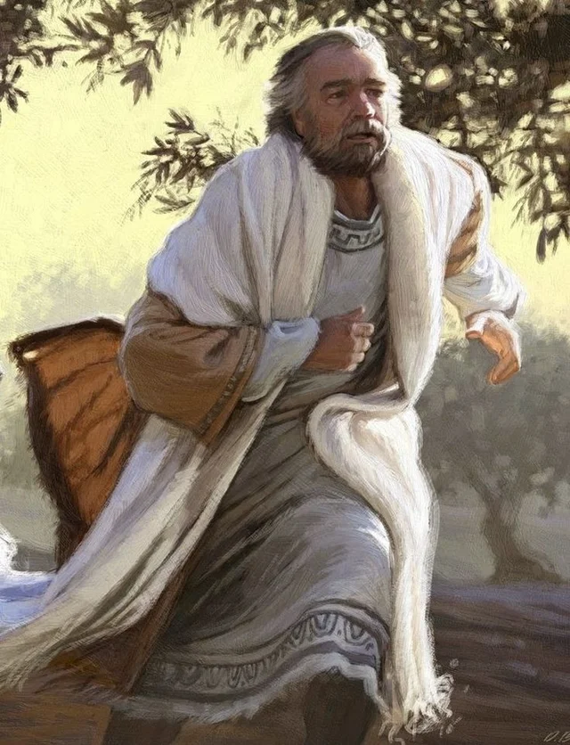
Prompted to action – challenge ideas
Think about the idea of the ‘running father’ – not standing still and waiting, but running to offer forgiveness to his son.
Do we ‘run’ to forgive our friends or family when they hurt or upset us or do we find it hard to forgive?

Slide 34
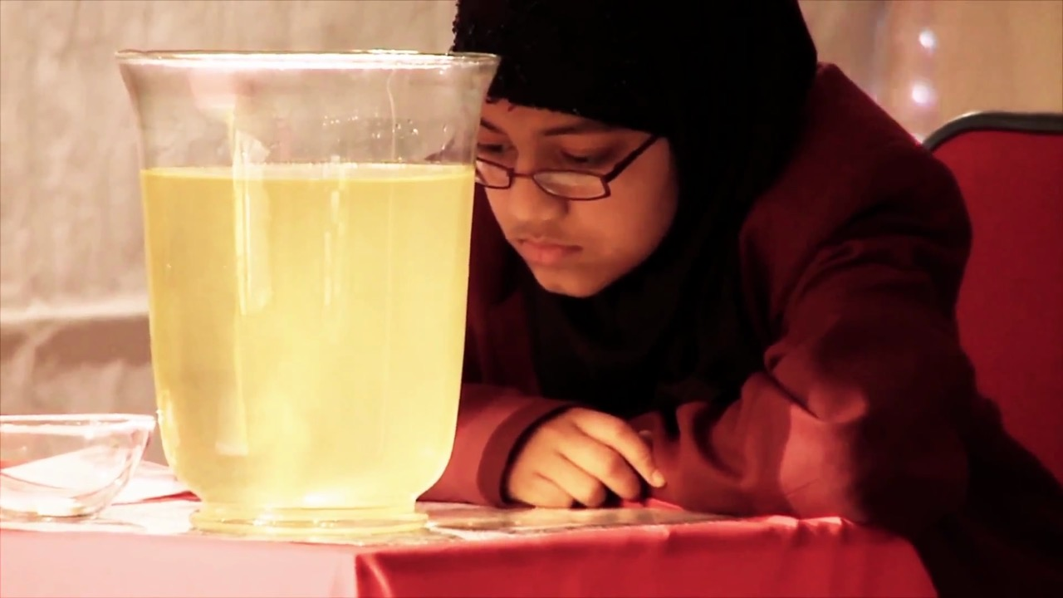
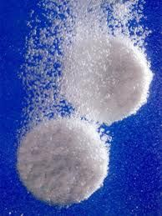
Prompted to action – challenge ideas
It can be really helpful to let go of the things that have hurt us and forgive other people.
The Bible reminds us to forgive each other, just as God forgives us. It is even mentioned in The Lord’s Prayer, which Jesus taught us to say.
Watch this video to see Fizzy Forgiveness in action. Think about how it could help you to forgive others.
https://www.youtube.com/watch?v=27zmOJGpzBw

Slide 35
Prayer
Encourage the pupils to respond with their own prayers in the class prayer space/area. You could use the school’s prayer or the Lord’s Prayer:
Our Father, in heaven,
Holy is your name.
Your Kingdom come,
Your will be done on earth, as it is in heaven.
Give us this day our daily bread,
And forgive us our sins,
As we forgive those who sin against us,
And lead us not into temptation,
But deliver us from evil.
Amen.

Slide 36

Thursday

Slide 37
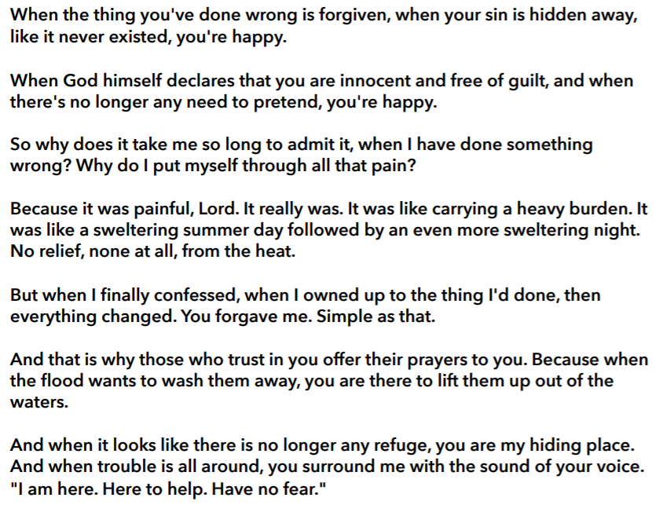
Use the Meditation resource alongside the Spiritual Encounters – bible-based meditation teacher’s pack: http://www.ldbe.co.uk/about/guidance- resources/worship-and-meditation/
This creative paraphrase of Psalm 32 by Bob Hartmann could work well as a meditation on forgiveness.

Slide 38

Friday

Slide 39
Take this time to celebrate what has happened during the week – you may want to give out awards. If possible, join the bubbles using Zoom or Teams so that the whole school can come together in a time of celebration.
Remember that this should also be a time of worship and celebration so begin with a gathering, include a prayer, a blessing, and a song of celebration.

