Slide 1

Class Worship and Reflections
Parable of the Good Samaritan

Slide 2

Church of England Colours for Worship

Slide 3
Church of England
COLLective worship
ABSTRACT
Collective worship in a classroom has a different feel from worship in the hall. The more intimate nature of the worship can make everyone feel more readily included.
It is also the perfect setting to look at some of life’s big issues in a prayerful and reflective manner.
This resource supports small group worship through the theme of Parables

Slide 4
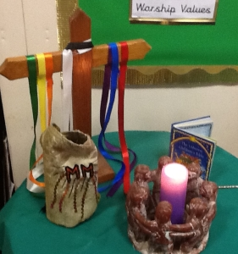
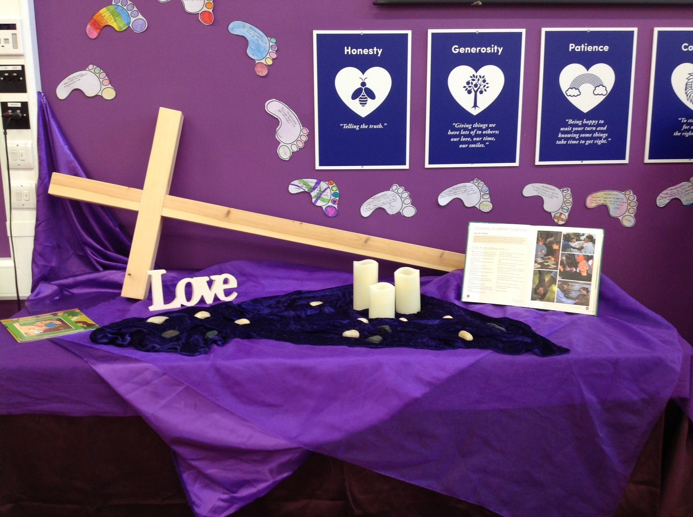
Classroom Worship
Introduction for Teachers
Ideas for the Worship Table
Special covering – possibly using liturgical colours
Candle or candles
Cross
Prayer box
Pebbles (prayer)
Flowers

Slide 5

Classroom Worship
Possible music
The Golden Rule
https://www.youtube.com/watch?v=se6gQUVscnw
Feels Good
https://www.youtube.com/watch?v=bPwsm5-inRM
All Through History
https://www.youtube.com/watch?v=hQS2HHayr38

Slide 6

Gathering these can be used at the beginning of each session
Once everyone is set up ready for worship you may want to start by lighting a candle, followed by one of these:
Leader: Peace be with you.
Pupils: And also with you.
Leader: Welcome everyone
Pupils: It is good to be here together
Play a ‘Welcome’ song as children settle.
We meet in the name of God:
  God the Father,
  God the Son,
  God the Spirit:
  God is one.
Sign: ‘Welcome everybody here’ in BSL

Slide 7
Gathering these can be used at the beginning of each session
Christ the light of the world is here
God help us to speak positive words
To share peace with everyone
To remember that you are with us
Let us celebrate what God has made
Let’s remember to show God’s love,
and to show a bit of heaven to everyone we meet.

Slide 8

Sending these can be used at the End of each session
You may want to end your time together with one of these short prayers or blessings:
As we end this time
May we live with your love
Build on your truth
Share your forgiveness
Rest in your peace
For the whole of the day. AMEN
Thank you for this day,
For fun, friendship and learning.
We give thanks for this time
As we share peace with each other. AMEN
Help us as we as we move on
To carry hope in us for the day
Turning our thoughts towards others,
Our hearts towards love,
And our hands towards serving those in need. AMEN

Slide 9
Sending these can be used at the End of each session
The Lord bless us and watch over us, he is kind and helps us to show peace. Amen
Let’s remember today to show peace and love
To forgive when others upset us
To remember that we are all equal to God
To think about what we say before we say it
To thank God for a new day
Thank you God for all your good gifts
Christ our Lord,
Just as kings bowed down and offered you gifts,
May we know your strength and peace
And see all the free gifts you have given to us
and the blessing of the Father, Son and Holy Spirit,
be with you all, evermore
Amen

Slide 10
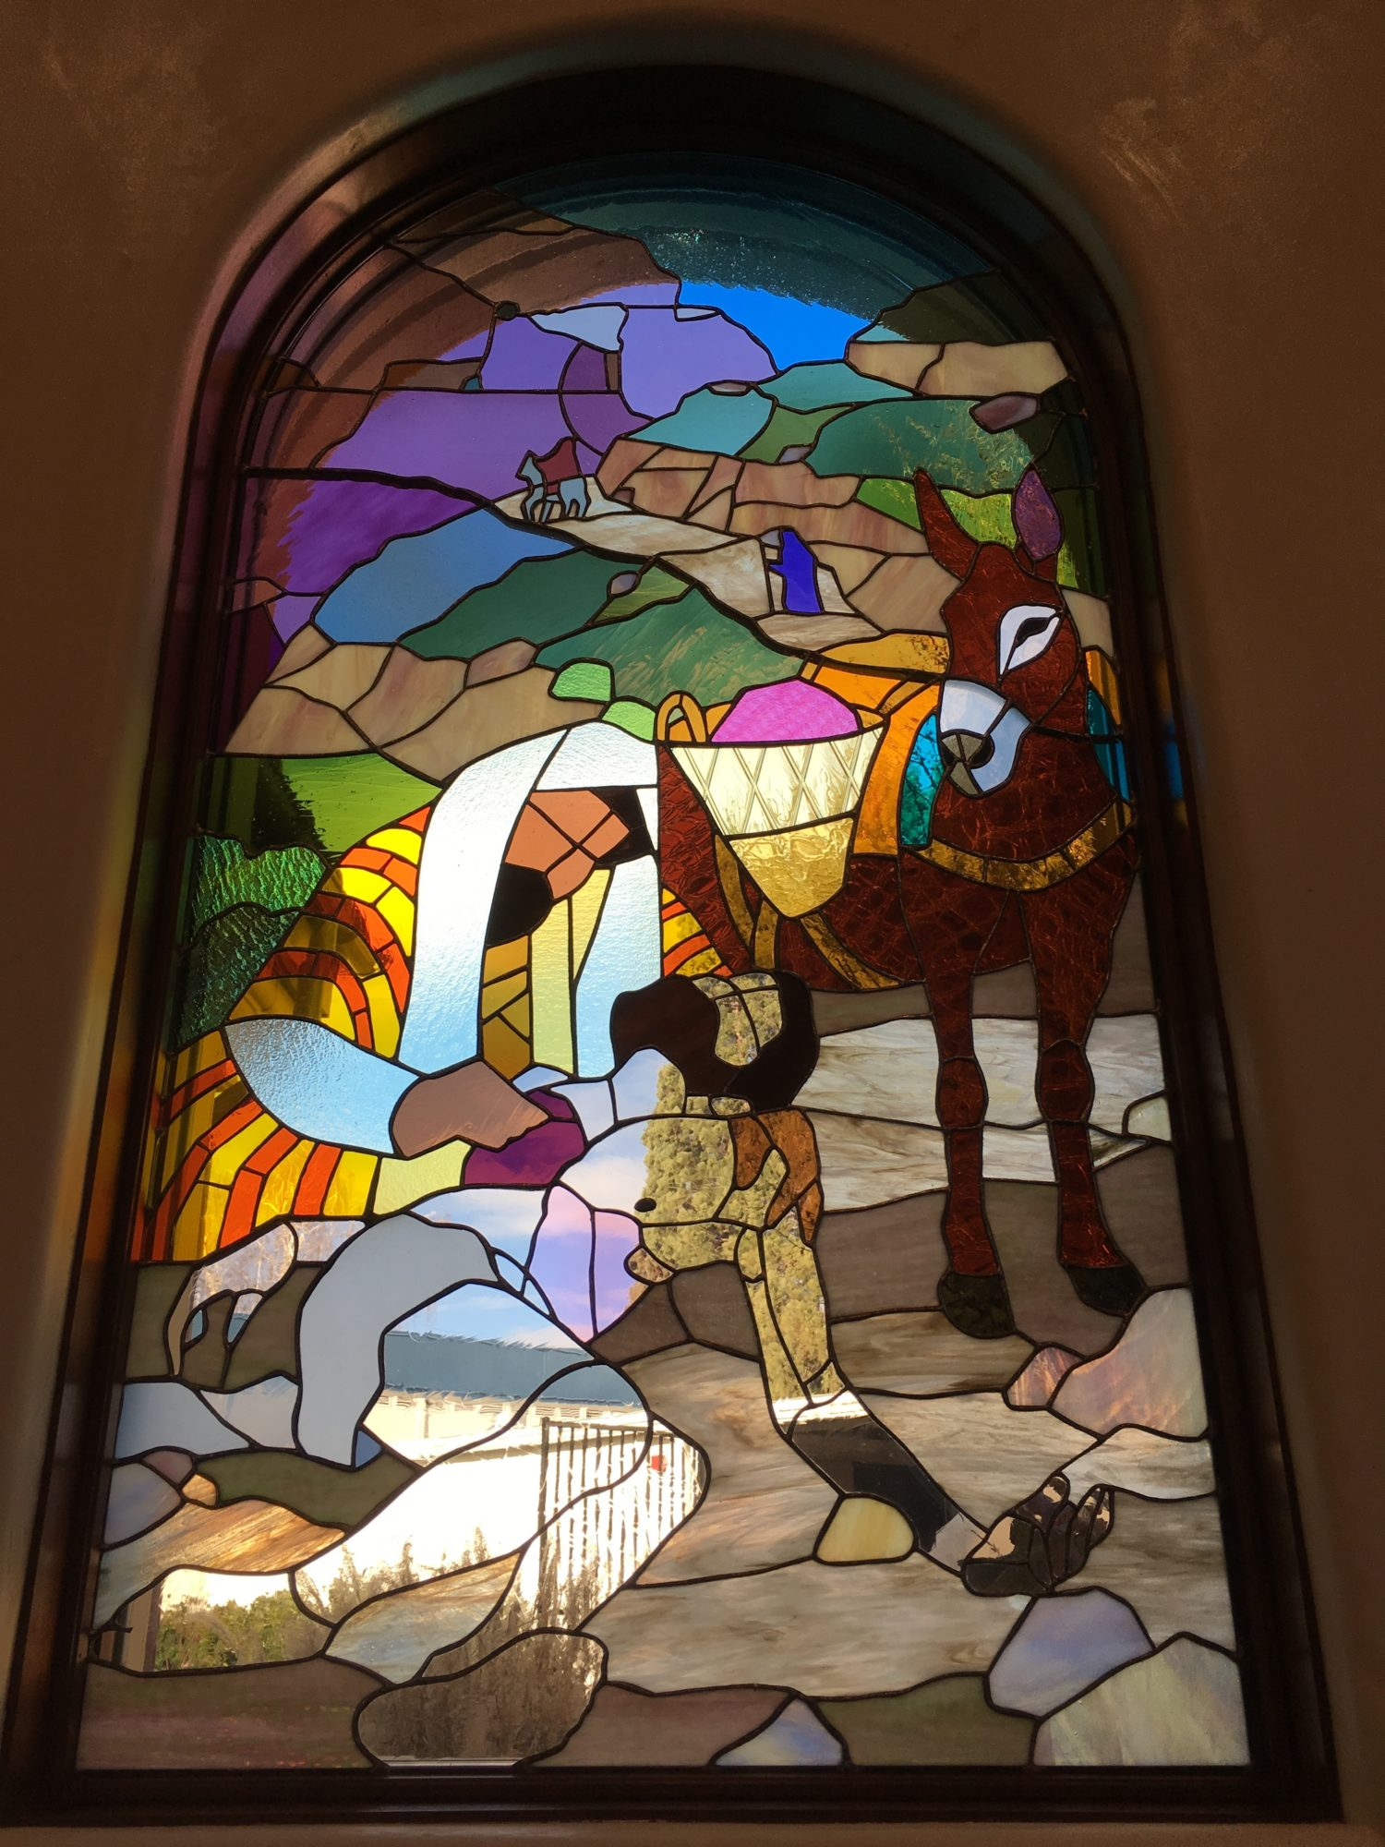
The parable of the good samaritan

Slide 11
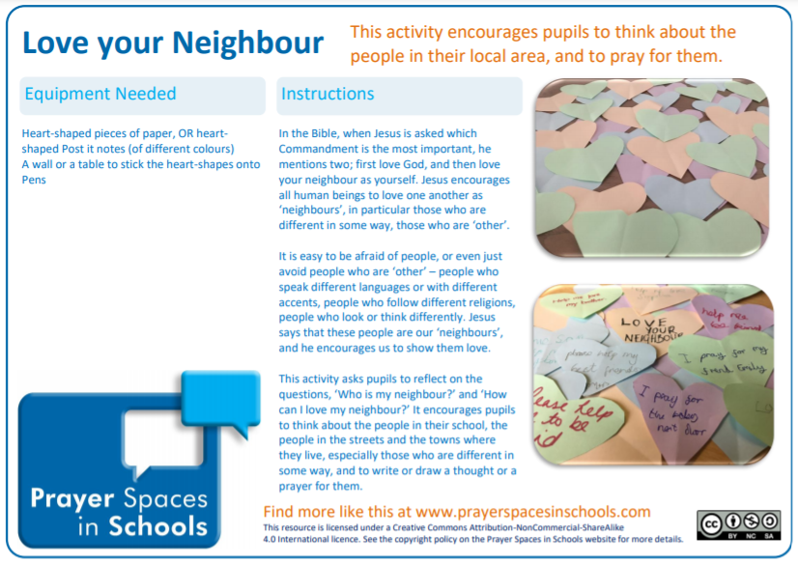
Classroom Worship
Reflection Space

Slide 12
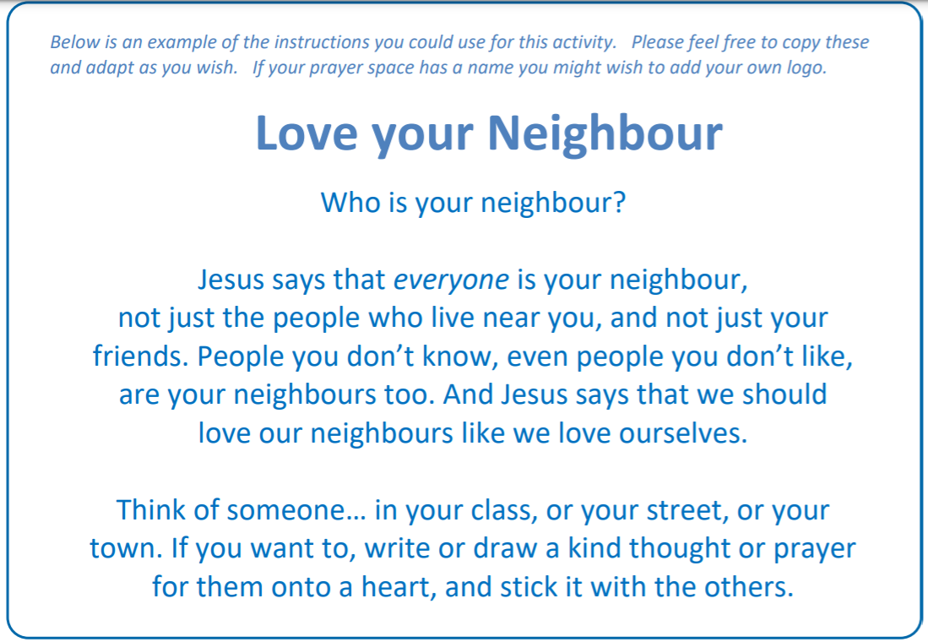

Slide 13

Monday

Slide 14
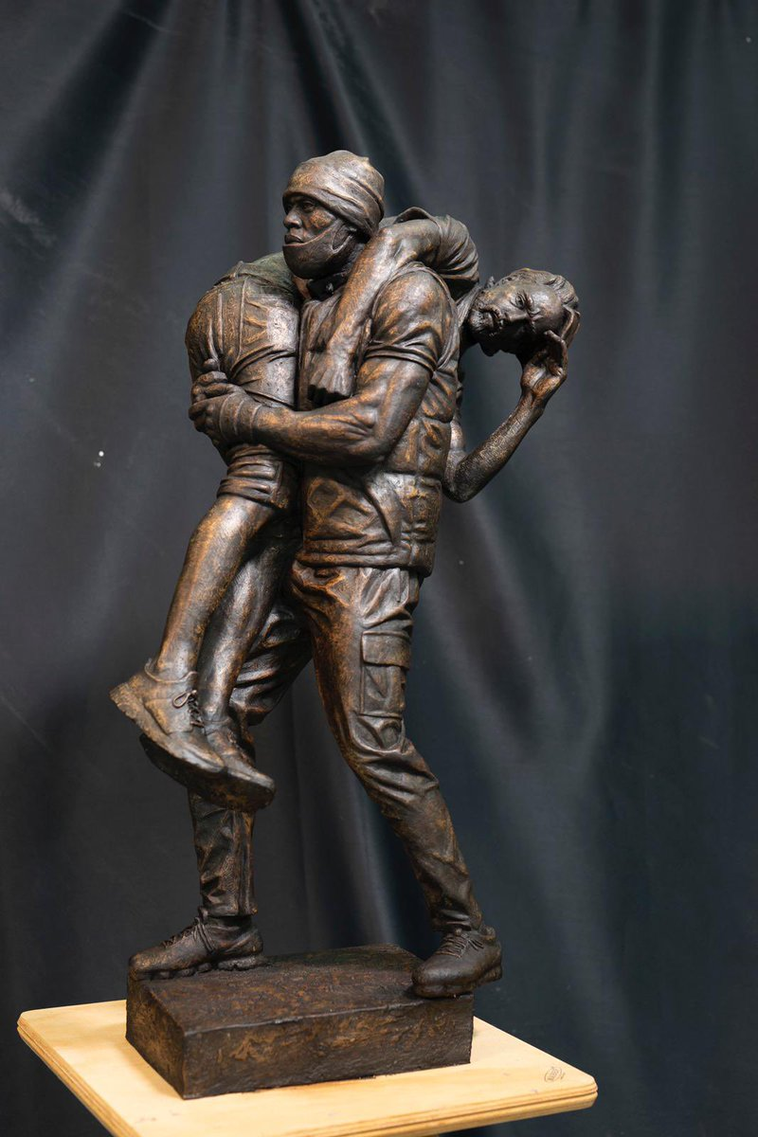


Slide 15

What do you see in the picture?
Can you make a prediction about what we are going to talk about today?
What questions does this picture make you ask?
Think of two or three questions.

Slide 16
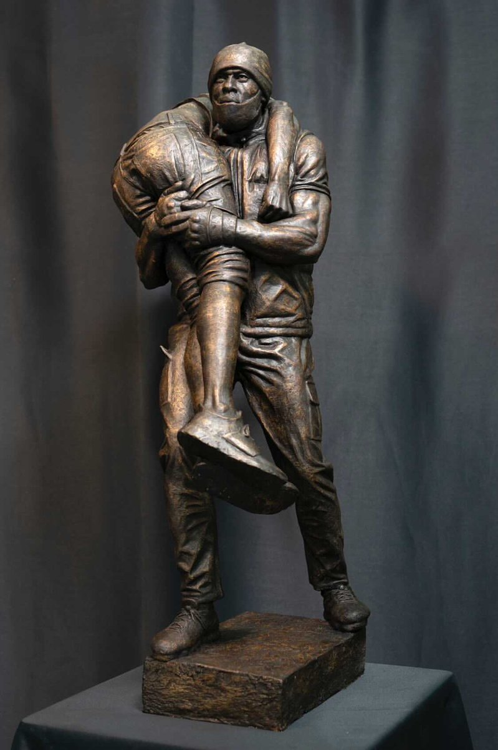
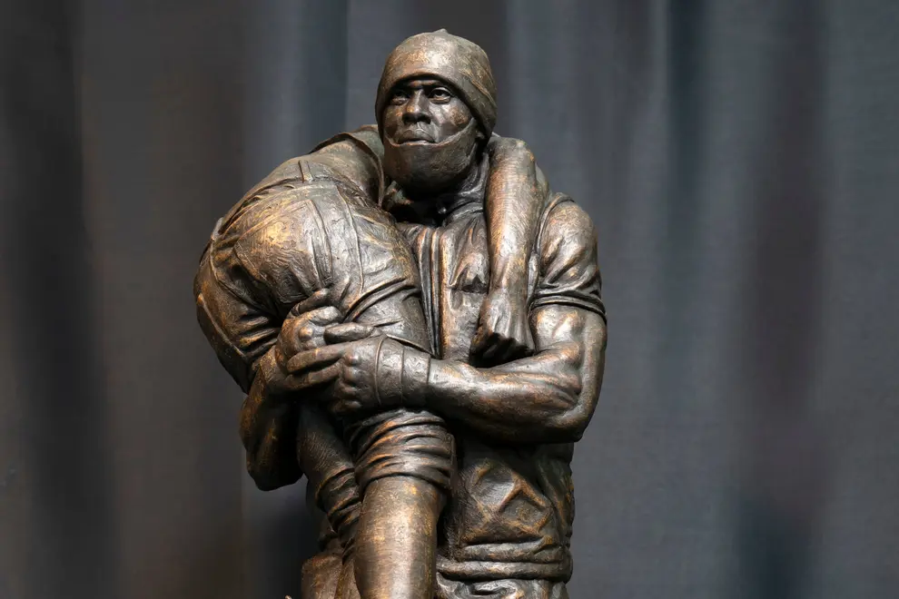
Reflection questions
Do you recognise this moment in recent history, that has been cast as a bronze sculpture?
Do you know who the man is and why he was carrying another man on his shoulder?

Slide 17

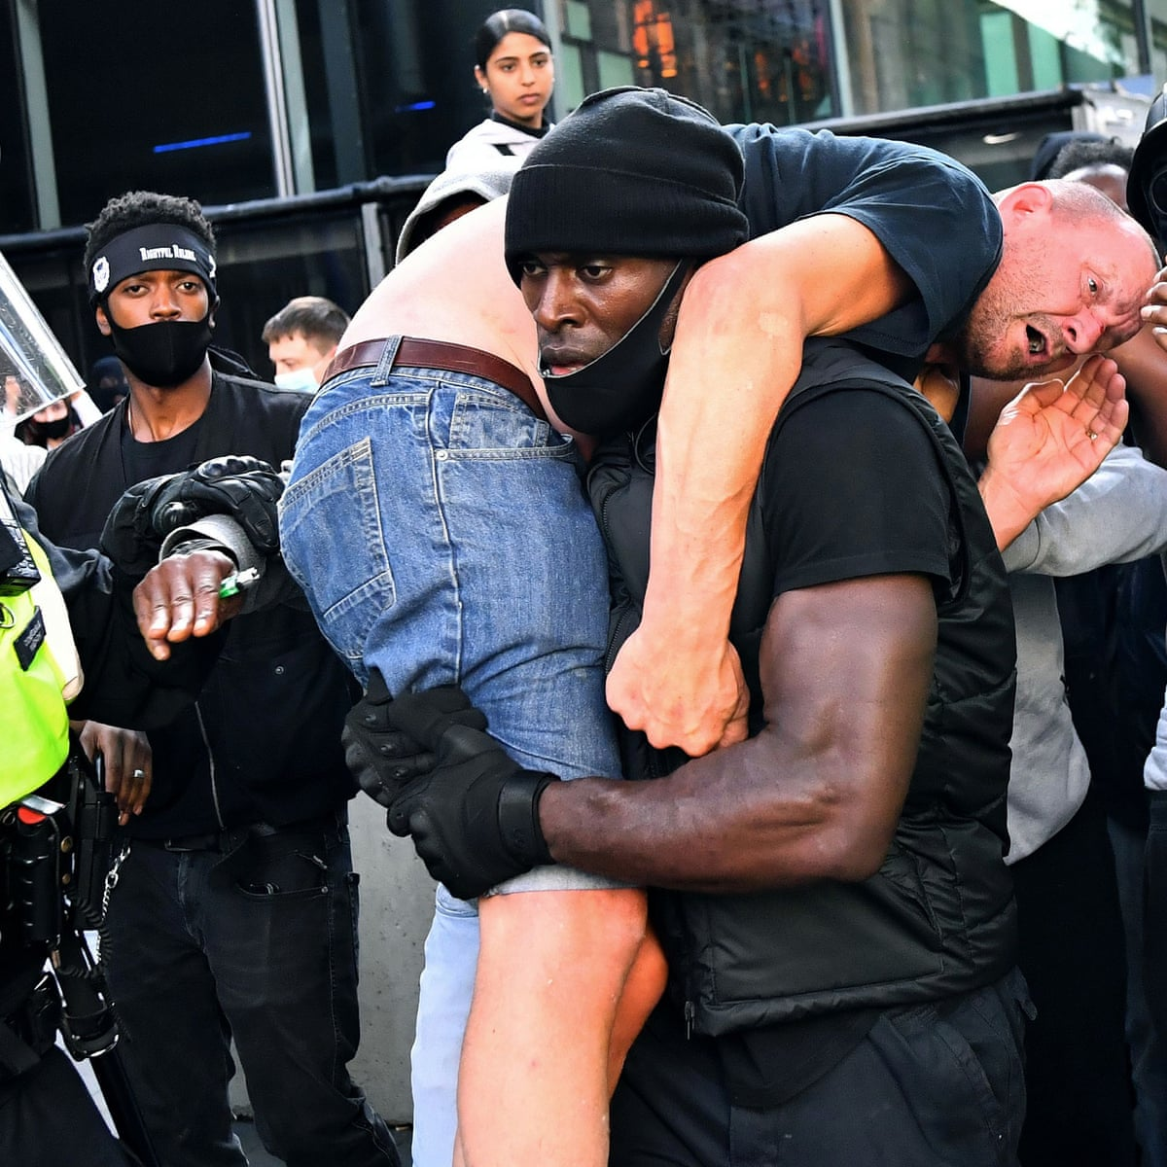
Reflection questions
Why do you think Patrick chose to help this man, even though they were not in agreement over the protests?
During the Black Lives Matter protests in London, in the summer of 2020, Patrick Hutchinson helped a man who had been badly hurt during the protests.
The man that he helped was not a supporter of the Black Lives Matter campaign but Patrick chose to help him anyway.

Slide 18
Bible passage: The parable of the good Samaritan
Luke 10:25-37
Read or Watch: https://www.youtube.com/watch?v=osfQg4yKtq8
The Good Samaritan
²⁵ Then a teacher of the law stood up. He was trying to test Jesus. He said, “Teacher, what must I do to get life forever?”
²⁶ Jesus said to him, “What is written in the law? What do you read there?”
²⁷ The man answered, “Love the Lord your God. Love him with all your heart, all your soul, all your strength, and all your mind.”^{[a]} Also, “You must love your neighbour as you love yourself.”^{[b]}
²⁸ Jesus said to him, “Your answer is right. Do this and you will have life forever.”
²⁹ But the man wanted to show that the way he was living was right. So he said to Jesus, “And who is my neighbour?”

Slide 19
Bible passage: The parable of the good samaritan
³⁰ To answer this question, Jesus said, “A man was going down the road from Jerusalem to Jericho. Some robbers attacked him. They tore off his clothes and beat him. Then they left him lying there, almost dead. ³¹ It happened that a Jewish priest was going down that road. When the priest saw the man, he walked by on the other side of the road. ³² Next, a Levite^{[c]} came there. He went over and looked at the man. Then he walked by on the other side of the road. ³³ Then a Samaritan^{[d]} traveling down the road came to where the hurt man was lying. He saw the man and felt very sorry for him. ³⁴ The Samaritan went to him and poured olive oil and wine^{[e]} on his wounds and bandaged them. He put the hurt man on his own donkey and took him to an inn. At the inn, the Samaritan took care of him. ³⁵ The next day, the Samaritan brought out two silver coins^{[f]} and gave them to the innkeeper. The Samaritan said, ‘Take care of this man. If you spend more money on him, I will pay it back to you when I come again.’”
³⁶ Then Jesus said, “Which one of these three men do you think was a neighbour to the man who was attacked by the robbers?”
³⁷ The teacher of the law answered, “The one who helped him.”
Jesus said to him, “Then go and do the same thing he did!”

Slide 20
Reflection questions
Who is my neighbour?
Talk to your partner and decide on your answer to the question…be ready to share your ideas!

Slide 21
Jesus wanted the man who asked ‘Who is my neighbour?’ to understand that everyone is our neighbour, not just those who live next door to us but those who live on the other side of the world too.
Anyone who needs our help is our neighbour.

Slide 22

Prayer
Encourage the pupils to respond with their own prayers first, using the class prayer space/area or with the prayer below:
Thank you God for the stories told by Jesus which show us how to live.
Help us to learn from these stories
And become more like Him.
Amen

Slide 23

Tuesday

Slide 24
Bible story recap: The parable of the Good Samaritan
³⁰ To answer this question, Jesus said, “A man was going down the road from Jerusalem to Jericho. Some robbers attacked him. They tore off his clothes and beat him. Then they left him lying there, almost dead. ³¹ It happened that a Jewish priest was going down that road. When the priest saw the man, he walked by on the other side of the road. ³² Next, a Levite^{[c]} came there. He went over and looked at the man. Then he walked by on the other side of the road. ³³ Then a Samaritan^{[d]} traveling down the road came to where the hurt man was lying. He saw the man and felt very sorry for him. ³⁴ The Samaritan went to him and poured olive oil and wine^{[e]} on his wounds and bandaged them. He put the hurt man on his own donkey and took him to an inn. At the inn, the Samaritan took care of him. ³⁵ The next day, the Samaritan brought out two silver coins^{[f]} and gave them to the innkeeper. The Samaritan said, ‘Take care of this man. If you spend more money on him, I will pay it back to you when I come again.’”
³⁶ Then Jesus said, “Which one of these three men do you think was a neighbour to the man who was attacked by the robbers?”
³⁷ The teacher of the law answered, “The one who helped him.”
Jesus said to him, “Then go and do the same thing he did!”

Slide 25

Responding
Talk to your partner and decide on your answer to the question…be ready to share your ideas!
What is compassion?

Slide 26
COMPASSION
Could you show compassion to someone who didn’t like you, or someone who disagreed with you?
Compassion- is all about putting yourself in someone else’s shoes, especially when they are having a hard time. It’s about trying to understand how they are feeling and then being pro-active in wanting to help.
Colossians 3 v12 ‘Clothe yourselves with compassion, kindness, humility, gentleness and patience.
The difference between pity and compassion: pity just feels sorry, compassion does something about it.

Slide 27
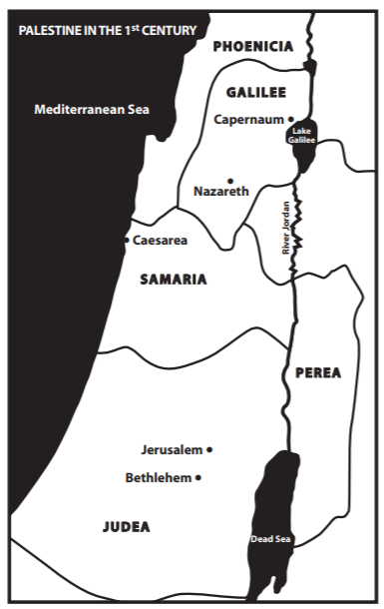
What did Jesus want us to understand about who we should show compassion to?
It’s interesting to know that the Jews and the Samaritans were enemies and did not like each other, at the time that Jesus told this story.
Most Jews would not travel through Samaria. They went by a longer route to avoid Samaria and any contact with Samaritans.
So Jesus chose a very interesting character to be the hero of this story.

Slide 28
Do you agree that Patrick Hutchinson was like the Good Samaritan? Why?

Slide 29
Prayer
Encourage the pupils to respond with their own prayers in the class prayer space/area. You could use the school’s prayer or the Lord’s Prayer:
Our Father, in heaven,
Holy is your name.
Your Kingdom come,
Your will be done on earth, as it is in heaven.
Give us this day our daily bread,
And forgive us our sins,
As we forgive those who sin against us,
And lead us not into temptation,
But deliver us from evil.
Amen.

Slide 30

Wednesday

Slide 31
Prompted to action - challenge
Can you remember our theme for worship this week?
The Parable of the Good Samaritan

Slide 32
Prompted to action challenge ideas: Close to Home
How could you be a Good Samaritan in your school?
Talk to your partner and decide on your answer to the question…be ready to share your ideas!

Slide 33
Prompted to action challenge ideas: being a courageous advocate
Could you be a courageous advocate?
Talk to your partner and decide on your answer to the question…be ready to share your ideas!
Remember what we said about compassion- it’s all about putting yourself in someone else’s shoes, especially when they are having a hard time. It’s about trying to understand how they are feeling and then being pro-active in wanting to help.
The difference between pity and compassion: pity just feels sorry, compassion does something about it.
Sometimes we have to be brave and courageous when we want to stand up for someone who is suffering…
Are there things in the world that you believe are wrong or not fair? Could you stand up and do something about it, as a class or school?

Slide 34
Prompted to action
Did you notice the two people at the back of the stained glass window?
These two people may have felt sorry for the man but they didn’t show compassion and they were not courageous enough to stop and do something about the problem!

Slide 35
Prayer
Encourage the pupils to respond with their own prayers in the class prayer space/area. You could use the school’s prayer or the Lord’s Prayer:
Lord, help us to be courageous advocates for the common good, in our school, in our community and wherever we go.
Help us to recognise and respond to the ups and downs of life
and to show compassion to those who are struggling.
Amen

Slide 36

Thursday

Slide 37
Use the Meditation resource alongside the Spiritual Encounters – bible-based meditation teacher’s pack: http://www.ldbe.co.uk/about/guidance- resources/worship-and-meditation/
³⁴ “Then the King will say to the good people on his right, ‘Come. My Father has given you his blessing. Come and receive the kingdom God has prepared for you since the world was made. ³⁵ I was hungry, and you gave me food. I was thirsty, and you gave me something to drink. I was alone and away from home, and you invited me into your house. ³⁶ I was without clothes, and you gave me something to wear. I was sick, and you cared for me. I was in prison, and you visited me.’
³⁷ “Then the good people will answer, ‘Lord, when did we see you hungry and give you food? When did we see you thirsty and give you something to drink? ³⁸ When did we see you alone and away from home and invite you into our house? When did we see you without clothes and give you something to wear? ³⁹ When did we see you sick or in prison and care for you?’
⁴⁰ “Then the King will answer, ‘I tell you the truth. Anything you did for any of my people here, you also did for me.’ Matthew 25:34-40

Slide 38

Friday

Slide 39
Take this time to celebrate what has happened during the week – you may want to give out awards. If possible, join the bubbles using Zoom or Teams so that the whole school can come together in a time of celebration.
Remember that this should also be a time of worship and celebration so begin with a gathering, include a prayer, a blessing, and a song of celebration.

