Slide 1

Class Worship and Reflections
Parable of the Two Builders

Slide 2

Church of England Colours for Worship

Slide 3
Church of England
COLLective worship
ABSTRACT
Collective worship in a classroom has a different feel from worship in the hall. The more intimate nature of the worship can make everyone feel more readily included.
It is also the perfect setting to look at some of life’s big issues in a prayerful and reflective manner.
This resource supports small group worship through the theme of Parables

Slide 4
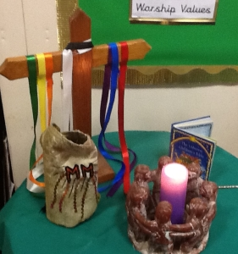
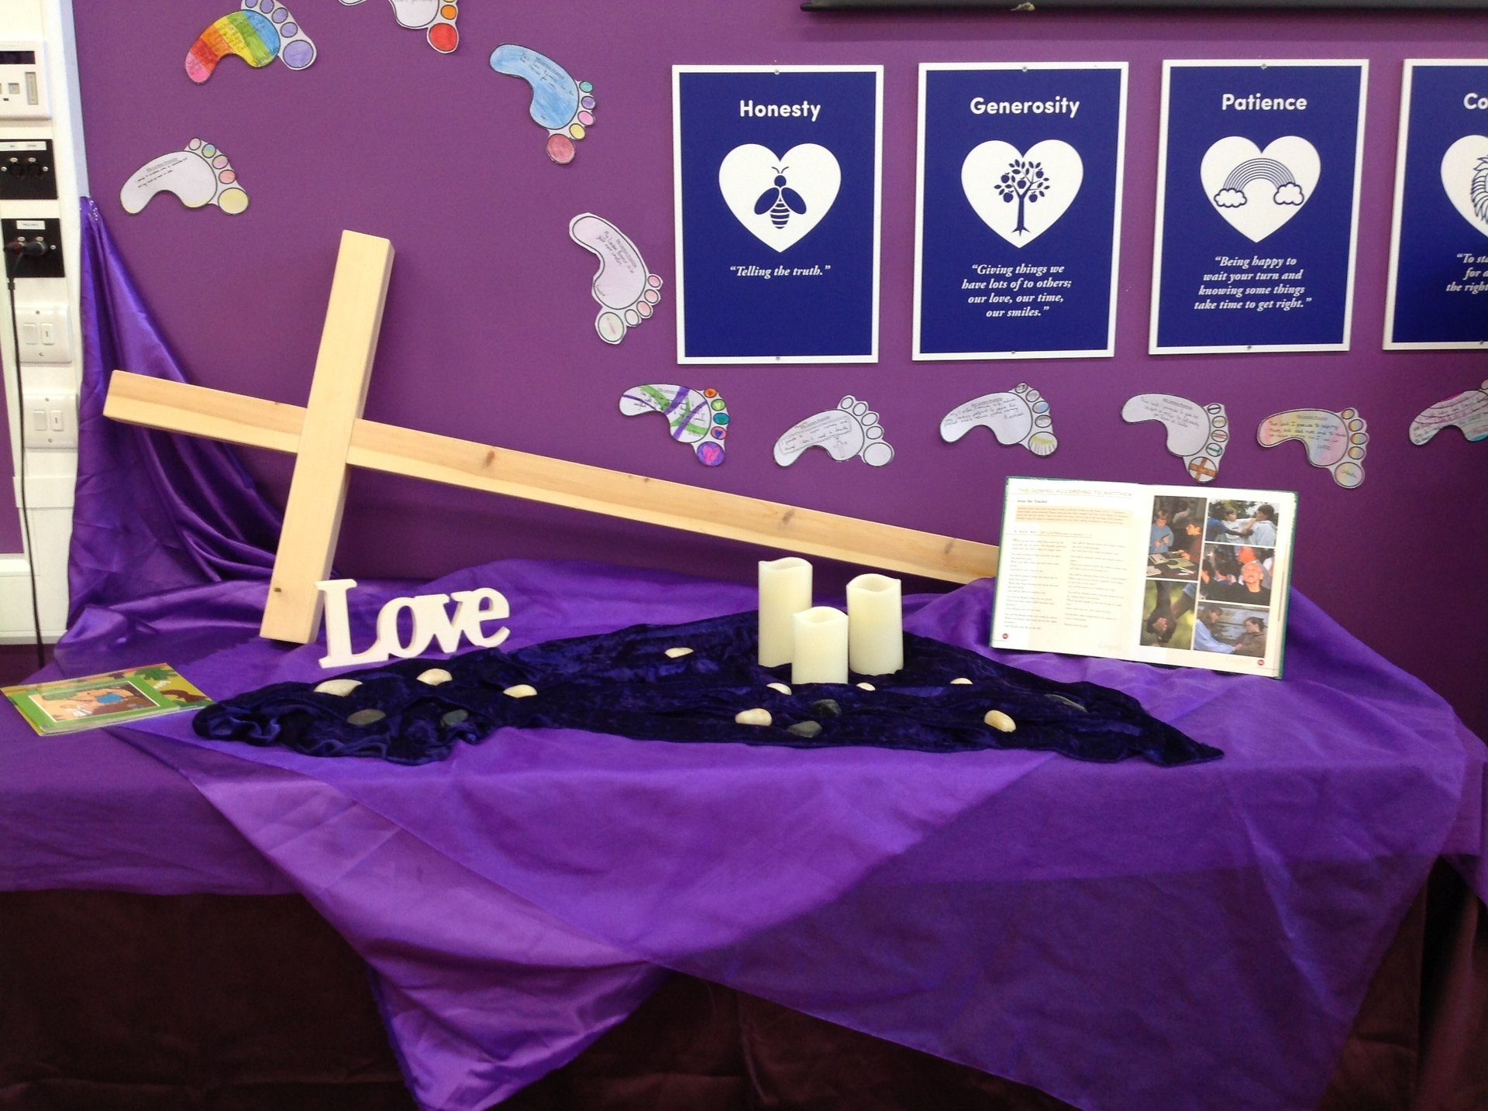
Classroom Worship
Introduction for Teachers
Ideas for the Worship Table
Special covering – possibly using liturgical colours
Candle or candles
Cross
Prayer box
Pebbles (prayer)
Flowers

Slide 5

Classroom Worship
Possible music
My Lighthouse
https://www.youtube.com/watch?v=JeJvKkBV6rY
Every Move I Make
https://www.youtube.com/watch?v=MPvnZILn6EY
Jesus You’re My Superhero
https://www.youtube.com/watch?v=zSI_vkdd978

Slide 6

Gathering these can be used at the beginning of each session
Once everyone is set up ready for worship you may want to start by lighting a candle, followed by one of these:
Leader: Peace be with you.
Pupils: And also with you.
Leader: Welcome everyone
Pupils: It is good to be here together
Play a ‘Welcome’ song as children settle.
We meet in the name of God:
  God the Father,
  God the Son,
  God the Spirit:
  God is one.
Sign: ‘Welcome everybody here’ in BSL

Slide 7
Gathering these can be used at the beginning of each session
Christ the light of the world is here
God help us to speak positive words
To share peace with everyone
To remember that you are with us
Let us celebrate what God has made
Let’s remember to show God’s love,
and to show a bit of heaven to everyone we meet.

Slide 8

Sending these can be used at the End of each session
You may want to end your time together with one of these short prayers or blessings:
As we end this time
May we live with your love
Build on your truth
Share your forgiveness
Rest in your peace
For the whole of the day. AMEN
Thank you for this day,
For fun, friendship and learning.
We give thanks for this time
As we share peace with each other. AMEN
Help us as we as we move on
To carry hope in us for the day
Turning our thoughts towards others,
Our hearts towards love,
And our hands towards serving those in need. AMEN

Slide 9
Sending these can be used at the End of each session
The Lord bless us and watch over us, he is kind and helps us to show peace. Amen
Let’s remember today to show peace and love
To forgive when others upset us
To remember that we are all equal to God
To think about what we say before we say it
To thank God for a new day
Thank you God for all your good gifts
Christ our Lord,
Just as kings bowed down and offered you gifts,
May we know your strength and peace
And see all the free gifts you have given to us
and the blessing of the Father, Son and Holy Spirit,
be with you all, evermore
Amen

Slide 10
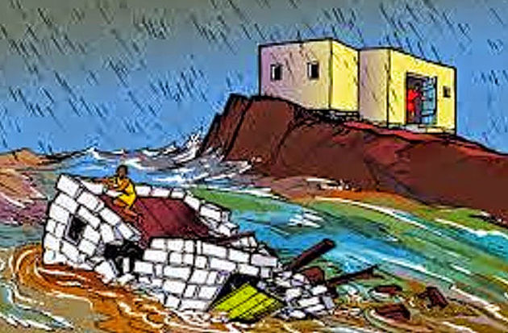
The parable of the builders

Slide 11
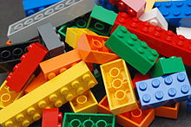
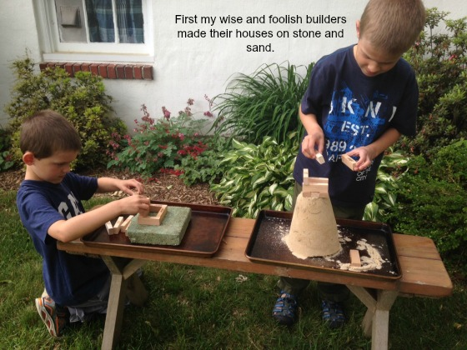
Classroom Worship
Reflection Space
Build houses out of some different things. E.g. Lego, old boxes, playdough, tins, sand
  Which was house was the strongest?
  Can you explain why?
Now try building your house on rock and then on sand. What do you notice?
.
I wonder what would happen if you poured water on it?

Slide 12

Monday

Slide 13
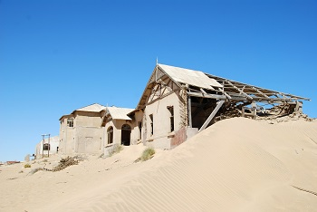
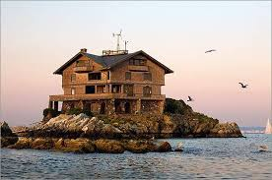


Slide 14

What do you see in the pictures?
Can you make a prediction about what we are going to talk about today?
What questions do these pictures make you ask?
Think of two or three questions.

Slide 15

Reflection questions
I wonder which house you would choose? Why?
I wonder what might happen if there was a really bad storm?

Slide 16

Bible passage: The parable of the two builders
²⁴ “Everyone who hears these things I say and obeys them is like a wise man. The wise man built his house on rock. ²⁵ It rained hard and the water rose. The winds blew and hit that house. But the house did not fall, because the house was built on rock. ²⁶ But the person who hears the things I teach and does not obey them is like a foolish man. The foolish man built his house on sand. ²⁷ It rained hard, the water rose, and the winds blew and hit that house. And the house fell with a big crash.”
Matthew 7 24:27
Read or Watch https://www.youtube.com/watch?v=CXWHLB1f6_U

Slide 17
Reflection questions
I wonder why Jesus told this story…
Have a think about the lesson He was trying to teach.

Slide 18
Prayer
Encourage the pupils to respond with their own prayers first, using the class prayer space/area or with the prayer below:
Thank you God for the stories told by Jesus which show us how to live.
Help us to learn from these stories
And become more like Him.
Amen

Slide 19

Tuesday

Slide 20
Bible passage: The parable of the two builders
²⁴ “Everyone who hears these things I say and obeys them is like a wise man. The wise man built his house on rock. ²⁵ It rained hard and the water rose. The winds blew and hit that house. But the house did not fall, because the house was built on rock. ²⁶ But the person who hears the things I teach and does not obey them is like a foolish man. The foolish man built his house on sand. ²⁷ It rained hard, the water rose, and the winds blew and hit that house. And the house fell with a big crash.”
Matthew 7 24:27
Read or Watch https://www.youtube.com/watch?v=CXWHLB1f6_U

Slide 21
Responding
PAIRED TALK:
Why do you think Jesus told this story?
Notes:
Allow children time to think about this. Was he giving advice about being a good builder or was it something else? Jesus is clear that His words give the foundations for good living.

Slide 22




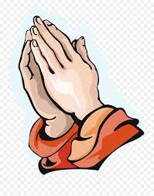









Living a Good Life.
These are some of the things people might use to help them decide how to live.
Which of these would help anyone?
Which of these would help Christians?
Are there any things that are not helpful?

Slide 23

Can you think of any other things which Jesus said help you lead a good life?

Slide 24
Prayer
Encourage the pupils to respond with their own prayers in the prayer space or use the prayer below:
Dear God,
We thank you for your love and promise to be with us
At school or work, at rest or play, help us to feel near you and hear your voice.
Guide us to always do our best in every situation and to love one another.
Amen

Slide 25

Wednesday

Slide 26
Prompted to action - challenge
Remind children of the theme for the week and of the Bible story
The Parable of the Two Builders

Slide 27
Prompted to action – challenge ideas
Christians try to live their lives by following the teachings of Jesus.
Forgiving
Loving
Giving – time and money
Praying
Notes:
Discuss the teachings of Jesus: Love God, love one another (even enemies), live in peace, forgive one another, be content with what you have and share with one another.

Slide 28
Prompted to action – challenge ideas
Think of one thing you could do in your life to follow these teachings?
How would this make your class/home a better place to be?
Notes:
Use a promise jar; add sticky notes to foundations for life wall; create a class pledge etc

Slide 29
Prayer
Encourage the pupils to respond with their own prayers in the class prayer space/area. You could use the school’s prayer or the Lord’s Prayer:
Our Father, in heaven,
Holy is your name.
Your Kingdom come,
Your will be done on earth, as it is in heaven.
Give us this day our daily bread,
And forgive us our sins,
As we forgive those who sin against us,
And lead us not into temptation,
But deliver us from evil.
Amen.

Slide 30

Thursday

Slide 31
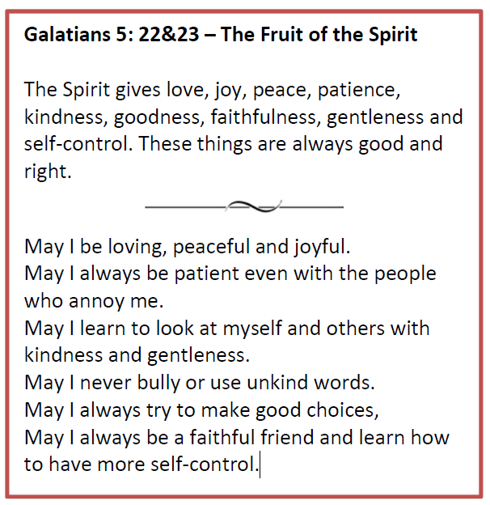
Use the Meditation resource alongside the Spiritual Encounters – bible-based meditation teacher’s pack: http://www.ldbe.co.uk/about/guidance- resources/worship-and-meditation/

Slide 32

Friday

Slide 33
Take this time to celebrate what has happened during the week – you may want to give out awards. If possible, join the bubbles using Zoom or Teams so that the whole school can come together in a time of celebration.
Remember that this should also be a time of worship and celebration so begin with a gathering, include a prayer, a blessing, and a song of celebration.

