Slide 1

Class Worship and Reflections
Parable of the Lost Sheep and Lost Coin

Slide 2

Church of England Colours for Worship

Slide 3
Church of England
COLLective worship
ABSTRACT
Collective worship in a classroom has a different feel from worship in the hall. The more intimate nature of the worship can make everyone feel more readily included.
It is also the perfect setting to look at some of life’s big issues in a prayerful and reflective manner.
This resource supports small group worship through the theme of Parables

Slide 4
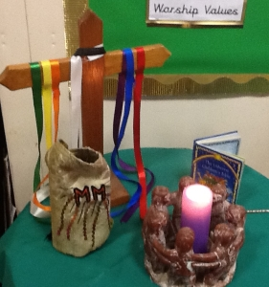
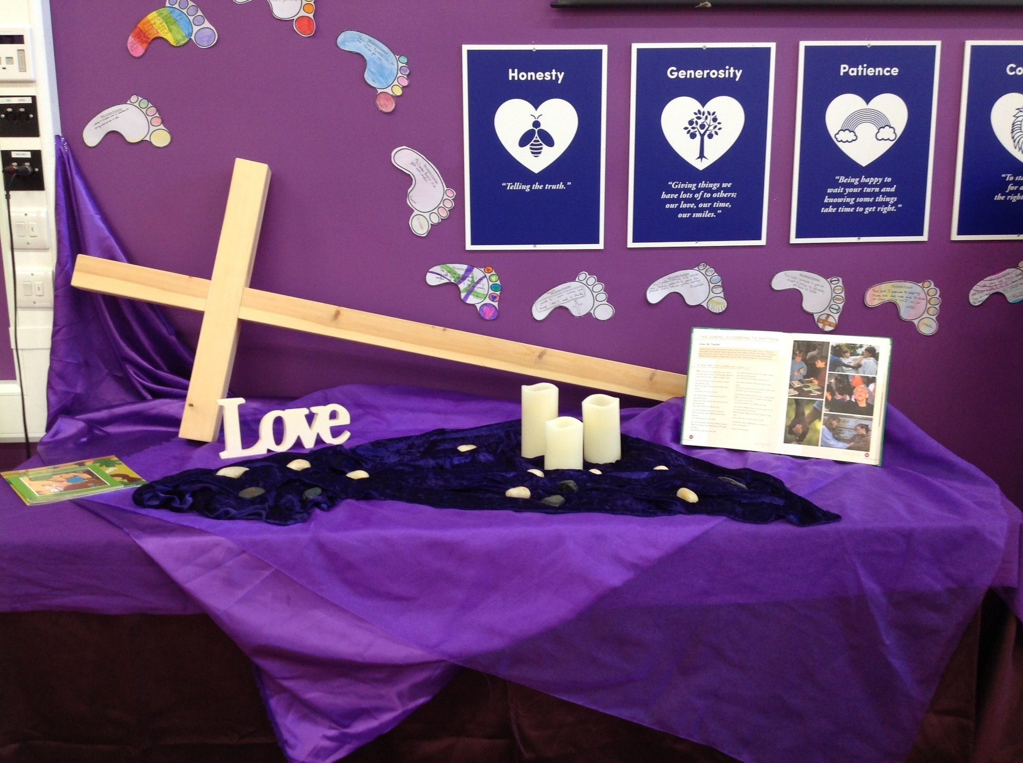
Classroom Worship
Introduction for Teachers
Ideas for the Worship Table
Special covering – possibly using liturgical colours
Candle or candles
Cross
Prayer box
Pebbles (prayer)
Flowers

Slide 5

Classroom Worship
Possible music
I came to praise
https://www.youtube.com/watch?v=7QPe-4kViU0
One Way
https://www.youtube.com/watch?v=Ktpi2ExrhDU
My Lighthouse
https://www.youtube.com/watch?v=JeJvKkBV6rY
Every Move I Make
https://www.youtube.com/watch?v=MPvnZILn6EY
Jesus You’re My Superhero
https://www.youtube.com/watch?v=zSI_vkdd978

Slide 6

Gathering these can be used at the beginning of each session
Once everyone is set up ready for worship you may want to start by lighting a candle, followed by one of these:
Leader: Peace be with you.
Pupils: And also with you.
Leader: Welcome everyone
Pupils: It is good to be here together
Play a ‘Welcome’ song as children settle.
We meet in the name of God:
  God the Father,
  God the Son,
  God the Spirit:
  God is one.
Sign: ‘Welcome everybody here’ in BSL

Slide 7
Gathering these can be used at the beginning of each session
Christ the light of the world is here
God help us to speak positive words
To share peace with everyone
To remember that you are with us
Let us celebrate what God has made
Let’s remember to show God’s love,
and to show a bit of heaven to everyone we meet.

Slide 8

Sending these can be used at the End of each session
You may want to end your time together with one of these short prayers or blessings:
As we end this time
May we live with your love
Build on your truth
Share your forgiveness
Rest in your peace
For the whole of the day. AMEN
Thank you for this day,
For fun, friendship and learning.
We give thanks for this time
As we share peace with each other. AMEN
Help us as we as we move on
To carry hope in us for the day
Turning our thoughts towards others,
Our hearts towards love,
And our hands towards serving those in need. AMEN

Slide 9
Sending these can be used at the End of each session
The Lord bless us and watch over us, he is kind and helps us to show peace. Amen
Let’s remember today to show peace and love
To forgive when others upset us
To remember that we are all equal to God
To think about what we say before we say it
To thank God for a new day
Thank you God for all your good gifts
Christ our Lord,
Just as kings bowed down and offered you gifts,
May we know your strength and peace
And see all the free gifts you have given to us
and the blessing of the Father, Son and Holy Spirit,
be with you all, evermore
Amen

Slide 10
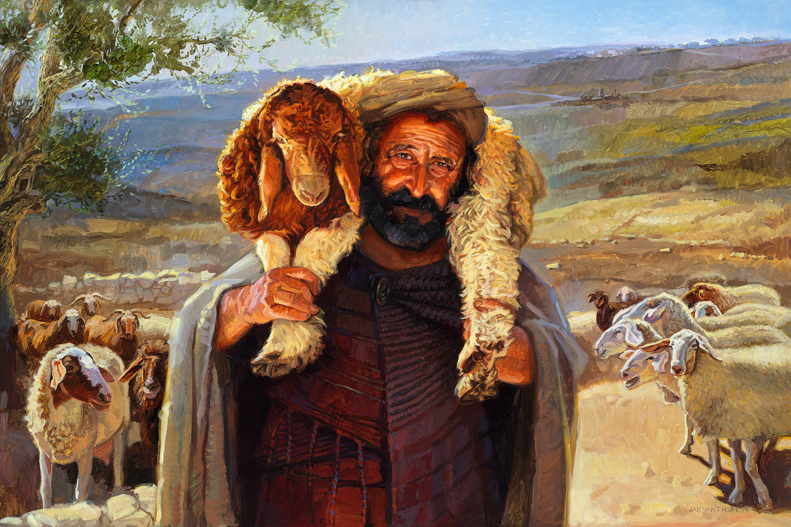
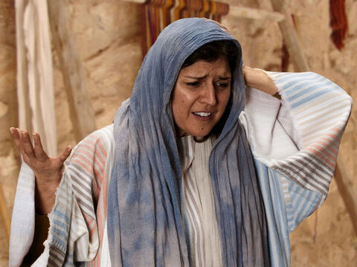
The parable of the LOST Sheep and lost coin

Slide 11
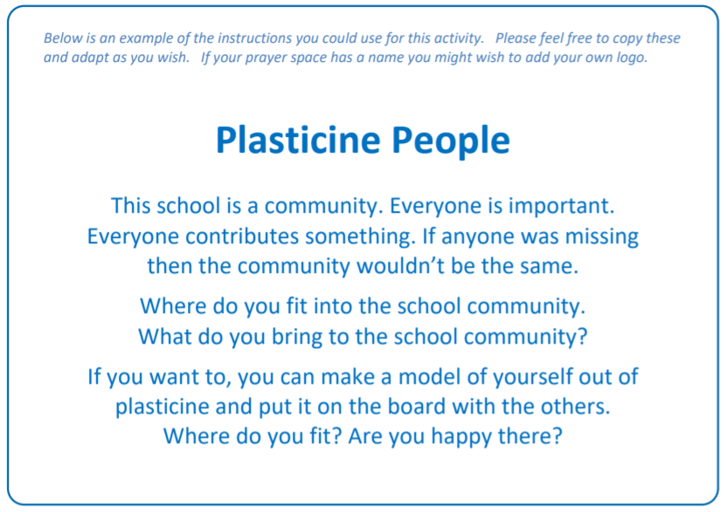
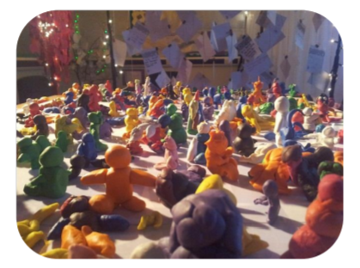
Classroom Worship
Reflection Space
.

Slide 12

Monday

Slide 13


Slide 14

What do you see in the picture?
Can you make a prediction about what we are going to talk about today?
What questions do these pictures make you ask?
Think of two or three questions.

Slide 15

Bible passage: The parable of the Lost sheep
Read or Watch https://www.youtube.com/watch?v=tyWZeOlaRo4
Many tax collectors and “sinners” came to listen to Jesus. ² The Pharisees and the teachers of the law began to complain: “Look! This man welcomes sinners and even eats with them!”
³ Then Jesus told them this story: ⁴ “Suppose one of you has 100 sheep, but he loses 1 of them. Then he will leave the other 99 sheep alone and go out and look for the lost sheep. The man will keep on searching for the lost sheep until he finds it. ⁵ And when he finds it, the man is very happy. He puts it on his shoulders ⁶ and goes home. He calls to his friends and neighbours and says, ‘Be happy with me because I found my lost sheep!’ ⁷ In the same way, I tell you there is much joy in heaven when 1 sinner changes his heart. There is more joy for that 1 sinner than there is for 99 good people who don’t need to change.
Luke 15:1-7

Slide 16

Reflection questions
I wonder who the shepherd could be?
Who do you think is the ‘lost sheep’?

Slide 17
Reflection questions
I wonder why Jesus told this story…
Have a think about what He was trying to say.
Notes:
Take ideas and responses from the children initially, giving them time to reflect on the meaning of the story. Jesus said: Sometimes people lose their way and do wrong things, but God never stops loving them. His story is saying God is calling them. He wants to rescue them and set them free.

Slide 18
Prayer
Encourage the pupils to respond with their own prayers first, using the class prayer space/area or with the prayer below:
Thank you God for loving each and every one of us
Thank you that you are always willing to forgive
Help us try hard to be the best we can be, loving ourselves and others.
Amen

Slide 19

Tuesday

Slide 20
Notes:
How does she feel? How do you know? What might have happened?

Slide 21
What do you see in the picture?
Can you make a prediction about what we are going to talk about today?
What questions do these pictures make you ask?
Think of two or three questions.
Notes:
Talk about how the woman is feeling. How do you know? What might have happened?

Slide 22
Bible passage: The parable of the LOST COIN
⁸ “Suppose a woman has ten silver coins, but she loses one of them. She will light a lamp and clean the house. She will look carefully for the coin until she finds it. ⁹ And when she finds it, she will call her friends and neighbours and say, ‘Be happy with me because I have found the coin that I lost!’ ¹⁰ In the same way, there is joy before the angels of God when 1 sinner changes his heart.”
Luke 15: 8 -11
Read or Watch https://www.youtube.com/watch?v=yvHxUxjaboE

Slide 23
Responding
I wonder if your ideas about the woman were right?
I wonder what this story is saying about Jesus?
Notes:
Allow children time to think about this.

Slide 24
Responding
I wonder what this story is saying about you?
I wonder what this story might mean for you today or in the next week?
Notes:
Allow children time to think about this.

Slide 25
Prayer
Encourage the pupils to respond with their own prayers in the prayer space or use the prayer below:
The light of God surrounds me,
the love of God enfolds me,
the power of God protects me,
the presence of God watches over me,
wherever I am, God is,
and where God is, all is perfect.
Amen

Slide 26

Wednesday

Slide 27
Prompted to action - challenge
Remind children of the theme for the week and of the Bible story
The Parable of the Lost Sheep and the Lost Coin

Slide 28
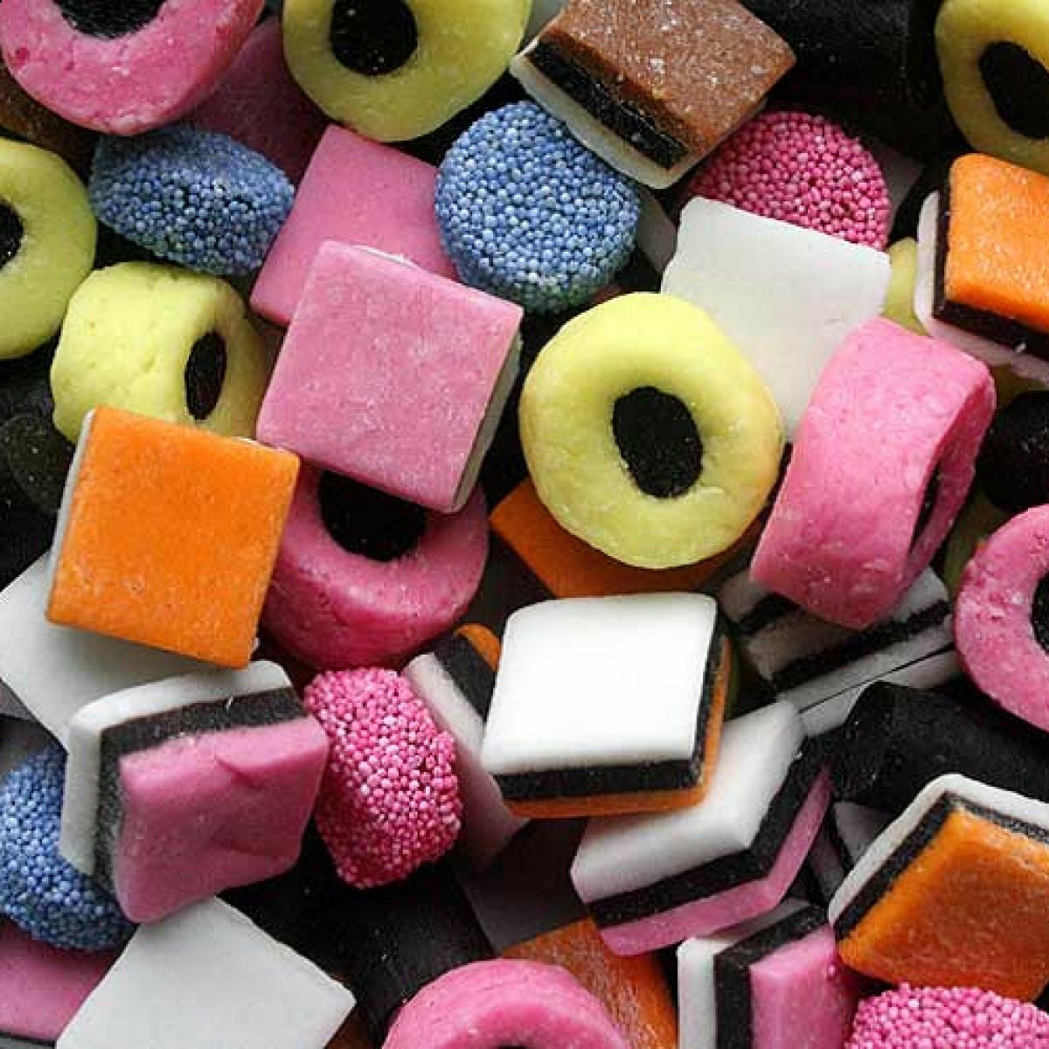
Prompted to action – challenge ideas
Hand round a plate/box of Liquorice Allsorts.
Liquorice Allsorts can divide people - some people just hate them while some love them.
Have a show of hands - for and against.
Notes:
The very name may also be a way of connecting with what this story is saying because 'all sorts' were now coming to Jesus, and a number of people didn't like it.

Slide 29
Prompted to action – challenge ideas
Think of one thing you could do in your life to include and love people?
How would this make your class/home a better place to be?
Find out something about someone in your class you don’t usually play with.

Slide 30
Prayer
Encourage the pupils to respond with their own prayers in the class prayer space/area. You could use the school’s prayer or the Lord’s Prayer:
Our Father, in heaven,
Holy is your name.
Your Kingdom come,
Your will be done on earth, as it is in heaven.
Give us this day our daily bread,
And forgive us our sins,
As we forgive those who sin against us,
And lead us not into temptation,
But deliver us from evil.
Amen.

Slide 31

Thursday

Slide 32
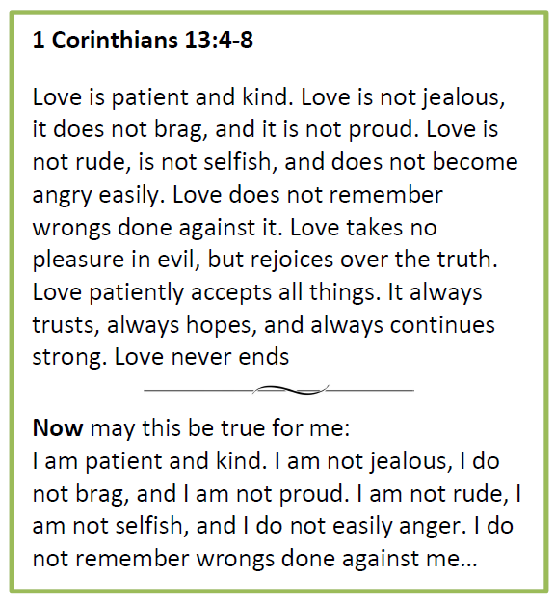
Use the Meditation resource alongside the Spiritual Encounters – bible-based meditation teacher’s pack: http://www.ldbe.co.uk/about/guidance- resources/worship-and-meditation/

Slide 33

Friday

Slide 34
Take this time to celebrate what has happened during the week – you may want to give out awards. If possible, join the bubbles using Zoom or Teams so that the whole school can come together in a time of celebration.
Remember that this should also be a time of worship and celebration so begin with a gathering, include a prayer, a blessing, and a song of celebration.

