Slide 1
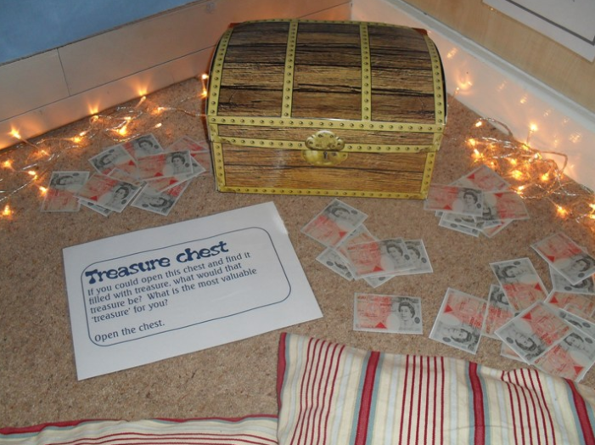


Class Worship and Reflections

Slide 2


Church of England Colours for Worship

Slide 3
Classroom Worship
ABSTRACT
Collective worship in a classroom has a different feel from worship in the hall. The more intimate nature of the worship can make everyone feel more readily included. It is also the perfect setting to look at some of life’s big issues in a prayerful and reflective manner. This resource supports small group worship through the theme of RESPECT:
Respect
Encourage
Serve
Patience
Enjoy and
Celebrate
Trust

Slide 4

Classroom Worship
Introduction for Teachers
Classroom worship can be organised at any time of day which best suits the needs of the group.
Collective worship in a classroom has a different feel from worship in the hall. The advantages of class worship are:
  • The more intimate nature of the worship can make everyone feel more readily included—there is nobody on the far edge or at the remote back
  • The worship can be planned to be more appropriate for the age and understanding of the children present than is possible in a large mixed age gathering
  • Children and adults may feel happier at leading worship in a more familiar setting with their peers rather than in front of the whole school
Preparing for class worship is very important. If the pupils have been busy just before you are due to start encourage them now to pause and sit quietly, stilling themselves ready to begin.
Create calm, quiet atmosphere – this can be done through music or changing the lighting in the room
A worship focus- in all places of worship there is what may be termed a worship focus, in your own hall this may be a cross or a candle. It is helpful to have a worship focus for your class worship. This does not have to be a permanent feature but something that can be brought out just for the worship. Consider what would be an appropriate worship focus for your classroom e.g. a cloth, candle, cross, bible, ornament, prayer bear. You may want to have a number of appropriate worship foci in a basket that the pupils can choose and set out ready for worship.
Structure - you may well find it helpful to have a set structure to your worship. This enables even of youngest children to feel comfortable and confident with what is happening. Here we have used the gather, engage, respond, and send framework.

Slide 5

Classroom Worship
Possible music
God’s Treasure: https://www.youtube.com/watch?v=MUugBKLCNe0
Treasure:
https://www.youtube.com/watch?v=2U42xWHMIHE
I Found a Treasure: https://www.youtube.com/watch?v=IbARUaX4frc

Slide 6

Gathering these can be used at the beginning of each session
Once everyone is set up ready for worship you may want to start by lighting a candle, followed by one of these:
Leader: Peace be with you.
Pupils: And also with you.
Leader: Welcome everyone
Pupils: It is good to be here together
Play a ‘Welcome’ song as children settle.
We meet in the name of God:
  God the Father,
  God the Son,
  God the Spirit:
  God is one.
Sign: ‘Welcome everybody here’ in BSL

Slide 7
Gathering these can be used at the beginning of each session
Christ the light of the world is here
God help us to speak positive words
To share peace with everyone
To remember that you are with us
Let us celebrate what God has made
Let’s remember to show God’s love,
and to show a bit of heaven to everyone we meet.

Slide 8

Sending these can be used at the End of each session
You may want to end your time together with one of these short prayers or blessings:
As we end this time
May we live with your love
Build on your truth
Share your forgiveness
Rest in your peace
For the whole of the day. AMEN
Thank you for this day,
For fun, friendship and learning.
We give thanks for this time
As we share peace with each other. AMEN
Help us as we as we move on
To carry hope in us for the day
Turning our thoughts towards others,
Our hearts towards love,
And our hands towards serving those in need. AMEN

Slide 9
Sending these can be used at the End of each session
The Lord bless us and watch over us, he is kind and helps us to show peace. Amen
Let’s remember today to show peace and love
To forgive when others upset us
To remember that we are all equal to God
To think about what we say before we say it
To thank God for a new day
Thank you God for all your good gifts
Christ our Lord,
Just as kings bowed down and offered you gifts,
May we know your strength and peace
And see all the free gifts you have given to us
and the blessing of the Father, Son and Holy Spirit,
be with you all, evermore
Amen

Slide 10
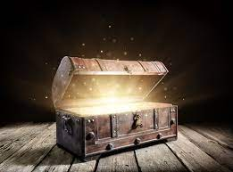
Hidden Treasure
Matthew 13:
44-46

Slide 11
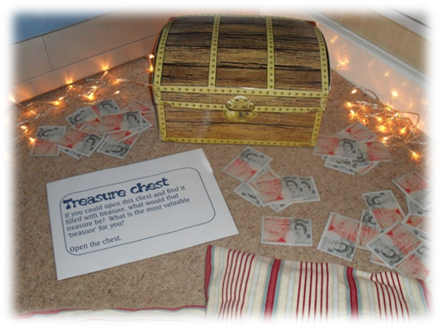
Classroom Worship
Reflection Space

Slide 12

Classroom Worship
Reflection Space
Equipment:
A box made to look like a treasure chest or picture of a treasure chest
Printed prayer cards
Printed reflection instructions
Focus:
The aim of this station is to help the pupils to think about the things that are really valuable and what is worth investing our time and effort into.

Slide 13
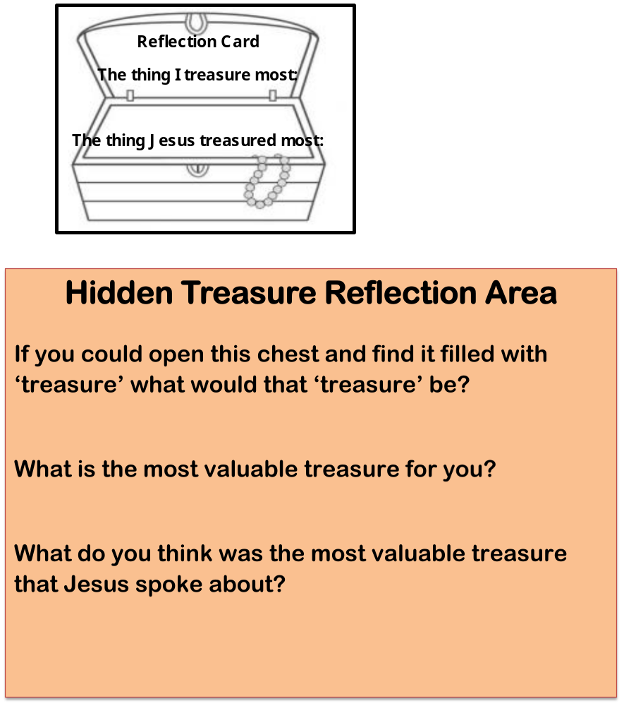
Classroom Worship
Reflection Space

Slide 14

Monday

Slide 15
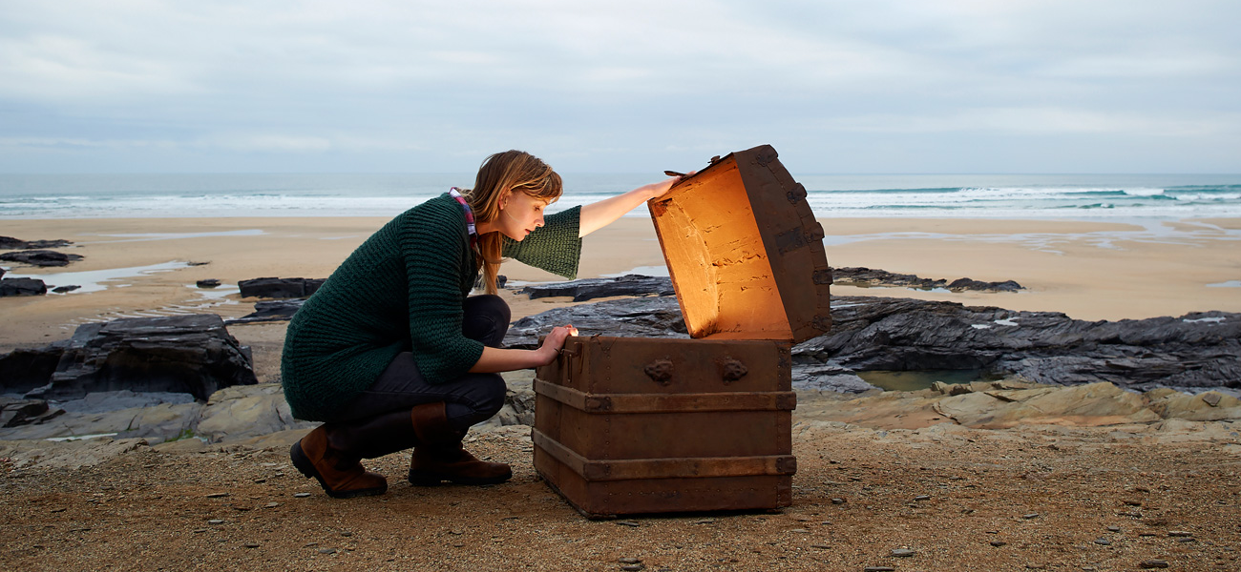


Slide 16
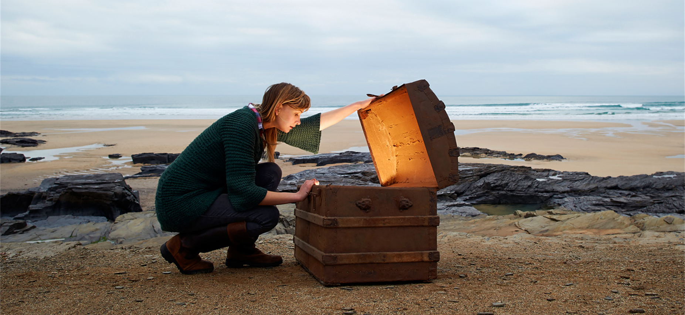


What do you see in the picture?
Can you make a prediction about what we are going to talk about today?
What questions do you have about this picture?
Come up with three questions.

Slide 17
Bible Passage Matthew 13:44-46
The parables of the hidden treasure and the pearl
44 ‘The kingdom of heaven is like treasure hidden in a field. When a man found it, he hid it again, and then in his joy went and sold all he had and bought that field.
45 ‘Again, the kingdom of heaven is like a merchant looking for fine pearls. 46 When he found one of great value, he went away and sold everything he had and bought it.

Slide 18

Responding
How do you feel about these parables?
What is the most valuable thing in your life?
How do you measure what is valuable?

Slide 19
Prayer
Encourage the pupils to respond with their own prayers first or through the pray space and if appropriate use the Lord’s prayer.
Our Father, in heaven,
Holy is your name.
Your Kingdom come,
Your will be done on earth, as it is in heaven.
Give us this day our daily bread,
And forgive us our sins,
As we forgive those who sin against us,
And lead us not into temptation,
But deliver us from evil.
Amen.
Y

Slide 20

Tuesday

Slide 21
prompt… (Matthew 13:44-46)
Read through the two parables and then watch the beginning part of this film looking at the finding of the Stafford Hoard (about 8 minutes).
https://www.youtube.com/watch?v=6ofCNSfF3vM
What would it be like to find something so valuable?
‘The kingdom of heaven is like treasure hidden in a field. When a man found it, he hid it again, and then in his joy went and sold all he had and bought that field.
‘Again, the kingdom of heaven is like a merchant looking for fine pearls. When he found one of great value, he went away and sold everything he had and bought it.

Slide 22

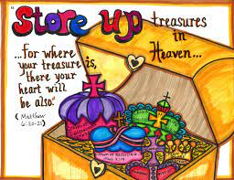

Reflection Challenge
Money is important and let’s be honest it would be very exciting to find real hidden treasure BUT do you really think that the treasure Jesus was talking about was the gold and silver kind?
What do you think the treasure is that Jesus was thinking about?
This saying of Jesus may help you think about that:
“Do not store up for yourselves treasures on earth, where moths and vermin destroy, and where thieves break in and steal. But store up for yourselves treasures in heaven, where moths and vermin do not destroy, and where thieves do not break in and steal. For where your treasure is, there your heart will be also.”

Slide 23

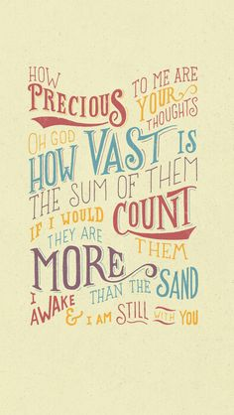
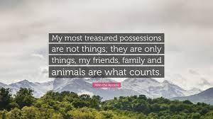
Reflection Challenge – which of these means most to you?

Slide 24
Prayer
Encourage the pupils to respond with their own prayers first or through the pray space and if appropriate use the Lord’s prayer.
Our Father, in heaven,
Holy is your name.
Your Kingdom come,
Your will be done on earth, as it is in heaven.
Give us this day our daily bread,
And forgive us our sins,
As we forgive those who sin against us,
And lead us not into temptation,
But deliver us from evil.
Amen.
Y

Slide 25

Wednesday

Slide 26
Prompted to action - challenge
Remind people of the theme for the week and of the bible verse
Then watch this video:
https://www.youtube.com/watch?v=zzqK9AZw8Wg

Slide 27
Prompted to action – challenge ideas
Our world is a priceless treasure that was given to us as a gift from God.
Think about what you could do to look after something so precious.
Think about those people you value most. Think about a way that you can show them how important they are to you.
Turn one of your ideas into a reality
Education is an extremely valuable gift. However there are many children around the world who are not educated. How can you help?

Slide 28

Links with British Values
Respect
We respect others
We know that we are all special
We understand the consequences of our actions
We treat everybody equally
This Photo by Unknown Author is licensed under CC BY-SA

Slide 29

Prayer
Encourage the pupils to respond with their own prayers first or through the pray space and if appropriate use the Lord’s prayer.
Our Father, in heaven,
Holy is your name.
Your Kingdom come,
Your will be done on earth, as it is in heaven.
Give us this day our daily bread,
And forgive us our sins,
As we forgive those who sin against us,
And lead us not into temptation,
But deliver us from evil.
Amen.
Y

Slide 30

Thursday

Slide 31
Use the Meditation resource alongside the Spiritual Encounters – bible-based meditation teacher’s pack: http://www.ldbe.co.uk/about/guidance- resources/worship-and-meditation/
(This can be adapted for use with all ages)
You may want to use the following reflection:

Slide 32

Friday

Slide 33
Take this time to celebrate what has happened during the week – you may want to give out awards. If possible, join the bubbles using Zoom or Teams so that the whole school can come together in a time of celebration.
Remember that this should also be a time of worship and celebration so begin with a gathering, include a prayer, a blessing, and a song of celebration.

