Slide 1
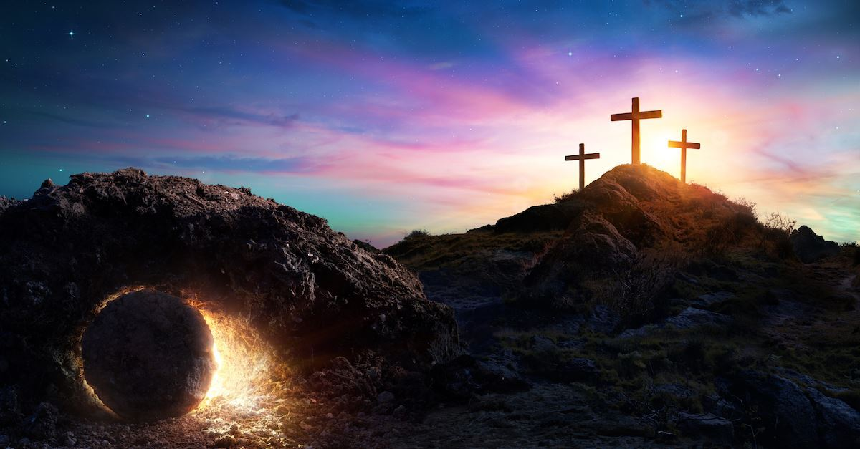

Class Worship and Reflections
Holy Week
The Last Supper

Slide 2

Church of England Colours for Worship

Slide 3
Classroom Worship
ABSTRACT
Collective worship in a classroom has a different feel from worship in the hall. The more intimate nature of the worship can make everyone feel more readily included. It is also the perfect setting to look at some of life’s big issues in a prayerful and reflective manner. This resource supports small group worship through the theme of
EASTER:
Palm Sunday
Clearing of the Temple
Anointing
Last Supper
Crucifixion
Resurrection

Slide 4
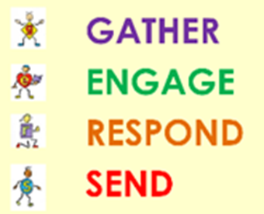
Classroom Worship
Introduction for Teachers
Classroom worship can be organised at any time of day which best suits the needs of the group.
Collective worship in a classroom has a different feel from worship in the hall. The advantages of class worship are:
  • The more intimate nature of the worship can make everyone feel more readily included—there is nobody on the far edge or at the remote back
  • The worship can be planned to be more appropriate for the age and understanding of the children present than is possible in a large mixed age gathering
  • Children and adults may feel happier at leading worship in a more familiar setting with their peers rather than in front of the whole school
Preparing for class worship is very important. If the pupils have been busy just before you are due to start encourage them now to pause and sit quietly, stilling themselves ready to begin.
Create calm, quiet atmosphere – this can be done through music or changing the lighting in the room
A worship focus- in all places of worship there is what may be termed a worship focus, in your own hall this may be a cross or a candle. It is helpful to have a worship focus for your class worship. This does not have to be a permanent feature but something that can be brought out just for the worship. Consider what would be an appropriate worship focus for your classroom e.g. a cloth, candle, cross, bible, ornament, prayer bear. You may want to have a number of appropriate worship foci in a basket that the pupils can choose and set out ready for worship.
Structure - you may well find it helpful to have a set structure to your worship. This enables even of youngest children to feel comfortable and confident with what is happening. Here we have used the gather, engage, respond, and send framework.

Slide 5

Classroom Worship
Possible music
Light of the World
https://www.youtube.com/watch?v=-MmRGSEG2LM
10,000 Reasons
https://www.youtube.com/watch?v=DXDGE_lRI0E
Blessed be the Name of the Lord
https://www.youtube.com/watch?v=PnWKehsOXu8
Hosanna in the Highest
https://www.youtube.com/watch?v=p8xHr8krAII

Slide 6

Gathering these can be used at the beginning of each session
Once everyone is set up ready for worship you may want to start by lighting a candle, followed by one of these:
Leader: Peace be with you.
Pupils: And also with you.
Leader: Welcome everyone
Pupils: It is good to be here together
Play a ‘Welcome’ song as children settle.
We meet in the name of God:
  God the Father,
  God the Son,
  God the Spirit:
  God is one.
Sign: ‘Welcome everybody here’ in BSL

Slide 7
Gathering these can be used at the beginning of each session
Christ the light of the world is here
God help us to speak positive words
To share peace with everyone
To remember that you are with us
Let us celebrate what God has made
Let’s remember to show God’s love,
and to show a bit of heaven to everyone we meet.

Slide 8

Sending these can be used at the End of each session
You may want to end your time together with one of these short prayers or blessings:
As we end this time
May we live with your love
Build on your truth
Share your forgiveness
Rest in your peace
For the whole of the day. AMEN
Thank you for this day,
For fun, friendship and learning.
We give thanks for this time
As we share peace with each other. AMEN
Help us as we as we move on
To carry hope in us for the day
Turning our thoughts towards others,
Our hearts towards love,
And our hands towards serving those in need. AMEN

Slide 9
Sending these can be used at the End of each session
The Lord bless us and watch over us, he is kind and helps us to show peace. Amen
Let’s remember today to show peace and love
To forgive when others upset us
To remember that we are all equal to God
To think about what we say before we say it
To thank God for a new day
Thank you God for all your good gifts
Christ our Lord,
Just as kings bowed down and offered you gifts,
May we know your strength and peace
And see all the free gifts you have given to us
and the blessing of the Father, Son and Holy Spirit,
be with you all, evermore
Amen

Slide 10
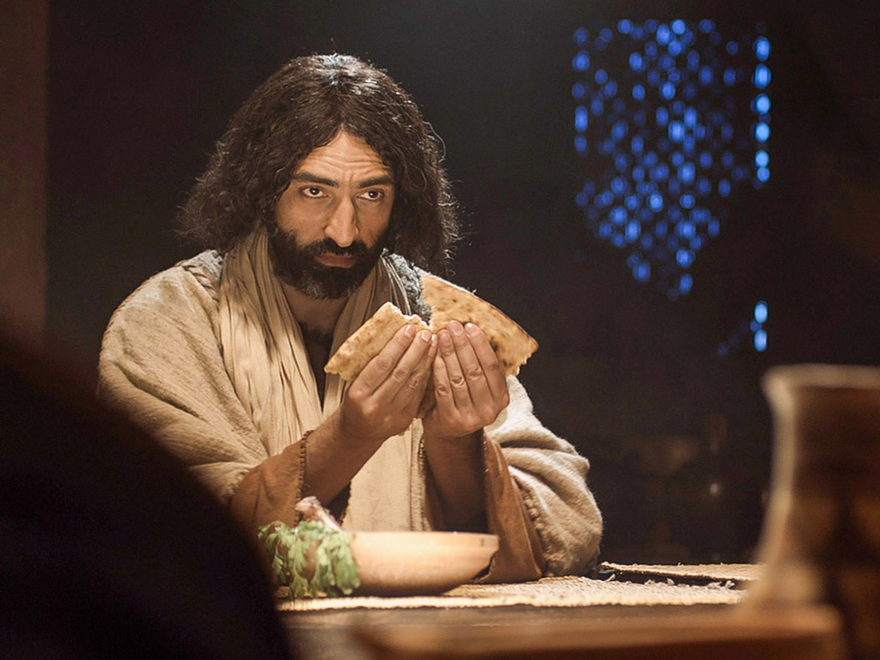
The Last SUpper

Slide 11
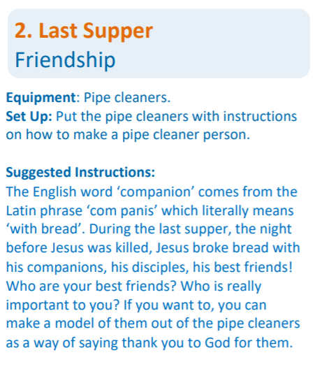
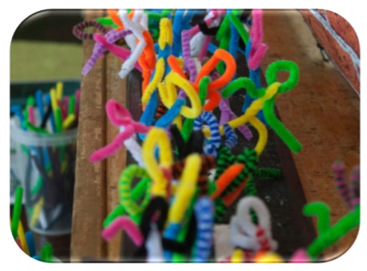
Classroom Worship
Reflection Space
The Last Supper

Slide 12

Monday

Slide 13
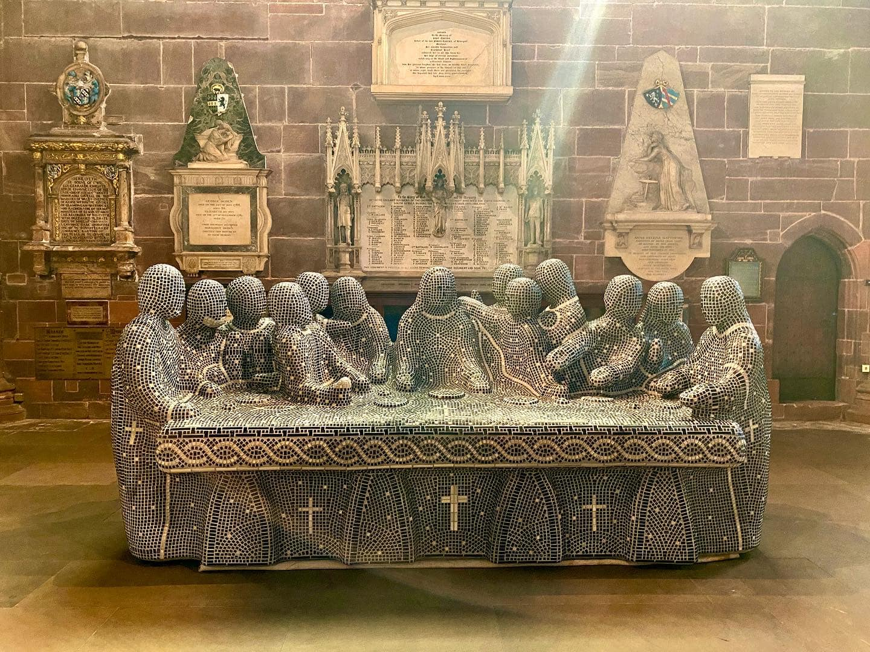


Slide 14

What do you see in the picture?
Can you make a prediction about what we are going to talk about today?
What questions do you have about this picture?
Come up with three questions.

Slide 15
Who do the figures represent?
Can you work out how this sculpture has been made?
What are they doing?

Slide 16
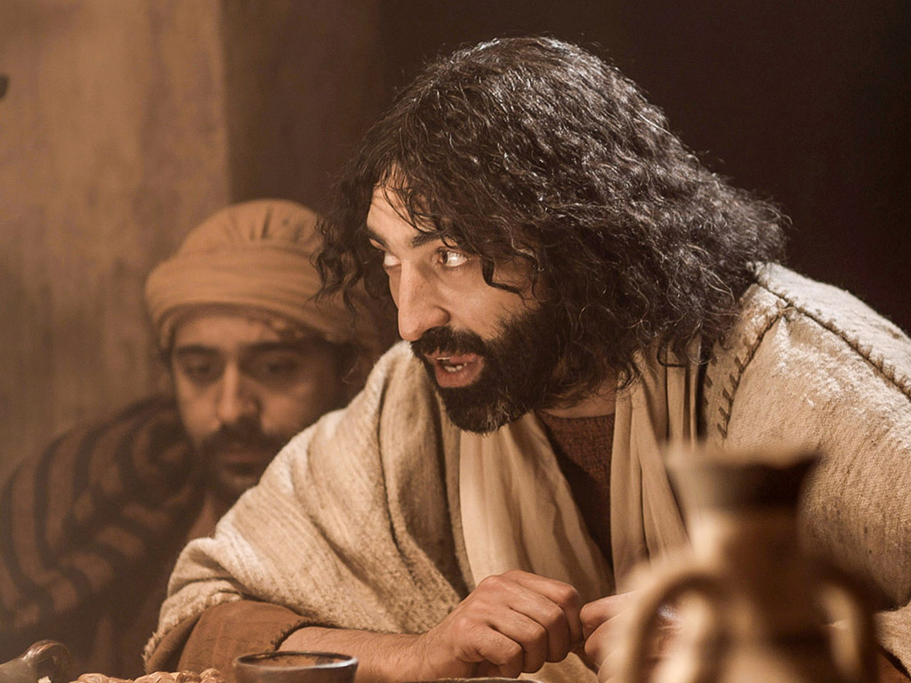
Bible passage Matthew 26:17-30
¹⁷ On the first day of the Feast of Unleavened Bread, the followers came to Jesus. They said, “We will prepare everything for you to eat the Passover Feast. Where do you want to have the feast?”
¹⁸ Jesus answered, “Go into the city to a certain man. Tell him that the Teacher says, ‘The chosen time is near. I will have the Passover Feast with my followers at your house.’” ¹⁹ The followers did what Jesus told them to do, and they prepared the Passover Feast.

Slide 17
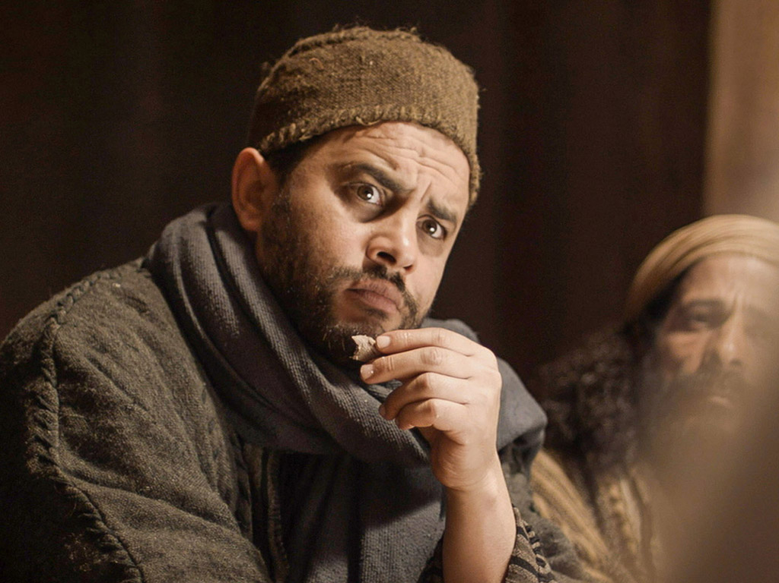
Bible passage Matthew 26:17-30
²⁰ In the evening Jesus was sitting at the table with his 12 followers. ²¹ They were all eating. Then Jesus said, “I tell you the truth. One of you 12 will turn against me.”
²² This made the followers very sad. Each one said to Jesus, “Surely, Lord, I am not the one who will turn against you. Am I?”
²³ Jesus answered, “The man who has dipped his hand with me into the bowl is the one who will turn against me. ²⁴ The Son of Man will die. The Scriptures say this will happen. But how terrible it will be for the person who gives the Son of Man to be killed. It would be better for him if he had never been born.”
²⁵ Then Judas said to Jesus, “Teacher, surely I am not the one. Am I?” (Judas is the one who would give Jesus to his enemies.)
Jesus answered, “Yes, it is you.”

Slide 18
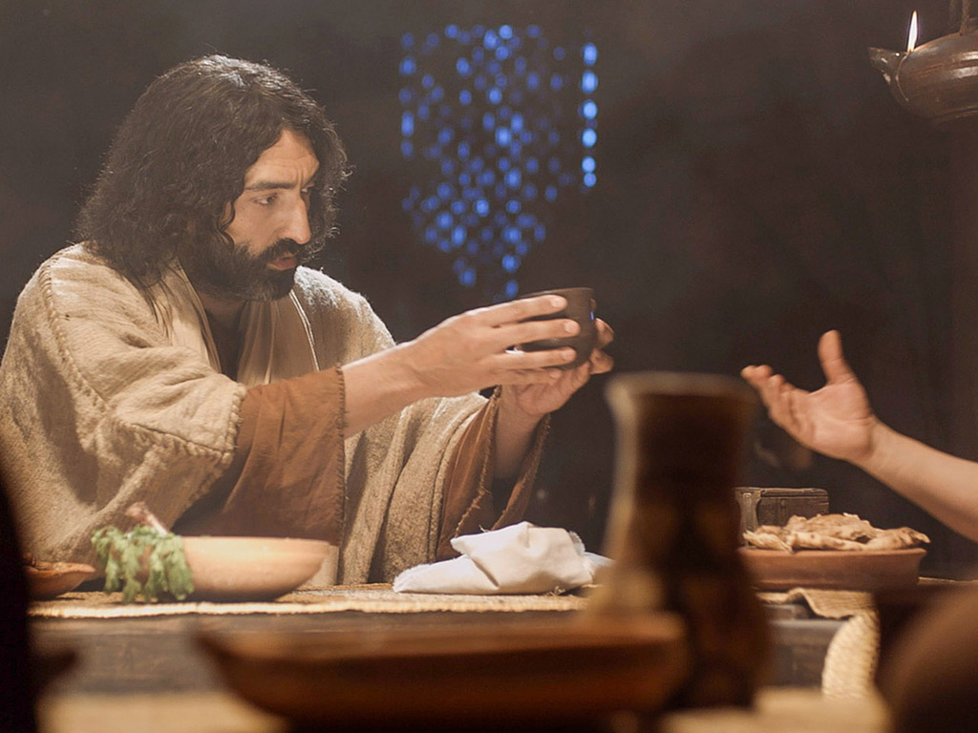
Bible passage Matthew 26:17-30
The Lord’s Supper
²⁶ While they were eating, Jesus took some bread. He thanked God for it and broke it. Then he gave it to his followers and said, “Take this bread and eat it. This bread is my body.”
²⁷ Then Jesus took a cup. He thanked God for it and gave it to the followers. He said, “Every one of you drink this. ²⁸ This is my blood which begins the new^{[a]} agreement that God makes with his people. This blood is poured out for many to forgive their sins. ²⁹ I tell you this: I will not drink of this fruit of the vine^{[b]} again until that day when I drink it new with you in my Father’s kingdom.”

Slide 19

Responding
What can we learn from this story?
What do you find encouraging?
What do you find challenging?

Slide 20
Who do the figures represent?
Can you work out how this sculpture has been made?
Are the questions easier to answer now?
What are they doing?
Where do you think this sculpture is?

Slide 21
Prayer
Encourage the pupils to respond with their own prayers first or through the prayer space. You could use your school prayer or the Lord’s Prayer:
Our Father, in heaven,
Holy is your name.
Your Kingdom come,
Your will be done on earth, as it is in heaven.
Give us this day our daily bread,
And forgive us our sins,
As we forgive those who sin against us,
And lead us not into temptation,
But deliver us from evil.
Amen.

Slide 22
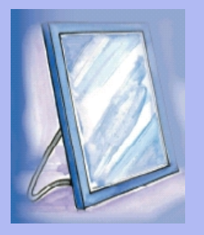
Tuesday

Slide 23
Bible passage Matthew 26:17-30
The Lord’s Supper
²⁶ While they were eating, Jesus took some bread. He thanked God for it and broke it. Then he gave it to his followers and said, “Take this bread and eat it. This bread is my body.”
²⁷ Then Jesus took a cup. He thanked God for it and gave it to the followers. He said, “Every one of you drink this. ²⁸ This is my blood which begins the new^{[a]} agreement that God makes with his people. This blood is poured out for many to forgive their sins. ²⁹ I tell you this: I will not drink of this fruit of the vine^{[b]} again until that day when I drink it new with you in my Father’s kingdom.”

Slide 24
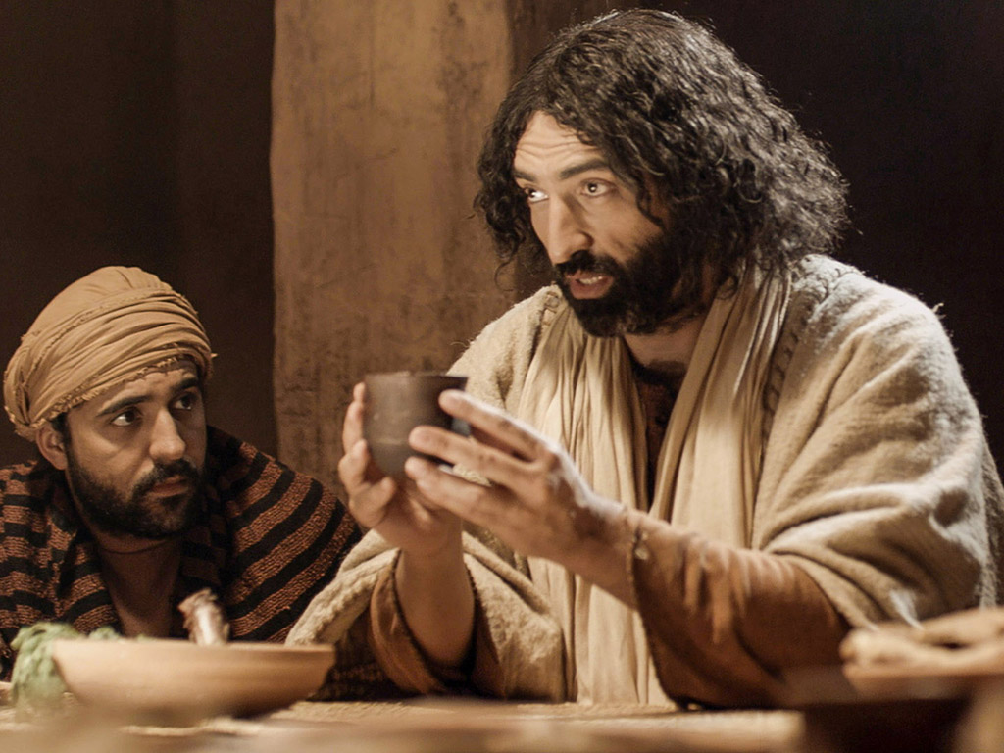
Bible passage Matthew 26:17-30
Take this bread and eat it. This bread is my body.
Every one of you drink this.
This is my blood which begins the new agreement that God makes with his people.
This blood is poured out for many to forgive their sins.

Slide 25
Responding
What did Jesus mean when he said this?
Do you think that the disciples understood?
Why do you think Jesus chose the Passover meal for this?

Slide 26

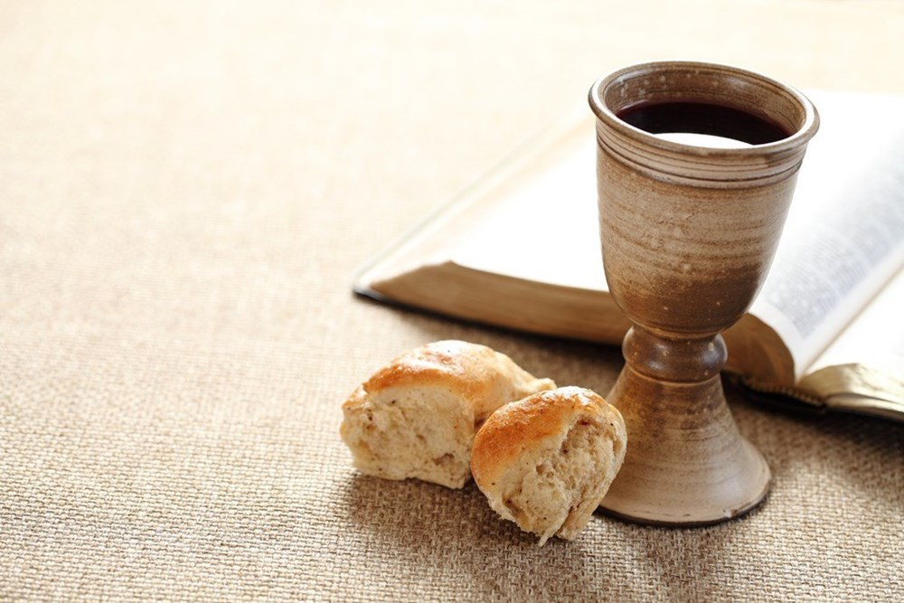
Reflection question
Why do Christians still take bread and wine in Eucharist or Holy Communion today?
How do the symbols that Jesus used help Christians to remember?

Slide 27
Prayer
Encourage the pupils to respond with their own prayers first or through the prayer space.
Father God,
In the great story of Jesus we hear your love for us
being retold and we remember all Jesus has
done for us because of that love.
And so we thank you that you have called us your children
sharing with us a love that is more powerful than the universe
and that you sit here with us.
Amen

Slide 28

Wednesday

Slide 29
Engage…
Let’s take a closer look at the sculpture…
…it is called The Last Supper and it was created by the sculptor Peter Barnes.
It was displayed in Chester Cathedral and it has a mosaic effect, made completely out of…

Slide 30
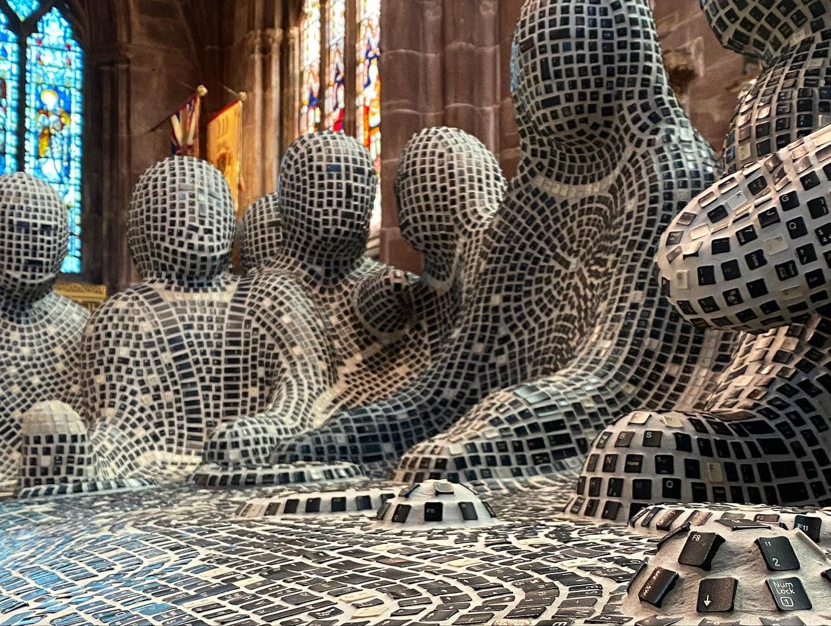
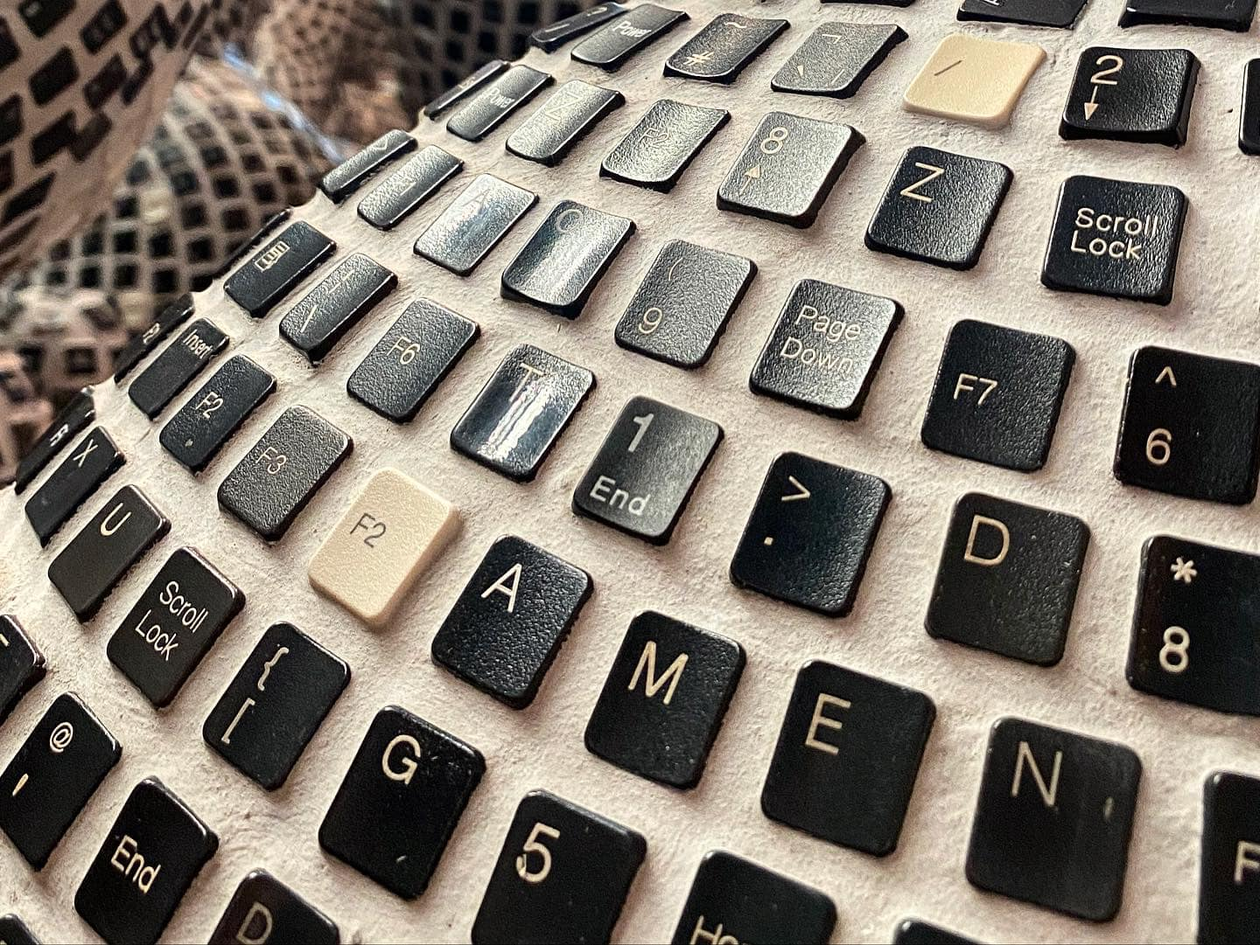
…old computer keyboard keys!

Slide 31
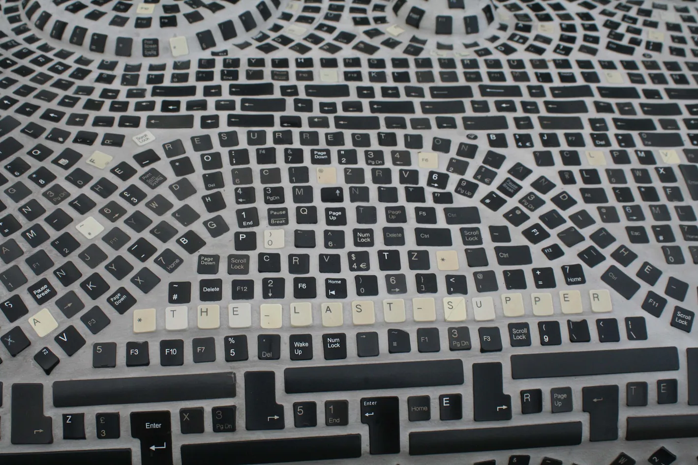
If you look closely you will see words and phrases spelled out on the sculpture!

Slide 32
Can you see it?

Slide 33
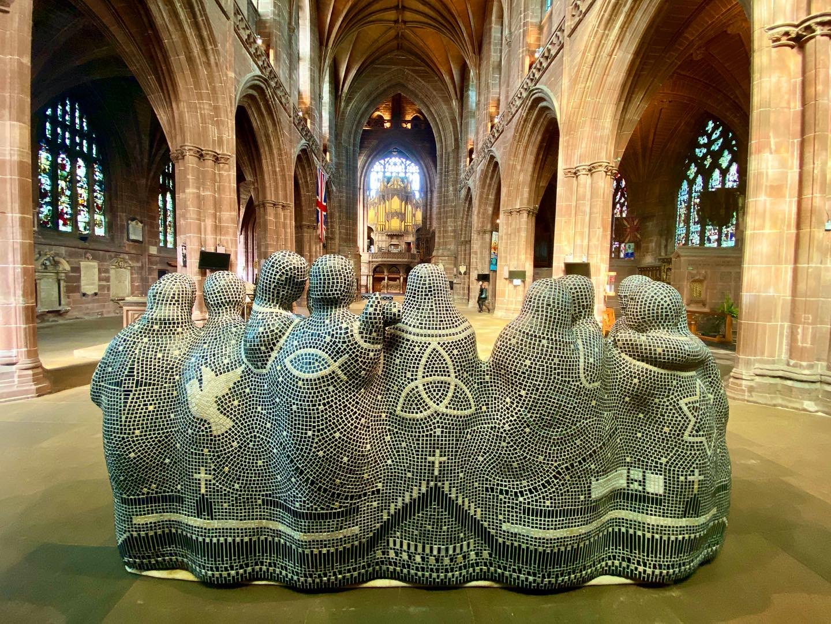
There are also some special symbols on the back of the sculpture!

Slide 34
Prompted to action - challenge
Which key words would you choose to spell out on the sculpture? Why?
Which symbols would you decorate the sculpture with? Why?

Slide 35
Prompted to action –
Challenge
Can you create a mosaic or sculpture of your own to help someone to understand the story of The Last Supper?
Maybe you could use recycled materials like Peter Barnes!

Slide 36
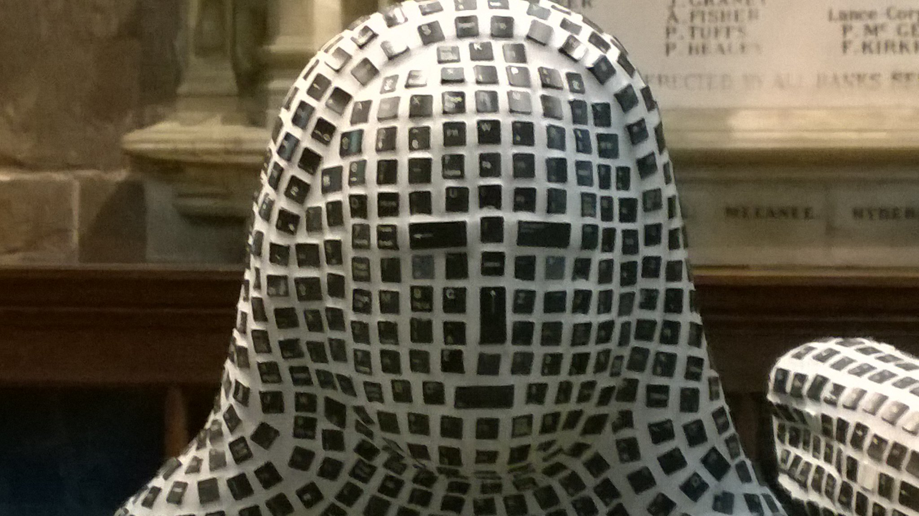

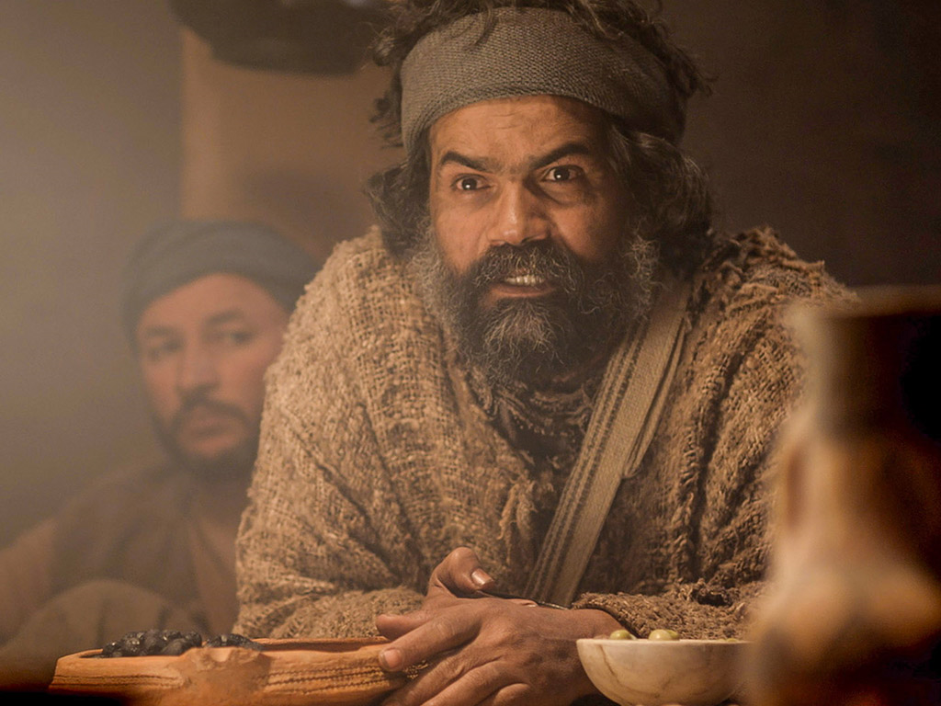

Prompted to action challenge
How would you create the facial expressions of Jesus and his disciples to show how they were feeling?
Jesus
Judas
Peter

Slide 37
Prayer
Encourage the pupils to respond with their own prayers first or through the prayer space. You could use your school prayer or the Lord’s Prayer:
Our Father, in heaven,
Holy is your name.
Your Kingdom come,
Your will be done on earth, as it is in heaven.
Give us this day our daily bread,
And forgive us our sins,
As we forgive those who sin against us,
And lead us not into temptation,
But deliver us from evil.
Amen.

Slide 38

Thursday

Slide 39
Use the Meditation resource alongside the Spiritual Encounters – bible-based meditation teacher’s pack:
http://www.ldbe.co.uk/about/guidance- resources/worship-and-meditation/
(This can be adapted for use with all ages)
Alternatively, you could also use the following:
https://www.engageworship.org/ideas/jesus-took-some-bread-intro-communion
https://www.engageworship.org/ideas/upper-room-poem-and-mime

Slide 40

Friday

Slide 41
Take this time to celebrate what has happened during the week – you may want to give out awards. If possible, join the bubbles using Zoom or Teams so that the whole school can come together in a time of celebration.
Remember that this should also be a time of worship and celebration so begin with a gathering, include a prayer, a blessing, and a song of celebration.

