Slide 1
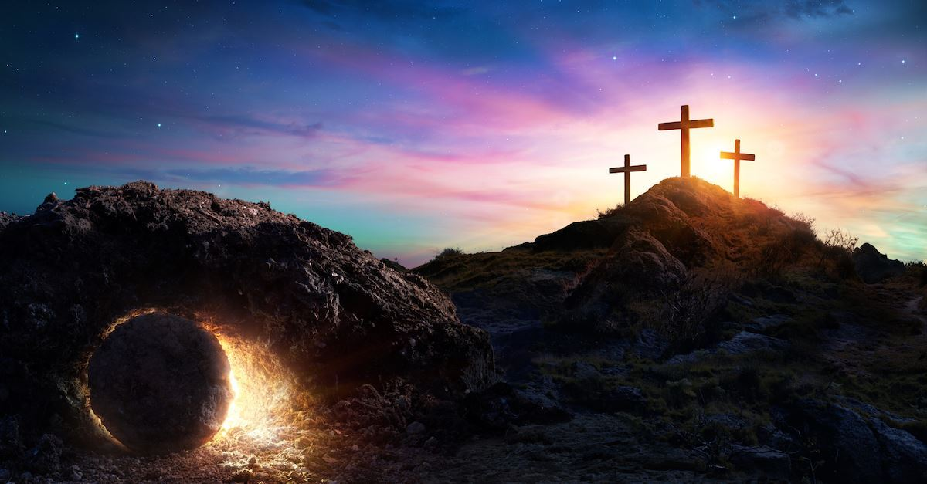

Class Worship and Reflections
Holy Week
Jesus’ Anointing

Slide 2

Church of England Colours for Worship

Slide 3
Classroom Worship
ABSTRACT
Collective worship in a classroom has a different feel from worship in the hall. The more intimate nature of the worship can make everyone feel more readily included. It is also the perfect setting to look at some of life’s big issues in a prayerful and reflective manner. This resource supports small group worship through the theme of
EASTER:
Palm Sunday
Clearing of the Temple
Anointing
Last Supper
Crucifixion
Resurrection

Slide 4

Classroom Worship
Introduction for Teachers
Classroom worship can be organised at any time of day which best suits the needs of the group.
Collective worship in a classroom has a different feel from worship in the hall. The advantages of class worship are:
  • The more intimate nature of the worship can make everyone feel more readily included—there is nobody on the far edge or at the remote back
  • The worship can be planned to be more appropriate for the age and understanding of the children present than is possible in a large mixed age gathering
  • Children and adults may feel happier at leading worship in a more familiar setting with their peers rather than in front of the whole school
Preparing for class worship is very important. If the pupils have been busy just before you are due to start encourage them now to pause and sit quietly, stilling themselves ready to begin.
Create calm, quiet atmosphere – this can be done through music or changing the lighting in the room
A worship focus- in all places of worship there is what may be termed a worship focus, in your own hall this may be a cross or a candle. It is helpful to have a worship focus for your class worship. This does not have to be a permanent feature but something that can be brought out just for the worship. Consider what would be an appropriate worship focus for your classroom e.g. a cloth, candle, cross, bible, ornament, prayer bear. You may want to have a number of appropriate worship foci in a basket that the pupils can choose and set out ready for worship.
Structure - you may well find it helpful to have a set structure to your worship. This enables even of youngest children to feel comfortable and confident with what is happening. Here we have used the gather, engage, respond, and send framework.

Slide 5

Classroom Worship
Possible music
Light of the World
https://www.youtube.com/watch?v=-MmRGSEG2LM
10,000 Reasons
https://www.youtube.com/watch?v=DXDGE_lRI0E
Blessed be the Name of the Lord
https://www.youtube.com/watch?v=PnWKehsOXu8
Hosanna in the Highest
https://www.youtube.com/watch?v=p8xHr8krAII

Slide 6

Gathering these can be used at the beginning of each session
Once everyone is set up ready for worship you may want to start by lighting a candle, followed by one of these:
Leader: Peace be with you.
Pupils: And also with you.
Leader: Welcome everyone
Pupils: It is good to be here together
Play a ‘Welcome’ song as children settle.
We meet in the name of God:
  God the Father,
  God the Son,
  God the Spirit:
  God is one.
Sign: ‘Welcome everybody here’ in BSL

Slide 7
Gathering these can be used at the beginning of each session
Christ the light of the world is here
God help us to speak positive words
To share peace with everyone
To remember that you are with us
Let us celebrate what God has made
Let’s remember to show God’s love,
and to show a bit of heaven to everyone we meet.

Slide 8

Sending these can be used at the End of each session
You may want to end your time together with one of these short prayers or blessings:
As we end this time
May we live with your love
Build on your truth
Share your forgiveness
Rest in your peace
For the whole of the day. AMEN
Thank you for this day,
For fun, friendship and learning.
We give thanks for this time
As we share peace with each other. AMEN
Help us as we as we move on
To carry hope in us for the day
Turning our thoughts towards others,
Our hearts towards love,
And our hands towards serving those in need. AMEN

Slide 9
Sending these can be used at the End of each session
The Lord bless us and watch over us, he is kind and helps us to show peace. Amen
Let’s remember today to show peace and love
To forgive when others upset us
To remember that we are all equal to God
To think about what we say before we say it
To thank God for a new day
Thank you God for all your good gifts
Christ our Lord,
Just as kings bowed down and offered you gifts,
May we know your strength and peace
And see all the free gifts you have given to us
and the blessing of the Father, Son and Holy Spirit,
be with you all, evermore
Amen

Slide 10
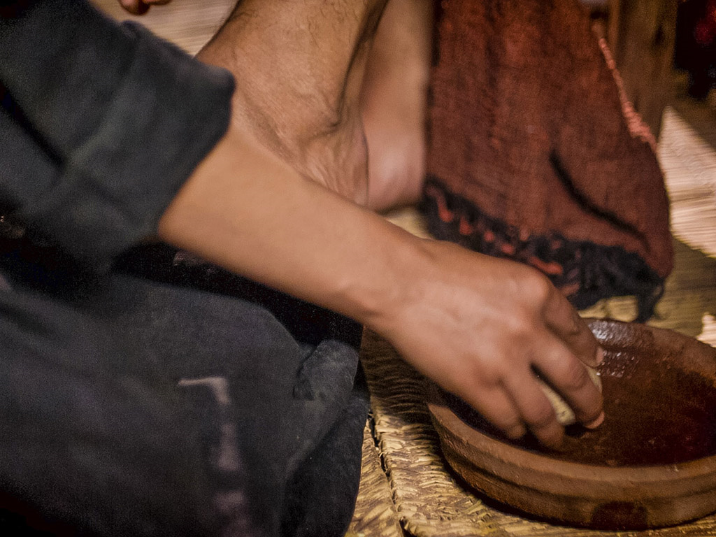
Jesus is Anointed

Slide 11
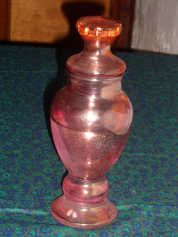
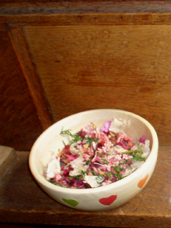

Classroom Worship
Reflection Space
Jesus is anointed
Fragrant Offerings
Equipment:
A collection of small boxes containing cotton wool with a variety of scents - lavender, rosemary, myrrh, frankincense - for people to smell.
Rose petals (real or fake)
Jar or bowl
Suggested instructions:
Different smells often remind us of different people, places or memories. As you take in the different fragrances, think of a memory or a person who you’re reminded of. You might want to say a prayer for them.
What do I have to offer Jesus?
Think about your own gifts and place a rose petal in the jar as a symbol of your offering.

Slide 12

Monday

Slide 13
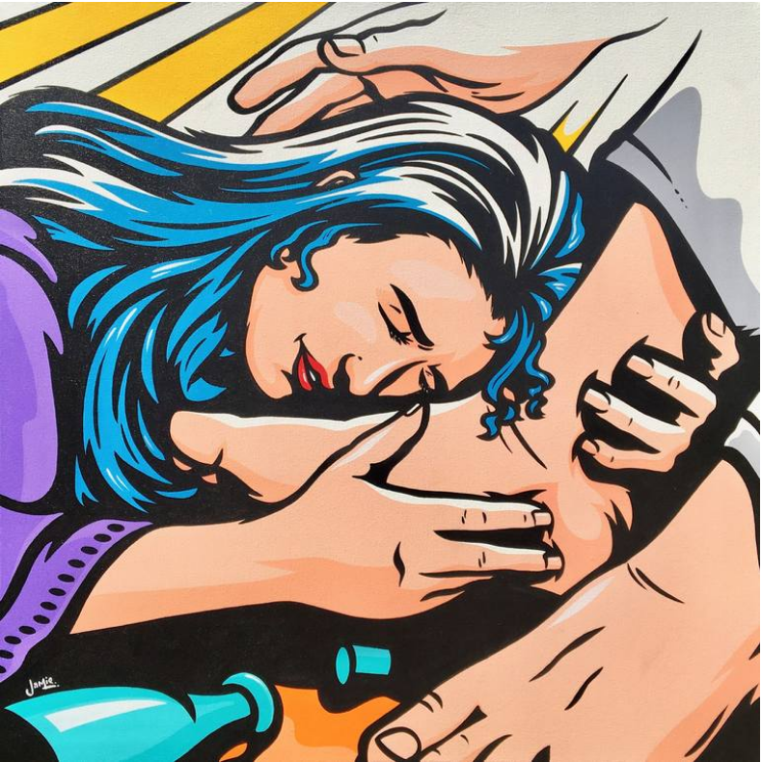

By James Lee

Slide 14

What do you see in the picture?
Can you make a prediction about what we are going to talk about today?
What questions do you have about this picture?
Come up with three questions.

Slide 15
Who is the woman?
Who do the feet belong to?
How does she feel?
What details has the artist included? Why?

Slide 16

Bible Passage: John 12:1-8
12 Six days before Passover Jesus went back to Bethany, where he had raised Lazarus from death. ² A meal had been prepared for Jesus. Martha was doing the serving, and Lazarus himself was there.

Slide 17

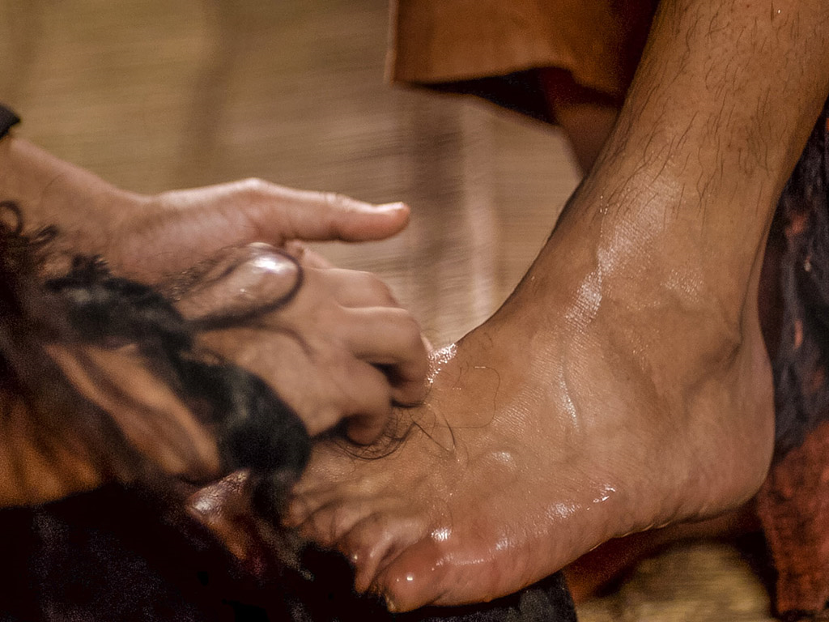
Bible Passage: John 12:1-8
³ Mary took a very expensive bottle of perfume^{[a]} and poured it on Jesus' feet. She wiped them with her hair, and the sweet smell of the perfume filled the house.

Slide 18
Who is the woman?
Are the questions easier to answer now?
Who do the feet belong to?
How does she feel?
What details has the artist included? Why?

Slide 19

Responding
What can we learn from this story?
What do you find encouraging?
What do you find challenging?

Slide 20
Prayer
Encourage the pupils to respond with their own prayers first or through the prayer space. You could use the school prayer or the Lord’s Prayer:
Our Father, in heaven,
Holy is your name.
Your Kingdom come,
Your will be done on earth, as it is in heaven.
Give us this day our daily bread,
And forgive us our sins,
As we forgive those who sin against us,
And lead us not into temptation,
But deliver us from evil.
Amen.

Slide 21

Tuesday

Slide 22
Bible Passage: John 12:1-8
12 Six days before Passover Jesus went back to Bethany, where he had raised Lazarus from death. ² A meal had been prepared for Jesus. Martha was doing the serving, and Lazarus himself was there.
³ Mary took a very expensive bottle of perfume^{[a]} and poured it on Jesus' feet. She wiped them with her hair, and the sweet smell of the perfume filled the house.

Slide 23
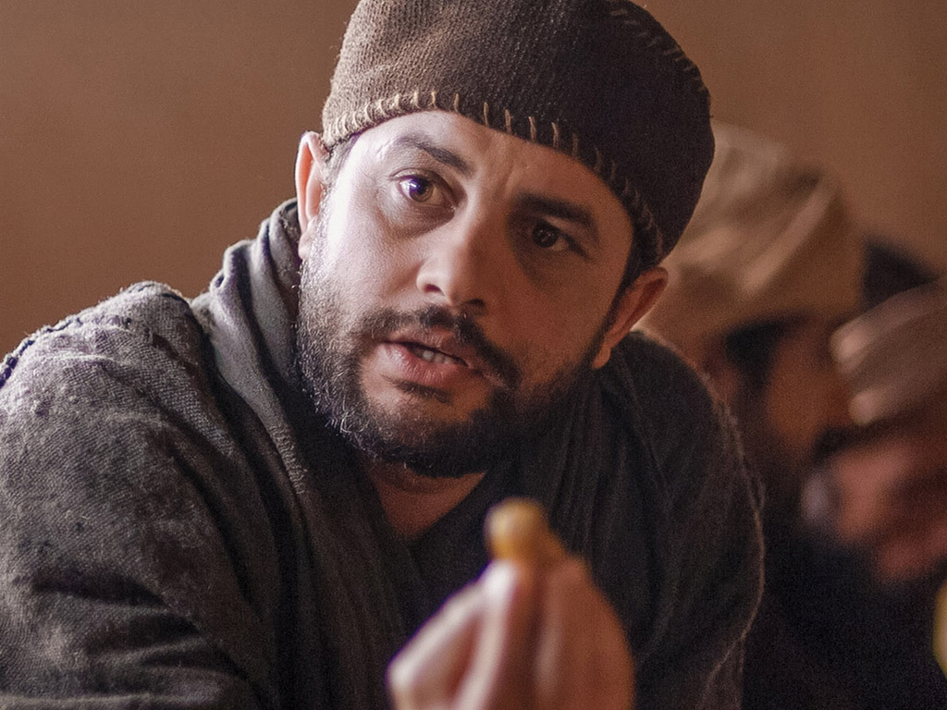
Bible Passage: John 12:1-8
⁴ A disciple named Judas Iscariot^{[b]} was there. He was the one who was going to betray Jesus, and he asked, ⁵ “Why wasn’t this perfume sold for three hundred silver coins and the money given to the poor?” ⁶ Judas did not really care about the poor. He asked this because he carried the moneybag and sometimes would steal from it.
⁷ Jesus replied, “Leave her alone! She has kept this perfume for the day of my burial. ⁸ You will always have the poor with you, but you won’t always have me.”

Slide 24
REFLECTION QUESTIONS
Was Judas right to say that the perfume had been wasted?
Was Judas thinking of the poor?

Slide 25
Reflection questions
What does it mean to ‘honour’ someone?
Honour (verb) – Collins Dictionary definition:
If someone is honoured, they are given public praise.

Slide 26
REFLECTION QUESTIONS
Why did Mary choose to honour Jesus in this way?

Slide 27

responding
Who deserves our honour today?

Slide 28
Prayer
Encourage the pupils to respond with their own prayers first or through the prayer space. You could use the school’s prayer or the prayer below.
Father God,
Help us to remember that we should always
love and honour each other.
Help us to recognise those around us who
deserve our love and respect,
even those who we may not be friends with.
Amen

Slide 29

Wednesday

Slide 30
Prompted to action - challenge
“Love one other with affection.
Outdo one another in showing honour”
Romans 12:10 (ESV)
Reflect on the story from John 12:1-8
Remember what it means to honour someone.

Slide 31
Prompted to action - challenge
What does this verse mean?
“Love one other with affection. Outdo one another in showing honour”
Romans 12:10 (ESV)
It means that you go out of your way to demonstrate honour to them.
Whether they deserve it or not you give it out freely.
Treat honour like there’s a never-ending supply.

Slide 32
Prompted to action - challenge
Who deserves our honour today?
Yesterday, you were asked to think about your answer to this question…
…the question for today is…

Slide 33
Prompted to action - challenge
HOW can I show honour today?
Talk about practical ways to honour someone
Think about how honour is similar to showing respect
How can you ‘publicly praise’ someone for what they do and who they are?
How are people honoured in your school?

Slide 34




Prompted to action - challenge
How can I show honour today?

Slide 35

HONOUR ROLL
Can you find out about an Honour Roll and create one for your class or school?
Are there people in the wider school community that could feature on your Honour Roll?

Slide 36
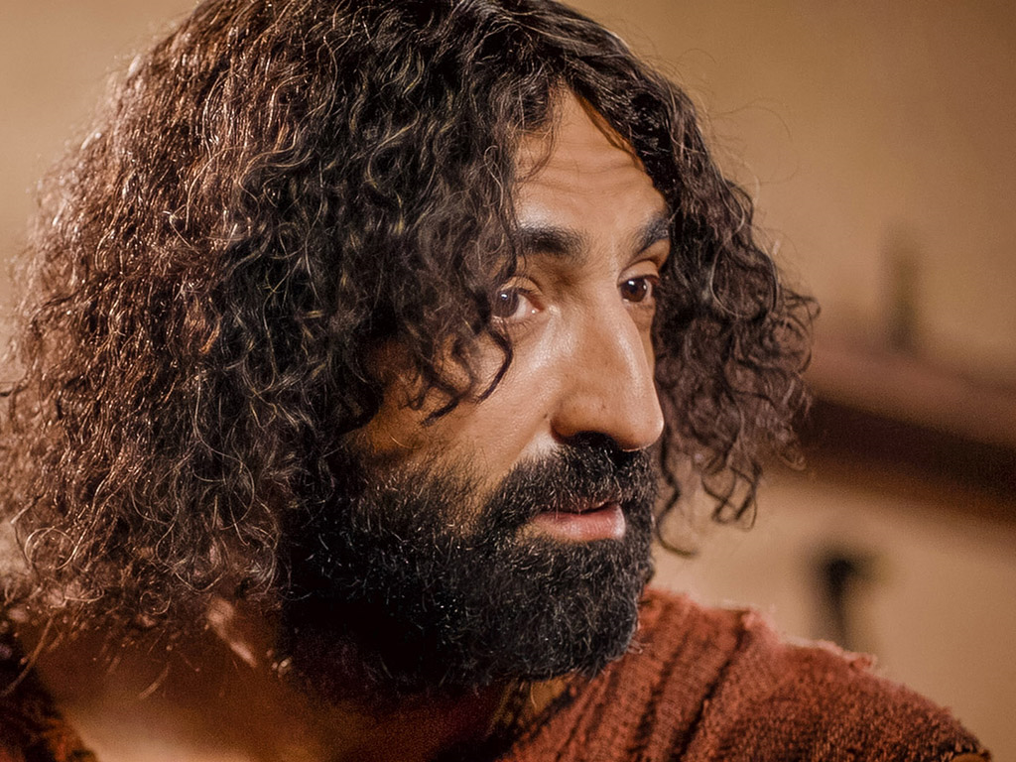
Responding – Going Deeper
What do you think Jesus meant by this?
Leave her alone! She has kept this perfume for the day of my burial.
You will always have the poor with you, but you won’t always have me.
What is the link between the perfume and Jesus’ burial?
What did Jesus want Judas to understand?

Slide 37
Prayer
Encourage the pupils to respond with their own prayers first or through the prayer space. You could use the school’s prayer or the prayer below.
Dear God,
Please show me how to honour
the people around me.
Help me to be brave and step out, like Mary,
to honour the people in my school community.
Help me to show them that they are
loved and appreciated.
Amen

Slide 38

Thursday

Slide 39
Use the Meditation resource alongside the Spiritual Encounters – bible-based meditation teacher’s pack:
http://www.ldbe.co.uk/about/guidance- resources/worship-and-meditation/
(This can be adapted for use with all ages)
Alternatively, you could also use the following:
https://www.engageworship.org/ideas/marys-gift-dramatic-reading#
https://www.engageworship.org/ideas/pure-nard-poem

Slide 40

Friday

Slide 41
Take this time to celebrate what has happened during the week – you may want to give out awards. If possible, join the bubbles using Zoom or Teams so that the whole school can come together in a time of celebration.
Remember that this should also be a time of worship and celebration so begin with a gathering, include a prayer, a blessing, and a song of celebration.

