Slide 1
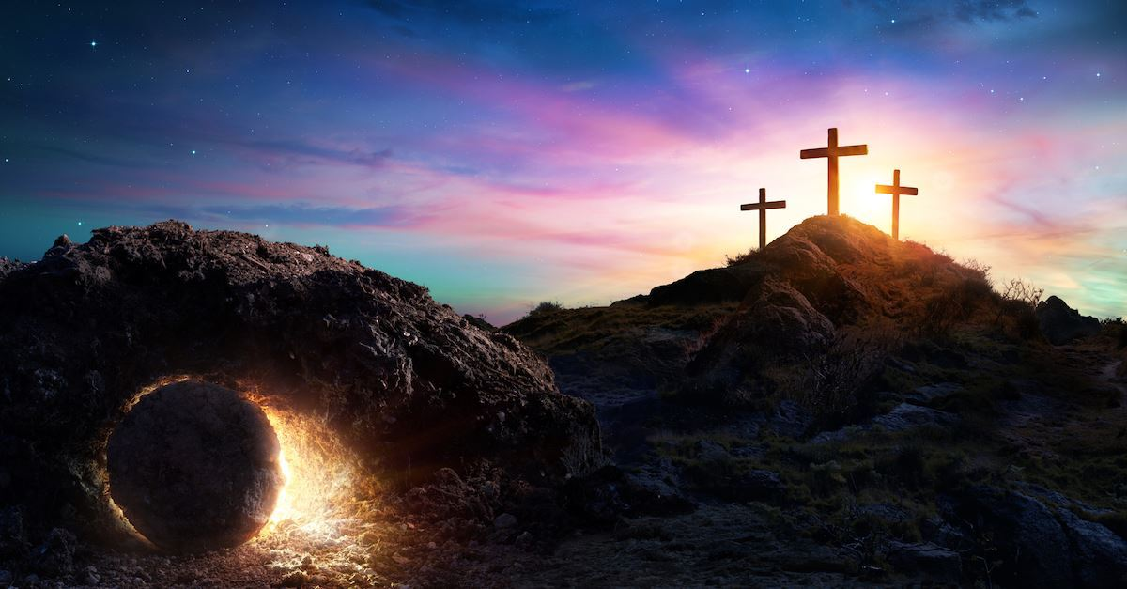

Class Worship and Reflections
Holy Week

Slide 2

Church of England Colours for Worship

Slide 3
Classroom Worship
ABSTRACT
Collective worship in a classroom has a different feel from worship in the hall. The more intimate nature of the worship can make everyone feel more readily included. It is also the perfect setting to look at some of life’s big issues in a prayerful and reflective manner. This resource supports small group worship through the theme of
EASTER:
Palm Sunday
Clearing of the Temple
Anointing
Last Supper
Crucifixion
Resurrection

Slide 4
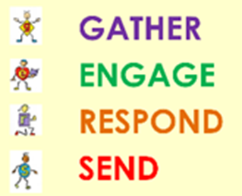
Classroom Worship
Introduction for Teachers
Classroom worship can be organised at any time of day which best suits the needs of the group.
Collective worship in a classroom has a different feel from worship in the hall. The advantages of class worship are:
  • The more intimate nature of the worship can make everyone feel more readily included—there is nobody on the far edge or at the remote back
  • The worship can be planned to be more appropriate for the age and understanding of the children present than is possible in a large mixed age gathering
  • Children and adults may feel happier at leading worship in a more familiar setting with their peers rather than in front of the whole school
Preparing for class worship is very important. If the pupils have been busy just before you are due to start encourage them now to pause and sit quietly, stilling themselves ready to begin.
Create calm, quiet atmosphere – this can be done through music or changing the lighting in the room
A worship focus- in all places of worship there is what may be termed a worship focus, in your own hall this may be a cross or a candle. It is helpful to have a worship focus for your class worship. This does not have to be a permanent feature but something that can be brought out just for the worship. Consider what would be an appropriate worship focus for your classroom e.g. a cloth, candle, cross, bible, ornament, prayer bear. You may want to have a number of appropriate worship foci in a basket that the pupils can choose and set out ready for worship.
Structure - you may well find it helpful to have a set structure to your worship. This enables even of youngest children to feel comfortable and confident with what is happening. Here we have used the gather, engage, respond, and send framework.

Slide 5

Classroom Worship
Possible music
Light of the World
https://www.youtube.com/watch?v=-MmRGSEG2LM
10,000 Reasons
https://www.youtube.com/watch?v=DXDGE_lRI0E
King of Kings
https://www.youtube.com/watch?v=Of5IcFWiEpg
Blessed be the Name of the Lord
https://www.youtube.com/watch?v=PnWKehsOXu8
Hosanna in the Highest
https://www.youtube.com/watch?v=p8xHr8krAII

Slide 6

Gathering these can be used at the beginning of each session
Once everyone is set up ready for worship you may want to start by lighting a candle, followed by one of these:
Leader: Peace be with you.
Pupils: And also with you.
Leader: Welcome everyone
Pupils: It is good to be here together
Play a ‘Welcome’ song as children settle.
We meet in the name of God:
  God the Father,
  God the Son,
  God the Spirit:
  God is one.
Sign: ‘Welcome everybody here’ in BSL

Slide 7
Gathering these can be used at the beginning of each session
Christ the light of the world is here
God help us to speak positive words
To share peace with everyone
To remember that you are with us
Let us celebrate what God has made
Let’s remember to show God’s love,
and to show a bit of heaven to everyone we meet.

Slide 8

Sending these can be used at the End of each session
You may want to end your time together with one of these short prayers or blessings:
As we end this time
May we live with your love
Build on your truth
Share your forgiveness
Rest in your peace
For the whole of the day. AMEN
Thank you for this day,
For fun, friendship and learning.
We give thanks for this time
As we share peace with each other. AMEN
Help us as we as we move on
To carry hope in us for the day
Turning our thoughts towards others,
Our hearts towards love,
And our hands towards serving those in need. AMEN

Slide 9
Sending these can be used at the End of each session
The Lord bless us and watch over us, he is kind and helps us to show peace. Amen
Let’s remember today to show peace and love
To forgive when others upset us
To remember that we are all equal to God
To think about what we say before we say it
To thank God for a new day
Thank you God for all your good gifts
Christ our Lord,
Just as kings bowed down and offered you gifts,
May we know your strength and peace
And see all the free gifts you have given to us
and the blessing of the Father, Son and Holy Spirit,
be with you all, evermore
Amen

Slide 10
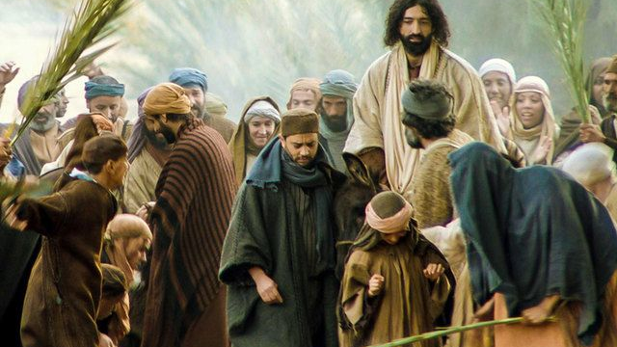
PALM SUNDAY

Slide 11
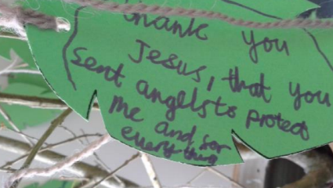
Classroom Worship
Reflection Space
When do you feel
like shouting ‘Hooray’?
.
What are you really happy about??
What are you really thankful for?

Slide 12
Classroom Worship
Reflection Space
Equipment:
Green paper, felt-tip pens,
Scissors.
Set up:
Cut out palm tree shaped leaves and put them with the pens

Slide 13

Classroom Worship
Reflection Space
Suggested Instructions:
When Jesus entered Jerusalem, people put palm leaves on the ground and shouted, ‘Hosanna in the highest!’ Shouting ‘Hosanna’ is a bit like shouting ‘Hooray’. When do you feel like shouting ‘Hooray’? What are you really happy about? What are you really thankful for? If you want, you can write a thank you/Hooray thought or prayer on a leaf-shape.

Slide 14

Monday

Slide 15
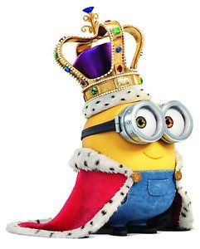


Slide 16

What do you see in the picture?
Can you make a prediction about what we are going to talk about today?
What questions do you have about this picture?
Come up with three questions.
Notes:
The theme is trust. Encourage children to notice the trust in the image.

Slide 17

Reflection questions
I wonder what job they do?
I wonder how they might travel around?

Slide 18
Reflection questions
I wonder what they are wearing?
What would you expect a King to be like?

Slide 19

Responding
Think about a King.
What qualities would they have?
Draw/write your ideas.

Slide 20
Responding
When Jesus walked upon the earth he looked like a normal human being, however he was really a King.
He was not a king like the Kings we see in the world.
Jesus brings about the reign of God, which is where God's ways become our ways and God's thoughts becomes our thoughts. This way leads to the fullness of life, peace in this world, and peace forever in the reign of God.

Slide 21
Prayer
Encourage the pupils to respond with their own prayers first, through the prayer space or with the prayer below:
Thank you God for sending Jesus to be our saviour and our friend.
Thank you also that he is a King.
Help us always to follow his teachings.
And become more like Him.
In Jesus Name,
Amen

Slide 22

Tuesday

Slide 23
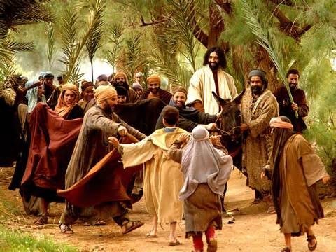

Slide 24
What do you see in the picture?
Can you make a prediction about what we are going to talk about today?
What questions do you have about this picture?
Come up with three questions.
Notes:
The theme is trust. Encourage children to notice the trust in the image.

Slide 25
Bible Passage (based on matthew 21:1 - 11)
21 Jesus and his followers were coming closer to Jerusalem. But first they stopped at Bethphage at the hill called the Mount of Olives. From there Jesus sent two of his followers into the town. 2 He said to them, “Go to the town you can see there. When you enter it, you will find a donkey tied there with its colt. Untie them and bring them to me. 3 If anyone asks you why you are taking the donkeys, tell him, ‘The Master needs them. He will send them back soon.’” 4 This was to make clear the full meaning of what the prophet said:
5 “Tell the people of Jerusalem,
‘Your king is coming to you.
He is gentle and riding on a donkey.
He is on the colt of a donkey.’” Isaiah 62:11; Zechariah 9:9

Slide 26
Bible Passage (based on matthew 21: 1 - 11)
6 The followers went and did what Jesus told them to do. 7 They brought the donkey and the colt to Jesus. They laid their coats on the donkeys, and Jesus sat on them. 8 Many people spread their coats on the road before Jesus. Others cut branches from the trees and spread them on the road. 9 Some of the people were walking ahead of Jesus. Others were walking behind him. All the people were shouting,
“Praise[a] to the Son of David!
God bless the One who comes in the name of the Lord! Psalm 118:26
Praise to God in heaven!”
¹⁰ Then Jesus went into Jerusalem. The city was filled with excitement. The people asked, “Who is this man?”
¹¹ The crowd answered, “This man is Jesus. He is the prophet from the town of Nazareth in Galilee.”

Slide 27
Responding
What can we learn from this story?
What do you find encouraging?
What do you find challenging?

Slide 28
Prayer
Encourage the pupils to respond with their own prayers first or through the prayer space or use the prayer below:
Dear God,
Help us to remember that day when all the adults and children waved palm branches and cheered as Jesus entered Jerusalem as King.
Help us to remember that he is our wonderful King
and that we can praise him everyday!
In Jesus’ name
Amen.

Slide 29

Wednesday

Slide 30
Prompted to action - challenge
Remind people of the theme for the week and of the Bible story- Jesus was welcomed as King.

Slide 31
Prompted to action – challenge ideas
What rules would Jesus have in His Kingdom?
Notes:
Discuss the teachings of Jesus: Love God, love one another (even enemies), live in peace, forgive one another, be content with what you have and share with one another.

Slide 32

Prompted to action – challenge ideas
Create a pledge to keep one of the rules.
Write it on coloured paper and add it to the pledge jar.

Slide 33
Prayer
Encourage the pupils to respond with their own prayers first or through the prayer space. You could use the school’s prayer or the Lord’s Prayer:
Our Father, in heaven,
Holy is your name.
Your Kingdom come,
Your will be done on earth, as it is in heaven.
Give us this day our daily bread,
And forgive us our sins,
As we forgive those who sin against us,
And lead us not into temptation,
But deliver us from evil.
Amen.

Slide 34

Thursday

Slide 35
Use the Meditation resource alongside the Spiritual Encounters – bible-based meditation teacher’s pack: http://www.ldbe.co.uk/about/guidance- resources/worship-and-meditation/
Alternatively, you could also use any of the the following: https://engageworship.org/ideas/jesus-king-of-kings-printable-crown https://www.youtube.com/watch?v=dQl4izxPeNU

Slide 36

Friday

Slide 37
Take this time to celebrate what has happened during the week – you may want to give out awards. If possible, join the bubbles using Zoom or Teams so that the whole school can come together in a time of celebration.
Remember that this should also be a time of worship and celebration so begin with a gathering, include a prayer, a blessing, and a song of celebration.

