Slide 1
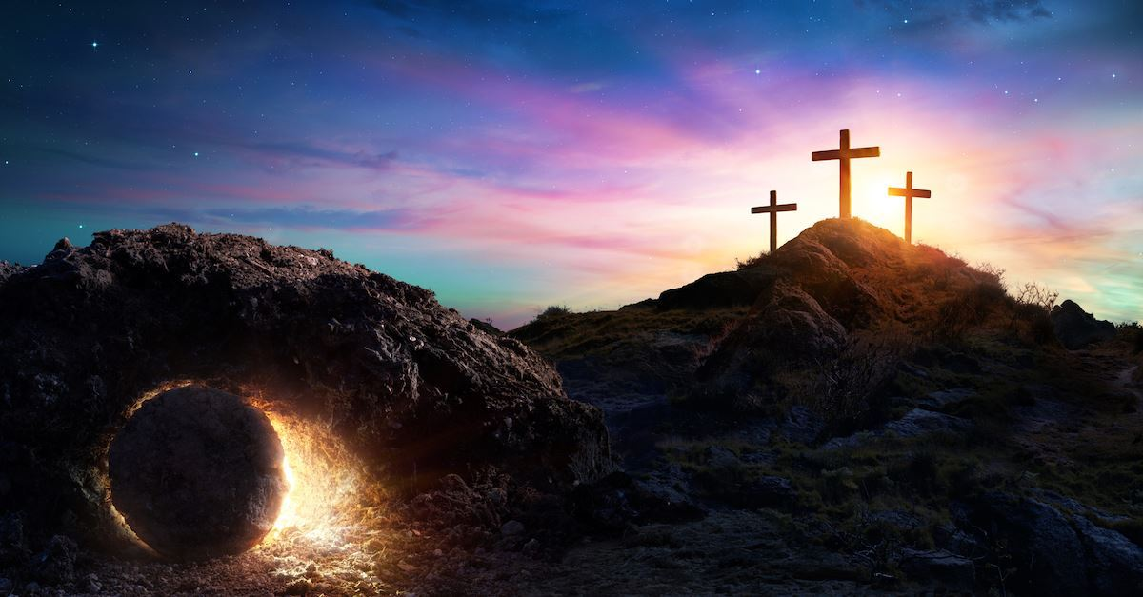

Class Worship and Reflections
Holy Week
Crucifixion

Slide 2

Church of England Colours for Worship

Slide 3
Classroom Worship
ABSTRACT
Collective worship in a classroom has a different feel from worship in the hall. The more intimate nature of the worship can make everyone feel more readily included. It is also the perfect setting to look at some of life’s big issues in a prayerful and reflective manner. This resource supports small group worship through the theme of
EASTER:
Palm Sunday
Clearing of the Temple
Anointing
Last Supper
Crucifixion
Resurrection

Slide 4

Classroom Worship
Introduction for Teachers
Classroom worship can be organised at any time of day which best suits the needs of the group.
Collective worship in a classroom has a different feel from worship in the hall. The advantages of class worship are:
  • The more intimate nature of the worship can make everyone feel more readily included—there is nobody on the far edge or at the remote back
  • The worship can be planned to be more appropriate for the age and understanding of the children present than is possible in a large mixed age gathering
  • Children and adults may feel happier at leading worship in a more familiar setting with their peers rather than in front of the whole school
Preparing for class worship is very important. If the pupils have been busy just before you are due to start encourage them now to pause and sit quietly, stilling themselves ready to begin.
Create calm, quiet atmosphere – this can be done through music or changing the lighting in the room
A worship focus- in all places of worship there is what may be termed a worship focus, in your own hall this may be a cross or a candle. It is helpful to have a worship focus for your class worship. This does not have to be a permanent feature but something that can be brought out just for the worship. Consider what would be an appropriate worship focus for your classroom e.g. a cloth, candle, cross, bible, ornament, prayer bear. You may want to have a number of appropriate worship foci in a basket that the pupils can choose and set out ready for worship.
Structure - you may well find it helpful to have a set structure to your worship. This enables even of youngest children to feel comfortable and confident with what is happening. Here we have used the gather, engage, respond, and send framework.

Slide 5

Classroom Worship
Possible music
Light of the World
https://www.youtube.com/watch?v=-MmRGSEG2LM
10,000 Reasons
https://www.youtube.com/watch?v=DXDGE_lRI0E
Jesus Is Alive – Out of the Ark
https://www.youtube.com/watch?v=RhHS7mNMNVQ&feature=youtu.be
Blessed be the Name of the Lord
https://www.youtube.com/watch?v=PnWKehsOXu8
Hosanna in the Highest
https://www.youtube.com/watch?v=p8xHr8krAII

Slide 6

Gathering these can be used at the beginning of each session
Once everyone is set up ready for worship you may want to start by lighting a candle, followed by one of these:
Leader: Peace be with you.
Pupils: And also with you.
Leader: Welcome everyone
Pupils: It is good to be here together
Play a ‘Welcome’ song as children settle.
We meet in the name of God:
  God the Father,
  God the Son,
  God the Spirit:
  God is one.
Sign: ‘Welcome everybody here’ in BSL

Slide 7
Gathering these can be used at the beginning of each session
Christ the light of the world is here
God help us to speak positive words
To share peace with everyone
To remember that you are with us
Let us celebrate what God has made
Let’s remember to show God’s love,
and to show a bit of heaven to everyone we meet.

Slide 8

Sending these can be used at the End of each session
You may want to end your time together with one of these short prayers or blessings:
As we end this time
May we live with your love
Build on your truth
Share your forgiveness
Rest in your peace
For the whole of the day. AMEN
Thank you for this day,
For fun, friendship and learning.
We give thanks for this time
As we share peace with each other. AMEN
Help us as we as we move on
To carry hope in us for the day
Turning our thoughts towards others,
Our hearts towards love,
And our hands towards serving those in need. AMEN

Slide 9
Sending these can be used at the End of each session
The Lord bless us and watch over us, he is kind and helps us to show peace. Amen
Let’s remember today to show peace and love
To forgive when others upset us
To remember that we are all equal to God
To think about what we say before we say it
To thank God for a new day
Thank you God for all your good gifts
Christ our Lord,
Just as kings bowed down and offered you gifts,
May we know your strength and peace
And see all the free gifts you have given to us
and the blessing of the Father, Son and Holy Spirit,
be with you all, evermore
Amen

Slide 10
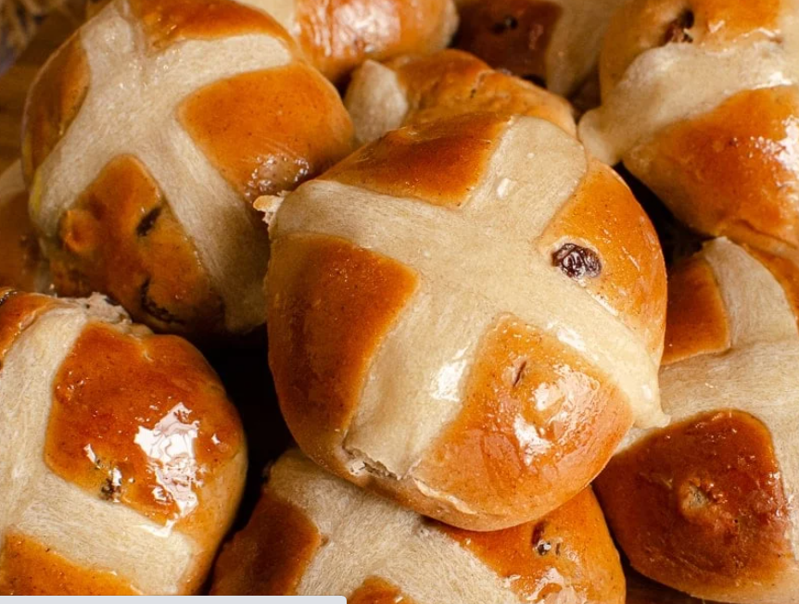
Good Friday

Slide 11
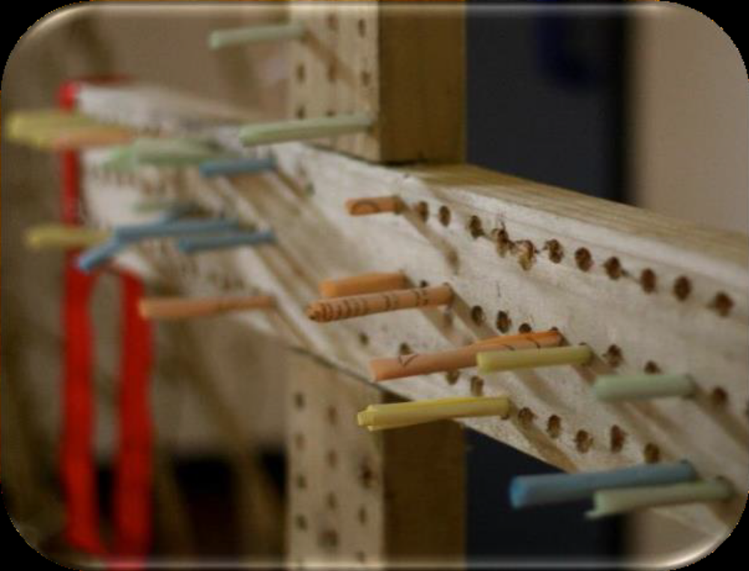
Classroom Worship
Reflection Space

Slide 12
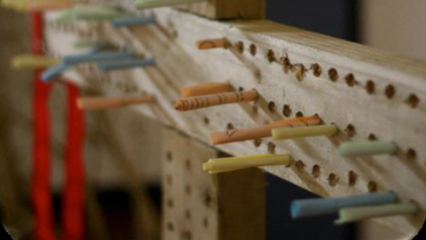
Classroom Worship
Reflection Space
Equipment:
Wooden cross, pins, paper, pens.
Set Up: Stand the large wooden cross in a corner, making sure it is stable. Put the rest of the equipment nearby.

Slide 13
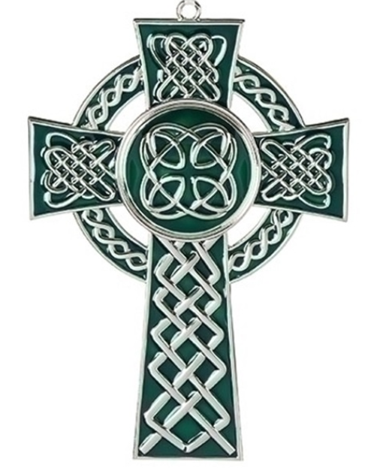
Classroom Worship
Reflection Space
Suggested Instructions:
Christians believe that because Jesus died on the cross, they can freely ask God for forgiveness - they can say sorry and know they are forgiven. We all do and say things wrong, things that we regret and wish we hadn’t. What have you done or said wrong? If you want to, you can write a sorry thought or prayer onto a piece of paper and pin it to the cross.

Slide 14

Monday

Slide 15
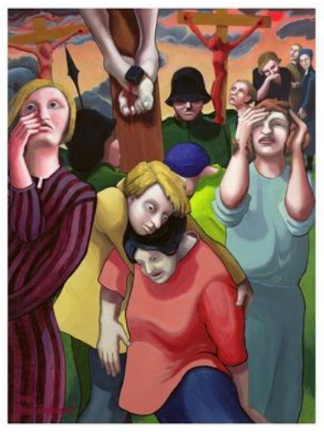


Slide 16
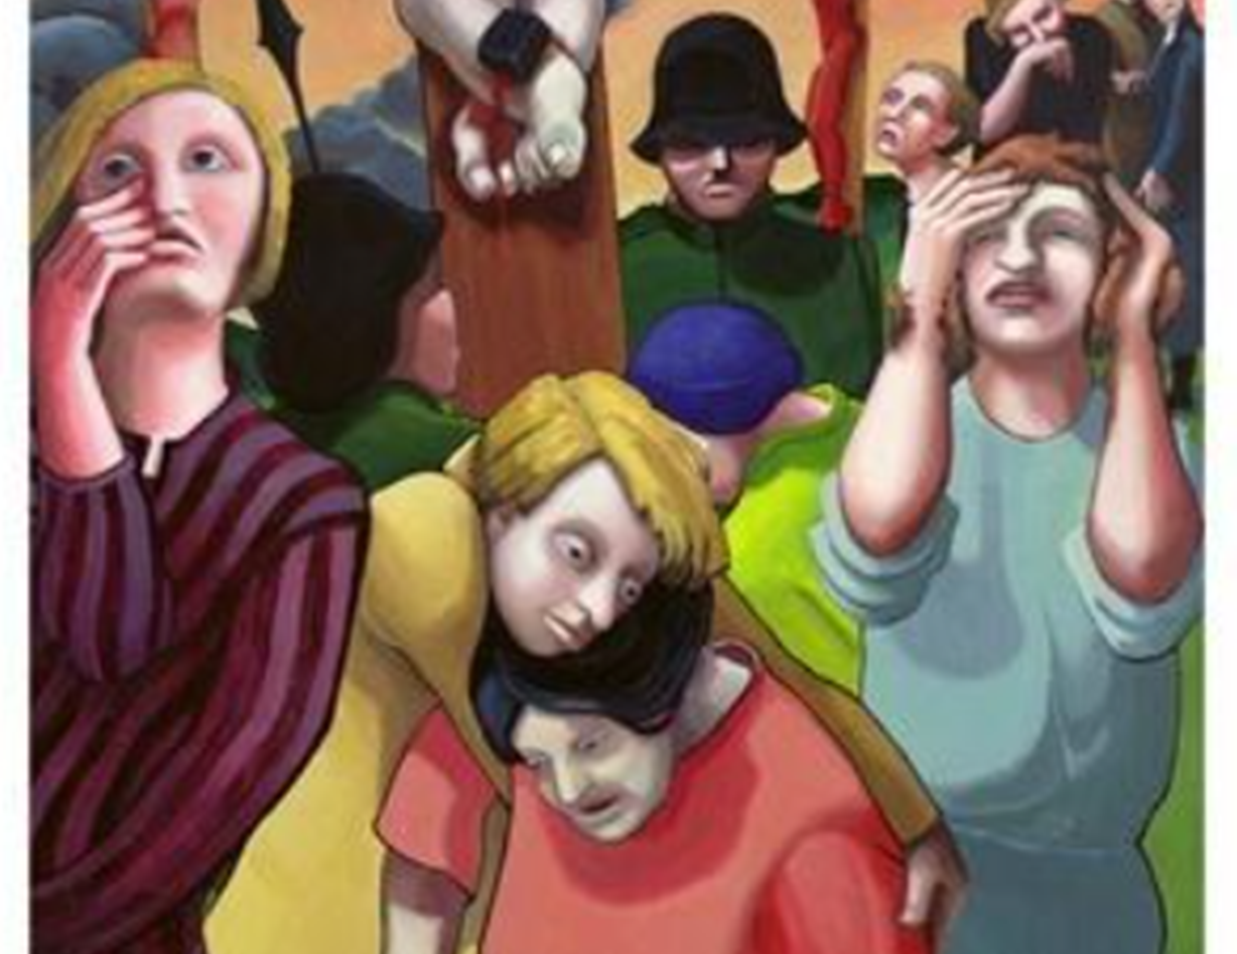
What do you see in the picture?
Can you make a prediction about what we are going to talk about today?
What questions do you have about this picture?
Come up with three questions.
Notes:
The theme is trust. Encourage children to notice the trust in the image.

Slide 17

Reflection questions
What do you think each person is thinking ?
What emotions are portrayed in the picture?

Slide 18
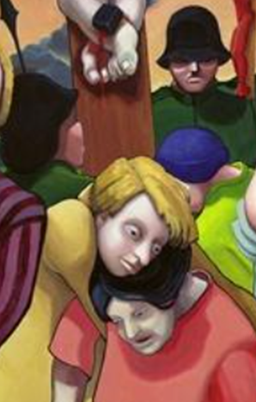

Read
The Nail
The nail is used for many things,
A useful securing tool;
A hammer is taken by the hand
And drives it, that's the rule.
A nail is needed when you build,
It's a necessary thing.
It was also used over two thousand years ago
To hang upon a tree, the King.
He took the pain and suffering
For all mankind, you see.
Yet He took the torture just for you,
And He took it just for me.

Slide 19

Responding
Jesus is crucified. The soldiers drove nails through Jesus’ hands and feet. They lifted up the cross and put it in place. Jesus was in a lot of pain.
Prayer: Many people suffer pain every day from being sick, hungry, poor, and because of war or natural disasters. Jesus, please comfort everyone who is in pain today.
Jesus dies on the cross. When Jesus died, the sky got dark and the ground started to shake. This made some people very scared. They saw that Jesus was innocent and that they had made a big mistake.
Prayer: Jesus, help me to admit when I make mistakes. Help me to say I’m sorry. Thank you for always forgiving me. I love you, and I want to do the right thing.

Slide 20

Tuesday

Slide 21
Bible Passage
The Crucifixion of Jesus
So the soldiers took charge of Jesus. 17 Carrying his own cross, he went out to the place of the Skull (which in Aramaic is called Golgotha). 18 There they crucified him, and with him two others—one on each side and Jesus in the middle.
19 Pilate had a notice prepared and fastened to the cross. It read: Jesus of Nazareth, the King of the Jews. 20 Many of the Jews read this sign, for the place where Jesus was crucified was near the city, and the sign was written in Aramaic, Latin and Greek. 21 The chief priests of the Jews protested to Pilate, “Do not write ‘The King of the Jews,’ but that this man claimed to be king of the Jews.”
22 Pilate answered, “What I have written, I have written.”

Slide 22
Bible Passage
23 When the soldiers crucified Jesus, they took his clothes, dividing them into four shares, one for each of them, with the undergarment remaining. This garment was seamless, woven in one piece from top to bottom.
24 “Let’s not tear it,” they said to one another. “Let’s decide by lot who will get it.”
This happened that the scripture might be fulfilled that said,
“They divided my clothes among them
and cast lots for my garment.”
So, this is what the soldiers did.

Slide 23
Bible Passage
25 Near the cross of Jesus stood his mother, his mother’s sister, Mary the wife of Clopas, and Mary Magdalene. 26 When Jesus saw his mother there, and the disciple whom he loved standing nearby, he said to her, “Woman, here is your son,” 27 and to the disciple, “Here is your mother.” From that time on, this disciple took her into his home.
28 Later, knowing that everything had now been finished, and so that Scripture would be fulfilled, Jesus said, “I am thirsty.” 29 A jar of wine vinegar was there, so they soaked a sponge in it, put the sponge on a stalk of the hyssop plant, and lifted it to Jesus’ lips. 30 When he had received the drink, Jesus said, “It is finished.” With that, he bowed his head and gave up his spirit.

Slide 24

After reading the passage can you identify the people in the painting?

Slide 25
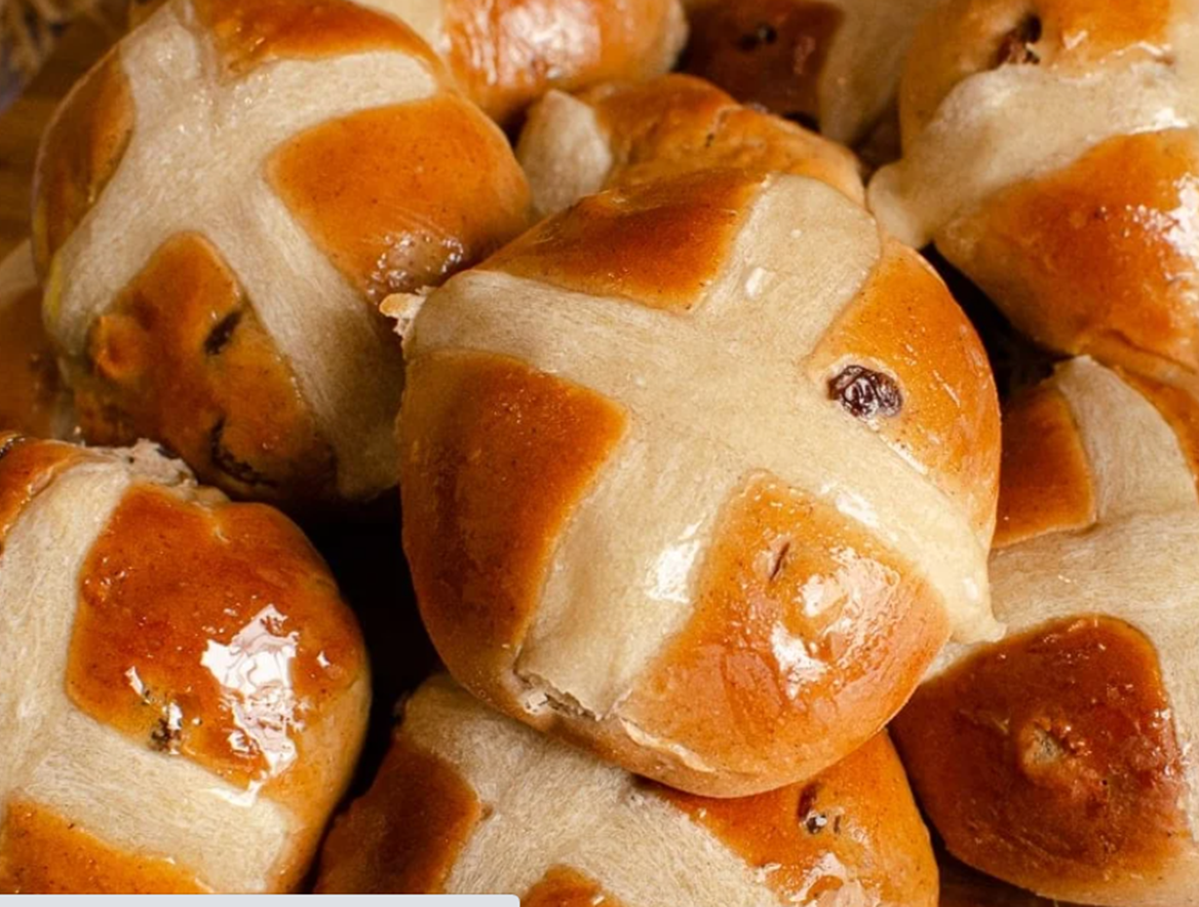
Responding
It is traditional to eat these on Good Friday.
Do you know what they are called?
Why do you think people eat them on this day?
If possible get some buns to share with the class. Can you taste the spice and the sugar?

Slide 26

Responding
The origins of hot cross buns may go back as far as the 12th century. According to the story, an Anglican monk baked the buns and marked them with a cross in honour of Good Friday.
Towards the end of the 16th century, Queen Elizabeth I passed a law limiting the sale of sweet buns to funerals, Christmas, and the Friday before Easter. At that time the English were deeply superstitious and believed the buns carried medicinal or magical properties. Some even believed that buns baked on Good Friday would never go stale.
As a way to get around the law, more and more people began baking these sweet buns at home. Not only did they grow in popularity, but the law became too difficult to enforce and was eventually scrapped.

Slide 27
Responding – going deeper
What does this song say about Jesus and his death on the cross?
Which phrase or words speak to you most?
Listen to the song:
https://www.youtube.com/watch?v=YlOJ5o8W4Lw
Man of Sorrows | Hillsong (Lyrics)
What questions do you have after listening?
What might this song teach you about a Christian view of Good Friday?

Slide 28
Prayer
Encourage the pupils to respond with their own prayers first or through the prayer space or use the prayer below:
Dear God,
Today we pause to remember your sacrificial love. That shone light into the darkness. That bore life from such emptiness. That revealed hope out of devastation. That spoke truth through incrimination. That released freedom in spite of imprisonment. And brought us forgiveness instead of punishment.
Thank you that we can now walk in the light of your life, Hope, truth, freedom and forgiveness, This day and everyday. Amen.

Slide 29

Wednesday

Slide 30

Prompted to action - challenge
Remind pupils of the theme for the week and of the Bible story- Jesus the sacrificial King.
You may want to watch the Crucifixion clip:
https://request.org.uk/restart/2017/03/14/holy-week-and-easter/
The LOVE logo was designed by Frank McGregor

Slide 31
Prompted to action - challenge
What do you see when you look at this cross?
The Bible teachers, ‘For God so loved the world that he gave his one and only Son.’
Christians believe that the cross is a sign of God’s sacrificial love for each one of us.
What do you think about that?
The LOVE logo was designed by Frank McGregor

Slide 32
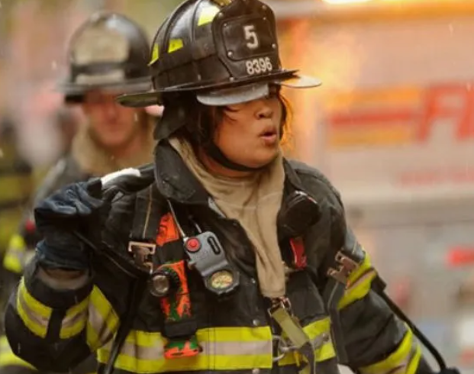
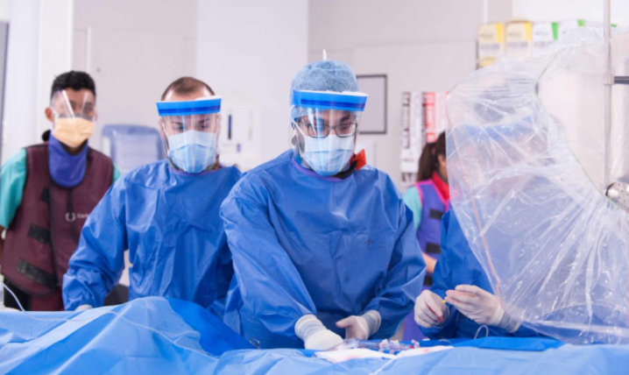
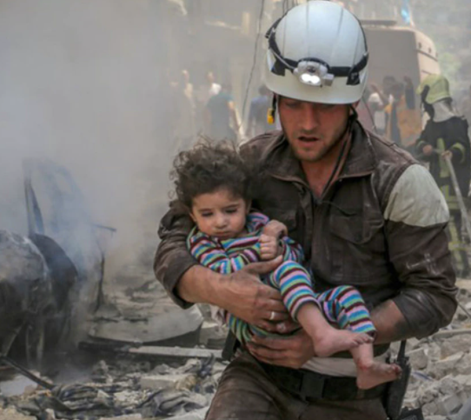

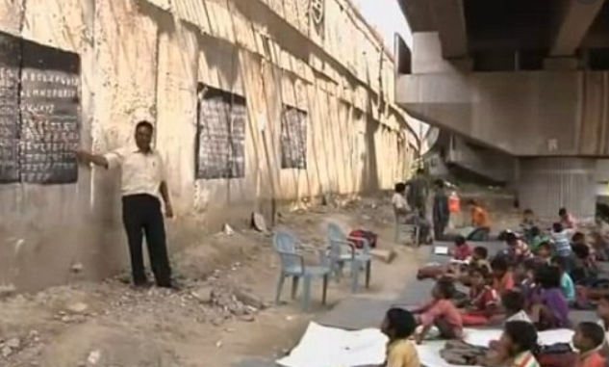
Prompted to action – challenge ideas
How are these people showing sacrificial love.

Slide 33
Prompted to action – challenge ideas
Whether we are Christians or not it is important to show love and respect to others.
How can we do that today?
Is there anything we can learn from the Easter story about showing love to others?
The Bible also says:
‘We love because
God first loved
us.’

Slide 34
Prayer
Encourage the pupils to respond with their own prayers first or through the prayer space. You could use the school’s prayer or the Lord’s Prayer:
Our Father, in heaven,
Holy is your name.
Your Kingdom come,
Your will be done on earth, as it is in heaven.
Give us this day our daily bread,
And forgive us our sins,
As we forgive those who sin against us,
And lead us not into temptation,
But deliver us from evil.
Amen.

Slide 35

Thursday

Slide 36
Use the Meditation resource alongside the Spiritual Encounters – bible-based meditation teacher’s pack: http://www.ldbe.co.uk/about/guidance- resources/worship-and-meditation/
Alternatively, you could also use any of the the following: https://engageworship.org/ideas/jesus-king-of-kings-printable-crown https://www.youtube.com/watch?v=dQl4izxPeNU

Slide 37

Friday

Slide 38
Take this time to celebrate what has happened during the week – you may want to give out awards. If possible, join the bubbles using Zoom or Teams so that the whole school can come together in a time of celebration.
Remember that this should also be a time of worship and celebration so begin with a gathering, include a prayer, a blessing, and a song of celebration.

