Slide 1
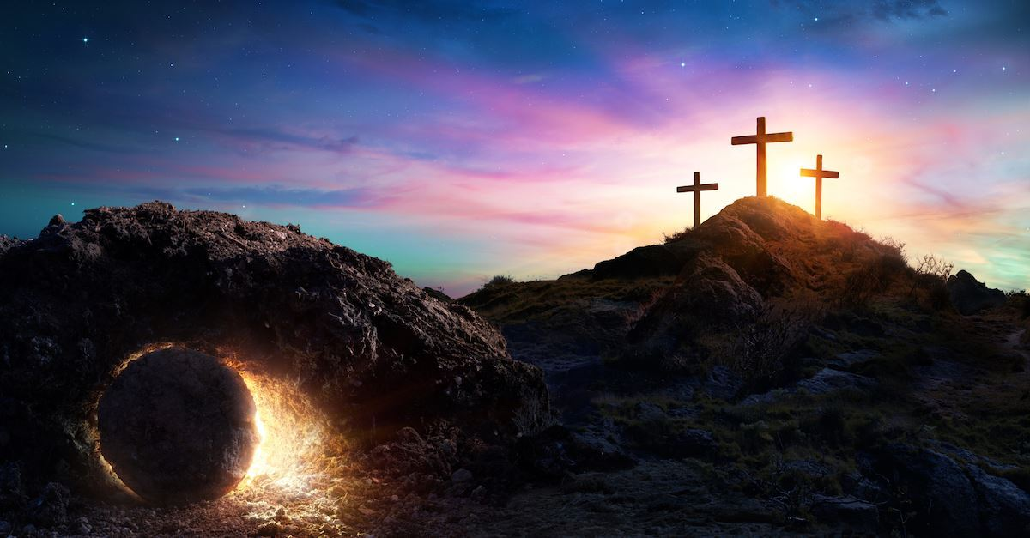

Class Worship and Reflections
Resurrection

Slide 2

Church of England Colours for Worship

Slide 3
Classroom Worship
ABSTRACT
Collective worship in a classroom has a different feel from worship in the hall. The more intimate nature of the worship can make everyone feel more readily included. It is also the perfect setting to look at some of life’s big issues in a prayerful and reflective manner. This resource supports small group worship through the theme of
EASTER:
Palm Sunday
Clearing of the Temple
Anointing
Last Supper
Crucifixion
Resurrection

Slide 4

Classroom Worship
Introduction for Teachers
Classroom worship can be organised at any time of day which best suits the needs of the group.
Collective worship in a classroom has a different feel from worship in the hall. The advantages of class worship are:
  • The more intimate nature of the worship can make everyone feel more readily included—there is nobody on the far edge or at the remote back
  • The worship can be planned to be more appropriate for the age and understanding of the children present than is possible in a large mixed age gathering
  • Children and adults may feel happier at leading worship in a more familiar setting with their peers rather than in front of the whole school
Preparing for class worship is very important. If the pupils have been busy just before you are due to start encourage them now to pause and sit quietly, stilling themselves ready to begin.
Create calm, quiet atmosphere – this can be done through music or changing the lighting in the room
A worship focus- in all places of worship there is what may be termed a worship focus, in your own hall this may be a cross or a candle. It is helpful to have a worship focus for your class worship. This does not have to be a permanent feature but something that can be brought out just for the worship. Consider what would be an appropriate worship focus for your classroom e.g. a cloth, candle, cross, bible, ornament, prayer bear. You may want to have a number of appropriate worship foci in a basket that the pupils can choose and set out ready for worship.
Structure - you may well find it helpful to have a set structure to your worship. This enables even of youngest children to feel comfortable and confident with what is happening. Here we have used the gather, engage, respond, and send framework.

Slide 5

Classroom Worship
Possible music
Light of the World
https://www.youtube.com/watch?v=-MmRGSEG2LM
10,000 Reasons
https://www.youtube.com/watch?v=DXDGE_lRI0E
Jesus Is Alive – Out of the Ark
https://www.youtube.com/watch?v=RhHS7mNMNVQ&feature=youtu.be
Blessed be the Name of the Lord
https://www.youtube.com/watch?v=PnWKehsOXu8
Hosanna in the Highest
https://www.youtube.com/watch?v=p8xHr8krAII

Slide 6

Gathering these can be used at the beginning of each session
Once everyone is set up ready for worship you may want to start by lighting a candle, followed by one of these:
Leader: Peace be with you.
Pupils: And also with you.
Leader: Welcome everyone
Pupils: It is good to be here together
Play a ‘Welcome’ song as children settle.
We meet in the name of God:
  God the Father,
  God the Son,
  God the Spirit:
  God is one.
Sign: ‘Welcome everybody here’ in BSL

Slide 7
Gathering these can be used at the beginning of each session
Christ the light of the world is here
God help us to speak positive words
To share peace with everyone
To remember that you are with us
Let us celebrate what God has made
Let’s remember to show God’s love,
and to show a bit of heaven to everyone we meet.

Slide 8

Sending these can be used at the End of each session
You may want to end your time together with one of these short prayers or blessings:
As we end this time
May we live with your love
Build on your truth
Share your forgiveness
Rest in your peace
For the whole of the day. AMEN
Thank you for this day,
For fun, friendship and learning.
We give thanks for this time
As we share peace with each other. AMEN
Help us as we as we move on
To carry hope in us for the day
Turning our thoughts towards others,
Our hearts towards love,
And our hands towards serving those in need. AMEN

Slide 9
Sending these can be used at the End of each session
The Lord bless us and watch over us, he is kind and helps us to show peace. Amen
Let’s remember today to show peace and love
To forgive when others upset us
To remember that we are all equal to God
To think about what we say before we say it
To thank God for a new day
Thank you God for all your good gifts
Christ our Lord,
Just as kings bowed down and offered you gifts,
May we know your strength and peace
And see all the free gifts you have given to us
and the blessing of the Father, Son and Holy Spirit,
be with you all, evermore
Amen

Slide 10

Easter Sunday
Resurrection

Slide 11

Classroom Worship
Reflection Space

Slide 12
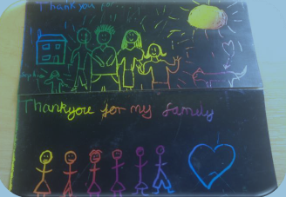
Classroom Worship
Reflection Space
Equipment: Scratch cards e.g.
www.bakerross.co.uk/scratch-art-doodle-sheets-1
Set Up: Scratch cards can be cut into halves or quarters.
Something to scratch with.

Slide 13
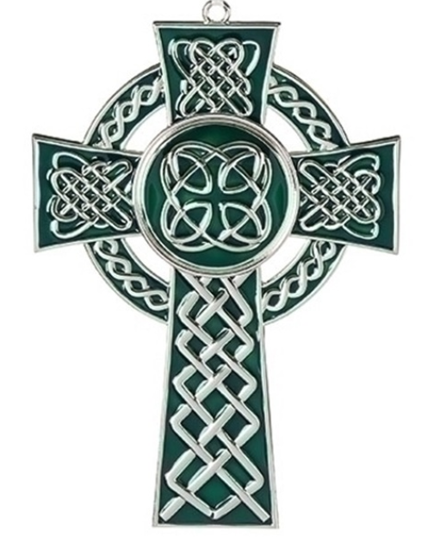
Classroom Worship
Reflection Space
Suggested Instructions:
After Jesus died, his body was put into a tomb. Jesus’ friends were afraid and confused; it was a dark time. It felt like all their hopes and dreams had died with Jesus. But three days later, the tomb was empty and Jesus was alive!
We all have hopes and dreams, things that seem impossible, but we hold onto our hopes. If you want to, you can scratch a thought or prayer or a picture about your hope or dreams onto the scratch card.
As you do this you will see the colours – like hope, coming through the darkness.

Slide 14

Monday

Slide 15
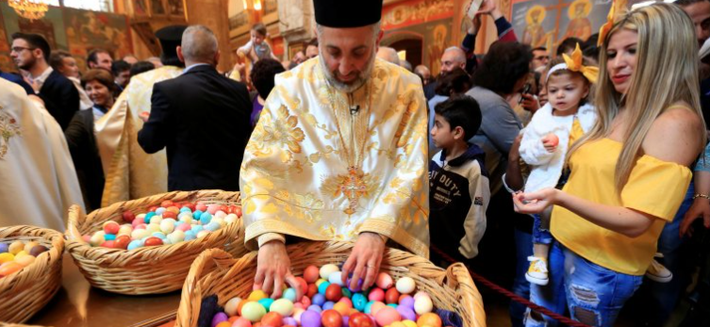


Slide 16
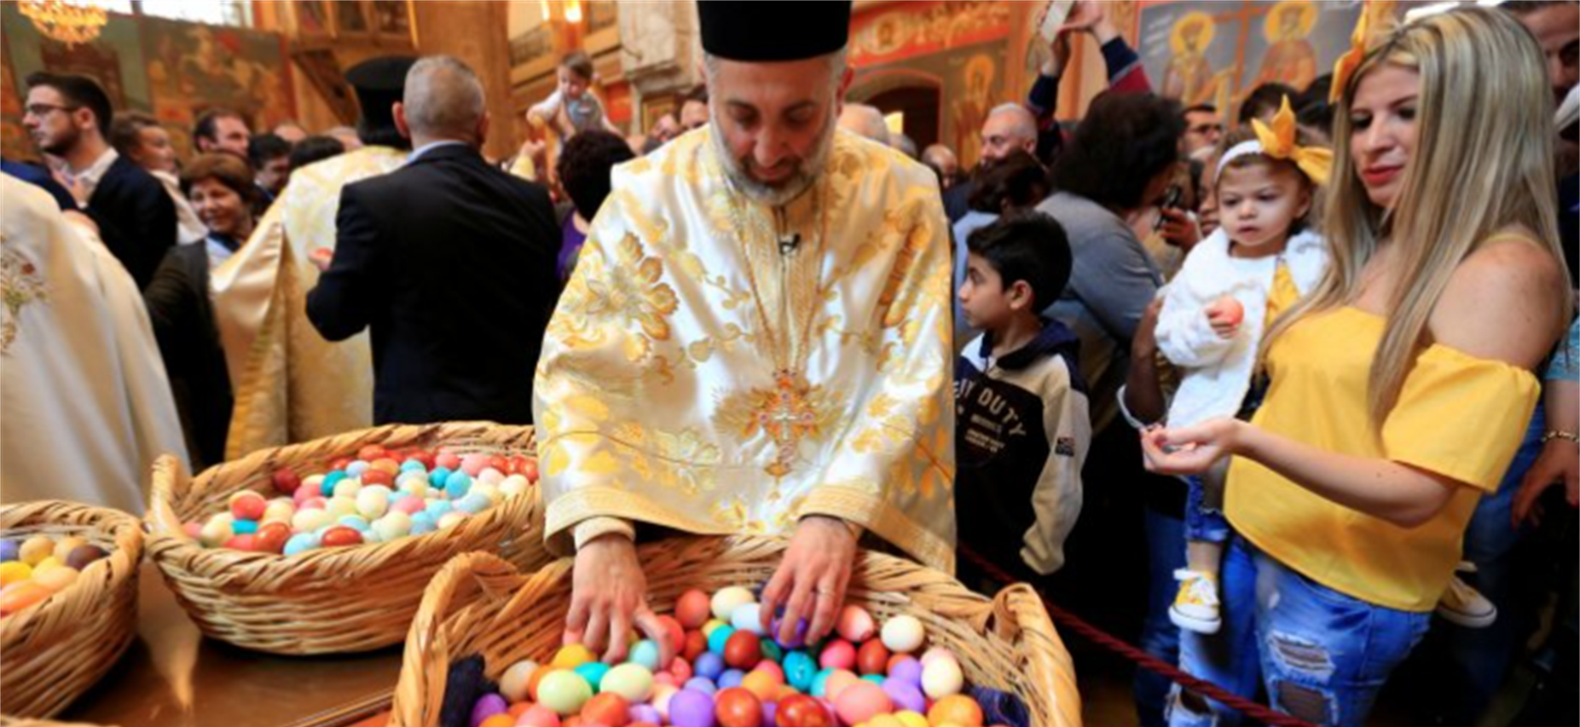
What do you see in the picture?
Can you make a prediction about what we are going to talk about today?
What questions do you have about this picture?
Come up with three questions.
Notes:
The theme is trust. Encourage children to notice the trust in the image.

Slide 17

Reflection questions
What do you think each person is thinking ?
What emotions are portrayed in the picture?

Slide 18

Jesus Has Risen – Luke 24
24 On the first day of the week, very early in the morning, the women took the spices they had prepared and went to the tomb. 2 They found the stone rolled away from the tomb, 3 but when they entered, they did not find the body of the Lord Jesus. 4 While they were wondering about this, suddenly two men in clothes that gleamed like lightning stood beside them. 5 In their fright the women bowed down with their faces to the ground, but the men said to them, “Why do you look for the living among the dead? 6 He is not here; he has risen! Remember how he told you, while he was still with you in Galilee: 7 ‘The Son of Man must be delivered over to the hands of sinners, be crucified and on the third day be raised again.’ ” 8 Then they remembered his words.
9 When they came back from the tomb, they told all these things to the Eleven and to all the others. 10 It was Mary Magdalene, Joanna, Mary the mother of James, and the others with them who told this to the apostles. 11 But they did not believe the women, because their words seemed to them like nonsense. 12 Peter, however, got up and ran to the tomb. Bending over, he saw the strips of linen lying by themselves, and he went away, wondering to himself what had happened.

Slide 19

Responding
Easter is the most important celebration for Christians all around the world – it is a time when they remember Jesus’ being raised from the dead. Christians believe that if Jesus had not be raised from the dead all that he taught and did would have meant nothing and there would not be a Christian church today.
The picture that we looked at was a picture of a priest in a Greek Orthodox church giving out Easter eggs as part of the celebrations.
You may want to listen to this song about Easter to get a sense of how important Easter is for Christians.
https://www.youtube.com/watch?v=9u7V-g_cJaU

Slide 20
Responding – an easter prayer that you may like to use
Lord of life
We pray for all who bring your word of life
As a light to those in darkness
For those who bring your word of peace
To those enslaved by fear
For those who bring your word of love
To those in need of comfort
Lord of love and Lord of peace
Lord of resurrection life
Be known
Through our lives
and through your power
Christ the Lord is risen to-day. Alleluia!

Slide 21
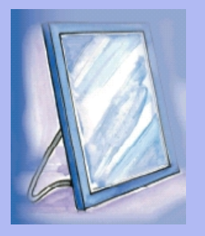
Tuesday

Slide 22
Bible Passage
Jesus Appears to the Disciples
35 Then the two from Emmaus told their story of how Jesus had appeared to them as they were walking along the road, and how they had recognized him as he was breaking the bread. 36 And just as they were telling about it, Jesus himself was suddenly standing there among them. “Peace be with you,” he said. 37 But the whole group was startled and frightened, thinking they were seeing a ghost!
38 “Why are you frightened?” he asked. “Why are your hearts filled with doubt? 39 Look at my hands. Look at my feet. You can see that it’s really me. Touch me and make sure that I am not a ghost, because ghosts don’t have bodies, as you see that I do.” 40 As he spoke, he showed them his hands and his feet.
41 Still they stood there in disbelief, filled with joy and wonder. Then he asked them, “Do you have anything here to eat?” 42 They gave him a piece of broiled fish, 43 and he ate it as they watched.

Slide 23
Bible Passage
44 Then he said, “When I was with you before, I told you that everything written about me in the law of Moses and the prophets and in the Psalms must be fulfilled.” 45 Then he opened their minds to understand the Scriptures. 46 And he said, “Yes, it was written long ago that the Messiah would suffer and die and rise from the dead on the third day. 47 It was also written that this message would be proclaimed in the authority of his name to all the nations,[f] beginning in Jerusalem: ‘There is forgiveness of sins for all who repent.’ 48 You are witnesses of all these things.
49 “And now I will send the Holy Spirit, just as my Father promised. But stay here in the city until the Holy Spirit comes and fills you with power from heaven.”

Slide 24
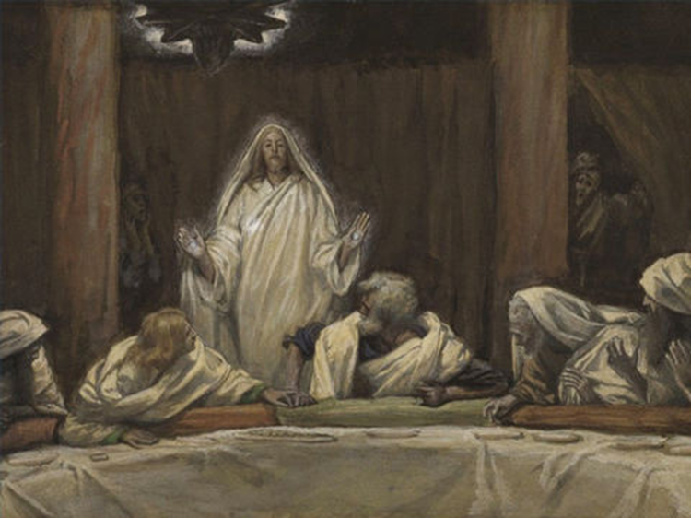

How do you think the disciples would have felt when they saw Jesus alive again?
Jesus showed them his scars and ate food with them – why do you think he did this?

Slide 25
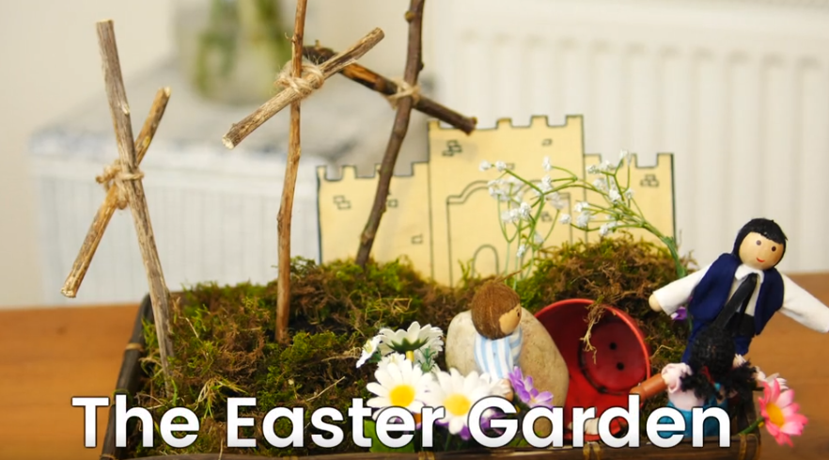
Easter Today – Make an easter garden https://request.org.uk/restart/2017/02/23/make-an-easter-garden/
It is traditional to make an Easter Garden
What can you see in the garden?
If you were to make a garden what would you put into it?
If possible make your own Easter Garden or draw a design for one.

Slide 26
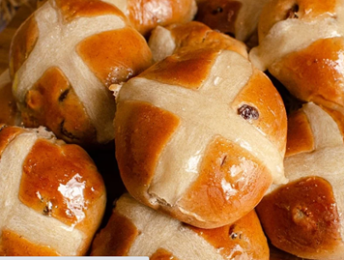
Responding
The origins of hot cross buns may go back as far as the 12th century. According to the story, an Anglican monk baked the buns and marked them with a cross in honour of Good Friday.
Towards the end of the 16th century, Queen Elizabeth I passed a law limiting the sale of sweet buns to funerals, Christmas, and the Friday before Easter. At that time the English were deeply superstitious and believed the buns carried medicinal or magical properties. Some even believed that buns baked on Good Friday would never go stale.
As a way to get around the law, more and more people began baking these sweet buns at home. Not only did they grow in popularity, but the law became too difficult to enforce and was eventually scrapped.

Slide 27
Responding – going deeper
What does this song say about Jesus, his death and resurrection?
Which phrase or words speak to you most?
Listen to the song:
https://www.youtube.com/watch?v=BOiIW8nrw5g
Tim Hughes - Happy Day
What questions do you have after listening?
What might this song teach you about a Christian view of Easter?

Slide 28
Prayer
Encourage the pupils to respond with their own prayers first or through the prayer space or use the prayer below:
Dear God,
Today we pause to remember your resurrection power. That shone light into the darkness. That bore life from such emptiness. That revealed hope out of devastation. That spoke truth through incrimination. That released freedom in spite of imprisonment. And brought us forgiveness instead of punishment.
Thank you that we can now walk in the light of your life, Hope, truth, freedom and forgiveness, This day and everyday. Amen.

Slide 29

Wednesday

Slide 30

Prompted to action - challenge
Remind pupils of the theme for the week and of the Bible story- Jesus the risen King.
For Christians Easter is all about love and hope shown through the cross and the resurrection.

Slide 31
Prompted to action - challenge
How can you share hope and love this Easter time?
Some ideas but there will be plenty more that you can think of:
Collect Easter Eggs to give to a local home or hospital
Design Easter cards to give out to people in your local community
Cut out Easter eggs from card and create a fun Easter Egg hunt in your local area
Collect food for a local food bank…
Remind pupils of the theme for the week and of the Bible story- Jesus the risen King.
For Christians Easter is all about love and hope shown through the cross and the resurrection.
Watch
https://www.youtube.com/watch?v=LllzW8lJPJ8
Bob Hartman’s the resurrection

Slide 32
Prayer
Encourage the pupils to respond with their own prayers first or through the prayer space. You could use the school’s prayer or the Lord’s Prayer:
Our Father, in heaven,
Holy is your name.
Your Kingdom come,
Your will be done on earth, as it is in heaven.
Give us this day our daily bread,
And forgive us our sins,
As we forgive those who sin against us,
And lead us not into temptation,
But deliver us from evil.
Amen.

Slide 33

Thursday

Slide 34
Use the Meditation resource alongside the Spiritual Encounters – bible-based meditation teacher’s pack: http://www.ldbe.co.uk/about/guidance- resources/worship-and-meditation/
Alternatively, you could also use any of the the following: https://engageworship.org/ideas/jesus-king-of-kings-printable-crown https://www.youtube.com/watch?v=dQl4izxPeNU

Slide 35

Friday

Slide 36
Take this time to celebrate what has happened during the week – you may want to give out awards. If possible, join the bubbles using Zoom or Teams so that the whole school can come together in a time of celebration.
Remember that this should also be a time of worship and celebration so begin with a gathering, include a prayer, a blessing, and a song of celebration.

