Slide 1
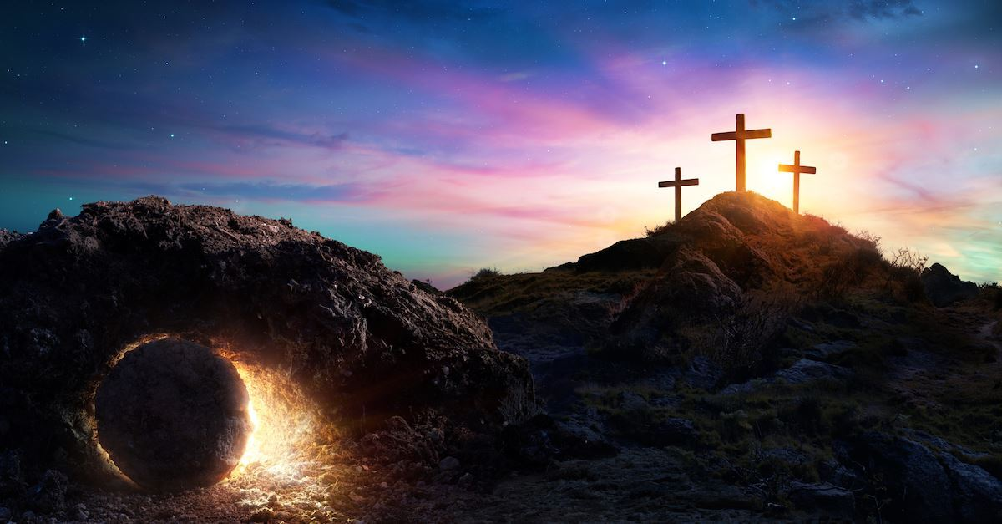

Class Worship and Reflections
Holy Week

Slide 2

Church of England Colours for Worship

Slide 3
Classroom Worship
ABSTRACT
Collective worship in a classroom has a different feel from worship in the hall. The more intimate nature of the worship can make everyone feel more readily included. It is also the perfect setting to look at some of life’s big issues in a prayerful and reflective manner. This resource supports small group worship through the theme of
EASTER:
Palm Sunday
Clearing of the Temple
Anointing
Last Supper
Crucifixion
Resurrection

Slide 4

Classroom Worship
Introduction for Teachers
Classroom worship can be organised at any time of day which best suits the needs of the group.
Collective worship in a classroom has a different feel from worship in the hall. The advantages of class worship are:
  • The more intimate nature of the worship can make everyone feel more readily included—there is nobody on the far edge or at the remote back
  • The worship can be planned to be more appropriate for the age and understanding of the children present than is possible in a large mixed age gathering
  • Children and adults may feel happier at leading worship in a more familiar setting with their peers rather than in front of the whole school
Preparing for class worship is very important. If the pupils have been busy just before you are due to start encourage them now to pause and sit quietly, stilling themselves ready to begin.
Create calm, quiet atmosphere – this can be done through music or changing the lighting in the room
A worship focus- in all places of worship there is what may be termed a worship focus, in your own hall this may be a cross or a candle. It is helpful to have a worship focus for your class worship. This does not have to be a permanent feature but something that can be brought out just for the worship. Consider what would be an appropriate worship focus for your classroom e.g. a cloth, candle, cross, bible, ornament, prayer bear. You may want to have a number of appropriate worship foci in a basket that the pupils can choose and set out ready for worship.
Structure - you may well find it helpful to have a set structure to your worship. This enables even of youngest children to feel comfortable and confident with what is happening. Here we have used the gather, engage, respond, and send framework.

Slide 5

Classroom Worship
Possible music
Light of the World
https://www.youtube.com/watch?v=-MmRGSEG2LM
10,000 Reasons
https://www.youtube.com/watch?v=DXDGE_lRI0E
King of Kings
https://www.youtube.com/watch?v=Of5IcFWiEpg
Blessed be the Name of the Lord
https://www.youtube.com/watch?v=PnWKehsOXu8
Hosanna in the Highest
https://www.youtube.com/watch?v=p8xHr8krAII

Slide 6

Gathering these can be used at the beginning of each session
Once everyone is set up ready for worship you may want to start by lighting a candle, followed by one of these:
Leader: Peace be with you.
Pupils: And also with you.
Leader: Welcome everyone
Pupils: It is good to be here together
Play a ‘Welcome’ song as children settle.
We meet in the name of God:
  God the Father,
  God the Son,
  God the Spirit:
  God is one.
Sign: ‘Welcome everybody here’ in BSL

Slide 7
Gathering these can be used at the beginning of each session
Christ the light of the world is here
God help us to speak positive words
To share peace with everyone
To remember that you are with us
Let us celebrate what God has made
Let’s remember to show God’s love,
and to show a bit of heaven to everyone we meet.

Slide 8

Sending these can be used at the End of each session
You may want to end your time together with one of these short prayers or blessings:
As we end this time
May we live with your love
Build on your truth
Share your forgiveness
Rest in your peace
For the whole of the day. AMEN
Thank you for this day,
For fun, friendship and learning.
We give thanks for this time
As we share peace with each other. AMEN
Help us as we as we move on
To carry hope in us for the day
Turning our thoughts towards others,
Our hearts towards love,
And our hands towards serving those in need. AMEN

Slide 9
Sending these can be used at the End of each session
The Lord bless us and watch over us, he is kind and helps us to show peace. Amen
Let’s remember today to show peace and love
To forgive when others upset us
To remember that we are all equal to God
To think about what we say before we say it
To thank God for a new day
Thank you God for all your good gifts
Christ our Lord,
Just as kings bowed down and offered you gifts,
May we know your strength and peace
And see all the free gifts you have given to us
and the blessing of the Father, Son and Holy Spirit,
be with you all, evermore
Amen

Slide 10
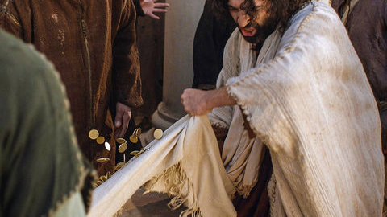
Jesus clears the temple

Slide 11

Classroom Worship
Reflection Space
.
https://www.prayerspacesinschools.com/prayer-spaces-at-home/?ps=12

Slide 12
Classroom Worship
Reflection Space
Equipment
Candle, matches
Set up
Put the candle in the middle of a table or on a windowsill (please ensure an adult is present)
Instructions
When life is difficult we often need someone to encourage and help us – to light up our darkness. Who do you know that needs encouragement or help today? Who needs light in their darkness? Ask an adult to light the candle. Say a prayer for this person. Perhaps you could ‘be the light’ by sending them a message today..

Slide 13

Monday

Slide 14
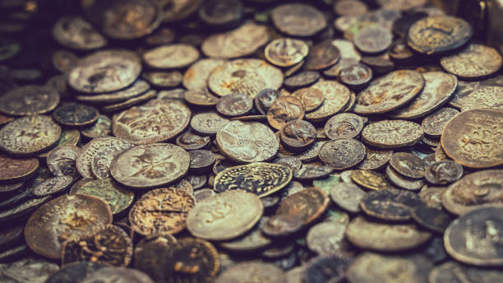


Slide 15

What do you see in the picture?
Can you make a prediction about what we are going to talk about today?
What questions do you have about this picture?
Come up with three questions.

Slide 16

Reflection questions
I wonder what the most important thing in your life is?
I wonder how important money is to you?

Slide 17

BIBLE STORY JOHN 2: 12-16 https://www.youtube.com/watch?v=boNIL1owRAI
Jesus in the Temple
¹² Then Jesus went to the town of Capernaum with his mother, brothers and his followers. They all stayed in Capernaum for a few days. ¹³ But it was almost time for the Jewish Passover Feast. So Jesus went to Jerusalem. ¹⁴ In the Temple he found men selling cattle, sheep, and doves. He saw others sitting at tables, exchanging money. ¹⁵ Jesus made a whip out of cords. Then he forced all these men, with the sheep and cattle, to leave the Temple. He turned over the tables and scattered the money of the men who were exchanging it. ¹⁶ Then he said to those who were selling pigeons, “Take these things out of here! Don’t make my Father’s house a place for buying and selling!”
Notes:
Jesus was angry because the people had turned God’s house into what? A market
What did Jesus do to when he saw that men had turned the temple courts into a market place? He made a whip out of cords and drove out all the animals, scattered the coins of the moneychangers, and turned over their tables.

Slide 18
Reflection questions
How do you think Jesus felt when he went into the temple?
Did the story make you ask any questions?
Explain why you think he felt that way.
Notes:
Possible questions which the story could prompt:
What kind of man was Jesus?
Why did Jesus get so angry?
If watching the clip, where do you think the story was set? Do children realise the sellers are in the temple?
Is it ever ok to sell things in a church/holy building?
What should the temple be used for?
Does the market matter more than worship?

Slide 19
Reflection questions
Is it ever right to be angry?
Notes:
Alternatively, you could discuss any questions which the children identified in the previous slide.

Slide 20
Prayer
Encourage the pupils to respond with their own prayers first, through the prayer space or with the prayer below:
Thank you God for sending Jesus to be our teacher and friend.
Thank you for helping us see which things in life are important.
And help us to notice the things that are not
Teach us to value our families and friends more than the ‘things’ we own.
Amen

Slide 21

Tuesday

Slide 22
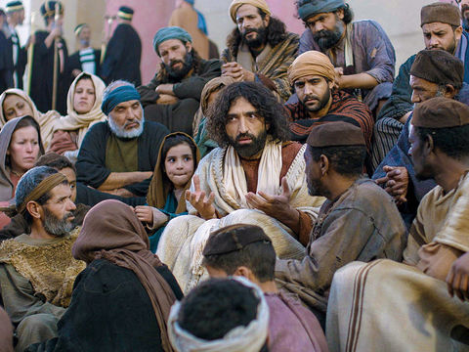
Notes:
The image shows Jesus teaching. In the crowd there are lots of different people. Men, women, children and people from all different nations/places. At this time, teachers/rabbis often directed there teaching to men – women and children would have not been included.

Slide 23
What do you see in the picture?
Can you make a prediction about what we are going to talk about today?
What questions do you have about this picture?
Come up with three questions.
Notes:
Look carefully at the image:
Who can you see in the picture?
What do you think Jesus is doing?

Slide 24
Bible Passage (based on mark 11:15 - 17)
Jesus Goes to the Temple
¹⁵ Jesus returned to Jerusalem and went into the Temple. He began to throw out those who were buying and selling things there. He overturned the tables that belonged to the men who were exchanging different kinds of money. And he turned over the benches of the men who were selling doves. ¹⁶ Jesus refused to allow anyone to carry goods through the Temple courts. ¹⁷ Then Jesus taught the people. He said, “It is written in the Scriptures, ‘My Temple will be a house where people from all nations will pray.’ But you are changing God’s house into a ‘hideout for robbers.’”
Notes:
The passage explored is the same story as the one explored yesterday but from a different perspective – another of the Gospel writers.
Verse 17 is vitally important and the purpose of discussions today. In the picture before, Jesus was teaching to lots of different people – men, women, children, those from different nations

Slide 25
Responding
What more can we learn from this story?
What do you find encouraging?
What do you find challenging?
Notes:
Would it make God angry…
…if people cared about money but not about prayer?
…if people excluded other races from worship? I
…if the market mattered more than worship?
Is this story of Jesus getting angry about the importance of prayer, or the value of holy buildings?
Does it teach that Gentiles have the right to pray as well as Jewish people, or that market traders had better watch out?
The people of God were always supposed to attract other nations (i.e. Gentiles, non-Jewish people) to God. Here they appear to be making it difficult. Jesus emphasises that the ‘good news’ is for all

Slide 26
Prayer
Encourage the pupils to respond with their own prayers first or through the prayer space or use the prayer below:
Dear God,
Thank you for showing us how important it is to include everyone.
Help us to include others in our work and play
And help us to share your good news and hope with everyone.
In Jesus name we pray,
Amen

Slide 27

Wednesday

Slide 28
Prompted to action - challenge
Remind people of the theme for the week and of the Bible story.
Jesus was angry because the temple was being used as a market and people from other nations were unable to pray.

Slide 29
Prompted to action – challenge ideas
Jesus was passionate about making sure that everyone was included. How can you follow his example?
Notes:
Jesus was angry that the place in the temple where people from all nations could pray was being used as a market.
Jesus’ ministry included all.

Slide 30

Prompted to action – challenge ideas
.
Write an idea on the outline of something you can do today to include everyone.
Notes:
This could be at school, at playtime or in group activities.
It could also be at home – how can I include my siblings? – Play a board game, play together outside etc
How can I include someone in my class in an activity (virtually/sending a letter/online game etc)
Shapes could be coloured to reflect how we are all unique and attached to one another to create a banner. Alternatively you could create a people chain. Various examples on Youtube https://www.youtube.com/watch?v=kZo68K6vWZ4

Slide 31
Prayer
Encourage the pupils to respond with their own prayers first or through the prayer space. You could use the school’s prayer or the Lord’s Prayer:
Our Father, in heaven,
Holy is your name.
Your Kingdom come,
Your will be done on earth, as it is in heaven.
Give us this day our daily bread,
And forgive us our sins,
As we forgive those who sin against us,
And lead us not into temptation,
But deliver us from evil.
Amen.

Slide 32

Thursday

Slide 33
Use the Meditation resource alongside the Spiritual Encounters – bible-based meditation teacher’s pack: http://www.ldbe.co.uk/about/guidance- resources/worship-and-meditation/
Alternatively, you could also use any of the following:

Slide 34

Friday

Slide 35
Take this time to celebrate what has happened during the week – you may want to give out awards. If possible, join the bubbles using Zoom or Teams so that the whole school can come together in a time of celebration.
Remember that this should also be a time of worship and celebration so begin with a gathering, include a prayer, a blessing, and a song of celebration.

