Slide 1
Picture Reflections
Appreciate beauty in the world

Slide 2
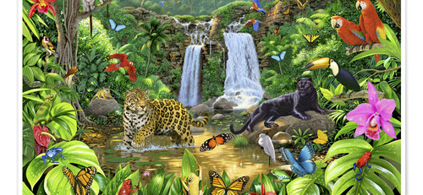

Slide 3
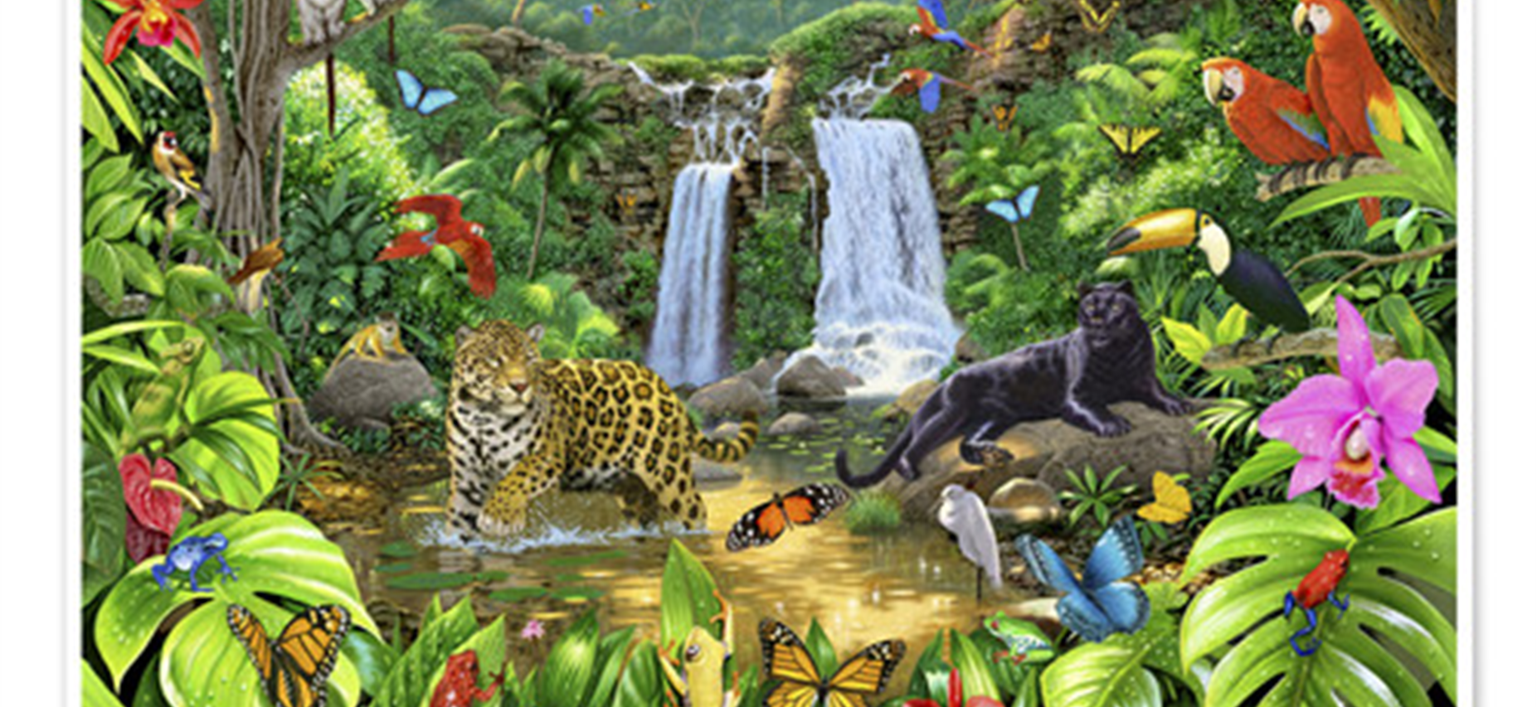

What do you see in the picture?
Can you make a prediction about what we are going to be talking about?
What questions do you have about this picture?
Come up with three questions.

Slide 4
What makes you go ‘Wow’ in nature? Psalm 8
Lord our Master,
your name is the most wonderful name in all the earth!
It brings you praise in heaven above.
2 You have taught children and babies
to sing praises to you.
This is because of your enemies.
And so you silence your enemies
and destroy those who try to get even.
3 I look at the heavens,
which you made with your hands.
I see the moon and stars,
which you created.
4 But why is man important to you?
Why do you take care of human beings?

Slide 5
What makes you go ‘Wow’ in nature? Psalm 8
5 You made man a little lower than the angels.
And you crowned him with glory and honour.
6 You put him in charge of everything you made.
You put all things under his control:
7 all the sheep, the cattle
and the wild animals,
8 the birds in the sky,
the fish in the sea,
and everything that lives under water.
9 Lord our Master,
your name is the most wonderful name in all the earth!

Slide 6
Why is showing gratitude so important?
How do you feel about this poem?
What do you think the writer was trying to say?
What is your one key emotional response word?

Slide 7
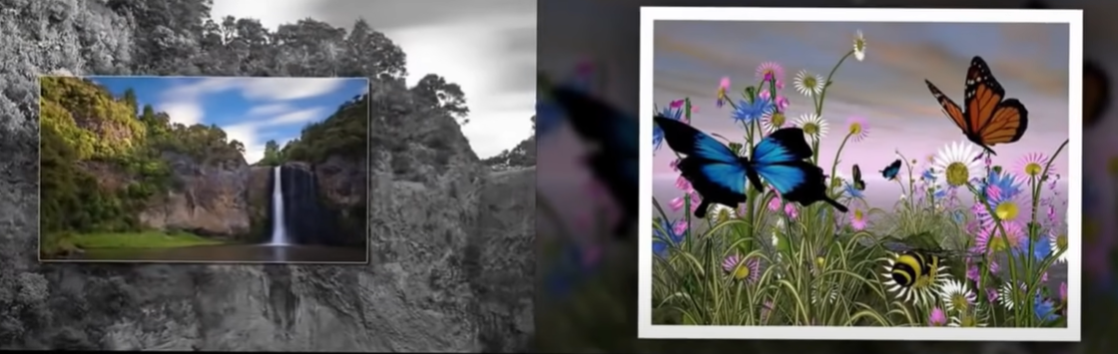
Challenge Question:
Watch and listen to Louis Armstrong’s ‘A wonderful world’?
Could you create a piece of art or poem that reflects the same message?
Watch this clip: https://www.youtube.com/watch?v=21LGv8Cf0us

Slide 8
reflection
Both the poem that we read and the song we have listened to speak of the beauty of the world that God created for us to enjoy. Sometimes we are so busy rushing around that we don’t see how amazing the world is. Even in the middle of a busy town or city we can still hear birds, see insects and plants and look into the faces of the people walking by. When we take note of these things then perhaps we begin to appreciate more how amazing the world we share is.

Slide 9

British Values
Individual Liberty
We promote the freedom of choice and the right to respectfully express views and beliefs in a safe environment. With this comes a responsibility to make good choices that impact ourselves and others in a positive way.
This Photo by Unknown Author is licensed under CC BY-SA

