Slide 1
Picture Reflections
Growing and Learning from our mistakes

Slide 2
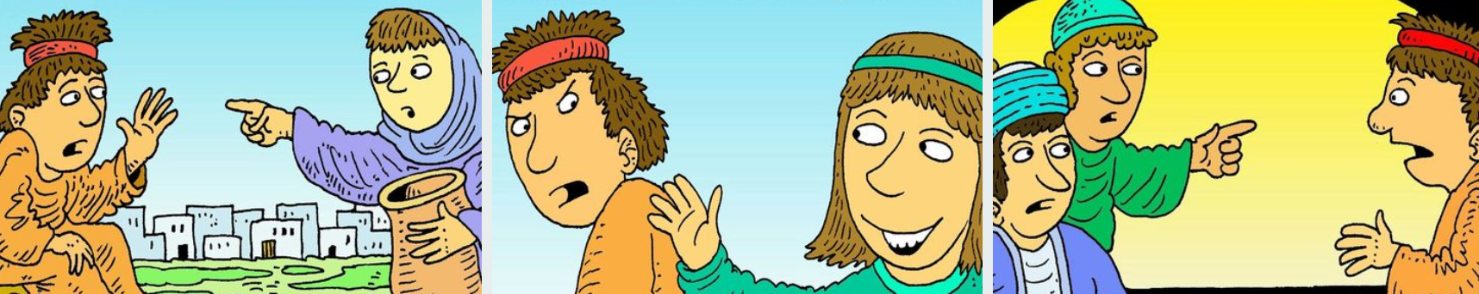
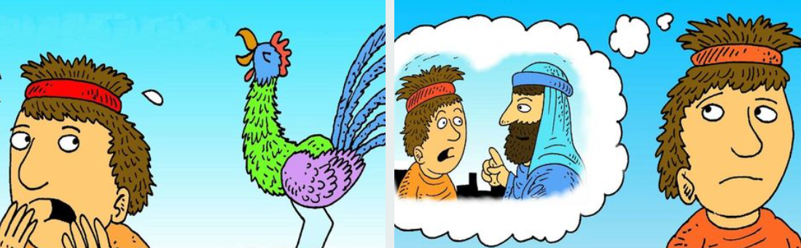

Slide 3



What do you see in the picture?
Can you make a prediction about what we are going to be talking about?
What questions do you have about this picture?
Come up with three questions.

Slide 4
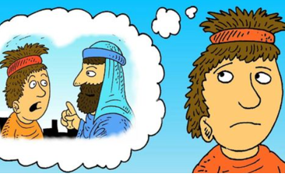
Peter – Learning from your mistakes https://www.freebibleimages.org/illustrations/ls-peter-rooster/ - view slide show to tell the story
This is a picture of Peter. Peter was one of Jesus’ closest friends, but he did something awful and afterwards he felt terrible. He thought life would never be the same again – he was so sorry and just wanted to give up. But things didn’t work out quite as Peter feared they might…

Slide 5
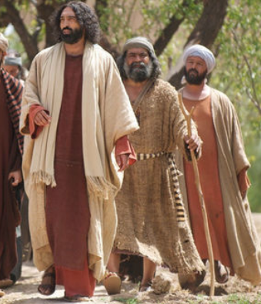
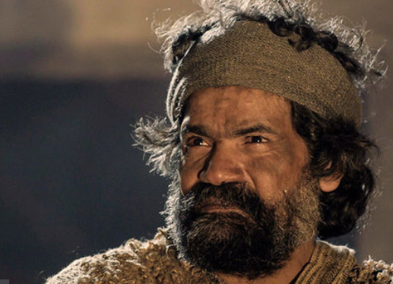
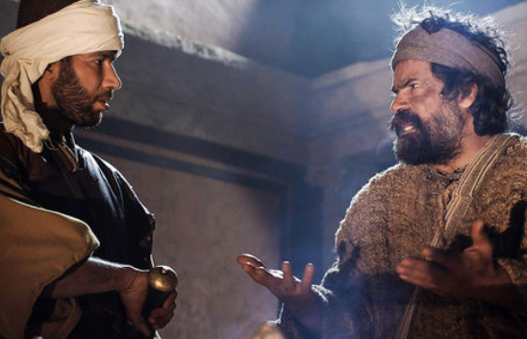
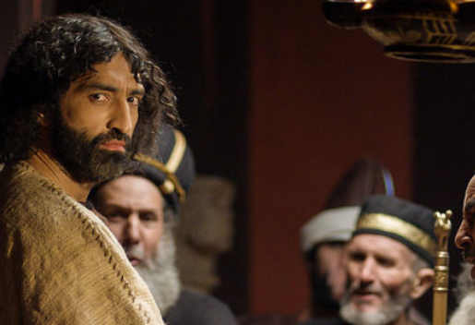
Peter’s Story – Learning from your mistakes
Peter was a one of Jesus’ closest friends. | After Jesus was arrested Peter followed the guards to the place where Jesus was put on trial. | Whilst Peter was waiting to see what would happen to Jesus a number of people came up and asked if Peter was Jesus’ friend. Peter denied it three times. | In Jesus’ hour of need Peter had let his best friend down. Peter didn’t know what to do especially as that night Jesus was sentenced to death. Peter couldn’t even say sorry.

Slide 6
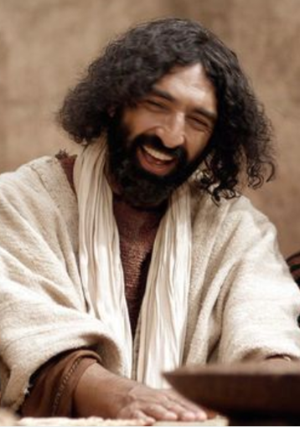
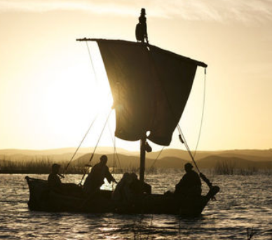
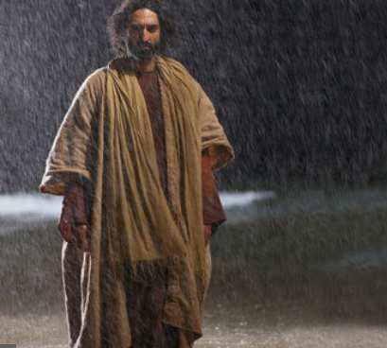
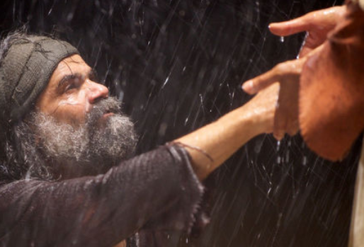
Peter’s Story – Learning from your mistakes
Before he had died, Jesus had once told Peter that one day he, Peter would be a leader in the church. | After he had let Jesus down so badly Peter thought that this couldn’t possibly happen now. So Peter went back to fishing. | One night after Jesus’ death on the cross something amazing happened. Jesus appeared to Peter and the other disciples whilst they were fishing. Jesus was alive! | Peter was able to say sorry to Jesus. What is more he learnt from his mistake and became one of the greatest leaders of the early church.

Slide 7
Peter’s Story – How can we learn from our mistakes?
How do you feel about this story?
What do you think we can learn from this story?
What is your one key emotional response word?

Slide 8
reflection
Peter was so annoyed with himself for what he had done that he just wanted to give up. He saw no way that things could be put right again. He could not forgive himself and couldn’t imagine that anyone else could forgive him.
Jesus had other ideas!
Jesus knew what Peter had done was not good but he did not want Peter to give up, instead he wanted him to learn from his mistakes. Jesus wanted Peter to take what he had learned and be a better person because of it.
It is the same for us – we will all make mistakes. When we do we have a choice to make – we can just give up or we can pick ourselves up, apologise and learn from what has just happened. In doing this we can become stronger people.

Slide 9

British Values
Individual Liberty
We promote the freedom of choice and the right to respectfully express views and beliefs in a safe environment. With this comes a responsibility to make good choices that impact ourselves and others in a positive way.
This Photo by Unknown Author is licensed under CC BY-SA

