Slide 1


Class Worship and Reflections

Slide 2

Church of England Colours for Worship

Slide 3
Classroom Worship
ABSTRACT
Collective worship in a classroom has a different feel from worship in the hall. The more intimate nature of the worship can make everyone feel more readily included. It is also the perfect setting to look at some of life’s big issues in a prayerful and reflective manner. This resource supports small group worship through the theme of RESPECT:
Respect
Equality
Serve
Patience
Enjoy and
Celebrate
Trust

Slide 4

Classroom Worship
Introduction for Teachers
Classroom worship can be organised at any time of day which best suits the needs of the group.
Collective worship in a classroom has a different feel from worship in the hall. The advantages of class worship are:
  • The more intimate nature of the worship can make everyone feel more readily included—there is nobody on the far edge or at the remote back
  • The worship can be planned to be more appropriate for the age and understanding of the children present than is possible in a large mixed age gathering
  • Children and adults may feel happier at leading worship in a more familiar setting with their peers rather than in front of the whole school
Preparing for class worship is very important. If the pupils have been busy just before you are due to start encourage them now to pause and sit quietly, stilling themselves ready to begin.
Create calm, quiet atmosphere – this can be done through music or changing the lighting in the room
A worship focus- in all places of worship there is what may be termed a worship focus, in your own hall this may be a cross or a candle. It is helpful to have a worship focus for your class worship. This does not have to be a permanent feature but something that can be brought out just for the worship. Consider what would be an appropriate worship focus for your classroom e.g. a cloth, candle, cross, bible, ornament, prayer bear. You may want to have a number of appropriate worship foci in a basket that the pupils can choose and set out ready for worship.
Structure - you may well find it helpful to have a set structure to your worship. This enables even of youngest children to feel comfortable and confident with what is happening. Here we have used the gather, engage, respond, and send framework.

Slide 5

Classroom Worship
Possible music
The Blessing (Kids)
https://www.youtube.com/watch?v=uiWZXLsdE9w
Rend Co. Kids - Feels Good
https://www.youtube.com/watch?v=LJxVHzARMmE&list=PLGXQK3aC61FSm_22oqfft0m2Oje499lC4&index=1
I the Lord of Sea and Sky
https://www.youtube.com/watch?v=4t6mz8yoocY

Slide 6

Gathering these can be used at the beginning of each session
Once everyone is set up ready for worship you may want to start by lighting a candle, followed by one of these:
Leader: Peace be with you.
Pupils: And also with you.
Leader: Welcome everyone
Pupils: It is good to be here together
Play a ‘Welcome’ song as children settle.
We meet in the name of God:
  God the Father,
  God the Son,
  God the Spirit:
  God is one.
Sign: ‘Welcome everybody here’ in BSL

Slide 7
Gathering these can be used at the beginning of each session
Christ the light of the world is here
God help us to speak positive words
To share peace with everyone
To remember that you are with us
Let us celebrate what God has made
Let’s remember to show God’s love,
and to show a bit of heaven to everyone we meet.

Slide 8

Sending these can be used at the End of each session
You may want to end your time together with one of these short prayers or blessings:
As we end this time
May we live with your love
Build on your truth
Share your forgiveness
Rest in your peace
For the whole of the day. AMEN
Thank you for this day,
For fun, friendship and learning.
We give thanks for this time
As we share peace with each other. AMEN
Help us as we as we move on
To carry hope in us for the day
Turning our thoughts towards others,
Our hearts towards love,
And our hands towards serving those in need. AMEN

Slide 9
Sending these can be used at the End of each session
The Lord bless us and watch over us, he is kind and helps us to show peace. Amen
Let’s remember today to show peace and love
To forgive when others upset us
To remember that we are all equal to God
To think about what we say before we say it
To thank God for a new day
Thank you God for all your good gifts
Christ our Lord,
Just as kings bowed down and offered you gifts,
May we know your strength and peace
And see all the free gifts you have given to us
and the blessing of the Father, Son and Holy Spirit,
be with you all, evermore
Amen

Slide 10

PATIENCE

Slide 11
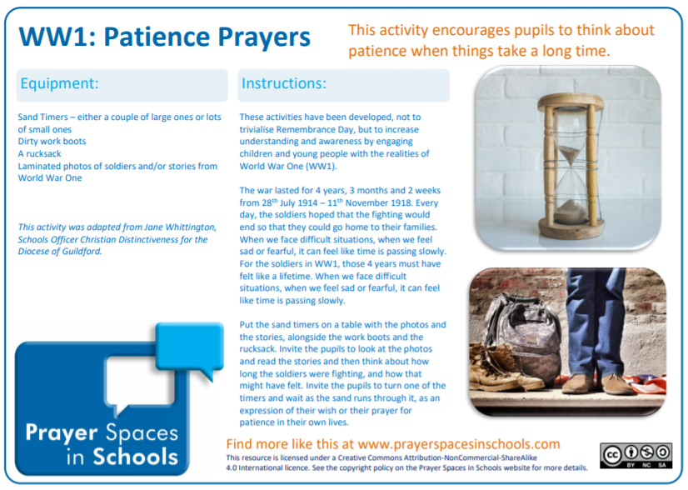
Classroom Worship
Reflection Space
Patience
Genesis 17 & 18

Slide 12
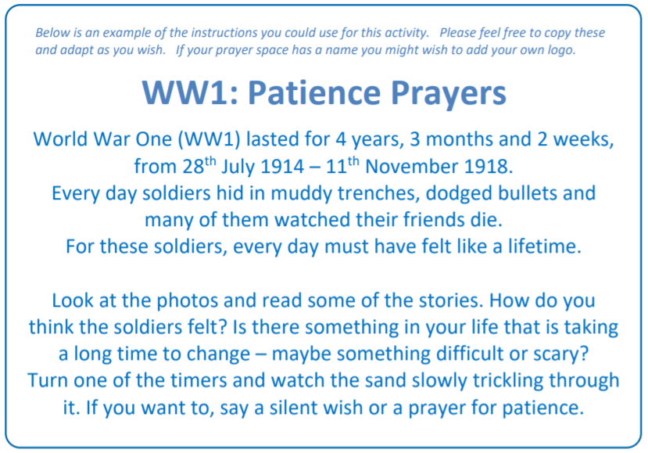

Slide 13

Monday

Slide 14
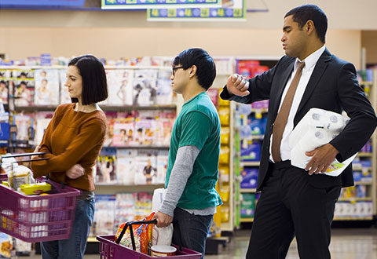


Slide 15

What do you see in the picture?
Can you make a prediction about what we are going to talk about today?
What questions do you have about this picture?
Come up with three questions.

Slide 16
Bible Passage (Genesis 17 & 18)
When Abram was 99 years old, the Lord appeared to him. The Lord said, “I am God All-Powerful. Obey me and do what is right. ² I will make an agreement between us. I will make you the ancestor of many people.”
³ Then Abram bowed facedown on the ground. God said to him, ⁴ “I am making my agreement with you: I will make you the father of many nations. ⁵ I am changing your name from Abram^{[a]} to Abraham.^{[b]} This is because I am making you a father of many nations. ⁶ I will give you many descendants. New nations will be born from you. Kings will come from you. ⁷ And I will make an agreement between me and you and all your descendants from now on: I will be your God and the God of all your descendants. ⁸ You live in the land of Canaan now as a stranger. But I will give you and your descendants all this land forever. And I will be the God of your descendants.”

Slide 17
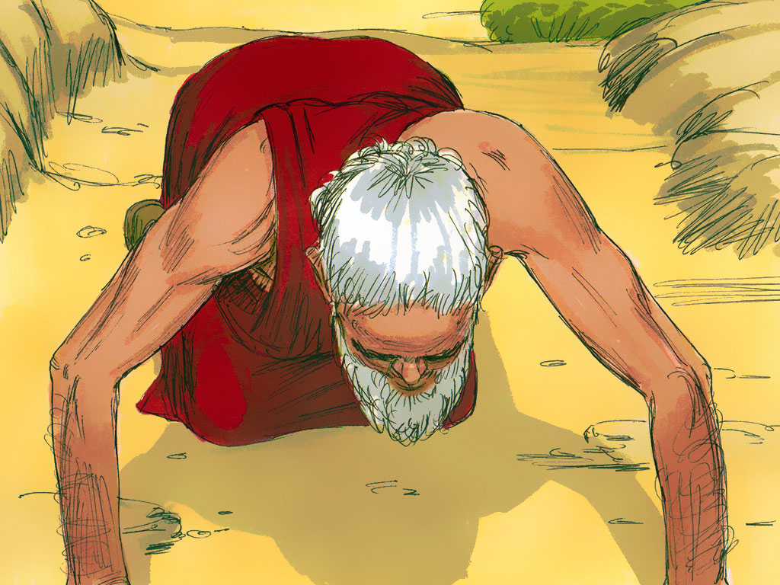
Bible Passage (Genesis 17 & 18)
¹⁷ Abraham bowed facedown on the ground and laughed. He said to himself, “Can a man have a child when he is 100 years old? Can Sarah give birth to a child when she is 90?” ¹⁸ Then Abraham said to God, “Please let Ishmael be the son you promised.”
¹⁹ God said, “No. Sarah your wife will have a son, and you will name him Isaac.^{[e]} I will make my agreement with him. It will be an agreement that continues forever with all his descendants.

Slide 18
Bible Passage (Genesis 17 & 18)
Later, the Lord again appeared to Abraham near the great trees of Mamre. At that time Abraham was sitting at the door of his tent. It was during the hottest part of the day. ² He looked up and saw three men standing near him. When Abraham saw them, he ran from his tent to meet them. He bowed facedown on the ground before them. ³ Abraham said, “Sir, if you think well of me, please stay awhile with me, your servant. ⁴ I will bring some water so all of you can wash your feet. You may rest under the tree. ⁵ I will get some bread for you, so you can regain your strength. Then you may continue your journey.”
The three men said, “That is fine. Do as you said.”

Slide 19
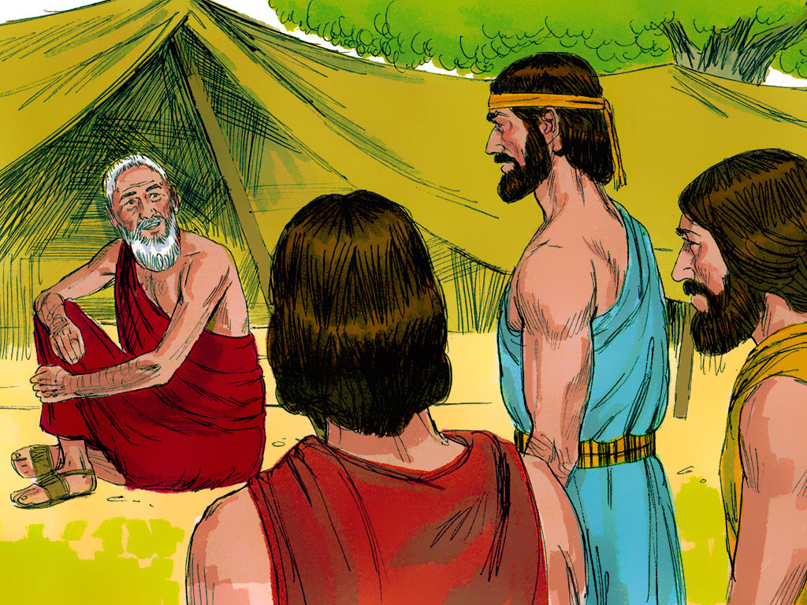

Slide 20
Bible Passage (Genesis 17 & 18)
⁹ The men asked Abraham, “Where is your wife Sarah?”
“There, in the tent,” said Abraham.
¹⁰ Then the Lord said, “I will certainly return to you about this time a year from now. At that time your wife Sarah will have a son.”
Sarah was listening at the entrance of the tent which was behind him. ¹¹ Abraham and Sarah were very old. Sarah was past the age when women normally have children. ¹² So she laughed to herself, “My husband and I are too old to have a baby.”
¹³ Then the Lord said to Abraham, “Why did Sarah laugh? Why did she say, ‘I am too old to have a baby’? ¹⁴ Is anything too hard for the Lord? No! I will return to you at the right time a year from now. And Sarah will have a son.”
¹⁵ Sarah was afraid. So she lied and said, “I didn’t laugh.”
But the Lord said, “No. You did laugh.”

Slide 21
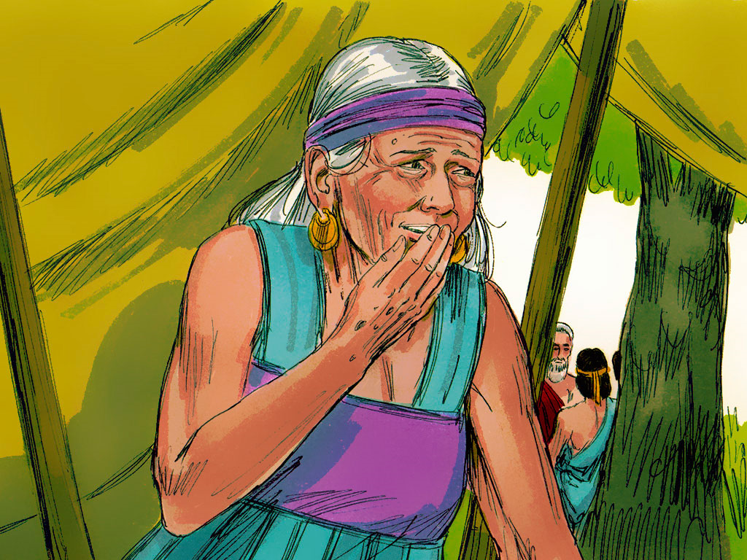

Slide 22
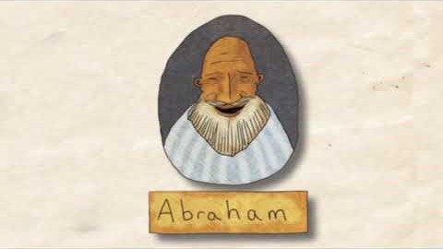
Bible Passage (Genesis 17 & 18)

Slide 23
Bible Passage (Genesis 17 & 18)
Abraham and Sarah waited an incredibly long time to have a baby.
Do you think they waited patiently?
Think about the way they both reacted to the news?
Did they really believe that their patience would be rewarded?

Slide 24

Responding
What can we learn from this story?
What do you find encouraging?
What do you find challenging?

Slide 25
Prayer
Encourage the pupils to respond with their own prayers first or through the prayer space and if appropriate use the Lord’s prayer.
Our Father, in heaven,
Holy is your name.
Your Kingdom come,
Your will be done on earth, as it is in heaven.
Give us this day our daily bread,
And forgive us our sins,
As we forgive those who sin against us,
And lead us not into temptation,
But deliver us from evil.
Amen.

Slide 26

Tuesday

Slide 27

Engage… (based on GENESIS 17 & 18)

Slide 28
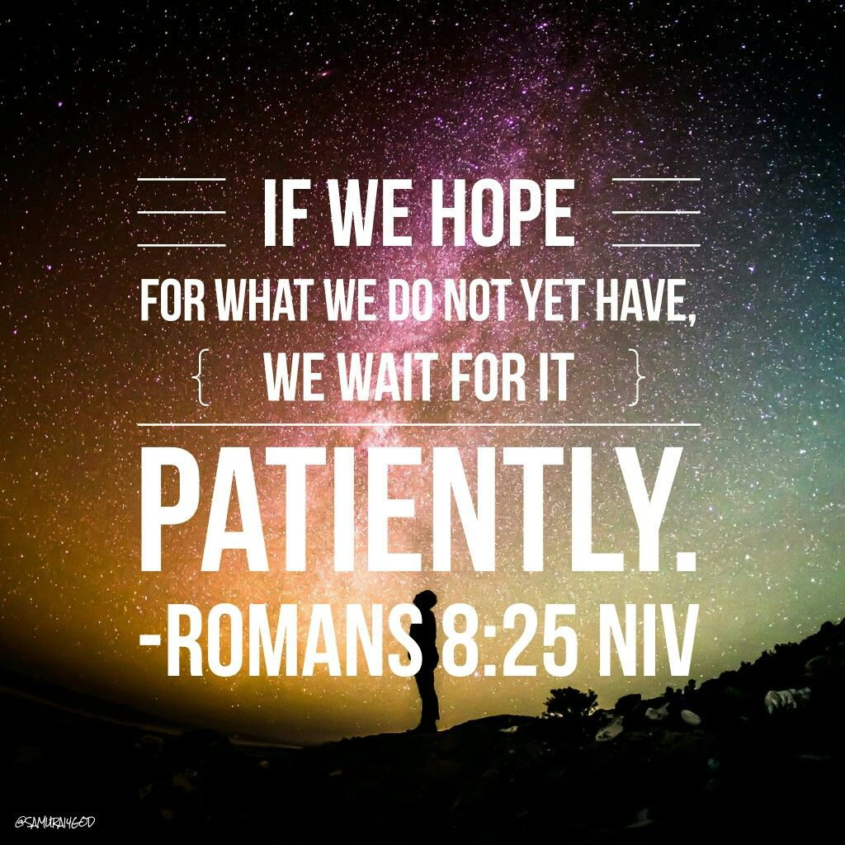
BIBLE PASSAGE… (linked to GENESIS 17 & 18)

Slide 29

Reflection question
Is it easy to be patient?

Slide 30
Reflection question
Have you ever had to wait a long time for something?

Slide 31
Prayer
Encourage the pupils to respond with their own prayers first or through the pray space and if appropriate use the Lord’s prayer.
Our Father, in heaven,
Holy is your name.
Your Kingdom come,
Your will be done on earth, as it is in heaven.
Give us this day our daily bread,
And forgive us our sins,
As we forgive those who sin against us,
And lead us not into temptation,
But deliver us from evil.
Amen.

Slide 32

Wednesday

Slide 33
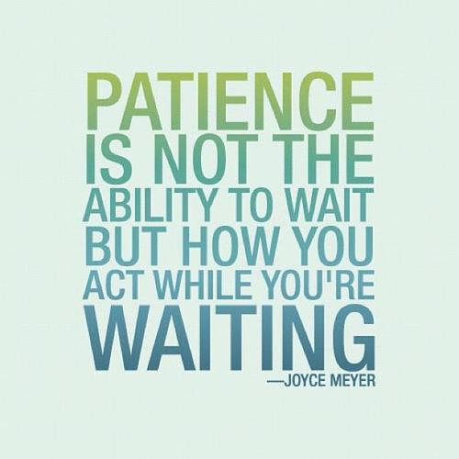
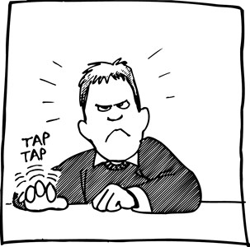
Prompted to action - challenge

Slide 34
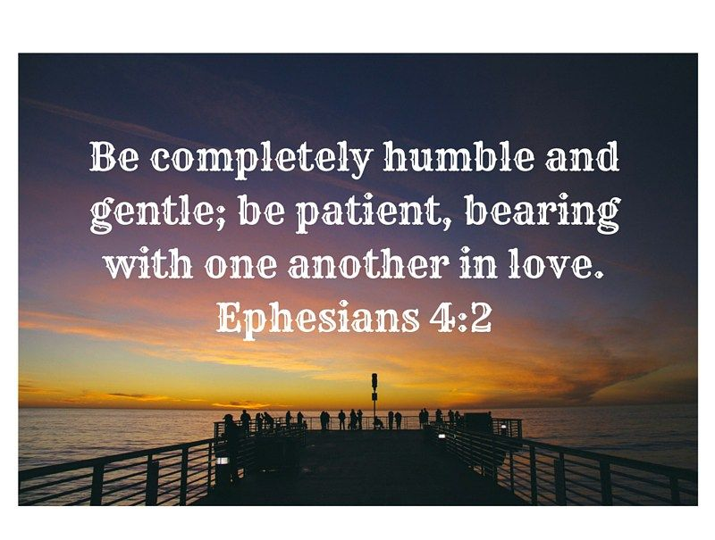
Prompted to action - challenge

Slide 35
Prompted to action - challenge
Is it easy to be patient with other people?

Slide 36
Prompted to action - challenge
When is being patient with others a challenge?

Slide 37
Prompted to action - challenge
Some activities to help you practice patience…

Slide 38
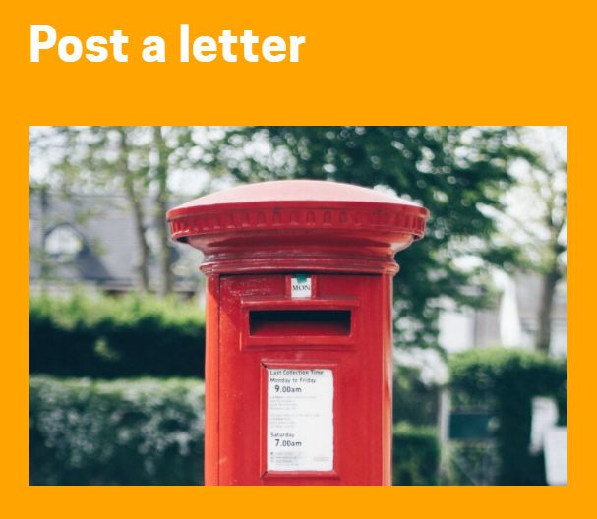
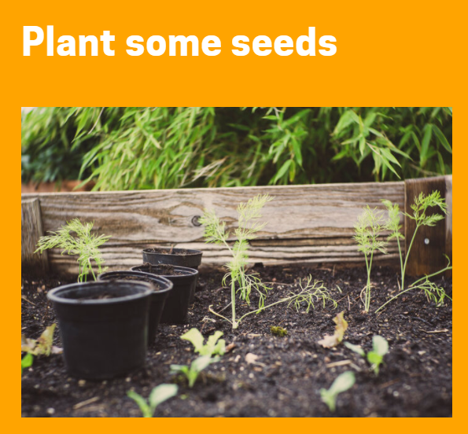
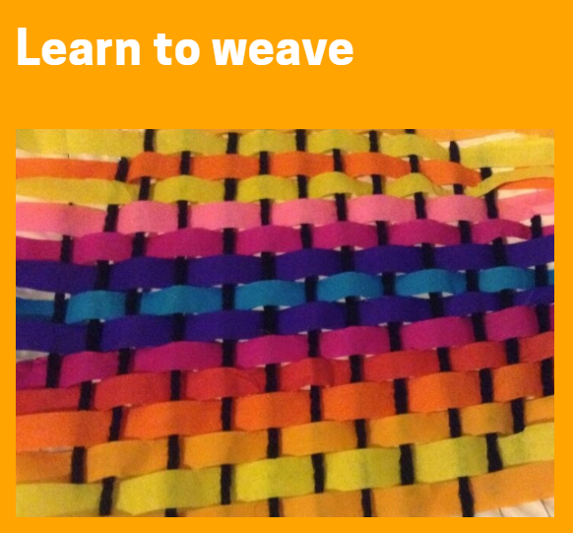
Prompted to action - challenge

Slide 39

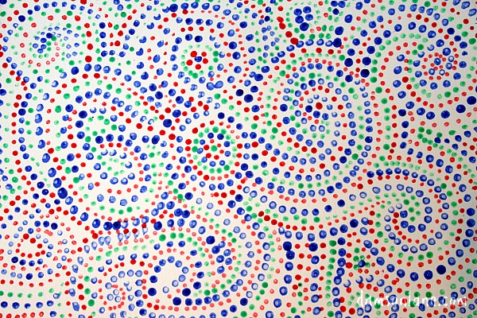
Prompted to action - challenge
I will give you many descendants. They will be as hard to count as the stars in the sky. Genesis 26:4
Can you patiently create a ‘cotton bud painted’ star?

Slide 40
Prayer
Encourage the pupils to respond with their own prayers first or through the pray space and if appropriate use the Lord’s prayer.
Our Father, in heaven,
Holy is your name.
Your Kingdom come,
Your will be done on earth, as it is in heaven.
Give us this day our daily bread,
And forgive us our sins,
As we forgive those who sin against us,
And lead us not into temptation,
But deliver us from evil.
Amen.

Slide 41

Thursday

Slide 42
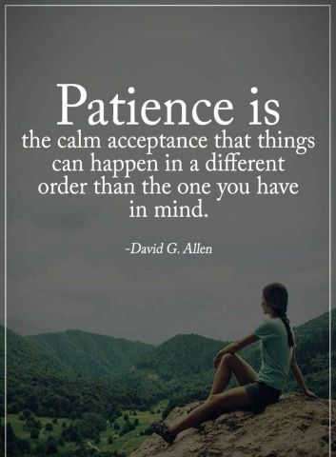
Use the Meditation resource alongside the Spiritual Encounters – bible-based meditation teacher’s pack: http://www.ldbe.co.uk/about/guidance- resources/worship-and-meditation/
(This can be adapted for use with all ages)

Slide 43

Friday

Slide 44
Take this time to celebrate what has happened during the week – you may want to give out awards. If possible, join the bubbles using Zoom or Teams so that the whole school can come together in a time of celebration.
Remember that this should also be a time of worship and celebration so begin with a gathering, include a prayer, a blessing, and a song of celebration.

