Slide 1


Class Worship and Reflections

Slide 2

Church of England Colours for Worship

Slide 3
Classroom Worship
ABSTRACT
Collective worship in a classroom has a different feel from worship in the hall. The more intimate nature of the worship can make everyone feel more readily included. It is also the perfect setting to look at some of life’s big issues in a prayerful and reflective manner. This resource supports small group worship through the theme of RESPECT:
Respect
Equality
Serve
Patience
Enjoy and
Celebrate
Trust

Slide 4

Classroom Worship
Introduction for Teachers
Classroom worship can be organised at any time of day which best suits the needs of the group.
Collective worship in a classroom has a different feel from worship in the hall. The advantages of class worship are:
  • The more intimate nature of the worship can make everyone feel more readily included—there is nobody on the far edge or at the remote back
  • The worship can be planned to be more appropriate for the age and understanding of the children present than is possible in a large mixed age gathering
  • Children and adults may feel happier at leading worship in a more familiar setting with their peers rather than in front of the whole school
Preparing for class worship is very important. If the pupils have been busy just before you are due to start encourage them now to pause and sit quietly, stilling themselves ready to begin.
Create calm, quiet atmosphere – this can be done through music or changing the lighting in the room
A worship focus- in all places of worship there is what may be termed a worship focus, in your own hall this may be a cross or a candle. It is helpful to have a worship focus for your class worship. This does not have to be a permanent feature but something that can be brought out just for the worship. Consider what would be an appropriate worship focus for your classroom e.g. a cloth, candle, cross, bible, ornament, prayer bear. You may want to have a number of appropriate worship foci in a basket that the pupils can choose and set out ready for worship.
Structure - you may well find it helpful to have a set structure to your worship. This enables even of youngest children to feel comfortable and confident with what is happening. Here we have used the gather, engage, respond, and send framework.

Slide 5

Classroom Worship
Possible music
My Lighthouse
https://www.youtube.com/watch?v=reAlJKv7ptU
City on a Hill
https://youtu.be/lTEadEftdnM
All Through History
https://www.youtube.com/watch?v=hQS2HHayr38

Slide 6

Gathering these can be used at the beginning of each session
Once everyone is set up ready for worship you may want to start by lighting a candle, followed by one of these:
Leader: Peace be with you.
Pupils: And also with you.
Leader: Welcome everyone
Pupils: It is good to be here together
Play a ‘Welcome’ song as children settle.
We meet in the name of God:
  God the Father,
  God the Son,
  God the Spirit:
  God is one.
Sign: ‘Welcome everybody here’ in BSL

Slide 7
Gathering these can be used at the beginning of each session
Christ the light of the world is here
God help us to speak positive words
To share peace with everyone
To remember that you are with us
Let us celebrate what God has made
Let’s remember to show God’s love,
and to show a bit of heaven to everyone we meet.

Slide 8

Sending these can be used at the End of each session
You may want to end your time together with one of these short prayers or blessings:
As we end this time
May we live with your love
Build on your truth
Share your forgiveness
Rest in your peace
For the whole of the day. AMEN
Thank you for this day,
For fun, friendship and learning.
We give thanks for this time
As we share peace with each other. AMEN
Help us as we as we move on
To carry hope in us for the day
Turning our thoughts towards others,
Our hearts towards love,
And our hands towards serving those in need. AMEN

Slide 9
Sending these can be used at the End of each session
The Lord bless us and watch over us, he is kind and helps us to show peace. Amen
Let’s remember today to show peace and love
To forgive when others upset us
To remember that we are all equal to God
To think about what we say before we say it
To thank God for a new day
Thank you God for all your good gifts
Christ our Lord,
Just as kings bowed down and offered you gifts,
May we know your strength and peace
And see all the free gifts you have given to us
and the blessing of the Father, Son and Holy Spirit,
be with you all, evermore
Amen

Slide 10

SERVE

Slide 11
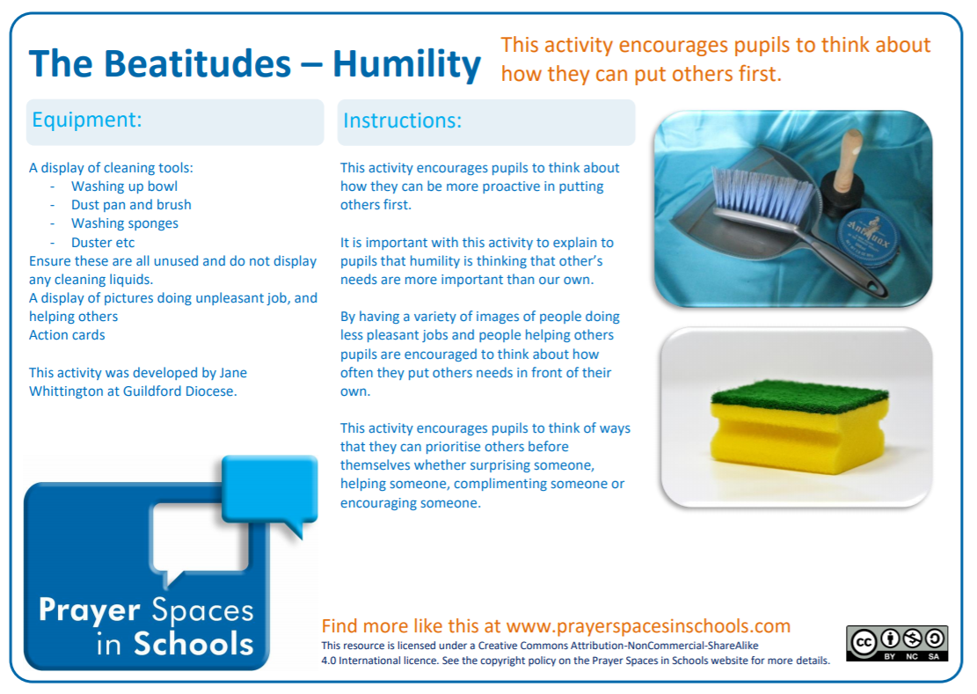
Classroom Worship
Reflection Space
Matthew 25:31-40

Slide 12
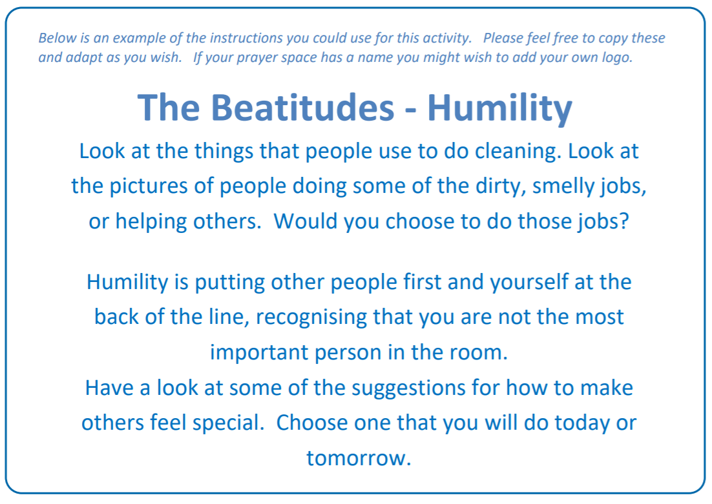
Classroom Worship
Reflection Space
MATTHEW 25:31- 40

Slide 13
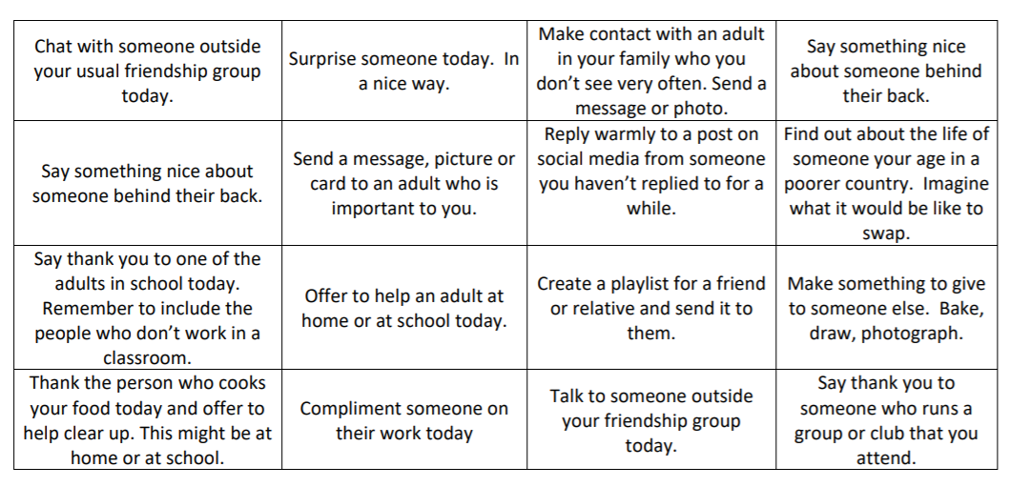
Classroom Worship
Reflection Space
Matthew 25:31-40

Slide 14

Monday

Slide 15
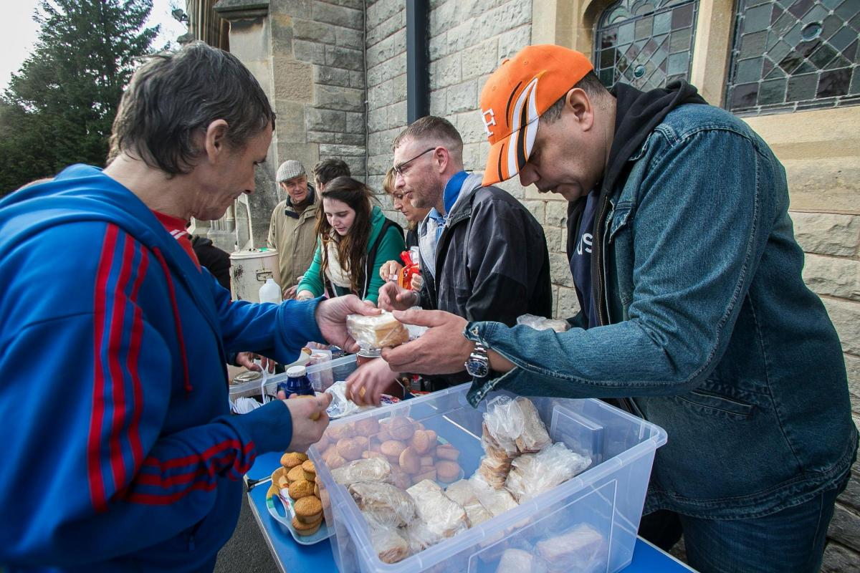


Slide 16

What do you see in the picture?
Can you make a prediction about what we are going to talk about today?
What questions do you have about this picture?
Come up with three questions.

Slide 17

Bible Passage (based on MATTHEW 25:31-40)
³¹ “The Son of Man will come again in his great glory. All his angels will come with him. He will be King and sit on his great throne.
³² All the people of the world will be gathered before him. Then he will separate them into two groups as a shepherd separates the sheep from the goats. ³³ The Son of Man will put the sheep, the good people, on his right and the goats, the bad people, on his left.
³⁴ “Then the King will say to the good people on his right, ‘Come. My Father has given you his blessing. Come and receive the kingdom God has prepared for you since the world was made.

Slide 18
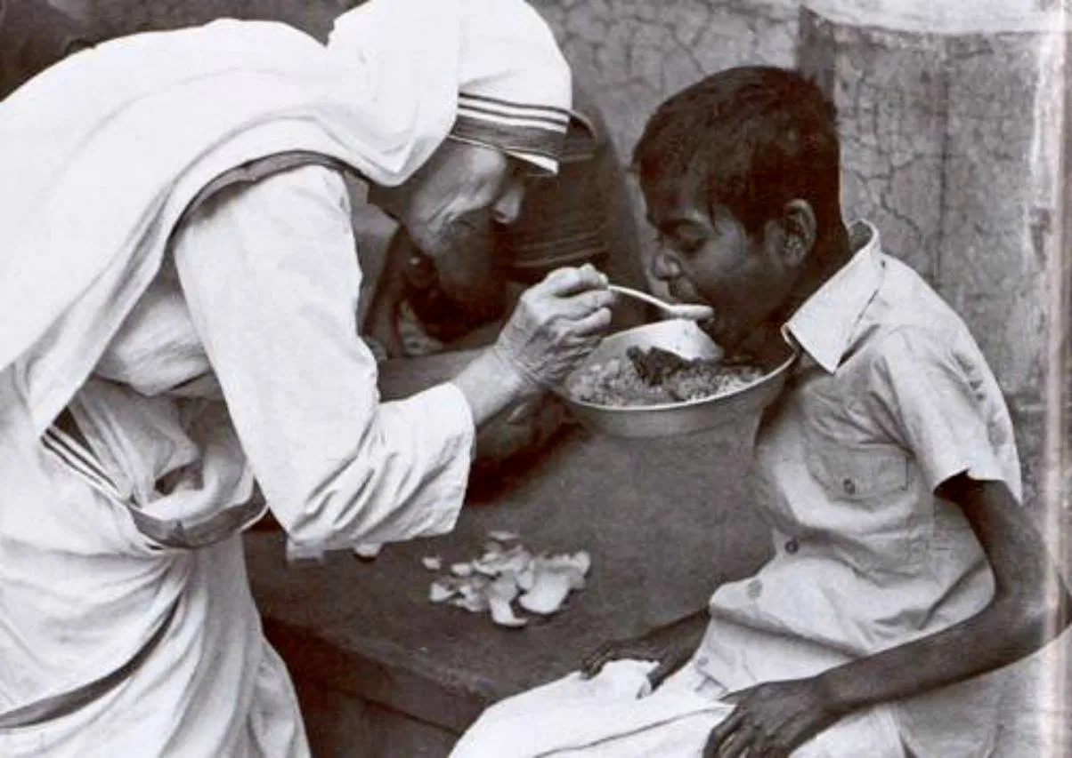
Bible Passage (based on MATTHEW 25:31-40)
³⁵ I was hungry, and you gave me food. I was thirsty, and you gave me something to drink. I was alone and away from home, and you invited me into your house.
³⁶ I was without clothes, and you gave me something to wear. I was sick, and you cared for me. I was in prison, and you visited me.’

Slide 19
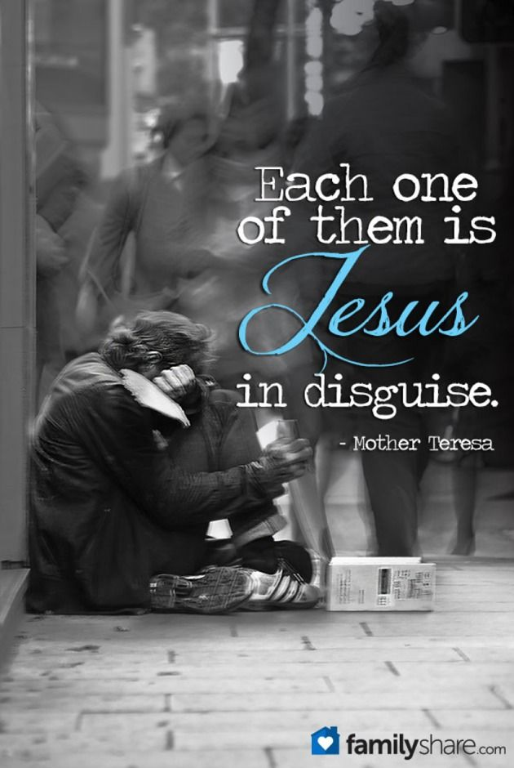
Bible Passage (based on MATTHEW 25:31-40)
³⁷ “Then the good people will answer, ‘Lord, when did we see you hungry and give you food? When did we see you thirsty and give you something to drink? ³⁸ When did we see you alone and away from home and invite you into our house? When did we see you without clothes and give you something to wear? ³⁹ When did we see you sick or in prison and care for you?’
⁴⁰ “Then the King will answer, ‘I tell you the truth. Anything you did for any of my people here, you also did for me.’

Slide 20

Responding
What can we learn from this story?
What do you find encouraging?
What do you find challenging?

Slide 21
Prayer
Encourage the pupils to respond with their own prayers first or through the prayer space or use the prayer below:
Dear God,
Help us to see the need in our world.
Help us to show compassion and love to others.
Help us to put others’ needs before our own.
Help us to be stirred into action.
Amen.

Slide 22

Tuesday

Slide 23
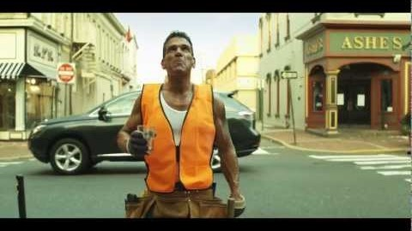
Engage… (MATTHEW 25:31-40)

Slide 24
BIBLE PASSAGE… (MATTHEW 25: 40)
“Then the King will answer, ‘I tell you the truth. Anything you did for any of my people here, you also did for me.’

Slide 25
Responding
What did Jesus mean when he said this?

Slide 26

Reflection question
How does the person being served feel?

Slide 27
Reflection question
How does the person that is serving feel?

Slide 28
Prayer
Encourage the pupils to respond with their own prayers first or through the pray space and if appropriate use the Lord’s prayer.
Our Father, in heaven,
Holy is your name.
Your Kingdom come,
Your will be done on earth, as it is in heaven.
Give us this day our daily bread,
And forgive us our sins,
As we forgive those who sin against us,
And lead us not into temptation,
But deliver us from evil.
Amen.

Slide 29

Wednesday

Slide 30
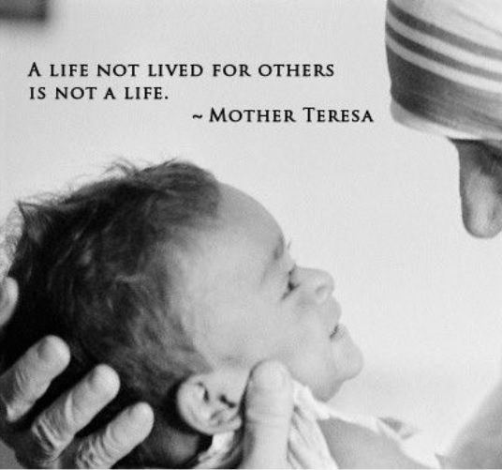
Prompted to action - challenge

Slide 31
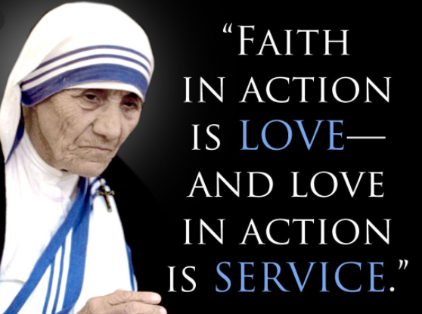
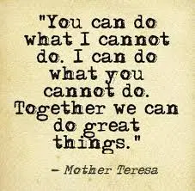
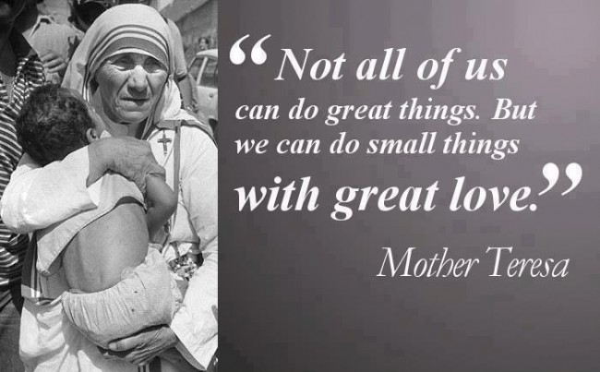
Prompted to action –
Mother Teresa

Slide 32
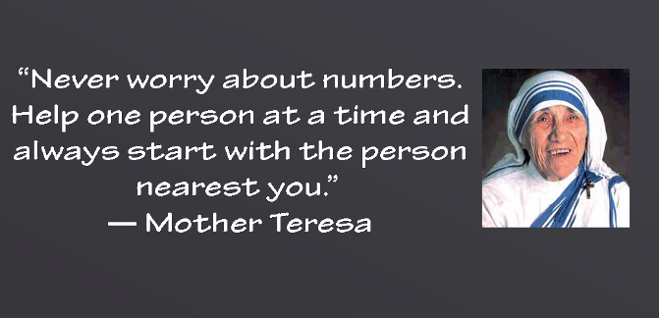
Prompted to action –
Mother Teresa
“At the end of life we will not be judged by how many diplomas we have received, how much money we have made, how many great things we have done.
We will be judged by “I was hungry, and you gave me something to eat, I was naked and you clothed me. I was homeless, and you took me in.”
Mother Teresa

Slide 33
Prompted to action - challenge
How could you serve in your school and community?

Slide 34
Prompted to action - challenge
Can you learn more about Mother Teresa and her life of service?

Slide 35
Prayer
Encourage the pupils to respond with their own prayers first or through the prayer space. You could use the school’s prayer or the prayer below.
Dear God,
Please show me how to spend this day,
Sharing your LOVE in every way.
Help me be kind to everyone,
To play and to laugh and have lots of fun.
Shining your light and giving your grace,
Sharing your joy with a smile on my face!
Amen

Slide 36

Thursday

Slide 37
Use the Meditation resource alongside the Spiritual Encounters – bible-based meditation teacher’s pack:
http://www.ldbe.co.uk/about/guidance- resources/worship-and-meditation/
(This can be adapted for use with all ages)
You may want to use the following reflection:
Prayer in action is love, and love in action is service. Try to give unconditionally whatever a person needs in the moment. The point is to do something, however small and show you care through your actions by giving your time … We are all God’s children so it is important to share His gifts. Do not worry about why problems exist in the world – just respond to people’s needs … We feel what we are doing is just a drop in the ocean, but that ocean would be less without that drop.’
(Mother Teresa)

Slide 38

Friday

Slide 39
Take this time to celebrate what has happened during the week – you may want to give out awards. If possible, join the bubbles using Zoom or Teams so that the whole school can come together in a time of celebration.
Remember that this should also be a time of worship and celebration so begin with a gathering, include a prayer, a blessing, and a song of celebration.

