Slide 1


Class Worship and Reflections

Slide 2

Church of England Colours for Worship

Slide 3
Classroom Worship
ABSTRACT
Collective worship in a classroom has a different feel from worship in the hall. The more intimate nature of the worship can make everyone feel more readily included. It is also the perfect setting to look at some of life’s big issues in a prayerful and reflective manner. This resource supports small group worship through the theme of RESPECT:
Respect
Equality
Serve
Patience
Enjoy and
Celebrate
Trust

Slide 4
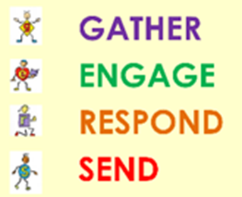
Classroom Worship
Introduction for Teachers
Classroom worship can be organised at any time of day which best suits the needs of the group.
Collective worship in a classroom has a different feel from worship in the hall. The advantages of class worship are:
  • The more intimate nature of the worship can make everyone feel more readily included—there is nobody on the far edge or at the remote back
  • The worship can be planned to be more appropriate for the age and understanding of the children present than is possible in a large mixed age gathering
  • Children and adults may feel happier at leading worship in a more familiar setting with their peers rather than in front of the whole school
Preparing for class worship is very important. If the pupils have been busy just before you are due to start encourage them now to pause and sit quietly, stilling themselves ready to begin.
Create calm, quiet atmosphere – this can be done through music or changing the lighting in the room
A worship focus- in all places of worship there is what may be termed a worship focus, in your own hall this may be a cross or a candle. It is helpful to have a worship focus for your class worship. This does not have to be a permanent feature but something that can be brought out just for the worship. Consider what would be an appropriate worship focus for your classroom e.g. a cloth, candle, cross, bible, ornament, prayer bear. You may want to have a number of appropriate worship foci in a basket that the pupils can choose and set out ready for worship.
Structure - you may well find it helpful to have a set structure to your worship. This enables even of youngest children to feel comfortable and confident with what is happening. Here we have used the gather, engage, respond, and send framework.

Slide 5

Classroom Worship
Possible music
My Lighthouse
https://www.youtube.com/watch?v=reAlJKv7ptU
You are my peace
https://www.youtube.com/watch?v=Dg56EmUG6nc
Oceans
https://www.youtube.com/watch?v=M9GcyHpptMk&feature=youtu.be

Slide 6
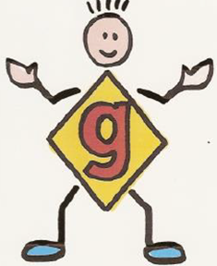
Gathering these can be used at the beginning of each session
Once everyone is set up ready for worship you may want to start by lighting a candle, followed by one of these:
Leader: Peace be with you.
Pupils: And also with you.
Leader: Welcome everyone
Pupils: It is good to be here together
Play a ‘Welcome’ song as children settle.
We meet in the name of God:
  God the Father,
  God the Son,
  God the Spirit:
  God is one.
Sign: ‘Welcome everybody here’ in BSL

Slide 7
Gathering these can be used at the beginning of each session
Christ the light of the world is here
God help us to speak positive words
To share peace with everyone
To remember that you are with us
Let us celebrate what God has made
Let’s remember to show God’s love,
and to show a bit of heaven to everyone we meet.

Slide 8

Sending these can be used at the End of each session
You may want to end your time together with one of these short prayers or blessings:
As we end this time
May we live with your love
Build on your truth
Share your forgiveness
Rest in your peace
For the whole of the day. AMEN
Thank you for this day,
For fun, friendship and learning.
We give thanks for this time
As we share peace with each other. AMEN
Help us as we as we move on
To carry hope in us for the day
Turning our thoughts towards others,
Our hearts towards love,
And our hands towards serving those in need. AMEN

Slide 9
Sending these can be used at the End of each session
The Lord bless us and watch over us, he is kind and helps us to show peace. Amen
Let’s remember today to show peace and love
To forgive when others upset us
To remember that we are all equal to God
To think about what we say before we say it
To thank God for a new day
Thank you God for all your good gifts
Christ our Lord,
Just as kings bowed down and offered you gifts,
May we know your strength and peace
And see all the free gifts you have given to us
and the blessing of the Father, Son and Holy Spirit,
be with you all, evermore
Amen

Slide 10
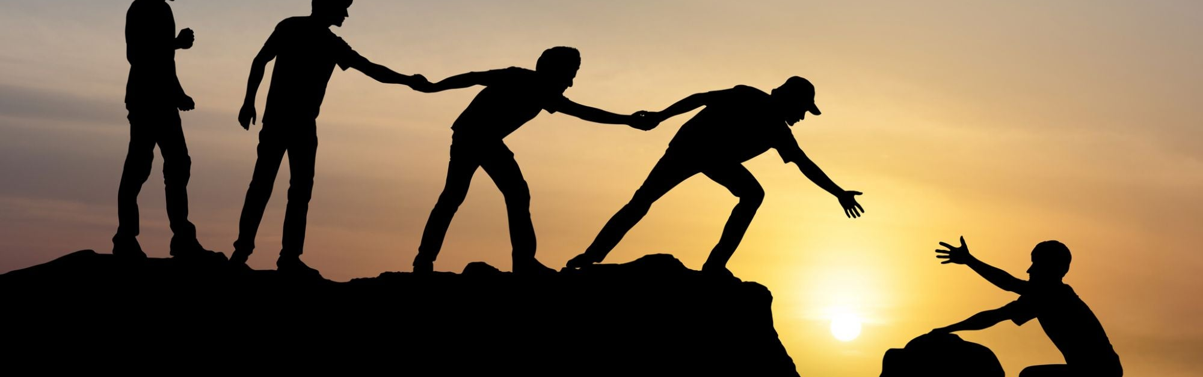
TRust

Slide 11
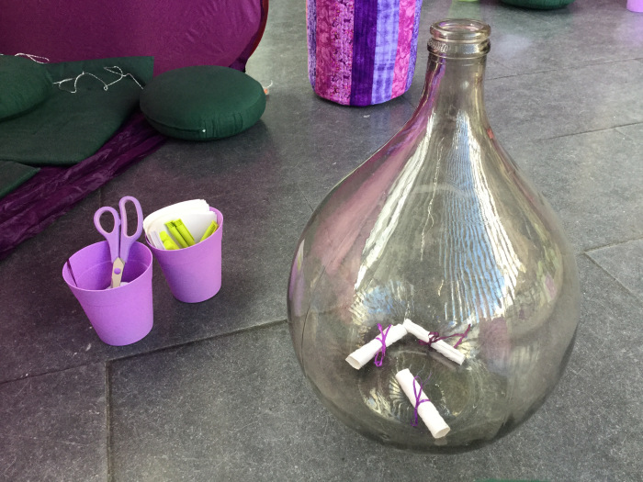
Classroom Worship
Reflection Space
What are the things you find hardest to trust people with?
.

Slide 12
Classroom Worship
Reflection Space
You will need:
A large bottle (carboy) the narrow neck is important like this one.
A4 paper cut into four pieces.
Narrow ribbon

Slide 13
Classroom Worship
Reflection Space
The scrolls in the bottle are out of reach and you can’t take them back.
If you would like, take a scroll to write on. As you drop it in the bottle, you might like to trust it to God.

Slide 14

Monday

Slide 15
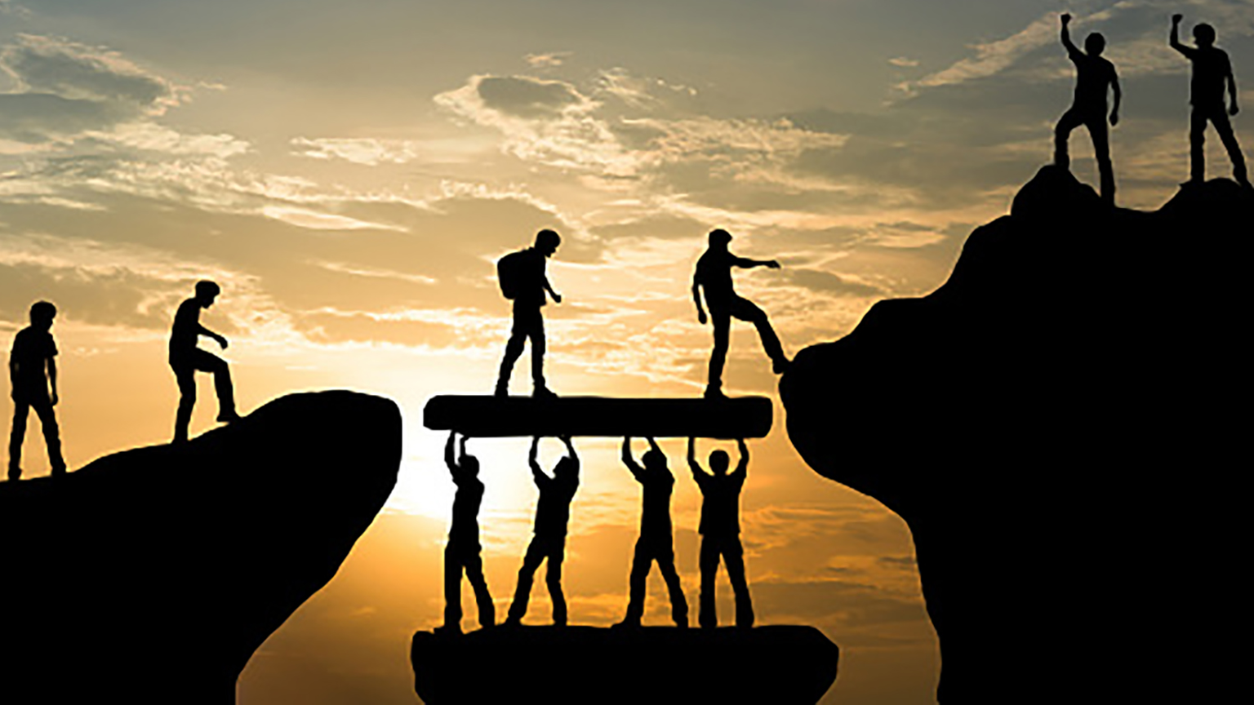



Slide 16

What do you see in the picture?
Can you make a prediction about what we are going to talk about today?
What questions do you have about this picture?
Come up with three questions.
Notes:
The theme is trust. Encourage children to notice the trust in the image.

Slide 17
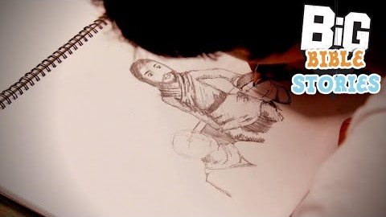
Bible Passage (based on matthew 14: 22 - 34)

Slide 18

Responding
What can we learn from this story?
What do you find encouraging?
What do you find challenging?

Slide 19
Prayer
Encourage the pupils to respond with their own prayers first or through the prayer space or use the prayer below:
Dear God,
Thank you for the example of Peter and all that we can learn about trust from his life.
May you help us to trust.
Help us to be surrounded by those we can trust.
Help us to be people who can be trusted by others.
Help us to be willing to step into the unknown and try new experiences.
Thank you that you promise to be with us wherever we go.
Amen.

Slide 20

Tuesday

Slide 21
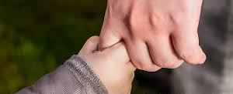
BIBLE PASSAGE… (based on Isaiah 41:13)
13 I am the Lord your God.
I am holding your right hand.
And I tell you, ‘Don’t be afraid.
I will help you.’

Slide 22
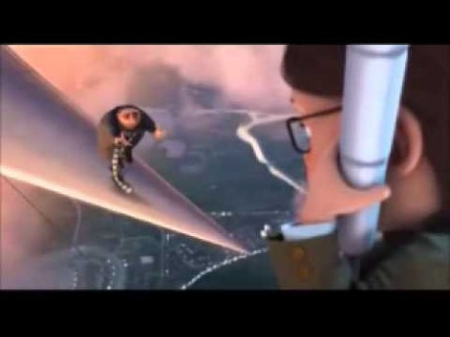
ENGAGE

Slide 23

Reflection question
Who do you trust?

Slide 24
Reflection question
Why is it important for us to trust people?

Slide 25
Reflection Challenge
Why is it so difficult for some people to trust others?

Slide 26
Responding
In the Bible there are many times where people are asked to trust God.

Slide 27
Prayer
Encourage the pupils to respond with their own prayers first, through the prayer space or with the prayer below:
Father God,
Thank you for being a safe place
When things are hard.
Help me to trust that you are by my side.
Amen

Slide 28

Wednesday

Slide 29
Prompted to action - challenge
Remind people of the theme for the week and of the Bible story and Bible verse.
Challenge yourself to trust your worries to another person or to God.
Add your worries to the cargo net/rope.

Slide 30
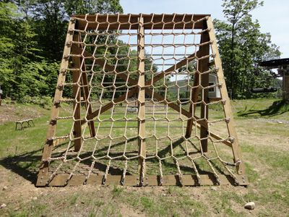
Prompted to action – challenge ideas

Slide 31
Prayer
Encourage the pupils to respond with their own prayers first or through the prayer space. You could use the school’s prayer or the prayer below:
Our Father, in heaven,
Holy is your name.
Your Kingdom come,
Your will be done on earth, as it is in heaven.
Give us this day our daily bread,
And forgive us our sins,
As we forgive those who sin against us,
And lead us not into temptation,
But deliver us from evil.
Amen.

Slide 32

Thursday

Slide 33
Use the Meditation resource alongside the Spiritual Encounters – bible-based meditation teacher’s pack: http://www.ldbe.co.uk/about/guidance- resources/worship-and-meditation/
(This can be adapted for use with all ages)
Joy
You may want to use the following reflection:
Psalm 121

Slide 34

Friday

Slide 35
Take this time to celebrate what has happened during the week – you may want to give out awards. If possible, join the bubbles using Zoom or Teams so that the whole school can come together in a time of celebration.
Remember that this should also be a time of worship and celebration so begin with a gathering, include a prayer, a blessing, and a song of celebration.

