Slide 1


Class Worship and Reflections

Slide 2

Church of England Colours for Worship

Slide 3
Classroom Worship
ABSTRACT
Collective worship in a classroom has a different feel from worship in the hall. The more intimate nature of the worship can make everyone feel more readily included. It is also the perfect setting to look at some of life’s big issues in a prayerful and reflective manner. This resource supports small group worship through the theme of RESPECT:
Respect
Equality
Serve
Patience
Enjoy and
Celebrate
Trust

Slide 4

Classroom Worship
Introduction for Teachers
Classroom worship can be organised at any time of day which best suits the needs of the group.
Collective worship in a classroom has a different feel from worship in the hall. The advantages of class worship are:
  • The more intimate nature of the worship can make everyone feel more readily included—there is nobody on the far edge or at the remote back
  • The worship can be planned to be more appropriate for the age and understanding of the children present than is possible in a large mixed age gathering
  • Children and adults may feel happier at leading worship in a more familiar setting with their peers rather than in front of the whole school
Preparing for class worship is very important. If the pupils have been busy just before you are due to start encourage them now to pause and sit quietly, stilling themselves ready to begin.
Create calm, quiet atmosphere – this can be done through music or changing the lighting in the room
A worship focus- in all places of worship there is what may be termed a worship focus, in your own hall this may be a cross or a candle. It is helpful to have a worship focus for your class worship. This does not have to be a permanent feature but something that can be brought out just for the worship. Consider what would be an appropriate worship focus for your classroom e.g. a cloth, candle, cross, bible, ornament, prayer bear. You may want to have a number of appropriate worship foci in a basket that the pupils can choose and set out ready for worship.
Structure - you may well find it helpful to have a set structure to your worship. This enables even of youngest children to feel comfortable and confident with what is happening. Here we have used the gather, engage, respond, and send framework.

Slide 5

Classroom Worship
Possible music
Chain of Love https://www.bbc.co.uk/teach/school-radio/primary-school-songs-assembly-collective-worship-chain-of-love/z6dvp4j
All together as a family https://www.bbc.co.uk/teach/school-radio/primary-school-songs-all-together-as-a-familly/zj3xjsg
Being a friend https://www.bbc.co.uk/teach/school-radio/primary-school-songs-assembly-collective-worship-being-a-friend/z8vmwnb

Slide 6

Gathering these can be used at the beginning of each session
Once everyone is set up ready for worship you may want to start by lighting a candle, followed by one of these:
Leader: Peace be with you.
Pupils: And also with you.
Leader: Welcome everyone
Pupils: It is good to be here together
Play a ‘Welcome’ song as children settle.
We meet in the name of God:
  God the Father,
  God the Son,
  God the Spirit:
  God is one.
Sign: ‘Welcome everybody here’ in BSL

Slide 7
Gathering these can be used at the beginning of each session
Christ the light of the world is here
God help us to speak positive words
To share peace with everyone
To remember that you are with us
Let us celebrate what God has made
Let’s remember to show God’s love,
and to show a bit of heaven to everyone we meet.

Slide 8

Sending these can be used at the End of each session
You may want to end your time together with one of these short prayers or blessings:
As we end this time
May we live with your love
Build on your truth
Share your forgiveness
Rest in your peace
For the whole of the day. AMEN
Thank you for this day,
For fun, friendship and learning.
We give thanks for this time
As we share peace with each other. AMEN
Help us as we as we move on
To carry hope in us for the day
Turning our thoughts towards others,
Our hearts towards love,
And our hands towards serving those in need. AMEN

Slide 9
Sending these can be used at the End of each session
The Lord bless us and watch over us, he is kind and helps us to show peace. Amen
Let’s remember today to show peace and love
To forgive when others upset us
To remember that we are all equal to God
To think about what we say before we say it
To thank God for a new day
Thank you God for all your good gifts
Christ our Lord,
Just as kings bowed down and offered you gifts,
May we know your strength and peace
And see all the free gifts you have given to us
and the blessing of the Father, Son and Holy Spirit,
be with you all, evermore
Amen

Slide 10
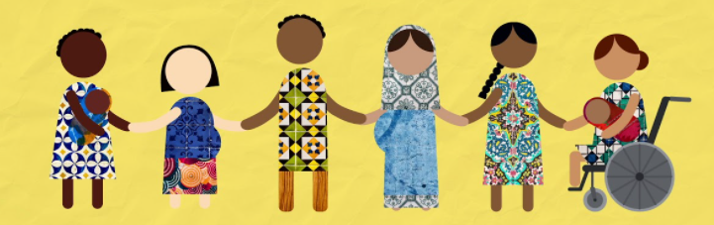
Equality

Slide 11
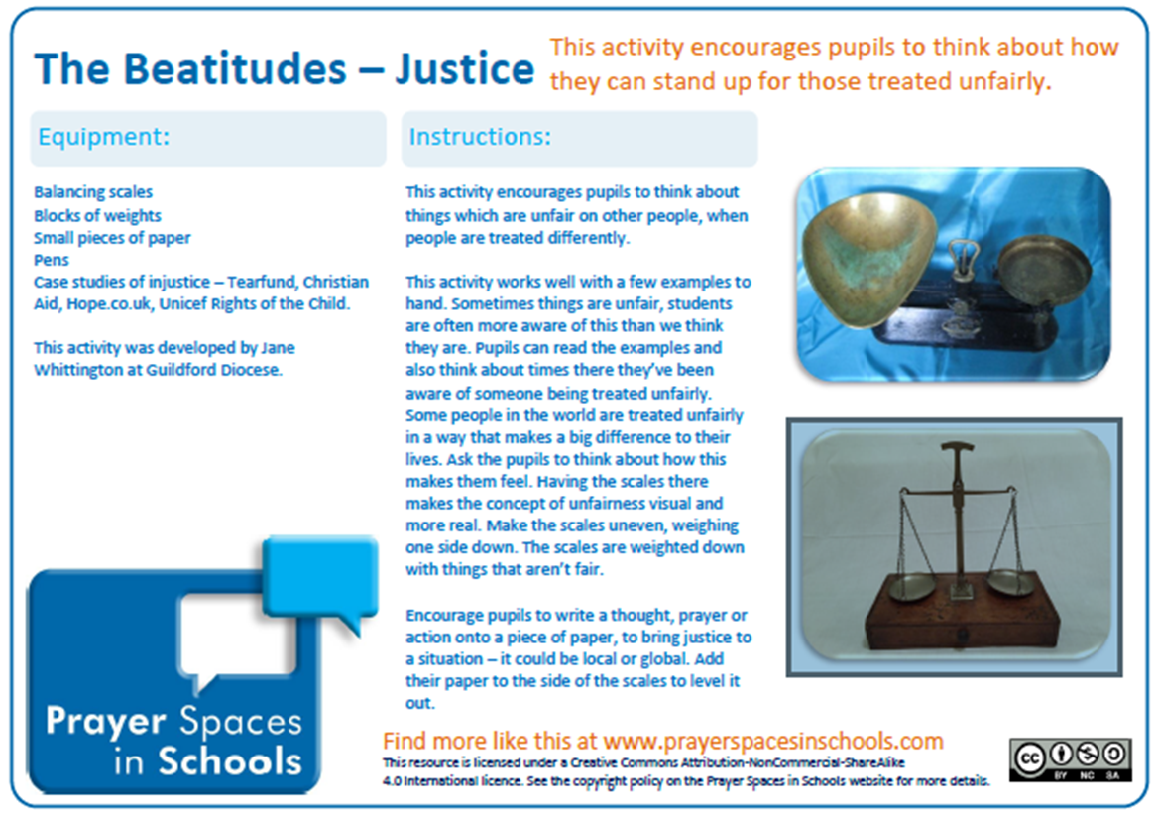
Classroom Worship
Reflection Space
Acts 10:34-35
Then Peter began to speak: “I now realise how true it is that God does not show favouritism but accepts from every nation the one who fears him and does what is right.
https://www.prayerspacesinschools.com/resources/168

Slide 12
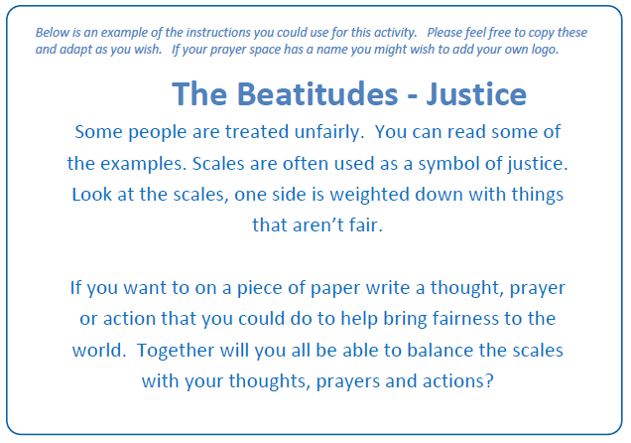
Classroom Worship
Reflection Space
Acts 10:34-35
Then Peter began to speak: “I now realise how true it is that God does not show favouritism but accepts from every nation the one who fears him and does what is right.

Slide 13

Monday

Slide 14
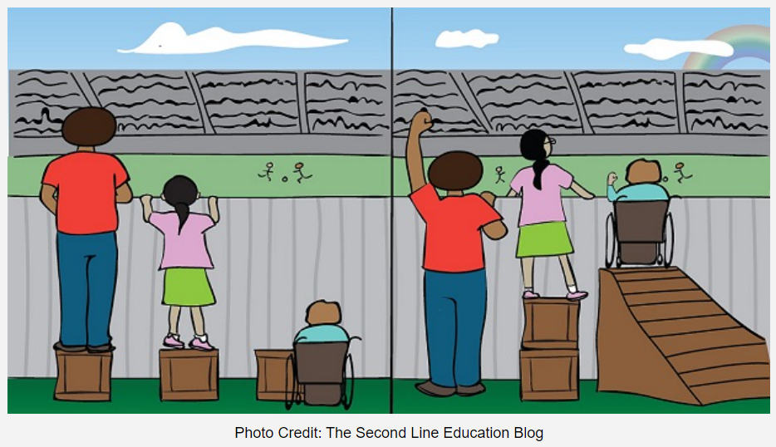


Slide 15



What do you see in the picture?
Can you make a prediction about what we are going to talk about today?
What questions do you have about this picture?
Come up with three questions.

Slide 16
Bible Passage (Acts 10) https://www.freebibleimages.org/illustrations/peter-cornelius/
There was a man named Cornelius who lived in Caesarea, he was a captain of the Roman Guard stationed there. He was a really good man. He had encouraged everyone in his house to live in the way that God would want them to live, he was always helping people in need, and would often pray. One day about three o’clock in the afternoon he had a vision. An angel of God, as real as his next-door neighbour, came in and said, “Cornelius.”
Cornelius stared hard, wondering if he was seeing things. Then he said, “What do you want, sir?”
The angel said, “God has heard your prayers and seen your good works. Here’s what you are to do. Send men to Joppa to get Simon, the one everyone calls Peter. He is staying with Simon the Tanner, whose house is down by the sea.”
As soon as the angel was gone, Cornelius called two servants and one of his soldiers from the guard. He told them what had happened and sent them to find Peter.

Slide 17
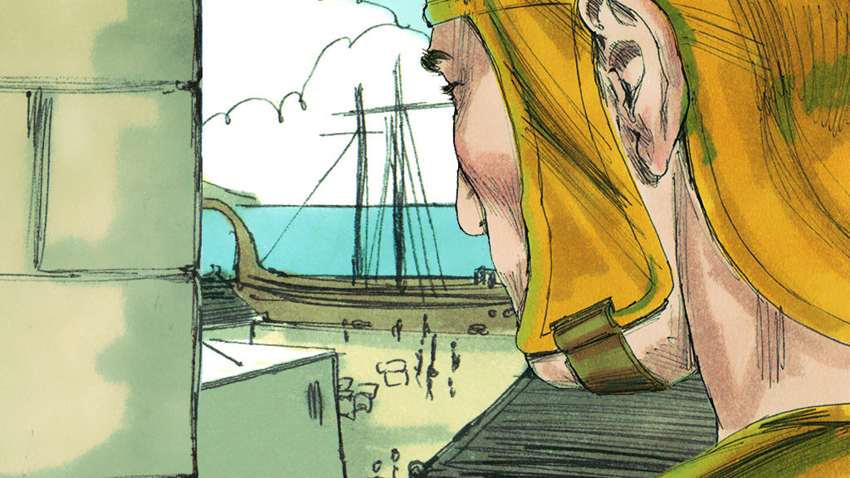

Slide 18
Bible Passage (Acts 10)
The next day as the three travellers were approaching the town, Peter went out on the balcony to pray. It was about noon. Peter got hungry and started thinking about lunch. While lunch was being prepared, he had a dream. He saw the skies open up. Something that looked like a huge blanket lowered by ropes at its four corners settled on the ground. Every kind of animal and reptile and bird you could think of was on it. Then a voice came: “Go to it, Peter—kill and eat.”
Peter said, “Oh, no, Lord. I’ve never so much as tasted food that was not clean”
The voice came a second time: “If God says it’s okay, it’s okay.”
This happened three times, and then the blanket was pulled back up into the skies.
As Peter sat there trying to work out what it all meant, the men sent by Cornelius showed up at Simon’s front door. They called in, asking if there was a Simon, also called Peter, staying there. Peter, lost in thought, didn’t hear them, so the Spirit whispered to him, “Three men are knocking at the door looking for you. Get down there and go with them. Don’t ask any questions. I sent them to get you.”

Slide 19
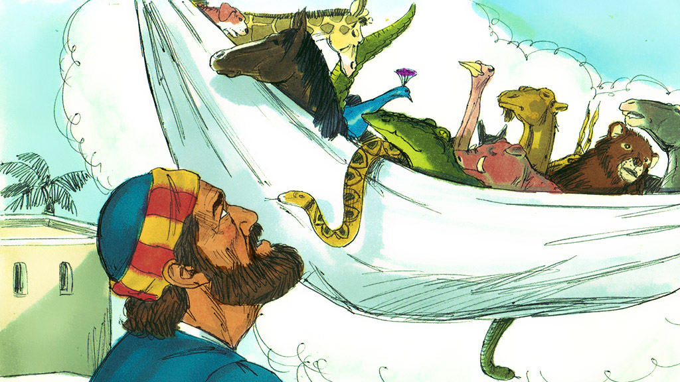

Slide 20
Bible Passage (Acts 10)
Peter went down and said to the men, “I think I’m the man you’re looking for. What’s up?”
They said, “Captain Cornelius, a God-fearing man well-known for his good heart was told by an angel to get you and bring you to his house so he could hear what you had to say.” Peter invited them in and made them feel at home.
The next day Peter travelled to Cornelius’ house where the two men talked about what God had done.
Peter was really excited to hear about what had happened with Cornelius and said: “It’s God’s own truth, nothing could be plainer: God plays no favourites! He sees everyone as equal. It makes no difference who you are or where you’re from—God loves you.’
Peter knew that he had been wrong not to see people as equal.

Slide 21
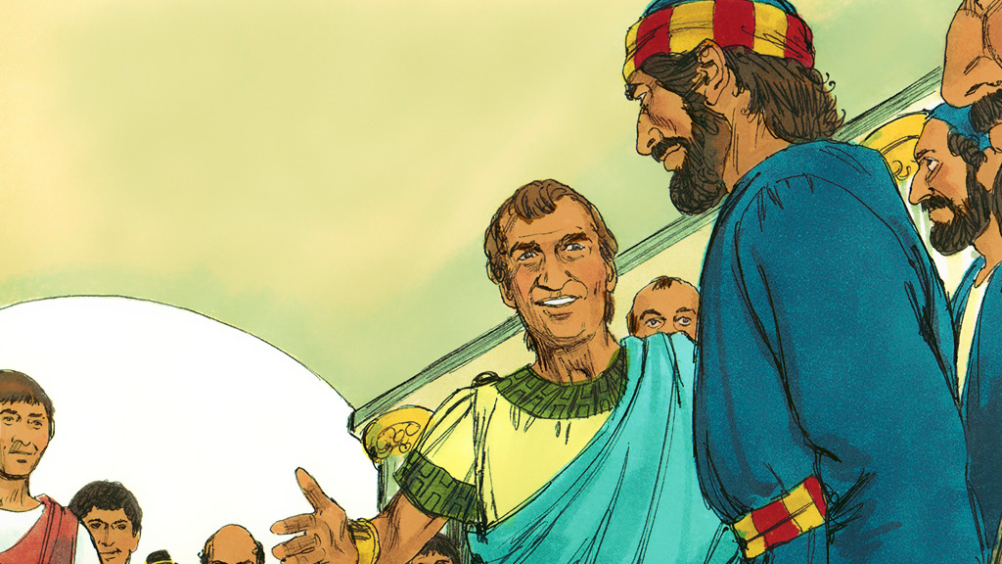

Slide 22

Responding
How do you feel about this story?
What do you find encouraging?
What do you find challenging?

Slide 23
Prayer
Encourage the pupils to respond with their own prayers first or through the pray space and if appropriate use the Lord’s prayer.
Our Father, in heaven,
Holy is your name.
Your Kingdom come,
Your will be done on earth, as it is in heaven.
Give us this day our daily bread,
And forgive us our sins,
As we forgive those who sin against us,
And lead us not into temptation,
But deliver us from evil.
Amen.
Y

Slide 24
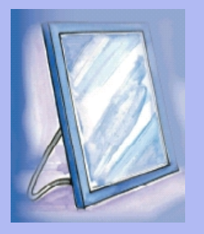
Tuesday

Slide 25

Prompt ~ Think back to yesterday’s story
Can you remember what Peter saw in the sheet coming down from heaven?
When Peter was on the rooftop of the house he saw a sheet coming down from heaven and it was full of all animals that according to his background he should not eat; yet Peter heard God tell him to eat.
At first Peter thought that God was just talking about the food he could and couldn’t eat but that wasn’t the case. God was trying to teach Peter a much more important lesson.
What lesson do you think God was trying to teach Peter?

Slide 26
Reflection question ~
What lesson do you think God was trying to teach Peter?
After Jesus had returned to heaven Peter became one of the leaders of the new church. He was a very good leader but there was one major thing that God wanted Peter to change. Not only were there foods that Peter wouldn’t eat there were also people that he wouldn’t be friends with – Peter did not treat everyone equally.
One group that Peter definitely didn’t get on with were the Romans. Some may say that there were good reasons why Peter didn’t like the Romans – the main one being that they were the ones who crucified Jesus. Yet God wanted to see a change of heart in Peter. God wanted His church to be made up of people who treated everyone equally and showed no favouritism. No matter who they were or the background they came from God loved them.
Once Peter met Cornelius he knew what God had been saying to him, ‘God is telling me that people of all different nations can be part of His family… Certainly, I now understand that God shows no favouritism.’
Peter had learned a big lesson.

Slide 27
Reflection question
Sometimes people grow up to be uncertain of those who are different from them. This may be because of who or what a person likes, what they look like, where they live or how they talk. This kind of attitude can lead to behaviour that is not right, when people see those who are different from them as less important – not equal to themselves.
If we all followed the example of Peter, and learn the lesson he learned – this behaviour would never happen in our world.
Take some time to think what a world like this would be like.

Slide 28


Reflection Challenge
Have you ever thought or behaved like Peter did at the beginning of this story?
How have you been challenged by Peter’s story?
What have you learned from Peter’s story?
Take time to listen to one of these clips and think about how we should be treating others…
The Black Eyed Peas: ‘Where is the Love’ https://youtu.be/WpYeekQkAdc
Lanny Sherwin's "Everyone Is Different“
https://www.youtube.com/watch?v=-QSLlEt_LJY

Slide 29
Prayer
Encourage the pupils to respond with their own prayers first or through the pray space and if appropriate use the Lord’s prayer.
Our Father, in heaven,
Holy is your name.
Your Kingdom come,
Your will be done on earth, as it is in heaven.
Give us this day our daily bread,
And forgive us our sins,
As we forgive those who sin against us,
And lead us not into temptation,
But deliver us from evil.
Amen.
Y

Slide 30

Wednesday

Slide 31

Prompted to action - challenge
Take a close look at the picture again.
Are the people all treated the same in the second picture?
What is different? Does this mean that they are not treated equally?
By treating people equally it doesn’t mean that we treat people the same as we all have different needs. What it does mean is making sure we all have equal opportunities to flourish and live life to the full.

Slide 32
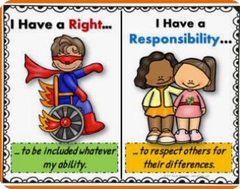

Prompted to action – challenge
Design a ‘Welcome’ poster for your school that expresses the ideas on equality that we have been talking about.

Slide 33


Prompted to action – challenge
Find out more about organisations that battle for equality in our society, ensuring all have the opportunities to flourish and live life to the full.
You could even try out a Paralympic School Day.
A Paralympic School Day kit contains a set of activities and background information, which can be used to educate children and youth about Paralympic sport, individual differences and disability issues in a fun and playful environment.
Created by specialists in Paralympic sport, disability and pedagogy, the kit provides the skills, knowledge and resources to conduct a successful Paralympic School Day. It mainly consists of a Paralympic School Day manual and a series of activity cards. https://www.paralympic.org/the-ipc/paralympic-school-day

Slide 34

Links with British Values
Respect
We respect others
We know that we are all special
We understand the consequences of our actions
We treat everybody equally
This Photo by Unknown Author is licensed under CC BY-SA

Slide 35

Prayer
Encourage the pupils to respond with their own prayers first or through the pray space and if appropriate use the Lord’s prayer.
Our Father, in heaven,
Holy is your name.
Your Kingdom come,
Your will be done on earth, as it is in heaven.
Give us this day our daily bread,
And forgive us our sins,
As we forgive those who sin against us,
And lead us not into temptation,
But deliver us from evil.
Amen.
Y

Slide 36

Thursday

Slide 37
Use the Meditation resource alongside the Spiritual Encounters – bible-based meditation teacher’s pack: http://www.ldbe.co.uk/about/guidance- resources/worship-and-meditation/
(This can be adapted for use with all ages)
You may want to use the following reflection:

Slide 38

Friday

Slide 39
Take this time to celebrate what has happened during the week – you may want to give out awards. If possible, join the bubbles using Zoom or Teams so that the whole school can come together in a time of celebration.
Remember that this should also be a time of worship and celebration so begin with a gathering, include a prayer, a blessing, and a song of celebration.

