Slide 1


Class Worship and Reflections

Slide 2

Church of England Colours for Worship

Slide 3
Classroom Worship
ABSTRACT
Collective worship in a classroom has a different feel from worship in the hall. The more intimate nature of the worship can make everyone feel more readily included. It is also the perfect setting to look at some of life’s big issues in a prayerful and reflective manner. This resource supports small group worship through the theme of RESPECT:
Respect
Equality
Serve
Patience
Enjoy and
Celebrate
Trust

Slide 4
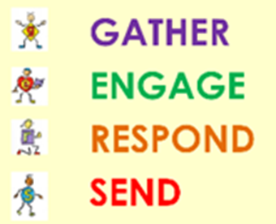
Classroom Worship
Introduction for Teachers
Classroom worship can be organised at any time of day which best suits the needs of the group.
Collective worship in a classroom has a different feel from worship in the hall. The advantages of class worship are:
  • The more intimate nature of the worship can make everyone feel more readily included—there is nobody on the far edge or at the remote back
  • The worship can be planned to be more appropriate for the age and understanding of the children present than is possible in a large mixed age gathering
  • Children and adults may feel happier at leading worship in a more familiar setting with their peers rather than in front of the whole school
Preparing for class worship is very important. If the pupils have been busy just before you are due to start encourage them now to pause and sit quietly, stilling themselves ready to begin.
Create calm, quiet atmosphere – this can be done through music or changing the lighting in the room
A worship focus- in all places of worship there is what may be termed a worship focus, in your own hall this may be a cross or a candle. It is helpful to have a worship focus for your class worship. This does not have to be a permanent feature but something that can be brought out just for the worship. Consider what would be an appropriate worship focus for your classroom e.g. a cloth, candle, cross, bible, ornament, prayer bear. You may want to have a number of appropriate worship foci in a basket that the pupils can choose and set out ready for worship.
Structure - you may well find it helpful to have a set structure to your worship. This enables even of youngest children to feel comfortable and confident with what is happening. Here we have used the gather, engage, respond, and send framework.

Slide 5

Classroom Worship
Possible music
Rend Co. Kids - Feels Good
https://www.youtube.com/watch?v=LJxVHzARMmE&list=PLGXQK3aC61FSm_22oqfft0m2Oje499lC4&index=1
Rend Co. Kids - FUN https://www.youtube.com/watch?v=O9FbdS4ddjY&list=PLGXQK3aC61FSm_22oqfft0m2Oje499lC4&index=4
If I was a Butterfly
https://www.worshipworkshop.org.uk/projector?id=1504&tracktype=full

Slide 6

Gathering these can be used at the beginning of each session
Once everyone is set up ready for worship you may want to start by lighting a candle, followed by one of these:
Leader: Peace be with you.
Pupils: And also with you.
Leader: Welcome everyone
Pupils: It is good to be here together
Play a ‘Welcome’ song as children settle.
We meet in the name of God:
  God the Father,
  God the Son,
  God the Spirit:
  God is one.
Sign: ‘Welcome everybody here’ in BSL

Slide 7
Gathering these can be used at the beginning of each session
Christ the light of the world is here
God help us to speak positive words
To share peace with everyone
To remember that you are with us
Let us celebrate what God has made
Let’s remember to show God’s love,
and to show a bit of heaven to everyone we meet.

Slide 8

Sending these can be used at the End of each session
You may want to end your time together with one of these short prayers or blessings:
As we end this time
May we live with your love
Build on your truth
Share your forgiveness
Rest in your peace
For the whole of the day. AMEN
Thank you for this day,
For fun, friendship and learning.
We give thanks for this time
As we share peace with each other. AMEN
Help us as we as we move on
To carry hope in us for the day
Turning our thoughts towards others,
Our hearts towards love,
And our hands towards serving those in need. AMEN

Slide 9
Sending these can be used at the End of each session
The Lord bless us and watch over us, he is kind and helps us to show peace. Amen
Let’s remember today to show peace and love
To forgive when others upset us
To remember that we are all equal to God
To think about what we say before we say it
To thank God for a new day
Thank you God for all your good gifts
Christ our Lord,
Just as kings bowed down and offered you gifts,
May we know your strength and peace
And see all the free gifts you have given to us
and the blessing of the Father, Son and Holy Spirit,
be with you all, evermore
Amen

Slide 10

Respect

Slide 11
Classroom Worship
Reflection Space
1 Peter 2:17
‘Show proper respect to everyone.’
This activity uses parts of C.S. Lewis' Narnia tales to encourage pupils to think about their differences, how they are unique and how each in their uniqueness deserves respect.
When Lucy first fumbled her way through the coats and out of the back of the wardrobe, she was surprised to find herself standing beside a lamp-post, surrounded by beautiful snow-covered trees. She'd arrived in Narnia.
Shortly after this, she met a faun who introduced himself as Mr Tumnus. Lucy and Mr Tumnus were very different, but they became the best of friends (and stayed friends to the end of CS Lewis's final Narnia Book) and respected one another.
Scientists say that every snowflake is unique. No two snowflakes are the same.
And people are unique too. No two people are the same. No two people have exactly the same story, the same looks, the same likes... not even identical twins!

Slide 12
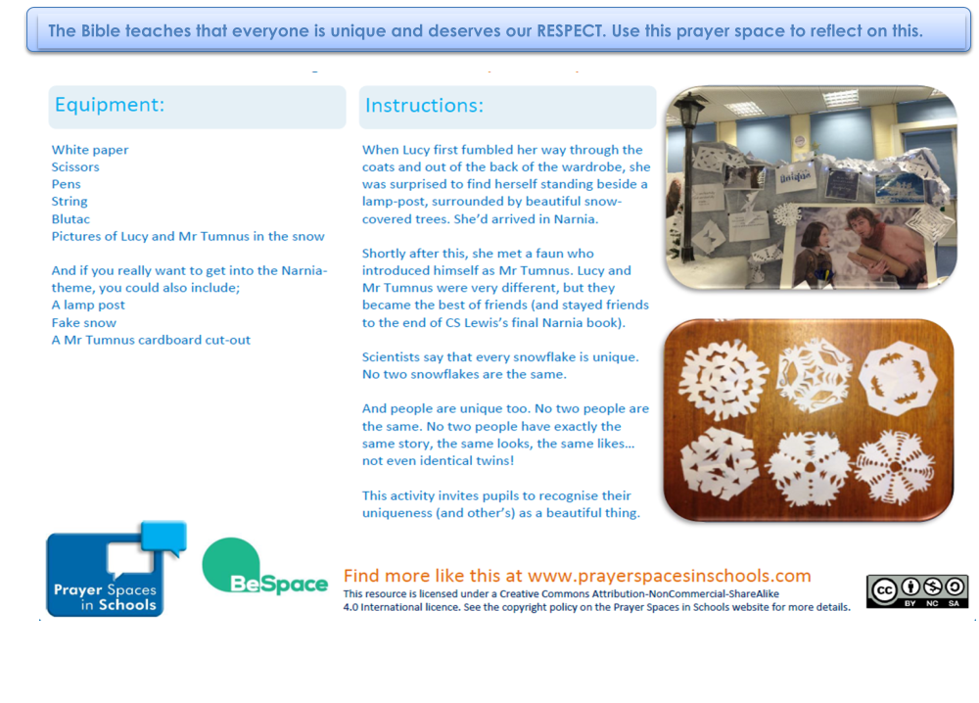

Classroom Worship
Reflection Space
1 Peter 2:17
‘Show proper respect to everyone.’

Slide 13
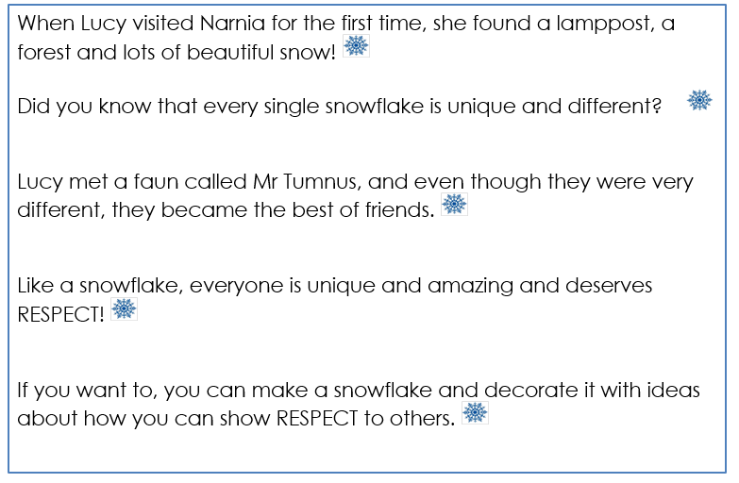
Classroom Worship
Reflection Space
1 Peter 2:17
‘Show proper respect to everyone.’

Slide 14

Monday

Slide 15
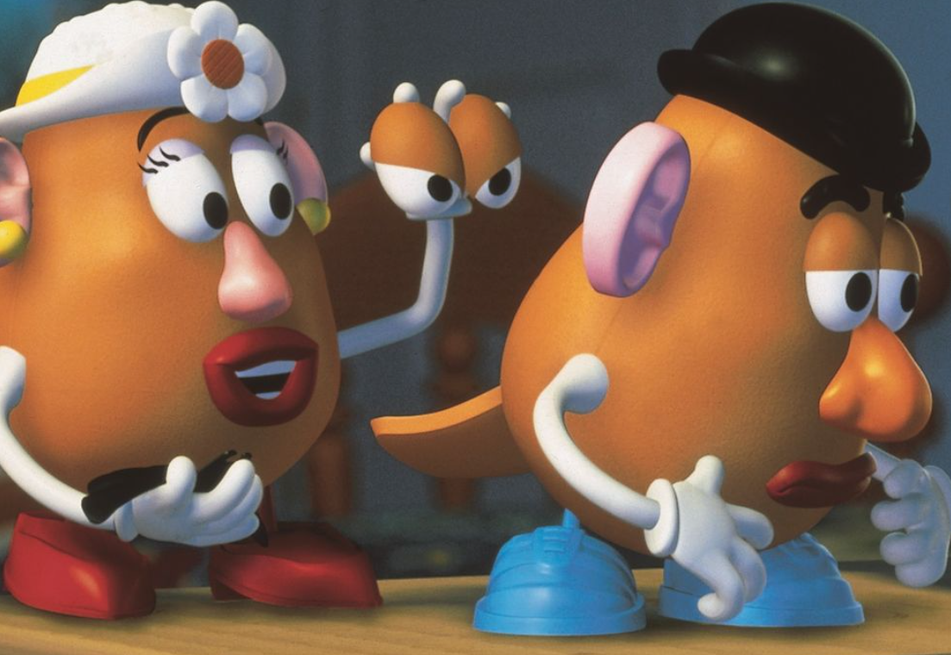


Slide 16



What do you see in the picture?
Can you make a prediction about what we are going to talk about today?
What questions do you have about this picture?
Come up with three questions.

Slide 17
Bible Passage (based on 1 Corinthians 12)
One day the different parts of the body were having an argument to see who should be valued most. The brain said, “I do all the thinking so I’m the most important and I should have the greatest value.”
The eyes said, “No, no, no! I see everything and let the rest of you know where we are, so I’m the most important and I should be in charge. I am the most important ”
The hands said, “Without me we wouldn’t be able to pick anything up or move anything – just think how difficult it would be to eat without me. So I’m the most important and I should be in charge.”
The stomach said, “I turn the food we eat into energy for the rest of you. Without me, we’d starve. So I’m the most important and I should be in charge.”
The heart said, “Wait a minute – you all have it wrong. If it wasn’t for me you wouldn’t have blood flowing through your body. I am the one that should be valued most.”
The argument continued…

Slide 18

Responding
How do you feel about this story?
What do you find encouraging?
What do you find challenging?

Slide 19
Prayer
Encourage the pupils to respond with their own prayers first or through the pray space and if appropriate use the Lord’s prayer.
Our Father, in heaven,
Holy is your name.
Your Kingdom come,
Your will be done on earth, as it is in heaven.
Give us this day our daily bread,
And forgive us our sins,
As we forgive those who sin against us,
And lead us not into temptation,
But deliver us from evil.
Amen.
Y

Slide 20
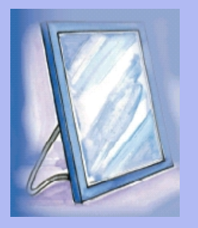
Tuesday

Slide 21
prompt… (1 Corinthians 12:12-21)
12 Just as a body, though one, has many parts, but all its many parts form one body, so it is with Christ.
15 Now if the foot should say, ‘Because I am not a hand, I do not belong to the body,’ it would not for that reason stop being part of the body. 16 And if the ear should say, ‘Because I am not an eye, I do not belong to the body,’ it would not for that reason stop being part of the body. 17 If the whole body were an eye, where would the sense of hearing be? If the whole body were an ear, where would the sense of smell be? 18 But in fact God has placed the parts in the body, every one of them, just as he wanted them to be. 19 If they were all one part, where would the body be? 20 As it is, there are many parts, but one body. 21 The eye cannot say to the hand, ‘I don’t need you!’ And the head cannot say to the feet, ‘I don’t need you!’

Slide 22
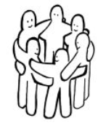
Reflection question
How do you feel when you see this image?
How would you describe what is happening?
Does this feel like a positive picture?
Why or why not?

Slide 23
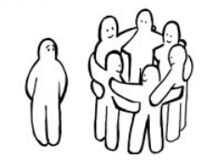
Reflection question
How do you feel now that you can see the whole image?
How would you describe what is happening?
Does this feel like a positive picture?
Why or why not?

Slide 24



Reflection Challenge
It can be hard to feel like the outsider especially when people don’t accept us for who we are.
Take some time to think about the times that we have felt left out or when we have left others out.
What ideas could we take from the passage in 1 Corinthians 12 to help in such situations?
Why is it important to respect all people regardless of whether they are the same as us or not?

Slide 25
Prayer
Encourage the pupils to respond with their own prayers first or through the pray space and if appropriate use the Lord’s prayer.
Our Father, in heaven,
Holy is your name.
Your Kingdom come,
Your will be done on earth, as it is in heaven.
Give us this day our daily bread,
And forgive us our sins,
As we forgive those who sin against us,
And lead us not into temptation,
But deliver us from evil.
Amen.
Y

Slide 26

Wednesday

Slide 27
Prompted to action - challenge
Remind people of the theme for the week and of the bible verse
Watch the film clip.
https://www.youtube.com/watch?v=PT-HBl2TVtI
Think about how one person, by showing respect to someone else, could have such a positive impact on so many people.
Set yourself some challenges today. Think about ways that you can show respect, you never know how many people you may impact. Make a pledge card to remind yourself of your challenge.
There are some ideas on the next slide…

Slide 28
Prompted to action – challenge ideas
Volunteer to help your teacher or someone at home even before you are asked to
Make three people smile by doing something nice for them
Help someone who is
struggling
Make friends with someone you do not know so well in your school
Raise some money for a local charity
Write a letter or make a card for someone who is lonely

Slide 29

Links with British Values
Respect
We respect others
We know that we are all special
We understand the consequences of our actions
We treat everybody equally
This Photo by Unknown Author is licensed under CC BY-SA

Slide 30

Prayer
Encourage the pupils to respond with their own prayers first or through the pray space and if appropriate use the Lord’s prayer.
Our Father, in heaven,
Holy is your name.
Your Kingdom come,
Your will be done on earth, as it is in heaven.
Give us this day our daily bread,
And forgive us our sins,
As we forgive those who sin against us,
And lead us not into temptation,
But deliver us from evil.
Amen.
Y

Slide 31

Thursday

Slide 32
Use the Meditation resource alongside the Spiritual Encounters – bible-based meditation teacher’s pack: http://www.ldbe.co.uk/about/guidance- resources/worship-and-meditation/
(This can be adapted for use with all ages)
You may want to use the following reflection:

Slide 33

Friday

Slide 34
Take this time to celebrate what has happened during the week – you may want to give out awards. If possible, join the bubbles using Zoom or Teams so that the whole school can come together in a time of celebration.
Remember that this should also be a time of worship and celebration so begin with a gathering, include a prayer, a blessing, and a song of celebration.

