Slide 1
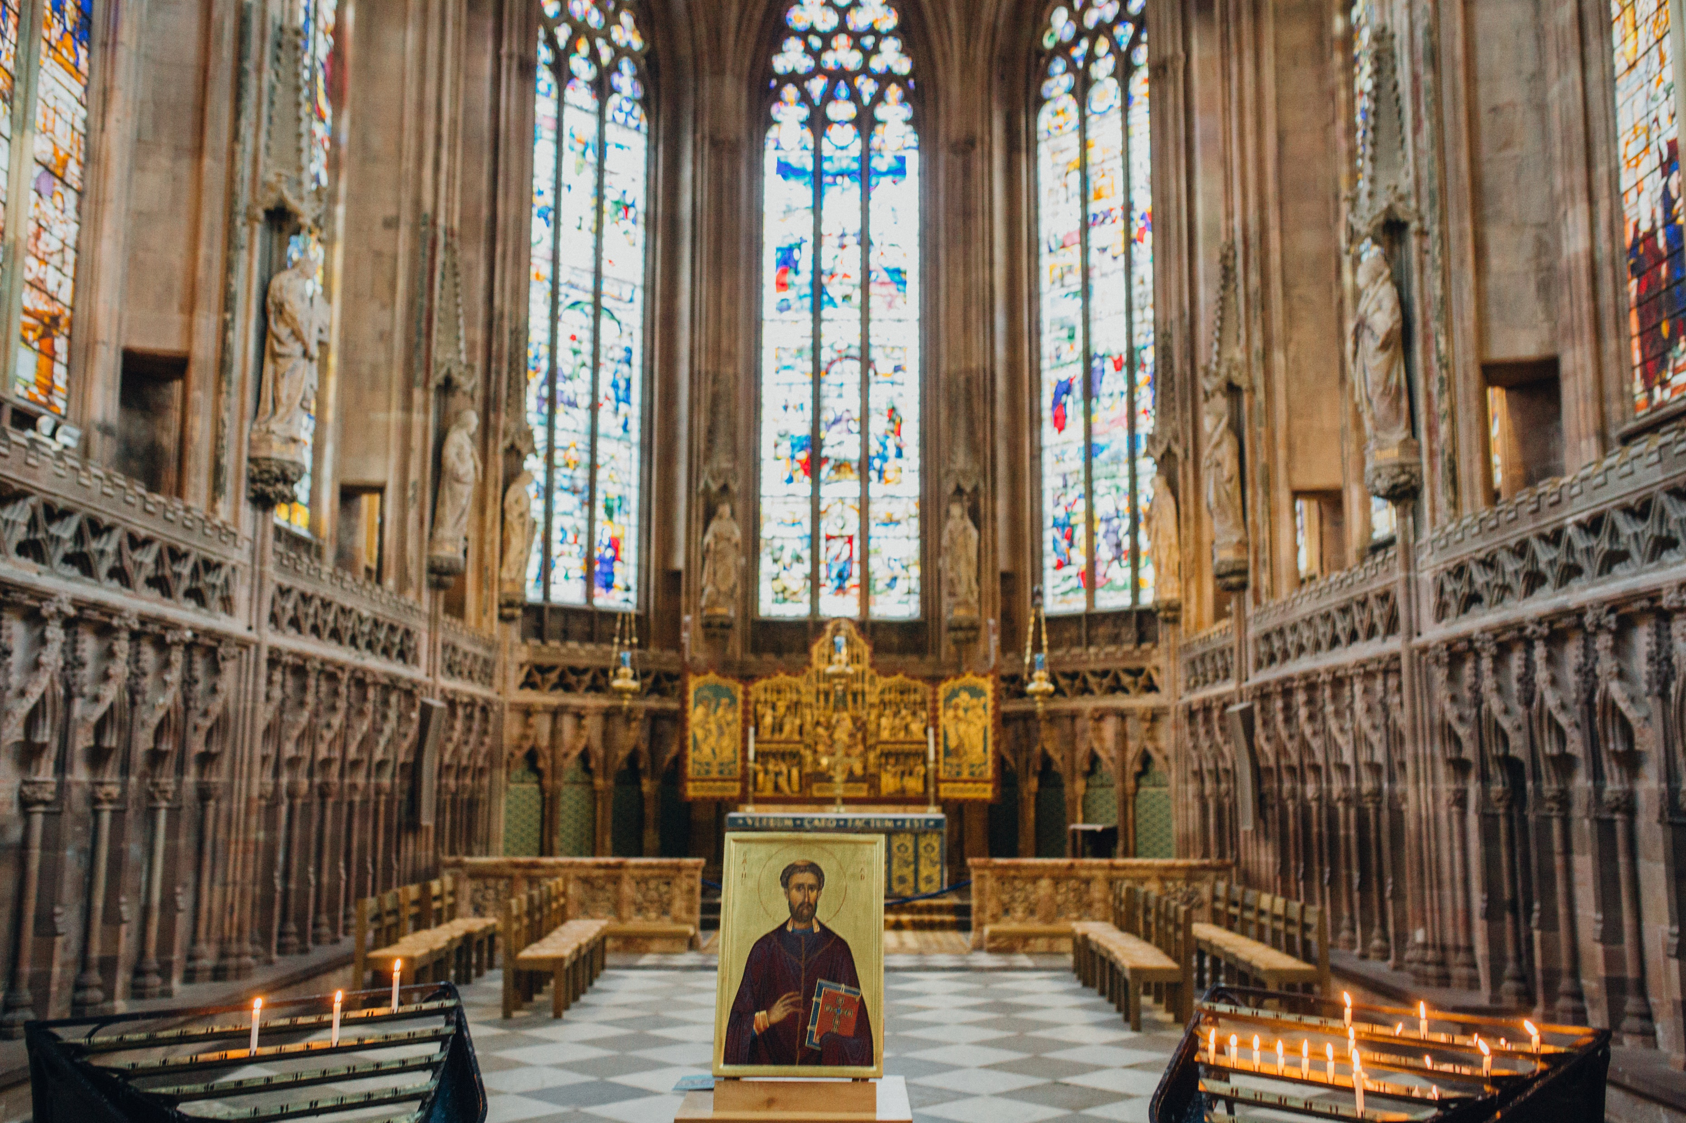
Remembering the Holocaust

Slide 2
Can you define these words?
Have you heard any of these words or phrases before?
What do you think it means?
Are there any which you don’t recognise? Can you guess what they might mean?
The Holocaust
Persecution
Prejudice
Jewish
Genocide
Nazi Persecution

Slide 3
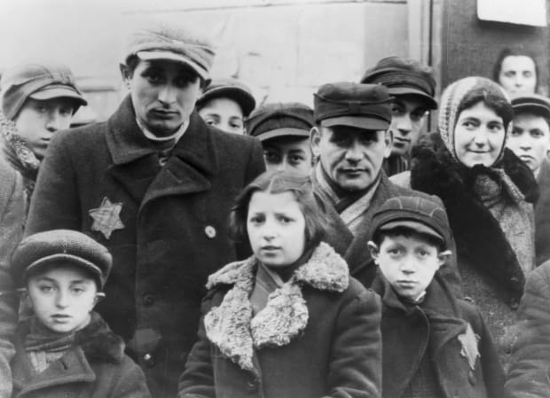
The Holocaust
The Holocaust describes the killing of over six-million Jews before and during World War II.
These killings were organised by the German Nazi party and were directed by the party leader, Adolf Hitler.
Hitler blamed the Jews for Germany losing the First World War and for the financial problems in Germany during the 1920s. In fact, Hitler sought to blame the Jews for many of his country’s problems.
He made the Jews a scapegoat and sought to promote a widespread public hatred of them. Jews had to wear a symbol called the Star of David so that others could recognise them.
This prejudice against Jews is called antisemitism.
Text source: Twinkl

Slide 4
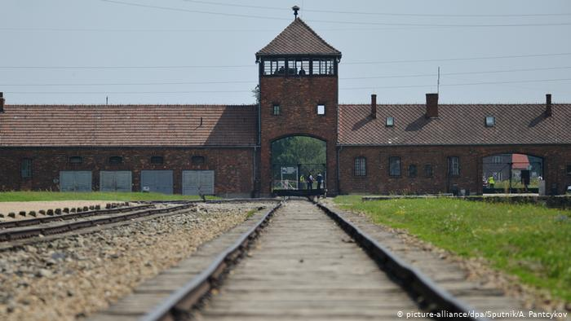
The Holocaust
The Jewish people lived in constant fear of being captured. Those who tried to fight back were shot or publicly humiliated and tortured by the Nazi soldiers. Jews found in hiding were rounded up and sent on cramped buses and trains to meet an unknown fate. Families were often separated.
Many Jews were sent to concentration camps where they were forced to work like slaves. Many died through infection, starvation or exhaustion. Others were sent to death camps where they were killed in gas chambers. This form of mass killing is called genocide.
Text source: Twinkl

Slide 5
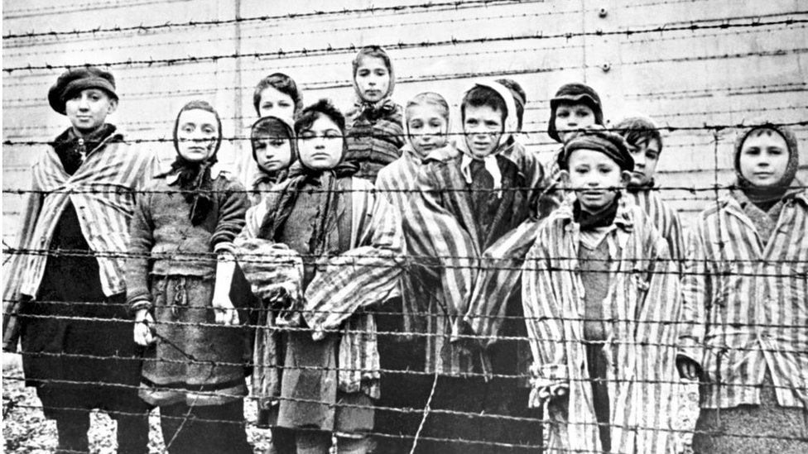
The Holocaust
At the end of the war, mass graves were revealed containing the bodies of thousands of people, who had been mercilessly executed.
The Jews and prisoners of war living in concentration camps were liberated and revealed the horrific truth about their treatment. Most were starving and badly beaten.
It was not just Jewish people that were victims. Hitler also targeted people from certain countries like Poland and the Soviet Union and minority groups, such as homosexuals and disabled people.
The atrocities committed during the Holocaust are still as shocking today as they were during the war.
Text source: Twinkl

Slide 6
These quotations were written by two survivors of the Holocaust, who were imprisoned in a camp called Auschwitz-Birkenau. Both went on to become famous writers and wrote about their experiences during the Holocaust.
What do the quotations mean?
Do you agree or disagree with the quotations?
Why might the two men have said these things?
What can these quotations tell us about why we should learn about and remember the Holocaust?
Text source: Holocaust Memorial Day Trust

Slide 7
Holocaust Memorial Day
Holocaust Memorial Day takes place each year on 27 January. It is a time to remember
the millions of people murdered during the Holocaust, under Nazi Persecution and in the
genocides which followed in Cambodia, Rwanda, Bosnia and Darfur.
The Holocaust Memorial Day Trust says that:
‘Holocaust Memorial Day is a time when we seek to learn the lessons of the past and recognise that genocide does not just take place on its own - it’s a steady process which can begin if discrimination, racism and hatred are not checked and prevented. We’re fortunate here in the UK; we are not at immediate risk of genocide. However, discrimination has not ended, nor has the use of the language of hatred or exclusion. There is still much to do to create a safer future and HMD is an opportunity to start this process.’
Each year thousands of activities take place for HMD, bringing people from all backgrounds together to learn lessons from the past in creative, reflective and inspiring ways.
Text source: Holocaust Memorial Day Trust

Slide 8
The theme for Holocaust Memorial Day 2021 is:
BE THE LIGHT IN THE DARKNESS
What do you think this means?
The Holocaust Memorial Day Trust says that:
‘Be the light in the darkness … asks us to consider different kinds of ‘darkness’, for example, identity-based persecution, misinformation, denial of justice; and different ways of ‘being the light’, for example, resistance, acts of solidarity, rescue and illuminating mistruths.’
Text source: Holocaust Memorial Day Trust

Slide 9
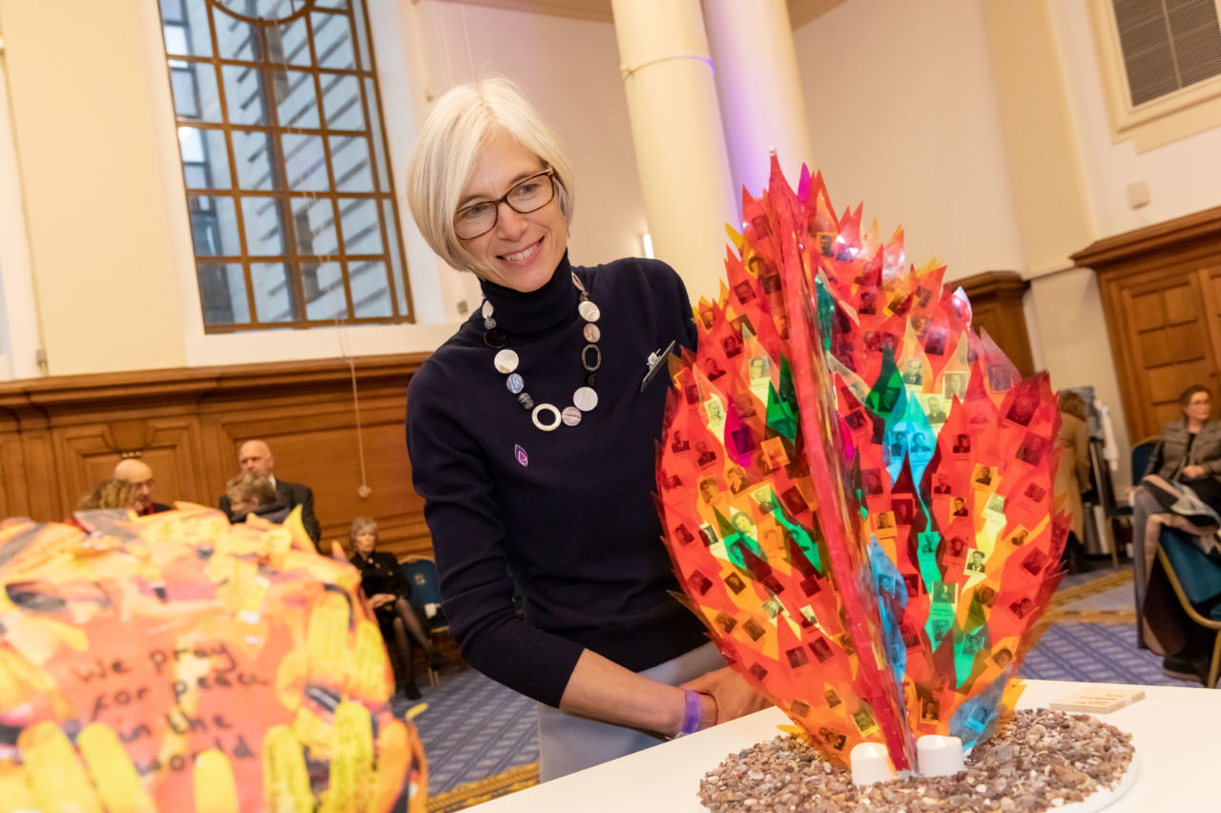
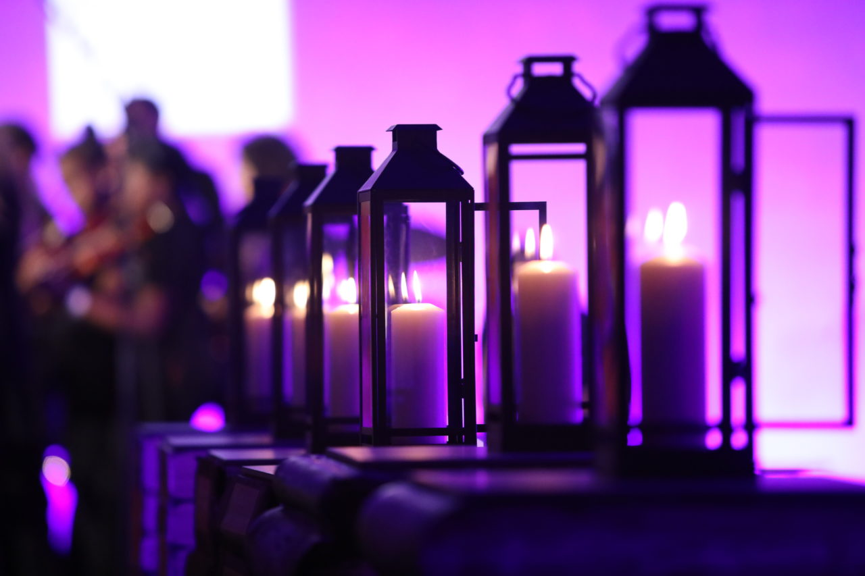
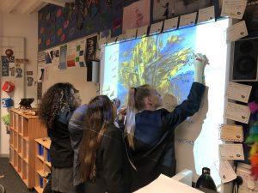
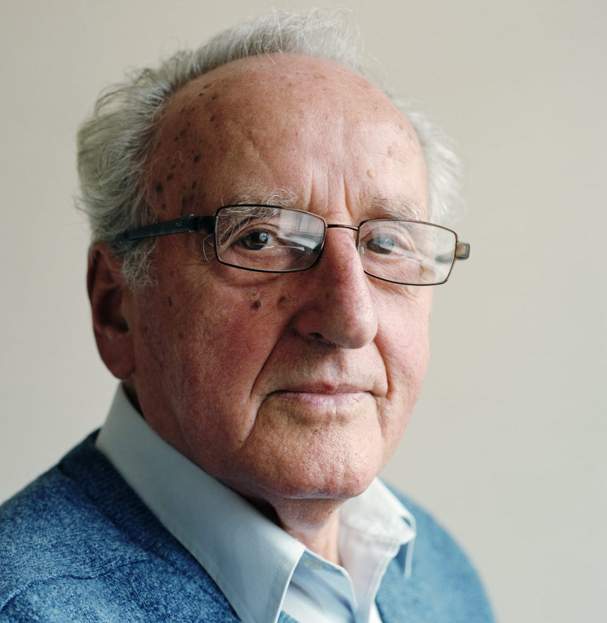
What do people do on HMD?
Music and Art
Create or watch films
Write songs
Listen to music
Community art projects
Ceremonies
Light a candle
Reflect together
Install a plaque or memorial
Writing
Write poetry or stories
Think about the experiences of others
Write an article for a website or magazine
Sharing
Hear stories from Holocaust survivors
Discuss your thoughts and experiences
Pass stories onto others
Images: Holocaust Memorial Day Trust

Slide 10
What can we do?
You could do any of the activities that you have just read about, but you have already begun to commemorate and remember the Holocaust by taking part in this lesson today.
You can also watch Lichfield Cathedral’s online Holocaust Memorial Day service and take part in an act of remembrance and reflection.

Slide 11
Lesson activity: hot air balloon debate
It can be hard to admit that we all have our own prejudices - these are often informed by propaganda and media messages.
We can explore these prejudices and the perceived value that people have in society by using the hot air balloon debate.
Divide into groups of 5. Each person in your group will be assigned a different character with a specific role in society.
Imagine that you are all enjoying a hot air balloon ride over a mountain range. Unfortunately you don’t have enough fuel and will crash unless you eject one (or more) of the passengers. To get to decide who lives you must have a debate.
Each of you must put your case forward. Consider questions such as ‘how does your job help people’ and ‘what will you give back to society if you survive’. You can also suggest other people to be ejected and give reasons why.
Finally, hold a vote to decide who gets to be thrown out of the balloon.

Slide 12
Example characters
The scientist
You are a researcher at a major university. You had a scientific breakthrough ten years ago when you discovered how to treat a rare disease. Presently you are focused on curing cancer. However, after ten years of research, you don’t appear to be any closer to a solution. You are divorced and never had children.
The doctor
You are a sixty year old surgeon. Last week you saved three people who had been in a horrible car accident. You have been in medicine for thirty five years, but you will retire in the next few years to spend time with your wife, children and grandchildren.
The footballer
You are a young, gifted footballer with the potential to play for the biggest clubs. Already you earn a lot of money, but you have spent it all on cars and parties. You are single with no children.
The factory worker
You are a low level employee in a big factory. You are married with five children. Your oldest child starts university soon. In your spare time, you are an active member of your community – coaching a children’s football team, helping out at a homeless shelter and driving a minibus for blind people.
The politician
You are a local politician who has been in office for five years. You are married and have two children at university. Recently you voted on several unpopular decisions, which has turned local people against you. However, you believe the decisions you made were in the best interests of the city.

