Slide 1
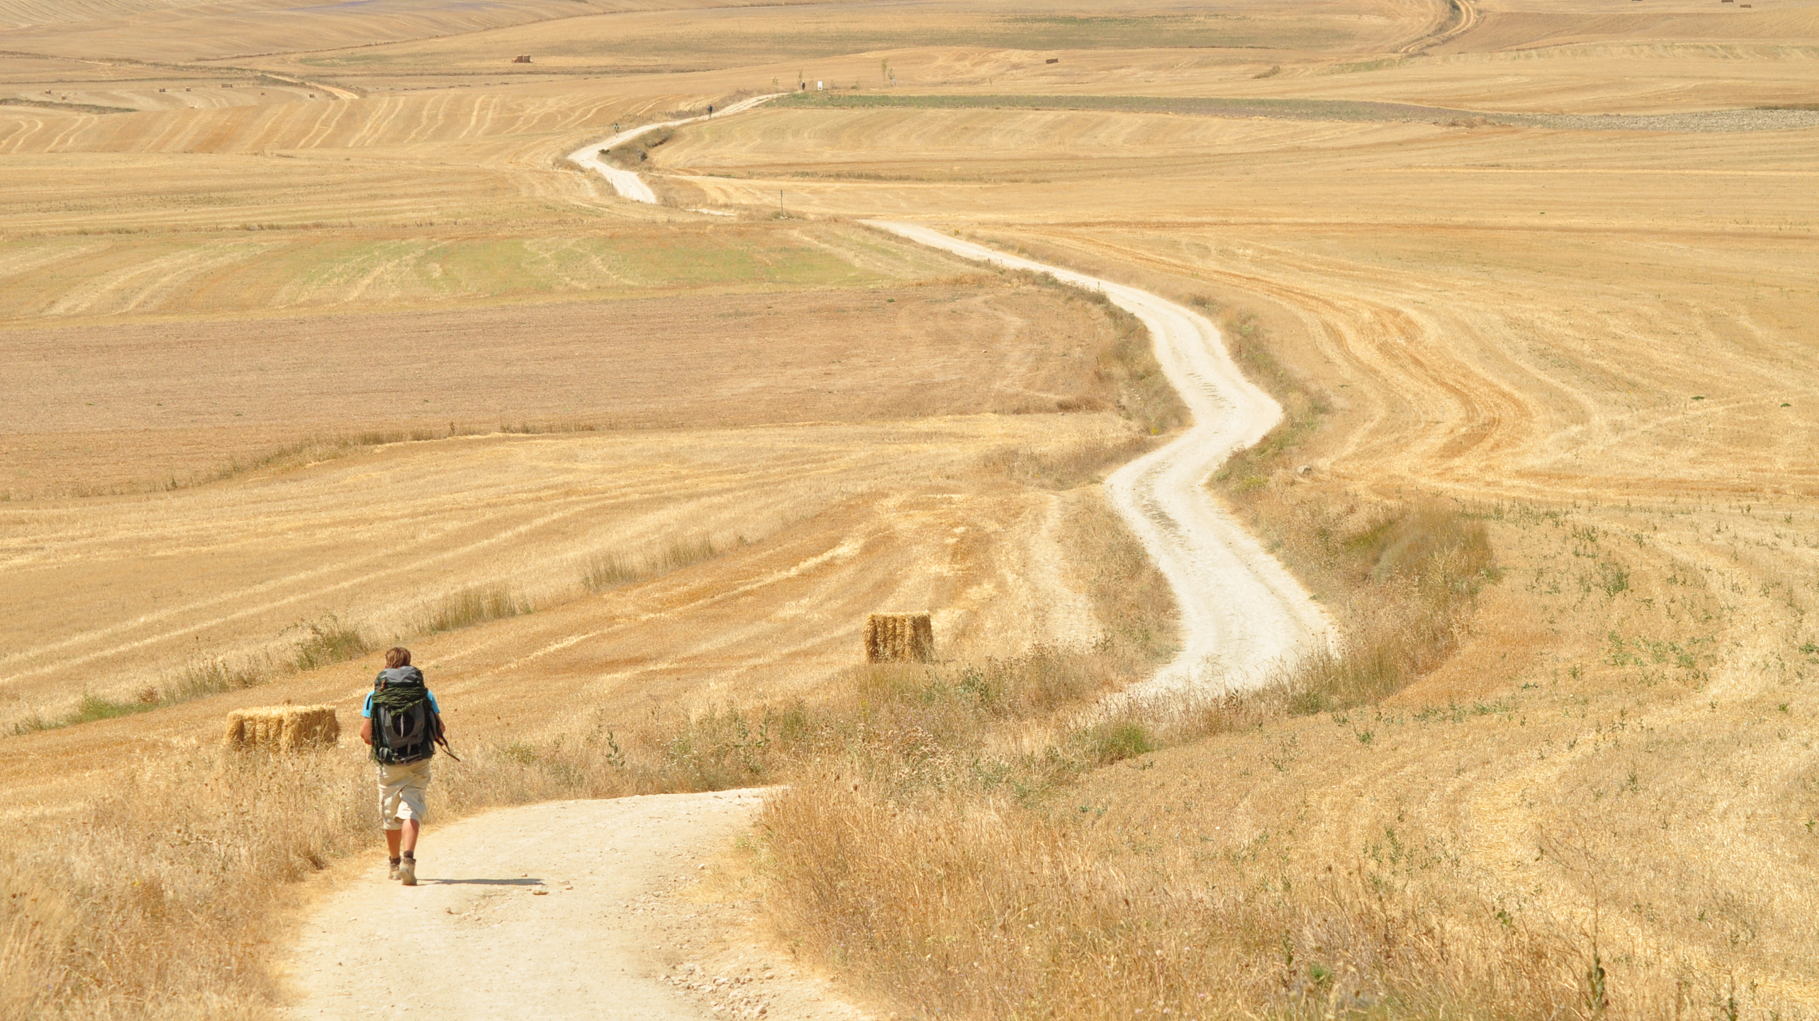


PILGRIMAGE:
A JOURNEY OF HOPE
How do people find hope on Pilgrimage?
Year 8

Slide 2
INTRODUCTION
This pack offers a range of activities linked to the theme of Pilgrimage. Teachers have the option of using the activities in sequence or offering them in ‘carousel’ form to the pupils.
The activities may provide a starting point for larger projects and the theme lends itself to becoming part of a transition project, as pupils move to the next year group or to a new school.

Slide 3
What is a Pilgrimage?
Pilgrimage (n.): A journey with purpose on foot to holy/wholesome/special places.
People have made pilgrimage across countless geographies, cultures and eras.
To turn a walk into a pilgrimage, at the beginning set your private ‘intention’ – dedicate your journey to something that you want help with, or for which you want to give thanks.
People who use their journeys to reflect on their relationship with God are called pilgrims. People from many different faiths do different kinds of pilgrimages – it often involves physically travelling, often walking, alone or with other people. It can be a challenge and hard work but is often an enlightening experience. The time that pilgrims spend with God and their experiences on the way are just as important as arriving at the final destination. This is because of what they discover about God, themselves and other people along the way.
Taking time to reflect and pause along the way can help to shed a light on a difficult situation or problem. A new discovery can be like a light shining in the darkness helping the pilgrim to find a way or a new way of being. It can also help the pilgrim to be a light shining in the darkness for others.

Slide 4
What is a Pilgrimage?
Pilgrimage Vocabulary
Pilgrim | A person who journeys to a sacred place for religious reasons.
Pilgrimage | A pilgrim’s journey.
Hajj | The fifth pillar of Islam. Muslims should perform a pilgrimage to Mecca at least once in their lifetime, or pay for someone to go on their behalf.
The Vatican | This is a separate state situated in the city of Rome. It is the residence of the Pope, the leader of the Roman Catholic Church. A centre of pilgrimage for Roman Catholic Christians.
Lourdes | This is a pilgrimage site in France for Roman Catholics and some Anglicans. It is associated with a vision of Mary by a young girl called Bernadette. It is associated with modern day miracles.
Western/Wailing Wall, Jerusalem | This is a very important pilgrimage site for Jews. It is the remains of the last Temple to worship Yahweh. This temple was destroyed by the Romans in AD70.
Harmandir Sahib, Amritsar, North India | The Harmandir Sahib is surrounded by a pool of clear water that is sacred to Sikhs. The sacred water is believed to have healing powers. It is also known as the Golden Temple and is the most famous place of worship for Sikhs.
Varansai, India | This is a pilgrimage site for Hindus. Many either want to die here or be cremated here on the banks of the River Ganges.
Two Saints Way | This is the pilgrimage route used by Christians from the Middle Ages, and today, between the Shrines of St Chad, Lichfield and St Werburgh, Chester.

Slide 5
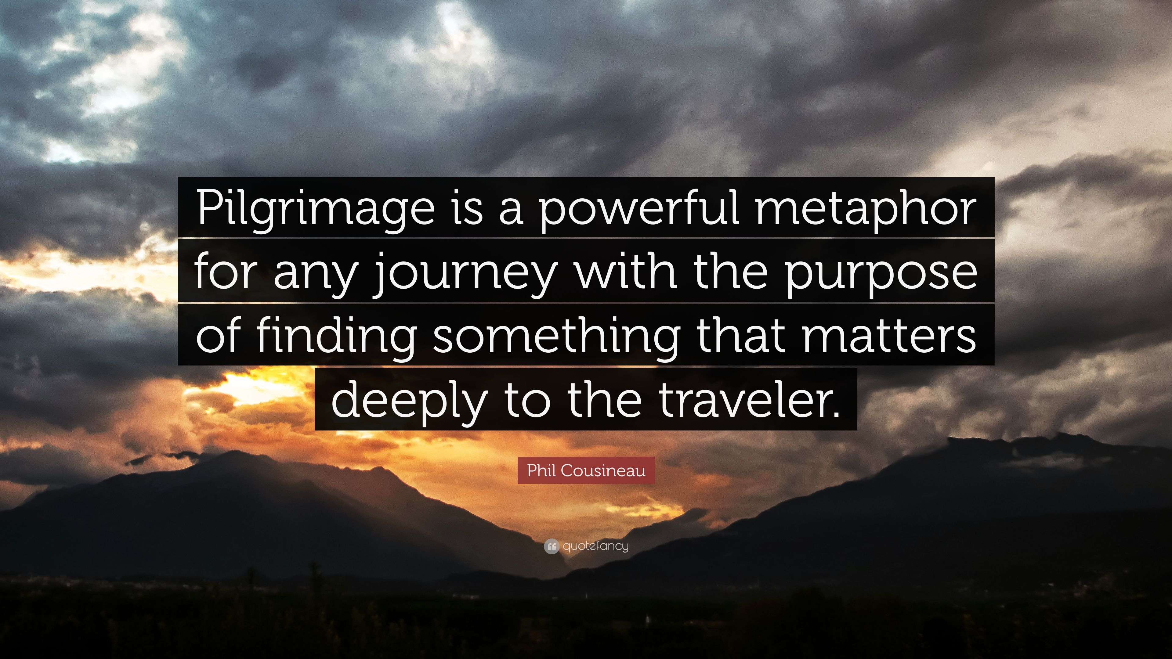
Activity 1: To be a Pilgrim…
“To turn a walk into a pilgrimage, at the beginning set your personal ‘intention’ – dedicate your journey to something that you want help with, or for which you want to give thanks.”
If you were to set off on a pilgrimage, what would be your reason?
Where would you travel to?

Slide 6
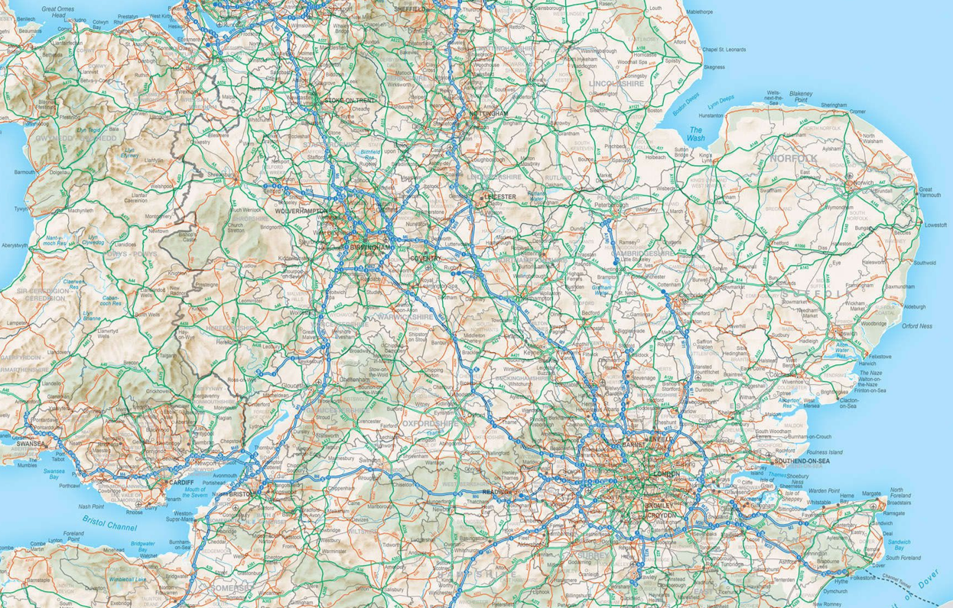
Why are you setting out on a pilgrimage?
Where are you travelling to and why?

Slide 7
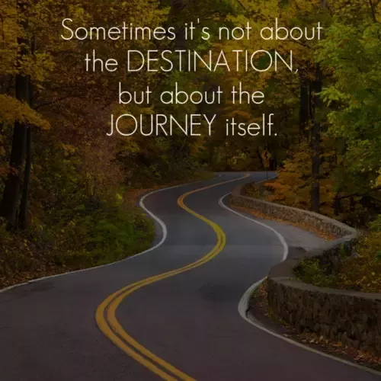
Activity 1: To be a Pilgrim…
To turn a walk into a pilgrimage, at the beginning set your private ‘intention’ – dedicate your journey to something that you want help with, or for which you want to give thanks.
Do you agree with this statement?
Which is more important, the destination or the journey?

Slide 8
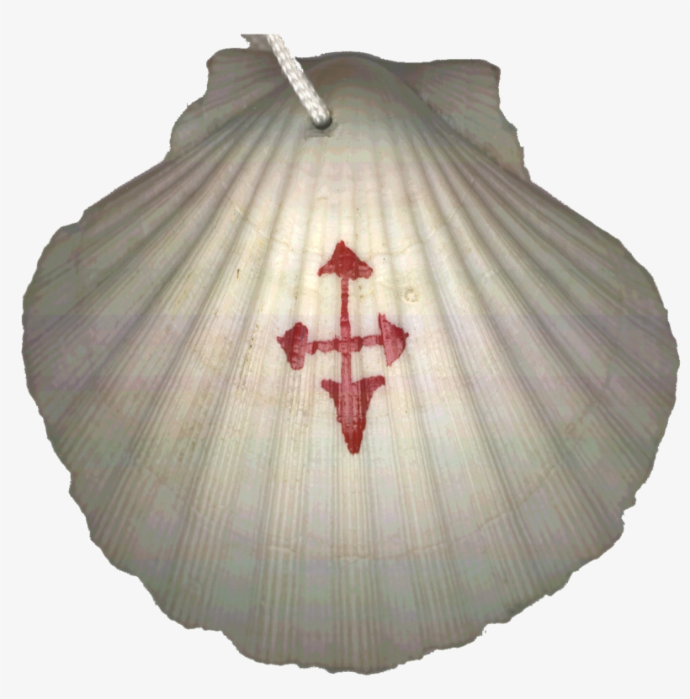
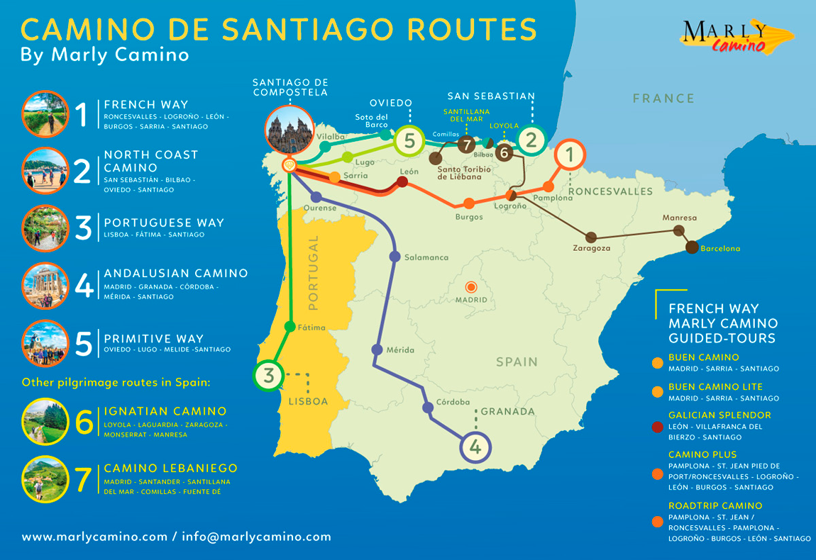
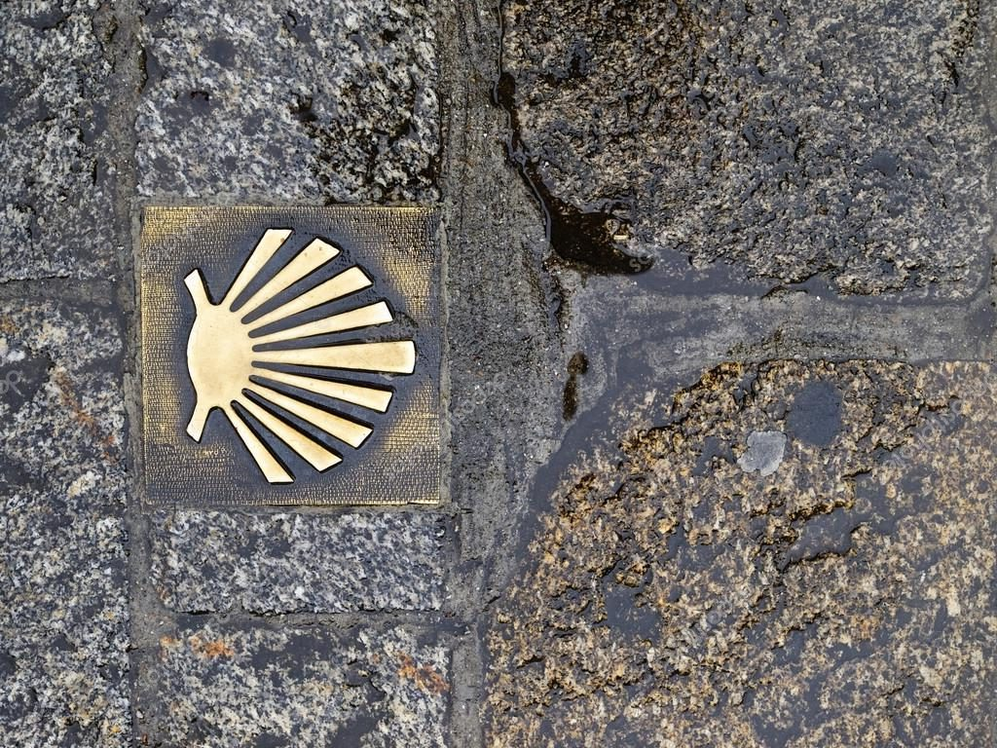
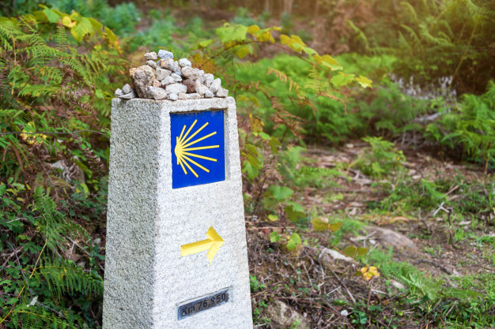
Activity 1: To Be A Pilgrim…
The Scallop Shell is the symbol of Pilgrimage. It is also the symbol of St James and you can see it used as a way marker along a famous pilgrimage route – the Camino de Santiago (The Way of St James), which has many routes that all end at Santiago de Compostela in Northern Spain.

Slide 9
Activity 1: To Be A Pilgrim…
The Scallop Shell is worn by pilgrims, especially on the Camino de Santiago.
What would you wear or carry as a symbol of your journey? It might be a special object, item of clothing or piece of jewellery. It may have religious significance or sentimental value.
Can you design a special symbol for your own personal journey?
You can find out more about the Camino de Santiago here:
https://caminoways.com/camino-de-santiago
https://followthecamino.com/en/camino-de-santiago-routes/

Slide 10
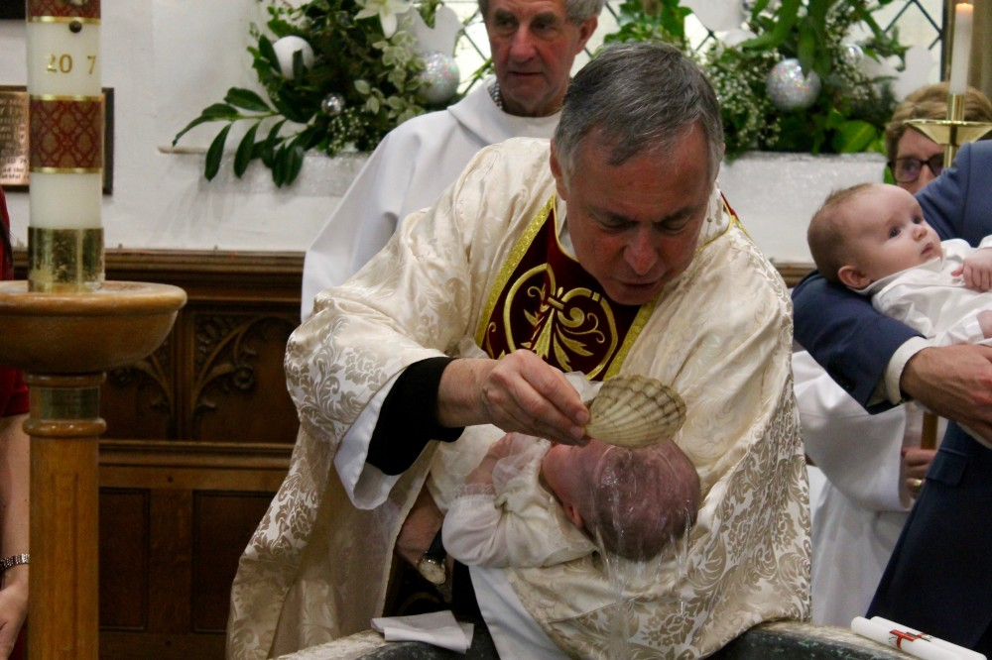
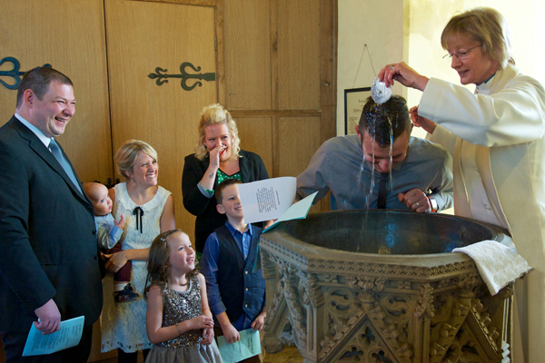
Activity 1: To Be A Pilgrim…
The Scallop shell is also often used in Christian baptism. The shell is used to scoop the water up from the font before pouring it on the head of the person being baptised.
Can you think of any reason why the symbol of the shell could connect baptism and pilgrimage?

Slide 11
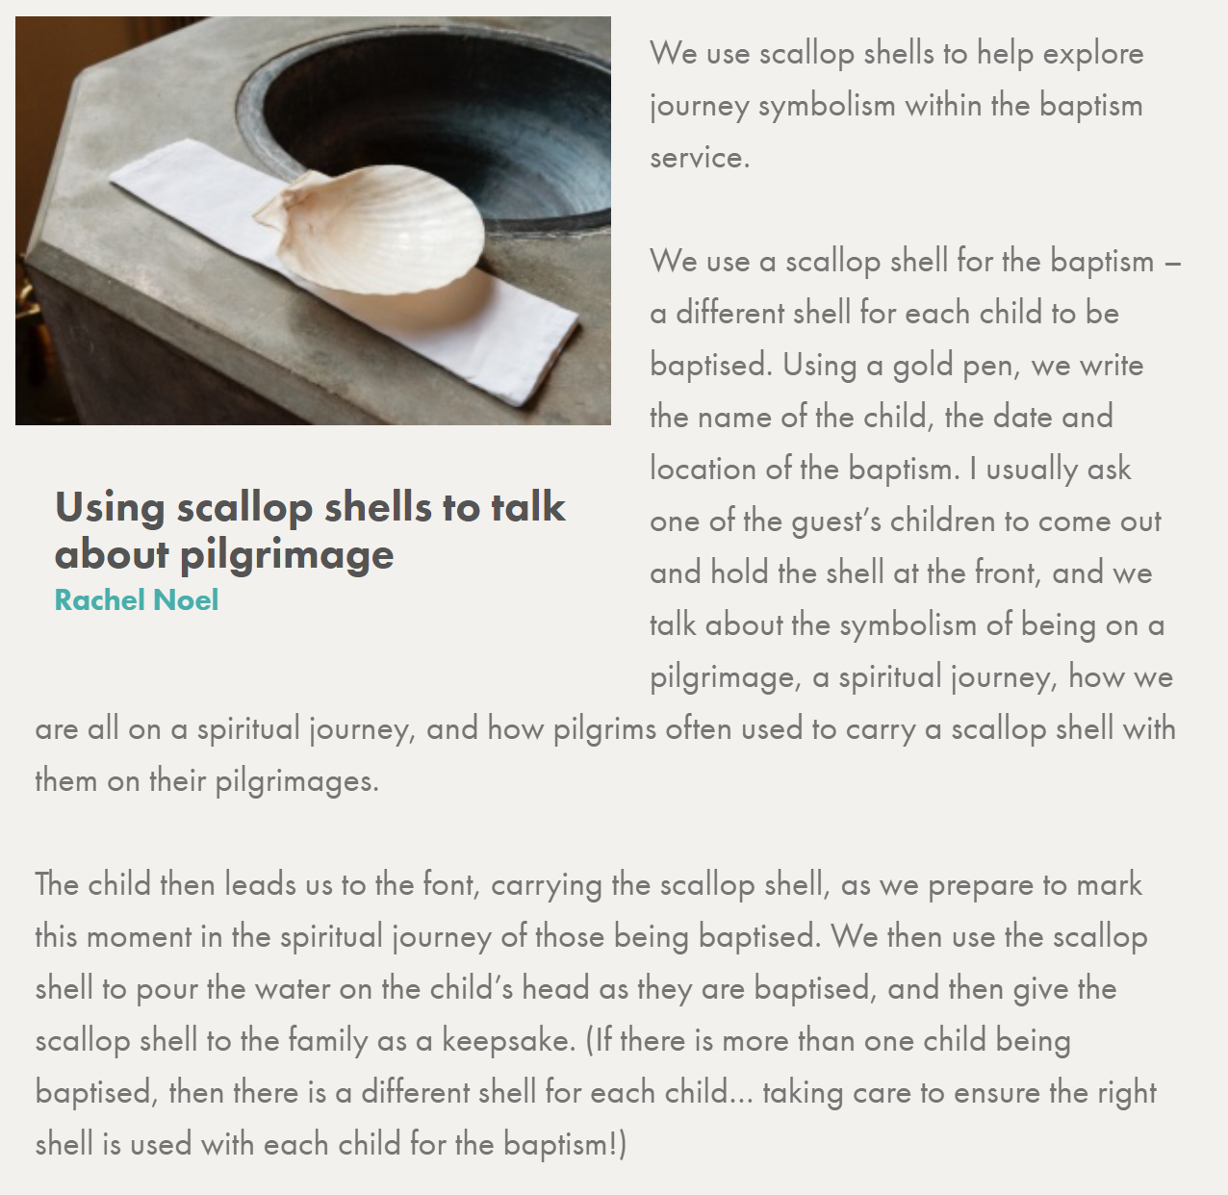
Activity 1: To Be A Pilgrim…
This is what happens in one church…

Slide 12
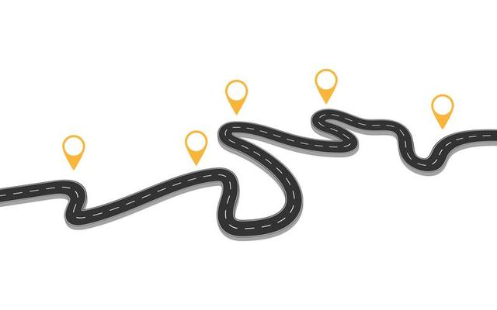
Activity 1: To Be A Pilgrim…
Create your life journey so far. You might have a clear destination in mind…or not. Record the key milestones along the way.
Reflect on the journey that you have taken through life to the point you are at now…you could be about to embark on a time of change, possibly to a new school or a new year group.
Think about all that you have learned along the way, the people you’ve met, the significant events and the moments that have shaped and changed you…

Slide 13
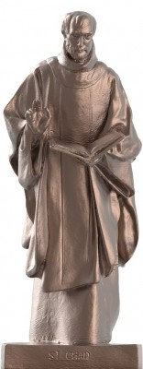
Activity 2: Following in the Footsteps of St Chad
The Bishop of Lichfield, Bishop Michael, chose St Chad as the focus for Lichfield Diocese with the strapline,
“Come follow Christ in the footsteps of St Chad.”
Who was St Chad and why can we link him to the idea of pilgrimage?
Lichfield Cathedral has commissioned local sculptor and its Artist-in-Residence, Peter Walker, to create a major new public sculpture of St Chad.
It will be unveiled with a new ‘hope garden’ in the Cathedral grounds.

Slide 14
Activity 2: Following in the Footsteps of St Chad
Who was St Chad?
What was his story?
Can you create a profile of St Chad?
Use the websites to find out about him and try to answer the key questions…be creative with your presentation…
e.g.
If he were alive today, what would his Instagram posts or Tweets say?
If you were asked to create a sculpture or a piece of artwork of St Chad, what would you include to help people understand his character and faith?
What values shone through in his life and work?
Why was he important?
How is he remembered today?
Where does pilgrimage fit into his story?
Useful Websites:
https://www.lichfield-cathedral.org/what-s-on/st-chad-statue-the-hope-garden
https://www.twosaintsway.co.uk/st-chad.html
http://saintchads.weebly.com/saint-chad.html

Slide 15
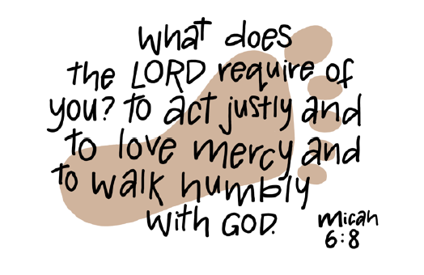
Activity 2: Following in the Footsteps of St Chad
How well does St Chad embody this verse from Micah?
Think of practical ways that you could live out this verse as you journey through life.

Slide 16
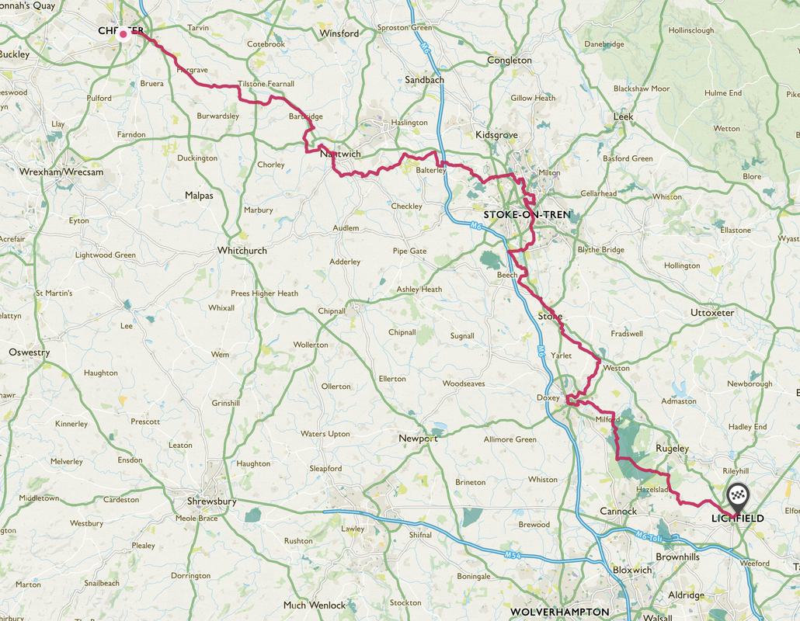

Activity 2: Following in the Footsteps of St Chad
The Two Saints Way is a 92-mile pilgrimage route between the cathedral cities of Chester and Lichfield.
The route can be walked from either the north or the south, through the beautiful countryside of Cheshire and Staffordshire along footpaths, canal paths and lanes which link the villages, towns and cities along the way.

Slide 17
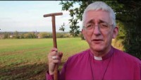
Activity 2: Following in the Footsteps of St Chad
Is your school close to the Two Saints Way?
Perhaps your school is named after St Chad?
You can find out more about the Two Saints Way here… www.twosaintsway.co.uk or by watching the video below.

Slide 18

Activity 2: Following in the Footsteps of St Chad
http://request.org.uk/life/spirituality/two-saints-pilgrimage-way/#
Further information on the RE Quest website about the Two Saints Way
http://request.org.uk/life/spirituality/pilgrim-diaries-the-two-saints-way/#
Watch this day-to-day diary of a group of men who decided to do the Two Saints Way Pilgrimage Walk from Chester to Lichfield.
Discover the highs and lows of such an adventure as you travel along with them over the four days.
Could you write a diary entry as if you were one of the Pilgrims on the Two Saints Way?

Slide 19

Activity 2: Following in the Footsteps of St Chad
http://request.org.uk/life/spirituality/pilgrim-diaries-the-two-saints-way/#
At the end of the pilgrimage, the group of pilgrims sang a song of praise ‘How Great is Our God’ as they walked towards their final destination, Lichfield Cathedral.
Create a play list for the pilgrimage journey…
Which songs would you choose that would inspire you to be filled with hope for the journey?
How would the music help you to reflect on your pilgrimage?

Slide 20
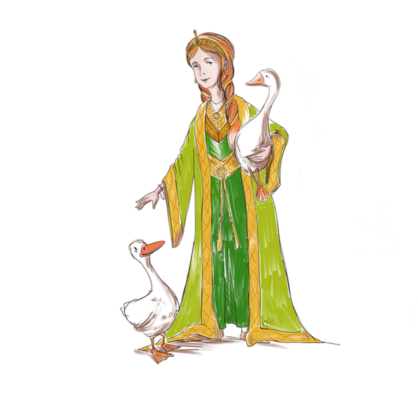
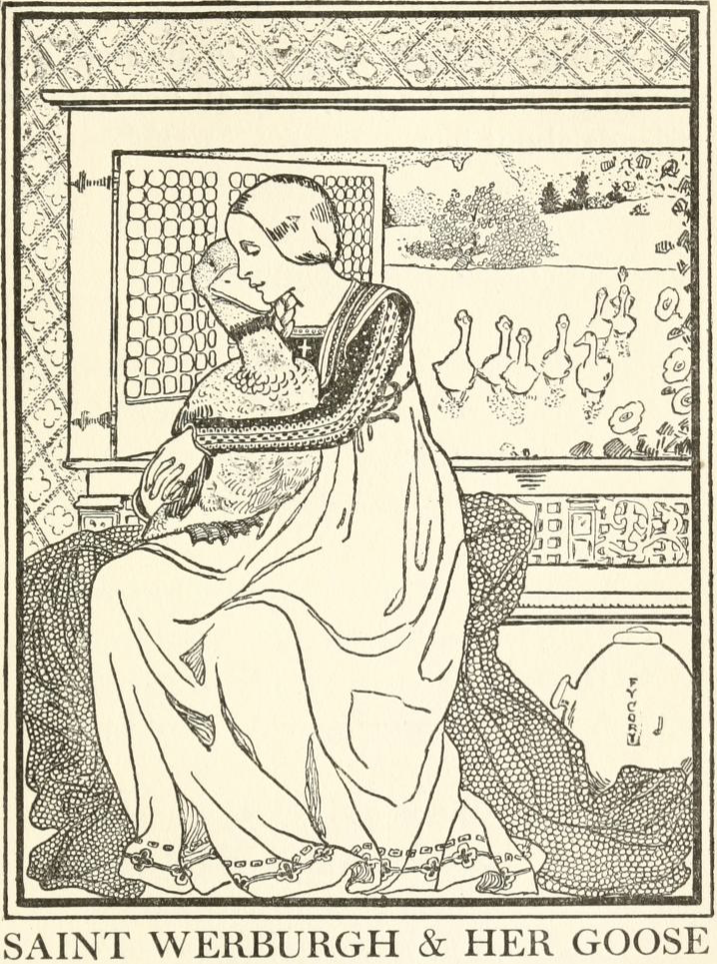
Activity 2: Following in the Footsteps of St Chad
You can find out about St Werburgh, the other saint of the Two Saints Way at these websites.
Find out about the significance of her goose!
https://www.twosaintsway.co.uk/st-werburgh.html
https://www.festivalstoke.co.uk/werburgh--the-wild-goose.html

Slide 21
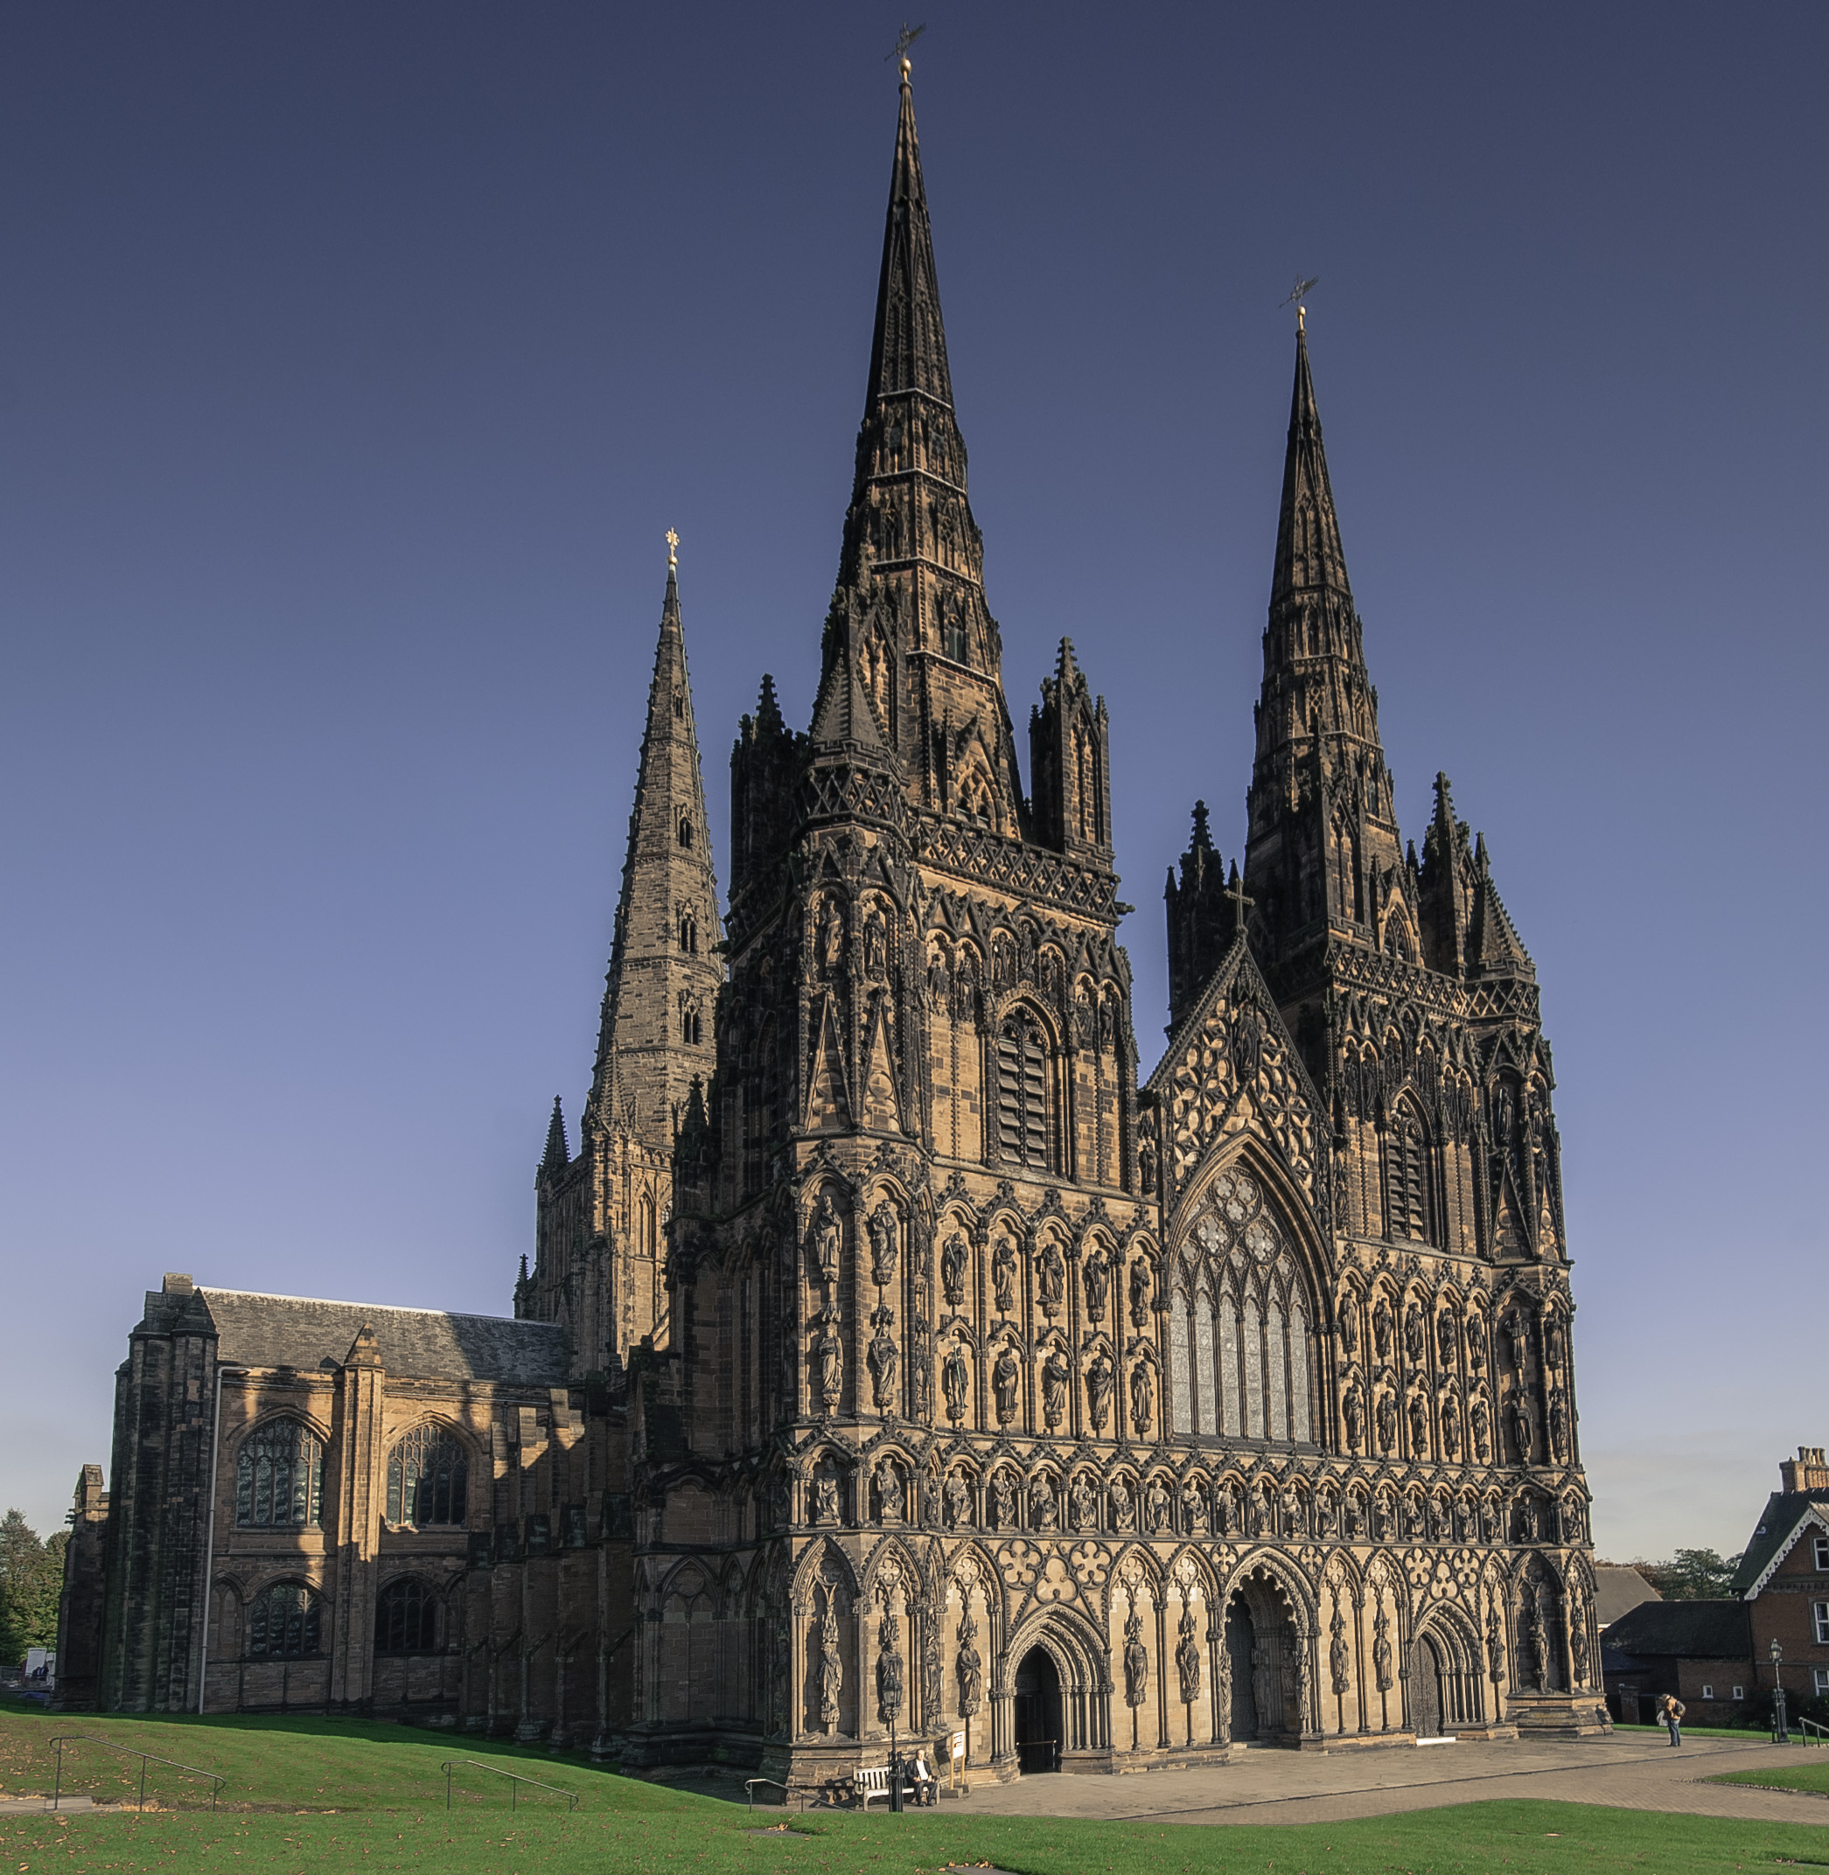
Activity 3: Pilgrim’s Progress
Pilgrim’s travelling the Two Saints Way from Chester to Lichfield end their pilgrimage at Lichfield Cathedral.
The cathedral is usually the venue for Inspire and you would have the opportunity to explore this ancient, amazing building, just as the pilgrims would have done on their arrival.
We’re not able to be in Lichfield for Inspire in person this year, but you can explore the cathedral ‘virtually’!

Slide 22
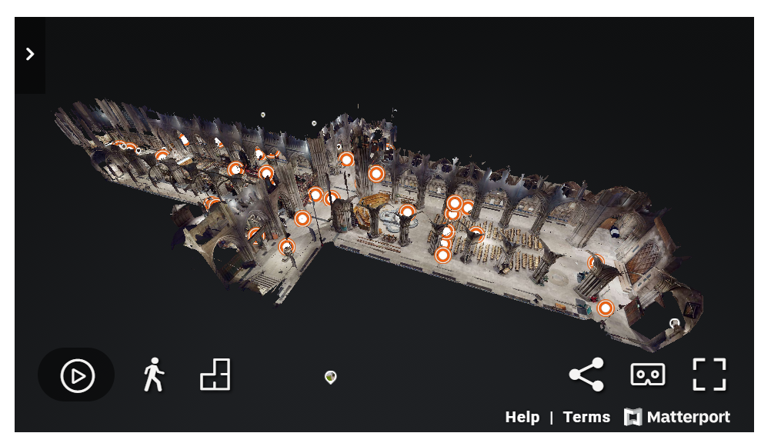
Activity 3: Pilgrim’s Progress
Explore the cathedral using the Virtual Tour:
https://www.lichfield-cathedral.org/welcome-back/a-virtual-visit
Use the Matterport Virtual tour to design a guide for pilgrims arriving at Lichfield Cathedral.
Which key parts of the cathedral would you direct them to?
How would they discover St Chad through your guide?
You could present your guide using IT, art or film/audio.

Slide 23
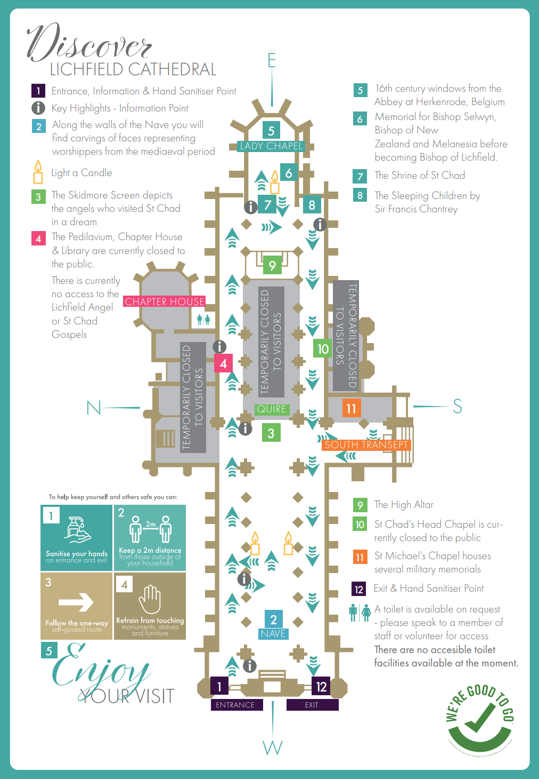
Activity 3: Pilgrim’s Progress
This map of the cathedral may help you as you explore the Virtual Tour and create your Pilgrim’s Guide.
https://www.lichfield-cathedral.org/downloads/whats-on/self-guided-tour-july-2020-a3.pdf

Slide 24
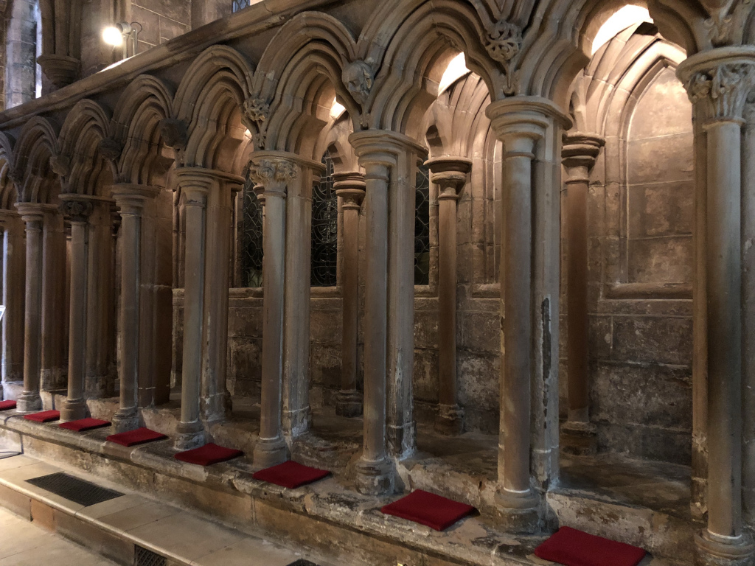
Activity 3: Pilgrim’s Progress
Pilgrims would have been greeted on arrival at the cathedral and taken to the Pedilavium, where their feet would have been washed, in an act of service.
Which part of the Bible do these two acts of service remind you of? Can you make the connection?
The Pedilavium was also the place where the monarch traditionally washed the feet of 12 poor men on Maundy Thursday.

Slide 25
Activity 3: Pilgrim’s Progress
Imagine arriving at Lichfield Cathedral as a pilgrim or being there to welcome pilgrims on their arrival…
Would you appreciate having your feet washed as an act of service?
If not, what would be a good welcome or act of service that you would value?
As someone greeting pilgrims on their arrival at the cathedral, what would you be prepared to do as a welcoming act of service? Wash their feet?

Slide 26
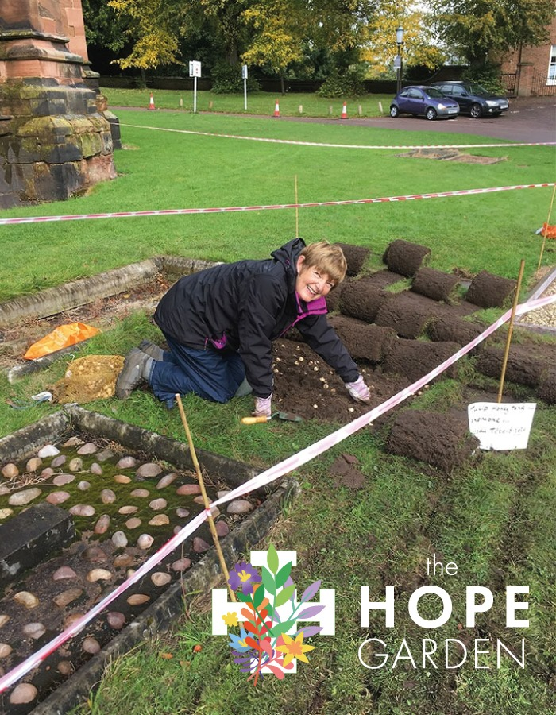
Activity 4: A Journey of Hope
Reaching the end of the pilgrimage gives a pilgrim hope that they can journey through challenges and obstacles.
People often need hope as they journey through life – there will be moments when life is difficult and the journey takes us through valleys; but there are mountain top moments that we can celebrate.
Since the first lockdown in spring 2020, people have longed to reach the end of a difficult journey, clinging to the hope that there will be better days ahead.
On difficult days the pilgrim will draw strength from the fact that they have come so far…that is the same for each one of us at this time.
In early October 2020 planting began on the Hope Garden; a gift to the city of Lichfield and a reminder of the resilience of everyone, as it blooms each year around the anniversary of Lockdown.

Slide 27
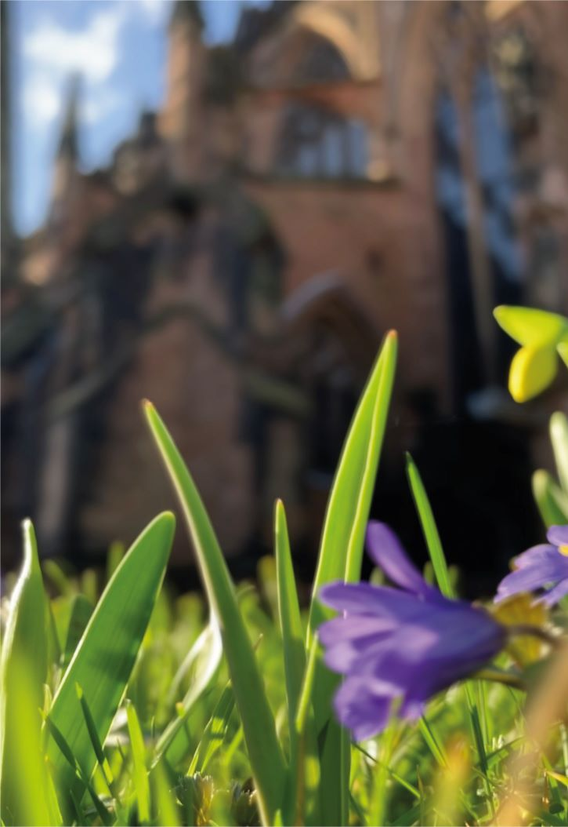
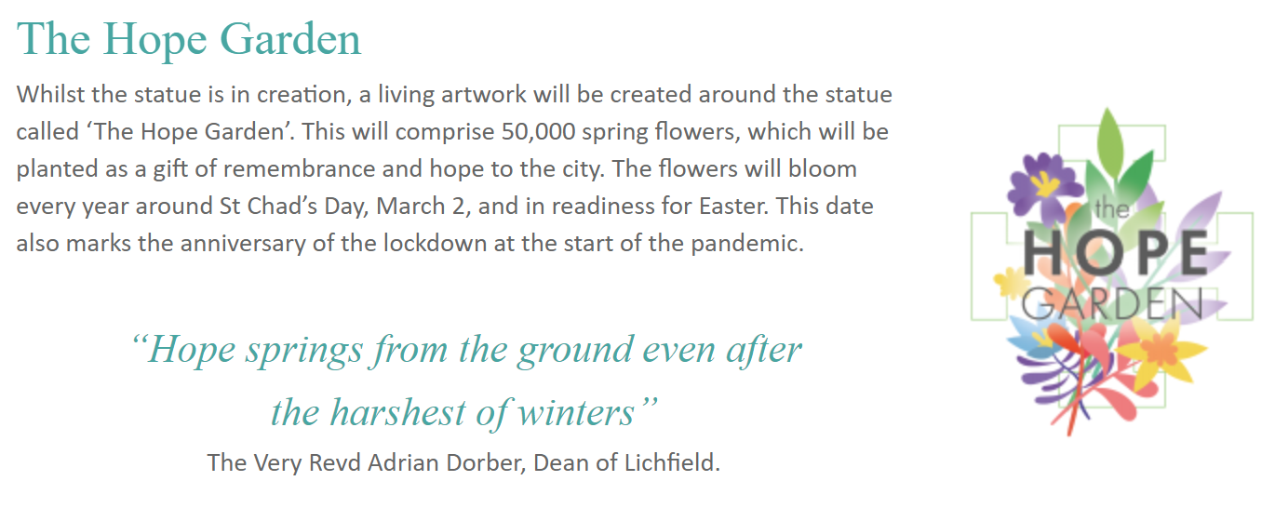
Activity 4: A Journey of Hope
After a difficult winter for us all, the first blooms started to appear…

Slide 28
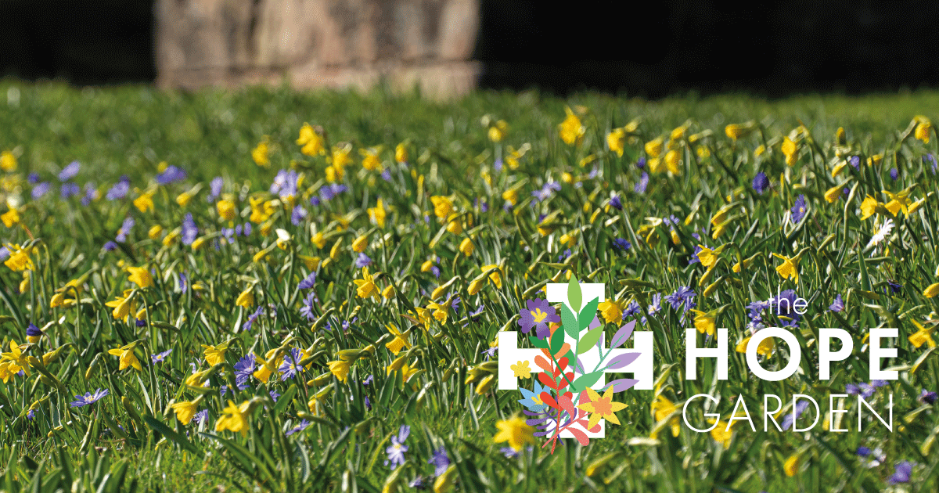
…and in spring 2021, the Hope Garden was there to see in all its glory.

Slide 29
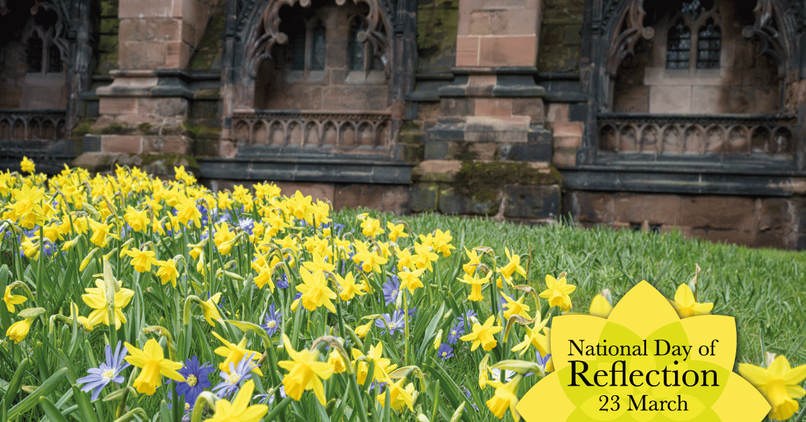
Activity 4: A Journey of Hope
The Hope Garden was in full bloom for the National Day of Reflection on 23rd March, a year on since the start of the first lock down.
It was a day to reflect and remember the often sad and difficult year behind us, but the garden was a symbol of hope; that better days were ahead.
Could you create a Hope Garden in your school?
Is there a space where you could provide your school community with a place to reflect and also to look forward?
What symbols of Hope would you include?

Slide 30
How would you help people to pause and reflect in your Hope Garden?
How could you help them to consider the journey they have been on?
Could you write a prayer or reflection on the theme of hope, to be used in your garden?

Slide 31


Activity 5: Spirited Arts Competition
OPTION 1
Do you believe in healing? Religions love to tell stories of healing, of body, mind and spirit. Jewish scripture has healing stories: God tells Moses ‘I am God who heals you.’ Sarah is healed so that she can have a child. Naaman, a foreigner, is cured of leprosy. In Christianity, Jesus is a famous healer, helping people with blindness, deafness or many afflictions.
Hindus travel to the Balaji Mandir in Rajasthan seeking healing. Christians go to Lourdes, in France.
But not everyone gets healed. And anyway, maybe having our minds or souls healed is more important that bodily healing. And some atheist philosophers argue that religious healing is always a con trick of some kind.
Make a work of art that explores a story of healing, or the whole idea. Use methods from theology and philosophy to make sure your work is deep!
Watch the video from 28:30 to 32:32 to find out more about this competition task

Slide 32
Activity 5: Spirited Arts Competition
OPTION 2
What inspires you? A song? A quote? Another person’s life? A place?
Religion offers people inspiration to live. Sometimes an inspirational life, a person’s example, a text or a piece of music crystallizes our inspiration.
In this theme, you are invited to identify what inspired you from a religion or from your own worldview – it doesn’t have to be your own faith, as inspiration tends to spill over the edges of religions.
Explain through your art and text what connects your inspiration to spiritual or religious life. You might use methods from the creative arts that relate to spirituality as you understand it.
Watch the video from 32:33 to 39:00 to find out more about this competition task

