Slide 1
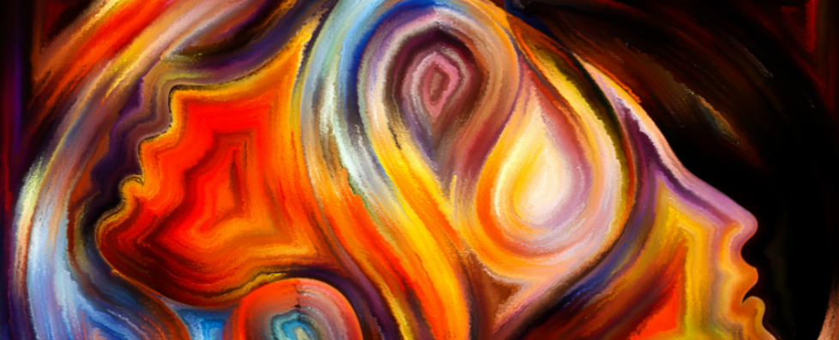

Finding hope in the spiritual
INSPIRE

Slide 2
What’s in the resource?
Spirituality through music
Spirituality through our senses
Let’s get talking about spirituality
Teachers notes
Spirituality through thinking about creation
Spirituality through stirring our minds

Slide 3

Finding hope in the spiritual.
The mental health and wellbeing: Towards a whole school approach, highlights that the exploration of spirituality can offer real benefits for mental health.
This Inspire session aims to take a cross-curricular approach to spiritual development using Kathryn Wright’s Sacred Pathway’s model. This inclusive approach to spiritual development can be found in the Spiritual Development – Interpretations of spiritual development in the classroom.
Throughout this set of four activities, opportunities are provided for pupils to encounter and reflect on spiritual thinking, through the use of questions posed in the Rickett Girds Progression in Spirituality. Kind thanks is expressed to Salisbury diocese for making these freely available.
Teacher’s overview.
Notes:
The Ricketts progression in spirituality grids (above) have been used to generate questions to develop pupils thinking about their own spirituality throughout these activities. The grids explore 4 aspects of spirituality – self, other, world and beauty and beyond. Class teachers may wish to use these grids to explore, at a deeper level, reflection questions and encouraging pupils to search for meaning, engage in critical reasoning and asking big questions around the sessions that are put together in this presentation.

Slide 4
Naturalists: Loving God outdoors. They are moved by creation, particularly being outside but also through the use of the Psalms.
Sensates: Loving God with the senses
Often moved by sights, sounds and smells. Visual imagery for Sensates is often particularly powerful.
Traditionalists: Loving God through ritual and symbol
GERS pattern In worship. Traditions and marking moment in the calendar of school.
E
S
A
R
D
C
Activists: Loving God through confrontation
Character development – Acting upon the big questions.
Caregivers: Loving God by Loving others
Welcoming into school and worship. Supporting vulnerable in the community – messages of support
Ascetics: Loving God in solitude and simplicity
Specific spaces for silence, prayer and reflection. Prayer Spaces.
S
P
A
W
A
Y
T
H
Enthusiasts: Loving God with Mystery and
Celebration
Celebration events. Shouting, singing and dancing.
Contemplatives: Loving God through Adoration
Use of stilling or Christian mindfulness
Intellectuals: Loving God with the Mind
Thought for the day in CW. Connect biblical teaching and news events.
For see p.27 – 31 of Interpretations of Spiritual development
in the classroom for further details
Notes:
4
The activities used within this presentation are rooted in an inclusive approach to spiritual development identified as Sacred Pathways. This model is discussed further on p.27 – 31 of the Spiritual Development – Interpretations of spiritual development in the classroom document (as above). This approach aims to counter the view that spiritual development goes much wider than simply having ‘quiet time’. Sacred pathways explore how individuals find their own ‘sacred space’ through their own default mode of spirituality. If schools are to ensure that pupils flourish spiritually, it is essential that different spiritual temperaments or sacred pathways are provided within a range of different learning opportunities. This range of learning activities explores one approach to achieve this, but clearly these will be many others.

Slide 5
What is spirituality?
Notes:
Spirituality is very difficult to define and it can be very challenging for both adults and pupils. To support teacher’s thinking a number of definitions are offered here:
The search for God, in response to God’s search for us. Jo Anne Taylor (Theologian)
Spirituality ranges from sensing of devine presence to the recognition of a heightened quality in an event or encounter and a response of awe and wonder. David Dixon (Educator).
A belief that there is an unseen order, and that our supreme good lies in harmoniously adjusting ourselves thereto. William James (Psychologist).
Spirituality is about opening up the possibility to people of an experience far beyond what they can see and see and touch. Above all an experience of God. A transcendent experience of the reality and presence of God, and amongst human beings that sense of mutual responsibility, not as an ethical duty but a deep sense of the sacredness of human life and of each human being, whoever they are. The change to see what is simply Infront of us, to have eyes that go beyond the surface of what we see is critical to developing human beings capable of empathy, of love, of sacrifice and imagination. (Archbishop of Canterbury – LDBE Leadership conference).

Slide 6
What does spirituality look like?
What does spirituality feel like?
What does spirituality taste like?
Let’s get talking about spirituality?
What does spirituality smell like?
What does spirituality sound like?
In a spiritual moment I…
Notes:
Slide 6 – 12 The next three slides are offered as a stimulus to get pupils talking thinking about how they perceive spirituality, and consider if or when they believe they have had a spiritual moment and if they are willing to describe this to others. The concepts behind each of these will require a great deal of discussion and will challenge thinking about spirituality. Some slides may be easier to access for learners than others.

Slide 7



Let’s get talking about spirituality?
Windows are for looking out onto the world and becoming aware of its wonders, both the ‘wows’ and the ‘ows’; things that are ‘awe-ful; and make us wonder and things that are ‘awful’ and make us wonder and ask questions.
Mirrors are for looking into and reflecting, alone and together, to see things more clearly, for thinking and asking important questions learning from our own and each other’s responses.
Doors are for looking through in order to then act or express this in some way in response; for moving on, making choices, and doing something creative, active and purposeful in response.
Notes:
This is one way that pupils may find helpful in thinking about how spirituality provides an opportunity to stop and think, before moving on. To what extent to the pupils understand this image of spirituality? Do they agree with this?

Slide 8

Let’s get talking about spirituality?
Self
Spiritual opportunities provide an chance to learn more about ourselves – our inner person and the way we thing about ourselves as a unique
human being.
Others
Spiritual opportunities provide a chance to grow empathy, concern and compassion for how to treat others.
Beauty
Spiritual opportunities allow
us to become aware of the physical and creative world – growing in a relationship with beauty and responding emotionally to the natural world and the results of human creativity.
Beyond
Spiritual opportunities to become aware of the concept of beyond – a relationship with the transcendent. The opportunity to search for the meaning of existence in the greater scheme of things.
Notes:
This is one way that pupils may find helpful in thinking about how spirituality provides an opportunity to stop and think, before moving on. To what extent to the pupils understand this image of spirituality? Do they agree with this?

Slide 9
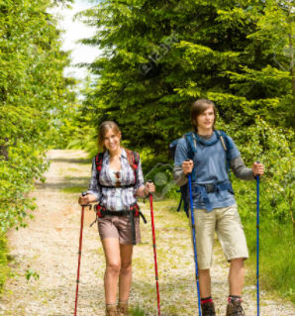
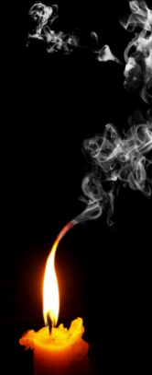
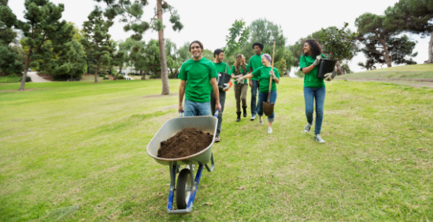
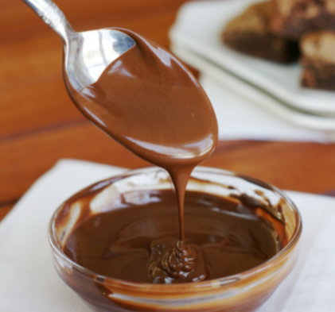
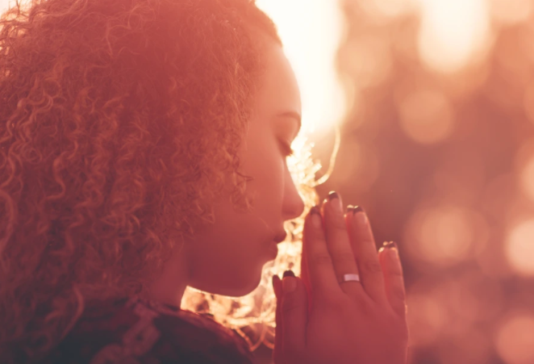
Let’s get talking about spirituality
Notes:
The following pictures also aim to provide stimuli for pupils to discuss spiritual moments building on the sacred pathways.
Spirituality in nature (Walkers)
Spirituality in the senses – Candle smoke and melted chocolate
Spirituality in prayer and reflection – Young person praying
Spirituality in serving others / being intimate with God –Wheel barrow – volunteer programme.
The pupils may have many more interesting and insightful interpretations of spirituality in these pictures and beyond.

Slide 10
What happens when I am being spiritual?
Have I ever been spiritual with others?
My most spiritual moments
When have I have experienced something beautiful in nature
Spiritual moments that are hard to explain.
Notes:
Slide 6 – 12 The next three slides are offered as a stimulus to get children talking thinking about how they perceive spirituality, and consider if or when they believe they have had a spiritual moment and if they are willing to describe this to others.

Slide 11
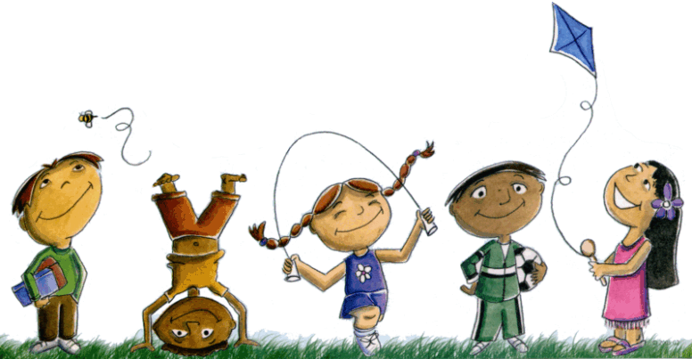
Looking after our own well being
Physical health
Spiritual health
Mental health
Emotional health
Notes:
This slide aims to encourage pupils to think about how they look after their own wellbeing and consider what they understand by mental, physical, spiritual and emotional health and the positive approaches that can be taken to ensure that individuals take positive proactive measures to support positive well-being.

Slide 12
Looking after our own spiritual health
Stimulating our senses
Time to reflect and be thoughtful
Serving other people
Engaging in worship
Singing and dancing
Standing up for others
Being outdoors
Making time to be with God
Developing our mind
Notes:
After considering what spirituality is and pupils experiences of spirituality, this slide aims to explore where pupils best meet their own spiritual needs.

Slide 13
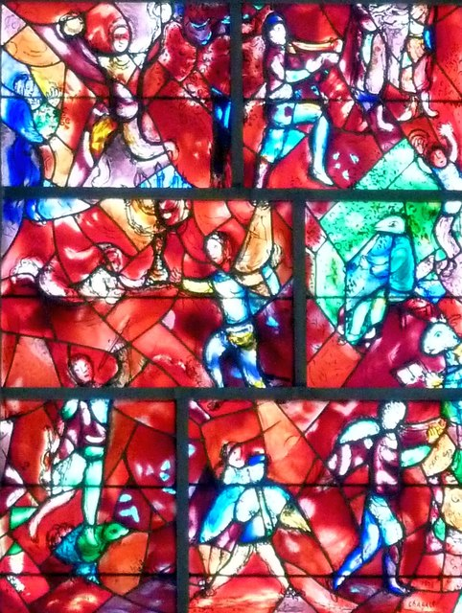


Enthusiasts: Loving God with Mystery and
Celebration
Celebration events. Shouting, singing and dancing.
Source:: Chichester Cathedral – Chagall Window – Rob Farrow Geograph
Session 1: Developing our spirituality through music and song
Praise God in his Temple!
Praise him in heaven, his strong fortress!
² Praise him for the great things he does!
Praise him for all his greatness!
³ Praise him with trumpets and horns!
Praise him with harps and lyres!
⁴ Praise him with tambourines and dancing!
Praise him with stringed instruments and flutes!
⁵ Praise him with loud cymbals!
Praise him with crashing cymbals!
⁶ Everything that breathes, praise the Lord!
Notes:
This session explores Enthusiasts: Loving God with Mystery and Celebration. They love to celebrate. They want to be ‘cheerleaders’ for God - shouting, dancing, singing. They value experiencing God’s power. Contemporary worship such as Hillsong would be an Enthusiast approach.
NC Link: Music KS3: listen with increasing discrimination to a wide range of music from great composers and musicians

Slide 14





Developing our spirituality through song
Listen to each of these songs (with or without the video)
How do these songs make me feel? Think? Do?
Can music be described as beautiful? Are any of these tracks beautiful?
What is inspiration? Where does it come from? Can music inspire?
What is the point of music? What would the world be like without music in it?
Notes:
Each of the 4 icons is linked to a piece of music that can be played with or without the video, alongside the accompanying questions taken from the Ricketts Progression of Spiritual development – Y8 World and Beauty. The next slide also compliments this activity with an opportunity for pupils to mark make to the songs.
NC Link: Music KS3: listen with increasing discrimination to a wide range of music from great composers and musicians

Slide 15
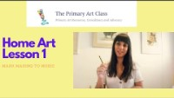
Developing our spirituality through music
Mark Making to music
Respond to the music
What was your favourite track from the previous activity? Can you listen again and respond through mark making?
You could use the tracks in the playlist to discuss further how music moves us emotionally.

Slide 16
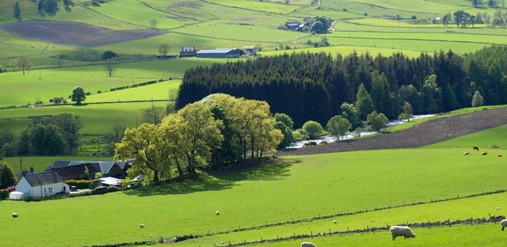
Sensates: Loving God with the senses
Often moved by sights, sounds and smells. Visual imagery for Sensates is often particularly powerful.
Session 2: Developing our spirituality through our senses
Places that inspire us
People often find themselves being moved by sights, sounds and smells. There are many artists that have been so inspired by a place that they have created beautiful pieces of art to capture what they experienced. By creating this piece of art, they hope that other people will experience and live out that wonderful moment.
Notes:
This session explores Sensates: Loving God with the senses. They are often moved by sights, sounds and smells. They often love incense,
beautiful architecture, liturgy and many forms of music. Visual imagery for Sensates is often particularly powerful. An example of a Sensate would be Michelangelo.
NC link: Art KS3: to use a range of techniques and media, including painting
KS3: to increase their proficiency in the handling of different materials

Slide 17
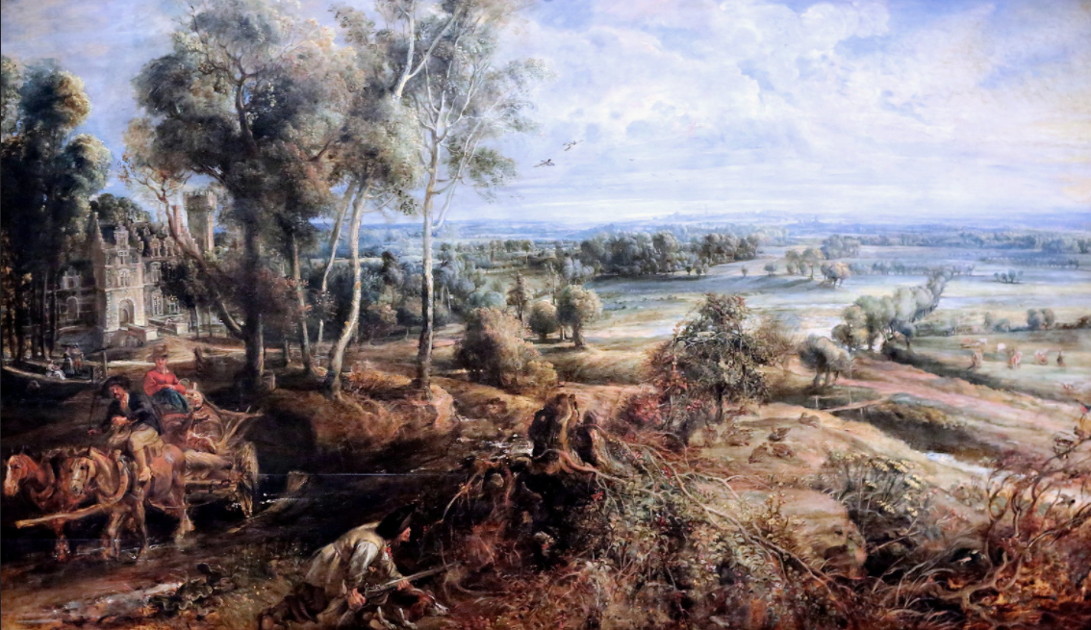

An autumn landscape with a view of Het Steen in the early morning – was painted by Peter Rubens 1636
Is this a true reflection of a beautiful scene? Are we a different type of human to those who lived in the 1600s? Would this scene look different if it was painted today?
Source:: Jean Lewis Maziers: Flikr
Notes:
The questions used to think about this painting arise from Rickett’s spirituality grids – Y9 Spiritual development of others alongside world and beauty. These build on the activities within the Y6 presentation, which also may be useful.
Alongside this image you will find embedded primary teachers’ notes for An Autumn Landscape with a view of Het Steen in the Early Morning
Primary Teachers' Notes: An Autumn Landscape with a View of Het Steen by Peter Paul Rubens (nationalgallery.org.uk) (Cut and paste into browser if needed). There are a range of useful activities in on P.2 to extend the pupil’s involvement within this picture which extend into KS3 learning.

Slide 18


Zoom in…
If I learn how to paint like a particular artist can I become a master?
If I create art work that is the same as does that make my another artist, work as beautiful?
Is creating an original piece of art more spiritually rewarding than copying someone else’s work?
Notes:
The link embedded in create like an artist provides opportunities to create work in the same way a great artist would Create Like an Artist – How To | Tate

Slide 19


The truth can be hard. Seeing injustices around you and knowing how to react to them can be challenging. Speaking up for what you believe can sometimes feel like the most difficult thing in the world. Think of your world. Perhaps you saw something on the news that made you sad, or made you think ‘that isn’t right’ or ‘why is this happening?’ Perhaps you saw something on your journey here today. What did you see and wish you could change? Draw, write, describe.
Explore art on display at Tate
Notes:
The linked resource above has been developed to extend and deepen student learning through encounters with art and artwork. The questions in the resource can be used to frame group discussions when exploring art work online., and possibly through a physical visit (as intended).
S is for Speaking Truth – Teaching Resource | Tate
There are a number of rich teaching resources to support further exploration of the concept of spiritual beauty and human creativity through Tate teaching resources: Teaching resources – Teaching Resource | Tate

Slide 20

Create your competition entry using poetry, drawing, painting, video, sculpture or other media
Inspiring!
What inspires you? A song? A quote? Another person’s life? A place? Religion offers people inspiration to live. Sometimes an inspirational life, a person’s example, a text or a piece of music crystallizes our inspiration. In this theme, you are invited to identify what inspired you from a religion or from your own worldview – it doesn’t have to be your own faith, as inspiration tends to spill over the edges of religions. Explain through your art and text what connects your inspiration to spiritual or religious life. You might use methods from the creative arts that relate to spirituality as you understand it.
Notes:
For further inspiration from previous entries please visit the Art in Heaven 2020 gallery: Art in Heaven 2020 (natre.org.uk)

Slide 21
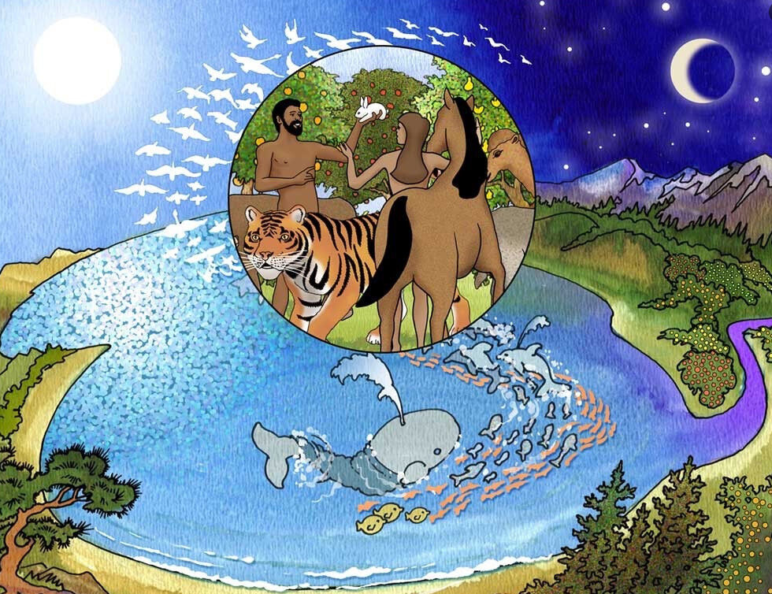

Naturalists: Loving God outdoors. They are moved by creation, particularly being outside but also through the use of the Psalms.
Session 3: Developing our spirituality through thinking about creation
2 So the earth, the sky, and everything in them were finished. 2 God finished the work he was doing, so on the seventh day he rested from his work. 3 God blessed the seventh day and made it a holy day. He made it special because on that day he rested from all the work he did while creating the world. Genesis 2:2
Notes:
This session explores Naturalists: Loving God outdoors. They are moved by creation, particularly being outside but also through the use of
the Psalms and other writings about God as creator and his creation. Naturalists love to surround themselves by what God has made. An example of a Naturalist would be St Francis of Assisi.
NC Links: Y8 Science: changes in the environment may leave individuals within a species, and some entire species, less well adapted to compete successfully and reproduce, which in turn may lead to extinction

Slide 22


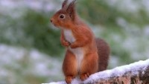
Photographer of the year 2021
Being outdoors and seeing nature up close can often move us and evoke many feelings.
Look through the pictures of ‘mammals during lockdown’.
Which image would you award the winning prize to? Why?
Which animal do you think is the most beautiful?
According to the mammal society:
Britain is now recognised as one of the most nature-depleted countries in the world.
One in four of our native mammals is threatened with extinction, and many others are in decline.
How do these statements make you feel?
Is there anything that you could do?

Slide 23
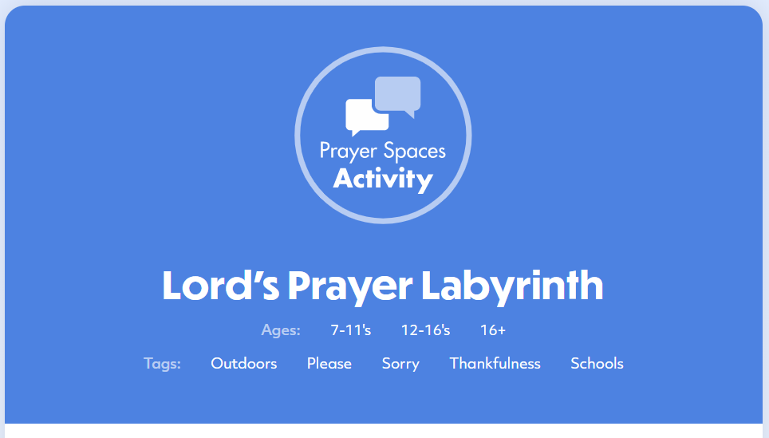
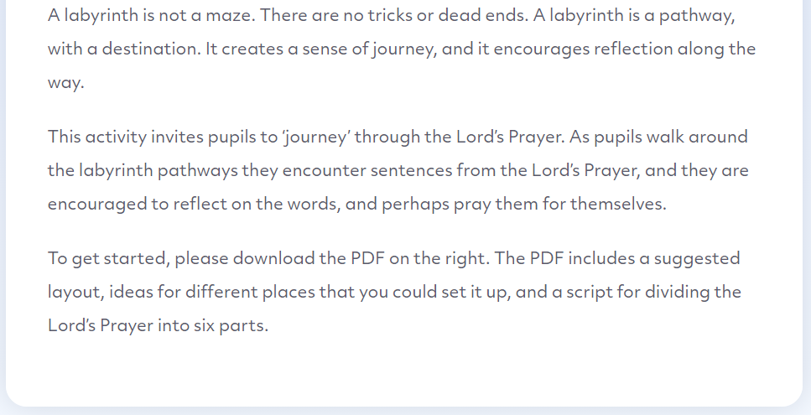
Sign up for a free account:Prayer Spaces In Schools

Slide 24
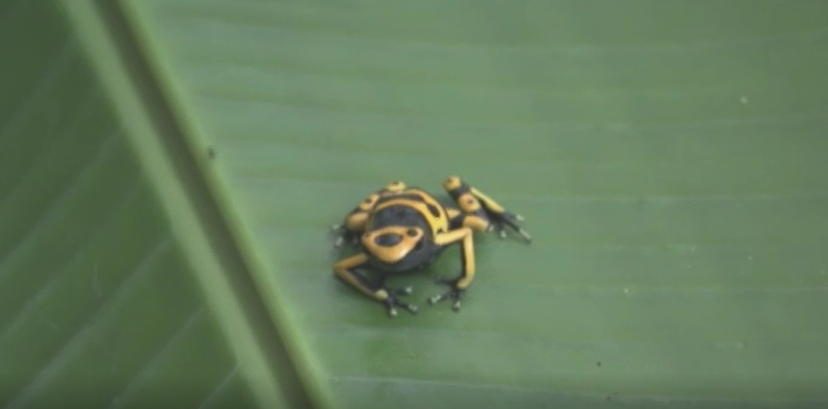
Is there such a thing as having a special affinity with a physical place?
Tarantula “Pretty… They are quite special”
Would you agree with the way different creatures are described?
Bumblebee Poison Dark Frog “Absolutely Stunning”
Rainbow Boa “So Beautiful”
Who decides what beauty is? Why do some people find something beautiful, while others may find it ugly?
What can animals / the natural world teach us?
Notes:
The linked BBC Video – Expedition to Guyana – life in the rainforest Geography KS2 & KS3: Expedition to Guyana - life in the rainforest - BBC Teach provides a wide variety of opportunities to draw out discussions about the spiritual development and responses to the world and beauty. The Y9 Ricketts Progression Grids have been used to promote discussion around a range of reflection questions.
Spiritual learners become increasingly aware of the concept of a physical and creative world – a growing relationship with beauty through the ability to respond emotionally to experiences of the wonder of the natural world and the results of human creativity. Spiritual learners explore their understanding beauty and the affect this has on their perception of and relationship with the world.

Slide 25

Intellectuals: Loving God with the Mind
Thought for the day in CW. Connect biblical teaching and news events.
Session 4: Developing our spirituality through stirring our minds.
Source:: Pixabay
¹⁹ The Lord God used dust from the ground and made every animal in the fields and every bird in the air. He brought all these animals to the man, and the man gave them all a name. ²⁰ The man gave names to all the tame animals, to all the birds in the air, and to all the wild animals. Genesis 2:19
Notes:
This session explores Intellectuals: Loving God with the Mind. They need their minds to be stirred. They like to study and read about their
faith in order to understand it more deeply. An example of an Intellectual would be C.S Lewis.

Slide 26

Making the right choice
Discover how your choices can change the world.
Notes:
The following activity aims to provide pupils with opportunities to understand what courageous advocacy is, and how they can take action on the environmental causes THEY care about. There is an opportunity for teachers to take this further by registering with the Dirt is Good academy. Dirt Is Good Academy - Teacher (natgeokids.com)

Slide 27
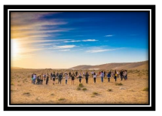
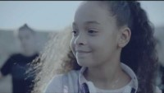
Hope works – Give a hand
Talk about it
The film shows the contagious nature of kindness. Is kindness contagious? Has something like this ever happened to you? How did you feel?
The film showed people of different ages, races, and abilities walking together. What are the benefits of working with people different than you?
What have you learned when working with someone who is different from you?
What have they learned from you?
Can you think of ways you could help someone with nothing but your hands?
Can you think of how much more you could do with many hands helping you?
Compassion has the ability to reduce anxiety and dissolve conflict – DO you agree?
Notes:
This embedded hope works video is accompanied by a supportive resource to continue discussion about this video through exploring emotions, reasoning and actions (with an accompanying now try this set of activities). The link to these is embedded in the icon at the top of this slide, or through cutting and pasting the following link: Give-a-Hand.pdf (hopeworksproject.com)

Slide 28

Inspire 2021
Finding hope in the spiritual

