Slide 1
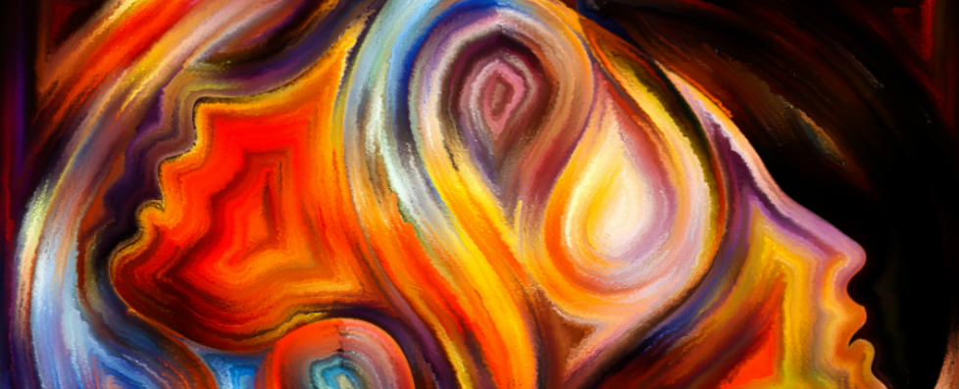

Finding hope in the spiritual
INSPIRE

Slide 2
What’s in the resource?
Spirituality through music
Spirituality through our senses
Let’s get talking about spirituality
Teachers notes
Spirituality through thinking about creation
Spirituality through stirring our minds

Slide 3

Finding hope in the spiritual.
The mental health and wellbeing: Towards a whole school approach, highlights that the exploration of spirituality can offer real benefits for mental health.
This Inspire session aims to take a cross-curricular approach to spiritual development using Kathryn Wright’s Sacred Pathway’s model. This inclusive approach to spiritual development can be found in the Spiritual Development – Interpretations of spiritual development in the classroom.
Throughout this set of four activities, opportunities are provided for pupils to encounter and reflect on spiritual thinking, through the use of questions posed in the Rickett Girds Progression in Spirituality. Kind thanks is expressed to Salisbury diocese for making these freely available.
Teacher’s overview.
Notes:
The Ricketts progression in spirituality grids (above) have been used to generate questions to develop pupils thinking about their own spirituality throughout these activities. The grids explore 4 aspects of spirituality – self, other, world and beauty and beyond. Class teachers may wish to use these grids to explore, at a deeper level, reflection questions and encouraging pupils to search for meaning, engage in critical reasoning and asking big questions around the sessions that are put together in this presentation.

Slide 4
Naturalists: Loving God outdoors. They are moved by creation, particularly being outside but also through the use of the Psalms.
Sensates: Loving God with the senses
Often moved by sights, sounds and smells. Visual imagery for Sensates is often particularly powerful.
Traditionalists: Loving God through ritual and symbol
GERS pattern In worship. Traditions and marking moment in the calendar of school.
E
S
A
R
D
C
Activists: Loving God through confrontation
Character development – Acting upon the big questions.
Caregivers: Loving God by Loving others
Welcoming into school and worship. Supporting vulnerable in the community – messages of support
Ascetics: Loving God in solitude and simplicity
Specific spaces for silence, prayer and reflection. Prayer Spaces.
S
P
A
W
A
Y
T
H
Enthusiasts: Loving God with Mystery and
Celebration
Celebration events. Shouting, singing and dancing.
Contemplatives: Loving God through Adoration
Use of stilling or Christian mindfulness
Intellectuals: Loving God with the Mind
Thought for the day in CW. Connect biblical teaching and news events.
For see p.27 – 31 of Interpretations of Spiritual development
in the classroom for further details
Notes:
4
The activities used within this presentation are rooted in an inclusive approach to spiritual development identified as Sacred Pathways. This model is discussed further on p.27 – 31 of the Spiritual Development – Interpretations of spiritual development in the classroom document (as above). This approach aims to counter the view that spiritual development goes much wider than simply having ‘quiet time’. Sacred pathways explore how individuals find their own ‘sacred space’ through their own default mode of spirituality. If schools are to ensure that pupils flourish spiritually, it is essential that different spiritual temperaments or sacred pathways are provided within a range of different learning opportunities. This range of learning activities explores one approach to achieve this, but clearly these will be many others.

Slide 5
What is spirituality?
Notes:
Spirituality is very difficult to define and it can be very challenging for both adults and pupils. To support teacher’s thinking a number of definitions are offered here:
The search for God, in response to God’s search for us. Jo Anne Taylor (Theologian)
Spirituality ranges from sensing of devine presence to the recognition of a heightened quality in an event or encounter and a response of awe and wonder. David Dixon (Educator).
A belief that there is an unseen order, and that our supreme good lies in harmoniously adjusting ourselves thereto. William James (Psychologist).
Spirituality is about opening up the possibility to people of an experience far beyond what they can see and see and touch. Above all an experience of God. A transcendent experience of the reality and presence of God, and amongst human beings that sense of mutual responsibility, not as an ethical duty but a deep sense of the sacredness of human life and of each human being, whoever they are. The change to see what is simply Infront of us, to have eyes that go beyond the surface of what we see is critical to developing human beings capable of empathy, of love, of sacrifice and imagination. (Archbishop of Canterbury – LDBE Leadership conference).

Slide 6
What does spirituality look like?
What does spirituality feel like?
What does spirituality taste like?
Let’s get talking about spirituality?
What does spirituality smell like?
What does spirituality sound like?
In a spiritual moment I…
Notes:
Slide 6 – 8 The next three slides are offered as a stimulus to get children talking thinking about how they perceive spirituality, and consider if or when they believe they have had a spiritual moment and if they are willing to describe this to others.

Slide 7
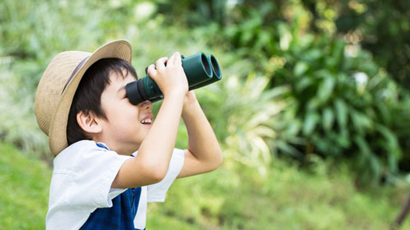
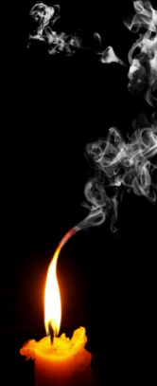
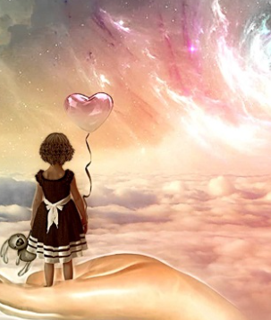
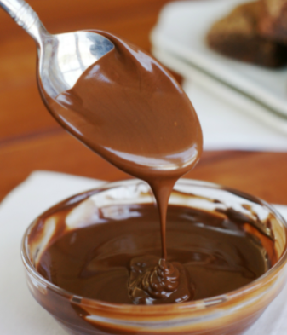
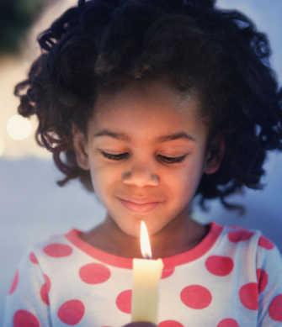
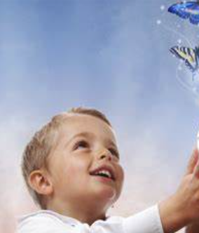
Let’s get talking about spirituality
Notes:
The following pictures also aim to provide stimuli for pupils to discuss spiritual moments building on the sacred pathways.
Spirituality in nature (Binoculars)
Spirituality in the senses – Candle smoke and melted chocolate
Spirituality in prayer and reflection – Child with candle
Spirituality in serving others / being intimate with God – Heart balloon picture.
The pupils may have many more interesting and insightful interpretations of spirituality in these pictures and beyond.

Slide 8
What happens when I am being spiritual?
Have I ever been spiritual with others?
My most spiritual moments
When have I have experienced something beautiful in nature
Spiritual moments that are hard to explain.
Notes:
Slide 6 – 8 The next three slides are offered as a stimulus to get children talking thinking about how they perceive spirituality, and consider if or when they believe they have had a spiritual moment and if they are willing to describe this to others.

Slide 9
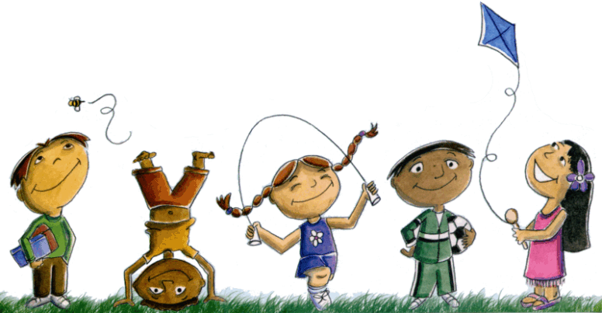
Looking after our own well being
Physical health
Spiritual health
Mental health
Emotional health
Notes:
This slide aims to encourage pupils to think about how they look after their own wellbeing and consider what they understand by mental, physical, spiritual and emotional health and the positive approaches that can be taken to ensure that individuals take positive proactive measures to support positive well-being.

Slide 10
Looking after our own spiritual health
Stimulating our senses
Time to reflect and be thoughtful
Serving other people
Engaging in worship
Singing and dancing
Standing up for others
Being outdoors
Making time to be with God
Developing our mind
Notes:
After considering what spirituality is and pupils experiences of spirituality, this slide aims to explore where pupils best meet their own spiritual needs.

Slide 11
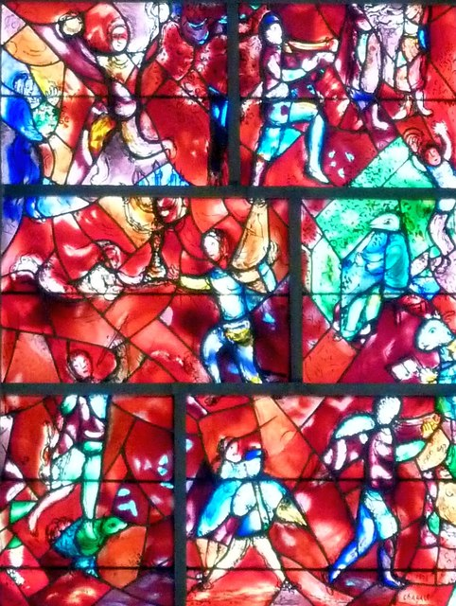


Enthusiasts: Loving God with Mystery and
Celebration
Celebration events. Shouting, singing and dancing.
Source:: Chichester Cathedral – Chagall Window – Rob Farrow Geograph
Session 1: Developing our spirituality through music and song
Praise God in his Temple!
Praise him in heaven, his strong fortress!
² Praise him for the great things he does!
Praise him for all his greatness!
³ Praise him with trumpets and horns!
Praise him with harps and lyres!
⁴ Praise him with tambourines and dancing!
Praise him with stringed instruments and flutes!
⁵ Praise him with loud cymbals!
Praise him with crashing cymbals!
⁶ Everything that breathes, praise the Lord!
Notes:
This session explores Enthusiasts: Loving God with Mystery and Celebration. They love to celebrate. They want to be ‘cheerleaders’ for God - shouting, dancing, singing. They value experiencing God’s power. Contemporary worship such as Hillsong would be an Enthusiast approach.

Slide 12





Developing our spirituality through song
Listen to each of these songs (with or without the video)
How do these songs make me feel? Think? Do?
How have these songs affected your mood?
What song did you most enjoy? Why?
What is the point of music? What would the world be like without music in it?
Notes:
Each of the 4 icons is linked to a piece of music that can be played with or without the video, alongside the accompanying questions taken from the Ricketts Progression of Spiritual development – Y4 World and Beauty. The next slide also compliments this activity with an opportunity for pupils to mark make to the songs.
NC Link: KS2: appreciate and understand a wide range of high-quality live and recorded music drawn from different traditions and from great composers and musicians

Slide 13
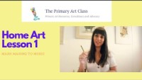
Developing our spirituality through music
Mark Making to music
Respond to the music
What was your favourite track from the previous activity? Can you listen again and respond through mark making?
You could use the tracks in the playlist to discuss further how music moves us emotionally.

Slide 14
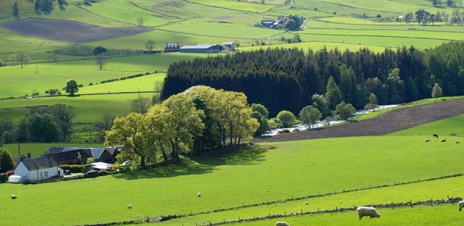
Sensates: Loving God with the senses
Often moved by sights, sounds and smells. Visual imagery for Sensates is often particularly powerful.
Session 2: Developing our spirituality through our senses
Places that inspire us
People often find themselves being moved by sights, sounds and smells. There are many artists that have been so inspired by a place that they have created beautiful pieces of art to capture what they experienced. By creating this piece of art, they hope that other people will experience and live out that wonderful moment.
Notes:
This session explores Sensates: Loving God with the senses. They are often moved by sights, sounds and smells. They often love incense,
beautiful architecture, liturgy and many forms of music. Visual imagery for Sensates is often particularly powerful. An example of a Sensate would be Michelangelo.
NC link: KS2: to improve their mastery of art and design techniques, including drawing, painting and sculpture with a range of materials [for example, pencil, charcoal, paint, clay]

Slide 15
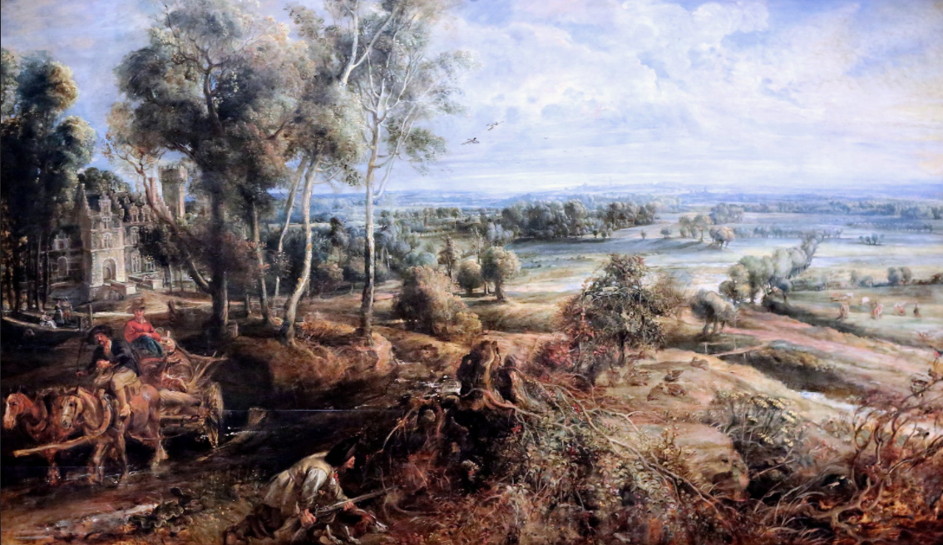

An autumn landscape with a view of Het Steen in the early morning – was painted by Peter Rubens 1636
Is this a true reflection of a beautiful scene? How do you feel about this picture?
Source:: Jean Lewis Maziers: Flikr

Slide 16
Zoom in…
Source:: Jean Lewis Maziers: Flikr
Peter Rubens lived in the country chateau in this picture. This is Het Steen (stone house). The National Gallery tells us that the sense of calm and reflection the artist felt comes from Ruben’s living here.
Would you feel peaceful here? Would being rich enough to own a mansion make you happy? Is it selfish for one family to live in such a large property?
Would this picture look better in a different season? Which season is best? Why?
Notes:
Alongside this image you will find embedded primary teachers’ notes for An Autumn Landscape with a view of Het Steen in the Early Morning
Primary Teachers' Notes: An Autumn Landscape with a View of Het Steen by Peter Paul Rubens (nationalgallery.org.uk) (Cut and paste into browser if needed). There are a range of useful activities in on P.2 to extend the pupil’s involvement within this picture.

Slide 17
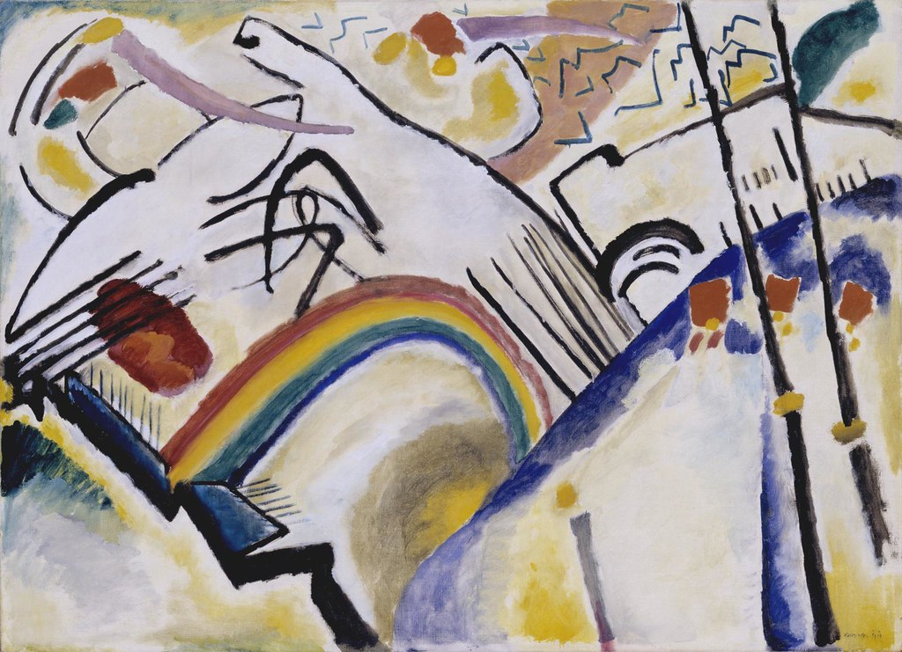
Tate Start – What emotion do you feel when you think of a colour?
What emotion do you feel when you think of a colour?
What do you think of these pieces of art?
Henri Matisse said “Creativity Takes Courage”
Do these pieces of art reflect this statement?
Source:: Tate

Slide 18
Tate Start – What emotion do you feel when you think of a colour?
When looking at these pieces of art, you might question what art is. Look closely and think about:
What is your first reaction to the work?
Why does it make you feel or think like that?
What is it made of?
Why has the artist chosen those materials?
Where is the artist from and when did they live? How has this influenced them?
What do you think the work is about?
Could you paint like an artist? Are you already an artist?
Source:: Tate
Notes:
This activity provides pupils with opportunity to consider what the point is of art and creativity. The hyperlink to the Colour and Shape – Teaching Resource | Tate (cut and paste to browser) provides pupils with a range of stimulating images that explore both colour and shape, with starter questions linked to the use of colour, that compliment the world and beauty reflection questions.
The Tate Create Like an Artist resource provides many further opportunities for pupils to create like a chosen artist (see link in slide).

Slide 19

Create your competition entry using poetry, drawing, painting, video, sculpture or other media
Inspiring!
What inspires you? A song? A quote? Another person’s life? A place? Religion offers people inspiration to live. Sometimes an inspirational life, a person’s example, a text or a piece of music crystallizes our inspiration. In this theme, you are invited to identify what inspired you from a religion or from your own worldview – it doesn’t have to be your own faith, as inspiration tends to spill over the edges of religions. Explain through your art and text what connects your inspiration to spiritual or religious life. You might use methods from the creative arts that relate to spirituality as you understand it.
Notes:
For further inspiration from previous entries please visit the Art in Heaven 2020 gallery: Art in Heaven 2020 (natre.org.uk)

Slide 20
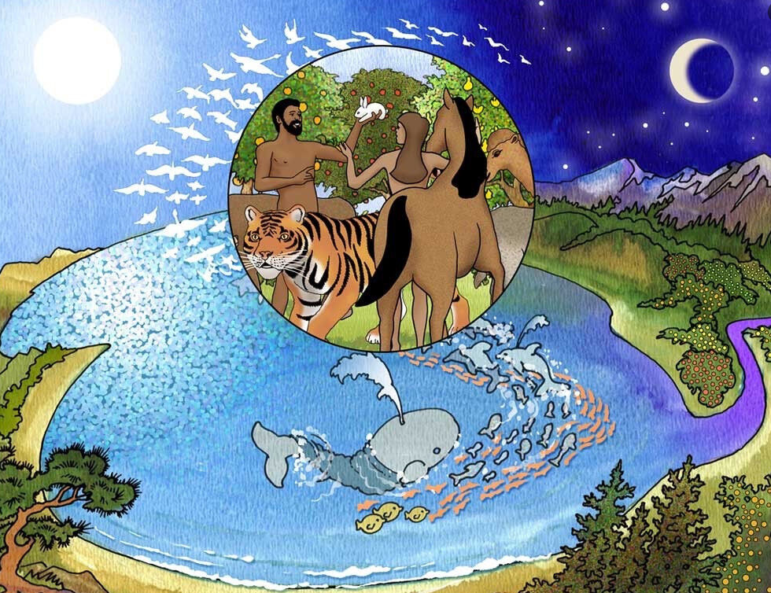

Naturalists: Loving God outdoors. They are moved by creation, particularly being outside but also through the use of the Psalms.
Session 3: Developing our spirituality through thinking about creation
2 So the earth, the sky, and everything in them were finished. 2 God finished the work he was doing, so on the seventh day he rested from his work. 3 God blessed the seventh day and made it a holy day. He made it special because on that day he rested from all the work he did while creating the world. Genesis 2:2
Notes:
This session explores Naturalists: Loving God outdoors. They are moved by creation, particularly being outside but also through the use of
the Psalms and other writings about God as creator and his creation. Naturalists love to surround themselves by what God has made. An example of a Naturalist would be St Francis of Assisi.
NC Links: Y4 Science: recognise that environments can change and that this can sometimes pose dangers to living things.

Slide 21


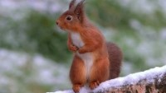
Photographer of the year 2021
Being outdoors and seeing nature up close can often move us and evoke many feelings.
Look through the pictures of ‘mammals during lockdown’.
Which image would you award the winning prize to? Why?
Which animal do you think is the most beautiful?
According to the mammal society:
Britain is now recognised as one of the most nature-depleted countries in the world.
One in four of our native mammals is threatened with extinction, and many others are in decline.
How do these statements make you feel?
Is there anything that you could do?

Slide 22
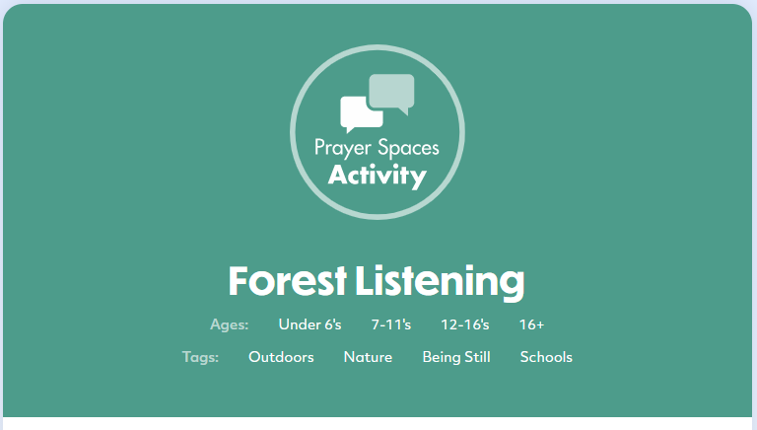
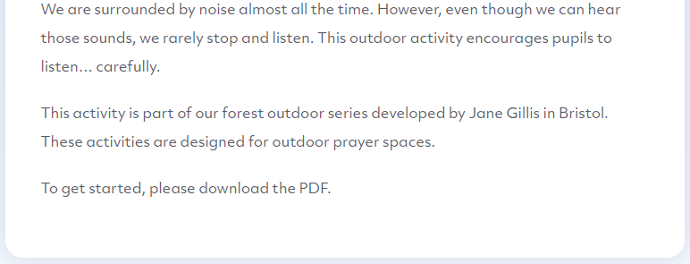
Sign up for a free account:Prayer Spaces In Schools

Slide 23

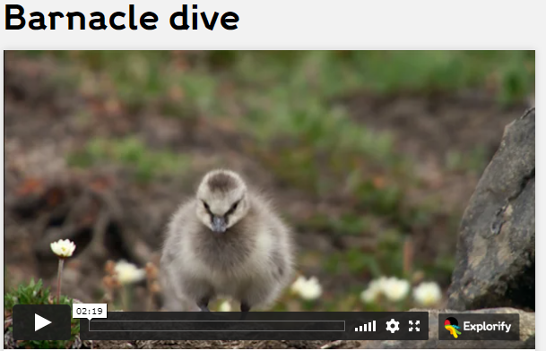
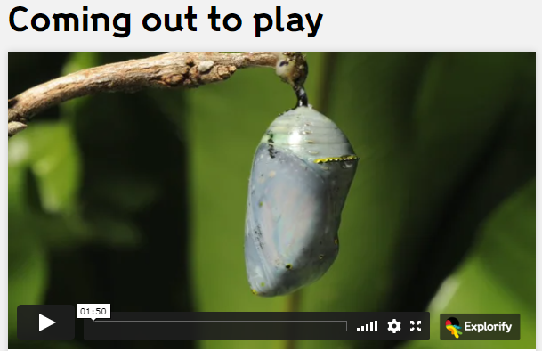
What’s going on?
Describe what you’ve seen in one word
Is this process miraculous?
What does this make me think about creation?
Are butterflies beautiful?
Sign up for a free Explorify account.
Notes:
How to run What's Going On? See Top tips: What's Going On? activities - Explorify (wellcome.ac.uk) The Explorify Logo is also linked for ease of access.
Please consider and (prepare if necessary) the reaction at around 1:00, and how this activity will be framed so pupils are not shocked by the barnacle dive video.

Slide 24
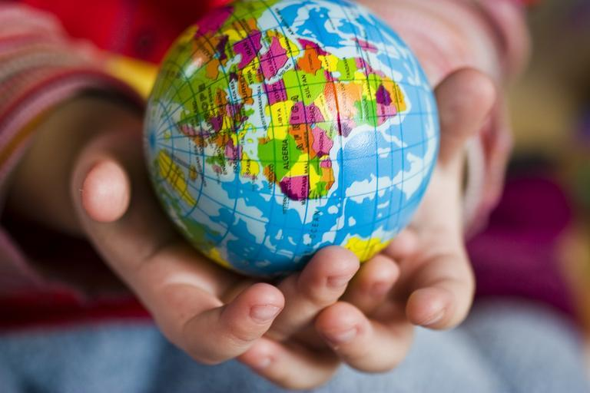
Intellectuals: Loving God with the Mind
Thought for the day in CW. Connect biblical teaching and news events.
Session 4: Developing our spirituality through stirring our minds.
Source:: Pixabay
¹⁹ The Lord God used dust from the ground and made every animal in the fields and every bird in the air. He brought all these animals to the man, and the man gave them all a name. ²⁰ The man gave names to all the tame animals, to all the birds in the air, and to all the wild animals. Genesis 2:19
Notes:
This session explores Intellectuals: Loving God with the Mind. They need their minds to be stirred. They like to study and read about their
faith in order to understand it more deeply. An example of an Intellectual would be C.S Lewis.

Slide 25
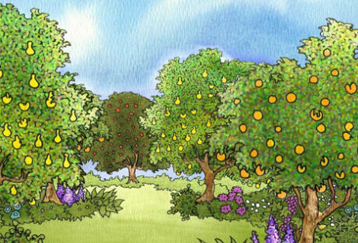
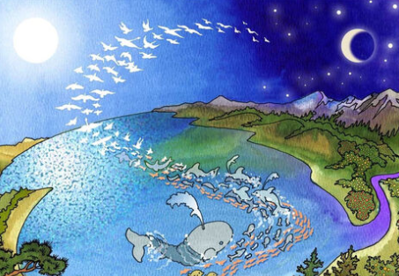
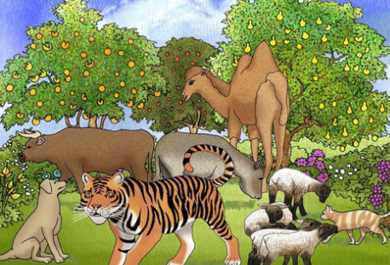
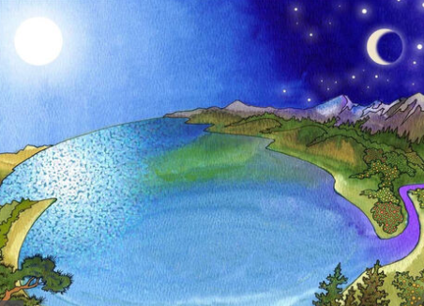
The story of creation
The story of creation can be read in the book of Genesis.
Source:: Free bible images
Notes:
The images in this slide are taken from Free Bible Images (see link embedded in slide). The image set can be downloaded for pupils to create a story board and write their own version of the story of creation, in response to this activity, drafting writing in narratives, creating settings.

Slide 26

The story of creation
Do you think that Christians should be greener than everyone else because of their beliefs about God, creation and stewardship?
The story of creation can be read in the book of Genesis.
What is stewardship?
Source:: Free bible images
Notes:
The link embedded in RE:Quest provides an opportynity for pupils to explore how Christians feel a deep responsibility to look after the world and everything in it, through the concept of stewardship. STEWARDSHIP-In-the-Beginning-2.pdf (request.org.uk)
The following activities support pupils to explore the big question within this activity.

Slide 27

Making the right choice
Discover how your choices can change the world.
Notes:
The following activity aims to provide pupils with opportunities to understand what courageous advocacy is, and how they can take action on the environmental causes THEY care about. There is an opportunity for teachers to take this further by registering with the Dirt is Good academy. Dirt Is Good Academy - Teacher (natgeokids.com)

Slide 28
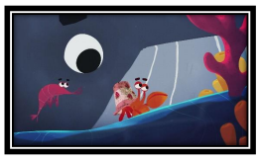
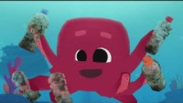
Being kind to the planet… The harmful effects of plastic on our oceans.
Under the sea
Do you recognize the garbage in the film as something that you might find in your school or in your house?
Do you think that it is okay to use plastic as long as you throw it away in a garbage can?
We can all learn about the importance of doing our part to keep the world healthy. What have you done?
What could you do?
Cleaning up is not fun, but the feeling of helping others is. Would you agree with that?
Does conservation matter?
Notes:
This embedded hope works video is accompanied by a supportive resource to continue discussion about this video through exploring emotions, reasoning and actions (with an accompanying now try this set of activities). The link to these is embedded in the icon at the top of this slide, or through cutting and pasting the following link: A-Whales-Tale.pdf (hopeworksproject.com)

Slide 29

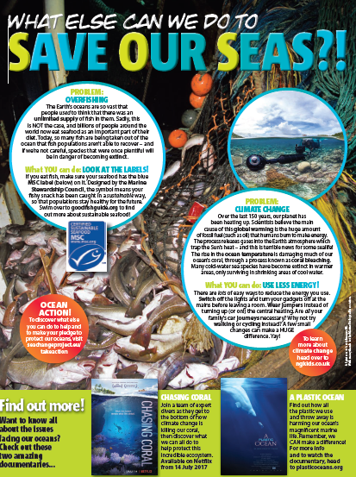
Being kind to the planet… The harmful effects of plastic on our oceans.
Under the sea
Do you think that Christians should be greener than everyone else because of their beliefs about God, creation and stewardship?
Notes:
Ask the children to think about all the plastic items they use and throw away every day. This could be done as an independent or group activity. Ask that instead, they clean out these items and bring them in to make a classroom display about the harmful effects of plastic on our oceans. The display could contain different facts and figures, as well as ways we can all help take action.
What are the pupils responses to the big question asked at the start of this activity regarding stewardship. Has their view changed at all? Why? (Spiritual development - others: Acknowledgement and respect for the rights of others to have their own deep thoughts that shape their inner self. A developing ability to enter into discussions with others about their values and opinions.)
KS2: Geography - Pupils should be taught: describe and understand key aspects of: physical geography, including: climate zones, biomes and vegetation belts, rivers, mountains, volcanoes and earthquakes, and the water cycle

Slide 30
SPIRITUALITY

