Slide 1


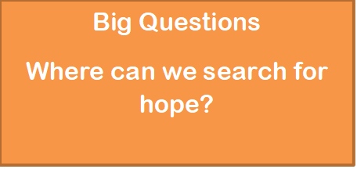


Inspire in a Box
‘Alive in Hope’
Year 8

Slide 2
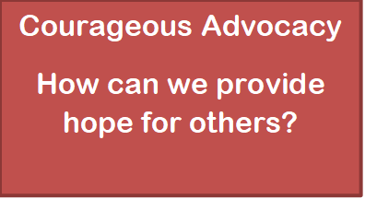

Introduction to Inspire
Inspire in a Box
‘Alive in Hope’
Activities to support a day of engagement for Y4, Y6 and Y8
The aim is for each session to last approximately 45 minutes to an hour
Pilgrimage a journey of hope
How do people find hope on Pilgrimage?
Spiritual Pathways
How do people find hope in the spiritual?
Big Questions
Where can we search for hope?
Notes:
2

Slide 3

Introduction to this session
Notes:
3

Slide 4
Introduction to this session
Humans have been asking ‘big’ questions since the beginning of time. It can be argued that our thinking and our understanding have evolved over time but that hasn’t stopped the questioning. For many, our ability to question is in fact an important part of what makes us human.
Questions also remain at the core of religious thinking and study and in fact it is through a quest for answers that many people actually turn to faith. All this makes RE a natural place to explore and reflect upon big questions.
Notes:
4

Slide 5
Purpose of this session
The purpose of this particular session is to explore, through a series of activities based around big questions, what it means to have hope and where that hope may be found.
It will explore hope from a believer’s point of view, from the student’s own world view and through the expression of hope that can be found in some works of art.
Notes:
5

Slide 6
Running this session
There are three distinct units based on the same theme with one aimed at year 4, one at year 6 and one at year 8 (as fitting with the traditional Inspire programme).
However please feel free to mix and match activities across the units for a bespoke session that best suits your class.
Each unit is made up of a number of different activities – you may choose to focus on one of these only, a selection them or all of them. Again this is entirely up to you and what suits your class and the allocated time better.
Notes:
6

Slide 7

Big, big questions…
Notes:
7

Slide 8
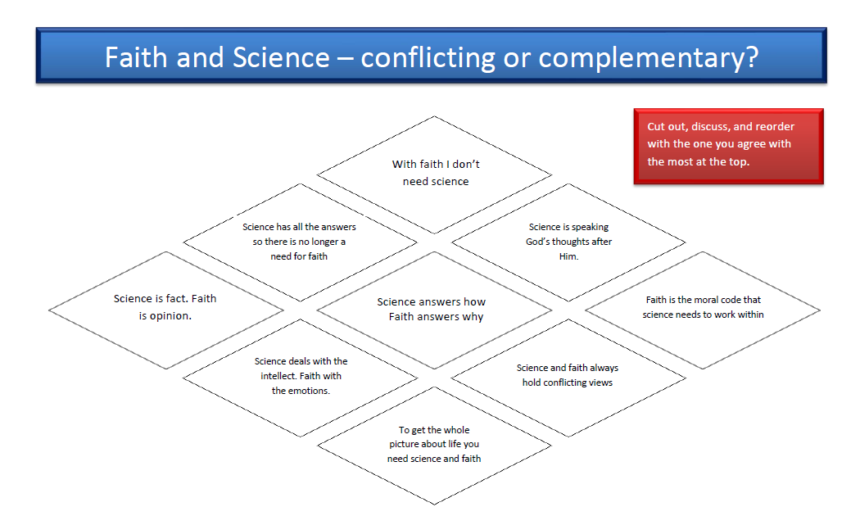


Big, big questions…
Is there a place for both faith and science in our complex world?
In groups discuss the statements on the diamonds and then put them in to a diamond nine order. Have the statement you agree most with at the top and the one you least agree with at the bottom.
Click on the link to download the Diamond Nine pdf
Notes:
8

Slide 9

Krish Kandiah is a scientist and a theologian.
This short film shows how he holds both of these together.
Notes:
9

Slide 10


Big, big questions…
Scientists and theologians are continually asking questions in the search of knowledge.
If you could ask an ‘omniscient being’ any four questions what would they be? Write your questions on post-it notes.
Going deeper. Create a display of your questions.
Working in groups – divide the questions between the groups.
Encourage the groups to answer from God’s view point.
Consider how this conversation is like prayer and how prayer
may give a person hope.
Notes:
10

Slide 11

Where is God?
For millions of people around the world today, a belief in God brings hope. In this next section the question of ‘Where is God?’ is explored in a creative way.
https://www.natre.org.uk/about-natre/projects/spirited-arts/spirited-arts-2021/
Notes:
11

Slide 12
Where is God?
Use this time as an opportunity to get involved in the 2021 NATRE Spirited Arts competition!
Join hundreds of schools from around the world taking part in this year's Spirited Arts competition! NATRE welcome entries in (almost!) any artform your pupils can think of, including:
Art (painting, drawing, sketching etc)
Poetry
Photography
Dance
Music
Drama
Sculpture
https://www.natre.org.uk/about-natre/projects/spirited-arts/spirited-arts-2021/
Notes:
12

Slide 13

Where is God?
Psalm 42
A deer thirsts for a stream of water.
In the same way, I thirst for you, God.
I thirst for the living God.
When can I go to meet with him?
Day and night, my tears have been my food.
People are always saying,
“Where is your God?”
When I remember these things,
I speak with a broken heart.
I used to walk with the crowd.
I led the happy crowd to God’s Temple,
with songs of praise.
Why am I so sad?
Why am I so upset?
I should put my hope in God.
I should keep praising him,
My Saviour and my God.
What three words would you use to describe how the writer of the psalm is feeling?
According to the writer what is the solution to the problems they are facing?
In the first part of the psalm, the writer asks two questions – what are these questions?
If you were the psalm writer how would you answer these questions?
https://www.natre.org.uk/about-natre/projects/spirited-arts/spirited-arts-2021/
This activity could be done in small groups.
Having discussed the psalm continue onto the next activity…
Notes:
13

Slide 14
Where is God?
Where is God?
Atheists, agnostics and believers in God might all respond to this by expressing their sense of the search for God or finding God. Where’s God? In your heart? In prayer? In the temple or the universe? Or is she hiding? Is he not there at all? Unreal? Imaginary? Looking for God, searching for him or her, matters to many, but how are we doing in finding God? Would you search with google or a ‘god-detector’? Is God on Instagram or WhatsApp? Can God be found by prayer or by looking among the world’s suffering people?
This popular ‘Art in Heaven’ theme produces great work where pupils use ideas from religions clearly: The Jewish Psalms 42 and 43 are where it starts. Use theological reflection as well as philosophical argument to make great work.
https://www.natre.org.uk/about-natre/projects/spirited-arts/spirited-arts-2021/
Get Creative. Using one of the artforms, answer the question, ‘Where is God?’
Notes:
14

Slide 15

Where are you placing your hope?
Good Hope by Benjamin Zephaniah
http://talktomeindia.org/blog-post/lesson-41-poem-good-hope/
Notes:
15

Slide 16
Where are you placing your hope?
There is hope,
That is what I hope
And this is what I believe,
I believe in you.
Believe me.
— Benjamin Zephaniah
Read all of this poem which is called Good Hope.
Do you share the same hopes and beliefs that Benjamin Zephaniah has?
What are your hopes for our world?
Where are you placing your hope that these hopes may come reality?
Use the target activity to help you think these questions through…
Good Hope by Benjamin Zephaniah
http://talktomeindia.org/blog-post/lesson-41-poem-good-hope/
Notes:
16

Slide 17


Where are you placing your hope?
Where are you placing your hope?
Cut out the cards and put them on the target with those you are placing your hope in the most, closer to the bullseye.
Click on the icon to download the sheet
Good Hope by Benjamin Zephaniah
http://talktomeindia.org/blog-post/lesson-41-poem-good-hope/
Notes:
17

Slide 18
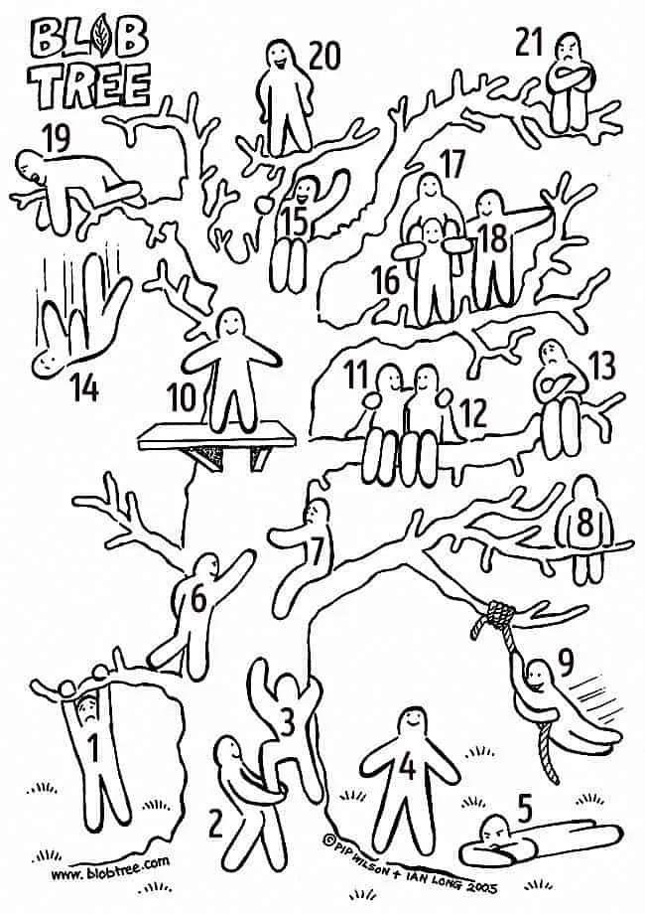
How can we be people of hope?
In groups look at the picture and then discuss…
Where do you see signs of hope in the picture? When have you felt that?
Where do you see signs of despair? When have you felt like that? What helped to restore hope?
Notes:
18

Slide 19
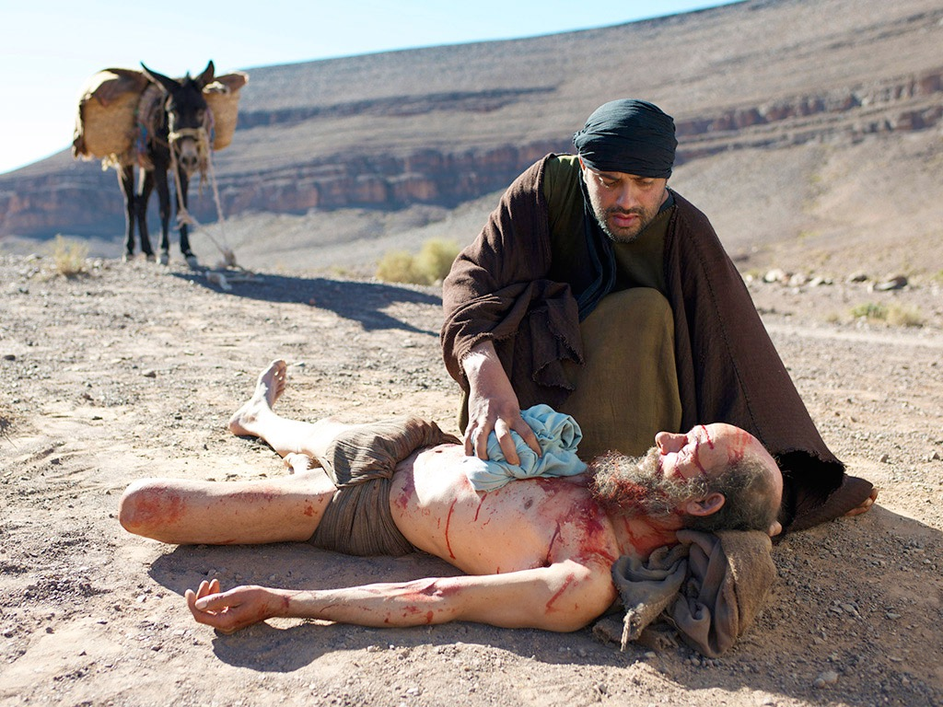
How can we be people of hope?
Read the story of the Good Samaritan
Luke 10:25-37
Sometimes we are called to be people of hope – just like the Samaritan
https://www.biblegateway.com/passage/?search=Luke%2010%3A25-37&version=NIV
Notes:
19

Slide 20

Watch or download the video on RE:quest or from our own website https://www.ldbe.co.uk/notices/inspire-spiritual-development/
http://request.org.uk/issues/global-issues/poverty-facing-the-issues/
One person’s response to be a person of hope when faced
with the injustice of poverty…
Notes:
20

Slide 21
How can we be people of hope?
Become a voice of the voiceless write to your MP or and organisation about an issue that matters to you either locally or nationally.
Food poverty is a real problem for many people around the world today.
How can you bring hope?
Try supporting a local Food Bank, setting up a community cupboard, growing your own and cut down on waste.
Bring some hope to the environment and make your classroom as sustainable as you can. There are ideas here:
https://populationeducation.org/24-ways-make-your-classroom-eco-friendly-year/
There are many people who are quite lonely. How can you bring them hope?
Partner with your church to help create a ‘Place of Welcome’ or ‘Well-being Café’
Hints on how to write to your MP:
https://www.writetothem.com/
Decide on one of the actions above that you could do as a class.
Use a snowball discussion to decide which one to do.
Discuss the ideas in pairs then join two pairs and then two groups of four etc…
Notes:
21

