Slide 1
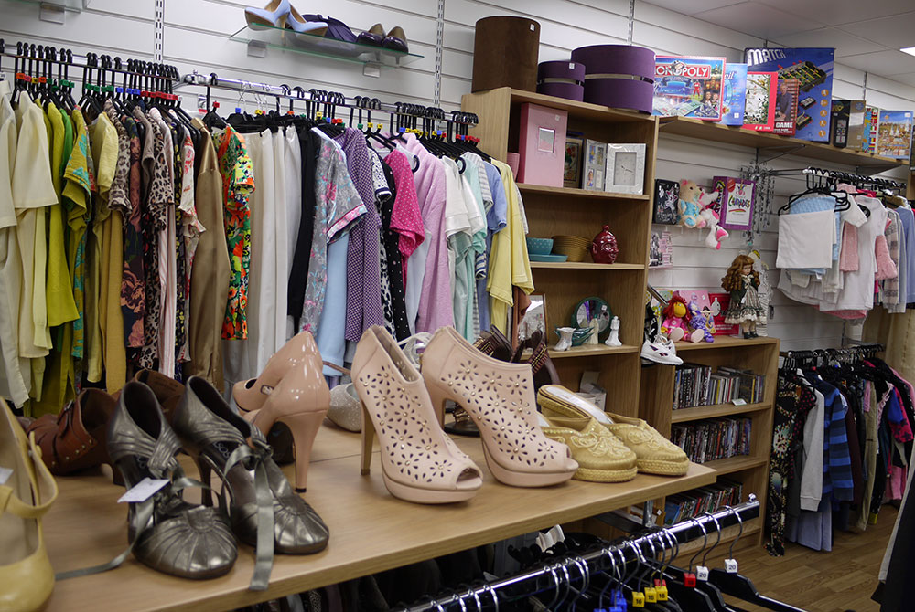

COURAGEOUS ADVOCACY
How can we provide hope for others?
(and our planet)
INSPIRE Y8

Slide 2
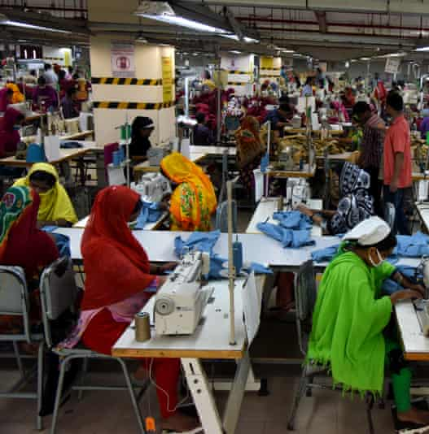

CONTENTS
5. Video inspiration
6. Big Questions
7. Spirited Arts Competition
10. ‘Where do my clothes come from?’
16 What happens to old clothes?
17. What can I do with old clothes?

Slide 3
INTRODUCTION
Where do your clothes come from?
What happens to them when you no longer wear them?
This mini-project will explore how clothes are made and how ‘fast fashion’ impacts our environment and contributes to climate change.

Slide 4
INFORMATION FOR TEACHERS
Contained within this pack are some prompts for activities around the theme of ‘fast fashion’ and how we can make changes which will inspire hope for others and our planet.
The included activities can be delivered as a carousel or provided as a choice for students.
Otherwise, teachers can select the most appropriate activity to use with their students.

Slide 5
Useful Videos
https://www.clothingmanufacturersasia.com/ethical-manufacturing/
Exploring the true cost of fast fashion
https://www.youtube.com/watch?v=zm_3HVLbggM
Teenagers exploring impact of fast fashion and considering buying second hand.
https://www.youtube.com/watch?v=kaqv9YwbQek
Being more sustainable

Slide 6
Big Questions
Do you think that
you have enough,
too many or too
few clothes?
Why do you shop?
Is it for need or do
clothes have other
meanings for you
such as expressing
your mood or
creativity?
How many unworn
clothes do you
have in your
wardrobe? What
are the three main
reasons for that?
How often do you
buy clothes? Do
you only buy them
when you know you
need something
specific or are you
more of an impulse
shopper?
Where do you buy
your clothes? How
would you describe
the experience? Do
you source clothes
in other ways such
as lending, making
or swapping?
How do you feel
about second-hand
clothes?

Slide 7
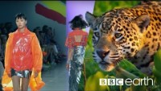
ACTIVITY 1
God’s good earth?
(“Beautiful World, wonderful God?")
https://www.youtube.com/watch?v=ZoiU8sprXpQ

Slide 8
ACTIVITY 1
God’s good earth?
(“Beautiful World, wonderful God?")
Are we spoiling God’s good earth? Does the Earth belong to God? Should we be thankful for it? Can we save it in time from the threats of climate change?
The beauty of the earth is celebrated in many religions, but the human spoiling of the earth is a danger and a coming crisis. In this theme, learners are invited to explore ideas and beliefs about the natural world, human responsibility for the earth and ways of praying about climate justice.
Great work will show some originality: the globe in God’s hands won’t win! Challenge pupils to use scripture quotations thoughtfully, but also the methods of scientific enquiry and moral study to develop deep answers and good writing to go with stunning images.

Slide 9

God’s good earth?
(“Beautiful World, wonderful God?")
Play clip from 9:00 until 17:57 to introduce this theme.
https://youtu.be/IMyW8hBxPPw

Slide 10
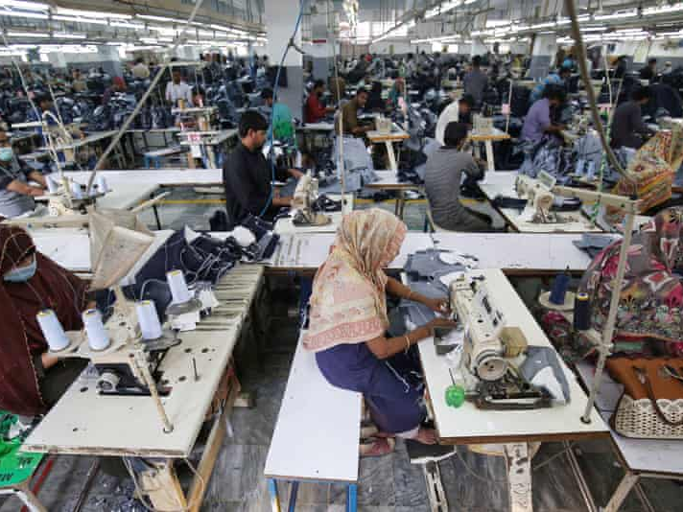
ACTIVITY 2
Where do my clothes come from?
THE TRUE COST VIDEO CLIP (PG-13)
**Watch first to ensure suitability for your pupils**
https://www.clothingmanufacturersasia.com/ethical-manufacturing/

Slide 11
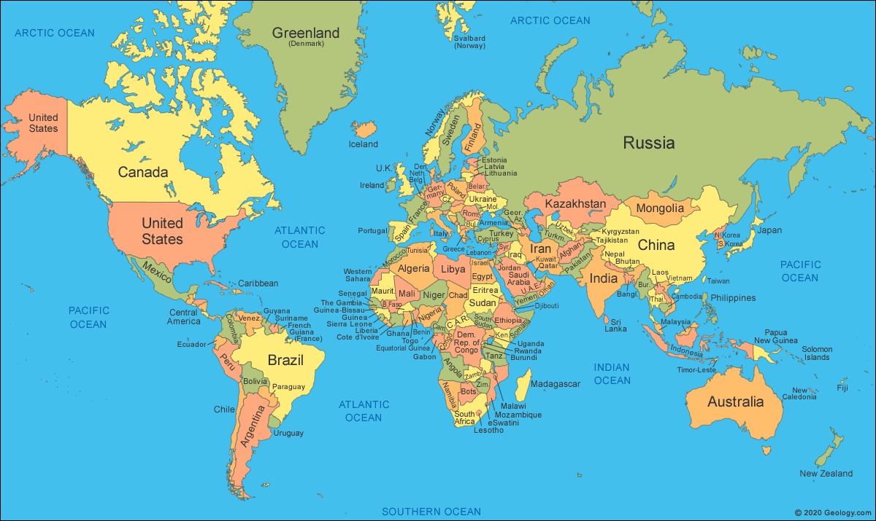
ACTIVITY 2
Where do my clothes come from?
Check garment labels
What is it made from?
Where was it made?
Locate on map/globe (add post-its)

Slide 12
ACTIVITY 2
Where do my clothes come from?
Why are UK retailers producing most of
our clothes outside of the UK?
Who should be responsible for making sure that
garment workers are paid enough money?

Slide 13
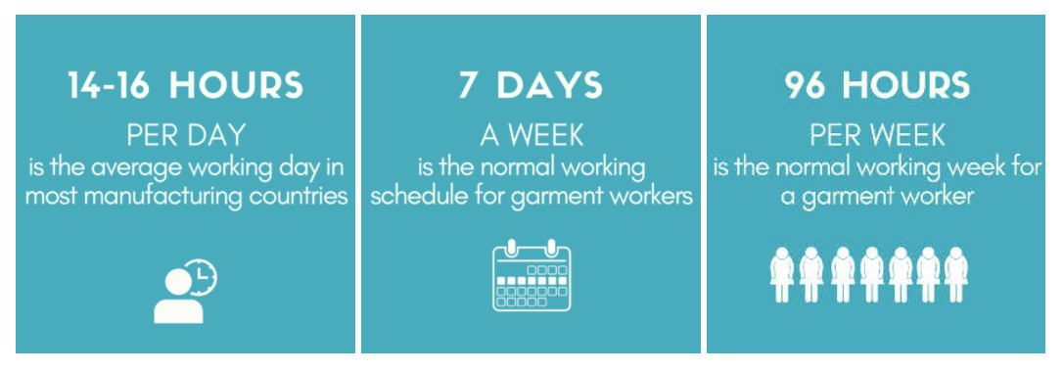
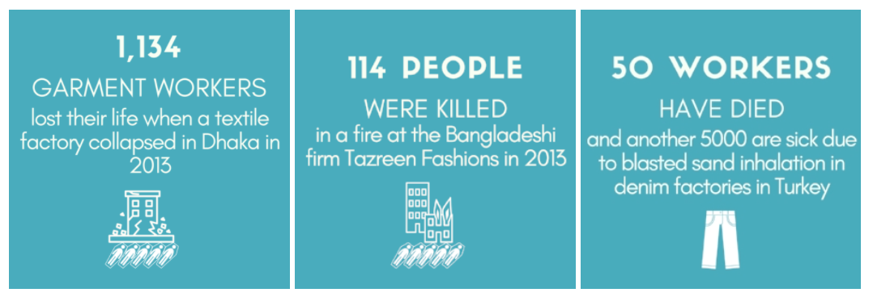
ACTIVITY 2
Where do my clothes come from?

Slide 14
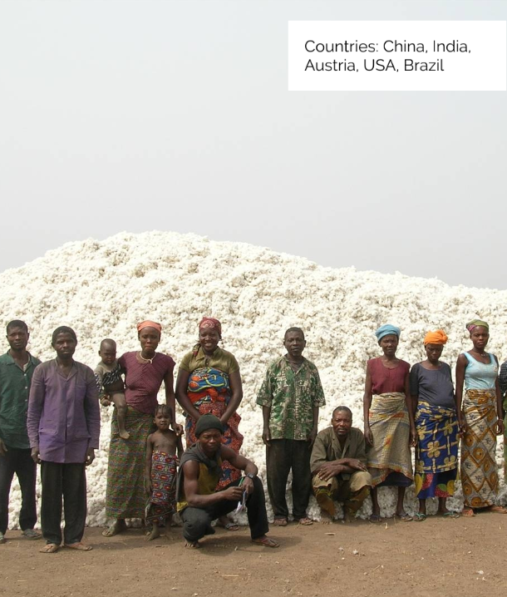
ACTIVITY 2
Where do my clothes come from?
Use to provide information about producing ‘fast fashion’.
https://prezi.com/view/RzgrcDQWPcNPyeIr9Etx/

Slide 15
ACTIVITY 2
Where do my clothes come from?
Create a poster, video or social media campaign, encouraging people to shop ethical brands when buying new clothes.

Slide 16
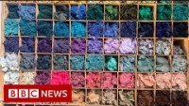
ACTIVITY 3
What happens to old clothes?
https://www.youtube.com/watch?v=7i0QMnz4ExY

Slide 17
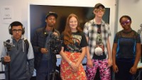
ACTIVITY 3
What can I do with my old clothes?
https://www.youtube.com/watch?v=zm_3HVLbggM

Slide 18
ACTIVITY 3
What can I do with my old clothes?
Can you upcycle an item of old clothing?
This could be any old item of clothing! Here are some ideas:
Use the fabric to create a headband
Add buttons, can pulls, ribbons to change the design
Change using tie-dye
Combine different fabrics
Change the item of clothing into a different item of clothing
Use contrasting fabric to patch areas of wear and make a design feature

Slide 19
ACTIVITY 3
What can I do with my old clothes?
Inspiration:
https://www.cosmopolitan.com/uk/fashion/news/a26528/how-to-upcycle-clothes-tips/
https://www.quirkybohemianmama.com/2019/06/11-ways-to-upcycle-old-clothes.html
https://www.1millionwomen.com.au/blog/12-ways-recycle-your-t-shirts/

Slide 20
Acknowledgements
https://schools.fairtrade.org.uk/
http://behind-the-seams.org/
https://www.traid.org.uk/

