Slide 1


COURAGEOUS ADVOCACY
How can we provide hope for others?
(and our planet)
INSPIRE Y6

Slide 2
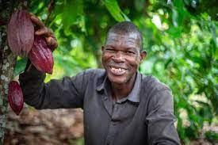

CONTENTS
5. Video inspiration
6. Big Questions
7. Spirited Arts Competition
10. ‘Where does our food come from?’
15. How can I make a change?

Slide 3
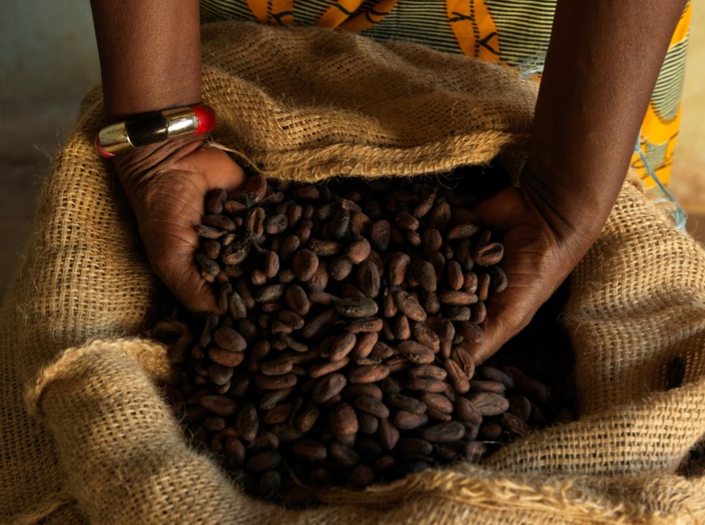
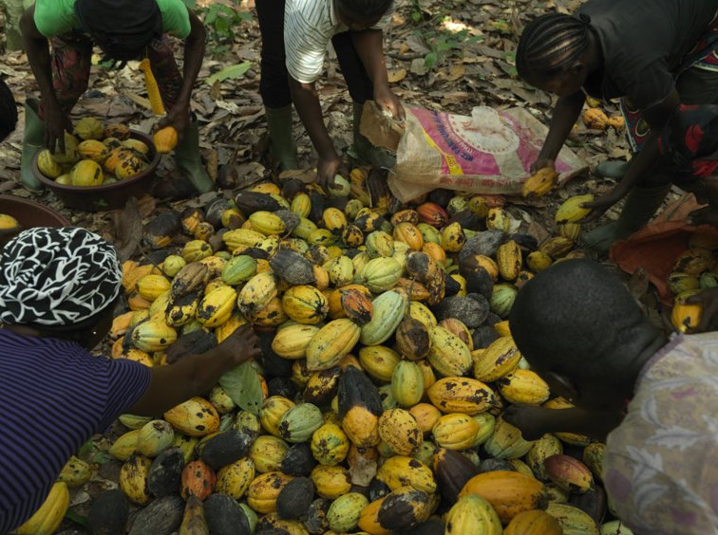

Where does our food come from?
This mini-project will explore where food comes from and how we can choose to make a difference for others.
INTRODUCTION

Slide 4

INFORMATION FOR TEACHERS
Contained within this pack are some prompts for activities around the theme of ‘fair trade’ and how we can make changes which will inspire hope for others and our planet.
The included activities can be delivered as a carousel or provided as a choice for pupils.
Otherwise, teachers can select the most appropriate activity to use with their pupils.

Slide 5
Useful Videos
https://schools.fairtrade.org.uk/teaching-resources/2257/
A day in the life of the child of a sugar farmer
https://schools.fairtrade.org.uk/teaching-resources/meet-norandino-coffee-co-op/
A film about the impact of climate change on coffee farming. Can be used to explore where coffee comes from.
https://schools.fairtrade.org.uk/teaching-resources/make-bananas-fair-a-film-for-schools/
A film about banana farming. Can be used to explore where banana comes from.
https://schools.fairtrade.org.uk/teaching-resources/guardians-of-the-rainforest-shorter-version/
A film about cocoa farming. Can be used to explore where cocoa comes from.

Slide 6
Big Questions
Where does my food come from?
Who grows the food I eat?
How is my food so cheap?
What impact do my food choices have on the growers?
What impact do my food choices have on the planet?

Slide 7
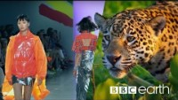
ACTIVITY 1
God’s good earth?
(“Beautiful World, wonderful God?")
https://www.youtube.com/watch?v=ZoiU8sprXpQ

Slide 8
ACTIVITY 1
God’s good earth?
(“Beautiful World, wonderful God?")
Are we spoiling God’s good earth? Does the Earth belong to God? Should we be thankful for it? Can we save it in time from the threats of climate change?
The beauty of the earth is celebrated in many religions, but the human spoiling of the earth is a danger and a coming crisis. In this theme, learners are invited to explore ideas and beliefs about the natural world, human responsibility for the earth and ways of praying about climate justice.
Great work will show some originality: the globe in God’s hands won’t win! Challenge pupils to use scripture quotations thoughtfully, but also the methods of scientific enquiry and moral study to develop deep answers and good writing to go with stunning images.

Slide 9

God’s good earth?
(“Beautiful World, wonderful God?")
Play clip from 9:00 until 17:57 to introduce this theme.
https://youtu.be/IMyW8hBxPPw

Slide 10
ACTIVITY 2
Where does my food come from?

Slide 11
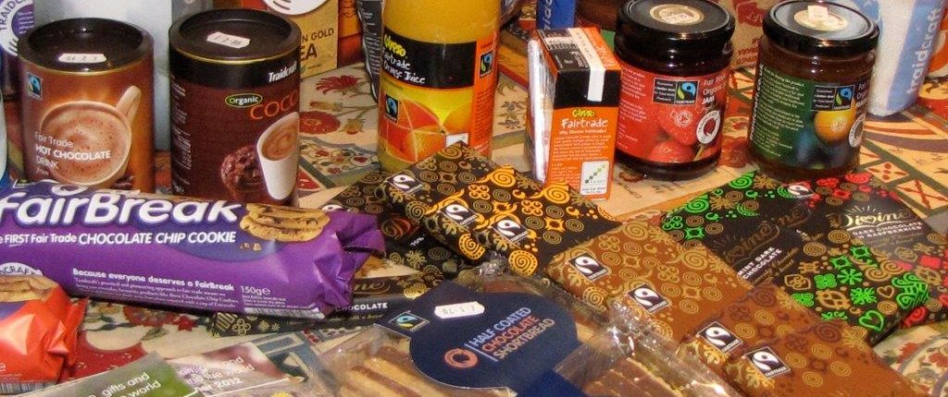
ACTIVITY 2
Where does my food come from?
Watch one of the films from slide 5. Choose the one that will interest your children most.

Slide 12
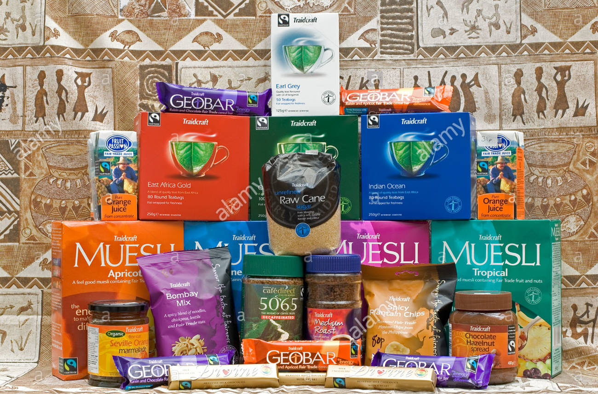
ACTIVITY 2
Where does my food come from?
Create a fair trade farm in a shoe box. What fair trade product is growing on your farm?

Slide 13
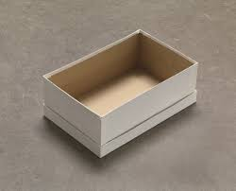
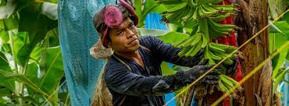
ACTIVITY 2
Where does my food come from?
You will need:
A shoe box
Junk or recycled materials
Drawing materials or paint
Inspiration from Fairtrade farmers

Slide 14
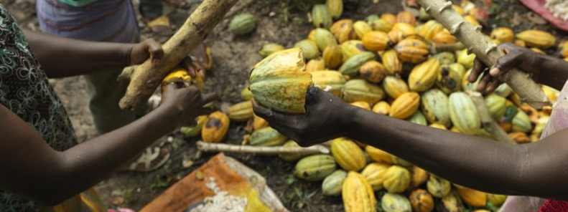
ACTIVITY 3
How can I make a change?
Watch
https://schools.fairtrade.org.uk/teaching-resources/change-the-world-through-your-choices/

Slide 15

ACTIVITY 3
How can I make a change?
Congratulations!
You are now the Head Chef at a world renowned restaurant.

Slide 16
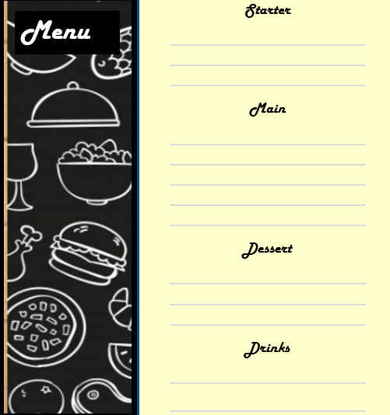
ACTIVITY 3
How can I make a change?
Design you’re a menu that makes a difference to the world.
Include Fair Trade products

Slide 17
Acknowledgements
https://schools.fairtrade.org.uk/
https://www.fairtrade.net/

