Slide 1


COURAGEOUS ADVOCACY
How can we provide hope for others?
(and our planet)
INSPIRE Y4

Slide 2
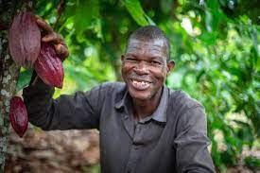

CONTENTS
5. Video inspiration
6. Big Questions
7. Spirited Arts Competition
10. ‘Where does my chocolate come from?’
15. How can I make a change?

Slide 3
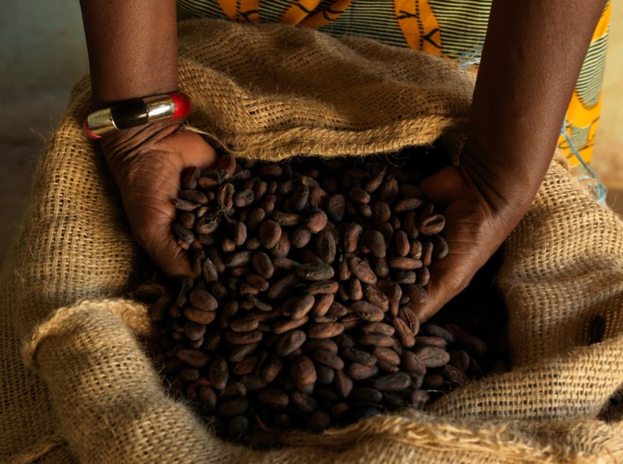
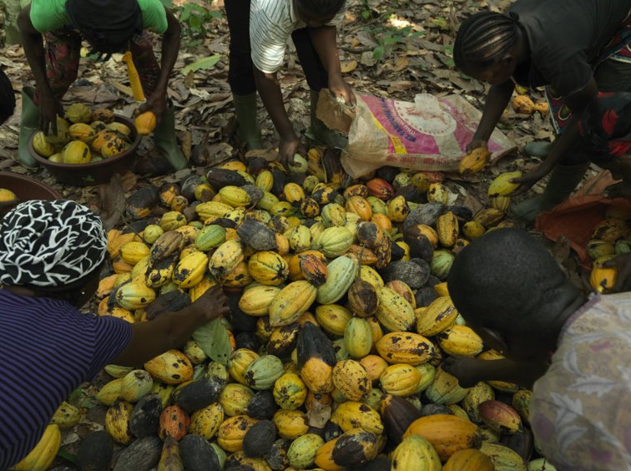

Where does chocolate come from?
This mini-project will explore where chocolate comes from
INTRODUCTION

Slide 4
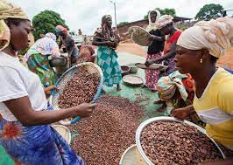
INFORMATION FOR TEACHERS
Contained within this pack are some prompts for activities around the theme of ‘fair trade’ and how we can make changes which will inspire hope for others and our planet.
The included activities can be delivered as a carousel or provided as a choice for pupils.
Otherwise, teachers can select the most appropriate activity to use with their pupils.

Slide 5
Useful Videos
https://schools.fairtrade.org.uk/teaching-resources/cocoa-climate-a-lesson-plan-for-primary-schools/
This film explores climate and considers the impact of climate change on cocoa farmers. It looks at the impact for farmers of buying Fairtrade.
https://schools.fairtrade.org.uk/teaching-resources/guardians-of-the-rainforest-shorter-version/
In the Gola Rainforest of Sierra Leone, a group of cocoa farmers work hard to protect their way of life, their beautiful forest and their livelihoods. Through having a better and more secure income, they can farm in a forest friendly way and protect their beautiful home from the threats of deforestation and biodiversity loss.
https://schools.fairtrade.org.uk/teaching-resources/fairtrade-story-a-fair-tale/
‘A Fair Tale’ is about cocoa farming in Ghana and the importance of Fairtrade.

Slide 6
Big Questions
How do you decide which chocolate to buy?
Where does chocolate come from?
Where do the ingredients needed to make chocolate come from?

Slide 7
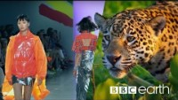
ACTIVITY 1
God’s good earth?
(“Beautiful World, wonderful God?")
https://www.youtube.com/watch?v=ZoiU8sprXpQ

Slide 8
ACTIVITY 1
God’s good earth?
(“Beautiful World, wonderful God?")
Are we spoiling God’s good earth? Does the Earth belong to God? Should we be thankful for it? Can we save it in time from the threats of climate change?
The beauty of the earth is celebrated in many religions, but the human spoiling of the earth is a danger and a coming crisis. In this theme, learners are invited to explore ideas and beliefs about the natural world, human responsibility for the earth and ways of praying about climate justice.
Great work will show some originality: the globe in God’s hands won’t win! Challenge pupils to use scripture quotations thoughtfully, but also the methods of scientific enquiry and moral study to develop deep answers and good writing to go with stunning images.

Slide 9

God’s good earth?
(“Beautiful World, wonderful God?")
Play clip from 9:00 until 17:57 to introduce this theme.
https://youtu.be/IMyW8hBxPPw

Slide 10
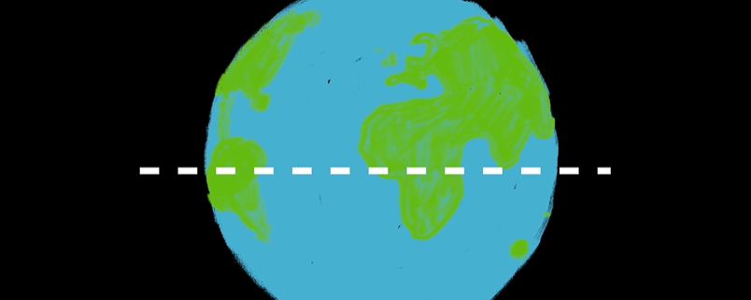
ACTIVITY 2
Where does my chocolate come from?
https://schools.fairtrade.org.uk/teaching-resources/cocoa-climate-a-lesson-plan-for-primary-schools/
Watch up to 1:27

Slide 11
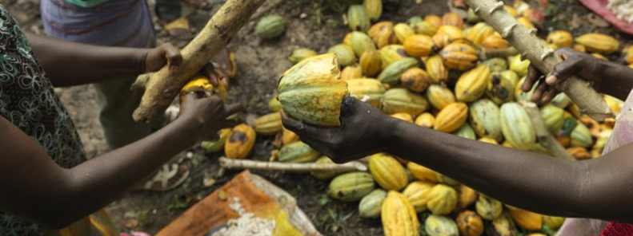
ACTIVITY 2
Where does my chocolate come from?
Watch
https://schools.fairtrade.org.uk/teaching-resources/guardians-of-the-rainforest-shorter-version/

Slide 12
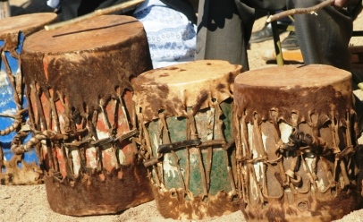
ACTIVITY 2
Where does my chocolate come from?
Grandmother Amie scares the chimpanzees away with a drum to help protect the forest.

Slide 13
ACTIVITY 2
Where does my chocolate come from?
Think of your own forest friendly way to stop animals eating the cocoa beans without harming the chimpanzees or the trees? .

Slide 14
ACTIVITY 2
Where does my chocolate come from?
Draw and label your design. Build/make it!

Slide 15
ACTIVITY 3
How can I make a change?
Watch
https://schools.fairtrade.org.uk/teaching-resources/shorter-version-of-the-story-of-chocolate-8-mins/

Slide 16

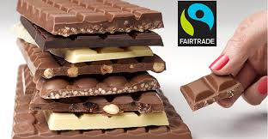
ACTIVITY 3
How can I make a change?
What could you do to make a difference to the lives of these farmers?

Slide 17
ACTIVITY 3
How can I make a change?
Design your own forest friendly chocolate bar.
You could make your own chocolate creation using Fairtrade chocolate.

Slide 18
ACTIVITY 3
How can I make a change?
Think carefully about the packaging and remember to include the Fairtrade mark.

Slide 19
Acknowledgements
https://schools.fairtrade.org.uk/
https://www.fairtrade.net/

