Slide 1

St Mary’s Catholic High School
Year 10 - Work Experience
Thursday 8th July 2027
Name:

Slide 2
Search for a placement
Start your placement search now! This booklet will guide you through it. Once you have one confirmed, it must be registered on Unifrog placement tool.
Key dates and support
Searching for and contacting an employer
Recording on Unifrog
Parental permission
GUIDE
CONTENTS

Slide 3
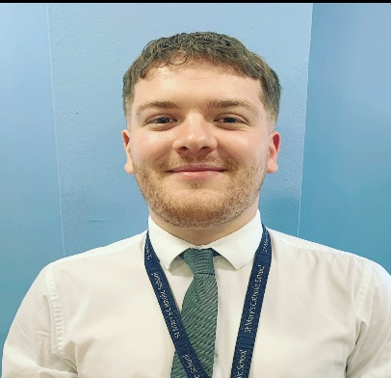
WORK EXPERIENCE
OVERVIEW
Mr Walton
Head of Personal Development & Careers
LAUNCH ASSEMBLY | October 2026
WEEKLY ‘DROP INS’ | Every Tuesday Lunch in G15
FIND PLACEMENT DEADLINE | Friday 28th May 2027
RECORD AND APPROVE PLACEMENT DEADLINE | Friday 18th June 2027
WORK EXEPRIENCE DATE | 8th July 2027

Slide 4

SEARCHING
Ask family and family friends first! Who has a job or careers that interests you? Can you ask them if you can shadow and support them for the day?
Know a place you’d like to go? Find their email address and ask! Make sure you specify the dates and what your career interests are.
Don’t know where you could go, but have a career/sector in mind?
Search for the sectors online and find the ‘contact us’ section on their website. Find an email address and email them to ask!

Slide 5
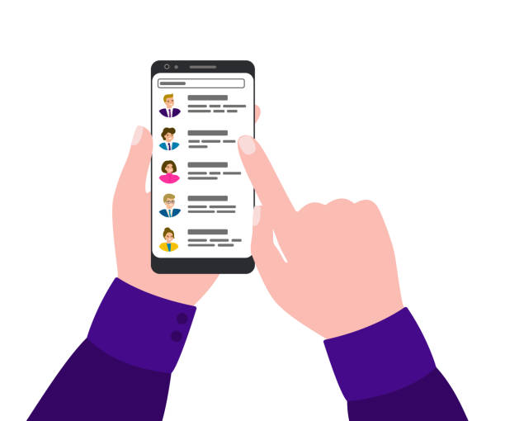
Contacting Employers
Dear ____, / To whom it may concern, I am a Y10 student at St Mary’s High School and I am seeking an opportunity to gain a work experience placement. I have an interest in _____ and would love to discuss the possibility of shadowing and supporting in____. Would you be able to take me on for a day placement on the 8th July 2027. I look forward to hearing from you soon. Kind regards, My Name

Slide 6
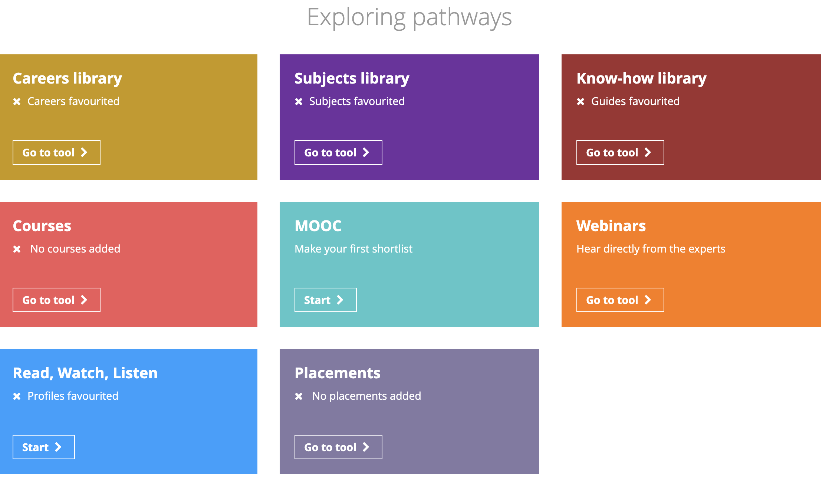
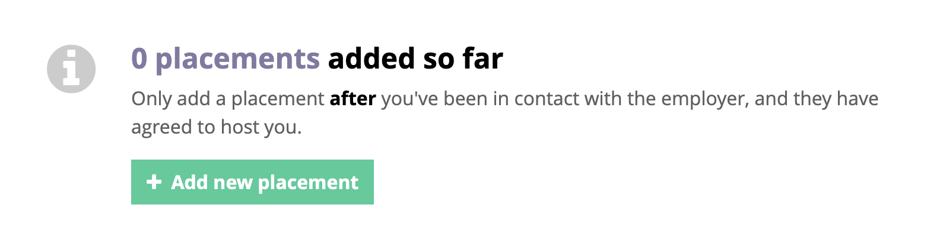
Registering a Placement
Go to Unifrog - log in with your student email. Click reset password if you don’t know it. Select ‘PLACEMENTS’ in the ‘Exploring Pathways’ section
Click on - ‘Add a Placement’

Slide 7
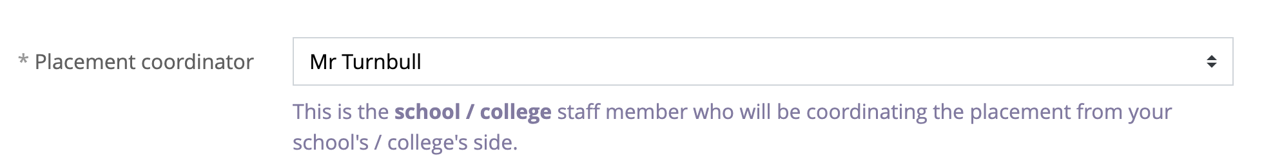
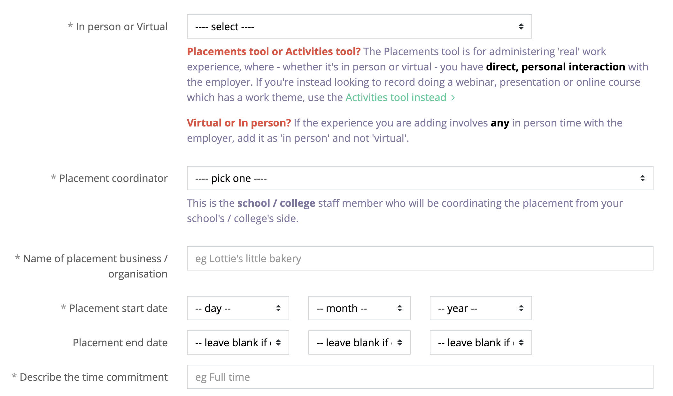
Select the placement coordinator - your coordinator is Mr Walton
Mr Walton
Start completing the ‘STUDENT INITIAL FORM’ with the correct dates and details. You will need an email address of the main placement contact, and a parent’s email

Slide 8
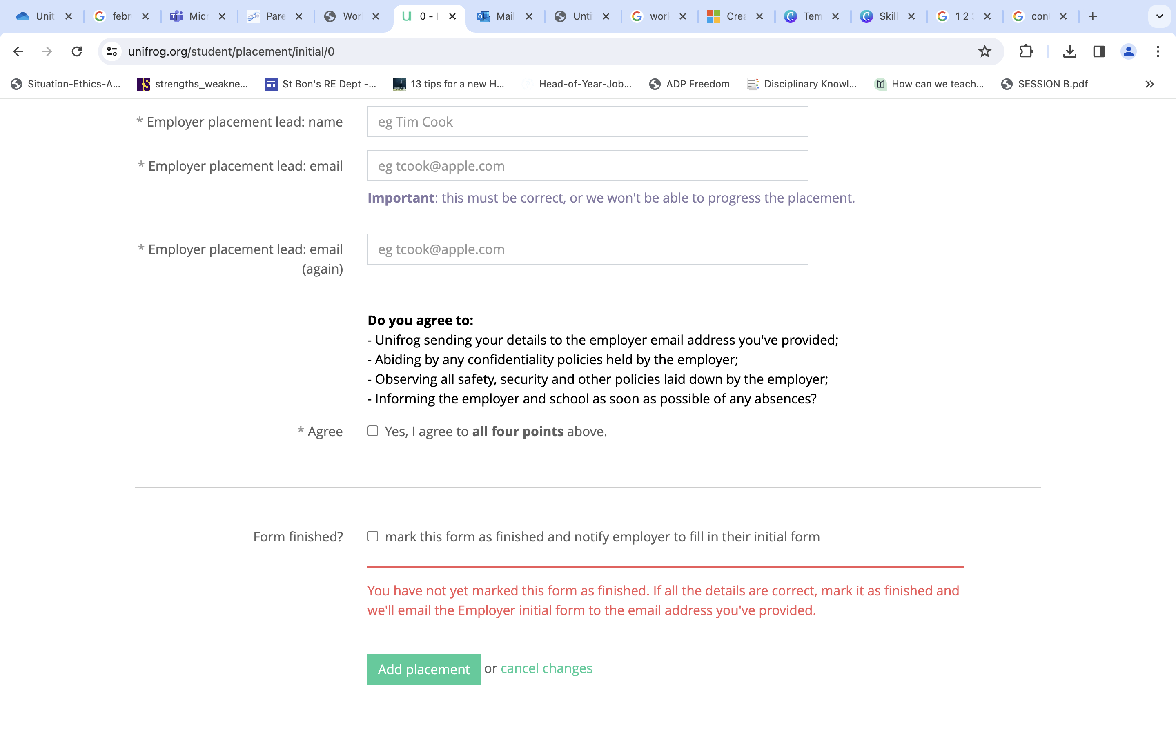
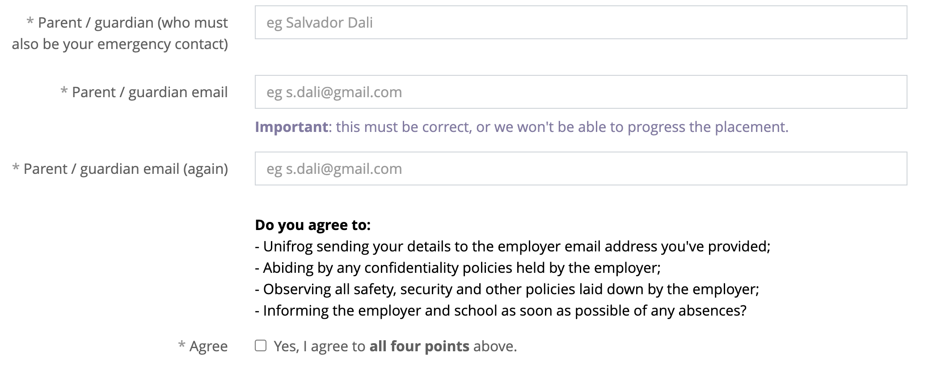
Add the employer’s email - this is the person who will be the main contact. Let them know that they will receive an email to fill in a form about you and your placement
Now you’ll need a parental email - Someone at home who can give permission for you to go on your placement. They will receive a quick Unifrog form to fill in by email, so make sure their email is correct!

Slide 9
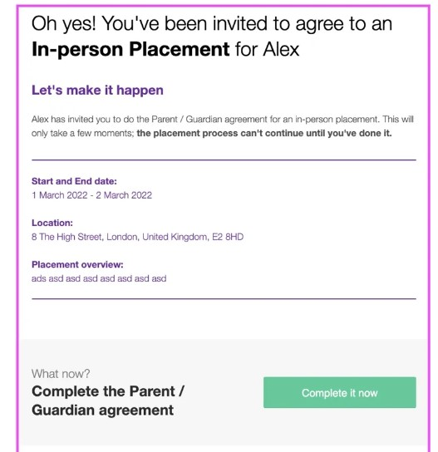
Parental Permission
As the parent, you will receive an email inviting you to complete a quick permission form (whichever email address the student has entered into their form)
Click on the green button “COMPLETE IT NOW”

Slide 10
You will be able to see all of the student form details as well as the employer information, health and safety procedures. You will be asked to add the following:
Name, email address and phone number
Does the student have any special needs, illnesses or injuries that may affect your placement? (the answer to this question is kept confidential from the student) Confirm you're aware that the placement provider will have primary responsibility for the health and safety of the student
Agreement for the student to take part in the placement
If you have any issues, please don’t hesitate to contact Mr Walton.

Slide 11


Remember…
Mr Walton is here to help! Attend the drop ins to use a computer and to have any questions answered
Don’t add a placement on Unifrog until you have permission from an employer to use their email address!

