Slide 1



St. Mary’s Catholic School
Supporting Speech, Language and Communication Needs
Gemma East
Speech and Language Therapist

Slide 2
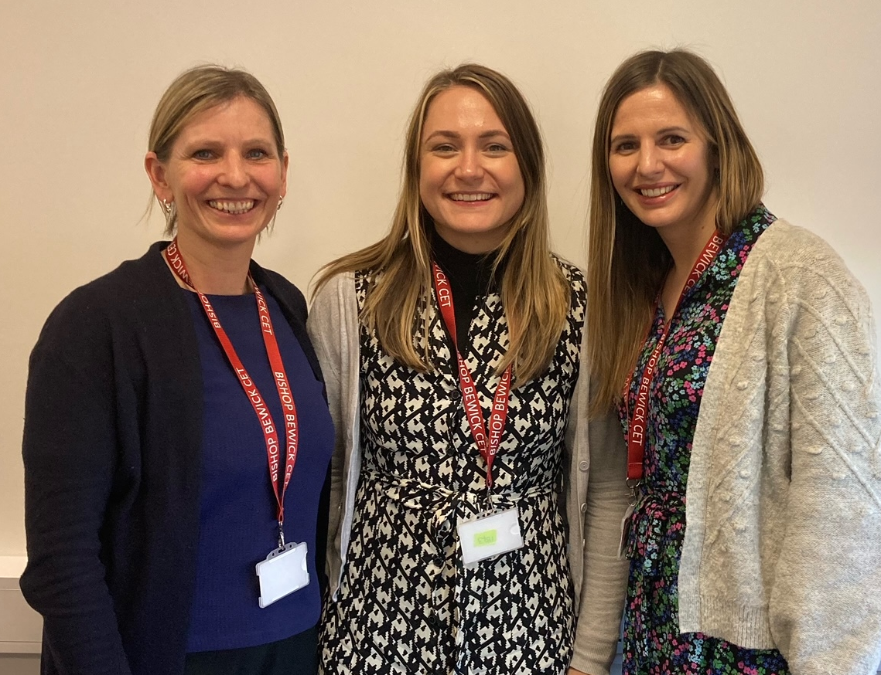
BBCET Speech and Language Therapists
Working in partnership with schools to:
Focus on Universal and Targeted support for Speech, Language and Communication Needs (SLCN)
Identify what's in place and working well
Identify new strategies, tools and intervention – Secondary Language Link
Training for school staff and families
Support links with NHS Speech and Language Therapy

Slide 3
Speech, Language and Communication Needs
What is SLCN?
What does SLCN look like in day-to-day life?
What can we be doing to support SLCN?
Secondary Language Link

Slide 4


Slide 5
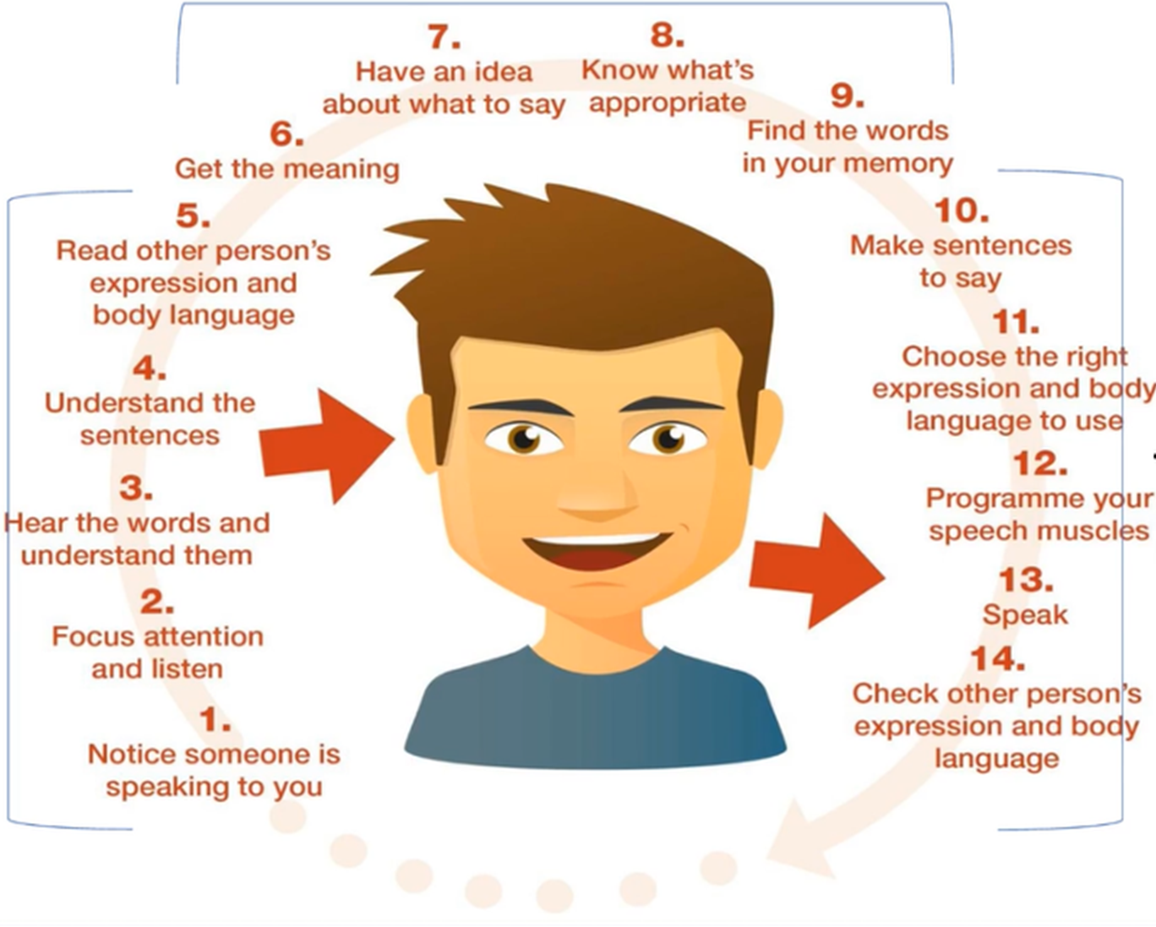















The Communication Chain
That dog is really dangerous
Notes:
In order for you to be able to identify where there might be a difficulty, it is useful for you to know how communication works in someone without any SLCN.
Here is the communication chain. I find it helpful to understand this process by thinking about what comes in (verbal information/instructions), what we do with it in our heads and then how it comes out.

Slide 6
Some definitions...
Speech
How words sound
Errors might be using the wrong sounds or using distorted sounds
Language
Understanding words, sentences, questions
Vocabulary knowledge
Communication
Listening and attention
Social awareness
Formulating sentences
Story telling ability
Verbal reasoning
Can be non-verbal
Inference
Using speech and language skills in context
Confidence to communicate
Speech may be difficult to understand
Notes:
OK, to delve into some facts and definitions – when we talk about SLCN we are talking about speech, language and communication, terms often used interchangeably, although they shouldn’t be.
When we talk about speech, we are talking about how words sound and how people use sounds within words. When people have difficulties in this area, they may sound different, or be very difficult to understand. As children and young people are learning to talk, we expect some errors with their speech sounds (these are called developmental errors, think tat instead of cat and pider instead of spider when children are 3 and 4). However, people may continue to do these things for longer than expected, this would be a speech delay, or they may do things that are not within these expected patterns (for example, replacing all front sounds with back sounds, like gog for dog and kiger for tiger; or they might replace all of their F sounds with H sounds, so hish instead of fish; or they may do lots of different things) and this is called a speech sound disorder.
When we talk about language, this is huge! This includes our vocabulary knowledge (our ability to learn new words, store new words and access them when we need them), our ability to understand what others are saying, our ability to form sentences and narratives and our verbal reasoning ability. (anyone know what we mean by verbal reasoning? – give examples once got some feedback).
Then we have communication, which can be used as a bit of an umbrella term, but also may be used to refer to the bits that don’t easily fall into speech or language – so thinking about the non-verbal skills, listening and attending to people and situations, being able to infer meaning (e.g. knowing that if I visit you and say ‘I’ve not had chance for a cuppa today’ I’m not simply stating a fact, I’m fishing for you to make me a brew!). Within this we would also include social awareness and being able to use the speech and language skills you have effectively in a range of situations – this might mean changing how you interact depending on your communication partner, or it might mean being able to use your voice in all situations (or not - i.e. SM).

Slide 7

Understanding spoken language
Listening and Attention
Using spoken language
SLCN
Speech
Stammering
Social communication
Speech Sound Disorder
Autism
ADHD
DLD

Slide 8
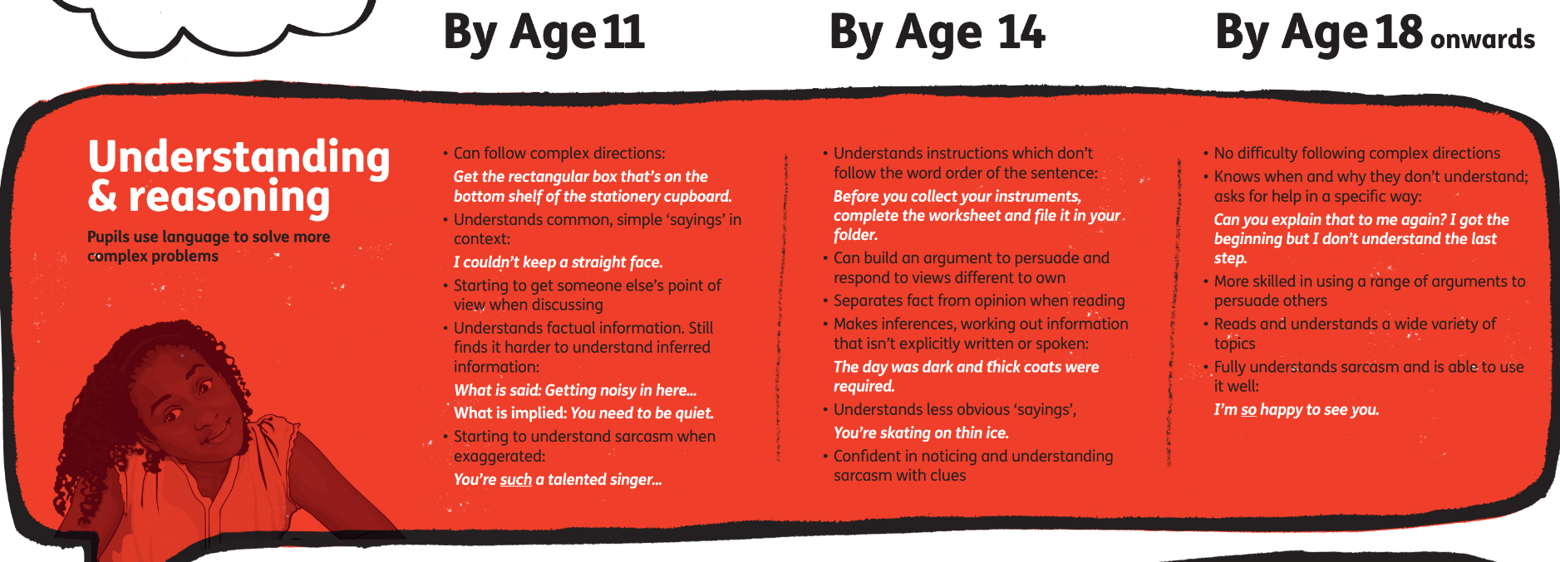
What’s ‘typical talk’ for secondary

Slide 9
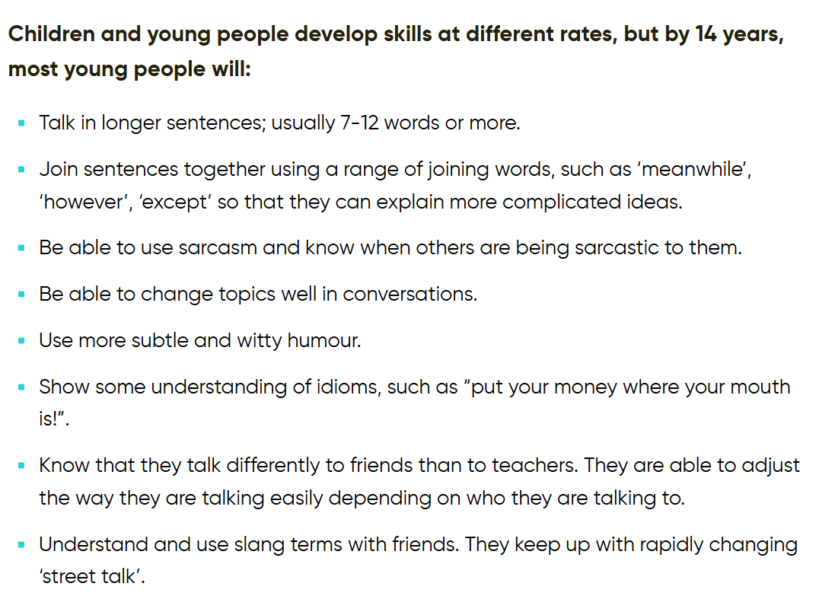

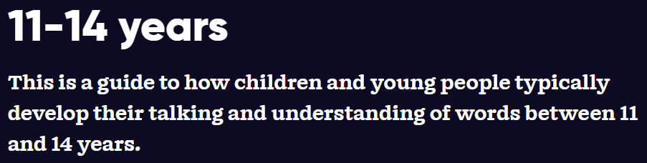
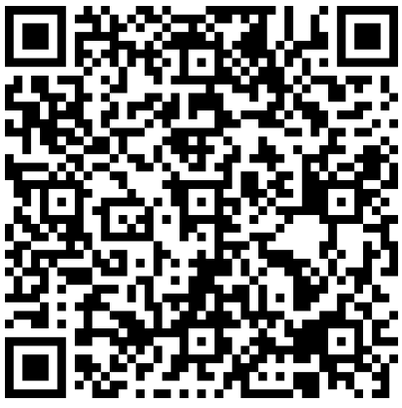

Slide 10
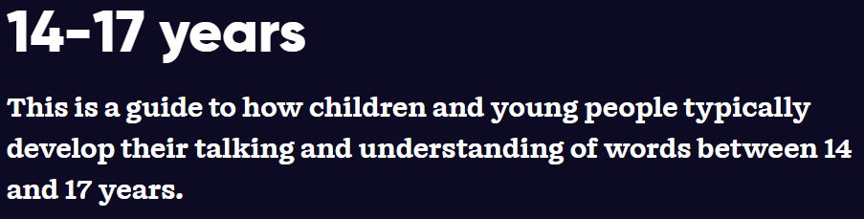
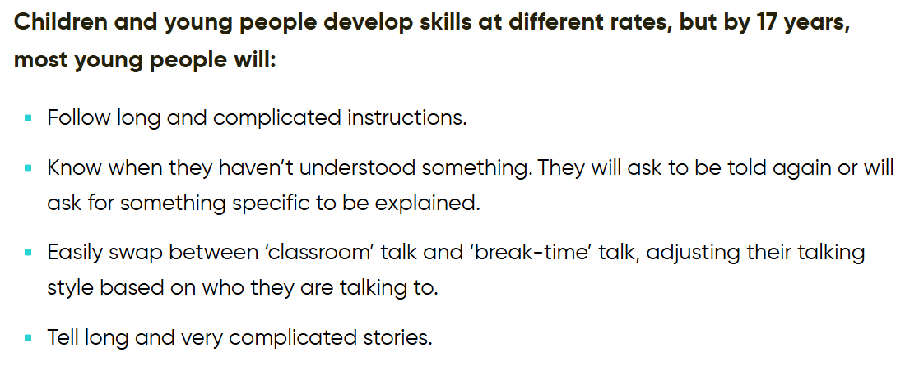
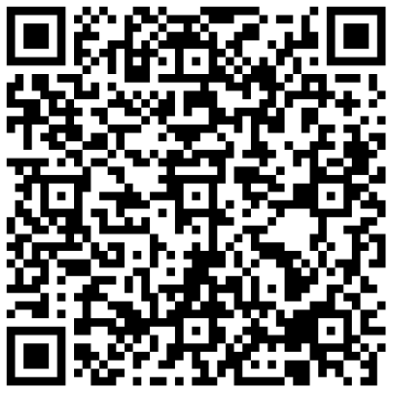

Slide 11
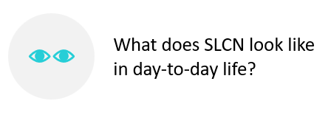

Slide 12
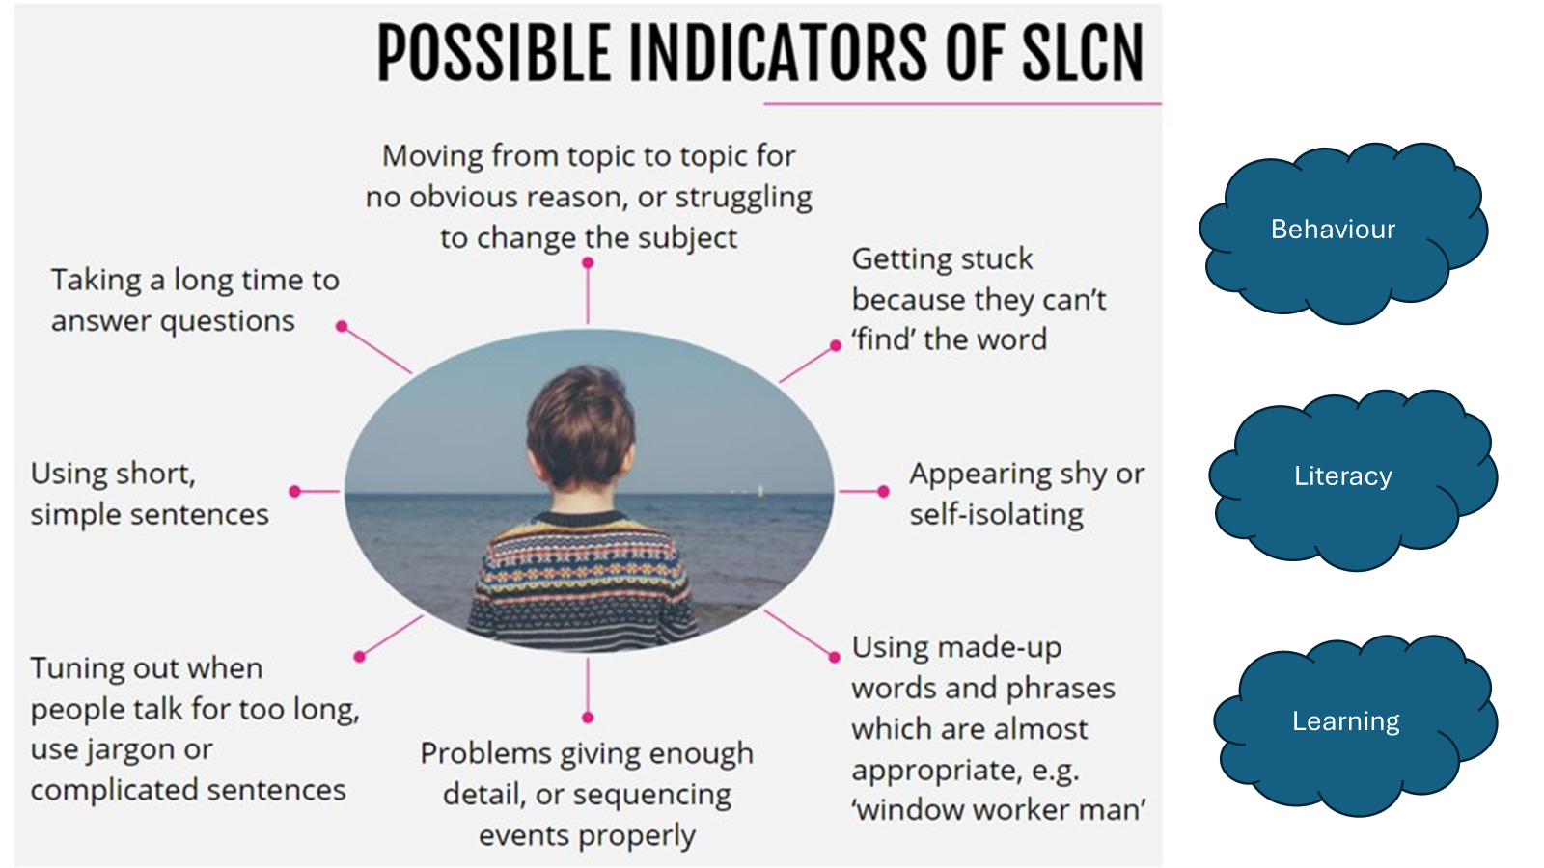

Slide 13
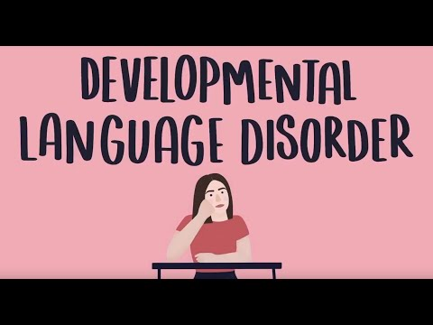
https://youtu.be/rwOfkj0dj_0
Notes:
https://www.youtube.com/watch?v=rwOfkj0dj_0

Slide 14
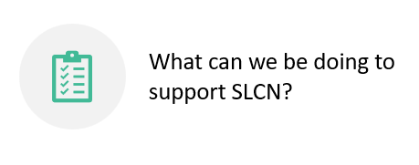

Slide 15


How to support SLCN?
Ensure the person is listening before speaking to them
Say their name first and give them one step at a time
Try asking the. to repeat the instruction back to you
Demonstrate an activity before they are required to do it independently
Visual strategies
* a visual schedule detailing step by step of a task
* writing key words down
* using pictures/symbols/objects alongside verbal instructions
“Turn to page 52”
Notes:
Some of these recommendations may sound very simple, however can be really useful and effective
Listening: say name first, make sure they are paying attention
Also consider background noise – are children shouting, chairs moving, music on?
Breaking down instructions into small manageable chunks e.g. consider before you get changed for P.E make sure you all put your English books on my desk? That may be difficult for some children so may be easier to give the child their book, point to the desk and say desk. Then when that step is complete tell them to get changed (this task again, may require being broken down further: shoes off, socks off etc)
- Visual strategies: can be done using symbols, can be written down on a whiteboard/paper and child cross out each one
Can be a whole class approach or individual for the child. Some students may benefit from their own individual timetable and referring back to this at different points in the day. Other students may be more independent and may be able to cope with this written down on a piece of paper and having it with them.
Schedules can be good for students as they visibly break down tasks into small manageable steps, which make it easier to understand and may relieve anxiety and promote motivation, if they know exactly what is going to be happening. This can also supports students independence. Some students can become quite reliant on support staff.
Staff may want to create symbol lanyards to reinforce your spoken language (e.g. wash your hands)

Slide 16
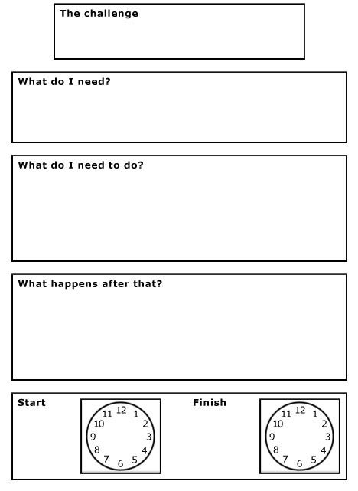
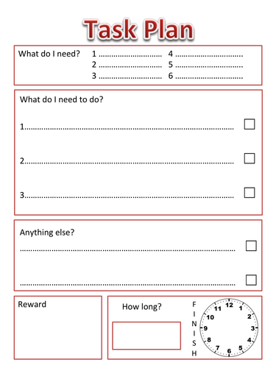
Notes:
Here are some examples of task plans which can be used in school. You could use this to support what is needed to do during an activity or task at home.

Slide 17


How to support SLCN?
Encourage comprehension monitoring as a family
(e.g. I didn’t understand what you said, please can you say it again?)
Agree a way for your child to ask for help if they need it
Practice following instructions during the day
(e.g. put your clothes away then bring your plates and cups down)
Use their interests and experiences where possible to support motivation and engagement
Notes:
Help: Can be a traffic light system where the student marks their level of understanding, or the help card can on the students table and the student can point to it to indicate to the teacher they need help (if don’t have the confidence to do this verbally)
Comprehension monitoring: support the child to identify when they have not understood (i.e. was there too much information, did the teacher speak too fast, were there words they did not understand?). This can be very difficult for students to do independently and will require support from adults to model how to do this. For example, the teacher asking first ‘were there any words you did not understand’, ‘do I need to say that again’ in the hopes students will be able to identify this themselves and say to the teacher “could you please say that again I cant remember all of what you said”
Student interests: not just for following instructions but can support engagement in all lessons. Could tasks be adapted to match students interests (e.g. if student is motivated by minecraft or fortnight, could maths problems be adapted to include characters/materials from these games?).

Slide 18

How to support SLCN?
Always give time to respond to a question (up to 10 seconds!)
Try to avoid finishing their sentence
Repeat back what your child has said correctly so they hear good language models.
For example, if they say ‘it falled down’ you could say ‘that’s right, it fell down’.
Do not do this all of the time – only when it feels natural to do so and does not affect the flow of conversation.
If you do not understand what your child has said tell them what you do understand so they know where the communication has broken down and it gives them the opportunity to try again.
Notes:
‘he is crying’ you could say ‘Sarah is crying, Sarah is a girl so we use the word she…she is crying’
For some grammatical concepts such as pronounces/verb tenses, SLT can provide activity packs to support students
Communication breakdown: “ah so you went to the cinema last night with Mam and Dad. Could you tell me again what film you saw”

Slide 19
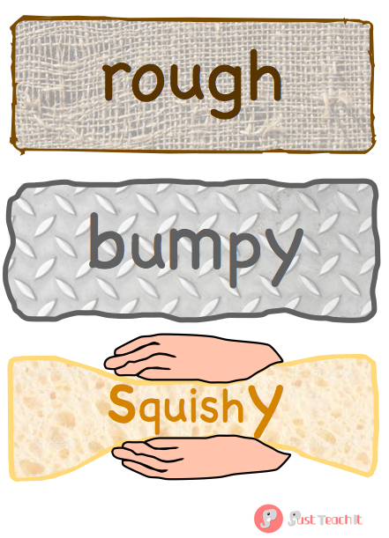
How to support learning new words
Teach new words within context
Use a multi-sensory approach: where possible and appropriate, use objects, pictures, TV clips, demonstrations to support learning
Frequent repetition of new words, across different curricular activities
Pre-teaching topic vocabulary
Word maps → single words
Mind maps → topics
Word walls/topic walls
Notes:
- Children may not learn words as easily as other children and require additional strategies/opportunities to learn new words
- Students may require activities being repeated several times to ensure they have really understood
Appreciate in secondary school this task of supporting vocabulary development may seem daunting (e.g. pre teaching vocab), however if used as a whole school/whole class approach it will be worth the initial effort.
Will benefit all children, not just children with ASD
Appreciate this can be difficult in secondary school, however important that careful considering and planning in done is support children’s vocabulary development and picking the correct vocabulary to teach

Slide 20
How to support learning new words
Talk about new words your child has heard/been learning in school
Use a multi-sensory approach: where possible and appropriate, use objects, pictures, TV clips
Frequent repetition of new words, across different contexts e.g. does a school word mean something else at home?
Create a culture of ‘looking things up’ e.g. ‘hmm I don’t know what that means shall we google it? (Or look in a dictionary)’
Recap any pre-taught topic vocabulary from school
Word maps → single words
Mind maps → topics
Useful revision tools!
Notes:
- Children may not learn words as easily as other children and require additional strategies/opportunities to learn new words
- Students may require activities being repeated several times to ensure they have really understood
Appreciate in secondary school this task of supporting vocabulary development may seem daunting (e.g. pre teaching vocab), however if used as a whole school/whole class approach it will be worth the initial effort.
Will benefit all children, not just children with ASD
Appreciate this can be difficult in secondary school, however important that careful considering and planning in done is support children’s vocabulary development and picking the correct vocabulary to teach

Slide 21
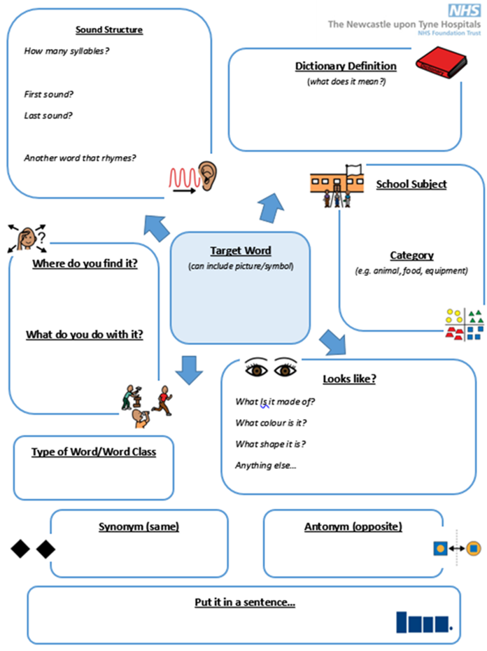
Word Maps
Important
Research has highlighted the importance of talking about different forms of the word and the student practicing using the word in a sentence!

Slide 22

Word Maps – Example
Image resolution refers to the amount of detail an image holds
Rhyming word
Definition
Noun
4
Number of syllables?
Pollution
Word type
Where?
Resolution
School subject
Photography
Art / Graphic design
Looks like

Slide 23

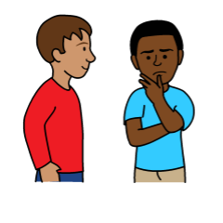
Supporting word retrieval
Give your child time
If you know the word, prompt them to think of their word maps or other things they know about the word:
You could then:
tell them the first sound, where would you find it, what category it belongs to etc.
If they cannot think of the word and you know it, give them a choice:
“Did you mean rocket or spaceship?”
Cue them in
(e.g. you put your coat on your…)
Category games (e.g. Scattergories)
Resources/Activities: Semantic Links, Semantic Steps,
which ones go together, odd one out

Slide 24
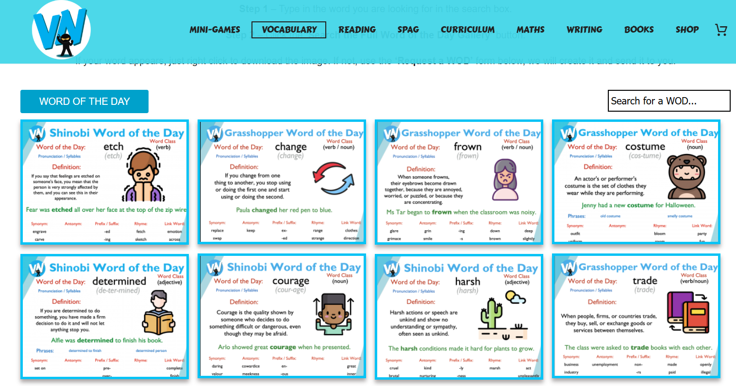
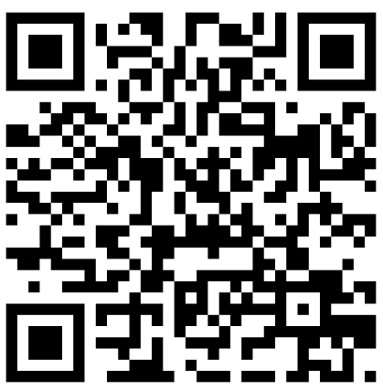
Supporting word retrieval

Slide 25
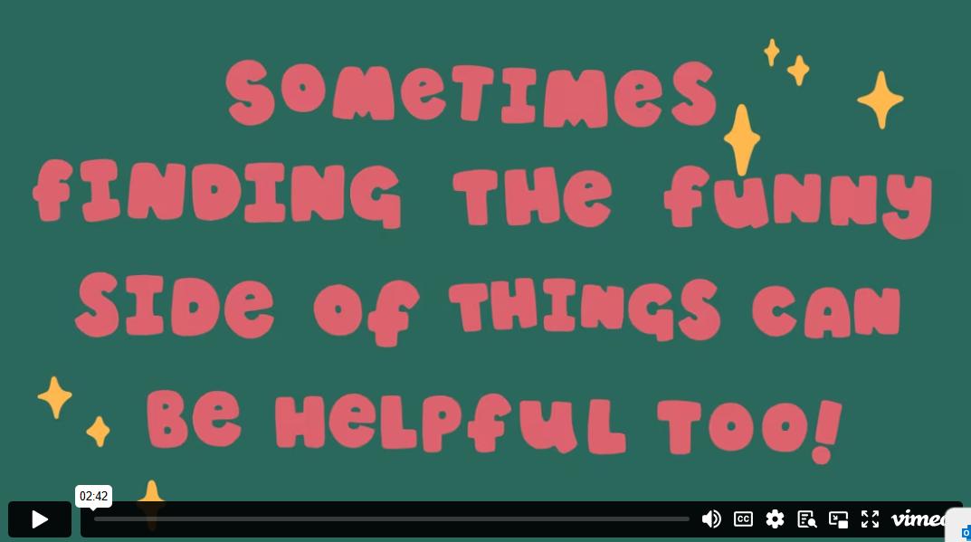
Strategies for families to support: NAPLIC | DLD resources for schools and families - NAPLIC

Slide 26


Slide 27

What is Secondary Language Link?
How is it being used in school?
What does the intervention look like?

Slide 28
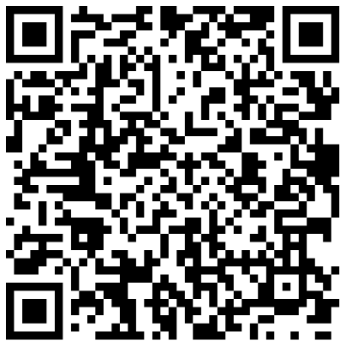

Slide 29
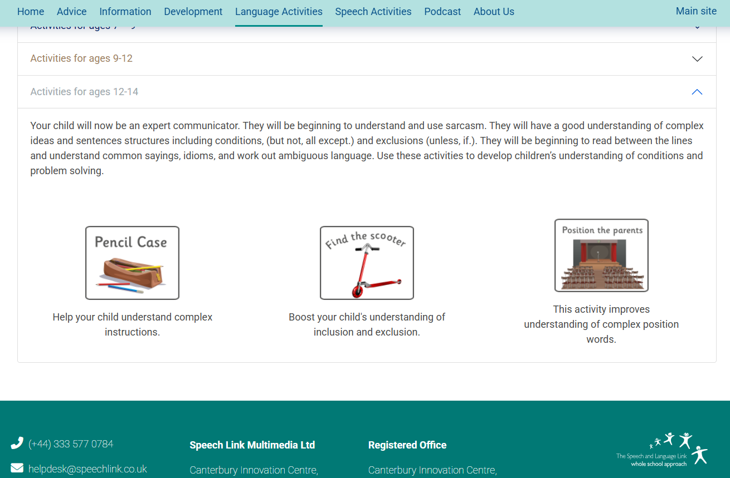

Slide 30


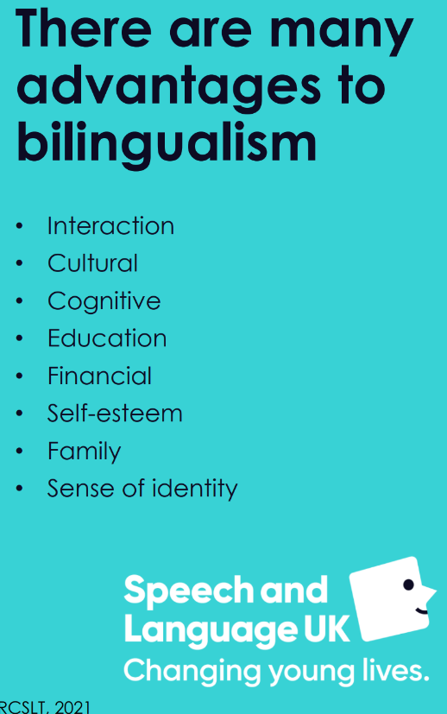
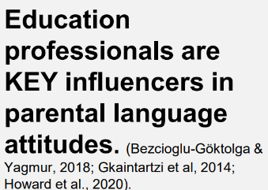

Bilingualism

Slide 31
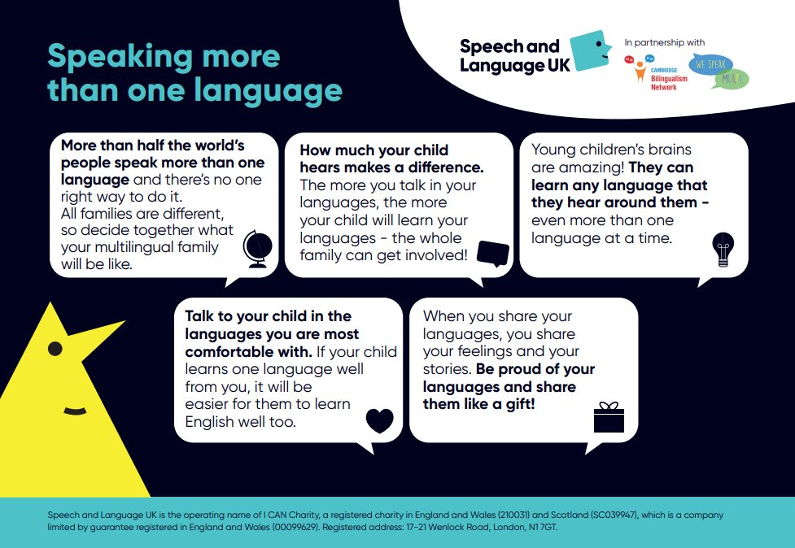

Slide 32

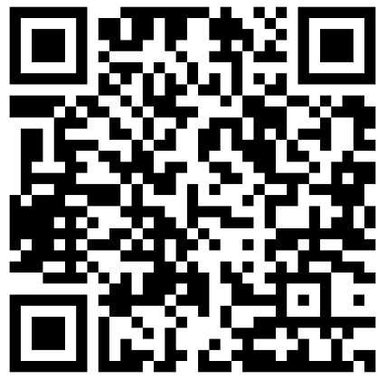


Wellbeing Hub sessions
UK Staff Spring Term Content Line-up 26

