Slide 1
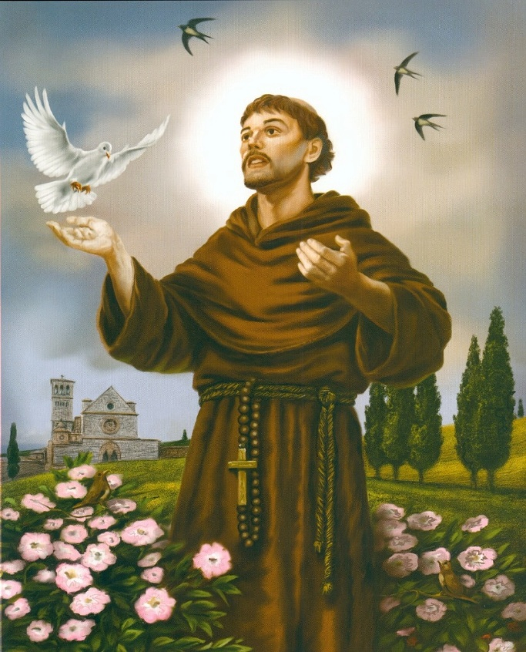
‘His face shown like the sun’
Matthew 17:2

Slide 2

What’s on this week…
Tuesday | Friday
Christian Union LOCATION : G16 TIME:12:20 – 12:50 | The Rosary LOCATION: Chapel TIME:12:15 – 12:25
On Monday 16th March there will be Eucharistic Adoration in the Chapel at lunchtime and there will also be the opportunity to receive the Sacrament of Reconciliation.
These will be available every Monday until the end of term.

Slide 3
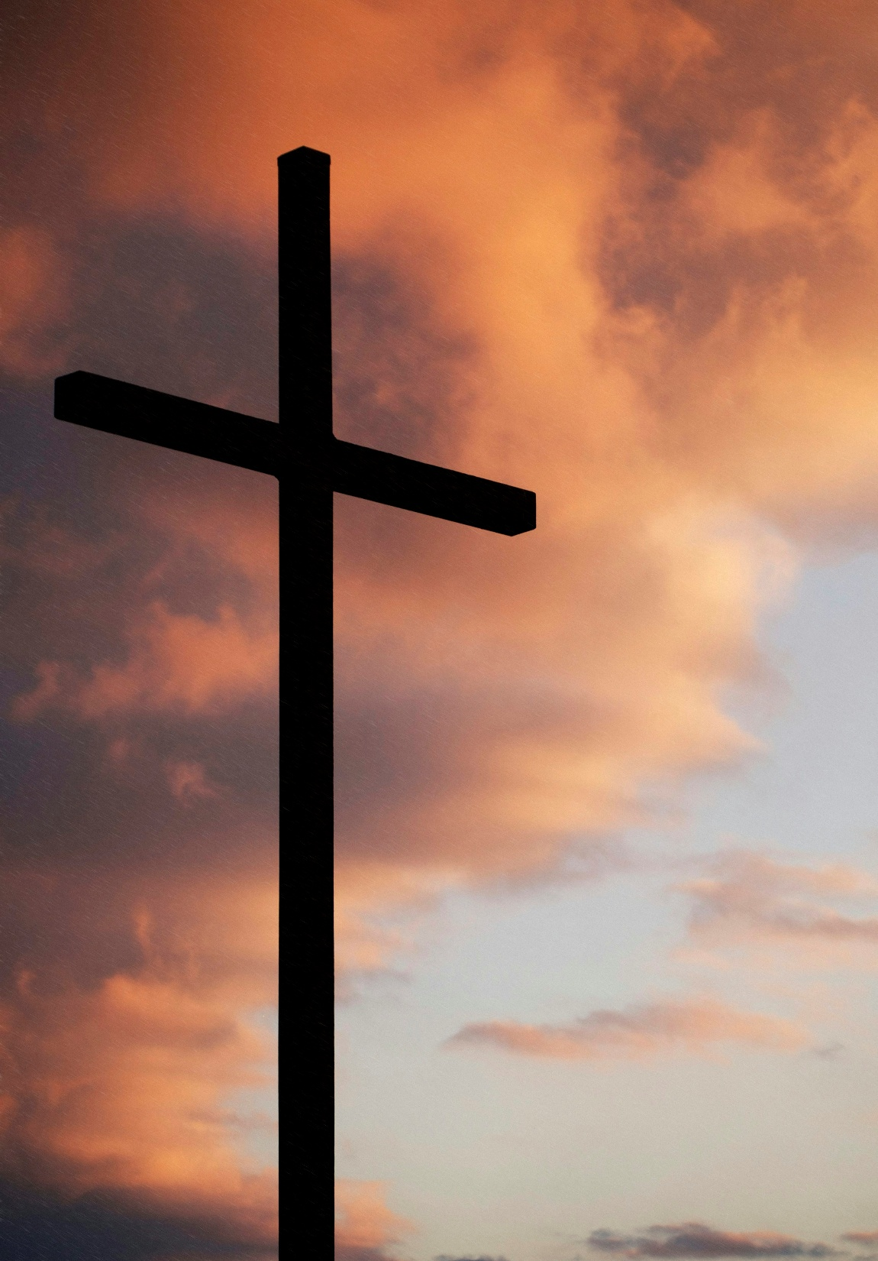
Morning Prayer Schedule
Monday – 13M
Tuesday – 13A
Once registration is complete, please come to the Chapel for 8:45am. Students please bring a pen and leave your bags in your form room.
Morning Prayer will not take place in the Chapel Wednesday - Friday due to the Year 8 retreat. The accompanying PowerPoint will be emailed out to 11A, 11I and 11S.

Slide 4
‘His face shown like the sun’
Matthew 17:2

Slide 5
Matthew 17:2
Matthew 17:2 describes the Transfiguration of Jesus. While Jesus was on a high mountain with Peter, James, and John, his appearance changed. His face shone brightly like the sun, and his clothes became dazzling white.
This event showed that Jesus was more than just a teacher - it revealed his divine nature and glory.
The Transfiguration: Jesus was transformed before his disciples, providing a glimpse of his heavenly, glorified state.
Symbolism: It represents the manifestation of Jesus' divine, internal nature and his identity as the Son of God.

Slide 6
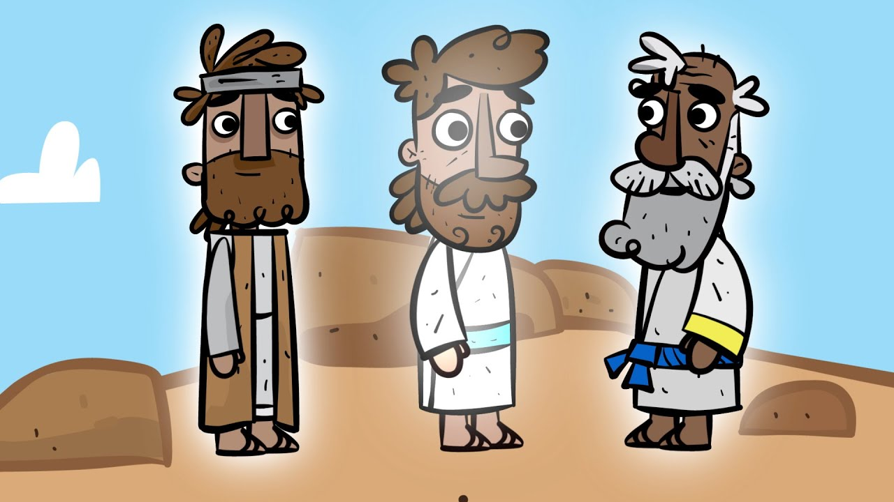
Please watch the video to explore Matthew 17:2 in detail

Slide 7
Let Us Pray
Lord,
As You were transfigured in glory, transform my heart. Let Your light shine into every shadow within me, changing me from the inside out.
Amen.

Slide 8
‘His face shown like the sun’
Matthew 17:2

Slide 9
Think, Pair, Share
How do you think Peter, James and John felt during Matthew 17:2?
Think about the emotions and feelings that they could be experiencing.
Thinking time - 2 minutes
Pair and share time with your partner - 3 minutes
Get ready to create a class mind map.

Slide 10
Class Mind Map

Slide 11
Let Us Pray
Lord,
You revealed Your true glory before the disciples. Open my eyes to see You more clearly, and renew my mind to reflect Your truth and beauty.
Amen.

Slide 12
‘His face shown like the sun’
Matthew 17:2

Slide 13
Quiz Time
For today’s quiz, you create a team with the person sitting next to you. All answers are multiple choice.
Please write down the question number and the letter of your chosen answer.

Slide 14
1. Multiple Choice
In Matthew 17:2, what happens to Jesus?
A. He disappears
B. He falls asleep
C. His appearance changes
D. He starts preaching

Slide 15
2. Fill in the Blank
Matthew 17:2 says that Jesus’ face shone like the __________.

Slide 16
3. Short Answer
What does the word “transformation” mean?

Slide 17
4. Short Answer
Name one way Jesus is described as changing in Matthew 17:2.

Slide 18
✅ Answers
1. Multiple Choice
Correct answer: C. His appearance changes and add flavour.
2. Fill in the Blank
Correct answer: the sun
3. Short Answer
Transformation means a change in appearance, form, or character.
(Answers such as “a big change” or “changing into something different” are also acceptable.)
4. Short Answer
His face shone like the sun
His clothes became white/light

Slide 19
Let Us Pray
Lord,
Just as Your Son’s face shone like the sun, reshape my life day by day. Make me more like You in love, humility, and holiness.
Amen.

Slide 20
‘His face shown like the sun’
Matthew 17:2

Slide 21
Let Us Pray
Lord,
Remind me that change is possible through You. When I feel stuck or weary, clothe me with hope and courage to walk in Your transforming grace.
Amen.

Slide 22
Digital Unplug - Class Discussion
In Matthew 17:2, Jesus is transformed and looks completely different to the disciples. What do you think this transformation shows about who Jesus really is, and how might it help us think about ways people can change or grow on the inside, even if they don’t look different on the outside?
‘His face shown like the sun’
Matthew 17:2

