Slide 1
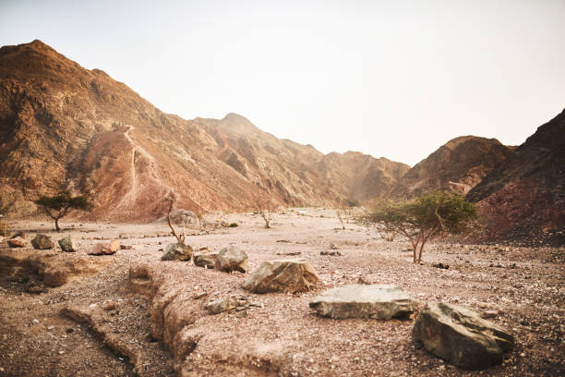
Theme of the week:
Wilderness
“Jesus was led by the Spirit out into the wilderness to be tempted by the devil.”
(Matthew 4:1)

Slide 2

Lent
Wednesday the 18th of February marked the start of Lent. Lent is the 40 days leading up to Easter.
Why 40 days? Because Jesus spent 40 days in the wilderness preparing for His mission whilst facing temptations.
It is about three things:
Pausing – stepping back from the noise, busyness, stress, and habits that don’t help us.
Reflecting – thinking about who we are, who we want to be, and how we treat others.
Growing – choosing small, meaningful actions that bring us closer to God, to others, and to ourselves.
It’s also about doing good, rebuilding hope, and choosing kindness, justice, and compassion.
Whether you are Catholic, of another faith, or no faith at all, everyone can take part - simply because Lent is a journey of becoming more loving, more grounded, and more human.

Slide 3


Let Us Pray
Lord,
Help us continue our Lenten journey with honesty and hope. May we take one small step today toward becoming more loving, more patient, more like You.
Help us see ourselves and each other the way You see us—with love, hope, and purpose.
When we feel lost or unsure, remind us that your Spirit leads us..
Amen

Slide 4
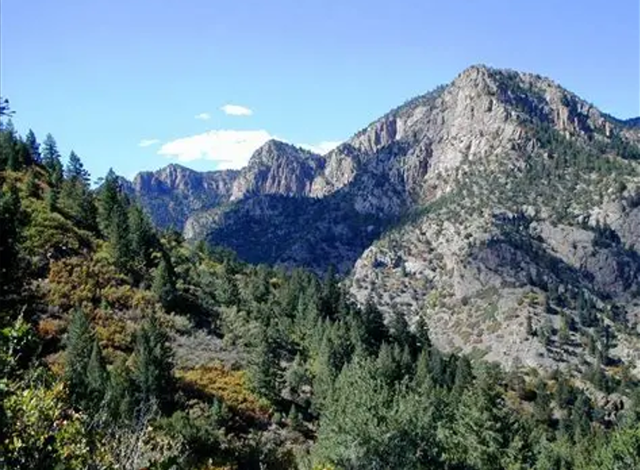
Theme of the week:
Wilderness
“Jesus was led by the Spirit out into the wilderness to be tempted by the devil.”
(Matthew 4:1)
23rd – 27th February

Slide 5
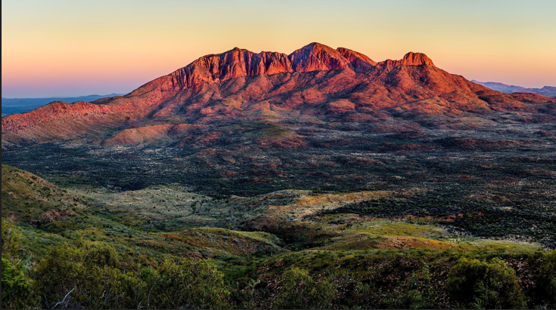
“Jesus was led by the Spirit out into the wilderness to be tempted by the devil.”
(Matthew 4:1)
🌵 1. “Led by the Spirit
This shows that the wilderness was not a mistake or punishment. It was part of Jesus’ journey. Sometimes, we’re led into difficult places not to break us, but to shape us.
Life lesson: Sometimes we find ourselves in places we do not choose — emotionally, socially, or spiritually.Growth often happens in uncomfortable places.
🏜️ 2. “Into the Wilderness”
The wilderness represents a space where distractions are stripped away. It’s where we face our fears, doubts, feeling lost, unsure, or tested and deepest questions.
Life lesson: Everyone has a “wilderness” season—times of loneliness, confusion, or struggle.
😈 3. “To Be Tempted”
Jesus faced real temptations—just like we do. Jesus responded with Scripture, He faces them with truth, faith, and inner strength.
Life lesson: . Temptation is not always obvious — it can look like peer pressure, shortcuts, or silence when we should speak up.
Being tempted doesn’t mean you’re weak. It means you’re human. What matters is how you respond.
Exploring The Bible

Slide 6
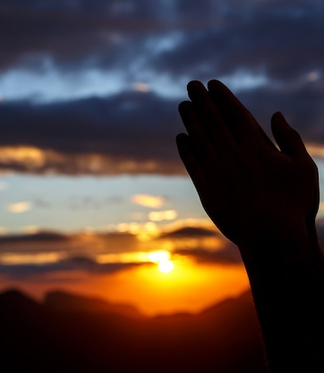
Let Us Pray
Loving God,
As Jesus resisted temptation in the wilderness, help us to stand firm when we are tested.
When we are tempted to give up, give in, or go along with the crowd, help us to stand firm in truth and love.
Thank you for the people who lift us up when we are down. Help us to be angels for others too.
Amen

Slide 7
Theme of the week:
Wilderness
“Jesus was led by the Spirit out into the wilderness to be tempted by the devil.”
(Matthew 4:1)

Slide 8


Digital Unplug
“Jesus didn’t leave the wilderness defeated — He left empowered.
What have you learned about yourself through your own struggles?
How can you use that strength to help others?
🎨 Activity: “My Wilderness Journey”
🧭 Objective: To help students reflect on their own “wilderness” experiences—times of challenge, growth, or self-discovery—through a symbolic and creative lens.
📝 Prompt question:
“If your life had a ‘wilderness’ moment—when things felt uncertain, lonely, or difficult—what would it look like?”
✅ “Wilderness Survival Kit”
- Create a list of spiritual tools (e.g., prayer, music, Scripture, friendship) that help you stay strong in tough times.

Slide 9
Let Us Pray
Lord,
Help us to choose honesty even when temptation makes the wrong path seem easy.
Give us the strength to stand by our values, the wisdom to see the consequences of our choices, and the courage to do what is right.
May we always seek success with integrity and trust in You for our worth.
Amen.

