Slide 1

Matthew 5:13-14

Slide 2
What’s on this week…
Monday | Tuesday | Friday
Father Jonathan will be in the Chapel at lunchtime. Pop in to say hello. | Christian Union LOCATION : G16 TIME:12:20 – 12:50 | The Rosary LOCATION: Chapel TIME:12:15 – 12:25

Slide 3

Morning Prayer Schedule
Monday – 9S
Tuesday – 12R
Wednesday – 9I
Thursday – 9N
Friday – 9R
Once registration is complete, please come to the Chapel for 8:45am. Students please bring a pen and leave your bags in your form room.

Slide 4
‘You are the salt of the earth... You are the light of the world’
(Matthew 5:13-14)
What do you think the meaning of Matthew 5:13-14 is?
Think, Pair, Share with the person sitting next to you and get to feedback.
Time limit - 3 minutes

Slide 5
Class Mindmap
‘You are the salt of the earth... You are the light of the world’
(Matthew 5:13-14)

Slide 6
Key Meanings in Matthew 5:13-14
Salt of the Earth (Preservation & Influence): As salt adds flavour and acts as a preservative, believers are called to impact the world by fighting injustice and promoting righteousness. If Christians lose their distinct, godly character ("saltiness"), they become ineffective.
Light of the World (Visibility & Guidance): Christians are called to be visible, letting their good works shine to glorify God, rather than hiding their faith.
Active Engagement: This is a call to be engaged in culture, speak the truth, and not remain passive or embarrassed in their faith.
Core Message
Jesus is calling his followers to be distinct from the world while simultaneously serving it by demonstrating the goodness of God's kingdom.

Slide 7
Let Us Pray
Lord,
You call me the salt of the earth. Help me bring Your flavor of love, truth, and grace into every place I go. Keep my heart faithful so my life never loses its purpose in You.
Amen.

Slide 8
Matthew 5:13-14

Slide 9

“In my everyday life at school, at home, or with friends, how can I be like salt that brings goodness and like light that makes things brighter for others?”
Reflect and think about the above question while you listen to the music. Remember that you do not have share your answer with anyone it is personal to you.

Slide 10

Please pre-load to avoid any adverts.

Slide 11
Aim to put your idea in action!
Remember that bringing joy and light to the lives others will amplify the joy and light in your life.
‘You are the salt of the earth... You are the light of the world’
(Matthew 5:13-14)

Slide 12
Let Us Pray
Lord,
You say I am the light of the world. Let Your light shine through me, bright enough to guide, gentle enough to heal, and strong enough to push back the darkness.
Amen.

Slide 13
Matthew 5:13-14

Slide 14
Quiz Time
For today’s quiz, you create a team with the person sitting next to you. All answers are multiple choice.
Please write down the question number and the letter of your chosen answer.

Slide 15
1. Multiple Choice
Jesus says, “You are the salt of the earth.” What is one thing salt is used for?
A. To make things heavier
B. To preserve and add flavour
C. To make food colder
D. To change colour

Slide 16
2. Short Answer
According to Jesus, what happens if salt loses its taste?

Slide 17
3. Multiple Choice
“You are the light of the world” means that Christians should:
A. Stay hidden from others
B. Show God’s goodness through their actions
C. Be famous
D. Only help their friends

Slide 18
4. True or False
Jesus says a light should be hidden under a bowl.
☐ True ☐ False

Slide 19
4. True or False
Jesus says a light should be hidden under a bowl.
☐ True ☐ False

Slide 20
✅ Answers
1. Multiple Choice
Correct answer: B. To preserve and add flavour.
2. Short Answer
If salt loses its taste, it is no longer useful and is thrown away or trampled.
3. Multiple Choice
Correct answer: B. Show God’s goodness through their actions.
4. True or False
Correct answer: False
(Jesus says a light should not be hidden but put where it can shine.)

Slide 21
Let Us Pray
Lord,
Teach me to live boldly as salt and light. May my words and actions point others to You, not for my glory, but so they may see You and praise Your name.
Amen.

Slide 22
Matthew 5:13-14

Slide 23
Think, Pair, Share
What emotion and feeling do you think the artist is trying to convey in this painting of Jesus with light and salt?
Get ready to discuss this as a class.
Thinking time - 3 minutes.
Discussion time - 4 minutes.

Slide 24
Let Us Pray
Lord,
Make us the salt of the earth,
preserving what is good, bringing flavor where life feels bland.
Make us the light of the world,
shining with Your love so others may find hope through us.
Amen.

Slide 25
Matthew 5:13-14

Slide 26
Let Us Pray
Lord,
In ordinary moments and hidden places, help me remain salt and light. Shape my choices, my attitude, and my love so the world tastes and sees that You are good.
Amen.

Slide 27
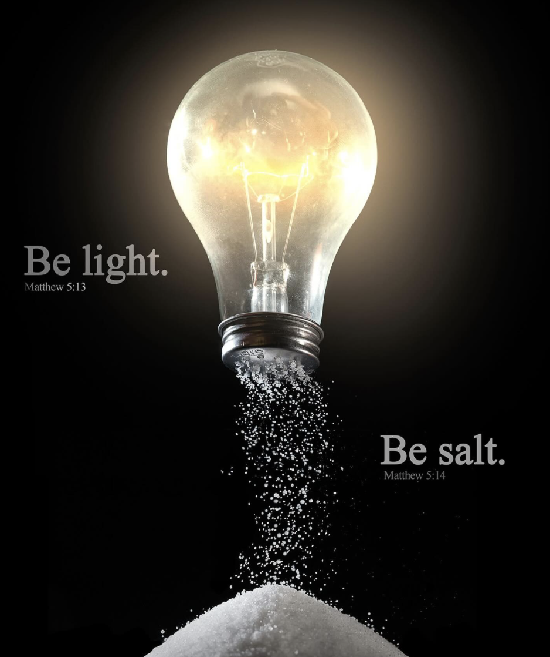
Digital Unplug - Class Discussion
“Salt and light both change the things around them. In what small ways can one person make a positive difference in a place that doesn’t always feel kind or fair?”
‘You are the salt of the earth... You are the light of the world’
(Matthew 5:13-14)

