Slide 1

Preparing for a personal guidance one-to-one

Slide 2


What is the role of a careers adviser? (3 mins)
Read the following quotes and decide which you think are true
and which you think are false. Explain your answers.
a. “A careers adviser’s job is to tell me what to do with my future.”
b. “A careers adviser can help me look at the pros and cons of different options.”
c. “Careers advisers don’t need to talk to students who know what they want to do.”
d. “A careers adviser can help me come up with an action plan.”
e. “A careers adviser helps students to consider and make decisions about their future.”
f. “A careers adviser will persuade me down a path I’m not keen on.”
Notes:
Teacher’s notes:
Answers revealed on the next two slides.

Slide 3

What is the role of a careers adviser?
These statements are false.
It’s unhelpful to think about a careers adviser as having a magic wand that tells you what career to do.
a. “A careers adviser’s job is to tell me what to do with my future.”
b. “A careers adviser can help me look at the pros and cons of different options.”
c. “Careers advisers don’t need to talk to students who know what they want to do.”
d. “A careers adviser can help me come up with an action plan.”
e. “A careers adviser helps students to consider and make decisions about their future.”
f. “A careers adviser will persuade me down a path I’m not keen on.”
Notes:
Teacher’s notes:
A careers adviser’s job is to tell me what to do with my future.
False - a careers adviser shouldn't decide your career path for you - they should help you to be able to do so for yourself.
Students can falsely believe that a career adviser’s role is simply to match them to a career; this is an out-of-date understanding of a career adviser’s work.
c. Careers advisers don’t need to talk to students who know what they want to do.
False – all students can benefit from talking to a careers adviser, even if they feel confident about what they want to do!
Many students (and teachers) falsely believe careers advisers are only there for students who don’t know what to do in the future. All students are required to have a one-to-one with a trained careers adviser (minimum level 6) at key decision points before 16 and 18. This includes students who know what they want to do. The purpose would be to explore their choices and ensure that it was based on sound reasoning, as well as to understand why some options had been discounted and to make sure the student hadn’t missed specific opportunities that would help them reach their career goals.
f. A careers adviser will try and persuade me down a path I’m not keen.
False – a careers adviser would not try to persuade you down a route you’re not keen on.
This is an outdated perception of how careers advisers approach helping students; their role is not to tell students what to do. They must provide impartial advice that is not influenced by the school wanting certain students to study specific subjects or apply to specific pathways. They help students identify their interests, skills and values and help them make decisions about which path is suitable for them. They may challenge students to explore options they might not have considered, but careers advisers would never push a student down a path they didn’t want to do.

Slide 4

What is the role of a careers adviser?
These statements are true.
Imagine a careers adviser’s role as helping you get from ‘one side of the river to the other’. The river represents a decision you have to make about your future. Together, you'll identify stepping stones to help you find your own way to the other side.
a. “A careers adviser’s job is to tell me what to do with my future.”
b. “A careers adviser can help me look at the pros and cons of different options.”
c. “Careers advisers don’t need to talk to students who know what they want to do.”
d. “A careers adviser can help me come up with an action plan.”
e. “A careers adviser helps students to consider and make decisions about their future.”
f. “A careers adviser will persuade me down a path I’m not keen on.”
Notes:
Teacher’s notes:
b. A careers adviser can help me look at the pros and cons of different options.
True - careers advisers can help students reflect on why different options could be more or less suitable.
d. A careers adviser can help me come up with an action plan.
True – each personal guidance one-to-one ends with writing an action plan.
This is always led by the student’s current thoughts, goals and choices. The careers adviser can help suggest different ways of action planning, such as backwards action planning, SMART/RAM goals, drawing a mind map, writing a list, using Post-it notes and taking a photo or filling out a pre-set template. There are many options, and careers advisers are flexible to work with what works best for the student.
e. A careers adviser helps students to consider and make decisions about their future.
True - a careers adviser uses lots of techniques to help students consider their options. This might include:
providing information about different career options
helping students achieve their goals
asking a series of questions to help students identify their skills and interests
Helping students identify and overcome barriers
Careers advisers may refer students to other resources or services as required.

Slide 5

What happens in a personal guidance one-to-one? (3 mins)
You will be offered at least one personal guidance one-to-one with a qualified careers adviser before you turn 16 and before you turn 18.
What might you talk to a careers adviser about in a personal guidance one-to-one?
List as many things as you can think of.
Notes:
Teacher’s notes:
Possible answers are revealed on the next slide.

Slide 6
What happens in a personal guidance one-to-one?
What might you talk to a careers adviser about in a personal guidance one-to-one?
List as many things as you can think of.
Your skills / interests
Writing a CV
Job opportunities
Work experience
Career ideas
What’s influencing your decisions
Going for an interview
Career values
Your subject choices
If there are barriers and how to overcome them
What you’d like your life to look like in the future
How you feel about making decisions
Different pathways
Notes:
Teacher’s notes:
Your skills / interests: Students might talk about what they think their skills and interests are. Some students might not know, and careers advisers will have a range of methods to help students identify these and link them to thoughts about their future options.
Career ideas: Students may share what careers they’re interested in, or have questions about specific careers and if they’re suitable. If students aren’t sure what careers they’re interested in, a careers adviser might use sources of LMI or tools (like Unifrog) in the one-to-one session. Additionally, a careers adviser may explore career areas that the student hasn’t thought about but link with the student’s skills, values and interests.
Your subject choices: Students may want to check if their subject choices make sense in relation to their plans. They might need support choosing between subjects, or whether a specific type of qualification (e.g. A level or T level) is right for them at all.
Different pathways: Students may want to explore which pathway is right for them (e.g. UK university or a degree apprenticeship). They may discuss different opinions and information they’ve heard, and seek impartial advice from a careers adviser.
Writing a CV: Students may want help applying for a specific job, opportunity or apprenticeship that requires a CV or cover letter. Students may need coaching on how to write a CV or need to check and review what they’ve written with a careers adviser.
What’s influencing your decisions: Students may not realise how things like parental pressure, school pressure, social media, fear/anxiety, their culture, heritage and identity may be positively or negatively influencing their choices.
How you feel about making decisions: Some students may feel confident making decisions, whereas other students may need more help and guidance to come up with strategies to improve their decision-making skills. For example, some students might not have made many big decisions in their life up until this point and therefore, talking to a professional can help improve the decision-making process.
Job opportunities: Students might want to learn more about what job opportunities are available to them locally, and how to find and apply for these opportunities. A careers adviser will have good knowledge of the local labour market and can provide advice and guidance.
Going for an interview: Students might need help preparing and practising for an interview; a careers adviser could run a mock interview, or help strategise about specific issues such as nerves or support students to get accommodations/reasonable adjustements required in job interviews.
If there are barriers and how to overcome them: Careers advisers may help students identify what barriers are preventing them from achieving their goals, and work together to help overcome them.
Work experience: Careers advisers may talk to students about what work experience they’ve already completed to identify anything they learned which could help their decision-making (e.g. did they like a particular work environment or dislike a specific type of task). Additionally, students may need support finding and securing additional work experience.
Career values: Students may not be aware of what is important to them in a job, e.g. having a good work-life balance or helping others. Some students may not know the type of career they want to do and therefore, looking at what they value in work can be a useful first step in assessing whether specific careers are suitable.
What you’d like your life to look like in the future: Students may want to explore how different career options fit into the overall picture of their future life. For example, if they want a good work-life balance but are considering working a job with long hours and high stress, then they may need to reconsider if this is a good option for them.

Slide 7


What to do before a personal guidance one-to-one (2 mins)
Write down at least one thing you could do before a one-to-one with a careers adviser.
Write down at least one thing you might bring to a one-to-one with a careers adviser.
Notes:
Teacher’s notes:
Answers revealed on next slide.

Slide 8


What to do before a personal guidance one-to-one
Write down at least one thing you could do before a 1-1 with a careers adviser.
Write down at least one thing you might bring to a 1-1 with a careers adviser.
Find the location and time
A CV or cover letter
Share any reasonable adjustments
A job application or advert
Prepare anything you want to bring
A Unifrog shortlist
Reflect on what you want to discuss
Something to help you stay focused
Unifrog quiz, shortlist or favourite careers
Laptop, tablet or notebook if helpful
Notes:
Teacher’s notes:
Write down at least one thing you could do before a 1-1 with a careers adviser.
Find the location and time
Share any reasonable adjustments – do you have a disability, additional need or health problem that requires an adaptation to accessing your personal guidance one-to-one?
Prepare anything you want to bring – for example, finish writing your CV, personal statement or cover letter if this is something you want to talk about.
Reflect on what you want to discuss – you’ll complete a self-reflection exercise later in this lesson. There may be something here you decide should be the focus of your one-to-one, for example, exploring career areas that have a good work-life balance, or deciding between different university subjects.
Unifrog quizzes, shortlists or favouriting careers – Take advantage of the Unifrog tools and complete some research before you go into your one-to-one. There may be interesting information you discover that you’d like to explore further in your one-to-one.
Write down at least one thing you might bring to a 1-1 with a careers adviser.
A CV or cover letter
A job application or advert
A Unifrog shortlist of courses
Something to help you stay focused – do you have a disability, health issue or additional need that makes you struggle to stay focused? Do you have any coping mechanisms or adaptations that would help you in the one-to-one? For example, if you use a portable fan because you have a condition that causes temperature dysregulation. Do you have ADHD and struggle sitting still without playing with something – do you have something to fiddle with to help you concentrate?
Laptop, tablet or notebook if helpful – some students might want to bring their laptop or tablet to show a shortlist they made, or to share their CV or cover letter. Additionally, some students may have jotted down notes of what they want to talk about it and find bringing this with them helps them to make the most out of the session. Some students like to jot down notes during the one-to-one.

Slide 9


What happens during a personal guidance one-to-one? (3 mins)
A careers personal guidance one-to-one usually lasts around 45 minutes and has three stages:
Deciding a focus
2. Exploring ideas
3. Making a plan
The careers adviser will remind you of the purpose of a 1-1 and you’ll be able to explain what you’d like to focus on.
This will take up most of the one-to-one. It might include exploring your understanding of opportunities available, how confident you feel at making decisions, your self-awareness of your likes/dislikes and what’s influencing your decision.
This is where you will agree on your next steps and write an action plan.
Notes:
Teacher’s notes:
A three stage model (Hambly and Bomford).

Slide 10
What happens during a personal guidance one-to-one?
Deciding a focus
2. Exploring ideas
3. Making a plan
The careers adviser will remind you of the purpose of a 1-1 and you’ll be able to explain what you’d like to focus on.
This will take up most of the one-to-one. It might include exploring your understanding of opportunities available, how confident you feel at making decisions, your self-awareness of your likes/dislikes and what’s influencing your decision.
This is where you will agree on your next steps and write an action plan.
You might also have shorter meetings with a careers adviser, for example, if you’re reviewing a CV or practising for an interview.
Notes:
Teacher’s notes:

Slide 11

What happens during a personal guidance one-to-one?
Some students decide they don’t need to go back for a follow up meeting. However, they can often be very useful.
In what situations might going for a follow-up meeting with your careers adviser be helpful?
Discuss with the person sitting next to you.
Notes:
Teacher’s notes:
Answers revealed on the next slide.

Slide 12
What happens during a personal guidance one-to-one?
In what situations might going for a follow-up meeting with your careers adviser be helpful?
You’re still struggling to make a decision and need help coming up with strategies.
You’ve found out more information and want to discuss it further.
There’s been a change in your circumstances and you need to reassess your plan.
You need help with your CV which you’ve drafted since your one-to-one.
You’ve received advice from a family member or teacher and you’re not sure what to make of it.
Notes:
Teacher’s notes:

Slide 13
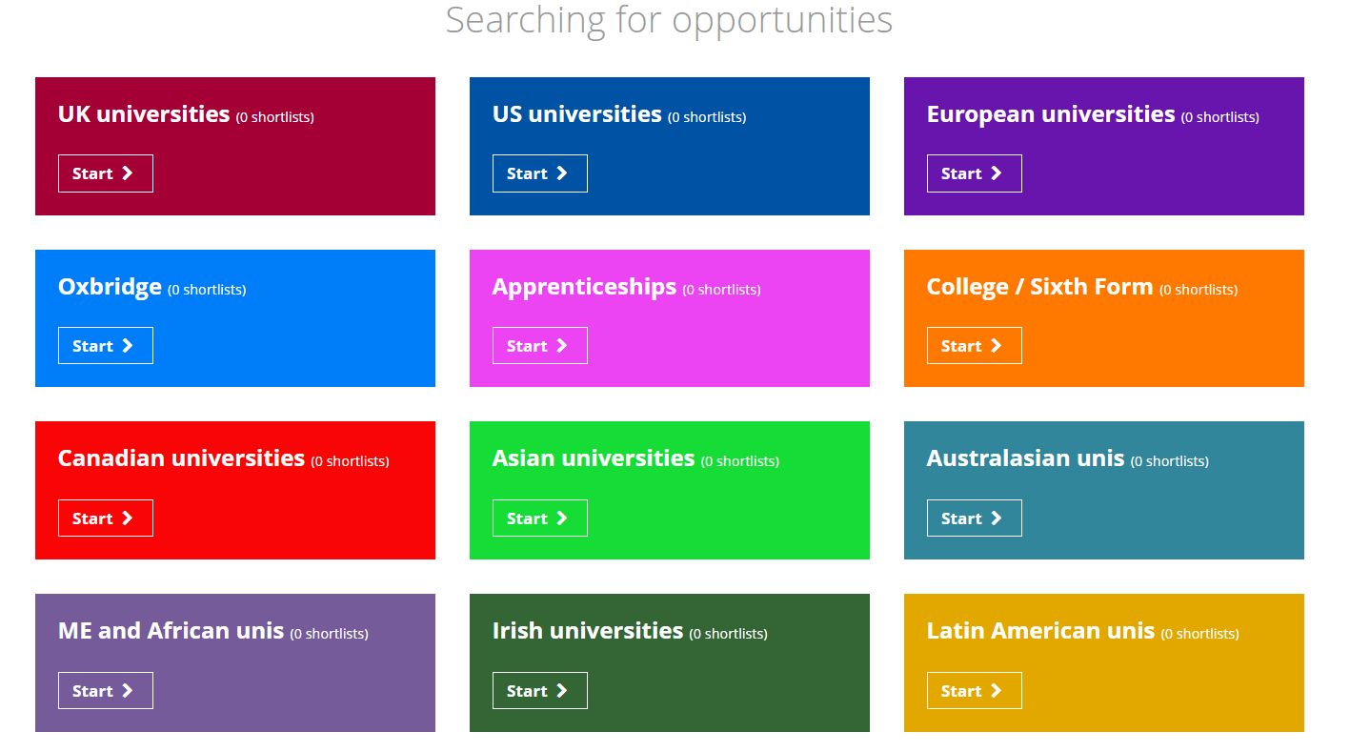
Independent learning (1 min)
After the lesson, make a shortlist using one of the following Unifrog tools:
    UK Universities
    Oxbridge
    College / Sixth form
    Universities abroad
    Apprenticeships
    Special opportunities
From the shortlist, write down at least one thing you might want to discuss in your personal guidance one-to-one.
Notes:
Teacher’s notes:
Tracking student progress:
Click Usage charts>Customise and filter> SELECT TOOL
Advanced view>Sort by>SELECT TOOL
The ‘Careers conversation: Self-reflection sheet’ can be downloaded from this lesson’s resource profile and printed or emailed for students to fill in before their one-to-one.

Slide 14



Plenary: reflection (2 mins)
On a scale of 1 – 10, how do you feel about talking about your future?
Low
1 | 2 | 3 | 4 | 5 | 6 | 7 | 8 | 9 | 10
High
I’m really not looking forward to it.
I’m a bit uncertain but think it’ll be helpful.
I’m looking forward to making a future plan!
Then, write down one thing you need to do before your one-to-one.
Notes:
Teacher’s notes:
The ‘Careers conversation: Self-reflection sheet’ can be downloaded from this lesson’s resource profile and printed or emailed for students to fill in before their one-to-one.

Slide 15


