Slide 1

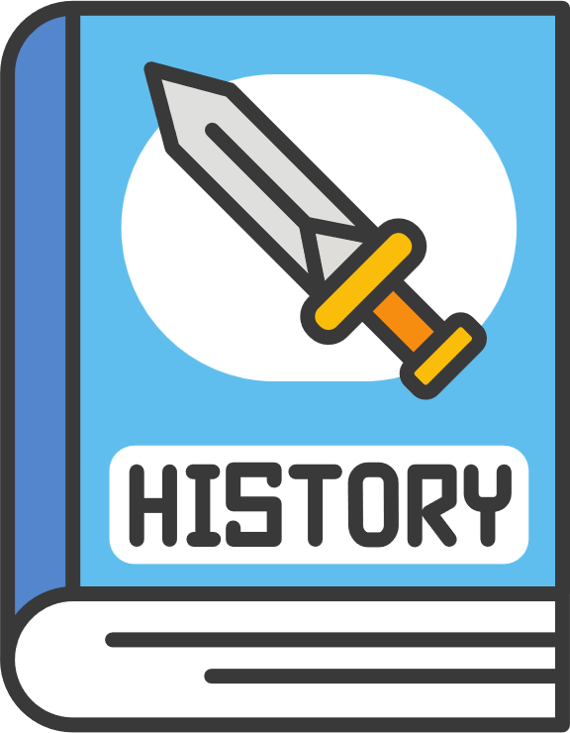
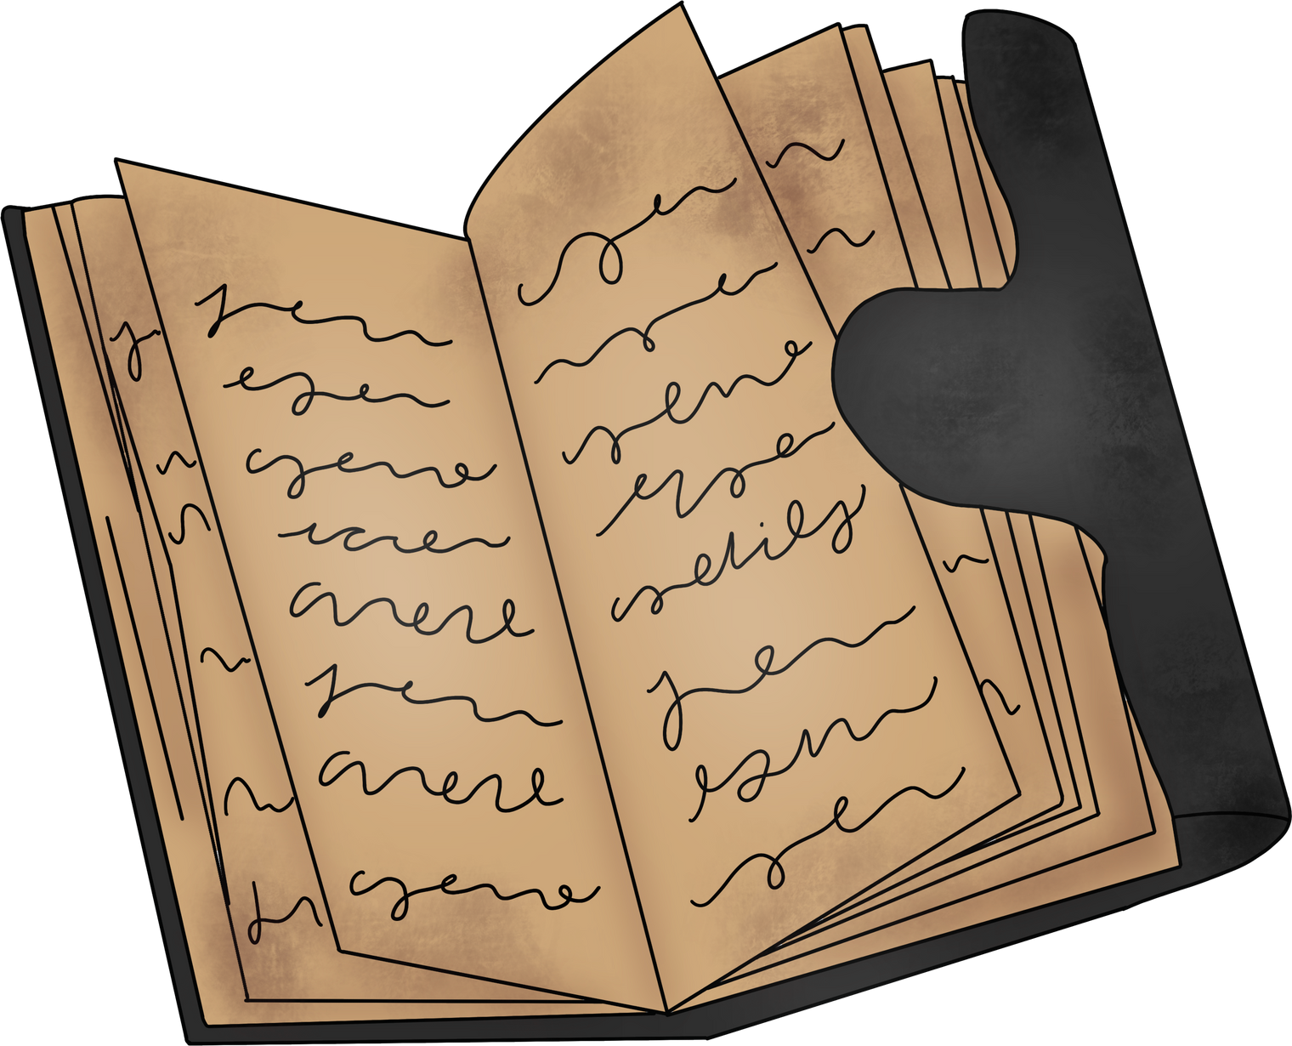

CAREER OF THE MONTH
History

Slide 2

Welcome!
History isn’t just about the past – it’s about the skills you’ll use in the future. From classrooms to courtrooms, from archives to newsrooms – history takes you everywhere.
Today we’ll explore:
Where history can lead
Surprising careers linked to history
Skills that make historians stand out

Slide 3

STARTER QUESTION
Which skill do you think employers value most: remembering dates, debating, or analysing evidence?

Slide 4
DID YOU KNOW?
History is one of the top degrees for developing transferable skills like critical thinking, writing, and analysis.
Many journalists, lawyers, politicians, and TV presenters started with a history degree.
History graduates are often recruited into business, finance, and the civil service because they can handle complex information.
Famous people who studied history:
  Louis Theroux (documentary filmmaker) – History at Oxford
  Prince Charles (King Charles III) – History at Cambridge
History graduates have one of the highest employment rates among humanities degrees.
Employers like history students because they can weigh up evidence, argue a case, and spot bias – skills vital in any job.

Slide 5
STARTING SALARY
Career Path | What They Do | Typical Entry Route | Starting Salary (approx.)
Archivist | Preserve and organise historical records/documents. | History degree + postgraduate qualification in archives | £25,000–£28,000
Museum Curator | Manage collections, organise exhibitions, engage the public with history. | Degree in history/heritage + postgraduate museum studies | £25,000–£28,000
Archaeologist | Study remains of past civilisations through excavation and analysis. | Archaeology/history degree | £23,000–£27,000
Lawyer | Use critical thinking and argument skills to represent clients. | History degree + law conversion (GDL/SQE) | £30,000–£40,000+
Journalist | Research and write news stories, often drawing on historical knowledge. | History or related degree + journalism training | £25,000–£28,000
Civil Service / Policy | Research, analyse and develop government policy. | History degree + Civil Service Fast Stream / graduate schemes | £28,000+

Slide 6

Careers & History Discussion Task
Scenario:
A new local museum is being planned to showcase the history of your town/city. The organisers need a team of people to make it happen.
Discussion Questions:
Which jobs would be needed to make the museum a success? (e.g. historian, curator, archaeologist, teacher, marketing officer, tour guide, archivist, conservator).
Which of these roles do you think would be the most important – and why?
How could the skills you learn in History lessons (research, analysing sources, writing arguments, understanding different viewpoints) be useful in these jobs?

Slide 7
DIFFERENT ROUTES
1. 🔧 Apprenticeships
Learn on the job while earning a wage – develop transferable skills like research, communication, and organisation.
Examples: Heritage Assistant, Library & Archive Assistant, Cultural Learning & Participation Officer.
Great for those who prefer practical learning and gaining experience straight away.
2. 🎓 University Degrees
Required for specialist roles such as Historian, Archivist, Archaeologist, Teacher, Museum Curator.
Usually 3–4 years. Opportunities for study abroad, fieldwork, and research projects.
Combine academic study with placements, volunteering, or internships in heritage and education.
3. 📘 College Courses
A-level History or BTECs in Humanities/Social Sciences.
Can lead to apprenticeships, university, or direct employment in roles needing analytical and communication skills.
Provides a strong foundation for careers in heritage, law, politics, education, and beyond.

