Slide 1





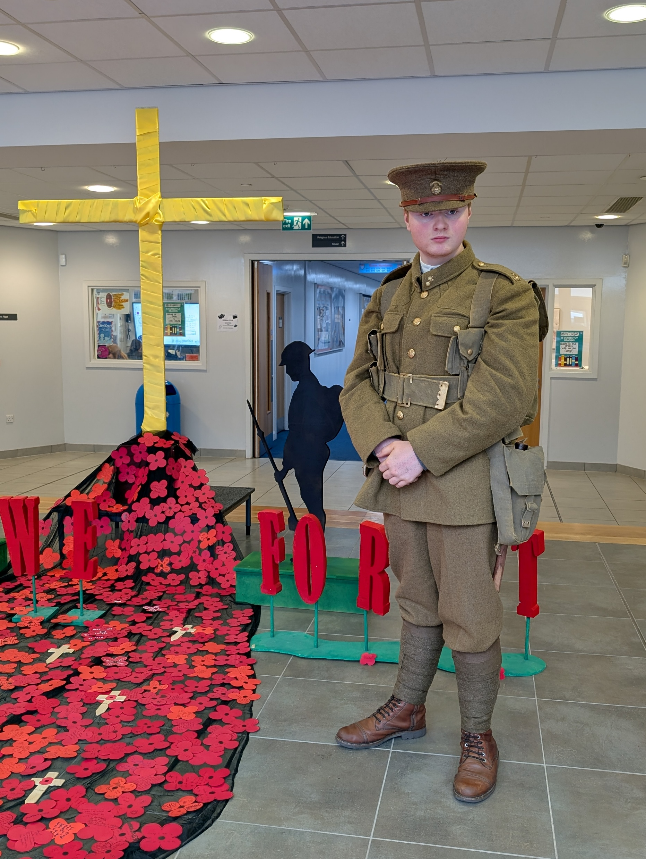
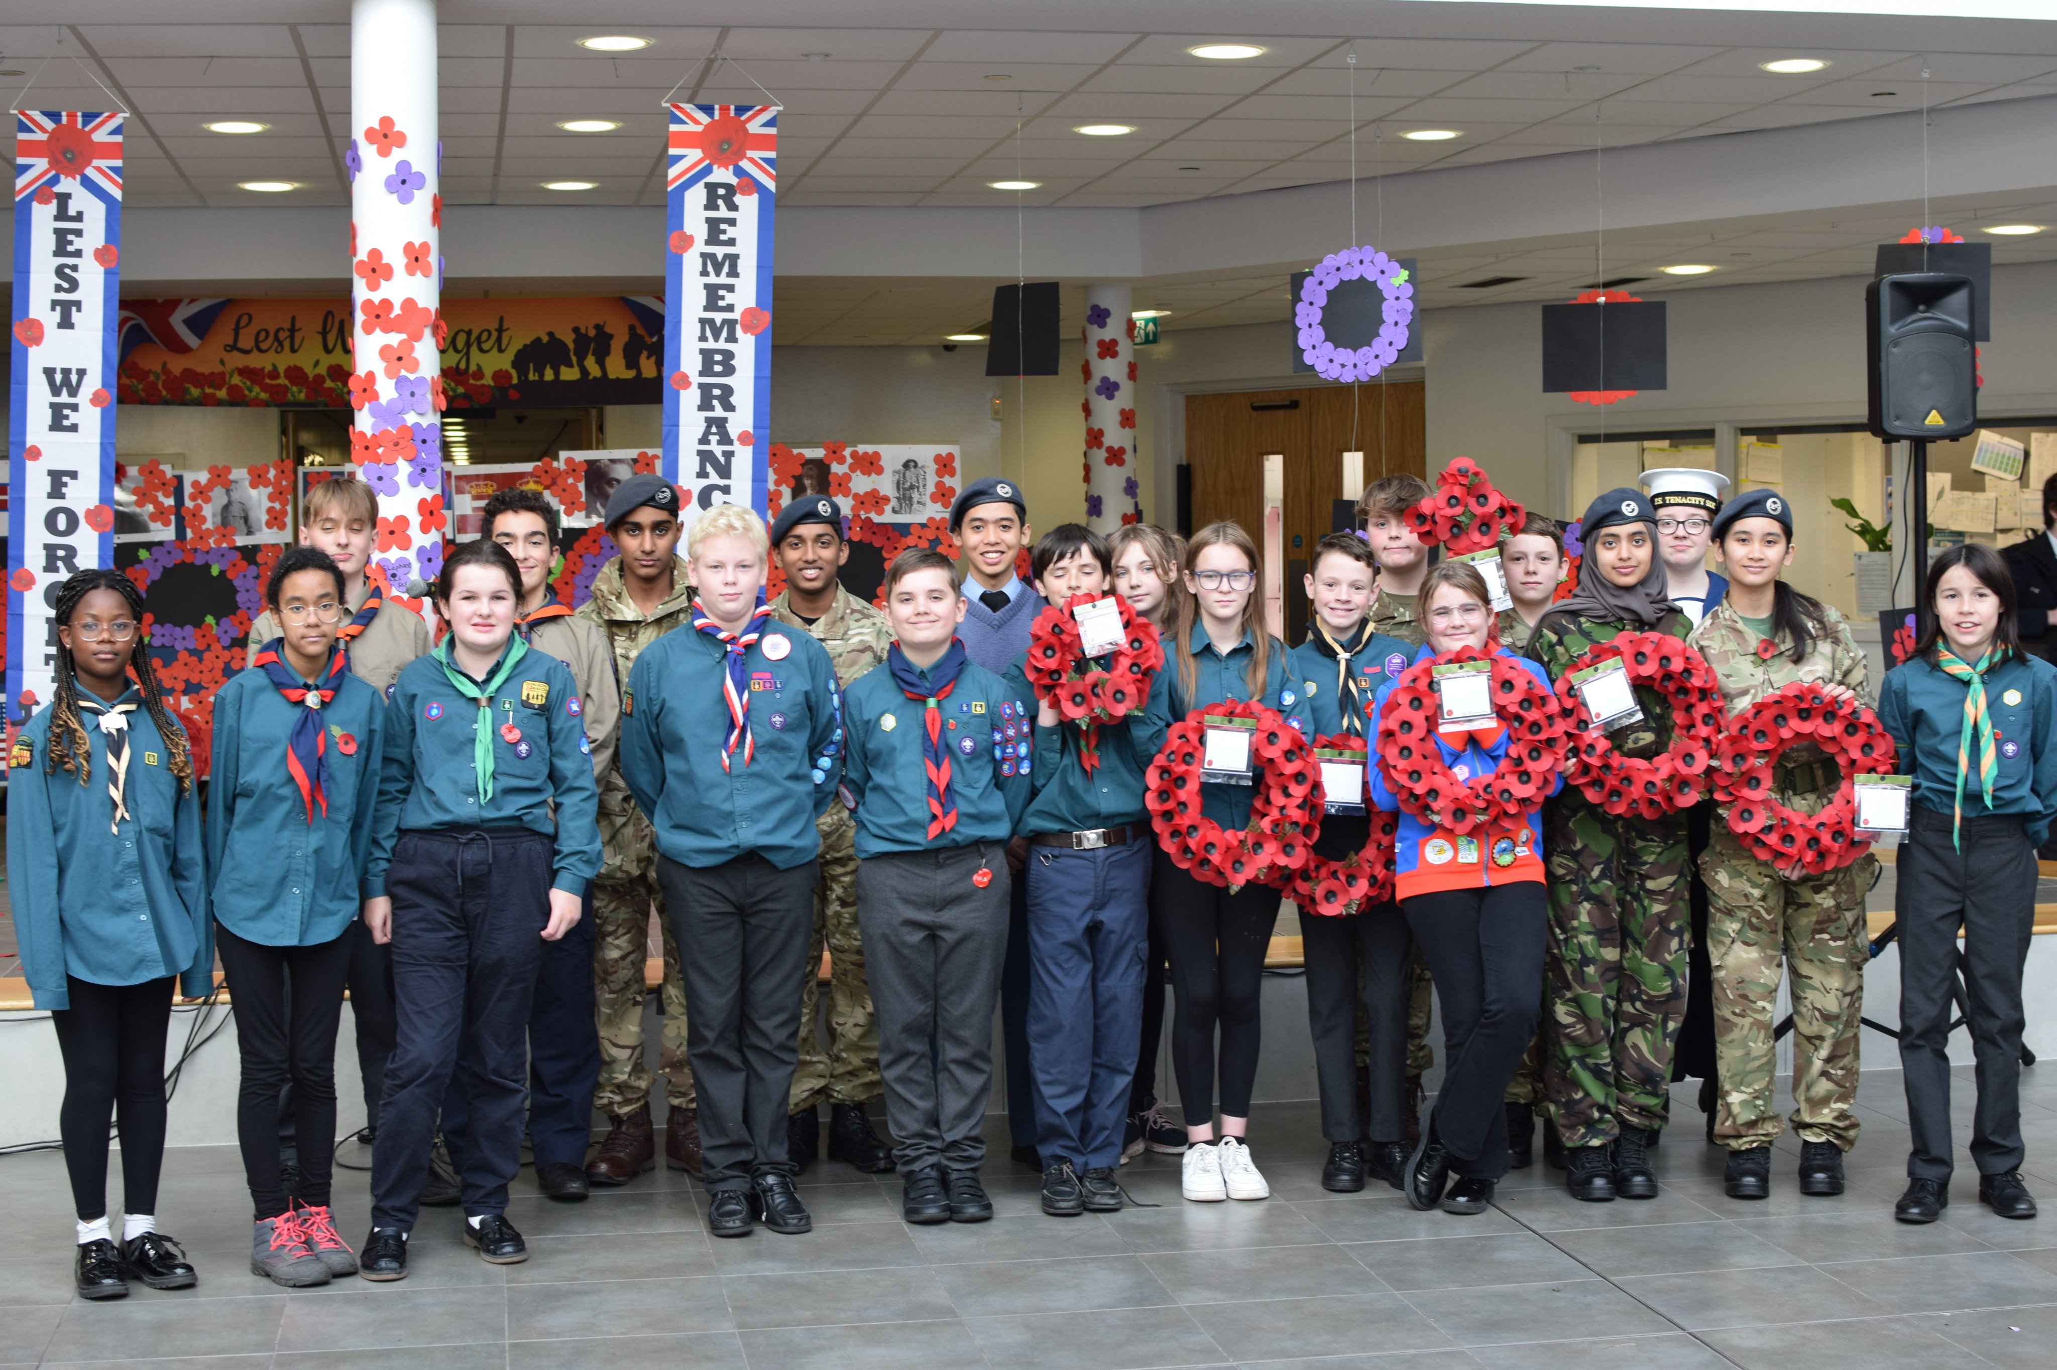
If you’re a Scout, Guide, Cadet or member of St Johns we’d love you to play a part (in uniform) at our school Remembrance Service on Friday 7th November.
Please see Dr Wood at break or lunchtime on Monday (in the office next to F32) to sign up. If you can’t make it just let Dr Wood Know ASAP.

Slide 2

Theme of the week : Do not Lose Heart
“Yet because this widow keeps bothering me, I will give her justice.” (Luke 18: 5)
20TH -24TH OCTOBER

Slide 3
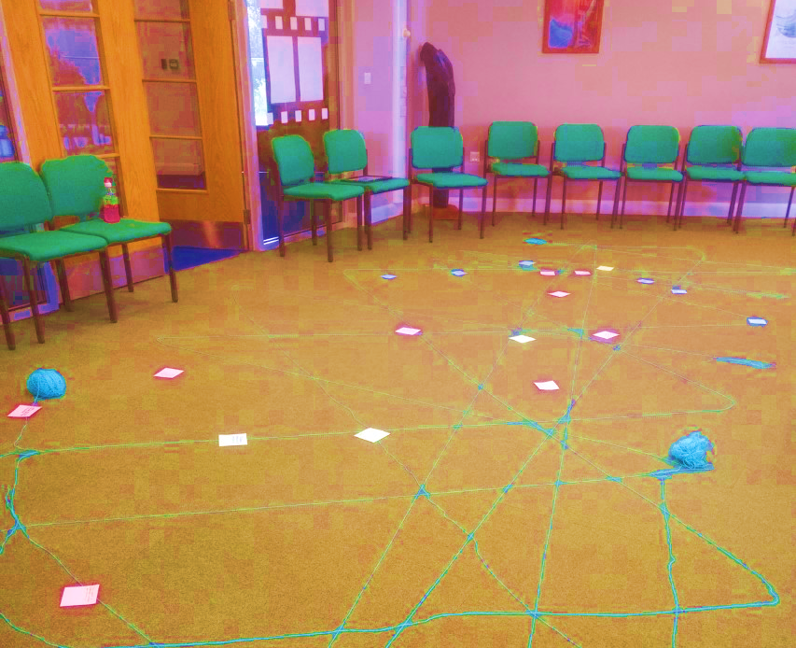

MORNING PRAYER IN THE CHAPEL THIS WEEK
Monday 20th October – 8A
Tuesday 21st October – 8I
Wednesday 22nd October – 8N
Thursday 23rd October – 12S
Friday 24th October – 8T
Please bring your pens along…

Slide 4

Theme of the week:
Do Not Lose Heart
On this week...
Monday | Tuesday | Thursday | Friday
Christmas Club LOCATION : F04 (Maths Corridor) TIME:12:25 – 12:50 Father Jonathon is in every Monday at Lunchtime. Come in and say Hello! | Christian Union LOCATION : G16 TIME:12:20 – 12:50 | Fundraising Club LOCATION : F04 TIME:12:20 – 12:50 WEEK B | Rosary Club LOCATION: Chapel TIME:12:15 – 12:25
Keep an eye out for even more events going on in the following weeks!

Slide 5

Music Groups to get involved with...
Wednesday | Thursday | Friday | Other things
Choir Open to all Year Groups. Lunchtime in G17 | Rock School After school in the Music Department. | Orchestra Lunchtime G17 All instruments welcome | If you are interested in anything to do with Music Tech, please see Miss Bloomfield for further information. ________________________ Interested in being in a band with other students? You do not need to have played an instrument to be in this band. If you are interested, please see Mrs Blackburn OR Miss Bloomfield
Keep an eye out for even more events going on in the following weeks!

Slide 6
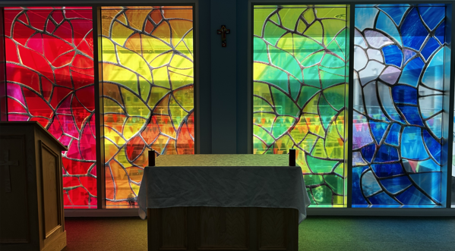
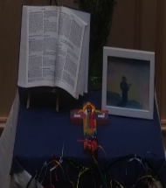
Mass at 8:20am on Friday Morning in the Chapel.
Everyone is welcome.
This week Friday Mass will be led by
10Y & 10M.

Slide 7

Important Festivals of All Faiths and other events this week!
(Month of October is dedicated to the Rosary)
‘As we begin October, the month dedicated to the holy Rosary, I invite you to pray the Rosary every day for peace in our world.’
“POPE LEO XIV”

Slide 8
Theme of the week : Do not Lose Heart
“Yet because this widow keeps bothering me, I will give her justice.” (Luke 18: 5)
20TH -24TH OCTOBER

Slide 9



Introducing the Theme
“Yet because this widow keeps bothering me, I will give her justice.” (Luke 18: 5)
What does it mean to Lose Heart?
📝 Activity: Discuss examples of injustice in school or society and how you can respond.
Lose Heart:
Become discouraged.
“Have you ever had to keep asking for something that was right or fair?
What helped you not give up?”
Class Discussion
🗣️
Notes:
ACTIVITY:
Cost-of-living crisis
Food insecurity
Children experiencing poverty
Homelessness

Slide 10
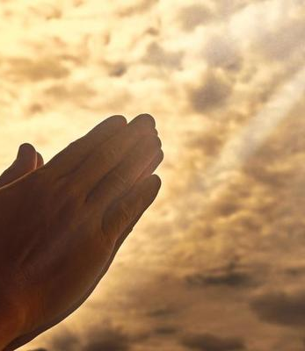
Lord,
Lord, give us the strength to keep showing up, even when it’s hard.
Help us to trust that our efforts matter and that You are with us.
God of patience, sometimes waiting is hard, give us peace while we wait.
Amen

Slide 11
Theme of the week : Do not Lose Heart
“Yet because this widow keeps bothering me, I will give her justice.” (Luke 18: 5)
20TH -24TH OCTOBER

Slide 12


“Yet because this widow keeps bothering me, I will give her justice.” (Luke 18: 5)
What Does This Mean for US?
God is NOT like the judge
If an unfair judge could give in to persistence, how much more will a loving God respond to us?
Don’t give up on prayer
Sometimes it feels like God is silent or slow to answer. But Jesus is encouraging us: Keep praying. Keep trusting. Don’t lose heart.
Your voice matters
The widow had no power in society, but her persistence made a difference. Teenagers might feel unheard sometimes—but this story says: You matter. Your voice matters. Keep speaking up for what is right.
Exploring The Bible

Slide 13

“Yet because this widow keeps bothering me, I will give her justice.” (Luke 18: 5)
✨ Key Catholic Social Teaching (CST) Principles Reflected in Luke 18:5:
🤝 Connection to Catholic Social Teaching (CST)
Catholic Social Teaching is a set of principles that guide how we treat others and to build a just society. Even if you don’t believe in God, these values can resonate with anyone who cares about fairness, dignity, and community.
Dignity of the Human Person
The widow represents someone with little power, yet her voice matters. CST teaches that every person has worth, no matter their status.
2. Rights and Responsibilities
She had the right to justice and took responsibility to demand it. CST encourages us to stand up for our rights and help others do the same.
3. Option for the Poor and Vulnerable
The story highlights someone vulnerable being ignored. CST calls us to prioritize the needs of those who are often overlooked.
4. Solidarity
Her persistence is a form of solidarity—standing firm for what’s right. CST teaches that we are one human family, called to support each other.
“Charity is no substitute for justice withheld.” – St. Augustine

Slide 14
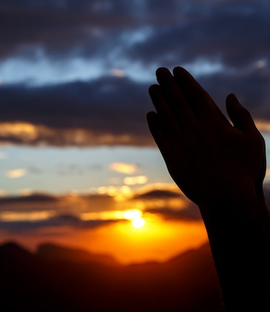
Loving God,
Sometimes we feel tired or discouraged. Help us to keep praying, even when it’s hard. Teach us to trust that You are always listening.
Help us to stand up for others and ourselves especially when it seems hard.
Amen

Slide 15
Theme of the week : Do not Lose Heart
“Yet because this widow keeps bothering me, I will give her justice.” (Luke 18: 5)
20TH -24TH OCTOBER

Slide 16

Quiz: The Persistent Widow – Luke 18:1–5
Explore the parable and its message of persistence and justice

Slide 17
1. Why did Jesus tell this parable?
A. To teach about forgiveness
B. To show the importance of prayer and not giving up
C. To explain how to become rich
D. To warn about false teachers
✅ Correct Answer: B

Slide 18
2. What kind of judge is described in the parable?
A. A kind and fair judge
B. A judge who feared God
C. A judge who didn’t care about God or people
D. A wise and respected judge
✅ Correct Answer: C

Slide 19
3. What did the widow keep asking the judge for?
A. Money
B. A new home
C. Justice against her adversary
D. A second chance
✅ Correct Answer: C

Slide 20
4. Why did the judge finally give in to the widow’s request?
A. He felt sorry for her
B. He wanted to look good in public
C. He was afraid she would attack him
D. He believed in justice
✅ Correct Answer: C

Slide 21

💬 Inclusive Reflection Questions
Have you ever seen someone stand up for what’s right, even when it was hard?
What does justice mean to you, and how can you help create it in our school and communities?
How can we make sure everyone’s voice is heard, especially those who are often ignored?
3 minutes REFLECTION

Slide 22
Lord,
God of justice, thank You that You are not indifferent. You are near, attentive, and just. Help us to rest in Your character and trust Your timing.
Thank You for showing us that persistence matters. Help us to stand up for what is right, just like the widow.
May we never give up on doing good.
Amen

Slide 23
Theme of the week : Do not Lose Heart
“Yet because this widow keeps bothering me, I will give her justice.” (Luke 18: 5)
20TH -24TH OCTOBER

Slide 24


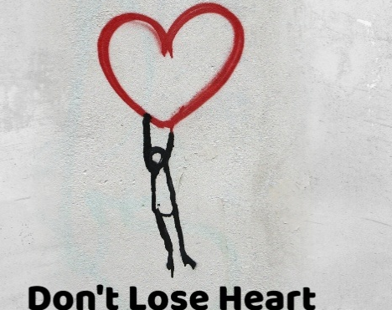
📝 Activity: Create a 'Wall of Voices' where students post anonymous messages about what they care about.
Digital Unplug
📝 Activity: Write one goal you’ve been working on and one small step you can take this week.
💡“Do not wait for leaders; do it alone, person to person.” – Mother Teresa
Whether you pray, reflect, or act—what matters is that you keep showing up for what is right.
Real change often starts with one person who refuses to give up.
You don’t need to be loud or powerful to make a difference—just consistent.
💡“Our lives begin to end the day we become silent about things that matter.”
– Martin Luther King Jr.
“It always seems impossible until it’s done.”
– Nelson Mandela
💡 “You must be the change you wish to see in the world.” – Mahatma Gandhi
Notes:
We will like to get pictures of student’s wall of Voices to put up on twitter as well as around the Chapel area. Please send via email

Slide 25
Lord,
Thank You for hearing every voice—no matter our age, background, or story. Help us to listen to others with the same love You show us.
God of hope, thank You for our school community. Help us to encourage one another, to be kind, and to keep doing good. May we be the light of the world.
Amen

